Slide 1
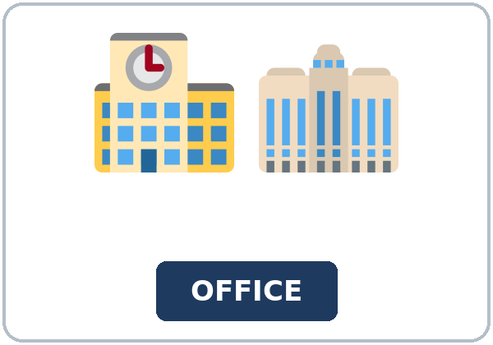
Do You Know If It's Tonight?
Today you will:
• I can ask Do you know if / whether…?
• I can keep statement order after if.
• I can ask Do you know when / where…? the Level 4 way.
Lesson 8 · Level 5
Notes:
Welcome learners as they arrive.
Read the three lines under Today you will.
Lesson plan: Topic; At a glance: Objectives.
Picture: Twemoji graphics by Twitter, Inc. and other contributors (https://github.com/jdecked/twemoji), CC BY 4.0 (https://creativecommons.org/licenses/by/4.0/); resized and combined, with signs and labels (images/CREDITS.md).

Slide 2
Today's
Goals
01
I can ask Do you know if / whether…?
02
I can keep statement order after if.
03
I can ask Do you know when / where…? the Level 4 way.
By the end of class, you can do these things.
04
I can report the answer with said or told.
Notes:
Read each goal slowly. Learners repeat.
Lesson plan: At a glance: Objectives.

Slide 3
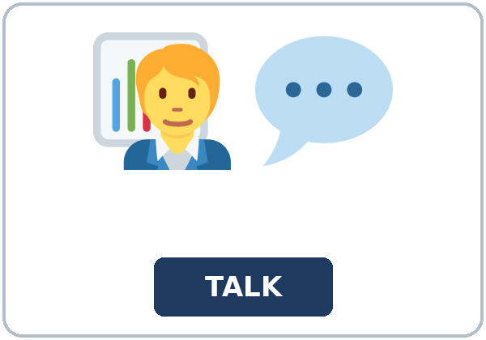
OPENING TALK · 6:00
Opening Talk
Work with a partner. A asks a tag
from last week. B answers with a short yes, a short no, or Actually. Then compare one homework sentence.
Homework check: read one sentence from
your confirmation email.
Notes:
Step 1 · 6:00–6:06 · Opening Talk.
Work with a partner.
Lesson plan: Step 1; Opening Talk page.
Picture: Twemoji graphics by Twitter, Inc. and other contributors (https://github.com/jdecked/twemoji), CC BY 4.0 (https://creativecommons.org/licenses/by/4.0/); resized and combined, with signs and labels (images/CREDITS.md).

Slide 4
Opening Talk
Cards
01
Add a tag: The class is on Tuesday, .
02
Answer a tag: Yes, it is. / No, it isn't.
Work with a partner. A asks a tag from last
week. B answers with a short yes, a short no, or Actually. Then compare one homework sentence.
03
Correct one detail: Actually, ...
04
Homework check: read one sentence from your confirmation email.
Notes:
Each click shows the next card.
A asks. B answers. Then switch.
Lesson plan: Step 1; Opening Talk page.

Slide 5
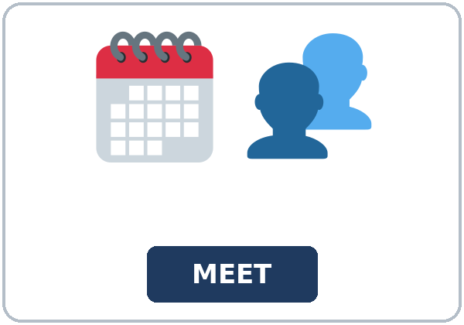
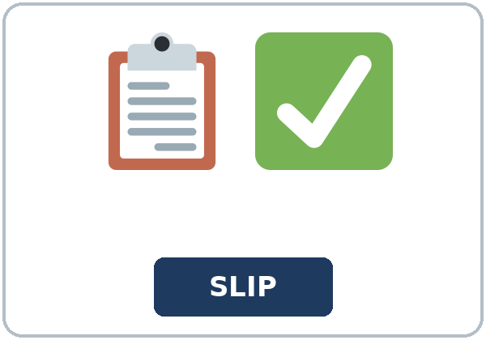
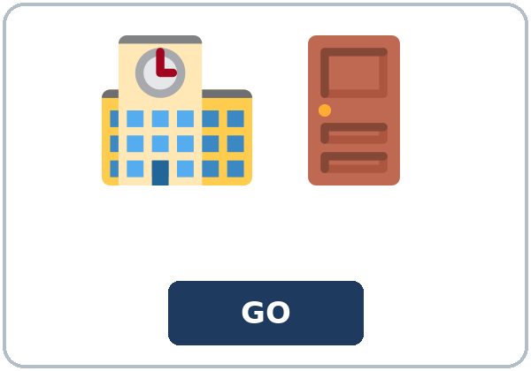
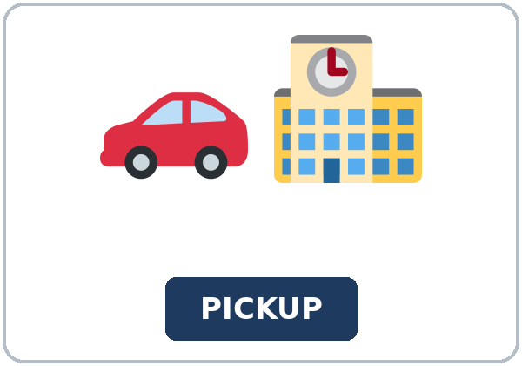
Look. Listen.
Repeat.
New Words
★ school office
★ counselor
★ conference
★ permission slip
★ dismissal
★ pickup
Notes:
Step 2 · 6:06–6:12 · New Words.
Point to each picture. Learners repeat. ★ = most important.
Lesson plan: Step 2; New Words page.
Pictures: Twemoji graphics by Twitter, Inc. and other contributors (https://github.com/jdecked/twemoji), CC BY 4.0 (https://creativecommons.org/licenses/by/4.0/); resized and combined, with signs and labels (images/CREDITS.md).

Slide 6


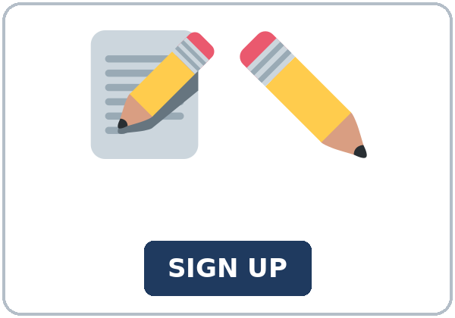
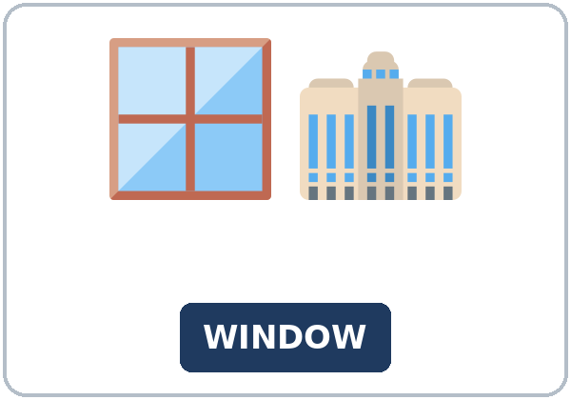

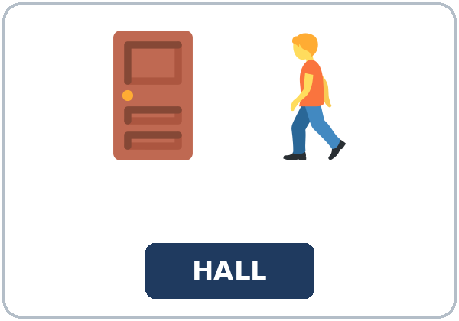
Partner game:
Point and ask
More New Words
★ newsletter
★ backpack
★ sign-up
★ office window
bell
hallway
Notes:
A points to a picture. B names it and uses it in one sentence. Then switch.
Lesson plan: Step 2; New Words page; Partner game.
Pictures: Twemoji graphics by Twitter, Inc. and other contributors (https://github.com/jdecked/twemoji), CC BY 4.0 (https://creativecommons.org/licenses/by/4.0/); resized and combined, with signs and labels (images/CREDITS.md).

Slide 7
Check the Meaning
Look at the picture. Answer the question.
1
2
3
What do you carry books in?
What rings in the hallway?
What paper does a parent bring for early pickup?
a backpack
a bell
a permission slip
Notes:
The answers are hidden. Ask, then click.
1. a backpack
2. a bell
3. a permission slip
Lesson plan: Step 2: Check the Meaning.
Pictures: Twemoji graphics by Twitter, Inc. and other contributors (https://github.com/jdecked/twemoji), CC BY 4.0 (https://creativecommons.org/licenses/by/4.0/); resized and combined, with signs and labels (images/CREDITS.md).

Slide 8
Before You
Listen for:
Listen
Listen. Why is she calling?
Maya calls the office at Northside School.
| 6:12–6:32 | Listening: play 1 (Task A), play 2 (Tasks B and C) +
01
Audio: about 1:43. It plays once.
Narrator
02
Mr. Reed
Play 1: Task A
03
Maya
Notes:
Step 3 · 6:12–6:32 · Listening. Play 1 is Task A. Play 2 is Tasks B and C. A third play is fine.
Maya calls the office at Northside School.
The script says going to and want to. Learners only need to recognize gonna and wanna.
Lesson plan: Step 3; Listening page.
Picture: Twemoji graphics by Twitter, Inc. and other contributors (https://github.com/jdecked/twemoji), CC BY 4.0 (https://creativecommons.org/licenses/by/4.0/); resized and combined, with signs and labels (images/CREDITS.md).

Slide 9
Listen. Why is she calling?
Listening A
1.
a. to ask about the bus
b. to ask about the conference
c. to join the office staff
Notes:
Click to circle b.
Lesson plan: Step 3; Listening Task A; Answer key.

Slide 10
B. Listen again. Circle the note.
Listening B
1. Day
tonight
tomorrow
Monday
2. Starts
6:00
6:30
7:00
3. Bring
the slip
the signup sheet
the newsletter
4. Arrive
on time
ten minutes early
after three
5. The window is
in the library
down the hallway
in the parking lot
6. A slip for Maya
yes
no
Notes:
Click to circle each answer: 1 tonight • 2 6:30 • 3 the signup sheet • 4 ten minutes early • 5 down the hallway • 6 no. Six thirty in the script is 6:30
Lesson plan: Step 3; Listening Task B; Answer key.

Slide 11
Listen again.
Listen again. Write if, whet
Listening C
1
Do you know ______ the conference is tonight?
if
2
Do you know ______ I should bring the signup sheet?
whether
3
Do you know ______ the office window is?
where
Write the missing words.
Then check together.
4
Can you tell me ______ I need a permission slip?
if
5
Do you know ______ dismissal is at the usual time?
if
6
Do you know ______ I should leave my backpack?
where
Notes:
Click to show each answer: 1 if • 2 whether • 3 where • 4 if • 5 if • 6 where
Lesson plan: Step 3; Listening Task C; Answer key.

Slide 12
Hear it: gonna and wanna are short forms
Hear It,
Say It
Say it: use the full forms
I want to ask about the conference.
I'm going to put the sheet in my backpack.
gonna and wanna are short forms. This listening uses the full forms.
You can say going to and want to.
Say each line two times.
Do you know if the conference is tonight?
Do you know where the office window is?
Notes:
gonna and wanna are short forms. This listening uses the full forms. Say each line two times.
Lesson plan: Step 3: Hear it, say it.

Slide 13
Grammar Box 1
if or whether
QUESTION
ANSWER
Do you know if the conference is tonight?
Yes. It starts at 6:30. / I'm not sure.
Do you know whether I need a permission slip?
Yes. Please bring the slip.
Can you tell me if the office is still open?
Yes. It closes at seven.
Notes:
Grammar Box 1: if or whether. Each click shows the answer side.
Lesson plan: Step 4; Grammar Box 1.
Picture: Twemoji graphics by Twitter, Inc. and other contributors (https://github.com/jdecked/twemoji), CC BY 4.0 (https://creativecommons.org/licenses/by/4.0/); resized and combined, with signs and labels (images/CREDITS.md).

Slide 14
Grammar Box 2
when or where
QUESTION
ANSWER
Do you know where the office is?
It's down the hallway, by the office window.
Do you know when it starts?
It starts at 6:30.
Do you know where I sign up?
At the office window.
Notes:
Grammar Box 2: when or where. Each click shows the answer side.
Lesson plan: Step 4; Grammar Box 2.
Picture: Twemoji graphics by Twitter, Inc. and other contributors (https://github.com/jdecked/twemoji), CC BY 4.0 (https://creativecommons.org/licenses/by/4.0/); resized and combined, with signs and labels (images/CREDITS.md).

Slide 15
Grammar Box 3
said or told
QUESTION
ANSWER
What did he say about the night?
He said the conference was tonight.
What did he tell you to bring?
He told me to bring the slip.
What did he say about the time?
He said it starts at 6:30.
Notes:
Grammar Box 3: said or told. Each click shows the answer side.
Lesson plan: Step 4; Grammar Box 3.
Picture: Twemoji graphics by Twitter, Inc. and other contributors (https://github.com/jdecked/twemoji), CC BY 4.0 (https://creativecommons.org/licenses/by/4.0/); resized and combined, with signs and labels (images/CREDITS.md).

Slide 16
Grammar Box 4
statement order
NOT THIS
SAY THIS
Do you know if is the conference tonight?
Do you know if the conference is tonight?
Do you know where is the office?
Do you know where the office is?
Do you know when does it start?
Do you know when it starts?
Notes:
Grammar Box 4: statement order. Each click shows the answer side.
Lesson plan: Step 4; Grammar Box 4.
Picture: Twemoji graphics by Twitter, Inc. and other contributors (https://github.com/jdecked/twemoji), CC BY 4.0 (https://creativecommons.org/licenses/by/4.0/); resized and combined, with signs and labels (images/CREDITS.md).

Slide 17
Practice A
Write.
Practice A
1
Do you know ______ the office is?
where
2
Do you know ______ it starts?
when
3
Do you know ______ I need a permission slip?
whether
Write the missing word.
Pairs: check your answers.
4
Can you tell me ______ the office is still open?
if
5
Do you know ______ the signup sheet is?
where
6
Do you know ______ the bell rings?
when
Notes:
Click to show each answer: 1 where • 2 when • 3 whether • 4 if • 5 where • 6 when
Lesson plan: Step 4; Grammar Practice A; Answer key.

Slide 18
Circle the correct words.
Practice B
1. Do you know if ______ tonight?
the conference is
is the conference
2. Do you know where ______ ?
the office is
is the office
3. Do you know when ______ ?
it starts
does it start
4. He ______ the conference was tonight.
said
said me
5. He told ______ to bring the slip.
me
to me
6. Can you tell me if ______ open?
the office is
is the office
Notes:
Click to circle each answer: 1 the conference is • 2 the office is • 3 it starts • 4 said • 5 me • 6 the office is
Lesson plan: Step 4; Grammar Practice B; Answer key.

Slide 19
Common Mistakes
Don't say
Say
Do you know if is the office open?
Do you know if the office is open?
Do you know where is the conference?
Do you know where the conference is?
He told to me to bring the slip.
He told me to bring the slip.
He said me the conference was tonight.
He said the conference was tonight.
Do you know when does it start?
Do you know when it starts?
Notes:
Read Don't say, then Say. Learners try first. Then click.
Lesson plan: Grammar: Common mistakes.
Picture: Twemoji graphics by Twitter, Inc. and other contributors (https://github.com/jdecked/twemoji), CC BY 4.0 (https://creativecommons.org/licenses/by/4.0/); resized and combined, with signs and labels (images/CREDITS.md).

Slide 20
Pair Check
A says.
01
Work with a partner.
Some cards are a parent.
B answers.
02
Some are a volunteer.
Notes:
Some cards are a parent. Some are a volunteer. Pick either one. | Volunteer card | Parent card | |---|---| | Ask if the conference is tonight. Ask if you should bring the signup sheet. | Ask if you can pick up early.
Break · 6:45–7:00.
Lesson plan: Step 4: Pair check.
Picture: Twemoji graphics by Twitter, Inc. and other contributors (https://github.com/jdecked/twemoji), CC BY 4.0 (https://creativecommons.org/licenses/by/4.0/); resized and combined, with signs and labels (images/CREDITS.md).

Slide 21
Talk Time
Talk Time
Work together.
Sit back to back.
7:00–7:18
1
Sit back to back.
2
Sit back to back.
3
Sit back to back.
Notes:
Round 1.
Lesson plan: Step 5; Talk Time.
Picture: Twemoji graphics by Twitter, Inc. and other contributors (https://github.com/jdecked/twemoji), CC BY 4.0 (https://creativecommons.org/licenses/by/4.0/); resized and combined, with signs and labels (images/CREDITS.md).

Slide 22
Talk Time
Talk Time
Pairs.
Find a new partner.
7:00–7:18
1
Find a new partner.
2
Find a new partner.
3
Find a new partner.
Notes:
Round 2.
Lesson plan: Step 5; Talk Time.
Picture: Twemoji graphics by Twitter, Inc. and other contributors (https://github.com/jdecked/twemoji), CC BY 4.0 (https://creativecommons.org/licenses/by/4.0/); resized and combined, with signs and labels (images/CREDITS.md).

Slide 23
Read.
Answer.
Read &
Write
1
When is the conference?
Tonight at 6:30
2
Where is the conference?
In the library
Read the page.
Answer the questions.
3
What does a volunteer bring?
The signup sheet
4
What does a parent bring for early pickup?
A permission slip
5
How early should people arrive?
Ten minutes early
Notes:
Step 6 · 7:18–7:25 · Read & Write.
Click to show each answer: 1 Tonight at 6:30 • 2 In the library • 3 The signup sheet • 4 A permission slip • 5 Ten minutes early
Lesson plan: Step 6; Read & Write page; Answer key.

Slide 24
Before You Go 7:25–7:30
01
Exit ticket
02
Homework
Write the question you would ask the office, and the answer you hope for.
Name: Date:
Two with Do you know if / whether.
Give this page to your teacher.
About 20–25 minutes.
1. Finish the question. Use statement order.
2. Finish your email to the office (Read & Write C).
3. Ask one person Do you know if…? Report the answer with said or
4. Review (a tag). Write the tag.
Bring it next week!
Notes:
Step 7 · 7:25–7:30 · Exit ticket and homework. Never skip the exit ticket.
Write the question you would ask the office, and the answer you hope for.
Lesson plan: Step 7; Exit Ticket page; Homework page.
Picture: Twemoji graphics by Twitter, Inc. and other contributors (https://github.com/jdecked/twemoji), CC BY 4.0 (https://creativecommons.org/licenses/by/4.0/); resized and combined, with signs and labels (images/CREDITS.md).

Slide 25
Goodbye! See You Next Week!
Now you can:
• I can ask Do you know if / whether…?
• I can keep statement order after if.
• I can ask Do you know when / where…? the Level 4 way.
Lesson 8 · Level 5
Notes:
Read the three Now you can lines.
Homework is about 20–25 minutes. Bring it next week.
Lesson plan: At a glance: Objectives; Step 7.
Picture: Twemoji graphics by Twitter, Inc. and other contributors (https://github.com/jdecked/twemoji), CC BY 4.0 (https://creativecommons.org/licenses/by/4.0/); resized and combined, with signs and labels (images/CREDITS.md).

Slide 26
Credits
Pictures
Vocabulary pictures use Twemoji graphics by Twitter, Inc. and other contributors (https://github.com/jdecked/twemoji), licensed under CC BY 4.0 (https://creativecommons.org/licenses/by/4.0/). The graphics were resized and combined, and signs and labels were added.
Names and story
Mr. Reed and Maya are invented names. The listening story is invented.
Audio and font
Audio: synthetic voices made with Chatterbox TTS (MIT License), cloned from short synthetic reference clips made with Kokoro-82M (Apache License 2.0). No recordings of real people were used. Each file carries an inaudible Perth watermark marking it as AI-generated. Font: Lexend Deca (OFL 1.1).
© 2026 the authors. The authors license this deck under CC BY-NC-SA 4.0.
Notes:
Credits. You don't need to read this slide in class.
Pictures: Twemoji graphics by Twitter, Inc. and other contributors, CC BY 4.0; the file-by-file list is in images/CREDITS.md.
Audio: synthetic voices, computer-generated (Chatterbox TTS cloned from Kokoro-82M reference clips). No recordings of real people. The names and the story are invented.
Course materials: © 2026 the authors, licensed under CC BY-NC-SA 4.0 (https://creativecommons.org/licenses/by-nc-sa/4.0/).
Lesson plan: Picture Credits. Picture list: images/CREDITS.md.

