Slide 1
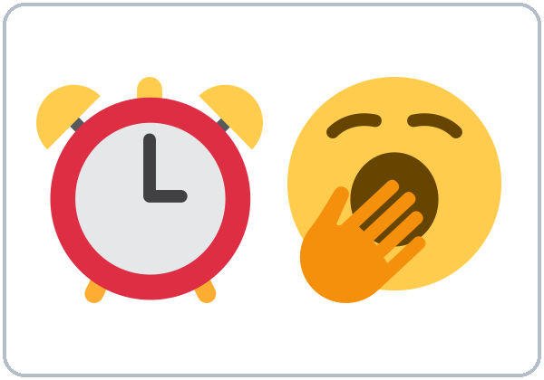
A Day in My Life
Today you will:
• Talk about your day
• Use he / she + -s
• Say how often: always ... never
Lesson 2 · Level 2
Notes:
Welcome back. Read the three goals together; learners repeat.
Objectives: describe a daily routine with 10 or more routine verbs; use he/she + -s, doesn't, Does...?; use always ... never in the correct position.
Source: Level2_Curriculum_v4_1_public.md, Lesson 2 (At a glance).
Picture: Twemoji graphics by Twitter, Inc. and other contributors (https://github.com/jdecked/twemoji), CC BY 4.0 (https://creativecommons.org/licenses/by/4.0/); resized and combined.

Slide 2
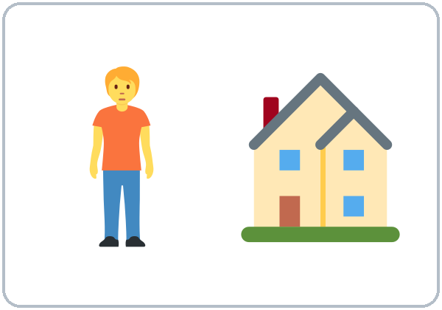
OPENING TALK · 6:00
Warm-Up
Same partner.
Ask 3 questions.
Where do you live?
Do you work?
Are you from a big city?
Notes:
Step 1 · 6:00–6:10 · Opening Talk + Homework Check (pairs, same partner for both parts). Minutes 0–5: ask 3 questions. Each click shows one question.
Late arrivals join a pair.
Source: Level2_Curriculum_v4_1_public.md, Lesson 2 (Step 1).
Picture: Twemoji graphics by Twitter, Inc. and other contributors (https://github.com/jdecked/twemoji), CC BY 4.0 (https://creativecommons.org/licenses/by/4.0/); resized and combined.

Slide 3
Homework
Check
HW
Homework check
Ask your 5 homework questions.
1
Do you have kids?
Yes, I do.
Answer with the same helper.
Do you...? Yes, I do.
2
Does she live here?
Yes, she does.
3
Are you married?
No, I'm not.
4
Is he a cook?
Yes, he is.
Notes:
Step 1, minutes 5–10: partners ask each other their 5 homework questions (Lesson 1 homework: 3 with do/does, 2 with am/is/are).
Each click shows one model answer from the Lesson 1 Grammar Boxes. Walk around; write only 2 corrected questions on the board.
If behind: collect the homework; return it next week with one correction each.
Source: Level2_Curriculum_v4_1_public.md, Lesson 2 (Step 1); Lesson 1 Grammar Boxes 1–2 and Homework.

Slide 4
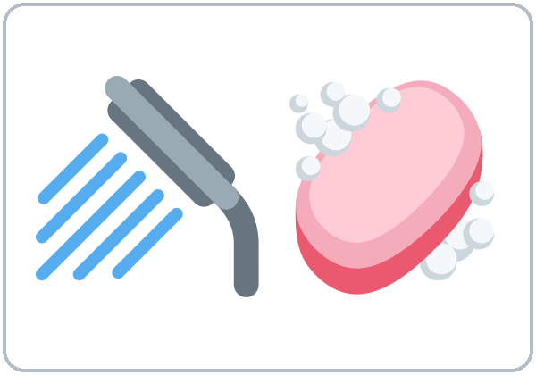
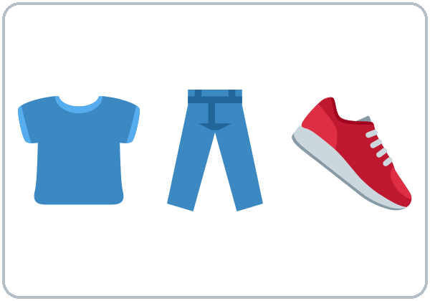
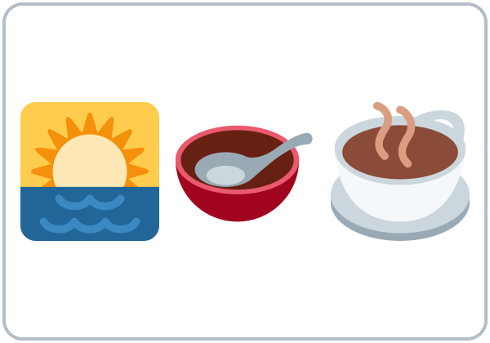
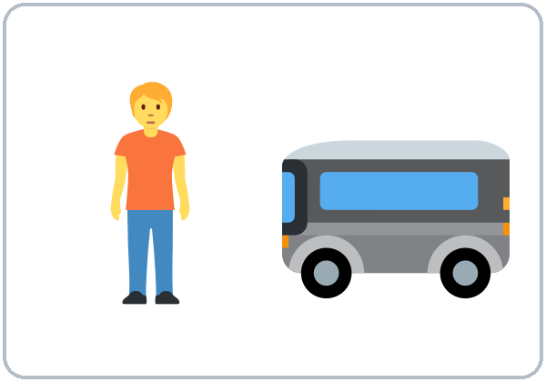
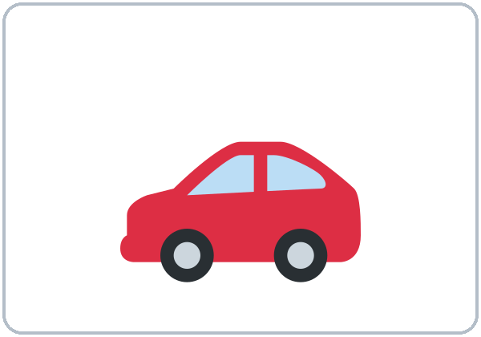
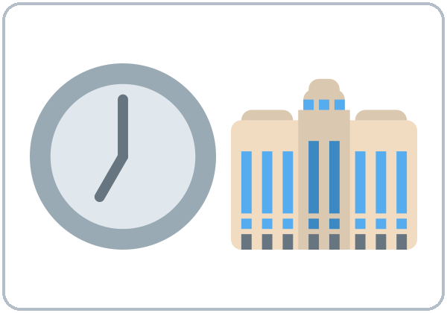
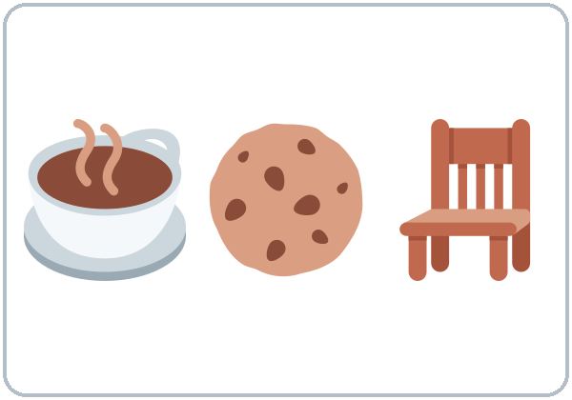
Look. Listen.
Repeat.
New Words
get up
take a shower
get dressed
have breakfast
take the bus
drive
start work
take a break
Notes:
Step 2 · 6:10–6:18 · New Words (groups of 4–5 / 2 groups). Point, say, repeat twice. Each click shows one word.
Star words here: get up, take a shower, have breakfast, take the bus, start work.
If behind: teach the star words only.
Source: Level2_Curriculum_v4_1_public.md, Lesson 2 (Step 2; Student Page 2 New Words).
Picture: Twemoji graphics by Twitter, Inc. and other contributors (https://github.com/jdecked/twemoji), CC BY 4.0 (https://creativecommons.org/licenses/by/4.0/); resized and combined.

Slide 5
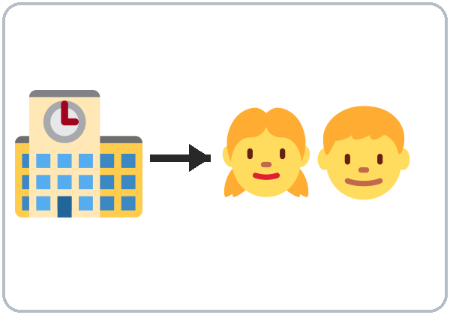
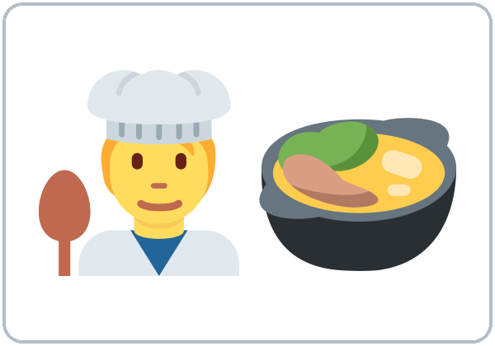
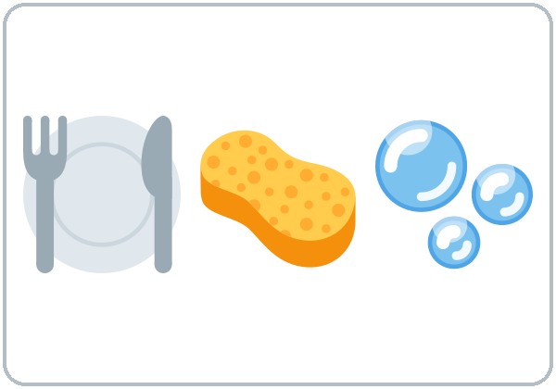
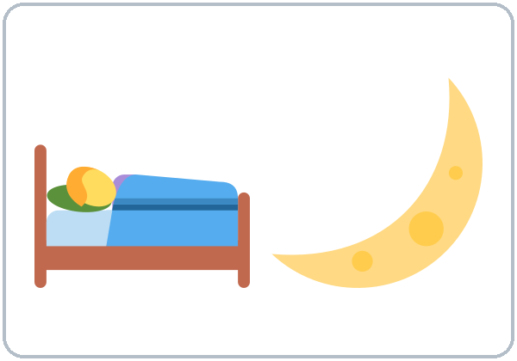
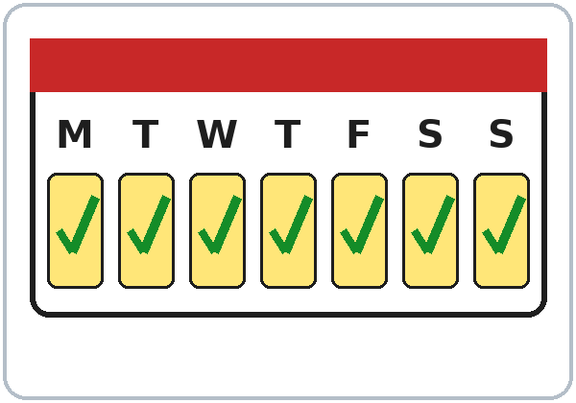
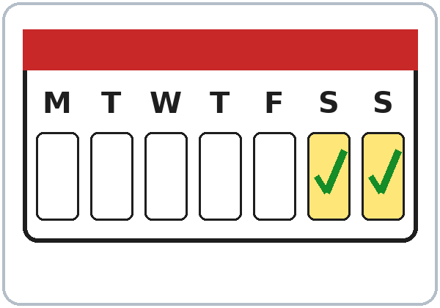

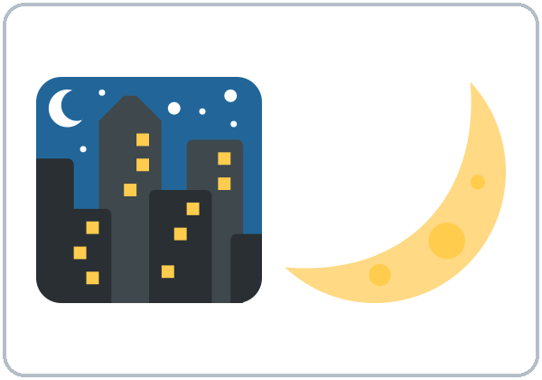
Put the day
in order.
More New Words
pick up the kids
cook dinner
do the dishes
go to bed
every day
on weekends
in the morning
at night
Notes:
New Words, part 2. Each click shows one word. Star words here: cook dinner, go to bed, every day.
Picture Sequence: groups put the 12 routine cards in order for a typical day and say each one aloud. If time: mime-and-guess.
Some learners work night shifts. Accept any routine: "morning" means whenever they wake up.
Source: Level2_Curriculum_v4_1_public.md, Lesson 2 (Step 2; Student Page 2; Teacher notes).
Picture: Twemoji graphics by Twitter, Inc. and other contributors (https://github.com/jdecked/twemoji), CC BY 4.0 (https://creativecommons.org/licenses/by/4.0/); resized and combined.

Slide 6
Listening A
01
Marco gets up at ...
5:30
6:30
7:00
Listen. Circle the time.
02
He starts work at ...
6:00
7:00
8:00
03
He picks up the kids at ...
3:00
3:30
4:30
04
On Sundays he sleeps until ...
8:00
9:00
10:00
Notes:
Step 3 · 6:18–6:30 · Listening (L2_listening.mp3, about 0:58; plays once, so play the audio again if needed). Before you listen: "Marco looks tired. Why?"
Listen 1 → Task A (circle the times). Pairs compare. Each click circles one answer.
Answer key: 5:30; 7:00; 3:30; 9:00.
No speaker? Read the script aloud with a volunteer learner.
Source: Level2_Curriculum_v4_1_public.md, Lesson 2 (Step 3; Answer key).
Picture: Twemoji graphics by Twitter, Inc. and other contributors (https://github.com/jdecked/twemoji), CC BY 4.0 (https://creativecommons.org/licenses/by/4.0/); resized and combined.

Slide 7
Listen again.
Who does it?
Listening B
works at the hospital
Marco
His wife
drives
Marco
His wife
works at night
Marco
His wife
picks up the kids
Marco
His wife
cooks dinner
Marco
His wife
Notes:
Listen 2 → Task B (Marco or his wife?). Each click circles one answer.
Answer key: works at the hospital = Marco; drives = wife; works at night = wife; picks up the kids = Marco; cooks dinner = Marco.
Source: Level2_Curriculum_v4_1_public.md, Lesson 2 (Step 3; Answer key).

Slide 8
Listening C
C
Listen again.
Write the missing word.
1
My wife ____. She has the car.
drives
Why drives with an -s?
His wife = she.
2
She ____ at a restaurant.
works
3
I ____ pick them up at three thirty.
always
4
On Sundays, I ____ get up early.
never
Notes:
Listen 3 → Task C (fill in). Each click fills one blank.
Answer key: drives; works; always; never.
Ask: "Why drives with an -s?" (his wife = she).
"Say it" (1–2 min): the class repeats "My wife drives. She works at a restaurant." Make the -s loud.
If behind: skip the third play.
Source: Level2_Curriculum_v4_1_public.md, Lesson 2 (Step 3; Answer key).

Slide 9
Grammar Box 1
Yes / No Questions
QUESTION
ANSWER
Do
you work?
Yes, I do.
No, I don't.
Does
she drive?
Yes, she does.
No, she doesn't.
Notes:
Step 4 · 6:30–6:45 · Grammar: simple present + frequency. Say: "We use the simple present for routines and facts. With he, she, it, the verb gets an -s. With does / doesn't, the -s moves to does, so the main verb has no -s."
Click 1 highlights Do and its answers; click 2 highlights Does and its answers. Read across one row of the question side, then the answer side.
More from the box: Do you / they work? drive? cook? · Does he / she / it work? drive? cook? Answer about yourself: Do you work? → Yes, I do.
Source: Level2_Curriculum_v4_1_public.md, Lesson 2 (Step 4; Grammar Box 1).
Picture: Twemoji graphics by Twitter, Inc. and other contributors (https://github.com/jdecked/twemoji), CC BY 4.0 (https://creativecommons.org/licenses/by/4.0/); resized and combined.

Slide 10
Sentences
Positive and
Negative
POSITIVE
NEGATIVE
I work.
I don't work.
She works.
She doesn't work.
Notes:
Positive and negative sentences. Click 1 highlights I / I don't; click 2 highlights she + -s / she doesn't.
The "one -s" rule: the -s moves to does. She works. → She doesn't work. → Does she work?
Add -s only with he, she, it. Spelling: work → works; watch → watches; go → goes; study → studies; have → has.
Source: Level2_Curriculum_v4_1_public.md, Lesson 2 (Sentences: positive and negative; Questions and answers).
Picture: Twemoji graphics by Twitter, Inc. and other contributors (https://github.com/jdecked/twemoji), CC BY 4.0 (https://creativecommons.org/licenses/by/4.0/); resized and combined.

Slide 11
What time?
How often?
How often?
always (100%)
usually
often
Helper: do / does.
sometimes
rarely
What time
do
you get up?
never (0%)
What time
does
she get up?
I usually take the bus.
How often
do
you cook?
How often
does
she cook?
Notes:
Grammar Box 2: What time...? and How often...? Each click highlights the helper word: do, does, do, does.
Answers from the box: I get up at 6:00. / She gets up at 6:00. / I always / sometimes / never cook. / She always / sometimes / never cooks.
Where do always, usually, never go? Before the main verb: I usually take the bus. After be: He is always late. Longer phrases go at the end: I cook every day.
Source: Level2_Curriculum_v4_1_public.md, Lesson 2 (Grammar Box 2; Questions and answers).
Picture: Twemoji graphics by Twitter, Inc. and other contributors (https://github.com/jdecked/twemoji), CC BY 4.0 (https://creativecommons.org/licenses/by/4.0/); resized and combined.

Slide 12
Common Mistakes
Don't say
Say
She work at a store.
She works at a store.
He doesn't works.
He doesn't work.
Does she works?
Does she work?
Notes:
Common mistakes (part 1). Read the left side; ask "What's wrong?" Each click shows the correct sentence.
Repeat the "one -s rule" every time the error appears this week.
Source: Level2_Curriculum_v4_1_public.md, Lesson 2 (Common mistakes; Teacher notes).
Picture: Twemoji graphics by Twitter, Inc. and other contributors (https://github.com/jdecked/twemoji), CC BY 4.0 (https://creativecommons.org/licenses/by/4.0/); resized and combined.

Slide 13
Fix These Mistakes
Don't say
Say
I go always to the park.
I always go to the park.
I am work at a restaurant.
I work at a restaurant.
He have two kids.
He has two kids.
Notes:
Common mistakes (part 2). Each click shows the correct sentence.
Frequency words go before the main verb. Don't use am with another verb: I work (not I am work). have → has with he / she / it.
Learners can read the note on their Grammar page; you don't need to explain it.
Source: Level2_Curriculum_v4_1_public.md, Lesson 2 (Common mistakes).
Picture: Twemoji graphics by Twitter, Inc. and other contributors (https://github.com/jdecked/twemoji), CC BY 4.0 (https://creativecommons.org/licenses/by/4.0/); resized and combined.

Slide 14
Quick Check
Read. Then answer.
1
2
3
Marco takes the bus. One day or every day?
She ____. (not drive)
I take usually or I usually take?
every day
doesn't drive
I usually take
Notes:
Step 4 check questions. Learners answer; each click shows one answer.
Answers: every day · She doesn't drive. · I usually take.
Short Information Gap (last 5 min): A has Rosa's week, B has Ali's. Ask 3 questions each (What time does Rosa start work?). Don't show papers. If behind: skip it.
Source: Level2_Curriculum_v4_1_public.md, Lesson 2 (Step 4).

Slide 15
The one -s rule
One -s Only
She works. Negative?
doesn't
She doesn't work.
She works. Question?
Does
Does she work?
Notes:
After does or doesn't, the verb has no -s. Click 1: She works. → She doesn't work. Click 2: She works. → Does she work?
Source: Level2_Curriculum_v4_1_public.md, Lesson 2 (Questions and answers: the one -s rule).
Picture: Twemoji graphics by Twitter, Inc. and other contributors (https://github.com/jdecked/twemoji), CC BY 4.0 (https://creativecommons.org/licenses/by/4.0/); resized and combined.

Slide 16
Talk Time
Frequency Line
Report: We both take the bus.
7:00–7:10
1
Frequency Line
How often do you cook?
2
Stand at a sign.
Tell a neighbor.
3
Our Week
Find 2 same, 2 different.
Notes:
Step 5 · 7:00–7:10 · Talk Time. Put the ALWAYS ... NEVER signs on the wall during the break. Each click shows one step.
Frequency Line (4 min): call "How often do you cook?" Learners stand at a sign and tell a neighbor.
Our Week (6 min): pairs find 2 things in common and 2 differences, then report: "We both take the bus. Maria usually cooks, but I never cook!"
If behind: do "Our Week" only.
Source: Level2_Curriculum_v4_1_public.md, Lesson 2 (Step 5).
Picture: Twemoji graphics by Twitter, Inc. and other contributors (https://github.com/jdecked/twemoji), CC BY 4.0 (https://creativecommons.org/licenses/by/4.0/); resized and combined.

Slide 17
Before You Go
01
Exit ticket
02
Homework
Write one sentence
about a family member.
Use -s!
Write 6 sentences about
someone's routine.
Use 3 frequency words.
Listen to the audio again.
Repeat Marco's lines.
Notes:
Step 6 · 7:10–7:15 · Exit Ticket + Homework. NEVER SKIP.
Exit ticket: one sentence about a family member with -s.
Homework (10 minutes): 1. Write 6 sentences about the routine of someone you know (My sister gets up at 6. She always takes the bus...). Use at least 3 frequency words. 2. Listen to the audio again at home and repeat Marco's lines. Explain it and do item 1 together.
Source: Level2_Curriculum_v4_1_public.md, Lesson 2 (Step 6; Student Page 2 Homework).
Picture: Twemoji graphics by Twitter, Inc. and other contributors (https://github.com/jdecked/twemoji), CC BY 4.0 (https://creativecommons.org/licenses/by/4.0/); resized and combined.

Slide 18
Credits
Pictures
Vocabulary pictures use Twemoji graphics by Twitter, Inc. and other contributors (https://github.com/jdecked/twemoji), licensed under CC BY 4.0 (https://creativecommons.org/licenses/by/4.0/). The graphics were resized and combined, and arrows, calendars, clocks, and labels were added.
This deck
© 2026 the authors. The authors license this deck under CC BY-NC-SA 4.0.
Audio and font
Audio: Chatterbox TTS (Resemble AI, MIT); AI voices with a Perth watermark. Font: Lexend Deca (OFL 1.1). Provided as-is, without warranty.
Notes:
Credits. Lesson content: Level 2 Adult ESL Curriculum v4.1, public edition, Lesson 2.
Image credit line copied exactly from images/CREDITS.md. Deck notice: © 2026 the authors; the authors license this deck under CC BY-NC-SA 4.0 (Section 7.2).
Audio and font credits: Chatterbox TTS (Resemble AI, MIT; Perth watermark), Lexend Deca (SIL OFL 1.1).

