Slide 1

Right Now
Today you will:
• Say what people are doing now
• Ask: What are you doing?
• Now or every day?
• Tell the time
Lesson 4 · Level 2
Notes:
Welcome back. Read the goals together; learners repeat.
Objectives: say what people are doing now (am/is/are + -ing); ask What are you doing?; tell the difference between now (present continuous) and every day (simple present); review telling time.
Source: Level2_Curriculum_v4_1_public.md, Lesson 4 (At a glance).
Picture: Twemoji graphics by Twitter, Inc. and other contributors (https://github.com/jdecked/twemoji), CC BY 4.0 (https://creativecommons.org/licenses/by/4.0/); resized and combined.

Slide 2
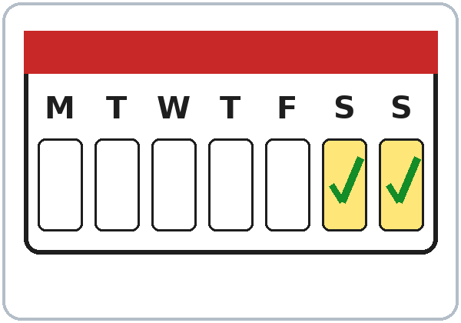
OPENING TALK · 6:00
Warm-Up
Same group.
Reply: Me too! / Me neither!
What do you love doing on weekends?
What do you hate doing?
Notes:
Step 1 · 6:00–6:10 · Opening Talk + Homework Check. Groups of 3–4 (15) / whole group (7–8); same group for both parts.
Minutes 0–5: these questions review Lesson 3; answer with Me too / Me neither / Really? Each click shows one question.
Source: Level2_Curriculum_v4_1_public.md, Lesson 4 (Step 1).
Picture: Twemoji graphics by Twitter, Inc. and other contributors (https://github.com/jdecked/twemoji), CC BY 4.0 (https://creativecommons.org/licenses/by/4.0/); resized and combined.

Slide 3
Homework
Check
HW
Homework check
Share 2 sentences. Vote!
1
She hates ____. (clean)
cleaning
After like, love, hate:
verb + -ing.
2
She ____ dancing. (like)
likes
3
I like ____. (cook)
cooking
4
I don't like coffee.
Me neither.
Notes:
Step 1, minutes 5–10: each person shares 2 homework sentences about other people (Lesson 3 homework); the group votes for the funniest.
Each click shows one answer. Lines review Lesson 3 (homework model, Common mistakes, Grammar Box 3).
Teacher: correct 2 sentences on the board. If behind: skip the vote.
Source: Level2_Curriculum_v4_1_public.md, Lesson 4 (Step 1); Lesson 3 Homework, Common mistakes, Grammar Box 3.

Slide 4
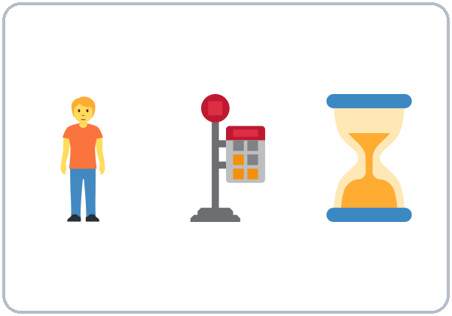
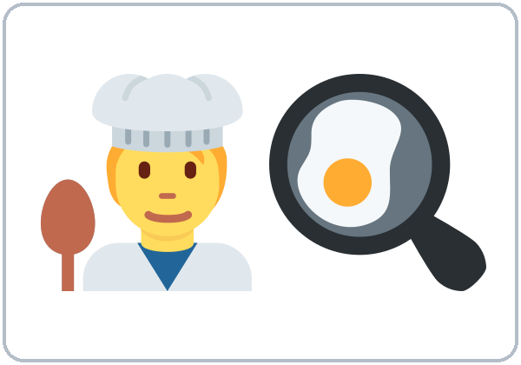




Look. Listen.
Repeat.
New Words
waiting
(for the bus)
cooking
(now)
working late
doing homework
watching TV
looking at
Notes:
Step 2 · 6:10–6:18 · New Words (2 teams / 1 team). Point, say, repeat. Each click shows one word.
Star words here: waiting (for the bus), cooking (now), doing homework, watching TV.
If behind: teach the star words and do 3 charades.
Source: Level2_Curriculum_v4_1_public.md, Lesson 4 (Step 2; Student Page 4 New Words).
Picture: Twemoji graphics by Twitter, Inc. and other contributors (https://github.com/jdecked/twemoji), CC BY 4.0 (https://creativecommons.org/licenses/by/4.0/); resized and combined.

Slide 5


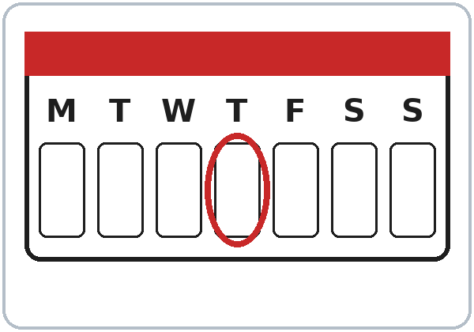
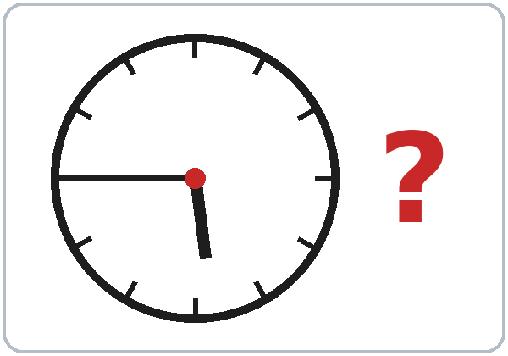
Charades:
You're cooking!
More New Words
calling
(on the phone)
coming
(The bus is coming.)
right now
today
What time is it?
(It's 5:45.)
Notes:
New Words, part 2. Each click shows one word. Star words here: calling (on the phone), What time is it? (It's 5:45.)
Charades: a learner mimes an action; the class says "You're cooking!"
Source: Level2_Curriculum_v4_1_public.md, Lesson 4 (Step 2; Student Page 4).
Picture: Twemoji graphics by Twitter, Inc. and other contributors (https://github.com/jdecked/twemoji), CC BY 4.0 (https://creativecommons.org/licenses/by/4.0/); resized and combined.

Slide 6
Listening A
Sam is ...
01
cooking
sleeping
driving
Listen. Circle the answer.
Rosa is ...
02
at home
at the bus stop
at work
It's ...
03
5:15
5:45
6:15
Notes:
Step 3 · 6:18–6:30 · Listening (L4_listening.mp3, about 1:40). Before you listen: show a woman at a bus stop on the phone: "Who is she calling? Why?"
Listen 1 → Task A (circle). Each click circles one answer.
Answer key: 1 cooking, 2 at the bus stop, 3 5:45.
Rosa and Sam are the same characters as in Lesson 1. No speaker? Read the script with a volunteer learner.
Source: Level2_Curriculum_v4_1_public.md, Lesson 4 (Step 3; Answer key; Teacher notes).
Picture: Twemoji graphics by Twitter, Inc. and other contributors (https://github.com/jdecked/twemoji), CC BY 4.0 (https://creativecommons.org/licenses/by/4.0/); resized and combined.

Slide 7
Listen again.
True or False?
Listening B
1. Rosa's daughters are doing their homework.
True
False
2. Rosa's husband is watching TV.
True
False
He's working late.
3. Rosa is coming to class tonight.
True
False
4. Sam doesn't have the homework page.
True
False
He has it.
Notes:
Listen 2 → Task B (true / false). Each click circles one answer and shows the correction.
Answer key: 1 T, 2 F (he's working late), 3 T, 4 F (he has it / he's looking at it).
Source: Level2_Curriculum_v4_1_public.md, Lesson 4 (Step 3; Answer key).

Slide 8
Listening C
C
Listen again.
Write the missing word.
1
I'm ____ dinner.
cooking
Rosa is waiting for the bus.
Every day or right now?
2
What ____ you doing?
are
3
They're ____ their homework.
doing
4
The bus ____ coming now.
is
Notes:
Listen 3 → Task C (fill in). Each click fills one blank.
Answer key: cooking; are; doing; is.
Ask: "Is Rosa waiting for the bus every day or right now?" (right now)
"Say it" (1–2 min): repeat "I'm cooking dinner. What are you doing?"
If behind: skip the third play; do Task C together.
Source: Level2_Curriculum_v4_1_public.md, Lesson 4 (Step 3; Answer key).

Slide 9
What are
Answers
you doing?
I'm cooking.
She's working late.
They're doing homework.
Helper: am / is / are.
What
are
you doing?
What
is
she doing?
am / is / are + -ing
What
are
they doing?
Notes:
Step 4 · 6:30–6:45 · Grammar. Say: "For something happening right now, use am / is / are + verb-ing. For every day / usually, use the simple present."
Board: a timeline with a dot labeled NOW and X X X marks (every day).
Grammar Box 1: each click highlights the helper: are, is, are.
Q: Is What do you do? the same as What are you doing? No! What do you do? = What's your job? What are you doing? = right now.
Source: Level2_Curriculum_v4_1_public.md, Lesson 4 (Step 4; Grammar Box 1; Questions and answers).
Picture: Twemoji graphics by Twitter, Inc. and other contributors (https://github.com/jdecked/twemoji), CC BY 4.0 (https://creativecommons.org/licenses/by/4.0/); resized and combined.

Slide 10
Grammar Box 2
Yes / No Questions
QUESTION
ANSWER
Are
you coming?
Yes, I am.
No, I'm not.
Is
she cooking?
Yes, she is.
No, she isn't.
Are
they sleeping?
Yes, they are.
No, they aren't.
Notes:
Grammar Box 2: Yes / No questions. Each click highlights one helper and its answers: Are, Is, Are.
More from the box: Are you working today? Is he / she working late? Are they doing homework?
Source: Level2_Curriculum_v4_1_public.md, Lesson 4 (Grammar Box 2).
Picture: Twemoji graphics by Twitter, Inc. and other contributors (https://github.com/jdecked/twemoji), CC BY 4.0 (https://creativecommons.org/licenses/by/4.0/); resized and combined.

Slide 11
Now or every day?
Right Now or
Every Day
RIGHT NOW
EVERY DAY
I'm cooking right now.
I cook every day.
She's working late today.
She works at a hotel.
Notes:
Q: What's the difference between I cook and I'm cooking? I cook = every day, a routine. I'm cooking = right now.
Click 1 and click 2 highlight one pair each.
Right-now words: now, right now, today, at the moment. Every-day words: every day, usually, always, on Mondays.
Stative verbs (like, know, want): don't teach the rule now. If someone says I'm liking it, just recast: "Oh, you like it!"
Source: Level2_Curriculum_v4_1_public.md, Lesson 4 (Questions and answers; Teacher notes).
Picture: Twemoji graphics by Twitter, Inc. and other contributors (https://github.com/jdecked/twemoji), CC BY 4.0 (https://creativecommons.org/licenses/by/4.0/); resized and combined.

Slide 12
Common Mistakes
Don't say
Say
I cooking now.
I'm cooking now.
She is work today.
She is working today.
Notes:
Common mistakes (part 1). Each click shows the correct sentence.
Q: Can I leave out am / is / are? No. Point to the 'm every time. Learners can read the note on their Grammar page; you don't need to explain it.
Source: Level2_Curriculum_v4_1_public.md, Lesson 4 (Common mistakes; Questions and answers; Teacher notes).
Picture: Twemoji graphics by Twitter, Inc. and other contributors (https://github.com/jdecked/twemoji), CC BY 4.0 (https://creativecommons.org/licenses/by/4.0/); resized and combined.

Slide 13
Fix These Mistakes
Don't say
Say
What you are doing?
What are you doing?
I'm cooking every day.
I cook every day.
Notes:
Common mistakes (part 2). Each click shows the correct sentence.
Every day = simple present: I cook every day.
Source: Level2_Curriculum_v4_1_public.md, Lesson 4 (Common mistakes).
Picture: Twemoji graphics by Twitter, Inc. and other contributors (https://github.com/jdecked/twemoji), CC BY 4.0 (https://creativecommons.org/licenses/by/4.0/); resized and combined.

Slide 14
Quick Check
Now or every day?
1
2
3
"I'm cooking."
"She works at night."
Is "I cooking" OK?
now
every day
No: I'm cooking.
Notes:
Step 4 check questions. Learners answer; each click shows one answer.
Answers: now · every day · No: I'm cooking.
Short Picture Talk (last 5 min): pairs describe a busy picture ("The man is waiting."); B points to the person. If behind: skip it.
Source: Level2_Curriculum_v4_1_public.md, Lesson 4 (Step 4 Check).

Slide 15
Grammar Box 3 · Telling time
What Time Is It?
What time is it?
5:45
It's five forty-five.
What time is it?
6:00
It's six o'clock.
Notes:
Grammar Box 3: What time is it? → It's five forty-five. / six o'clock. / seven fifteen. Click 1 and click 2 show one answer each.
Pronunciation (if time): fifteen (fif-TEEN) vs. fifty (FIF-ty). A says a time; B points to it on the clock.
Source: Level2_Curriculum_v4_1_public.md, Lesson 4 (Grammar Box 3; If time).
Picture: Twemoji graphics by Twitter, Inc. and other contributors (https://github.com/jdecked/twemoji), CC BY 4.0 (https://creativecommons.org/licenses/by/4.0/); resized and combined.

Slide 16
Talk Time
Phone Call
Then switch cards and partners.
7:00–7:10
1
Sit back to back.
No lip reading!
2
A: You're at the bus stop.
B: You're at home cooking.
3
Use the frame.
What are you doing? I'm ___.
Notes:
Step 5 · 7:00–7:10 · Talk Time: Phone Call Role Play. Set chairs back to back during the break. Each click shows one step.
Card A: "You're at the bus stop. The bus is late." Card B: "You're at home cooking. Your kids are doing homework."
Frame: Hi, it's ___. What are you doing? / I'm ___. Where are you? / I'm ___.
Then switch cards, then switch partners (15: 7 pairs + a 3-person conference call; 7–8: everyone does 3 calls). If behind: one call each.
Source: Level2_Curriculum_v4_1_public.md, Lesson 4 (Step 5).
Picture: Twemoji graphics by Twitter, Inc. and other contributors (https://github.com/jdecked/twemoji), CC BY 4.0 (https://creativecommons.org/licenses/by/4.0/); resized and combined.

Slide 17
Before You Go
01
Exit ticket
02
Homework
What is your family
doing right now?
Write one sentence.
3 times this week:
write what you and
your family are doing.
It's 8:00 PM. My son
is watching TV.
Notes:
Step 6 · 7:10–7:15 · Exit Ticket + Homework. NEVER SKIP.
Exit ticket: "What is your family doing right now?" (one sentence).
Homework (10 minutes): at 3 different times this week, write what you and your family are doing: It's 8:00 PM. I'm washing the dishes. My son is watching TV. My husband is working. Bring the 3 "photos in words" next week (Lesson 5's Opening Talk uses them). Do the first one together.
Source: Level2_Curriculum_v4_1_public.md, Lesson 4 (Step 6; Student Page 4 Homework).
Picture: Twemoji graphics by Twitter, Inc. and other contributors (https://github.com/jdecked/twemoji), CC BY 4.0 (https://creativecommons.org/licenses/by/4.0/); resized and combined.

Slide 18
Credits
Pictures
Vocabulary pictures use Twemoji graphics by Twitter, Inc. and other contributors (https://github.com/jdecked/twemoji), licensed under CC BY 4.0 (https://creativecommons.org/licenses/by/4.0/). The graphics were resized and combined, and arrows, calendars, clocks, and labels were added.
This deck
© 2026 the authors. The authors license this deck under CC BY-NC-SA 4.0.
Audio and font
Audio: Chatterbox TTS (Resemble AI, MIT); AI voices with a Perth watermark. Font: Lexend Deca (OFL 1.1). Provided as-is, without warranty.
Notes:
Credits. Lesson content: Level 2 Adult ESL Curriculum v4.1, public edition, Lesson 4.
Image credit line copied exactly from images/CREDITS.md. Deck notice: © 2026 the authors; the authors license this deck under CC BY-NC-SA 4.0 (Section 7.2).
Audio and font credits: Chatterbox TTS (Resemble AI, MIT; Perth watermark), Lexend Deca (SIL OFL 1.1).

