Slide 1
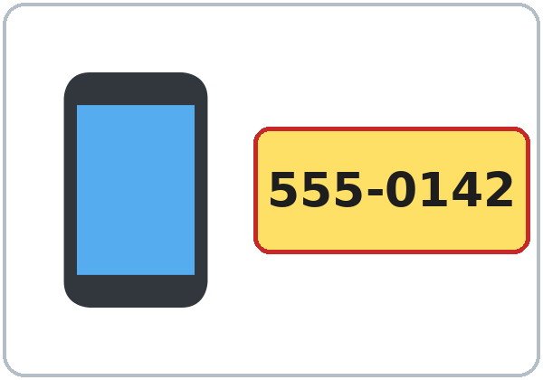
My Phone Number and Address
Today you will:
• Say a phone number
• Ask: What's your address?
• Fill out a simple form
Lesson 3 · Level 1
Notes:
Welcome everyone. Smile and say: "Hello! Welcome back to English class."
Point to the title. Read it slowly: "My phone number and address." Learners repeat.
Say first: "This is practice. You don't need your real phone number or your real address." Practice numbers are 555-0100 to 555-0199.
Point to the phone picture and read the number in groups: "five-five-five... oh-one-four-two."
Read the three lines, one at a time. Learners repeat each one.
Source: Level1_Lesson3.md (Topic; At a glance: Objectives; How to Use This Plan: Privacy this week).
Picture: Twemoji graphics by Twitter, Inc. and other contributors (https://github.com/jdecked/twemoji), CC BY 4.0 (https://creativecommons.org/licenses/by/4.0/); resized and combined on a card with drawn parts (see images/CREDITS.md).

Slide 2
Today's
Goals
01
I can say a phone number.
It's 555-0142.
02
I can say an address.
Tonight you learn these things.
Numbers to 100: 13 or 30?
Progress Check at 7:25!
03
I can ask: What's your address?
04
I can use my, your, his, her.
05
I can fill out a simple form.
Notes:
Point to each line and read it. Learners repeat. Click to show the next goal.
Say: "Tonight: phone numbers, addresses, and a form." Mime writing on a form.
Point to 13 and 30 on the board: "Thirteen... thirty. We practice this at 7:15."
Say: "At 7:25 we do the Progress Check."
Source: Level1_Lesson3.md (At a glance: Objectives; Clock-time plan).

Slide 3
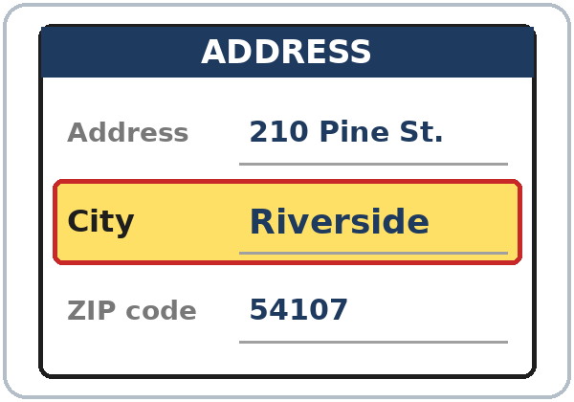
WARM-UP · 6:00
Hello + Review
Where are you from?
What city?
A: Where is she from?
B: She's from Mexico.
Is she from Honduras?
Notes:
Before class, write on the board: Where are you from? What city? Where is he / she from? Is he / she from ___?
Model with one learner: "Where are you from?" "Guatemala." "What city?" "Antigua." Then point to another learner: "Where is she from?" "She's from Mexico."
Click to show the A line, then the B line. Pairs: A asks, B answers. Then ask about a classmate. Switch. Then find a new partner.
Help lines: Can you repeat, please? How do you spell it?
Last 3 minutes: partners show each other last week's homework. Look at item 2 (am / is / are).
If behind: one partner only.
Source: Level1_Lesson3.md (Step 1 Hello + Review; Student Page 1).
Picture: Twemoji graphics by Twitter, Inc. and other contributors (https://github.com/jdecked/twemoji), CC BY 4.0 (https://creativecommons.org/licenses/by/4.0/); resized and combined on a card with drawn parts (see images/CREDITS.md).

Slide 4
How We
Work
01
Listen.
02
Repeat.
Class: 6:00–7:30
Break: 6:45–7:00
Model it. Check it. Then go.
This is practice: 555-0100 to 555-0199.
03
Point. Circle.
04
Write.
05
Partner. Group.
Notes:
Point to each word and do the action: listen (hand to ear), repeat, point, circle, write, partner, group. Learners copy you.
Say: "Model it. Check it. Then go." Do one example with a learner. Ask: "Listen or write?" Then everyone starts.
Privacy: say "This is practice. You don't need your real phone number or address." Use practice numbers 555-0100 to 555-0199 and the practice ID cards.
Pairs: turn to a neighbor. With an odd number, make one group of 3.
Source: Level1_Lesson3.md (How to Use This Plan: Instruction rule, Grouping toolkit, Privacy this week; Clock-time plan).

Slide 5
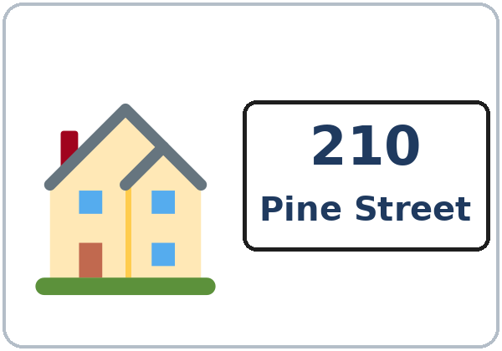
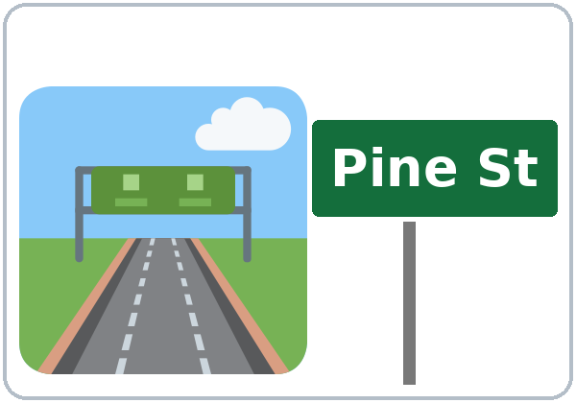

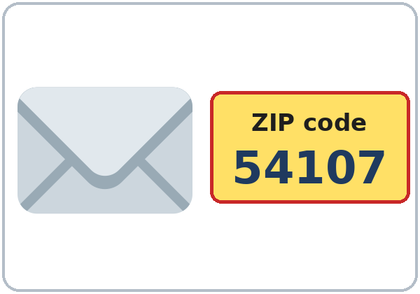
Look. Listen.
Repeat.
New Words
★ phone number
★ address
★ street
apartment (Apt.)
★ city
★ ZIP code
Notes:
Say first: "This is practice. You don't need your real phone number or your real address."
Show a real paper form (no one's information on it). Point to the lines: "This is a form. First name. Last name. Phone number. Address."
Click: each picture and word appears. Point and say the word. Learners repeat twice.
★ = most important words. Apt. = apartment.
If behind: teach the ★ words only.
Source: Level1_Lesson3.md (Step 2 New Words; Student Pages: New Words).
Picture: Twemoji graphics by Twitter, Inc. and other contributors (https://github.com/jdecked/twemoji), CC BY 4.0 (https://creativecommons.org/licenses/by/4.0/); resized and combined on a card with drawn parts (see images/CREDITS.md).

Slide 6

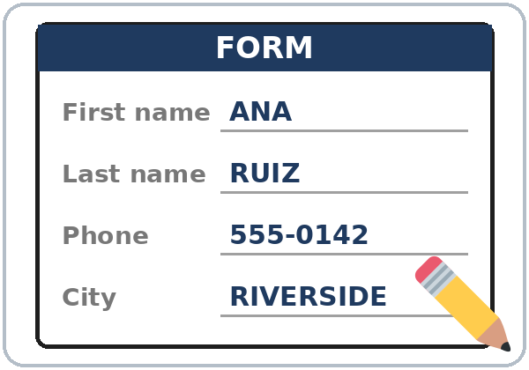
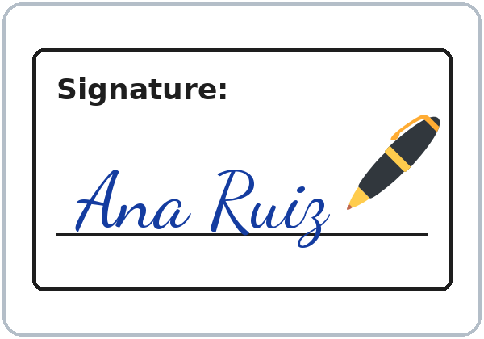
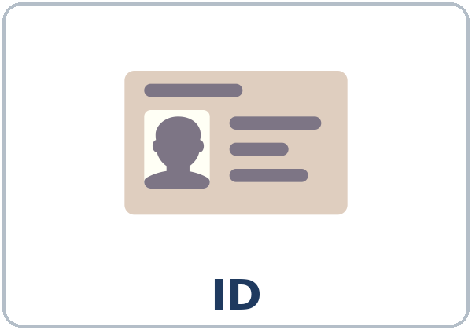
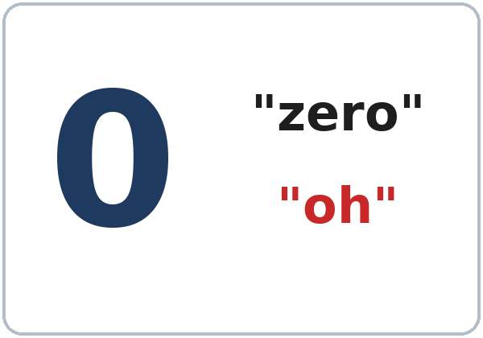
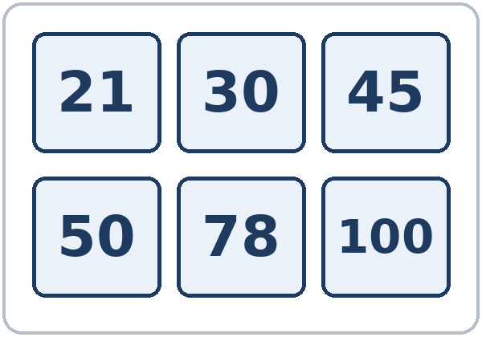
Partner game:
A points. B says.
More New Words
★ email
★ form
★ signature
ID card
★ zero ("oh")
numbers 21–100
Notes:
Click: each picture and word appears. Say the word. Learners repeat twice.
Act it out: signature (sign your name in the air), email (type on a phone).
zero = "oh": write 555-0142 on the board. Say it slowly in groups: "five-five-five... oh-one-four-two." Point to the 0: "Oh. In phone numbers, 0 is often oh."
numbers 21–100: point to the tiles and say them. Learners repeat.
Partner game (4 min): A points to a picture, B says the word. Switch. Then A points to a line on the form picture, B says the word (city, ZIP code...).
Source: Level1_Lesson3.md (Step 2 New Words; Student Pages: New Words, Partner game).
Picture: Twemoji graphics by Twitter, Inc. and other contributors (https://github.com/jdecked/twemoji), CC BY 4.0 (https://creativecommons.org/licenses/by/4.0/); resized and combined on a card with drawn parts (see images/CREDITS.md).

Slide 7
Picture Check
Look at the picture. What's the word?
1
2
3
_________
_________
_________
street
signature
ZIP code
Notes:
Point to picture 1. Ask: "What's the word?" Learners say it. Click to show the answer: street.
Picture 2: click to show signature. Picture 3: click to show ZIP code.
Learners say each word 2 times. Point to the sign: "Pine Street."
Source: Level1_Lesson3.md (Student Pages: New Words).
Picture: Twemoji graphics by Twitter, Inc. and other contributors (https://github.com/jdecked/twemoji), CC BY 4.0 (https://creativecommons.org/licenses/by/4.0/); resized and combined on a card with drawn parts (see images/CREDITS.md).

Slide 8
Before You
Say it!
Listen
What's your phone number?
Ana is at a clinic. She's a new patient.
Can you repeat, please?
01
What's your address?
Listen 1: Circle.
02
Listen 2: The form.
Listen and repeat.
03
Listen 3: Check ✓.
Notes:
Say: "This is Ana. She's at a clinic. She's a new patient. The receptionist asks: What's your phone number? What's your address?" Point to the form (Task B).
Click to show each listen: Listen 1 = Task A (circle). Listen 2 = Task B (the form). Listen 3 = Task C (check what Ana writes).
The audio L1_L3_listening.mp3 (about 1:05) plays the conversation once. Press play again for the next listen. Voices: Narrator, Receptionist, Ana.
Say it (2 min): the class repeats each line twice. Then pairs ask and answer with a practice number.
No speaker? Read the script with a volunteer. Read numbers slowly, in groups: five-five-five... oh-one-four-two.
Source: Level1_Lesson3.md (Step 3 Listening + Say it; Listening script); audio/README.md.
Picture: Twemoji graphics by Twitter, Inc. and other contributors (https://github.com/jdecked/twemoji), CC BY 4.0 (https://creativecommons.org/licenses/by/4.0/); resized and combined on a card with drawn parts (see images/CREDITS.md).

Slide 9
Listen to Ana.
Circle the right one.
Listening A
1. Phone number
555-0142
555-0124
555-0412
2. Street number
201
210
120
3. Apartment
3
13
30
4. ZIP code
54107
54170
45107
Notes:
Listen 1. Play the audio once. Learners circle the right one in each row.
Pairs compare: "Show your partner." Then click 4 times to show the answers, one row at a time.
Answers: 1 555-0142, 2 210, 3 3, 4 54107.
Say the numbers in groups: five-five-five... oh-one-four-two. Two-ten Pine Street. Five-four-one-oh-seven.
Source: Level1_Lesson3.md (Student Pages: Listening Task A; Answer key).

Slide 10
Listen again. Fill out Ana's form.
First name: ANA
Listening B
1
Last name:
RUIZ
2
Phone number:
555-0142
Ana's form.
Write in CAPITAL letters.
Pairs: show your partner.
3
Address:
___ Pine St., Apt. ___
210 · 3
4
City:
RIVERSIDE
5
ZIP code:
54107
Notes:
Listen 2. Play the audio again. Learners fill out Ana's form. First name is done: ANA.
Listen 3 (with Task C): learners finish the form.
Pairs compare. Then click 5 times to show the answers, one line at a time.
Answers: Last name RUIZ. Phone number 555-0142. Address 210 Pine Street, Apt. 3. City RIVERSIDE. ZIP code 54107.
On forms we use CAPITAL letters: ANA RUIZ.
Source: Level1_Lesson3.md (Student Pages: Listening Task B; Answer key; Questions and answers: How do I write on a form?).

Slide 11
Listen again. What does Ana write?
Yes or No?
Listening C
1. her email
Yes
No
2. her signature
Yes
No
3. her ID card number
Yes
No
Notes:
Listen 3. Play the audio again. Ask: "What does Ana write?" Learners say Yes or No for each line.
Click 3 times to show the answers: 1 email, Yes. 2 signature, Yes. 3 ID card number, No.
In the audio the receptionist says: "Please write your email here. And sign here, please."
Then finish Task B (the form). Pairs compare.
Source: Level1_Lesson3.md (Student Pages: Listening Task C; Listening script; Answer key).

Slide 12
Grammar Box 1
What's your phone number?
QUESTION
ANSWER
What's your phone number?
It's 555-0142.
What's her address?
It's 210 Pine Street.
What's her ZIP code?
It's 54107.
What's your email?
It's ana@mail.com.
Notes:
Show the box: the left side is the question. The right side is the answer. Point left, then right.
You read a question. Click to show the answer. The class reads the answer.
Change the word: your / his / her. Use practice numbers: 555-0142, 555-0163. Addresses: 210 Pine Street, 46 Oak Street.
Say phone numbers in groups: five-five-five... oh-one-four-two.
Source: Level1_Lesson3.md (Step 4 Grammar Q&A; Grammar Box 1).
Picture: Twemoji graphics by Twitter, Inc. and other contributors (https://github.com/jdecked/twemoji), CC BY 4.0 (https://creativecommons.org/licenses/by/4.0/); resized and combined on a card with drawn parts (see images/CREDITS.md).

Slide 13
Grammar Box 2
my, your, his, her…
I → my · you → your
his
= he (Carlos)
my phone number
your address
we → our · they → their
her
= she (Ana)
our class
their city
Notes:
This is the key point. Point to a man: "his phone number." Point to a woman: "her phone number."
Point to yourself: "my." To a learner: "your." To the class and you: "our class." To two learners: "their city."
Write on the board: he → his. she → her. Click to show the examples.
The big mistake this week: his and her. The word depends on the person, not the thing. Correct by pointing to the person: "Carlos... his."
Check questions: point to a man: "What's ___ name?" (his). To a woman (her). "I'm Ana. ___ last name is Ruiz." (My)
Source: Level1_Lesson3.md (Step 4 Grammar Q&A, Box 2; Grammar Box 2; Teacher notes).
Picture: Twemoji graphics by Twitter, Inc. and other contributors (https://github.com/jdecked/twemoji), CC BY 4.0 (https://creativecommons.org/licenses/by/4.0/); resized and combined on a card with drawn parts (see images/CREDITS.md).

Slide 14
Grammar Box 3
Is your phone number
555-0124?
QUESTION
ANSWER
Is
your / his / her
phone number 555-0124?
Yes, it is.
No, it isn't. It's 555-0142.
Can
you repeat, please?
you spell it, please?
Sure. 555-0142.
Sure. P-I-N-E.
Notes:
Read a wrong number on purpose: "Is your phone number 555-0124?" Click: "No, it isn't. It's 555-0142."
Then ask the right number: "Is your phone number 555-0142?" The class says: "Yes, it is."
Can you repeat, please? Can you spell it, please? Click to show: "Sure. 555-0142." / "Sure. P-I-N-E." (Pine Street)
Pairs ask and answer with a practice number.
Source: Level1_Lesson3.md (Step 4 Grammar Q&A, Box 3; Grammar Box 3).
Picture: Twemoji graphics by Twitter, Inc. and other contributors (https://github.com/jdecked/twemoji), CC BY 4.0 (https://creativecommons.org/licenses/by/4.0/); resized and combined on a card with drawn parts (see images/CREDITS.md).

Slide 15
Grammar Box 4
How do I say it?
Say it in groups
555 … 0142
0 = "oh"
210 = two-ten
Number first!
WRITE
SAY
555-0142
five-five-five, oh-one-four-two
210 Pine Street
two-ten Pine Street
1850 Lake Avenue
eighteen-fifty Lake Avenue
Apt. 3
apartment three
54107
five-four-one-oh-seven
Notes:
Read the left side. Click to show the right side. The class reads it.
Say the groups with a small stop: 555 ... 0142. 0 is usually "oh."
Street numbers are usually in pairs: 210 = two-ten, 1850 = eighteen-fifty. The number comes before the street name: 210 Pine Street (not Pine Street 210).
Pair drill (3–4 min): A asks about a person (Ana, Carlos); B answers. Then switch. If behind, skip the pair drill; it becomes homework.
Source: Level1_Lesson3.md (Step 4 Grammar Q&A, Box 4; Grammar Box 4; Questions and answers; Teacher notes).

Slide 16
Write my, your, his, or her.
Use one word.
my, your,
his, her?
1
I'm Rosa.
____ last name is Diaz.
My
2
This is Carlos.
____ phone number is 555-0163.
His
I: my
you: your
he: his · she: her
Pairs: check your answers.
3
This is Ana.
____ address is 210 Pine Street.
Her
4
What's ____ phone number?
It's 555-0187.
your
5
Kim is a student.
____ email is kim@mail.com.
Her
Notes:
Learners write one word in each line. Then pairs check.
Click to show each answer: 1 My, 2 His, 3 Her, 4 your, 5 Her.
Look at the person: a man → his (Carlos). A woman → her (Ana, Kim).
Pair drill: A asks "What's his phone number?" B answers from the line.
Source: Level1_Lesson3.md (Student Pages: Practice; Answer key: Grammar practice).

Slide 17
Common Mistakes
Don't say
Say
Carlos… her phone number.
Carlos… his phone number.
What is you phone number?
What's your phone number?
Pine Street 210.
210 Pine Street.
Is 555-0142.
It's 555-0142.
Notes:
Read the Don't say line. Learners think. Click to show the Say line. The class repeats it 2 times.
1 his for a man, her for a woman. 2 What's your phone number? 3 The number comes first: 210 Pine Street. 4 It's 555-0142.
Two more from the student page: say five-five-five (not five hundred fifty-five); My phone number is 555-0142 (with is).
Source: Level1_Lesson3.md (Student Pages: Common mistakes; Tip for speakers of other languages).
Picture: Twemoji graphics by Twitter, Inc. and other contributors (https://github.com/jdecked/twemoji), CC BY 4.0 (https://creativecommons.org/licenses/by/4.0/); resized and combined on a card with drawn parts (see images/CREDITS.md).

Slide 18
Talk Time
Practice ID Cards
A asks. B answers.
Don't show your page.
7:00–7:10
1
What's your phone number?
Can you repeat, please?
2
Check: show your cards.
Is the form the same?
3
Her phone number is ___.
His address is ___.
Notes:
Give half the class the Student A page and half the Student B page. Partners don't show their pages. With an odd number, two Bs share one A.
Model with one learner (you are A): "What's your first name?" "Marco." "How do you spell your last name?" "S-I-L-V-A." "What's your phone number?" "555-0163." "Can you repeat, please?"
Part 1 (5 min): A asks and writes B's information. Then B asks and writes A's.
Part 2 (2 min): partners show their pages and check. Fix mistakes together.
Part 3 (2 min): join another pair. Say 2 sentences: "Her name is Rosa Diaz. Her phone number is 555-0187." / "His address is 1850 Lake Avenue."
Baseline snapshot: while pairs work, call the last learners you haven't checked. If behind: skip Part 3.
Source: Level1_Lesson3.md (Step 5 Talk Time; Talk Time Student A and Student B).
Picture: Twemoji graphics by Twitter, Inc. and other contributors (https://github.com/jdecked/twemoji), CC BY 4.0 (https://creativecommons.org/licenses/by/4.0/); resized and combined on a card with drawn parts (see images/CREDITS.md).

Slide 19
Before You Go 7:10–7:15
01
Exit ticket
02
Homework
Say a phone number:
My phone number is
555-01__.
Or write one sentence:
Her phone number is
555-0187.
1. Fill out the form.
2. Write my, his, her…
3. Write the number.
4. Say a phone number.
5. Write about you.
Bring it next week!
Notes:
Exit ticket (never skip): each learner says a phone number (a practice number is fine: "My phone number is 555-01__.") or writes one sentence with his or her ("Her phone number is 555-0187."). Copying is fine.
Homework: open the Homework page. Do item 1 together (the first two lines of the form). Point to each instruction.
Homework items: 1 fill out the form in CAPITAL letters and sign (own information or the practice ID card); 2 write my, his, her, our, or their; 3 write the number; 4 say a phone number 3 times, in groups; 5 review: write about you.
Source: Level1_Lesson3.md (Step 6 Exit Ticket + Homework; Student Pages: Homework).
Picture: Twemoji graphics by Twitter, Inc. and other contributors (https://github.com/jdecked/twemoji), CC BY 4.0 (https://creativecommons.org/licenses/by/4.0/); resized and combined on a card with drawn parts (see images/CREDITS.md).

Slide 20
Letters & Numbers · 7:15
-teen or -ty?
Numbers to 100
20 30 40 50
60 70 80 90
100
21 35 99
-teen · strong end
-ty · strong start
13
thir-TEEN
30 THIR-ty
14
four-TEEN
40 FOR-ty
15
fif-TEEN
50 FIF-ty
16
six-TEEN
60 SIX-ty
19
nine-TEEN
90 NINE-ty
Notes:
See it (1 min): point to 20, 30, 40... 100 on the left and say each one. Learners repeat.
Say it (3 min): say each pair 3 times: "thir-TEEN... THIR-ty." Click to show the -ty side. Clap on the strong part. -teen is long and strong at the end; -ty is short and strong at the start.
Learners show 1 finger + 3 for 13, and 3 fingers + a circle (0) for 30. The page also has 17 / 70 (seven-TEEN, SEV-en-ty) and 18 / 80 (eigh-TEEN, EIGH-ty).
Quick check (1 min): say 14 or 40, 15 or 50... Learners point.
When you hear a mix-up, ask: "One-three or three-zero?" and write both on the board.
Source: Level1_Lesson3.md (Letters & Numbers step; Student Pages: Letters & Numbers A and -teen or -ty?; Teacher notes).

Slide 21
Listen to the teacher.
Circle the number.
Numbers: Task B
1.
13
30
2.
14
40
3.
15
50
4.
16
60
5.
19
90
Notes:
Say each number 2 times: 1 thirty, 2 fourteen, 3 fifty, 4 sixteen, 5 ninety. Learners circle.
Pairs compare. Then click 5 times to show the answers: 30, 14, 50, 16, 90.
Task C: read 2 practice phone numbers in groups, 2 times each: 555-0163 (five-five-five, oh-one-six-three) and 555-0118 (five-five-five, oh-one-one-eight). Learners write them.
Task D: learners copy the card (Rosa Diaz, 46 Oak Street, Riverside) into the form in CAPITAL letters: ROSA, DIAZ, 46 OAK STREET, RIVERSIDE.
Partners: A says a practice phone number (555-01__), B writes it. Switch. Learners who can't write yet say the numbers and point; in Task D they copy only the first and last name.
If behind: do Tasks A and B only.
Source: Level1_Lesson3.md (Letters & Numbers step; Student Pages: Letters & Numbers B, C, D; Answer key).

Slide 22
Progress Check 7:25
D. I can…
😀 🙂 😐
Check one face.
B. Match the question
Answer
1. What's your phone number?
b. It's 555-0142.
2. What's your address?
d. It's 210 Pine Street.
3. What's your ZIP code?
a. It's 54107.
4. Is your phone number 555-0124?
c. No, it isn't.
Notes:
Part A: read the 5 numbers slowly, 2 times each: 13, 40, 15, 70, 80. Learners circle.
Part B: learners match the question and the answer. Click to show the answers: 1 b, 2 d, 3 a, 4 c.
Part C (write my, his, or her): 1 His, 2 Her, 3 My.
Part D: read each "I can..." line and point to the faces: 😀 "I can do it." 🙂 "A little." 😐 "Not yet." Learners check one.
Score: A /5 + B /4 + C /3 = /12. This is not a test grade. Collect the pages. If behind, do it in Week 4 at 6:00.
Source: Level1_Lesson3.md (Progress Check step; Student Pages: Progress Check; Answer key).

Slide 23
Great Work! See You Next Week!
Now you can:
• Say a phone number: 555-0142
• Ask: What's your address?
• Say his phone number, her address
Lesson 3 · Level 1
Notes:
Say: "Great work! See you next week!" Wave.
Read the three lines. Learners repeat. Point: "his" (a man), "her" (a woman).
Remind: bring the homework next week. Lesson 4: family, and his / her (This is my sister. Her name is Ana.).
Source: Level1_Lesson3.md (At a glance: Objectives; Teacher notes: Looking ahead).
Picture: Twemoji graphics by Twitter, Inc. and other contributors (https://github.com/jdecked/twemoji), CC BY 4.0 (https://creativecommons.org/licenses/by/4.0/); resized and combined on a card with drawn parts (see images/CREDITS.md).

Slide 24
Credits
Pictures
Vocabulary pictures use Twemoji graphics by Twitter, Inc. and other contributors (https://github.com/jdecked/twemoji), licensed under CC BY 4.0 (https://creativecommons.org/licenses/by/4.0/). The graphics were resized and combined, and drawings and labels were added. The handwritten name on the signature picture uses the Dancing Script font (SIL Open Font License).
Other small pictures (the faces on the Progress Check) are standard emoji characters shown with the computer's emoji font.
Names
Ana, Carlos, Rosa, Marco, and Kim are invented names. All phone numbers (555-01__) and addresses are invented.
Audio and font
Audio: synthetic voices (Narrator, Receptionist, Ana) made with Chatterbox TTS (Resemble AI, MIT License), cloned from short synthetic clips made with Kokoro-82M (Apache 2.0); no recordings of real people were used. Each file carries an inaudible Perth watermark. Font: Lexend Deca (OFL 1.1).
© 2026 the authors. The authors license this deck under CC BY-NC-SA 4.0.
Notes:
Credits. You don't need to read this slide in class.
Pictures: Twemoji (CC BY 4.0), see images/CREDITS.md. Audio: Chatterbox TTS (MIT), cloned from Kokoro-82M (Apache 2.0) clips; no recordings of real people.
Source: Level1_Lesson3.md (Picture Credits); images/CREDITS.md; audio/README.md.

