Slide 1

Yes, I Can!
Today you will:
• Ask: Can you drive?
• Say: I can cook. I can't swim.
• Practice a job interview.
Lesson 13 · Level 1
Notes:
Welcome. Say: "Today: can and can't. Job skills. A job interview." Mime: "I can cook."
Before class: print the Student Pages (number expected + 3 spares), one set of picture cards per group of 3–4, skill picture cards (cook, drive, clean…), the job-interview picture and the job application, mini whiteboards or scrap paper. Have the phone + small speaker and L1_L13_listening.mp3 ready. Prep time: 30 min.
Invented interview: learners may invent skills. Graduation talk (Week 16): learners prepare 3 sentences this week; reading from paper is fine.
Class plan: 6:00 Hello + Review, 6:10 New Words, 6:20 Listening, 6:32 Grammar, 6:45 Break, 7:00 Talk Time, 7:10 Exit Ticket + Homework, 7:15 Real-World Reading, 7:25 Progress Check.
Source: level1_curriculum/lesson13/Level1_Lesson13.md (At a glance, Clock-time plan, How to Use This Plan, Teacher notes).
Pictures: Twemoji graphics by Twitter, Inc. and other contributors (https://github.com/jdecked/twemoji), CC BY 4.0 (https://creativecommons.org/licenses/by/4.0/); resized and combined, labels added. The I can / I can't cards and the job application are drawn in code (see lesson13/images/CREDITS.md).

Slide 2
Today's
Goals
01
I can ask: Can you…?
Yes, I can. / No, I can't.
02
I can say: I can… / I can't…
Tonight you learn these things.
Job skills
A job interview
Progress Check at 7:25!
03
I can understand a job interview.
04
I can fill a job application.
05
I can prepare 3 sentences about me.
Notes:
Click to show each goal, one at a time. Read it aloud. Learners repeat.
Goal 1: ask and answer "Can you…? Yes, I can. / No, I can't."
Goal 2: say "I can… / I can't…" for job and life skills.
Goal 3: understand a short job interview.
Goal 4: fill a simple job application (name, phone, skills).
Goal 5: prepare 3 sentences for the graduation "All About Me" talk.
Source: level1_curriculum/lesson13/Level1_Lesson13.md (At a glance: Objectives).

Slide 3

WARM-UP · 6:00
Hello + Review
Are you OK?
What's wrong?
A: How do you feel?
B: I feel fine.
A: Can you cook?
B: Yes, I can.
Notes:
Pairs. 15 learners: 7 pairs + 1 group of 3. 7–8 learners: 3–4 pairs. Late arrivals join any pair.
Before class, write on the board: How do you feel? Can you cook? Can you drive?
Model with one learner: "How do you feel?" → "I feel fine." Then "Can you cook?" → "Yes, I can."
Click to show the A question. Click again for the answers. Pairs use the Hello + Review page: 1 Are you OK? → Yes, I am. / No, I'm not. 2 What's wrong? → ___. 3 Are you OK? Switch. Then find a new partner.
Homework check (last 3 min): partners show last week's homework. Walk around and look.
New learners: pair them with a strong partner. If behind: one partner only.
Source: level1_curriculum/lesson13/Level1_Lesson13.md (Step 1: Hello + Review; Student Pages: Hello + Review).
Review picture: "sick" from Lesson 12 (lesson12/images/L1_L12_sick.png). Twemoji graphics by Twitter, Inc. and other contributors (https://github.com/jdecked/twemoji), CC BY 4.0 (https://creativecommons.org/licenses/by/4.0/); resized (see lesson12/images/CREDITS.md).

Slide 4
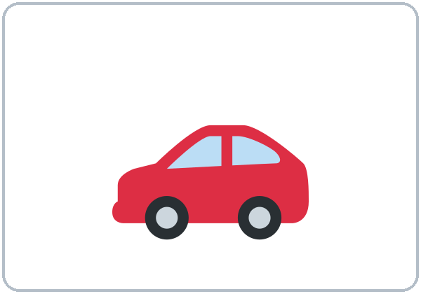
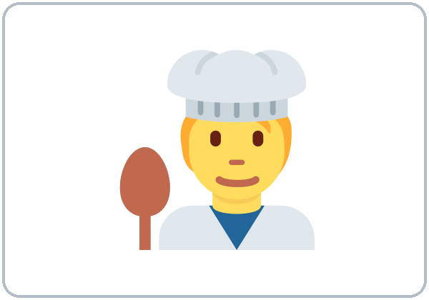

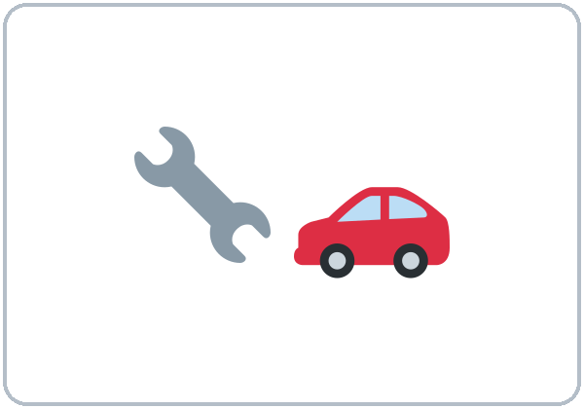


Look. Listen.
Repeat.
New Words
★ drive
★ cook
★ clean
★ fix (cars)
★ paint
★ use a computer
Notes:
Mime the skills: "Cook. Drive. Clean." Hold up a picture: "Computer."
Click to show each picture. Point and say the word. Learners repeat 2 times. ★ words 2 more times.
★ = most important words (as on the New Words page). If behind: teach the ★ words only.
Source: level1_curriculum/lesson13/Level1_Lesson13.md (Step 2: New Words; Student Pages: New Words).
Pictures: Twemoji graphics by Twitter, Inc. and other contributors (https://github.com/jdecked/twemoji), CC BY 4.0 (https://creativecommons.org/licenses/by/4.0/); resized and combined, labels added. The I can / I can't cards and the job application are drawn in code (see lesson13/images/CREDITS.md).

Slide 5

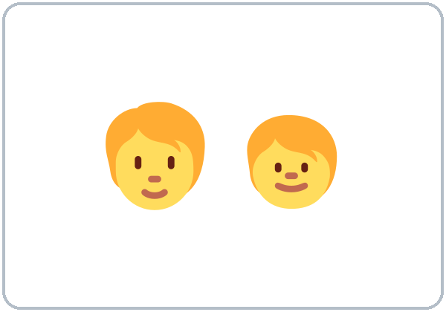



Partners:
A points. B says.
More New Words
★ speak English
★ take care of (kids)
★ lift
★ swim
★ job interview
★ skill
Notes:
Mime: "Lift. Swim." Hold up a picture: "Speak English."
Click to show each picture. Say the word. Learners repeat 2 times.
Pairs (4 min): A points to a picture, B says the word. Then A asks "Can you ___?" B answers "Yes, I can. / No, I can't."
★ = most important words. If behind: teach the ★ words only. I can / I can't are on the Grammar slide.
Source: level1_curriculum/lesson13/Level1_Lesson13.md (Step 2: New Words; Student Pages: New Words).
Pictures: Twemoji graphics by Twitter, Inc. and other contributors (https://github.com/jdecked/twemoji), CC BY 4.0 (https://creativecommons.org/licenses/by/4.0/); resized and combined, labels added. The I can / I can't cards and the job application are drawn in code (see lesson13/images/CREDITS.md).

Slide 6
Before You Listen
Say it!
Can you work on weekends?
Ana has a job interview
at a restaurant.
Yes, I can.
01
No, I can't.
Listen 1: What can she do?
02
Listen 2: What can't she do?
Listen and repeat.
03
Listen 3: Days and time.
Notes:
Before you listen (1 min). Say: "Ana has a job interview at a restaurant. The manager asks: Can you…?"
Click to show each listen. Listen 1: Task A (check what she can do). Listen 2: Task B (what can't she do?). Listen 3: Task C (days and time).
Say it!: class repeats: "Can you work on weekends?" "Yes, I can." "No, I can't."
The audio L1_L13_listening.mp3 (about 1:10) plays the conversation once. Press play again for the next listen. Pairs compare after each task. Write answers on the board.
No speaker? Read the script with a volunteer. The restaurant interview is invented.
Voices: Narrator, Manager, Ana. Synthetic voices made with Chatterbox TTS (MIT), copied from short reference clips made with Kokoro-82M (Apache 2.0); no recordings of real people.
If behind: play 2 times; do Task C together.
Source: level1_curriculum/lesson13/Level1_Lesson13.md (Step 3: Listening; Listening script).
Pictures: Twemoji graphics by Twitter, Inc. and other contributors (https://github.com/jdecked/twemoji), CC BY 4.0 (https://creativecommons.org/licenses/by/4.0/); resized and combined, labels added. The I can / I can't cards and the job application are drawn in code (see lesson13/images/CREDITS.md).

Slide 7
Listen. Check ✓.
What can Ana do?
Listening A
1
cook
clean tables
✓ cook
✓ clean tables
2
use a computer
work on weekends
✗ computer
✓ weekends
Check ✓: what she can do.
Pairs: show your partner.
3
work at night
start on Monday
✓ night
✓ Monday
Notes:
Listen 1 (Task A). Learners check what Ana can do.
Pairs compare. Then click to show each answer: cook ✓, clean tables ✓; use a computer ✗ (but she can learn), work on weekends ✓; work at night ✓, start on Monday ✓.
In the audio: "I can cook rice, beans, and tacos." "Can you use a computer?" "No, I can't. But I can learn."
Source: level1_curriculum/lesson13/Level1_Lesson13.md (Step 3: Listening; Student Pages: Listening A; Answer key; Listening script).

Slide 8
Listen again. Check. Circle.
What can't she do? Days and time.
Listening B + C
B. She can't:
cook
use a computer
work on Saturday
1
use a computer
B: what she can't do.
C: circle the days and time.
Pairs: show your partner.
C. Work on:
Saturday Sunday Friday
Starts on:
Monday Tuesday at ___
Saturday
Sunday
Monday at nine
2
Notes:
Listen 2 (Task B): what can't Ana do? Listen 3 (Task C): circle the days and write the time.
Pairs compare. Then click to show each answer.
Task B: use a computer ("No, I can't. But I can learn.").
Task C: she can work on Saturday and Sunday; she starts on Monday at nine ("See you Monday at nine.").
If behind: play the audio 2 times, and do Task C together.
Source: level1_curriculum/lesson13/Level1_Lesson13.md (Step 3: Listening; Student Pages: Listening B and C; Answer key; Listening script).

Slide 9
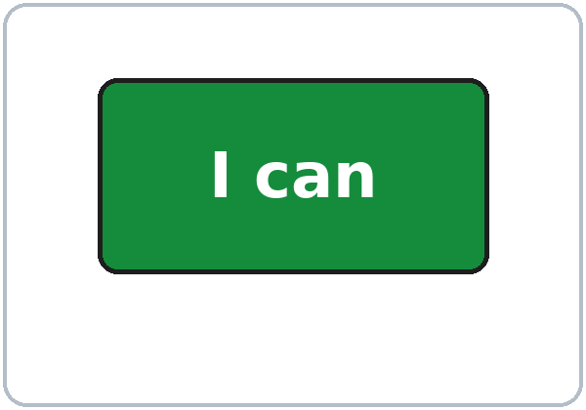

Grammar Box 1
Can you…?
QUESTION
ANSWER
Can you drive?
Yes, I can.
Can you cook?
No, I can't.
Can you swim?
Yes, I can.
No, I can't.
____ you drive?
Can you drive?
Notes:
Show the Grammar page. Left = question. Right = answer. Point left, then right.
New words: I can / I can't (the two pictures). Point to the green card: "I can." Point to the red card: "I can't."
Box 1: "Can you drive?" Click: "Yes, I can." "Can you cook?" Click: "No, I can't." "Can you swim?" Click: "Yes, I can. / No, I can't."
Check question: "___ you drive?" Click: Can. Then: "No, I ___." (can't)
can is often short and soft. can't is longer and clear: stress it so people hear the t.
Source: level1_curriculum/lesson13/Level1_Lesson13.md (Step 4: Grammar Q&A, Box 1; Grammar Box 1; New Words; Questions and answers).
Pictures: Twemoji graphics by Twitter, Inc. and other contributors (https://github.com/jdecked/twemoji), CC BY 4.0 (https://creativecommons.org/licenses/by/4.0/); resized and combined, labels added. The I can / I can't cards and the job application are drawn in code (see lesson13/images/CREDITS.md).

Slide 10
Grammar Box 2
I can… / I can't…
I can:
I can
+ cook.
I can cook.
I can drive.
I can't:
I can't
+ swim.
I can't use a computer.
I can't swim.
Notes:
Box 2: "I can cook. I can drive." Click. "I can't use a computer. I can't swim." Click.
Mime each one. Learners repeat 2 times.
can + verb: no "to", no "-s". I can cook (not I can to cook, not I can cooks).
Check question: "No, I ___." (can't)
Source: level1_curriculum/lesson13/Level1_Lesson13.md (Step 4: Grammar Q&A, Box 2; Grammar Box 2).
Pictures: Twemoji graphics by Twitter, Inc. and other contributors (https://github.com/jdecked/twemoji), CC BY 4.0 (https://creativecommons.org/licenses/by/4.0/); resized and combined, labels added. The I can / I can't cards and the job application are drawn in code (see lesson13/images/CREDITS.md).

Slide 11
Grammar Box 2
No to. No -s.
Questions and answers
can = short, soft
can't = long, clear t
DON'T SAY
SAY
1
I can to cook.
I can cook.
2
I can cooks.
I can cook.
Notes:
Read each DON'T SAY line. Shake your head. Cross it out on the board. Click to show the SAY line. Learners repeat it.
"Does can take to or -s?" No. I can drive (not I can to drive or I can drives).
Side card: "How do can and can't sound?" can is often short and soft. can't is longer and clear: stress it so people hear the t.
Big mistake this week: I can to cook / I can cooking. Point to Grammar Box 2.
Source: level1_curriculum/lesson13/Level1_Lesson13.md (Grammar Box 2; Questions and answers; Step 4; Teacher notes).

Slide 12
Grammar Box 3
Manager asks.
You answer.
Then switch.
Can you start on Monday?
Can you work on weekends?
Yes, I can.
Yes, I can. / No, I can't.
Notes:
Box 3 (interview questions): "Can you work on weekends?" Click: "Yes, I can. / No, I can't."
Right box: "Can you start on Monday?" Click: "Yes, I can."
Pairs: A is the manager, B answers. Then switch. Invented interview: learners may invent skills.
Pair drill (last 3–4 min): A asks 4 "Can you…?" questions from the skill cards; B answers; switch. If behind: skip the pair drill; Talk Time practices the same language.
Source: level1_curriculum/lesson13/Level1_Lesson13.md (Step 4: Grammar Q&A, Box 3 and pair drill; Grammar Box 3).
Pictures: Twemoji graphics by Twitter, Inc. and other contributors (https://github.com/jdecked/twemoji), CC BY 4.0 (https://creativecommons.org/licenses/by/4.0/); resized and combined, labels added. The I can / I can't cards and the job application are drawn in code (see lesson13/images/CREDITS.md).

Slide 13
Write can or can't.
Look at Grammar Boxes 1–2.
Practice
1
I ____ cook.
can
2
I ____ fly.
can't
can · can't
Then write:
I can ___. I can't ___.
3
____ you drive?
Can
4
Yes, I ____.
can
5
No, I ____.
can't
Notes:
Learners write can or can't. Then pairs check.
Click to show each answer: 1 can, 2 can't, 3 Can, 4 can, 5 can't.
Lines 6–7 on the page: learners write I can ___ and I can't ___ (answers will vary).
Source: level1_curriculum/lesson13/Level1_Lesson13.md (Grammar: Practice; Answer key: Grammar practice).

Slide 14
Common Mistakes
Don't say
Say
I can to drive.
I can drive.
I can drives.
I can drive.
I no can cook.
I can't cook.
Notes:
Read each "Don't say" line. Shake your head. Click to show the correct line. Learners repeat it.
I can to drive → I can drive. I can drives → I can drive. I no can cook → I can't cook.
Spanish speakers: can has no "to" and no "-s". can sounds short; can't sounds clear and long. Learners can read the Spanish note on their Grammar page.
Tip for speakers of other languages: read the grammar boxes left to right. Copy one question and one answer.
Source: level1_curriculum/lesson13/Level1_Lesson13.md (Grammar: Common mistakes).
Pictures: Twemoji graphics by Twitter, Inc. and other contributors (https://github.com/jdecked/twemoji), CC BY 4.0 (https://creativecommons.org/licenses/by/4.0/); resized and combined, labels added. The I can / I can't cards and the job application are drawn in code (see lesson13/images/CREDITS.md).

Slide 15
Talk Time
Skills Survey
Ask 3 classmates.
Write ✓ or ✗.
7:00–7:10
1
Ask:
Can you cook?
2
Partner answers:
Yes, I can. / No, I can't.
3
Write ✓ or ✗:
cook, drive, computer, English
Notes:
Part 1 — Skills survey (4 min). Learners ask 3 classmates "Can you…?" and write ✓ or ✗ in the table: cook, drive, use a computer, speak English.
Click to show each step. Model with one learner first.
Learners who can't write yet: they say "Yes, I can" and check boxes.
If behind: one round only.
Source: level1_curriculum/lesson13/Level1_Lesson13.md (Step 5: Talk Time, Part 1; Student Pages: Talk Time Skills Survey; Teacher notes).
Pictures: Twemoji graphics by Twitter, Inc. and other contributors (https://github.com/jdecked/twemoji), CC BY 4.0 (https://creativecommons.org/licenses/by/4.0/); resized and combined, labels added. The I can / I can't cards and the job application are drawn in code (see lesson13/images/CREDITS.md).

Slide 16
TALK TIME · PART 2
A asks:
Can you cook?
Can you work at night?
Can you start on Monday?
B: invent skills OK.
Then: switch.
Job Interview
A = manager.
B = applicant.
A: Can you work on weekends?
B: Yes, I can.
Notes:
Part 2 — Interview (5 min). A = manager, B = applicant; then switch. Use the job-interview page.
Model it: "Can you work on weekends?" Click: "Yes, I can."
Student A asks: 1 Can you cook? 2 Can you work on weekends? 3 Can you work at night? 4 Can you start on Monday? and writes the answers.
Student B says: Yes, I can. / No, I can't. • I can ___. • I can't ___. • Thank you! Remind: invent answers OK.
If behind: half of Talk Time only.
Source: level1_curriculum/lesson13/Level1_Lesson13.md (Step 5: Talk Time, Part 2; Student Pages: Talk Time Interview A and B).

Slide 17
Before You Go 7:10–7:15
01
Exit ticket
02
Homework
Say:
I can ___.
Or say:
I can't ___.
1. Write about you.
2. Unscramble.
3. Talk: 3 sentences.
4. Ask: Can you cook?
5. I feel… / Call 911.
Bring it next week!
Notes:
Exit ticket (never skip): each learner says "I can ___." or "I can't ___."
Homework (10 minutes): open the Homework page. Do item 1, line 1 together. Point to each instruction.
Homework: 1) write about you: I can ___ (2 times), I can't ___, Can you drive? → ___; 2) unscramble: can / I / cook; can't / I / swim; you / Can / drive; 3) prepare your graduation talk (3 sentences): My name is ___. I can ___. I ___. Reading from paper is fine; 4) ask a family member "Can you cook?" and write the answer; 5) review: write I feel… or Call 911 (Lesson 12).
Graduation talk is in Week 16.
Source: level1_curriculum/lesson13/Level1_Lesson13.md (Step 6: Exit Ticket + Homework; Student Pages: Homework; Teacher notes).
Pictures: Twemoji graphics by Twitter, Inc. and other contributors (https://github.com/jdecked/twemoji), CC BY 4.0 (https://creativecommons.org/licenses/by/4.0/); resized and combined, labels added. The I can / I can't cards and the job application are drawn in code (see lesson13/images/CREDITS.md).

Slide 18
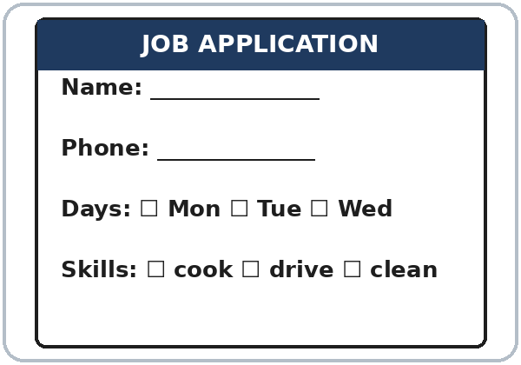
Job Application
1
Where do you write your name?
the Name line
2
Where do you write your phone?
the Phone line
Real-World Reading
Task A: point. Answer.
Notes:
Real-World Reading (10 min). Whole class, then pairs. Use the Real-World Reading page. The form is invented.
See it (2 min), Task A: point to Name / Phone / Skills on the form.
Click to show each answer: 1 the Name line, 2 the Phone line. Point to each line on the form.
Hear it (2 min): spell a short name; learners write letters they know.
Learners who can't read yet: they point to pictures and say key words with everyone.
Source: level1_curriculum/lesson13/Level1_Lesson13.md (Real-World Reading step; Student Pages: Real-World Reading A).
Pictures: Twemoji graphics by Twitter, Inc. and other contributors (https://github.com/jdecked/twemoji), CC BY 4.0 (https://creativecommons.org/licenses/by/4.0/); resized and combined, labels added. The I can / I can't cards and the job application are drawn in code (see lesson13/images/CREDITS.md).

Slide 19
Check ✓ your skills.
About you. Invented OK.
Your Skills
1
cook drive clean
2
use a computer speak English
Real-World Reading
Task B: check ✓.
Notes:
Read it (4 min), Task B: learners check ✓ skills on the form, about themselves. Invented answers are OK.
There is no right answer. Walk around and help. Ask: "Can you cook?" "Can you drive?"
Learners who can't write yet: they say "Yes, I can" and check boxes on the form.
If behind: do Tasks A and B only.
Source: level1_curriculum/lesson13/Level1_Lesson13.md (Real-World Reading step; Student Pages: Real-World Reading B; Teacher notes).
Pictures: Twemoji graphics by Twitter, Inc. and other contributors (https://github.com/jdecked/twemoji), CC BY 4.0 (https://creativecommons.org/licenses/by/4.0/); resized and combined, labels added. The I can / I can't cards and the job application are drawn in code (see lesson13/images/CREDITS.md).

Slide 20
Real-World Reading · Tasks C + D
Write 2 Sentences
About
you.
C: write.
D: A asks, B answers.
WRITE
EXAMPLE
I can ____.
I can cook.
I can't ____.
I can't use a computer.
Notes:
Task C: learners write 2 sentences about themselves: I can ___. I can't ___. Answers will vary.
Click to show an example for each line (from Grammar Box 2): I can cook. I can't use a computer. These are examples only.
Task D (pairs): A asks one question from the form ("Can you cook?" "Can you drive?"); B answers. Then switch.
Source: level1_curriculum/lesson13/Level1_Lesson13.md (Real-World Reading step; Student Pages: Real-World Reading C and D; Grammar Box 2).

Slide 21
Progress Check 7:25
D. I can…
😀 🙂 😐
Check one face.
B. Match the question
Answer
1. Can you cook?
b. Yes, I can.
2. Can you swim?
a. No, I can't.
3. Can you work on weekends?
c. Yes, I can. On Saturday.
4. Can you start on Monday?
d. Yes, I can. See you Monday.
Notes:
Progress Check (5 min). Individuals. Open the Progress Check page.
Part A: read each word slowly, 2 times: 1 cook, 2 drive, 3 computer, 4 clean, 5 swim. Learners circle.
Parts B and C: learners match and write on their own. Help with the instructions only. Click to show the Part B answers when you check together: 1 b, 2 a, 3 c, 4 d.
Part C answers: 1 can (I can cook.), 2 can't (I can't fly.), 3 Can (Can you drive?).
Part D: read each "I can…" line and point to the 3 faces. Learners check one.
Score: A /5 + B /4 + C /3 = /12. Not a test grade. Collect if you want. If behind: do it next week at 6:00.
Source: level1_curriculum/lesson13/Level1_Lesson13.md (Progress Check step; Student Pages: Progress Check; Answer key).

Slide 22
Great Work! See You Next Week!
Now you can:
• Ask: Can you cook?
• Say: Yes, I can. / No, I can't.
• Say: I can drive. I can't swim.
Lesson 13 · Level 1
Notes:
Say: "Great work! See you next week!" Remind learners: bring the homework next week and practice the 3 sentences for the graduation talk (Week 16).
Collect the Progress Check pages if you want.
Source: level1_curriculum/lesson13/Level1_Lesson13.md (At a glance: Objectives; Teacher notes).
Pictures: Twemoji graphics by Twitter, Inc. and other contributors (https://github.com/jdecked/twemoji), CC BY 4.0 (https://creativecommons.org/licenses/by/4.0/); resized and combined, labels added. The I can / I can't cards and the job application are drawn in code (see lesson13/images/CREDITS.md).

Slide 23
Credits
Pictures
Pictures use Twemoji graphics by Twitter, Inc. and other contributors (https://github.com/jdecked/twemoji), licensed under CC BY 4.0 (https://creativecommons.org/licenses/by/4.0/). The graphics were resized and combined, and drawings and labels were added. The I can and I can't cards and the job application are drawn in code. Labels use the DejaVu Sans font. The review picture (sick) is from Lesson 12.
Other small pictures (the faces on the Progress Check) are standard emoji characters shown with the computer's emoji font.
Names
All names and places on the slides (Ana, the restaurant, the manager) are invented.
Audio and font
Audio: synthetic voices (Narrator, Manager, Ana) made with Chatterbox TTS (Resemble AI, MIT License), copied from short reference clips made with Kokoro-82M (Apache 2.0); no recordings of real people were used. Each file carries an inaudible Perth watermark. Font: Lexend Deca (OFL 1.1).
© 2026 the authors. The authors license this deck under CC BY-NC-SA 4.0.
Notes:
Credits for the pictures, audio, and font.
Pictures: Twemoji (CC BY 4.0), https://github.com/jdecked/twemoji; resized and combined, labels added; I can / I can't cards and the job application drawn in code. Review picture (sick) from Lesson 12. Audio: Chatterbox TTS (MIT) voices copied from short Kokoro-82M (Apache 2.0) reference clips; no recordings of real people.
Sources: Level1_Lesson13.md (Picture Credits), lesson13/images/CREDITS.md, lesson13/audio/README.md.

