Slide 1
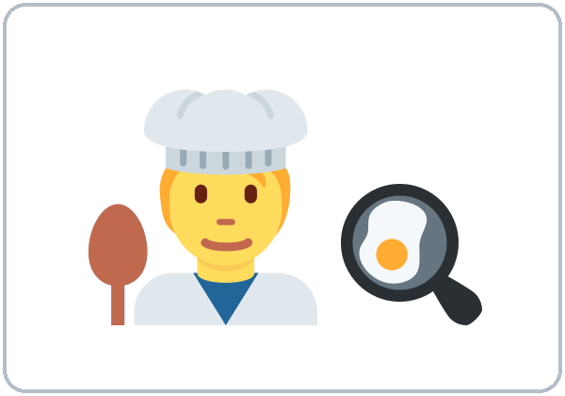
What's Your Job?
Today you will:
• Say your job
• Say: I work at a restaurant.
• Ask: What do you do?
Lesson 5 · Level 1
Notes:
Welcome. Say: "Today: jobs." Point to the picture: "He is a cook."
Say at the start: "Everyone has an answer. You can say: I'm a student. I'm a homemaker. I don't work now." Write these 3 answers on the board and leave them there.
Never ask about pay, bosses, or work papers. Never ask where someone works if they don't offer it.
Class plan: 6:00 Hello + Review, 6:10 New Words, 6:20 Listening, 6:32 Grammar, 6:45 Break, 7:00 Talk Time, 7:10 Exit Ticket + Homework, 7:15 Letters & Numbers, 7:25 Progress Check.
Source: level1_curriculum/lesson5/Level1_Lesson5.md (At a glance, How to Use This Plan, Clock-time plan).
Pictures: Twemoji graphics by Twitter, Inc. and other contributors (https://github.com/jdecked/twemoji), CC BY 4.0 (https://creativecommons.org/licenses/by/4.0/); resized and combined with drawn parts (see images/CREDITS.md).

Slide 2
Today's
Goals
01
I can say my job.
a cook, an office worker…
02
I can say: I work at a factory.
Tonight you learn these things.
a or an? The sh sound: cashier
Progress Check at 7:25!
03
I can ask: What do you do?
04
I can answer: Yes, I do. / No, I don't.
05
I can say: I don't work now.
Notes:
Click to show each goal, one at a time. Read it aloud. Learners repeat.
Goal 1: point to the job pictures: "I'm a cook. I'm an office worker."
Goal 4: nod for "Yes, I do." Shake your head for "No, I don't."
Goal 5: "I'm a student" and "I'm a homemaker" are good answers too.
Letters & Numbers at 7:15: a or an, the sh sound (cashier), and job signs.
Source: level1_curriculum/lesson5/Level1_Lesson5.md (At a glance: Objectives).

Slide 3
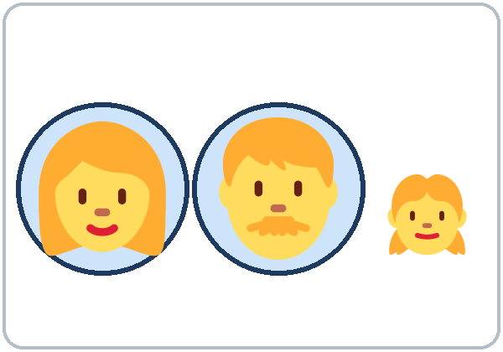
WARM-UP · 6:00
Hello + Review
Do you have kids?
Do you have brothers or sisters?
A: Who's this?
B: This is my mother.
Her name is ___.
Notes:
Pairs. Review of last week (family). 15 learners: 7 pairs + 1 group of 3. 7–8 learners: 3–4 pairs. Late arrivals join any pair.
Model with one learner: "Do you have brothers or sisters?" Learner: "Yes, I do. I have two brothers."
Point to the picture: "Who's this?" Click: "This is my mother." Click again for the next line. Learners can use their family or Ana's family.
Partners switch, then find a new partner. Help: "Can you repeat, please?" "How do you spell it?"
Last 3 minutes: homework check. Partners show each other the Lesson 4 homework. Look at item 2 (do / don't).
If behind: one partner only.
Source: level1_curriculum/lesson5/Level1_Lesson5.md (Step 1: Hello + Review; Student Pages: Hello + Review). Picture from the Lesson 4 deck.
Pictures: Twemoji graphics by Twitter, Inc. and other contributors (https://github.com/jdecked/twemoji), CC BY 4.0 (https://creativecommons.org/licenses/by/4.0/); resized and combined with drawn parts (see images/CREDITS.md).

Slide 4
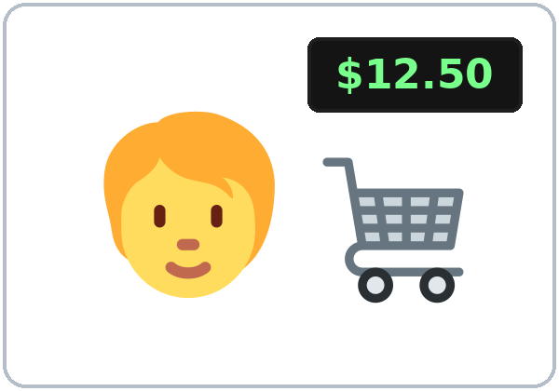
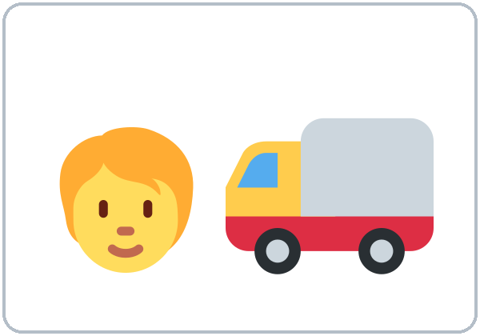
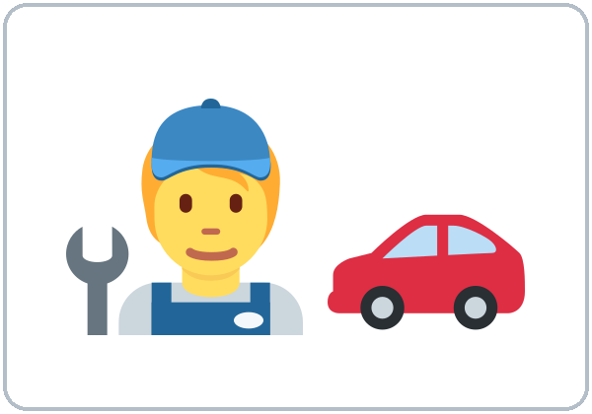
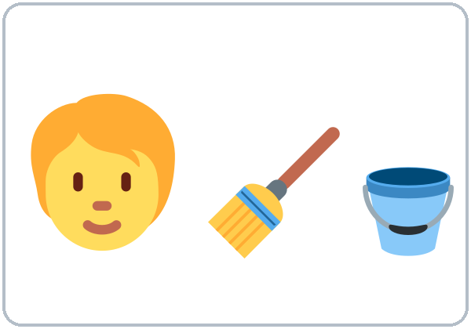
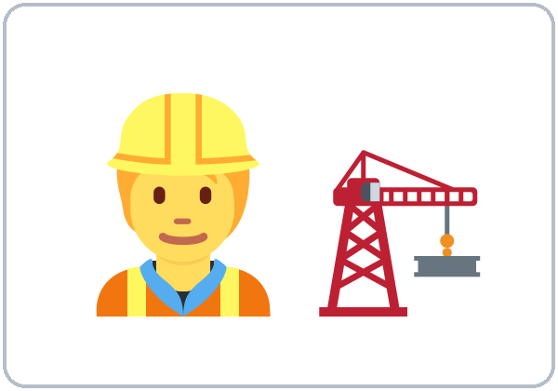
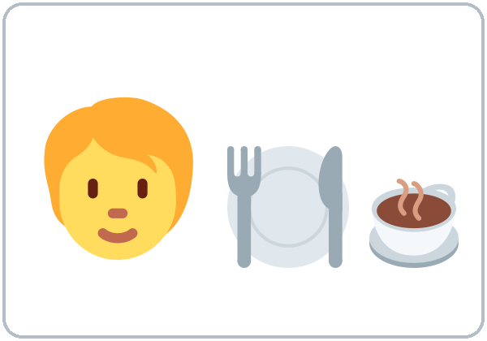
Look. Listen.
Repeat.
New Words
★ cook
★ cashier
★ driver
★ mechanic
★ cleaner
(housekeeper)
★ construction
worker
★ server
Notes:
Say first: "Today: jobs. What do you do? You can say: I'm a student. I'm a homemaker. I don't work now."
Click to show each picture. Point and say the word. Learners repeat 2 times.
Act out each job. Learners copy the action. Cook: stir a pot. Cashier: scan and count money. Driver: turn a wheel. Cleaner: sweep.
cleaner = housekeeper. Both words are OK.
★ = most important words. If behind: teach the ★ words only.
Source: level1_curriculum/lesson5/Level1_Lesson5.md (Step 2: New Words; Student Pages: New Words).
Pictures: Twemoji graphics by Twitter, Inc. and other contributors (https://github.com/jdecked/twemoji), CC BY 4.0 (https://creativecommons.org/licenses/by/4.0/); resized and combined with drawn parts (see images/CREDITS.md).

Slide 5
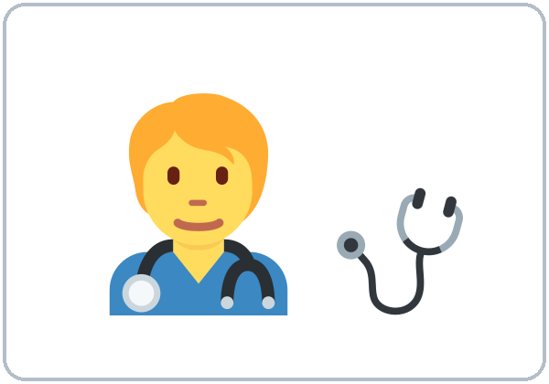
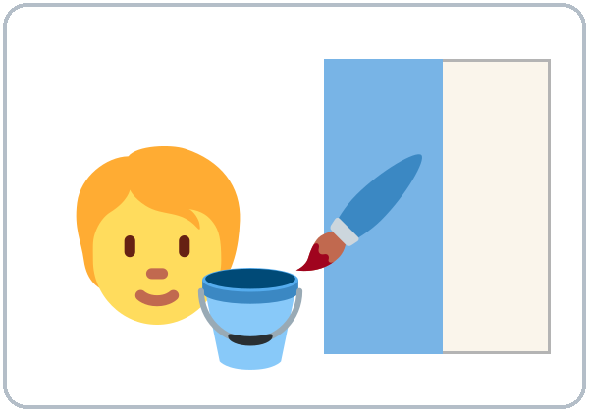
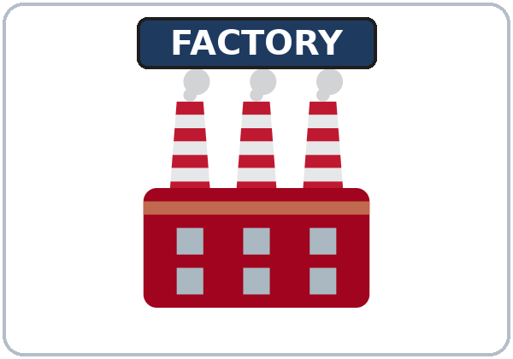
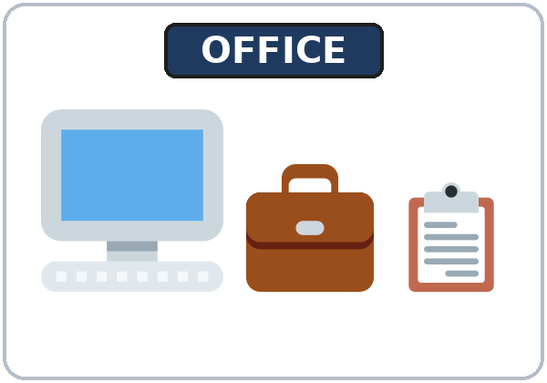
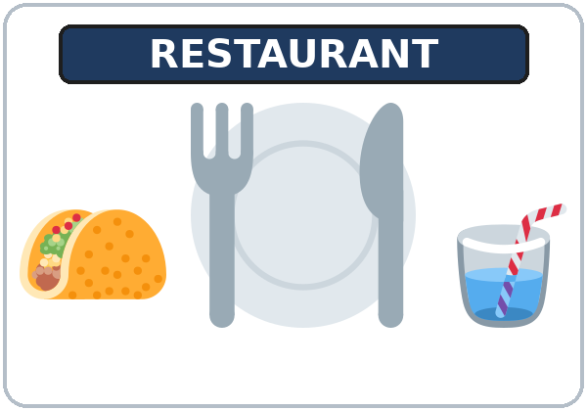

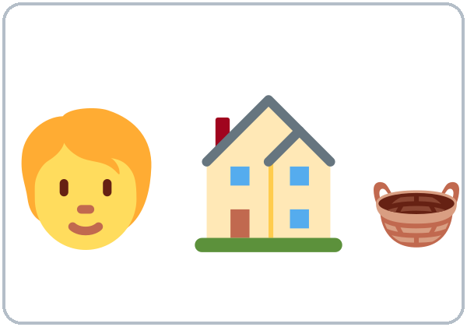
Partner game:
A acts out. B says.
More New Words
nurse
painter
★ factory
★ office
★ restaurant
student
homemaker
Notes:
Click to show each picture. Say the word. Learners repeat 2 times.
factory, office, restaurant are places. Say: "A cook works at a restaurant."
student and homemaker: good answers for learners who don't work now.
Pairs (4 min): A acts out a job, B says it. Then switch. Then A points to a picture, B says it.
★ = most important words.
Source: level1_curriculum/lesson5/Level1_Lesson5.md (Step 2: New Words; Student Pages: New Words).
Pictures: Twemoji graphics by Twitter, Inc. and other contributors (https://github.com/jdecked/twemoji), CC BY 4.0 (https://creativecommons.org/licenses/by/4.0/); resized and combined with drawn parts (see images/CREDITS.md).

Slide 6
Before You
Say it!
Listen
What do you do?
Rosa and Marco are neighbors.
I'm a cook.
01
Do you work at night?
Listen 1: The jobs.
02
Listen 2: Yes or No.
Listen and repeat.
03
Listen 3: do / don't.
Notes:
Before you listen (1 min). Say: "This is Rosa. This is Marco. They are neighbors." Draw two houses on the board, side by side. "They talk about their jobs."
Click to show each listen. Listen 1: Task A (write the letter of the job). Listen 2: Task B (Yes or No). Listen 3: Task C (do, don't, or does).
Say it!: read each line. Learners repeat.
The audio L1_L5_listening.mp3 (about 1:10) plays the conversation once. Press play again for the next listen. Pairs compare after each task.
No speaker? Read the script with a volunteer.
Voices: Narrator, Rosa, Marco. Synthetic voices made with Chatterbox TTS (MIT), copied from short reference clips made with Kokoro-82M (Apache 2.0); no recordings of real people.
Source: level1_curriculum/lesson5/Level1_Lesson5.md (Step 3: Listening; Listening script).
Pictures: Twemoji graphics by Twitter, Inc. and other contributors (https://github.com/jdecked/twemoji), CC BY 4.0 (https://creativecommons.org/licenses/by/4.0/); resized and combined with drawn parts (see images/CREDITS.md).

Slide 7
Listening A
Listen. Write the letter of the job.
a
_____
b
_____
c
_____
d
_____
2
1
4
3
1 Rosa 2 Marco 3 Marco's wife 4 Rosa's husband
Notes:
Listen 1. Learners match each person to a job picture. They write the letter: 1 Rosa ___, 2 Marco ___, 3 Marco's wife ___, 4 Rosa's husband ___.
Pairs compare: "Show your partner." Then click to show each number on its picture: 1 Rosa = b (cashier), 2 Marco = a (cook), 3 Marco's wife = d (nurse), 4 Rosa's husband = c (mechanic).
Answer key: 1 b, 2 a, 3 d, 4 c.
Source: level1_curriculum/lesson5/Level1_Lesson5.md (Step 3: Listening; Answer key, Listening Task A).
Pictures: Twemoji graphics by Twitter, Inc. and other contributors (https://github.com/jdecked/twemoji), CC BY 4.0 (https://creativecommons.org/licenses/by/4.0/); resized and combined with drawn parts (see images/CREDITS.md).

Slide 8
Listen again. Circle Yes or No.
Rosa and Marco.
Listening B
1
Marco works at a restaurant.
Yes
2
Marco works at night.
Yes
Circle: Yes / No
Pairs: show your partner.
3
Marco works in the morning.
No
4
Rosa works at a factory.
No
5
Rosa works on weekends.
Yes
Notes:
Listen 2 (Task B). Learners circle Yes or No.
Pairs compare. Then click to show each answer: 1 Yes, 2 Yes, 3 No (he doesn't work in the morning), 4 No (at a store), 5 Yes.
Ask: "Where does Rosa work?" Point to the cashier picture: "At a store."
Source: level1_curriculum/lesson5/Level1_Lesson5.md (Answer key, Listening Task B).

Slide 9
Write do, don't, or does.
Listen again. Use one word.
Listening C
1
Do you work at night?
Yes, I ____.
do
2
I ____ work in the morning.
don't
4 is a preview: does
does = he / she
Pairs: show your partner.
3
Do you work on weekends?
Yes, I ____.
do
4
Does your wife work, too?
Yes, she ____.
does
Notes:
Listen 3 (Task C). Learners write do, don't, or does.
Pairs compare. Then click to show each answer: 1 do, 2 don't, 3 do, 4 does.
The preview line: play the end again or read it: "Does your wife work, too? Yes, she does. She's a nurse."
Say: "Does = a question about he or she. Level 2 practices it. Today: only listen."
If behind: play the audio 2 times, and do Task C together.
Source: level1_curriculum/lesson5/Level1_Lesson5.md (Step 3: Listening; Answer key, Listening Task C).

Slide 10
Grammar Box 1
What do you do?
QUESTION
ANSWER
What do you do?
I'm a cook.
What do you do?
I'm an office worker.
What do you do?
I'm a student.
What do you do?
I'm a homemaker.
I don't work now.
Notes:
Show the Grammar page. The left side is the question. The right side is the answer. Point left, then right.
Ask: "What do you do?" Click: "I'm a cook." Write on the board: a cook, a driver / an office worker.
Say: before a, e, i, o, u → an. Hold up one finger: "a cook."
Click for each answer. Point to the 3 "everyone" answers: I'm a student. I'm a homemaker. I don't work now. These are good answers.
The big mistake: "I'm cook." In English a job needs a or an: I'm a cook.
Source: level1_curriculum/lesson5/Level1_Lesson5.md (Step 4: Grammar Q&A, Box 1; Teacher notes).
Pictures: Twemoji graphics by Twitter, Inc. and other contributors (https://github.com/jdecked/twemoji), CC BY 4.0 (https://creativecommons.org/licenses/by/4.0/); resized and combined with drawn parts (see images/CREDITS.md).

Slide 11
Grammar Box 2
Where do you work?
Where do you work?
at
at home
I work at a restaurant.
I work at a factory.
I work at…
an
at an office
at a store.
at home.
Notes:
Ask: "Where do you work?" Click: "I work at a restaurant. I work at a factory." Point to the place pictures.
Click again: at a store, at home. "I work at home" is a good answer.
Right side: an office (o is a vowel, so an). "In an office" is also fine; don't correct it.
Questions need do: Where do you work? (not "Where you work?").
Source: level1_curriculum/lesson5/Level1_Lesson5.md (Step 4: Grammar Q&A, Box 2; Teacher notes).
Pictures: Twemoji graphics by Twitter, Inc. and other contributors (https://github.com/jdecked/twemoji), CC BY 4.0 (https://creativecommons.org/licenses/by/4.0/); resized and combined with drawn parts (see images/CREDITS.md).

Slide 12
Grammar Box 3
Do you work at night?
Grammar Box 4
I work at night.
I don't work in the morning.
We / They don't work on weekends.
QUESTION
ANSWER
Do
you work at night?
Yes, I do.
No, I don't.
Do
you work on
weekends?
Yes, I do.
No, I don't.
Notes:
Box 3: ask "Do you work at night?" Nod: "Yes, I do." Shake your head: "No, I don't." The same as "Do you have kids?" in Lesson 4.
Click to show each answer.
Box 4 (top right): "I work at night. I don't work in the morning." Use the board: ✓ work / ✗ don't work.
Check question: "Do you work on weekends?" (Yes, I do. / No, I don't.)
Common mistake: "I no work." Say: "I don't work."
Source: level1_curriculum/lesson5/Level1_Lesson5.md (Step 4: Grammar Q&A, Boxes 3 and 4).

Slide 13
Preview
Level 2 teaches this.
Just listen and repeat.
You don't need to write it.
Does your husband
work, too?
Does your wife work, too?
Yes, he does.
No, he doesn't.
No, she doesn't.
Yes, she does. She's a nurse.
Notes:
Preview box (1–2 min, no practice needed). Read the question. Click: "Yes, she does. She's a nurse." The class repeats once.
Click again for the other answers. Read them once. The class repeats.
Say: "Level 2. Only listen today." Don't test it and don't explain the -s in works.
If a learner says "She work at a hospital," just repeat it correctly: "Yes, she works at a hospital."
Source: level1_curriculum/lesson5/Level1_Lesson5.md (Step 4: Preview box; Grammar: Preview; Teacher notes).
Pictures: Twemoji graphics by Twitter, Inc. and other contributors (https://github.com/jdecked/twemoji), CC BY 4.0 (https://creativecommons.org/licenses/by/4.0/); resized and combined with drawn parts (see images/CREDITS.md).

Slide 14
Write a, an, at, do, or don't.
Use one word.
a, an, at,
do, don't?
1
I'm ____ cashier.
a
2
She's ____ office worker.
an
a cook
an office worker
Short answer: do / don't
Pairs: check your answers.
3
I work ____ a factory.
at
4
Do you work at night?
Yes, I ____.
do
5
I ____ work on weekends.
don't
Notes:
Learners write one word on each line. Then pairs check.
Click to show each answer: 1 a, 2 an, 3 at, 4 do, 5 don't.
Pair drill (last 3–4 min): A asks from the left side of the Grammar page; B answers from the right side about a picture card (or about themselves). Then switch.
If behind: skip the pair drill. It becomes homework, and Talk Time practices the same questions.
Source: level1_curriculum/lesson5/Level1_Lesson5.md (Grammar: Practice; Answer key, Grammar practice; Step 4: pair drill).

Slide 15
Common Mistakes
Don't say
Say
I'm cook.
I'm a cook.
I'm a office worker.
I'm an office worker.
Where you work?
Where do you work?
Do you work at night? Yes, I work.
Yes, I do.
I no work on Sunday.
I don't work on Sunday.
I work in a restaurant at night
in Main Street.
I work at a restaurant on Main Street.
Notes:
Read each "Don't say" line. Shake your head. Click to show the correct line. Learners repeat it.
The big mistake this week: "I'm cook." A job needs a or an: I'm a cook. Correct by holding up one finger: "a cook."
Questions need do: Where do you work? "No" is don't: I don't work on Sunday.
Workplaces use at: at a restaurant, at a factory, at home. Streets use on: on Main Street.
Source: level1_curriculum/lesson5/Level1_Lesson5.md (Grammar: Common mistakes; Teacher notes).
Pictures: Twemoji graphics by Twitter, Inc. and other contributors (https://github.com/jdecked/twemoji), CC BY 4.0 (https://creativecommons.org/licenses/by/4.0/); resized and combined with drawn parts (see images/CREDITS.md).

Slide 16
Talk Time
Job Guessing Game
Groups of 3–4.
Take a card.
7:00–7:10
1
Act out the job.
Don't show the card.
2
The group asks:
Are you a cook?
3
You answer:
No, I'm not. / Yes, I am!
Notes:
Part 1, guessing game (4 min). Groups of 3–4. Each group has a set of job picture cards.
Model it first: you act out "driver"; the class guesses. "Are you a cook?" "No, I'm not." "Are you a driver?" "Yes, I am!"
Click to show each step. One learner takes a card (don't show it) and acts out the job. The others ask: "Are you a ___?" The winner takes the next card.
Learners who can't read or write yet can play this game fully.
If behind: do only the guessing game.
Source: level1_curriculum/lesson5/Level1_Lesson5.md (Step 5: Talk Time, Part 1; Student Pages: Talk Time 1).
Pictures: Twemoji graphics by Twitter, Inc. and other contributors (https://github.com/jdecked/twemoji), CC BY 4.0 (https://creativecommons.org/licenses/by/4.0/); resized and combined with drawn parts (see images/CREDITS.md).

Slide 17
TALK TIME · PART 2
Find someone who…
1. Do you work at night?
2. Do you work on weekends?
3. Do you work at a restaurant?
4. Do you work in the morning?
5. Are you a student?
6. Do you work now?
Find Someone Who
Stand up. Ask.
Write a name.
A: Do you work at night?
B: Yes, I do.
Write the name.
Notes:
Part 2, Find Someone Who (6 min). Everyone stands with the Talk Time page.
Model it: "Do you work at night?" → "No, I don't." → ask someone else → "Yes, I do." → write that name. Click to show the B line.
Learners write a name when someone says "Yes, I do." For line 6 (Do you work now?), write a name for "No, I don't." One name per line; a different person for each line if possible.
Finish: 2–3 learners report one line: "Ana works at night." (A preview of works; accept "Ana work at night" too.)
Learners who can't write yet ask the questions while a partner writes names, or they draw a check.
Source: level1_curriculum/lesson5/Level1_Lesson5.md (Step 5: Talk Time, Part 2; Student Pages: Talk Time 2).

Slide 18
Before You Go 7:10–7:15
01
Exit ticket
02
Homework
Say one sentence:
I'm a cook.
I work at a factory.
I don't work now.
Or write a or an:
___ cook, ___ office worker
1. Write about you.
2. Write a or an.
3. Write do or don't.
4. Ask: What do you do?
5. Write about your family.
Bring it next week!
Notes:
Exit ticket (never skip): each learner says one sentence about work: "I'm a cook." / "I work at a factory." / "I'm a student." / "I don't work now."
Or learners write a or an for two words on the board: ___ cook, ___ office worker (a cook, an office worker).
Homework (10 minutes): open the Homework page. Do item 1 together (the first sentence). Point to each instruction.
Homework: 1) I'm a / an ___. I work at ___. (or I'm a student / I'm a homemaker / I don't work now); 2) a or an; 3) do or don't; 4) ask a family member or a friend: What do you do? Where do you work?; 5) review: one sentence about your family (or Ana's family).
Homework answers: item 2: 1 a, 2 an, 3 a, 4 an, 5 a. Item 3: do or don't, if it matches the learner's Yes / No.
Source: level1_curriculum/lesson5/Level1_Lesson5.md (Step 6: Exit Ticket + Homework; Student Pages: Homework; Answer key).
Pictures: Twemoji graphics by Twitter, Inc. and other contributors (https://github.com/jdecked/twemoji), CC BY 4.0 (https://creativecommons.org/licenses/by/4.0/); resized and combined with drawn parts (see images/CREDITS.md).

Slide 19
Letters & Numbers · 7:15
a or an?
Vowels:
a e i o u
Say sh!
she · shoe
cashier
English · wash
a + consonant
an + vowel sound
a cook
an office
a cashier
an apartment
a driver
an address
a nurse
an email
Notes:
Letters & Numbers (10 min). Whole class, then pairs. Use the Letters & Numbers page.
Task A (2 min): point to the vowel letters a e i o u. Read the a column. Click to show each an word. Learners repeat.
An goes before a vowel sound: an office, an apartment. More from the page: a server, an ID card.
Task C (2 min): say sh like "Quiet!" (finger on lips). Then: she, shoe, cashier, English, wash. Learners repeat each word 2 times.
Spanish speakers often say ch (as in chair): show the difference with a long, soft "shhh."
Partners: A says a job, B says a or an + the job. Switch.
Source: level1_curriculum/lesson5/Level1_Lesson5.md (Letters & Numbers, Tasks A and C).

Slide 20
Write a or an.
Pairs: say it.
Letters: Task B
1. mechanic
a
an
4. apartment
a
an
2. office worker
a
an
5. painter
a
an
3. factory
a
an
6. email
a
an
Notes:
Task B (2 min). Learners write a or an before each word. Then pairs check.
Click to show each answer circle: 1 a mechanic, 2 an office worker, 3 a factory, 4 an apartment, 5 a painter, 6 an email.
Say each answer. Learners repeat: "a mechanic."
Learners who can't read or write yet say the words with everyone and point.
Source: level1_curriculum/lesson5/Level1_Lesson5.md (Letters & Numbers, Task B; Answer key, Task B).

Slide 21


Read the
Signs
01
NOW HIRING: the store wants new workers.
Yes
02
NOW HIRING: the store wants doctors.
No
03
EMPLOYEES ONLY: customers can go in.
No
04
EMPLOYEES ONLY: workers can go in.
Yes
Circle Yes or No.
Where do you see this sign?
Notes:
Task D (3 min). Point to each sign and read it: NOW HIRING. EMPLOYEES ONLY. Learners repeat.
Read each line. Learners circle Yes or No. Then click to show each answer: 1 Yes, 2 No, 3 No, 4 Yes.
Ask: "Where do you see this sign?" (a store window; a door at work).
Learners who can't read yet: read the signs aloud for them and let them answer by pointing.
If behind: do Tasks A and B only (skip this slide).
Source: level1_curriculum/lesson5/Level1_Lesson5.md (Letters & Numbers, Task D; Answer key, Task D).
Pictures: the two signs are drawn in code for this curriculum (see images/CREDITS.md).

Slide 22
Progress Check 7:25
D. I can…
😀 🙂 😐
Check one face.
B. Match the question
Answer
1. What do you do?
c. I'm a driver.
2. Where do you work?
a. I work at a factory.
3. Do you work on weekends?
d. No, I don't.
4. Are you a cook?
b. No, I'm not.
Notes:
Progress Check (5 min). Individuals. Open the Progress Check page.
Part A: read the 5 words slowly, 2 times each: 1 cashier, 2 mechanic, 3 nurse, 4 factory, 5 server. Learners circle.
Parts B and C: learners match and write on their own. Help with the instructions only. Click to show the Part B answers when you check together: 1 c, 2 a, 3 d, 4 b.
Part C answers: 1 a, 2 an, 3 don't.
Part D: read each "I can…" line and point to the 3 faces: 😀 "I can do it." 🙂 "A little." 😐 "Not yet." Learners check one.
Score: A /5 + B /4 + C /3 = /12. This is not a test grade. Collect the pages. If behind: do it in Week 6 at 6:00.
Source: level1_curriculum/lesson5/Level1_Lesson5.md (Progress Check; Answer key).

Slide 23
Great Work! See You Next Week!
Now you can:
• Say: I'm a cook.
• Ask: Where do you work?
• Say: I don't work at night.
Lesson 5 · Level 1
Notes:
Say: "Great work! See you next week!" Remind learners: bring the homework next week.
Collect the Progress Check pages (or check them at the start of Week 6).
Looking ahead: Lesson 6 (time and days) uses "I work on Monday… at 6:00" and "When do you work?"
Source: level1_curriculum/lesson5/Level1_Lesson5.md (Teacher notes: Looking ahead).
Pictures: Twemoji graphics by Twitter, Inc. and other contributors (https://github.com/jdecked/twemoji), CC BY 4.0 (https://creativecommons.org/licenses/by/4.0/); resized and combined with drawn parts (see images/CREDITS.md).

Slide 24
Credits
Pictures
Vocabulary pictures use Twemoji graphics by Twitter, Inc. and other contributors (https://github.com/jdecked/twemoji), licensed under CC BY 4.0 (https://creativecommons.org/licenses/by/4.0/). The graphics were resized and combined, and signs, a register screen, a painted wall, and labels were added. The two job signs are drawn in code. Labels on the pictures use the DejaVu Sans font. The review picture is from Lesson 4.
Other small pictures (the faces on the Progress Check) are standard emoji characters shown with the computer's emoji font.
Names
All names on the slides (Rosa and Marco) are invented.
Audio and font
Audio: synthetic voices (Narrator, Rosa, Marco) made with Chatterbox TTS (Resemble AI, MIT License), copied from short reference clips made with Kokoro-82M (Apache 2.0); no recordings of real people were used. Each file carries an inaudible Perth watermark. Font: Lexend Deca (OFL 1.1).
© 2026 the authors. The authors license this deck under CC BY-NC-SA 4.0.
Notes:
Credits for the pictures, audio, and font.
Pictures: Twemoji (CC BY 4.0), https://github.com/jdecked/twemoji. Signs drawn in code. Audio: Chatterbox TTS (MIT) voices copied from short Kokoro-82M (Apache 2.0) reference clips; no recordings of real people.
Sources: Level1_Lesson5.md (Picture Credits), images/CREDITS.md.

