Slide 1
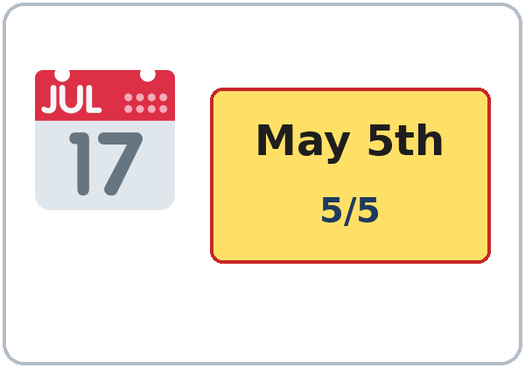
What's the Date?
Today you will:
• Ask: When is your birthday?
• Say: It's on May 5th. It's in May.
• Ask: How's the weather?
Lesson 9 · Level 1
Notes:
Welcome. Say: "Today: dates and the weather." Point to the calendar: "May 5th."
Before class: print the Student Pages (number expected + 3 spares), one set of picture cards per group of 3–4, the appointment cards for Talk Time, and the ordinals card (1st–5th…). Have the phone + small speaker and L1_L9_listening.mp3 ready. Prep time: 30 min.
No holidays: never ask about religious or cultural holidays. Invented birthdays are fine.
Teach in English. Show, point, and gesture. Say less, show more.
Class plan: 6:00 Hello + Review, 6:10 New Words, 6:20 Listening, 6:32 Grammar, 6:45 Break, 7:00 Talk Time, 7:10 Exit Ticket + Homework, 7:15 Real-World Reading, 7:25 Progress Check.
Source: level1_curriculum/lesson9/Level1_Lesson9.md (At a glance, Clock-time plan, Teacher notes).
Pictures: Twemoji graphics by Twitter, Inc. and other contributors (https://github.com/jdecked/twemoji), CC BY 4.0 (https://creativecommons.org/licenses/by/4.0/); resized and combined, labels added. Calendar, month, months, ordinals, and appointment card are drawn in code (see lesson9/images/CREDITS.md).

Slide 2
Today's
Goals
01
I can say and write a date.
May 5th · 5/5
02
I can say my birthday.
Tonight you learn these things.
Months and dates
How's the weather?
Progress Check at 7:25!
03
I can use in, on, at.
04
I can say the weather.
05
I can read an appointment card.
Notes:
Click to show each goal, one at a time. Read it aloud. Learners repeat.
Goal 1: say the months and write a date: May 5th / 5/5.
Goal 2: "When is your birthday?" "It's on May 5th." / "It's in May."
Goal 3: in + month, on + date or day, at + time.
Goal 4: "How's the weather?" "It's cold / hot / sunny / rainy."
Goal 5: understand an appointment day and time; read a simple appointment card (Real-World Reading at 7:15).
Source: level1_curriculum/lesson9/Level1_Lesson9.md (At a glance: Objectives).

Slide 3

WARM-UP · 6:00
Hello + Review
What do you want for lunch?
What day is today?
A: Do you like fish?
B: Yes, I do.
No, I don't.
Notes:
Pairs. 15 learners: 7 pairs + 1 group of 3. 7–8 learners: 3–4 pairs. Late arrivals join any pair.
Before class, write on the board: Do you like fish? What do you want for lunch? What day is today?
Model with one learner: "Do you like fish?" "Yes, I do." Then "What day is today?"
Click to show the A question. Click again for the B answers. Pairs use the Hello + Review page: 1 Do you like fish? 2 What do you want for lunch? I want ___. 3 What day is today? It's ___. Switch. Then find a new partner.
Homework check (last 3 min): partners show last week's homework. Walk around and look.
New learners: pair them with a strong partner. If behind: one partner only.
Source: level1_curriculum/lesson9/Level1_Lesson9.md (Step 1: Hello + Review; Student Pages: Hello + Review).
Review picture: the fish from Lesson 8 (lesson8/images/L1_L8_fish.png). Twemoji graphics by Twitter, Inc. and other contributors (https://github.com/jdecked/twemoji), CC BY 4.0 (https://creativecommons.org/licenses/by/4.0/); resized (see lesson8/images/CREDITS.md).

Slide 4
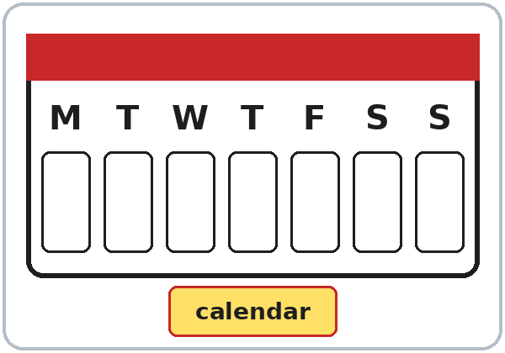
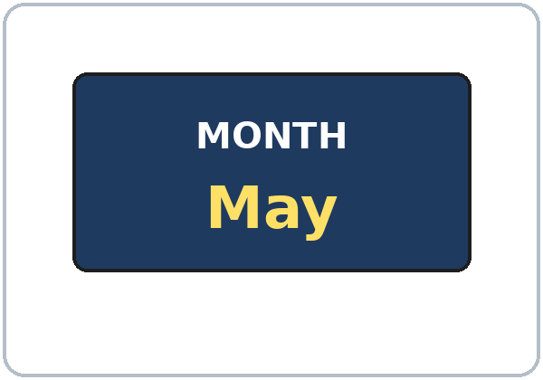
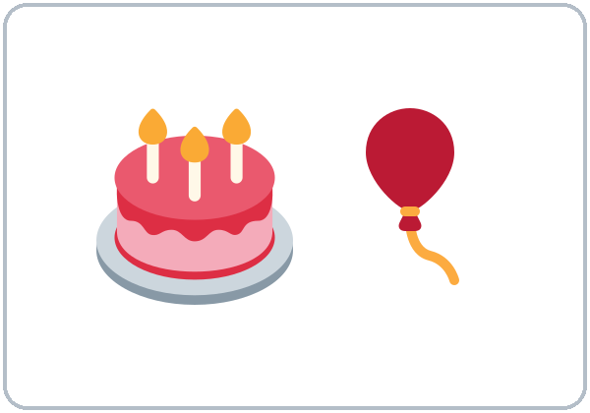
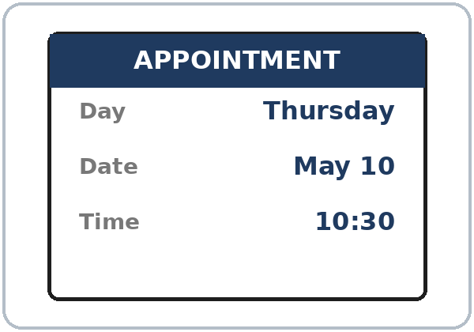
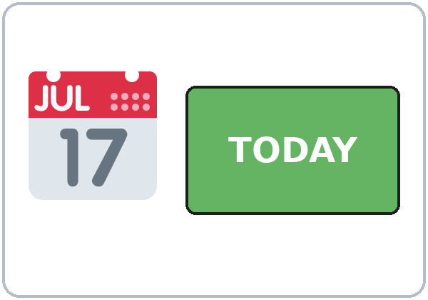
Look. Listen.
Repeat.
New Words
★ calendar
★ month
★ date
★ birthday
★ appointment
★ today
Notes:
Point to a calendar: "Month. Date. Today. Tomorrow."
Click to show each picture. Point and say the word. Learners repeat 2 times. ★ words 2 more times.
appointment: the card says Thursday, May 10, 10:30.
★ = most important words. If behind: teach the ★ words only.
Source: level1_curriculum/lesson9/Level1_Lesson9.md (Step 2: New Words; Student Pages: New Words).
Pictures: Twemoji graphics by Twitter, Inc. and other contributors (https://github.com/jdecked/twemoji), CC BY 4.0 (https://creativecommons.org/licenses/by/4.0/); resized and combined, labels added. Calendar, month, months, ordinals, and appointment card are drawn in code (see lesson9/images/CREDITS.md).

Slide 5
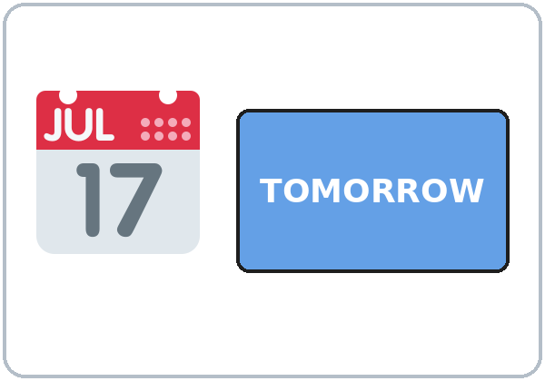




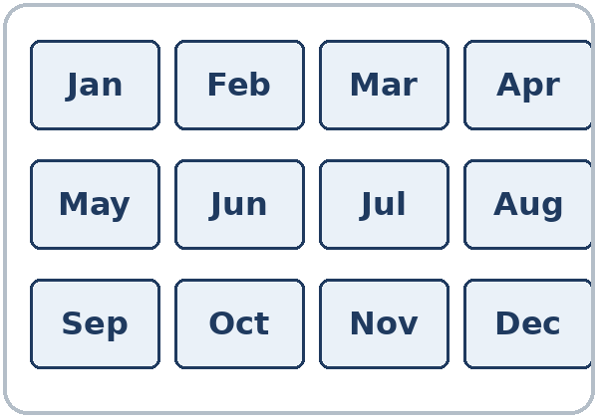
Partners:
A points. B says.
More New Words
★ tomorrow
★ sunny
★ rainy
★ cold
★ hot
months
Notes:
Mime the weather: "Sunny. Rainy. Cold. Hot." Click to show each picture. Learners repeat 2 times.
months: January to December. Months always start with a capital letter: May, October.
Show the ordinals card: "first, second, third…" (1st 2nd 3rd 4th 5th).
Pairs (4 min): A points to a picture, B says the word. Then A asks "When is your birthday?" (invented OK).
★ = most important words. If behind: teach the ★ words only.
Source: level1_curriculum/lesson9/Level1_Lesson9.md (Step 2: New Words; Student Pages: New Words).
Pictures: Twemoji graphics by Twitter, Inc. and other contributors (https://github.com/jdecked/twemoji), CC BY 4.0 (https://creativecommons.org/licenses/by/4.0/); resized and combined, labels added. Calendar, month, months, ordinals, and appointment card are drawn in code (see lesson9/images/CREDITS.md).

Slide 6
Before You Listen
Say it!
Thursday, May tenth, at ten thirty.
Kim calls the clinic.
How's the weather?
01
It's sunny and hot.
Listen 1: The appointment.
02
Listen 2: The weather.
Listen and repeat.
03
Listen 3: The birthdays.
Notes:
Before you listen (1 min). Say: "Kim calls the clinic. She makes an appointment. Then Kim and Marco talk about the weather and birthdays."
Click to show each listen. Listen 1: Task A (the appointment: day, date, time). Listen 2: Task B (circle the weather). Listen 3: Task C (write the birthdays).
Say it!: read each line. Learners repeat: "Thursday, May tenth, at ten thirty." "How's the weather?"
The audio L1_L9_listening.mp3 (about 1:10) plays the conversation once. Press play again for the next listen. Pairs compare after each task. Write answers on the board.
No speaker? Read the script with a volunteer. Say dates as words: May tenth, May fifth, ten thirty.
Voices: Narrator, Receptionist, Kim, Marco. Synthetic voices made with Chatterbox TTS (MIT), copied from short reference clips made with Kokoro-82M (Apache 2.0); no recordings of real people. Riverside Clinic is invented.
If behind: play 2 times; do Task C together.
Source: level1_curriculum/lesson9/Level1_Lesson9.md (Step 3: Listening; Listening script).
Pictures: Twemoji graphics by Twitter, Inc. and other contributors (https://github.com/jdecked/twemoji), CC BY 4.0 (https://creativecommons.org/licenses/by/4.0/); resized and combined, labels added. Calendar, month, months, ordinals, and appointment card are drawn in code (see lesson9/images/CREDITS.md).

Slide 7
Listen. Circle and write.
Part one. Kim calls the clinic.
Listening A
1
A. Day:
Tuesday Thursday Friday
Thursday
2
A. Date:
May ________
May 10
Day: circle.
Date and time: write.
Pairs: show your partner.
3
A. Time:
________
10:30
Notes:
Listen 1 (Task A). Kim calls the clinic. Learners circle the day and write the date and the time.
Pairs compare. Then click to show each answer: Thursday; May 10; 10:30 (in the morning).
In the audio: "How about Thursday, May tenth, at ten thirty?" "Is that in the morning?" "Yes, it is."
Source: level1_curriculum/lesson9/Level1_Lesson9.md (Step 3: Listening; Student Pages: Listening A; Answer key, Listening A).

Slide 8
Listen again. Circle. Write.
Part two. Kim and Marco talk.
Listening B + C
B. Circle the weather.
sunny · hot
1
a sunny
b rainy
c cold
d hot
B: circle the weather.
C: write the birthdays.
Pairs: show your partner.
C. The birthdays:
Marco: ______
Kim: ______
May 5th
October
2
Notes:
Listen 2 (Task B): learners circle the weather. Listen 3 (Task C): learners write the birthdays of Marco and Kim.
Pairs compare. Then click to show each answer.
Task B: sunny, hot ("It's sunny and hot. I like sunny days.").
Task C: Marco: May 5th ("It's on May fifth. Next week!"). Kim: October ("My birthday is in October.").
If behind: play the audio 2 times, and do Task C together.
Source: level1_curriculum/lesson9/Level1_Lesson9.md (Step 3: Listening; Student Pages: Listening B and C; Answer key).
Pictures: Twemoji graphics by Twitter, Inc. and other contributors (https://github.com/jdecked/twemoji), CC BY 4.0 (https://creativecommons.org/licenses/by/4.0/); resized and combined, labels added. Calendar, month, months, ordinals, and appointment card are drawn in code (see lesson9/images/CREDITS.md).

Slide 9
Grammar Boxes 1 + 2
What's the date?
QUESTION
ANSWER
What's the date today?
It's October 20th.
October twentieth
What's the date today?
It's May 5th.
May fifth
When is your birthday?
It's on May 5th.
on + date
When is your birthday?
It's in May.
in + month
Notes:
Show the Grammar page. Left = question. Right = answer. Point left, then right.
Box 1: "What's the date today?" Click: "It's October 20th." Box 2: "When is your birthday?" Click: "It's on May 5th." / "It's in May."
Click to show each answer. Learners repeat the question and the answer.
Write on the board: on + date or day; in + month. Months always start with a capital letter.
Check questions: "My birthday is ___ May." (in) • "My birthday is ___ May 5th." (on)
Source: level1_curriculum/lesson9/Level1_Lesson9.md (Step 4: Grammar Q&A, Boxes 1–2; Grammar Boxes 1 and 2; Questions and answers).
Pictures: Twemoji graphics by Twitter, Inc. and other contributors (https://github.com/jdecked/twemoji), CC BY 4.0 (https://creativecommons.org/licenses/by/4.0/); resized and combined, labels added. Calendar, month, months, ordinals, and appointment card are drawn in code (see lesson9/images/CREDITS.md).

Slide 10
Grammar Box 3
When is your appointment?
When is your appointment?
on
+ date or day
It's on Tuesday,
at 3:00.
in, on, or at?
at
+ time
in May (month)
on May 5th · at 3:00
Notes:
Box 3: "When is your appointment?" Click: "It's on Tuesday, at 3:00." at + time.
Then click: in, on, or at? in + month (in May). on + date or day (on May 5th, on Tuesday). at + time (at 3:00).
Check question: "Class is ___ 6:00." (at)
Big mistake this week: in May 5th / at May. Point to Grammar Box 2.
Source: level1_curriculum/lesson9/Level1_Lesson9.md (Step 4: Grammar Q&A, Box 3; Grammar Box 3; Questions and answers; Teacher notes).
Pictures: Twemoji graphics by Twitter, Inc. and other contributors (https://github.com/jdecked/twemoji), CC BY 4.0 (https://creativecommons.org/licenses/by/4.0/); resized and combined, labels added. Calendar, month, months, ordinals, and appointment card are drawn in code (see lesson9/images/CREDITS.md).

Slide 11
Grammar Box 4
How's the weather?
How's the weather?
It's sunny. It's rainy.
It's cold. It's hot.
People: I'm cold.
DON'T SAY
SAY
1
It makes cold.
It's cold.
2
I have cold.
I'm cold.
Notes:
Box 4: "How's the weather?" "It's sunny / rainy / cold / hot." Point out the window. Learners answer.
Read each DON'T SAY line. Shake your head. Click to show the SAY line. Learners repeat it.
Weather: It's cold (not It makes cold). For people: I'm cold. Cross out It makes cold on the board.
Pair drill (last 3–4 min): A asks birthday / appointment / weather; B answers; switch. If behind: skip the pair drill; Talk Time practices the same language.
Source: level1_curriculum/lesson9/Level1_Lesson9.md (Step 4: Grammar Q&A, Box 4 and pair drill; Grammar Box 4; Common mistakes; Teacher notes).

Slide 12
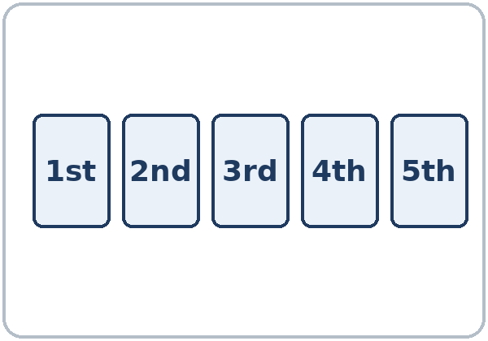
Write the Date
Month / day / year.
5/10 = May 10
1st, 2nd, 3rd…
Months: capital letter?
In the U.S., 5/10 is…
Yes. May, October (always).
May 10. Not October 5.
Notes:
How do I write a date in the U.S.? Month / day / year. Ask: "In the U.S., 5/10 is…?" Click: "May 10 (not October 5)."
Right box: "Do months start with a capital letter?" Click: "Yes. May, October (always)."
Ordinals 1st–31st: teach with the card. Say: first, second, third, fourth, fifth.
Spanish speakers: in the U.S. the date is month/day/year (5/10 = 10 de mayo). Learners can read the Spanish note on their Grammar page.
Source: level1_curriculum/lesson9/Level1_Lesson9.md (Grammar: Questions and answers; Teacher notes).
Pictures: Twemoji graphics by Twitter, Inc. and other contributors (https://github.com/jdecked/twemoji), CC BY 4.0 (https://creativecommons.org/licenses/by/4.0/); resized and combined, labels added. Calendar, month, months, ordinals, and appointment card are drawn in code (see lesson9/images/CREDITS.md).

Slide 13
Write in, on, at, or a weather word.
Look at Grammar Boxes 1–4.
in, on, at?
1
My birthday is ____ May 5th.
on
2
My birthday is ____ May.
in
in + month
on + date or day
at + time
3
The class is ____ 6:00.
at
4
How's the weather?
It's ________.
sunny
5
My appointment is
____ Tuesday.
on
Notes:
Learners write in, on, at, or a weather word on lines 1–5. Then pairs check.
Click to show each answer: 1 on, 2 in, 3 at, 4 sunny (or rainy / cold / hot), 5 on (on + day).
Line 6 on the page: write today's date (answers will vary).
Source: level1_curriculum/lesson9/Level1_Lesson9.md (Grammar: Practice; Answer key, Grammar practice; Questions and answers).

Slide 14
Common Mistakes
Don't say
Say
It makes cold.
It's cold.
I have cold.
I'm cold. / It's cold.
in May 5th
on May 5th
at May
in May
Notes:
Read each "Don't say" line. Shake your head. Click to show the correct line. Learners repeat it.
It makes cold → It's cold. I have cold → I'm cold. / It's cold.
in May 5th → on May 5th (on + date). at May → in May (in + month).
Tip: read the grammar boxes left to right. Copy one question and one answer.
Source: level1_curriculum/lesson9/Level1_Lesson9.md (Grammar: Common mistakes; Teacher notes).
Pictures: Twemoji graphics by Twitter, Inc. and other contributors (https://github.com/jdecked/twemoji), CC BY 4.0 (https://creativecommons.org/licenses/by/4.0/); resized and combined, labels added. Calendar, month, months, ordinals, and appointment card are drawn in code (see lesson9/images/CREDITS.md).

Slide 15
Talk Time
Birthday Line
Whole class.
Stand up. Ask only.
7:00–7:10
1
Ask:
When is your birthday?
2
Answer:
It's on ___. / It's in ___.
3
Line up by
month and day.
Notes:
Part 1, birthday line (5 min). Whole class. Learners line up by birthday month and day by asking only: "When is your birthday?" Invented birthdays are OK.
Model with 2 learners first. Click to show each step.
On the page: My birthday is ___. Write 2 classmates' birthdays.
No holidays: never ask about religious or cultural holidays.
If behind: do half of Talk Time only.
Source: level1_curriculum/lesson9/Level1_Lesson9.md (Step 5: Talk Time, Part 1; Student Pages: Talk Time, Birthday Line; Teacher notes).
Pictures: Twemoji graphics by Twitter, Inc. and other contributors (https://github.com/jdecked/twemoji), CC BY 4.0 (https://creativecommons.org/licenses/by/4.0/); resized and combined, labels added. Calendar, month, months, ordinals, and appointment card are drawn in code (see lesson9/images/CREDITS.md).

Slide 16
TALK TIME · PART 2
A says:
Your appointment is
on ___, at ___.
B repeats: On ___, at ___.
OK. Thank you!
Then: switch.
Appointment
A is the receptionist.
B is the patient.
B: When is my appointment?
A: On Thursday, at 10:30.
Notes:
Part 2, appointment (5 min). A–B pairs. A = receptionist with the appointment card (Thursday, May 10, 10:30). B = patient. Then switch.
Model it: "When is my appointment?" Click: "On Thursday, at 10:30."
A says: "Your appointment is on ___, at ___." B repeats: "On ___, at ___. OK. Thank you!" B writes the day, the date, and the time. B can also ask "What time?"
If behind: one round only.
Source: level1_curriculum/lesson9/Level1_Lesson9.md (Step 5: Talk Time, Part 2; Student Pages: Talk Time, Appointment A and B).

Slide 17
Before You Go 7:10–7:15
01
Exit ticket
02
Homework
Say:
My birthday is
in ___.
Or say:
It's on ___.
1. Today, tomorrow.
2. Write in, on, or at.
3. Write 3 months.
4. Today's date 2 ways.
5. One food you like.
Bring it next week!
Notes:
Exit ticket (never skip): each learner says "My birthday is in ___." or "It's on ___." Copying from the box is fine.
Homework (10 minutes): open the Homework page. Do item 1, line 1 together. Point to each instruction.
Homework: 1) write: Today is… Tomorrow is… My birthday is… How's the weather today?; 2) write in, on, or at; 3) write 3 months and say them to a family member or a friend; 4) look at a calendar and write today's date two ways (words and month/day/year); 5) review: write one food you like (Lesson 8).
Homework answers: item 2: 1 in (October), 2 on (Monday), 3 at (7:00), 4 on (May 5th).
Source: level1_curriculum/lesson9/Level1_Lesson9.md (Step 6: Exit Ticket + Homework; Student Pages: Homework; Answer key).
Pictures: Twemoji graphics by Twitter, Inc. and other contributors (https://github.com/jdecked/twemoji), CC BY 4.0 (https://creativecommons.org/licenses/by/4.0/); resized and combined, labels added. Calendar, month, months, ordinals, and appointment card are drawn in code (see lesson9/images/CREDITS.md).

Slide 18
Read the Card
1
What day? ________
Thursday
2
What date? ________
May 10
3
What time? ________
10:30
Real-World Reading
Task A: answer.
Notes:
Real-World Reading (10 min). Whole class, then pairs. Use the Real-World Reading page.
See it (2 min), Task A: point to the day, the date, and the time on the appointment card.
Learners answer. Then click to show each answer (answer key): Thursday, May 10, 10:30.
Hear it (2 min): say 3 dates; learners point or write.
Learners who can't read yet: they point to the pictures and say key words with everyone.
Source: level1_curriculum/lesson9/Level1_Lesson9.md (Real-World Reading step; Student Pages: Real-World Reading A).
Pictures: Twemoji graphics by Twitter, Inc. and other contributors (https://github.com/jdecked/twemoji), CC BY 4.0 (https://creativecommons.org/licenses/by/4.0/); resized and combined, labels added. Calendar, month, months, ordinals, and appointment card are drawn in code (see lesson9/images/CREDITS.md).

Slide 19
Match. Draw a line.
U.S. dates: month / day.
U.S. Dates
1
5/10
b. May 10
2
10/5
a. October 5
a. October 5
b. May 10
c. December 25
3
12/25
c. December 25
Notes:
Read it (4 min), Task B: U.S. date order is month / day / year. 5/10 = May 10.
Learners match each date to a, b, or c. Then click to show each answer: 5/10 → b May 10; 10/5 → a October 5; 12/25 → c December 25.
If behind: do Tasks A and B only.
Source: level1_curriculum/lesson9/Level1_Lesson9.md (Real-World Reading step; Student Pages: Real-World Reading B; Answer key, Real-World Reading B).

Slide 20
Real-World Reading · Tasks C + D
Say the Date
5/10
May tenth
C: write today's date.
D: A says, B points.
NUMBERS
SAY
5/10
May tenth
10/5
October fifth
12/25
December twenty-fifth
Notes:
Task C: learners write today's date two ways: words and numbers (month/day/year). Answers vary.
Task D (pairs): A says a date from Task B; B points. Then switch. Partners: A is the receptionist, B repeats the appointment.
Click to show how to say each date. Learners repeat: May tenth, October fifth, December twenty-fifth.
Source: level1_curriculum/lesson9/Level1_Lesson9.md (Real-World Reading step; Student Pages: Real-World Reading C and D).

Slide 21
Progress Check 7:25
D. I can…
😀 🙂 😐
Check one face.
B. Match the question
Answer
1. When is your birthday?
b. It's on May 5th.
2. How's the weather?
a. It's sunny.
3. When is your appointment?
c. On Tuesday at 3:00.
4. What's the date today?
d. It's October 20th.
Notes:
Progress Check (5 min). Individuals. Open the Progress Check page.
Part A: read each item slowly, 2 times: 1 May, 2 sunny, 3 10:30, 4 cold, 5 today. Learners circle.
Parts B and C: learners match and write on their own. Help with the instructions only. Click to show the Part B answers when you check together: 1 b, 2 a, 3 c, 4 d.
Part C answers: 1 in (June), 2 on (Friday), 3 at (9:00), 4 on (May 10th).
Part D: read each "I can…" line and point to the 3 faces. Learners check one.
Score: A /5 + B /4 + C /4 = /13. Not a test grade. Collect if you want. If behind: do it next week at 6:00.
Source: level1_curriculum/lesson9/Level1_Lesson9.md (Progress Check step; Student Pages: Progress Check; Answer key).

Slide 22
Great Work! See You Next Week!
Now you can:
• Ask: When is your birthday?
• Say: It's on May 5th. It's in May.
• Say: It's sunny. It's cold.
Lesson 9 · Level 1
Notes:
Say: "Great work! See you next week!" Remind learners: bring the homework next week.
Collect the Progress Check pages if you want.
Source: level1_curriculum/lesson9/Level1_Lesson9.md (At a glance: Objectives).
Pictures: Twemoji graphics by Twitter, Inc. and other contributors (https://github.com/jdecked/twemoji), CC BY 4.0 (https://creativecommons.org/licenses/by/4.0/); resized and combined, labels added. Calendar, month, months, ordinals, and appointment card are drawn in code (see lesson9/images/CREDITS.md).

Slide 23
Credits
Pictures
Pictures use Twemoji graphics by Twitter, Inc. and other contributors (https://github.com/jdecked/twemoji), licensed under CC BY 4.0 (https://creativecommons.org/licenses/by/4.0/). The graphics were resized and combined, and labels were added. The calendar, month, months, ordinals, and appointment-card pictures are drawn in code. Labels on the pictures use the DejaVu Sans font. The review picture (the fish) is from Lesson 8.
Other small pictures (the faces on the Progress Check) are standard emoji characters shown with the computer's emoji font.
Names
All names, places, and dates on the slides (Kim, Marco, Riverside Clinic, the appointment) are invented.
Audio and font
Audio: synthetic voices (Narrator, Receptionist, Kim, Marco) made with Chatterbox TTS (Resemble AI, MIT License), copied from short reference clips made with Kokoro-82M (Apache 2.0); no recordings of real people were used. Each file carries an inaudible Perth watermark. Font: Lexend Deca (OFL 1.1).
© 2026 the authors. The authors license this deck under CC BY-NC-SA 4.0.
Notes:
Credits for the pictures, audio, and font.
Pictures: Twemoji (CC BY 4.0), https://github.com/jdecked/twemoji; resized and combined, labels added; calendar, months, ordinals, and appointment card drawn in code. Review picture (fish) from Lesson 8. Audio: Chatterbox TTS (MIT) voices copied from short Kokoro-82M (Apache 2.0) reference clips; no recordings of real people.
Sources: Level1_Lesson9.md (Picture Credits), lesson9/images/CREDITS.md, lesson9/audio/README.md.

