Slide 1
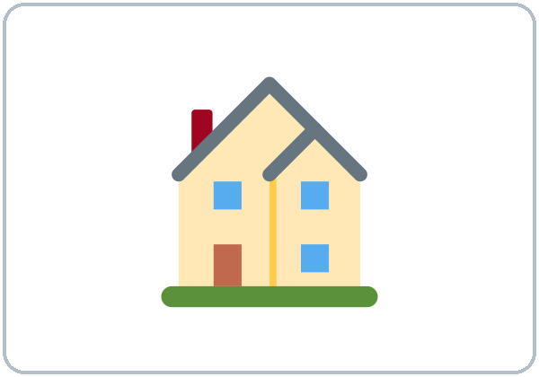
Home Sweet Home
Today you will:
• Say: There is a kitchen.
• Ask: Is there a sofa?
• Ask: How many bedrooms are there?
Lesson 10 · Level 1
Notes:
Welcome. Say: "Today: homes." Point to the house: "This is a house."
Before class: print the Student Pages (number expected + 3 spares), one set of picture cards per group of 3–4, the floor-plan picture for Talk Time, and the apartment ad for Real-World Reading. Have the phone + small speaker and L1_L10_listening.mp3 ready. Prep time: 30 min.
The apartment and the ad are invented. Never ask for real rent or real addresses. A dream home is fine.
Teach in English. Show, point, and gesture. Say less, show more.
Class plan: 6:00 Hello + Review, 6:10 New Words, 6:20 Listening, 6:32 Grammar, 6:45 Break, 7:00 Talk Time, 7:10 Exit Ticket + Homework, 7:15 Real-World Reading, 7:25 Progress Check.
Source: level1_curriculum/lesson10/Level1_Lesson10.md (At a glance, Clock-time plan, Teacher notes).
Pictures: Twemoji graphics by Twitter, Inc. and other contributors (https://github.com/jdecked/twemoji), CC BY 4.0 (https://creativecommons.org/licenses/by/4.0/); resized and combined, labels added. The floor plan and the apartment ad are drawn in code (see lesson10/images/CREDITS.md).

Slide 2
Today's
Goals
01
I can name rooms and furniture.
kitchen, bedroom, bed, table
02
I can say: There is… / There are…
Tonight you learn these things.
Rooms and furniture
There is / There are
Progress Check at 7:25!
03
I can ask: Is there a…? Are there…?
04
I can ask: How many… are there?
05
I can read an apartment ad.
Notes:
Click to show each goal, one at a time. Read it aloud. Learners repeat.
Goal 1: rooms and furniture: house, apartment, kitchen, bedroom, bathroom, living room, bed, table, chair, sofa, refrigerator, window.
Goal 2: "There is a kitchen. There are two bedrooms."
Goal 3: "Is there a sofa?" "Are there windows?"
Goal 4: "How many bedrooms are there?" "There are two."
Goal 5: understand a simple apartment phone call; read an apartment ad (BR / BA / mo) at 7:15.
Source: level1_curriculum/lesson10/Level1_Lesson10.md (At a glance: Objectives).

Slide 3
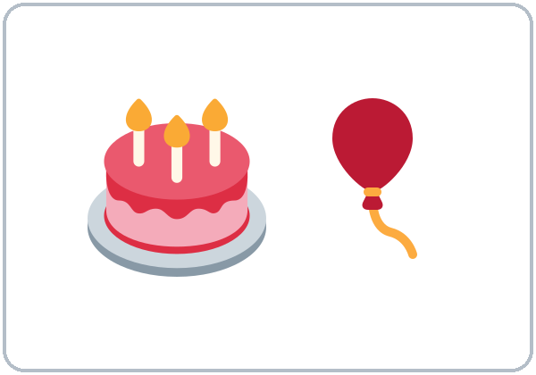
WARM-UP · 6:00
Hello + Review
How's the weather today?
What day is today?
A: When is your birthday?
B: It's in May.
It's on May 5th.
Notes:
Pairs. 15 learners: 7 pairs + 1 group of 3. 7–8 learners: 3–4 pairs. Late arrivals join any pair.
Before class, write on the board: When is your birthday? How's the weather today? Is there a kitchen?
Model with one learner: "When is your birthday?" "It's in May." Then "Is there a kitchen in your home?"
Click to show the A question. Click again for the B answers. Pairs use the Hello + Review page: 1 When is your birthday? 2 How's the weather today? 3 What day is today? It's ___. Switch. Then find a new partner.
Homework check (last 3 min): partners show last week's homework. Walk around and look.
New learners: pair them with a strong partner. If behind: one partner only.
Source: level1_curriculum/lesson10/Level1_Lesson10.md (Step 1: Hello + Review; Student Pages: Hello + Review).
Review picture: the birthday cake from Lesson 9 (lesson9/images/L1_L9_birthday.png). Twemoji graphics by Twitter, Inc. and other contributors (https://github.com/jdecked/twemoji), CC BY 4.0 (https://creativecommons.org/licenses/by/4.0/); resized and combined (see lesson9/images/CREDITS.md).

Slide 4

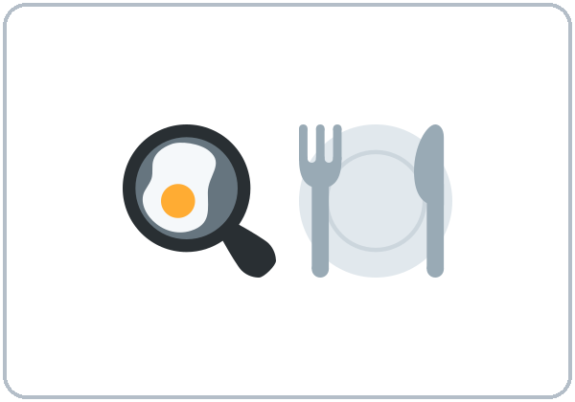
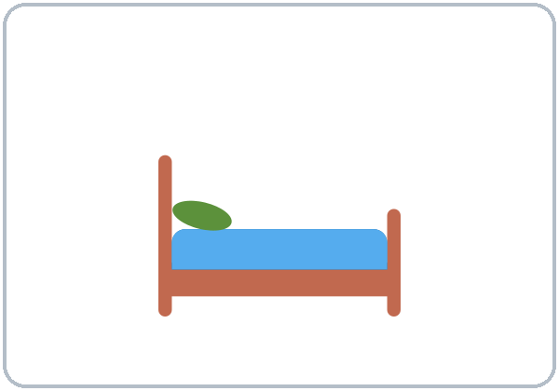
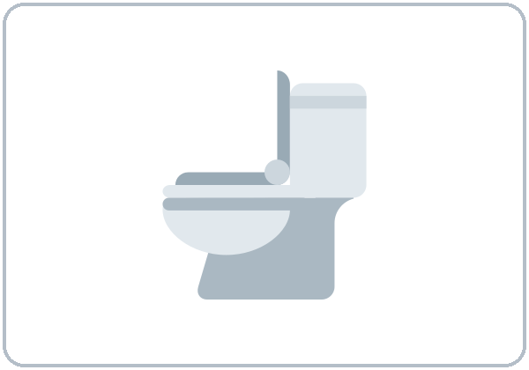
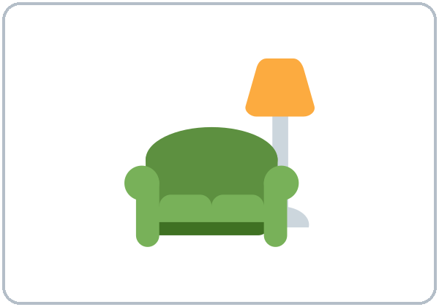
Look. Listen.
Repeat.
New Words
★ house
★ apartment
★ kitchen
★ bedroom
★ bathroom
★ living room
Notes:
Point to the floor plan: "Kitchen. Bedroom. Bathroom. Living room."
Click to show each picture. Point and say the word. Learners repeat 2 times. ★ words 2 more times.
Tip: apartment = a home in a building. house = a home that stands alone.
★ = most important words. If behind: teach the ★ words only.
Source: level1_curriculum/lesson10/Level1_Lesson10.md (Step 2: New Words; Student Pages: New Words).
Pictures: Twemoji graphics by Twitter, Inc. and other contributors (https://github.com/jdecked/twemoji), CC BY 4.0 (https://creativecommons.org/licenses/by/4.0/); resized and combined, labels added. The floor plan and the apartment ad are drawn in code (see lesson10/images/CREDITS.md).

Slide 5
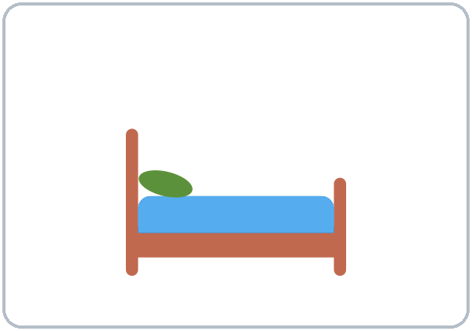
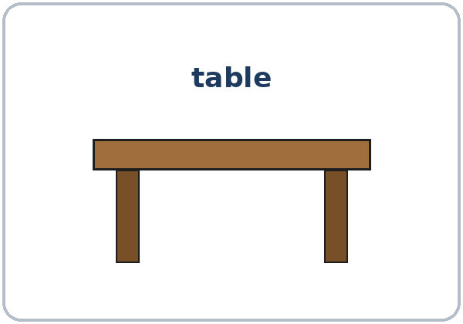
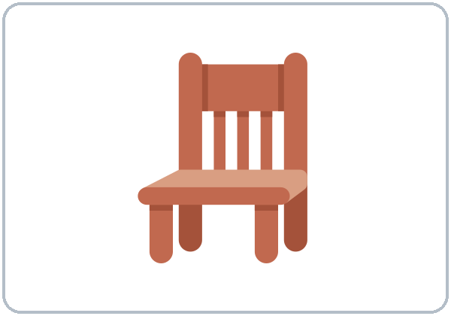
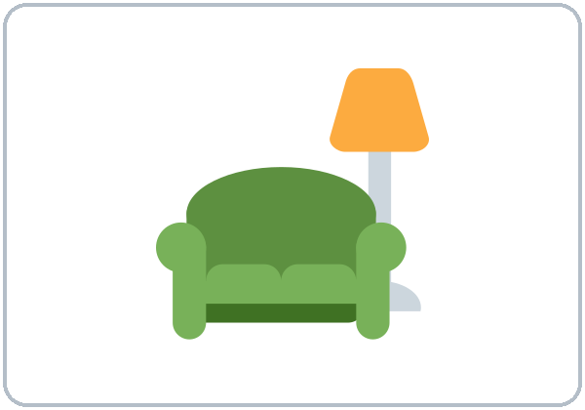
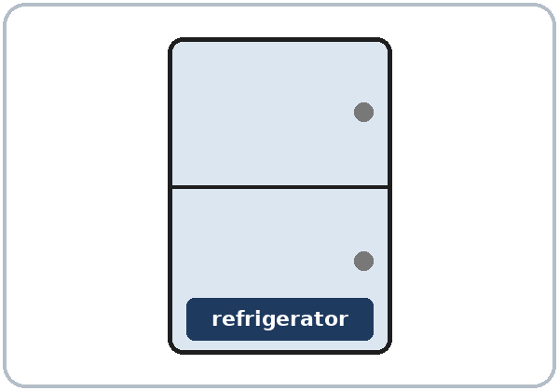
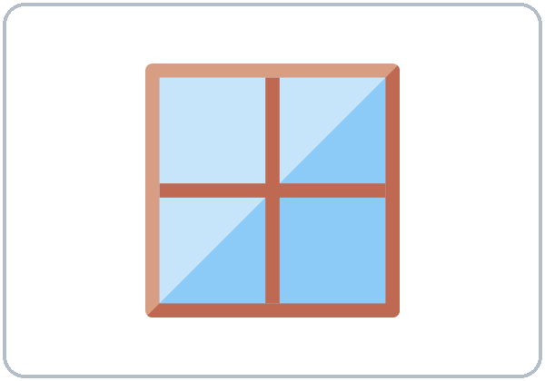
Partners:
A points. B says.
More New Words
★ bed
★ table
★ chair
sofa
refrigerator
window
Notes:
Hold up the furniture cards: "Bed. Table. Chair. Sofa." Click to show each picture. Learners repeat 2 times.
Pairs (4 min): A points to a picture, B says the word. Then A asks "Is there a ___?" B answers "Yes, there is." / "No, there isn't."
★ = most important words. sofa, refrigerator, and window have no ★. If behind: teach the ★ words only.
Source: level1_curriculum/lesson10/Level1_Lesson10.md (Step 2: New Words; Student Pages: New Words).
Pictures: Twemoji graphics by Twitter, Inc. and other contributors (https://github.com/jdecked/twemoji), CC BY 4.0 (https://creativecommons.org/licenses/by/4.0/); resized and combined, labels added. The floor plan and the apartment ad are drawn in code (see lesson10/images/CREDITS.md).

Slide 6
Before You Listen
Say it!
There are two bedrooms.
Rosa calls about an apartment.
Is there a washing machine?
01
No, there isn't.
Listen 1: What is there?
02
Listen 2: How many rooms?
Listen and repeat.
03
Listen 3: The rent.
Notes:
Before you listen (1 min). Say: "Rosa calls about an apartment. She asks: Is there…? Are there…?"
Click to show each listen. Listen 1: Task A (check what the apartment has). Listen 2: Task B (circle the number of bedrooms and bathrooms). Listen 3: Task C (when is the rent due?).
Say it!: read each line. Learners repeat: "There are two bedrooms." "Is there a washing machine?"
The audio L1_L10_listening.mp3 (about 1:10) plays the conversation once. Press play again for the next listen. Pairs compare after each task. Write answers on the board.
No speaker? Read the script with a volunteer. The apartment is invented. Never ask learners for real rent.
Voices: Narrator, Agent, Rosa. Synthetic voices made with Chatterbox TTS (MIT), copied from short reference clips made with Kokoro-82M (Apache 2.0); no recordings of real people. Green Street Apartments is invented.
If behind: play 2 times; do Task C together.
Source: level1_curriculum/lesson10/Level1_Lesson10.md (Step 3: Listening; Listening script).
Pictures: Twemoji graphics by Twitter, Inc. and other contributors (https://github.com/jdecked/twemoji), CC BY 4.0 (https://creativecommons.org/licenses/by/4.0/); resized and combined, labels added. The floor plan and the apartment ad are drawn in code (see lesson10/images/CREDITS.md).

Slide 7
Listen. Check what it has.
Rosa calls about an apartment.
Listening A
1
two bedrooms
✓ yes
2
washing machine
✗ no
Check ✓: what is there?
Pairs: show your partner.
3
refrigerator
✓ yes
4
windows in the kitchen
✓ yes
5
big living room
✓ yes
Notes:
Listen 1 (Task A). Rosa calls about an apartment. Learners check ✓ what the apartment has.
Pairs compare. Then click to show each answer: two bedrooms ✓; washing machine ✗ ("No, there isn't."); refrigerator ✓; windows in the kitchen ✓; big living room ✓.
Source: level1_curriculum/lesson10/Level1_Lesson10.md (Step 3: Listening; Student Pages: Listening A; Answer key, Listening A).

Slide 8
Listen again. Circle.
How many? When is the rent due?
Listening B + C
B. Circle.
Bedrooms: 1 2 3
Bathrooms: 1 2
2 bedrooms
1 bathroom
1
B: circle the numbers.
C: when is the rent due?
Pairs: show your partner.
C. The rent is due…
on the first
on Friday
on the weekend
2
on the first
Notes:
Listen 2 (Task B): learners circle how many bedrooms and bathrooms. Listen 3 (Task C): when is the rent due?
Pairs compare. Then click to show each answer.
Task B: bedrooms 2, bathrooms 1 ("There are two bedrooms and one bathroom.").
Task C: on the first ("The rent is due on the first of the month.").
Say it with a partner (page D): "Is there a refrigerator?" "Yes, there is." / "No, there isn't." "How many bedrooms are there?" "There are two."
If behind: play the audio 2 times, and do Task C together.
Source: level1_curriculum/lesson10/Level1_Lesson10.md (Step 3: Listening; Student Pages: Listening B, C, D; Answer key).

Slide 9
Grammar Box 1
There is / There are
One thing:
is
+ a kitchen
There is a kitchen.
There is a bed.
Two or more:
are
+ two bedrooms
There are two bedrooms.
There are chairs.
Notes:
Show the Grammar page. Box 1: "There is a kitchen. There is a bed." Click. "There are two bedrooms. There are chairs." Click.
Write on the board: one → is; two or more → are. Learners repeat.
Spanish hay = there is / there are (two English forms). Learners can read the Spanish note on their Grammar page.
Yes, use a for one countable thing: There is a bed.
Check questions: "There ___ a table." (is) • "There ___ two chairs." (are)
Source: level1_curriculum/lesson10/Level1_Lesson10.md (Step 4: Grammar Q&A, Box 1; Grammar Box 1; Questions and answers; Teacher notes).
Pictures: Twemoji graphics by Twitter, Inc. and other contributors (https://github.com/jdecked/twemoji), CC BY 4.0 (https://creativecommons.org/licenses/by/4.0/); resized and combined, labels added. The floor plan and the apartment ad are drawn in code (see lesson10/images/CREDITS.md).

Slide 10
Grammar Boxes 2 + 3
Is there…? Are there…?
QUESTION
ANSWER
Is there a sofa?
Yes, there is.
No, there isn't.
Is there a washing machine?
No, there isn't.
Are there windows?
Yes, there are.
No, there aren't.
How many bedrooms are there?
There are two.
Notes:
Left = question. Right = answer. Point left, then right.
Box 2: "Is there a sofa?" Click: "Yes, there is." / "No, there isn't." "Is there a washing machine?" Click: "No, there isn't."
Box 3: "Are there windows?" Click: "Yes, there are." / "No, there aren't." "How many bedrooms are there?" Click: "There are two."
One thing → Is there…? Two or more → Are there…?
Check question: "___ there a sofa?" (Is)
Source: level1_curriculum/lesson10/Level1_Lesson10.md (Step 4: Grammar Q&A, Boxes 2–3; Grammar Boxes 2 and 3).
Pictures: Twemoji graphics by Twitter, Inc. and other contributors (https://github.com/jdecked/twemoji), CC BY 4.0 (https://creativecommons.org/licenses/by/4.0/); resized and combined, labels added. The floor plan and the apartment ad are drawn in code (see lesson10/images/CREDITS.md).

Slide 11
Grammar Boxes 4 + 5
Short answers
Box 5: in the + room
There is a table
in the kitchen.
There are two windows
in the bedroom.
QUESTION
SHORT ANSWER
1
Is there a bed?
Yes, there is.
No, there isn't.
2
Are there chairs?
Yes, there are.
No, there aren't.
Notes:
Box 4: "Is there a bed?" Click: "Yes, there is." / "No, there isn't." "Are there chairs?" Click: "Yes, there are." / "No, there aren't."
Box 5 (side card): rooms + in the: "There is a table in the kitchen. There are two windows in the bedroom."
Pair drill (last 3–4 min): A looks at the floor plan; B asks Is there…? Are there…? How many…? Switch. If behind: skip the pair drill; Talk Time practices the same language.
Source: level1_curriculum/lesson10/Level1_Lesson10.md (Step 4: Grammar Q&A, pair drill; Grammar Boxes 4 and 5).

Slide 12
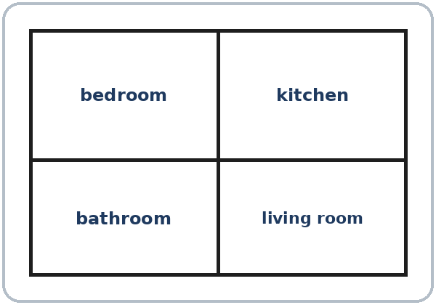
is or are?
One thing: is
Two or more: are
Spanish: hay
Do I say a with there is?
Spanish: hay. English?
Yes: There is a bed.
There is / There are
Notes:
How is this different from Spanish? Spanish hay is one word. English has two forms: there is and there are. Click to show.
Right box: "Do I say a with there is?" Click: "Yes for one countable thing: There is a bed."
Point to the floor plan: "There is a kitchen. There is a bathroom. Is there a living room? Yes, there is."
Source: level1_curriculum/lesson10/Level1_Lesson10.md (Grammar: Questions and answers; Teacher notes).
Pictures: Twemoji graphics by Twitter, Inc. and other contributors (https://github.com/jdecked/twemoji), CC BY 4.0 (https://creativecommons.org/licenses/by/4.0/); resized and combined, labels added. The floor plan and the apartment ad are drawn in code (see lesson10/images/CREDITS.md).

Slide 13
Write is, are, Is, or Are.
Look at Grammar Boxes 1–4.
is, are, Is, Are?
1
There ____ a table.
is
2
There ____ two chairs.
are
one: is
two or more: are
Pairs: check your answers.
3
____ there a sofa?
Is
4
____ there windows?
Are
5
How many bedrooms
____ there?
are
Notes:
Learners write is, are, Is, or Are on lines 1–5. Then pairs check.
Click to show each answer: 1 is, 2 are, 3 Is, 4 Are, 5 are (How many bedrooms are there?).
Lines 6–7 on the page: write one sentence with There is… and one with There are… (answers will vary).
Source: level1_curriculum/lesson10/Level1_Lesson10.md (Grammar: Practice; Answer key, Grammar practice; Grammar Box 3).

Slide 14
Common Mistakes
Don't say
Say
Have two bedrooms.
There are two bedrooms.
There is two beds.
There are two beds.
Is there windows?
Are there windows?
Notes:
Read each "Don't say" line. Shake your head. Click to show the correct line. Learners repeat it.
Have two bedrooms → There are two bedrooms. There is two beds → There are two beds. Is there windows? → Are there windows?
Big mistake this week: Have two bedrooms / There is two beds. Point to Grammar Box 1.
Source: level1_curriculum/lesson10/Level1_Lesson10.md (Grammar: Common mistakes; Teacher notes).
Pictures: Twemoji graphics by Twitter, Inc. and other contributors (https://github.com/jdecked/twemoji), CC BY 4.0 (https://creativecommons.org/licenses/by/4.0/); resized and combined, labels added. The floor plan and the apartment ad are drawn in code (see lesson10/images/CREDITS.md).

Slide 15
Talk Time
Floor Plan
A–B pairs.
A looks at the plan.
7:00–7:10
1
B asks:
Is there a kitchen?
2
A answers:
Yes, there is. / No, there isn't.
3
B writes or draws.
Compare. Then switch.
Notes:
Part 1, floor plan (6 min). A–B pairs. A looks at the floor plan (Student A page); partners don't show it. B asks and draws or writes. Then compare. Then switch.
B asks: Is there a kitchen? How many bedrooms are there? Is there a washing machine? Are there windows? A answers from the plan: Yes, there is. / No, there isn't. / There are ___.
Click to show each step.
Learners who can't write yet: they point on the floor plan and say "Yes, there is."
Source: level1_curriculum/lesson10/Level1_Lesson10.md (Step 5: Talk Time, Part 1; Student Pages: Talk Time A and B; Teacher notes).
Pictures: Twemoji graphics by Twitter, Inc. and other contributors (https://github.com/jdecked/twemoji), CC BY 4.0 (https://creativecommons.org/licenses/by/4.0/); resized and combined, labels added. The floor plan and the apartment ad are drawn in code (see lesson10/images/CREDITS.md).

Slide 16
TALK TIME · PART 2
You say:
There is ___.
There are ___.
Partner asks: Is there ___?
How many ___ are there?
Then: switch.
Dream Home
Say 3 sentences.
Then switch.
There is a kitchen.
There are two bedrooms.
Notes:
Part 2, dream home (3 min). Each learner says 3 sentences about a dream home: There is… There are…
Model: "There is a kitchen." Click: "There are two bedrooms."
The partner can ask: Is there ___? How many ___ are there? Then switch.
A dream home is fine. Never ask for real rent or real addresses.
If behind: do half of Talk Time only.
Source: level1_curriculum/lesson10/Level1_Lesson10.md (Step 5: Talk Time, Part 2; Student Pages: Talk Time B, Dream home; Teacher notes).

Slide 17
Before You Go 7:10–7:15
01
Exit ticket
02
Homework
Say:
There is a ___.
There are ___.
Or write:
one sentence.
1. Write about a home.
2. Write is or are.
3. Draw a floor plan.
4. Ask a family member.
5. Write today's date.
Bring it next week!
Notes:
Exit ticket (never skip): each learner says "There is a ___." or "There are ___." Copying is fine.
Homework (10 minutes): open the Homework page. Do item 1, line 1 together. Point to each instruction.
Homework: 1) write about a home (yours or a dream home; never write a real rent amount if you don't want to); 2) write is or are; 3) draw a simple floor plan and label 3 rooms; 4) ask a family member "Is there a table in the kitchen?" and write the answer; 5) review: write today's date (Lesson 9).
Homework answers (answer key, Homework 2): 1 is, 2 are, 3 is, 4 are.
Source: level1_curriculum/lesson10/Level1_Lesson10.md (Step 6: Exit Ticket + Homework; Student Pages: Homework; Answer key).
Pictures: Twemoji graphics by Twitter, Inc. and other contributors (https://github.com/jdecked/twemoji), CC BY 4.0 (https://creativecommons.org/licenses/by/4.0/); resized and combined, labels added. The floor plan and the apartment ad are drawn in code (see lesson10/images/CREDITS.md).

Slide 18
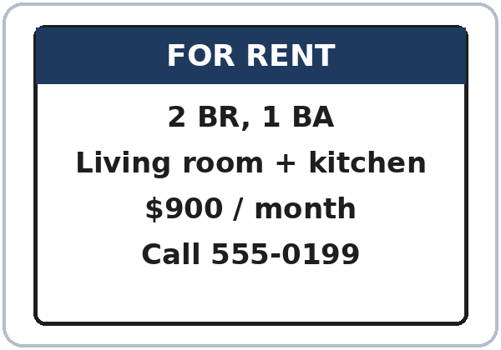
Read the Ad
1
How many bedrooms? (BR)
2
2
How many bathrooms? (BA)
1
3
How much per month?
$900
Real-World Reading
Task A: answer.
Notes:
Real-World Reading (10 min). Whole class, then pairs. Use the Real-World Reading page.
See it (2 min), Task A: point to BR, BA, and the price on the ad.
Learners answer. Then click to show each answer (answer key): 2 bedrooms, 1 bathroom, $900 per month.
Hear it (2 min): say "2 BR, 1 BA"; learners point.
The ad is invented. Never ask learners for real rent. Learners who can't read yet: they point to the pictures and say key words with everyone.
Source: level1_curriculum/lesson10/Level1_Lesson10.md (Real-World Reading step; Student Pages: Real-World Reading A; Answer key).
Pictures: Twemoji graphics by Twitter, Inc. and other contributors (https://github.com/jdecked/twemoji), CC BY 4.0 (https://creativecommons.org/licenses/by/4.0/); resized and combined, labels added. The floor plan and the apartment ad are drawn in code (see lesson10/images/CREDITS.md).

Slide 19
Match. Draw a line.
Words in the ad.
Ad Words
1
2 BR
b. bedrooms
2
1 BA
a. bathroom
a. bathroom
b. bedrooms
c. per month
3
/mo
c. per month
Notes:
Read it (4 min), Task B: abbreviations. Learners match each one to a, b, or c.
Then click to show each answer: 2 BR → b bedrooms; 1 BA → a bathroom; /mo → c per month.
If behind: do Tasks A and B only.
Source: level1_curriculum/lesson10/Level1_Lesson10.md (Real-World Reading step; Student Pages: Real-World Reading B; Answer key, Real-World Reading B).

Slide 20
Real-World Reading · Tasks C + D
Yes or No?
2 BR, 1 BA
$900 / month
C: circle Yes or No.
D: A asks, B answers.
THE AD
ANSWER
There are two bedrooms.
Yes
There is one bathroom.
Yes
How many bedrooms?
There are two.
Notes:
Task C: learners read the ad and circle Yes or No. Click to show each answer (answer key): 1 Yes, 2 Yes (the ad: 2 BR, 1 BA).
Task D (pairs): A asks "How many bedrooms?" B answers from the ad: "There are two." Then switch.
Source: level1_curriculum/lesson10/Level1_Lesson10.md (Real-World Reading step; Student Pages: Real-World Reading C and D; Answer key).

Slide 21
Progress Check 7:25
D. I can…
😀 🙂 😐
Check one face.
B. Match the question
Answer
1. Is there a bed?
b. Yes, there is.
2. Are there chairs?
c. Yes, there are.
3. How many bedrooms are there?
a. There are two.
4. Is there a washing machine?
d. No, there isn't.
Notes:
Progress Check (5 min). Individuals. Open the Progress Check page.
Part A: read each word slowly, 2 times: 1 apartment, 2 kitchen, 3 sofa, 4 bedroom, 5 window. Learners circle.
Parts B and C: learners match and write on their own. Help with the instructions only. Click to show the Part B answers when you check together: 1 b, 2 c, 3 a, 4 d.
Part C answers: 1 is, 2 are, 3 Is, 4 Are.
Part D: read each "I can…" line and point to the 3 faces. Learners check one.
Score: A /5 + B /4 + C /4 = /13. Not a test grade. Collect if you want. If behind: do it next week at 6:00.
Source: level1_curriculum/lesson10/Level1_Lesson10.md (Progress Check step; Student Pages: Progress Check; Answer key).

Slide 22
Great Work! See You Next Week!
Now you can:
• Say: There is a kitchen.
• Ask: Is there a sofa? Are there windows?
• Ask: How many bedrooms are there?
Lesson 10 · Level 1
Notes:
Say: "Great work! See you next week!" Remind learners: bring the homework next week.
Collect the Progress Check pages if you want.
Source: level1_curriculum/lesson10/Level1_Lesson10.md (At a glance: Objectives).
Pictures: Twemoji graphics by Twitter, Inc. and other contributors (https://github.com/jdecked/twemoji), CC BY 4.0 (https://creativecommons.org/licenses/by/4.0/); resized and combined, labels added. The floor plan and the apartment ad are drawn in code (see lesson10/images/CREDITS.md).

Slide 23
Credits
Pictures
Pictures use Twemoji graphics by Twitter, Inc. and other contributors (https://github.com/jdecked/twemoji), licensed under CC BY 4.0 (https://creativecommons.org/licenses/by/4.0/). The graphics were resized and combined, and labels were added. The floor plan and the apartment ad are drawn in code. Labels on the pictures use the DejaVu Sans font. The review picture (the birthday cake) is from Lesson 9.
Other small pictures (the faces on the Progress Check) are standard emoji characters shown with the computer's emoji font.
Names
All names, places, prices, and phone numbers on the slides (Rosa, Green Street Apartments, the ad) are invented.
Audio and font
Audio: synthetic voices (Narrator, Agent, Rosa) made with Chatterbox TTS (Resemble AI, MIT License), copied from short reference clips made with Kokoro-82M (Apache 2.0); no recordings of real people were used. Each file carries an inaudible Perth watermark. Font: Lexend Deca (OFL 1.1).
© 2026 the authors. The authors license this deck under CC BY-NC-SA 4.0.
Notes:
Credits for the pictures, audio, and font.
Pictures: Twemoji (CC BY 4.0), https://github.com/jdecked/twemoji; resized and combined, labels added; floor plan and apartment ad drawn in code. Review picture (birthday cake) from Lesson 9. Audio: Chatterbox TTS (MIT) voices copied from short Kokoro-82M (Apache 2.0) reference clips; no recordings of real people.
Sources: Level1_Lesson10.md (Picture Credits), lesson10/images/CREDITS.md, lesson10/audio/README.md.

