Slide 1
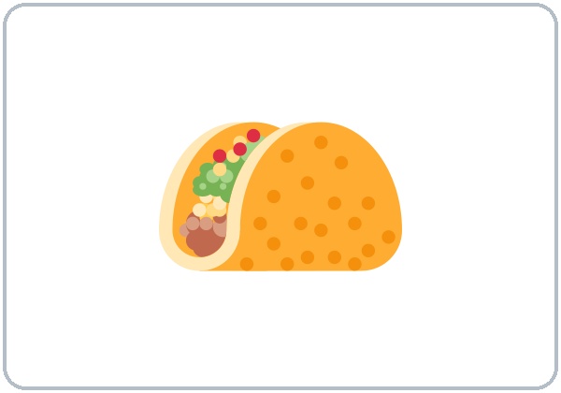
Let's Eat!
Today you will:
• Ask: Do you like fish?
• Say: I like tacos.
• Order: A taco, please. To go.
Lesson 8 · Level 1
Notes:
Welcome. Say: "Today: food." Point to the taco: "This is a taco. Tortillas. Beans."
This is the first lesson after the midterm (Week 8). Keep the energy light.
Before class: print the Student Pages (number expected + 3 spares). Cut one New Words page per group of 3–4 for food picture cards, or point to the page. Have the phone + small speaker and L1_L8_listening.mp3 ready. Prep time: 30 min.
Food tip: ask about allergies and food rules without making anyone explain why. "I don't eat ___." is always an OK answer. Never ask how much learners spend on food.
Teach in English. Show, point, and gesture. Say less, show more.
Class plan: 6:00 Hello + Review, 6:10 New Words, 6:20 Listening, 6:32 Grammar, 6:45 Break, 7:00 Talk Time, 7:10 Exit Ticket + Homework, 7:15 Real-World Reading, 7:25 Progress Check.
Source: level1_curriculum/lesson8/Level1_Lesson8.md (At a glance, How to Use This Plan, Clock-time plan).
Pictures: Twemoji graphics by Twitter, Inc. and other contributors (https://github.com/jdecked/twemoji), CC BY 4.0 (https://creativecommons.org/licenses/by/4.0/); resized and combined, labels added (see lesson8/images/CREDITS.md).

Slide 2
Today's
Goals
01
I can name foods and drinks.
breakfast, lunch, dinner
02
I can ask: Do you like fish?
Tonight you learn these things.
Food and drinks
For here or to go?
Progress Check at 7:25!
03
I can say: I like… / I don't like…
04
I can order: A taco, please.
05
I can read a picture menu.
Notes:
Click to show each goal, one at a time. Read it aloud. Learners repeat.
Goal 1: point to the food pictures: breakfast, lunch, dinner, beans, tortillas, meat, fish, fruit, vegetables, juice, soda, pizza.
Goal 2: "Do you like fish?" "Yes, I do." / "No, I don't."
Goal 3: "I like tacos. I don't like coffee."
Goal 4: "I want a taco and a soda." / "A coffee, please." The server asks: "For here or to go?" "Anything else?"
Goal 5: Real-World Reading at 7:15: a simple picture menu with prices.
Source: level1_curriculum/lesson8/Level1_Lesson8.md (At a glance: Objectives).

Slide 3
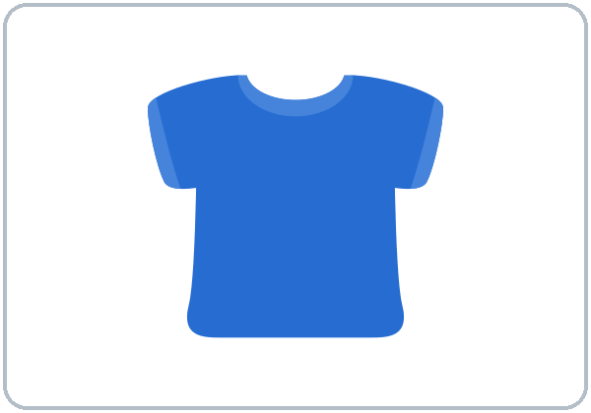
WARM-UP · 6:00
Hello + Review
How much is this shirt?
How much are these shoes?
A: Do you like coffee?
B: Yes, I do.
No, I don't.
Notes:
Pairs. 15 learners: 7 pairs + 1 group of 3. 7–8 learners: 3–4 pairs. Late arrivals join any pair.
Before class, write on the board: How much is this shirt? Do you like coffee? Do you work on weekends?
Model with one learner: "Do you like coffee?" "Yes, I do." / "No, I don't."
Click to show the A question. Click again for the B answers. Pairs use the Hello + Review page: 1 How much is this shirt? It's $___. 2 How much are these shoes? They're $___. 3 Do you like coffee? 4 What color is your shirt? It's ___. Switch. Then find a new partner.
Homework check (last 3 min): partners show the Lesson 7 homework (prices). Walk around and look.
New learners: pair them with a strong partner. They can review Lesson 7 New Words at home. If behind: one partner only.
Source: level1_curriculum/lesson8/Level1_Lesson8.md (Step 1: Hello + Review; Student Pages: Hello + Review).
Review picture: the blue shirt from Lesson 7 (lesson7/images/L1_L7_shirt.png). Twemoji graphics by Twitter, Inc. and other contributors (https://github.com/jdecked/twemoji), CC BY 4.0 (https://creativecommons.org/licenses/by/4.0/); resized and recolored (see lesson7/images/CREDITS.md).

Slide 4
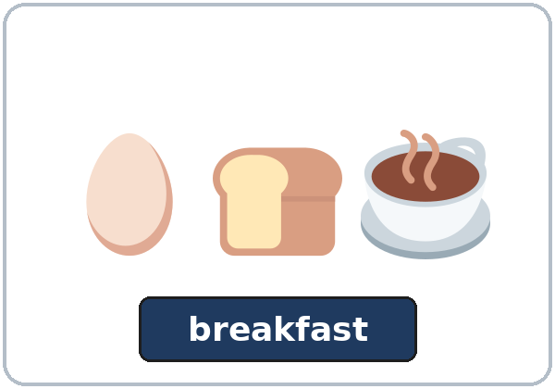
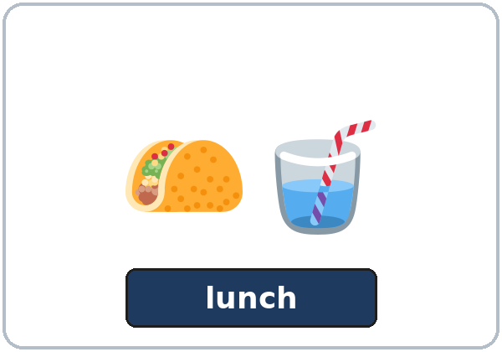
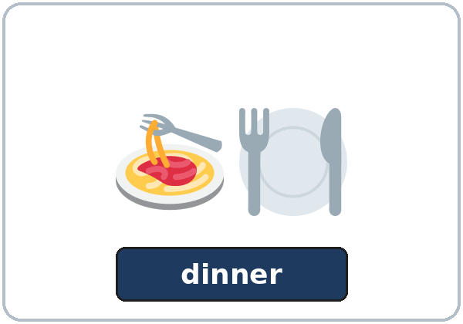
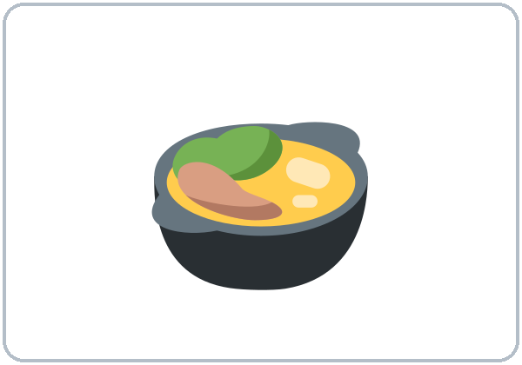
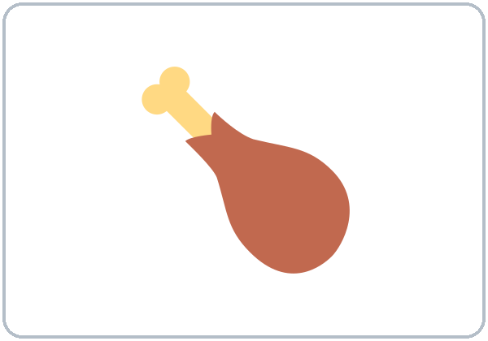
Look. Listen.
Repeat.
New Words
★ breakfast
★ lunch
★ dinner
★ beans
★ tortillas
★ meat
Notes:
Hold up or draw a taco: "This is a taco. Tortillas. Beans." Mime eating: "Breakfast. Lunch. Dinner."
Click to show each picture. Point and say the word. Learners repeat 2 times. ★ words 2 more times.
★ = most important words. If behind: teach the ★ words only.
Source: level1_curriculum/lesson8/Level1_Lesson8.md (Step 2: New Words; Student Pages: New Words).
Pictures: Twemoji graphics by Twitter, Inc. and other contributors (https://github.com/jdecked/twemoji), CC BY 4.0 (https://creativecommons.org/licenses/by/4.0/); resized and combined, labels added (see lesson8/images/CREDITS.md).

Slide 5

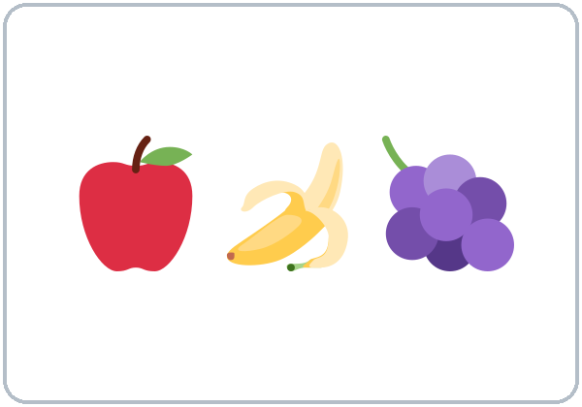
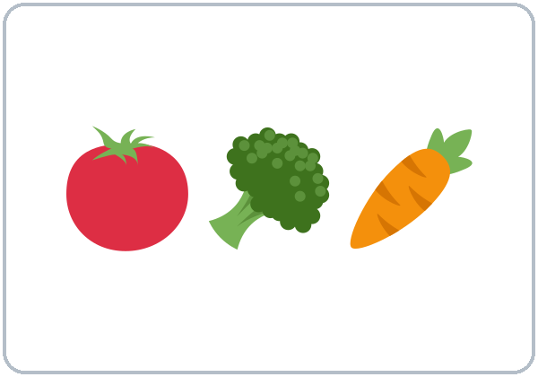
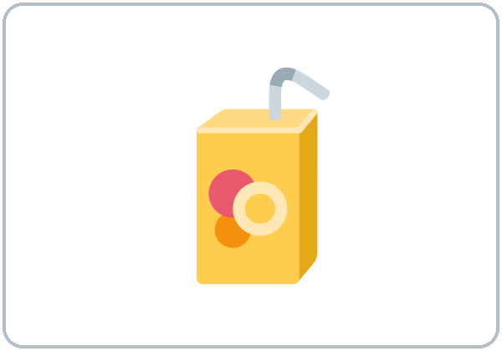
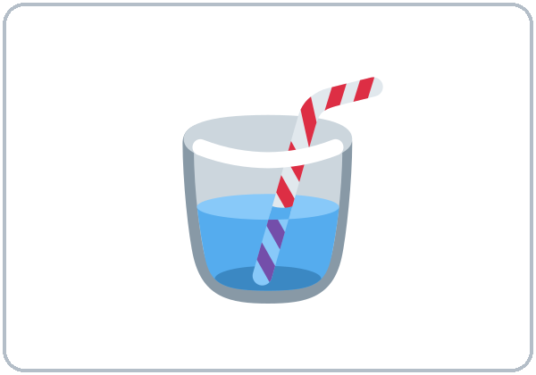

Partners:
A points. B says.
More New Words
★ fish
★ fruit
★ vegetables
★ juice
soda
pizza
Notes:
Click to show each picture. Say the word. Learners repeat 2 times.
Pairs (4 min): A points to a picture, B says the word. Then A asks "Do you like ___?" and B answers "Yes, I do." / "No, I don't."
Spanish tip (on the page only): I like tacos (no "the" for things in general).
★ = most important words. soda and pizza have no ★. If behind: teach the ★ words only.
Source: level1_curriculum/lesson8/Level1_Lesson8.md (Step 2: New Words; Student Pages: New Words).
Pictures: Twemoji graphics by Twitter, Inc. and other contributors (https://github.com/jdecked/twemoji), CC BY 4.0 (https://creativecommons.org/licenses/by/4.0/); resized and combined, labels added (see lesson8/images/CREDITS.md).

Slide 6
Before You Listen
Say it!
I want a fish taco and a soda, please.
Ana is at a taco truck.
For here or to go?
01
To go, please.
Listen 1: What Ana orders.
02
Listen 2: Fish tacos?
Listen and repeat.
03
Listen 3: The numbers.
Notes:
Before you listen (1 min). Say: "Ana is at a taco truck. She asks: Do you like…? She wants food." Point to the Task A pictures.
Click to show each listen. Listen 1: Task A (circle what Ana orders). Listen 2: Task B (does the server like fish tacos? circle 😀 or 😐). Listen 3: Task C (write the prices, cash, change, for here / to go).
Say it!: read each line. Learners repeat: "I want a fish taco and a soda, please." "For here or to go?" "To go, please."
The audio L1_L8_listening.mp3 (about 1:10) plays the conversation once. Press play again for the next listen. Pairs compare after each task. Write answers on the board.
No speaker? Read the script with a volunteer. Say the prices as words: three dollars, two dollars, five dollars, ten dollars.
Voices: Narrator, Server, Ana. Synthetic voices made with Chatterbox TTS (MIT), copied from short reference clips made with Kokoro-82M (Apache 2.0); no recordings of real people.
If behind: play 2 times; do Task C together.
Source: level1_curriculum/lesson8/Level1_Lesson8.md (Step 3: Listening; Listening script).
Pictures: Twemoji graphics by Twitter, Inc. and other contributors (https://github.com/jdecked/twemoji), CC BY 4.0 (https://creativecommons.org/licenses/by/4.0/); resized and combined, labels added (see lesson8/images/CREDITS.md).

Slide 7
Listen. Circle what she orders.
Ana is at a taco truck.
Listening A
the food
1
a fish taco
a fish taco
b pizza
Circle: a or b
Pairs: show your partner.
the drink
2
a soda
a soda
b juice
Notes:
Listen 1 (Task A). Learners circle what Ana orders: the food and the drink.
Pairs compare: "Show your partner." Then click to show each answer: fish taco and soda (not pizza, not juice).
In the audio: "OK. I want a fish taco and a soda, please."
Source: level1_curriculum/lesson8/Level1_Lesson8.md (Step 3: Listening; Student Pages: Listening A; Answer key, Listening A).
Pictures: Twemoji graphics by Twitter, Inc. and other contributors (https://github.com/jdecked/twemoji), CC BY 4.0 (https://creativecommons.org/licenses/by/4.0/); resized and combined, labels added (see lesson8/images/CREDITS.md).

Slide 8
Listen again. Circle. Write.
B: fish tacos? C: the numbers.
Listening B + C
1
B. Does the server like
fish tacos? likes · doesn't like
likes
2
C. The taco is $___.
The soda is $___.
$3 · $2
B: circle.
C: write the numbers.
Pairs: show your partner.
3
C. The total is $___.
Ana gives $___.
$5 · $10
4
C. Her change is $___.
for here to go
$5 · to go
Notes:
Listen 2 (Task B): does the server like fish tacos? Learners circle 😀 likes or 😐 doesn't like. Listen 3 (Task C): learners write the numbers and check for here or to go.
Pairs compare. Then click to show each answer.
Task B: 😀 likes ("Yes, I do. They're really good.").
Task C: the taco is $3, the soda is $2, the total is $5, Ana gives $10, her change is $5, and she wants the food to go.
If behind: play the audio 2 times, and do Task C together.
Source: level1_curriculum/lesson8/Level1_Lesson8.md (Step 3: Listening; Answer key, Listening B and C).

Slide 9
Grammar Box 1
Do you like…?
QUESTION
ANSWER
Do you like fish?
Yes, I do.
No, I don't.
Do you like tacos?
Yes, I do.
I like tacos.
Do you like coffee?
No, I don't.
I don't like coffee.
Do you like fruit?
Yes, I do.
I like fruit.
Notes:
Show the Grammar page. Left = question. Right = answer. Point left, then right.
Box 1: "Do you like fish?" Click: "Yes, I do." / "No, I don't." Ask the class each question. Click to show each answer. Learners repeat the question and the answer.
Short answers: Yes, I do. / No, I don't. After I, use don't + verb: I don't like coffee.
Check question: "Do you ___ fish?" (like).
Source: level1_curriculum/lesson8/Level1_Lesson8.md (Step 4: Grammar Q&A, Boxes 1–2; Grammar Box 1; Questions and answers).
Pictures: Twemoji graphics by Twitter, Inc. and other contributors (https://github.com/jdecked/twemoji), CC BY 4.0 (https://creativecommons.org/licenses/by/4.0/); resized and combined, labels added (see lesson8/images/CREDITS.md).

Slide 10
Grammar Box 2
I like… / I don't like…
Yes, I do.
like
+ tacos, fruit
I like tacos.
I like fruit. I like juice.
No, I don't.
don't like
+ coffee, meat
I don't like coffee.
I don't like meat.
Notes:
Box 2: "I like tacos. I like fruit. I like juice." Click to show the I like lines. Then "I don't like coffee. I don't like meat." Click to show them.
Learners say one true sentence: I like ___. / I don't like ___.
like = it's good for me (I like fish). No "the" for things in general: I like tacos, not I like the tacos.
Big mistake this week: Me like tacos and I like the tacos. Cross them out on the board.
Spanish speakers: like does not work like gustar. Learners can read the Spanish note on their Grammar page.
Source: level1_curriculum/lesson8/Level1_Lesson8.md (Step 4: Grammar Q&A, Boxes 1–2; Grammar Box 2; Teacher notes).
Pictures: Twemoji graphics by Twitter, Inc. and other contributors (https://github.com/jdecked/twemoji), CC BY 4.0 (https://creativecommons.org/licenses/by/4.0/); resized and combined, labels added (see lesson8/images/CREDITS.md).

Slide 11
Grammar Box 3
What do you want?
like or want?
like = it's good for me
want = I ask for it now
I want a taco. I want an apple.
QUESTION
ANSWER
1
What do you want?
I want a taco
and a soda.
2
What do you want?
A coffee, please.
Notes:
Box 3: "What do you want?" Click: "I want a taco and a soda." Ask again. Click: "A coffee, please."
Learners repeat the question and both answers.
like or want? like = it's good for me (I like fish). want = I ask for it now (I want a taco).
One thing: I want a taco. I want an apple.
Check question: "I ___ a soda." (want).
Source: level1_curriculum/lesson8/Level1_Lesson8.md (Step 4: Grammar Q&A, Box 3; Grammar Box 3; Questions and answers).

Slide 12
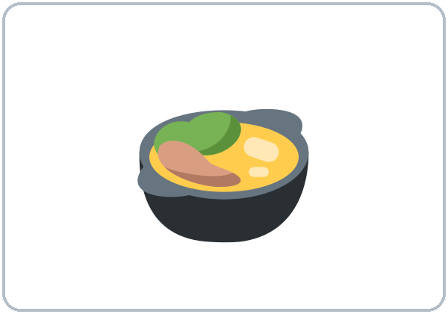
Grammar Box 4
Server asks.
You answer.
Then switch.
Anything else?
For here or to go?
No, thanks.
To go, please. / For here, please.
Notes:
Box 4: mime the counter. "For here or to go?" Click: "To go, please." Another answer: "For here, please."
Right box: "Anything else?" Click: "No, thanks." The server asks if you want more. Answer No, thanks. or name one more food.
Check question: "To go or ___ here?" (for).
Pair drill (last 3–4 min): A asks Do you like…? B answers; then A orders from the menu and B is the server. If behind: skip the pair drill; Talk Time practices the same language.
Source: level1_curriculum/lesson8/Level1_Lesson8.md (Step 4: Grammar Q&A, Box 4 and pair drill; Grammar Box 4).
Pictures: Twemoji graphics by Twitter, Inc. and other contributors (https://github.com/jdecked/twemoji), CC BY 4.0 (https://creativecommons.org/licenses/by/4.0/); resized and combined, labels added (see lesson8/images/CREDITS.md).

Slide 13
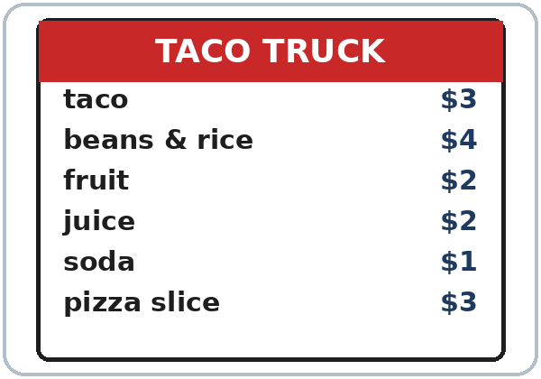
Grammar Box 5
How much is it?
SERVER
YOU
How much is it?
It's $5.
five dollars.
That's $5.
Here's $10.
Your change is $5.
Thank you!
Notes:
Box 5: prices at the counter (from Lesson 7). Left = server. Right = you.
"How much is it?" Click: "It's $5. / five dollars." "That's $5." Click: "Here's $10." "Your change is $5." Click: "Thank you!"
Learners repeat each line. Then pairs: A is the server, B pays. Switch.
This is the same language as Listening C (total $5, cash $10, change $5).
Source: level1_curriculum/lesson8/Level1_Lesson8.md (Grammar Box 5; Answer key, Listening C).
Pictures: Twemoji graphics by Twitter, Inc. and other contributors (https://github.com/jdecked/twemoji), CC BY 4.0 (https://creativecommons.org/licenses/by/4.0/); resized and combined, labels added (see lesson8/images/CREDITS.md).

Slide 14
Write like, don't, want, or to go.
Look at Grammar Boxes 1–4.
like, don't, want?
1
I ____ fruit.
like
2
I ____ like soda.
don't
like: good for me
want: I ask now
Pairs: check your answers.
3
I ____ a taco, please.
want
4
To go or for here?
→ ____, please.
To go
5
Do you ____ fish?
→ Yes, I do.
like
6
I ____ coffee
in the morning.
like / want
Notes:
Learners write like, don't, want, or to go. Then pairs check.
Click to show each answer: 1 like, 2 don't, 3 want, 4 To go, 5 like, 6 like or want (answers will vary: either is OK if it fits).
Source: level1_curriculum/lesson8/Level1_Lesson8.md (Grammar: Practice; Answer key, Grammar practice).

Slide 15
Common Mistakes
Don't say
Say
Me like tacos.
I like tacos.
I like the tacos.
I like tacos.
I no like coffee.
I don't like coffee.
I want taco.
I want a taco.
Notes:
Read each "Don't say" line. Shake your head. Click to show the correct line. Learners repeat it.
Me like tacos → I like tacos. I like the tacos (for food in general) → I like tacos.
I no like coffee → I don't like coffee. I want taco → I want a taco (one thing).
Tip: like = general preference. want = order now. Point to Grammar Box 2 for the big mistake.
Source: level1_curriculum/lesson8/Level1_Lesson8.md (Grammar: Common mistakes; Teacher notes).
Pictures: Twemoji graphics by Twitter, Inc. and other contributors (https://github.com/jdecked/twemoji), CC BY 4.0 (https://creativecommons.org/licenses/by/4.0/); resized and combined, labels added (see lesson8/images/CREDITS.md).

Slide 16
Talk Time
Food Survey
Groups of 3–4.
Ask 3 classmates.
7:00–7:10
1
Ask:
Do you like fish?
2
They answer:
Yes, I do. / No, I don't.
3
Write 😀 or 😐.
fish · beans · pizza · juice
Notes:
Part 1, food survey (4 min). Groups of 3–4. Each learner asks 3 classmates "Do you like…?" and writes 😀 or 😐 on the survey (fish, beans, pizza, juice).
Model: "Do you like fish?" "Yes, I do." Write 😀. Click to show each step.
Allergies and food rules: accept "I don't eat ___." or "I don't like ___." with no questions about why.
If behind: do only the survey.
Source: level1_curriculum/lesson8/Level1_Lesson8.md (Step 5: Talk Time, Part 1; Student Pages: Talk Time B, Food survey; Teacher notes).
Pictures: Twemoji graphics by Twitter, Inc. and other contributors (https://github.com/jdecked/twemoji), CC BY 4.0 (https://creativecommons.org/licenses/by/4.0/); resized and combined, labels added (see lesson8/images/CREDITS.md).

Slide 17
TALK TIME · PART 2
A says:
For here or to go?
Anything else? That's $___.
B says: To go, please.
How much is it? Here's $___.
Then: switch.
Taco Truck
A is the server.
B is the customer.
A: Hi! What do you want?
B: I want a taco, please.
Notes:
Part 2, taco truck (5 min). A–B pairs. Give half the class the Student A page (server, menu with prices) and half the Student B page (customer). Partners don't show their role cards.
Model with one learner first: "Hi! What do you want?" Click: "I want a taco, please." "For here or to go?" "To go, please." "How much is it?" "It's $3." "Here's $5." "Your change is $2."
A is the server: says Hi! What do you want? / For here or to go? / Anything else? / That's $___, and writes what the partner orders and the price.
B is the customer: orders, says for here or to go, asks the price, and pays. B writes the food, the price, and the change. Then switch.
Menu prices: taco $3, beans & rice $4, fruit $2, juice $2, soda $1, pizza slice $3.
Odd number: two customers share one server. Learners who can't write yet can point on the menu and say "A taco, please." / "To go."
Source: level1_curriculum/lesson8/Level1_Lesson8.md (Step 5: Talk Time, Part 2; Student Pages: Talk Time A and B; picture menu; Teacher notes).
The picture menu is drawn in code; the food names and prices are invented (see lesson8/images/CREDITS.md).

Slide 18
Before You Go 7:10–7:15
01
Exit ticket
02
Homework
Say:
I like ___.
I want ___.
Or write:
one sentence.
1. Write about you.
2. Unscramble.
3. Ask: Do you like fish?
4. Menu: 3 foods + prices.
5. One price from Lesson 7.
Bring it next week!
Notes:
Exit ticket (never skip): each learner says "I like ___." or "I want ___." or writes one sentence. Copying from the box is fine.
Homework (10 minutes): open the Homework page. Do item 1, line 1 together. Point to each instruction.
Homework: 1) write about you (I like… / I don't like… / For breakfast, I want… / For lunch, I like…); 2) unscramble; 3) ask a family member or a friend "Do you like fish?" and write the answer; 4) look at a menu (paper or phone) and write 3 foods and prices; 5) review: write one price from Lesson 7 and say it aloud.
Homework answers (answer key, Homework 2): 1 I like fruit. 2 I don't like coffee. 3 I want a taco.
Source: level1_curriculum/lesson8/Level1_Lesson8.md (Step 6: Exit Ticket + Homework; Student Pages: Homework; Answer key).
Pictures: Twemoji graphics by Twitter, Inc. and other contributors (https://github.com/jdecked/twemoji), CC BY 4.0 (https://creativecommons.org/licenses/by/4.0/); resized and combined, labels added (see lesson8/images/CREDITS.md).

Slide 19
Read the Menu
1
taco $___
$3
2
juice $___
$2
3
pizza slice $___
$3
4
soda $___
$1
Real-World Reading
Task A: write the prices.
Notes:
Real-World Reading (10 min, Weeks 9–14). Whole class, then pairs. Use the Real-World Reading page (the same menu as Talk Time).
See it (2 min), Task A: point to each food and the price. Say the prices as words: "three dollars".
Hear it (2 min): say 3 prices; learners point.
Learners write the prices. Then click to show each answer: taco $3, juice $2, pizza slice $3, soda $1 (answer key).
Learners who can't read yet: they point to pictures and say the food words with everyone.
Source: level1_curriculum/lesson8/Level1_Lesson8.md (Real-World Reading step; Student Pages: Real-World Reading A; Answer key).
The picture menu is drawn in code; the food names and prices are invented (see lesson8/images/CREDITS.md).

Slide 20
Read. Circle.
for here or to go?
For Here
or To Go?
1
You eat at the truck.
for here to go
for here
2
You take the food home.
for here to go
to go
Read each line.
Circle: for here or to go.
Pairs: check your answers.
The server asks:
Anything else?
How old are you?
3
Anything else?
Notes:
Read it (4 min), Task B: read each line together. Learners circle.
Then click to show each answer: 1 for here (you eat at the truck), 2 to go (you take the food home), 3 Anything else? (the server asks).
If behind: do Tasks A and B only.
Source: level1_curriculum/lesson8/Level1_Lesson8.md (Real-World Reading step; Student Pages: Real-World Reading B; Answer key).

Slide 21
Real-World Reading · Tasks C + D
Copy and Say
taco $3
three dollars
C: copy 2 lines.
D: say the prices.
MENU
SAY
beans & rice $4
four dollars
fruit $2
two dollars
soda $1
one dollar
pizza slice $3
three dollars
Notes:
Task C: learners read the menu and copy two lines (for example: taco $3). Answers vary.
Task D (pairs): partner A says a food; B says the price. Then switch. Partners: A is the server, B orders one thing from the menu (no money this time).
Click to show each way to say the price. Learners repeat.
Menu: taco $3, beans & rice $4, fruit $2, juice $2, soda $1, pizza slice $3.
Source: level1_curriculum/lesson8/Level1_Lesson8.md (Real-World Reading step; Student Pages: Real-World Reading C and D).
The picture menu is drawn in code; the food names and prices are invented (see lesson8/images/CREDITS.md).

Slide 22
Progress Check 7:25
D. I can…
😀 🙂 😐
Check one face.
B. Match the question
Answer
1. Do you like tacos?
b. Yes, I do.
2. What do you want?
c. I want a soda.
3. For here or to go?
a. To go, please.
4. How much is it?
d. It's $5.
Notes:
Progress Check (5 min). Individuals. Open the Progress Check page.
Part A: read each word slowly, 2 times: 1 breakfast, 2 fish, 3 juice, 4 beans, 5 lunch. Learners circle.
Parts B and C: learners match and write on their own. Help with the instructions only. Click to show the Part B answers when you check together: 1 b, 2 c, 3 a, 4 d.
Part C (like / don't like / want): answers vary.
Part D: read each "I can…" line and point to the 3 faces: 😀 "I can." 🙂 "With help." 😐 "Not yet." Learners check one.
Score: A /5 + B /4 + C /3 = /12. Not a test grade. After the midterm, these checks are light. Collect if you want. If behind: do it next week at 6:00.
Source: level1_curriculum/lesson8/Level1_Lesson8.md (Progress Check step; Student Pages: Progress Check; Answer key).

Slide 23
Great Work! See You Next Week!
Now you can:
• Ask: Do you like fish?
• Say: I like tacos. I don't like coffee.
• Order: A taco, please. To go, please.
Lesson 8 · Level 1
Notes:
Say: "Great work! See you next week!" Remind learners: bring the homework next week.
Collect the Progress Check pages if you want.
Source: level1_curriculum/lesson8/Level1_Lesson8.md (At a glance: Objectives).
Pictures: Twemoji graphics by Twitter, Inc. and other contributors (https://github.com/jdecked/twemoji), CC BY 4.0 (https://creativecommons.org/licenses/by/4.0/); resized and combined, labels added (see lesson8/images/CREDITS.md).

Slide 24
Credits
Pictures
Pictures use Twemoji graphics by Twitter, Inc. and other contributors (https://github.com/jdecked/twemoji), licensed under CC BY 4.0 (https://creativecommons.org/licenses/by/4.0/). The graphics were resized and combined, and labels were added. The picture menu is drawn in code. Labels on the pictures use the DejaVu Sans font. The review picture (the blue shirt) is from Lesson 7.
Other small pictures (the faces on the Progress Check and the survey) are standard emoji characters shown with the computer's emoji font.
Names
All names, foods, and prices on the slides (Ana, the taco truck, the menu) are invented. No real restaurant is named.
Audio and font
Audio: synthetic voices (Narrator, Server, Ana) made with Chatterbox TTS (Resemble AI, MIT License), copied from short reference clips made with Kokoro-82M (Apache 2.0); no recordings of real people were used. Each file carries an inaudible Perth watermark. Font: Lexend Deca (OFL 1.1).
© 2026 the authors. The authors license this deck under CC BY-NC-SA 4.0.
Notes:
Credits for the pictures, audio, and font.
Pictures: Twemoji (CC BY 4.0), https://github.com/jdecked/twemoji; resized and combined, labels added. The picture menu is drawn in code. Review picture (blue shirt) from Lesson 7. Audio: Chatterbox TTS (MIT) voices copied from short Kokoro-82M (Apache 2.0) reference clips; no recordings of real people.
Sources: Level1_Lesson8.md (Picture Credits), lesson8/images/CREDITS.md, lesson8/audio/README.md.

