Slide 1
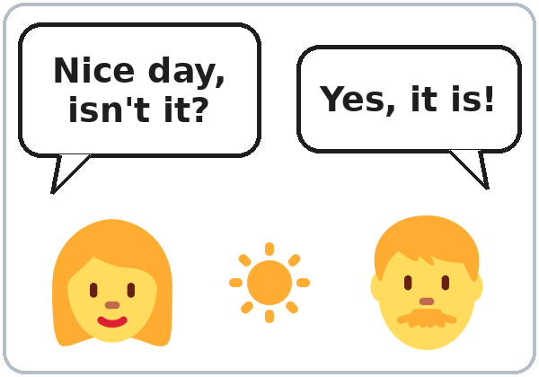
Tell Me More
Today you will:
• Ask follow-up questions
• Give a reason with because
• Say a result with so
Lesson 1 · Level 3
Notes:
Welcome learners as they arrive. Each learner writes a first name on a name tag.
Point to the title and read it: "Tell me more." Say: "Tonight we keep a conversation going. We don't stop at one word."
Read the three lines under "Today you will". Give one quick example of each: "Really? Why?" (a follow-up question) • "I take the bus because it's cheap." (a reason) • "My car broke down, so I took the bus." (a result).
Keep it short. Don't explain the grammar now. Go straight to the warm-up.
Source: Level3_Lesson1.md (Topic; At a glance: Objectives; Step 1).
Picture: Twemoji graphics by Twitter, Inc. and other contributors (https://github.com/jdecked/twemoji), CC BY 4.0 (https://creativecommons.org/licenses/by/4.0/); resized and combined, with drawn speech bubbles and labels (images/CREDITS.md).

Slide 2
Today's
Goals
01
I can ask about my week.
do · did · going to
02
I can ask a follow-up question.
By the end of class, you can do these five things.
Don't stop at one word.
We check at 7:25!
03
I can give a reason with because.
04
I can say a result with so.
05
I can write about a classmate.
Notes:
Read each goal slowly. Learners repeat.
Goal 1 is review from Level 2: do = now (What do you do on weekends?), did = the past (What did you do last weekend?), going to = the future (What are you going to do this weekend?).
Goals 2 to 4 are new tonight: follow-up questions (Really? Why? What happened? How was it? What about you?), because + a reason, so + a result.
Goal 5: later tonight, learners read a community center flyer and write 3 sentences about a classmate.
Say: "In Level 3, don't stop at one word. Give a reason. Ask a question back."
"We check at 7:25" = the Progress Check, the first can-do self-check. It is not a test grade.
Source: Level3_Lesson1.md (At a glance: Objectives; How Our Class Works; Progress Check).

Slide 3
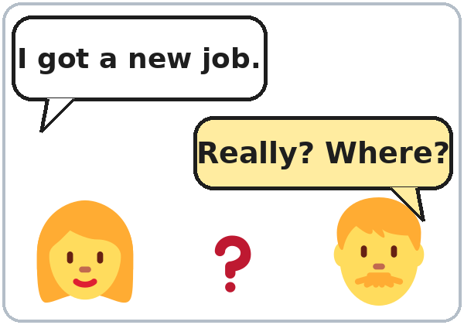
WARM-UP · 6:00
One Question,
One Follow-Up
Round 1
What did you do last weekend?
Really? How was it?
Round 2: new partner
What are you going to do this weekend?
Why?
Notes:
Step 1 · 6:00–6:10 · 10 min. Pairs. 15 learners: 7 pairs + 1 group of 3. 7–8 learners: 3–4 pairs.
Before class, write on the board: What did you do last weekend? → Really? How was it?
Model with one learner: ask "What did you do last weekend?" The learner answers. Then say "Really? How was it?" Point to the second question and say: "This is a follow-up question. It asks for more."
Round 1 (4 min): A asks the question, B answers, A asks one follow-up. Switch.
Round 2 (4 min): new partner. Add to the board: What are you going to do this weekend? → Why?
Late arrivals join any pair as a group of 3. If behind: one round only.
Privacy: learners choose what to share. Any answer can be invented. "I don't want to say" is always OK.
Source: Level3_Lesson1.md (Step 1; Teacher notes: Privacy).
Picture: Twemoji graphics by Twitter, Inc. and other contributors (https://github.com/jdecked/twemoji), CC BY 4.0 (https://creativecommons.org/licenses/by/4.0/); resized and combined, with drawn speech bubbles and labels (images/CREDITS.md).

Slide 4
How Our
Class Works
01
Listen. · Listen again.
02
Read. · Write.
Class: 6:00–7:30
Break: 6:45–7:00
English in class.
Homework every week.
Phones OK: audio, dictionary.
03
Circle. · Check. · Match.
04
Work with a partner or a group.
05
Ask a follow-up. Give a reason.
Notes:
Step 2 · 6:10–6:15 · Orientation · 5 min. Whole class. Learners open the Student Pages to How Our Class Works.
Show the times: class 6:00, break 6:45, back 7:00, end 7:30.
Say and show the 3 rules: (1) "English in class. A classmate can help you for a few seconds. Then back to English." (2) "Homework every week. About 15 minutes." (3) "Phones are OK for the audio and a dictionary."
Left side: the task words. We use the same short task words every week. Read each line; act it out (hand to ear for Listen, write in the air for Write, draw a circle for Circle).
Point to the Task Words page and say: "You can write them in your language here." Point to the My language column. No one has to.
Also say: "In this class, we don't give one-word answers. We give a reason, and we ask a question back."
If behind: show the times and say the 3 rules only.
Source: Level3_Lesson1.md (Step 2; How to Use This Plan: Instructions; Task Words; How Our Class Works).

Slide 5
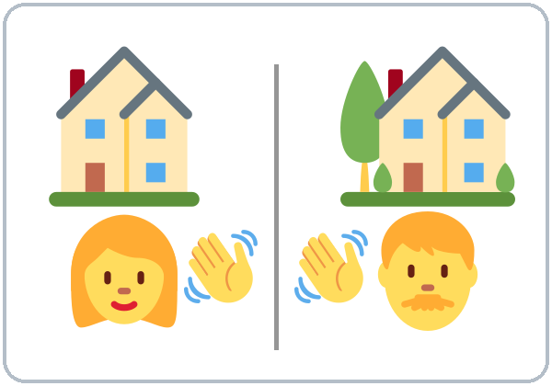
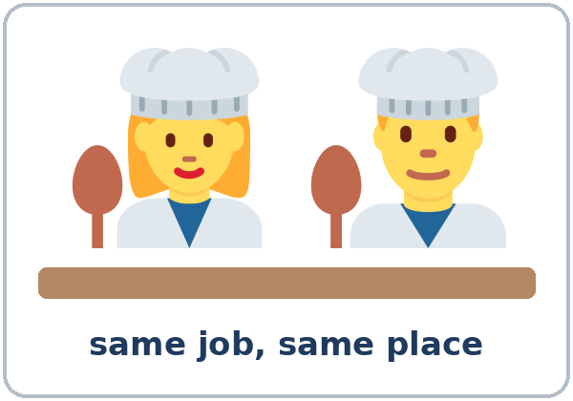
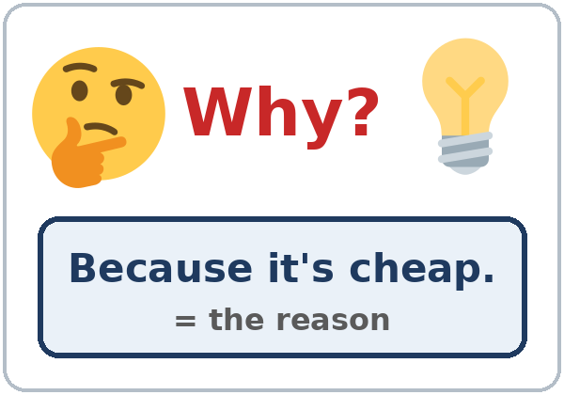

Look. Listen.
Repeat.
New Words
★ neighbor
★ coworker
★ small talk
★ follow-up question
★ reason
★ good news
Notes:
Step 3 · 6:15–6:22 · New Words · 7 min (this slide and the next). Whole class, then pairs.
Point to each picture and say the word. Learners repeat once. ★ = the most important words.
Act out small talk: say "Nice day, isn't it?" to a learner.
Follow-up question: point to the picture. "I got a new job." → "Really? Where?" The second question asks for more.
Reason: ask "Why?" and answer "Because it's cheap." Say: "That's the reason."
If behind: teach the ★ words only.
Source: Level3_Lesson1.md (Step 3; Key vocabulary; New Words page).
Pictures: Twemoji graphics by Twitter, Inc. and other contributors (https://github.com/jdecked/twemoji), CC BY 4.0 (https://creativecommons.org/licenses/by/4.0/); resized and combined, with drawn speech bubbles, signs, and labels (images/CREDITS.md).

Slide 6
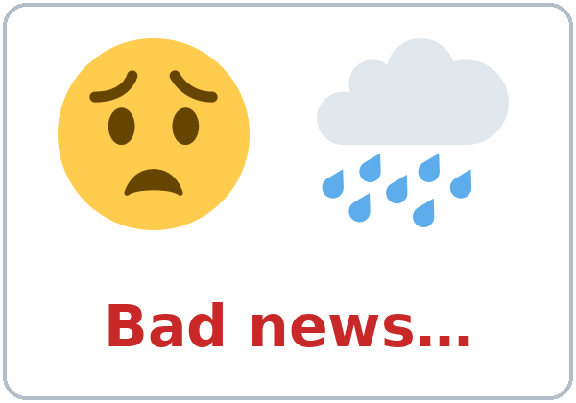
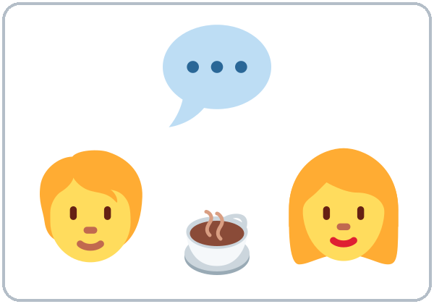
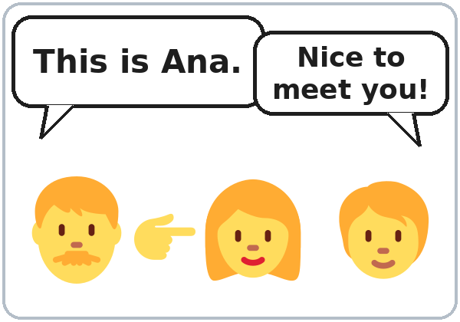

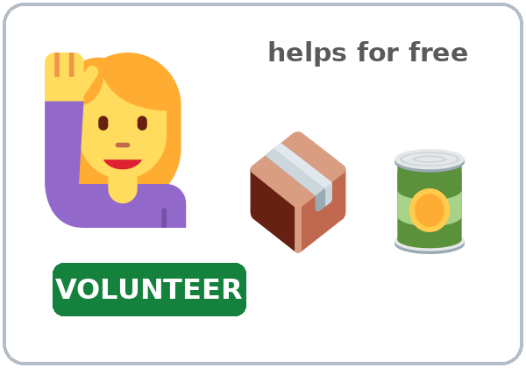
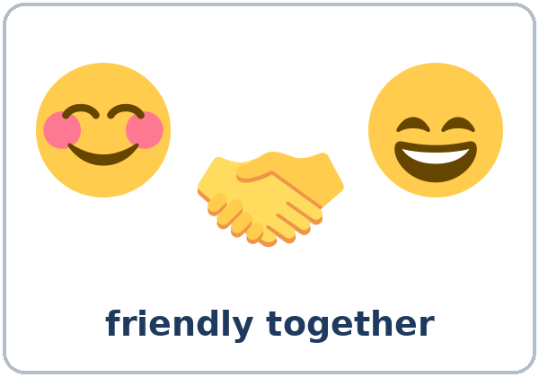
Partner game:
A says. B points.
More New Words
★ bad news
★ chat
★ introduce
community center
volunteer
get along
Notes:
Step 3, continued. Point to each picture and say the word. Learners repeat once.
Act out introduce: introduce one learner to another ("Rosa, this is Ana"). Act out get along: smile and shake hands with a learner.
Partner game (2 min): A says a word. B points to the picture and makes a short sentence ("My neighbor is friendly." / "My coworker is very friendly."). Switch.
My language column: learners may write each word in their language at home. Don't spend class time on it.
If behind: teach the ★ words only (bad news, chat, introduce).
Source: Level3_Lesson1.md (Step 3; New Words page; Partner game).
Pictures: Twemoji graphics by Twitter, Inc. and other contributors (https://github.com/jdecked/twemoji), CC BY 4.0 (https://creativecommons.org/licenses/by/4.0/); resized and combined, with drawn speech bubbles, signs, and labels (images/CREDITS.md).

Slide 7
Check the Meaning
Look at the picture. Answer the question.
1
2
3
Is a coworker at home or at work?
Is a new job good news or bad news?
Does a volunteer get money?
at work
good news
no
Notes:
Step 3 · Check meaning · 1 min. Whole class.
The answers are hidden. Ask each question and wait for the class to answer. Then click to show the answer. Each click shows one answer, in order: 1, 2, 3.
1. "Is your coworker at home or at work?" (at work) • 2. "Is a new job good news or bad news?" (good news) • 3. "Does a volunteer get money?" (no)
If a learner is stuck, point to the picture and give one more short example.
Source: Level3_Lesson1.md (Step 3: Check meaning).
Pictures: Twemoji graphics by Twitter, Inc. and other contributors (https://github.com/jdecked/twemoji), CC BY 4.0 (https://creativecommons.org/licenses/by/4.0/); resized and combined, with drawn labels (images/CREDITS.md).

Slide 8
Before You
Listen for:
Listen
Who has good news?
Elena and David are neighbors. It's Saturday morning, at the laundromat.
Who has bad news?
01
Audio: 1:31. It plays once.
Narrator
02
Elena
Play 1: Task A
03
David
Notes:
Step 4 · 6:22–6:34 · Listening + "Say it" · 12 min (slides 8 to 12). Individuals, then pairs check.
Before you listen (1 min). Point to the picture and say: "This is Elena. This is David. They're neighbors. They're at the laundromat. One person has good news. One person has bad news."
There are three voices: a Narrator, Elena, and David.
The audio (L3_L1_listening.mp3, about 1:31) plays the conversation once. Press play again for play 2. A third play is fine if the class needs it.
No speaker? Read the script with a volunteer at a normal, friendly speed.
Next slide: play 1, Task A.
Audio: synthetic voices, computer-generated (Chatterbox TTS cloned from Kokoro-82M reference clips). No recordings of real people. The names and the story are invented.
Source: Level3_Lesson1.md (Step 4; Listening script; Picture Credits).
Pictures: Twemoji graphics by Twitter, Inc. and other contributors (https://github.com/jdecked/twemoji), CC BY 4.0 (https://creativecommons.org/licenses/by/4.0/); resized and combined, with drawn labels (images/CREDITS.md).

Slide 9
Listen. Who is it?
Check ✓ Elena or David.
Listening A
1. has good news
Elena
David
2. has bad news
Elena
David
3. is very tired
Elena
David
4. has a new job
Elena
David
Notes:
Task A. Read the 4 lines with the class first: has good news, has bad news, is very tired, has a new job.
Play 1: play the whole audio (about 1:31). Learners check Elena or David on their page.
Pairs compare. Then check together: click to show the answer. Each click circles one answer, in order 1 to 4: 1 Elena, 2 David, 3 David, 4 Elena.
Then read Tasks B and C together (1 min), so learners know what to listen for in play 2.
Source: Level3_Lesson1.md (Step 4; Listening Task A; Answer key).

Slide 10
Listen again.
Check ✓ True or False.
Listening B
1. David's car broke down on Tuesday.
True
False
2. David took a taxi to work this week.
True
False
3. The car is maybe going to be ready next Friday.
True
False
4. Elena's new job is at a school.
True
False
5. Elena walks to work.
True
False
6. David starts work at seven.
True
False
Notes:
Task B (play 2). Before play 2, read Tasks B and C together (1 min) so learners know what to listen for.
Play 2: play the whole audio again. Learners check True or False on their page (and write because or so for Task C).
Pairs compare. Then check together: click to show the answer. Each click circles one answer, in order 1 to 6.
Answers: 1 True • 2 False (he took the bus) • 3 True • 4 False (at a hospital) • 5 True • 6 False (he starts at six).
A third play is fine if the class needs it.
Source: Level3_Lesson1.md (Step 4; Listening Task B; Answer key).

Slide 11
Listen again.
Write because or so.
Listening C
1
David: ____ my car broke down on Tuesday.
Because
2
Now it's at the mechanic, ____ I took the bus to work.
so
Pairs: compare your answers.
Then check together.
3
Yes, I love it, ____ the people are really friendly.
because
4
It's only ten minutes from my apartment, ____ I don't need a car.
so
5
I really need my car, ____ my job is far away.
because
Notes:
Task C (play 2, with Task B). Learners write because or so in each line.
Pairs compare. Then check together: click to show the answer. Each click shows one answer, in order 1 to 5.
Answers: 1 Because • 2 so • 3 because • 4 so • 5 because.
Line 2 is short on the slide. The full line on the page is: "Now it's at the mechanic, so I took the bus to work every day this week."
If behind: do Task C together on the board, reading the lines yourself.
Source: Level3_Lesson1.md (Step 4; Listening Task C; Answer key).

Slide 12
B
Fix the false sentences.
Check and
Say It
Task B: 2, 4, 6
2
David took the ____ to work.
bus
4
Elena's job is at a ____.
hospital
Pairs: compare your answers.
Then say it: make Really? go up.
6
David starts work at ____.
six
Say it: Really? Why?
Say it: What about you? How was your week?
Notes:
Answer check. Three sentences in Task B are false. Ask: "What's the right answer?" Learners say it first. Then click to show the answer. Each click shows one answer, in order 2, 4, 6.
2: David took the bus (not a taxi). • 4: Elena's new job is at a hospital (not a school). • 6: David starts at six (not seven).
"Say it" (2 min): read the 2 lines: "Really? Why?" and "What about you? How was your week?" The class repeats each line twice.
Make Really? go up and sound interested.
Source: Level3_Lesson1.md (Step 4: "Say it"; Answer key: Listening Task B).

Slide 13
Grammar Box 1 · review
Now, Past, Future
do = now · did = past · going to = future
QUESTION
ANSWER
What do
you do on weekends?
I usually play soccer.
I usually visit my family.
What did
you do last weekend?
I watched a movie.
I cleaned the house.
What are
you going to do this weekend?
I'm going to rest.
I'm going to cook for my family.
Notes:
Step 5 · 6:34–6:45 · Grammar Q&A · 11 min (slides 13 to 18). Whole class, then pairs.
Show the Grammar page. The left side is the question. The right side is the answer.
Box 1 (review, 2 min): read a question. The class answers from the right side. Then click to show the answer. Each click shows one answer, in order 1, 2, 3.
Point to the time words: on weekends (now), last weekend (the past), this weekend (the future). do = now, did = the past, going to = the future.
Don't re-teach. Level 2 taught these.
Source: Level3_Lesson1.md (Step 5; Grammar Box 1).
Picture: Twemoji graphics by Twitter, Inc. and other contributors (https://github.com/jdecked/twemoji), CC BY 4.0 (https://creativecommons.org/licenses/by/4.0/); resized and combined, with drawn speech bubbles and labels (images/CREDITS.md).

Slide 14
Grammar Box 2
Follow-up Questions
SOMEONE SAYS
YOU ASK A FOLLOW-UP
I got a new job.
Really? Where?
That's great! When do you start?
My car broke down.
Oh no! What happened?
Where is it now?
I went to a party.
How was it?
Who did you go with?
I'm really tired today.
Why?
Are you OK?
I like my neighborhood.
Why?
What do you like about it?
My week was busy. How was your week?
It was good, thanks.
What about you?
Notes:
Box 2 (3 min). A follow-up question is a second question about the same topic. It shows you are listening and keeps the conversation going.
Read a sentence from the left. The class says a follow-up question. Then click to show the follow-ups for that line. Each click shows one row, in order 1 to 6.
Then say your own news ("I have a new cat!") and wait for follow-ups.
To ask the question back, say: "What about you?" or "And you?"
Learners who are new to the class can use Box 2 on their page as a script.
Source: Level3_Lesson1.md (Step 5; Grammar Box 2; Questions and answers; Teacher notes).
Picture: Twemoji graphics by Twitter, Inc. and other contributors (https://github.com/jdecked/twemoji), CC BY 4.0 (https://creativecommons.org/licenses/by/4.0/); resized and combined, with drawn speech bubbles and labels (images/CREDITS.md).

Slide 15
Grammar Box 3
Why…? Because…
Because + the reason. It answers Why?
QUESTION
ANSWER
Why do
you take the bus?
Because it's cheap.
Because I don't have a car.
Why does
she like her job?
Because the people are friendly.
Because it's near her home.
Why did
you stay home?
Because I was tired.
Because it was cold.
Notes:
Box 3 (with Box 4, 3 min). Write on the board: because + reason.
Read a question from the left. The class answers with Because. Then click to show the answer. Each click shows one answer, in order 1, 2, 3.
Point to do / does / did: Why do you…? (now) • Why does she…? (she, now) • Why did you…? (the past). Don't forget do / did in the question.
In a conversation, after Why?, you can start with Because: "Why? Because I was tired." In writing, join it to the other sentence: "I stayed home because I was tired."
Check questions: "I stayed home ___ I was sick." (because) • "Why ___ you take the bus?" (do)
Typical mistake: "Why you take the bus?" Say the right form clearly: "Why do you take the bus?" The learner repeats.
Source: Level3_Lesson1.md (Step 5; Grammar Box 3; Questions and answers; Teacher notes).
Picture: Twemoji graphics by Twitter, Inc. and other contributors (https://github.com/jdecked/twemoji), CC BY 4.0 (https://creativecommons.org/licenses/by/4.0/); resized and combined, with drawn speech bubbles and labels (images/CREDITS.md).

Slide 16
Grammar Box 4
…, so… (the result)
THE REASON, so THE RESULT
because
= reason
My car broke down, so I took the bus.
It's only ten minutes away, so I walk.
Put a comma before so.
so
= result
I was tired, so I stayed home.
My job is far away, so I need a car.
Notes:
Box 4 (with Box 3, 3 min). Write on the board: because + reason, so + result.
Read one row from each box. Click to show the result lines (2 clicks: the white box, then the blue box).
Ask: "My car broke down. Is that the reason or the result?" (reason) "I took the bus." (result).
because comes before the reason; so comes before the result. Put a comma before so. Use one word, not both: "I was tired, so I stayed home." or "I stayed home because I was tired."
Quick test: "Why?" is answered by the because part.
Check question: "I was sick, ___ I stayed home." (so)
Pair drill (last 3 min): A asks a Why…? question. B answers with because. A asks one follow-up. Switch. If behind: skip the pair drill; Talk Time practices it.
Source: Level3_Lesson1.md (Step 5; Grammar Box 4; Questions and answers; Teacher notes).
Picture: Twemoji graphics by Twitter, Inc. and other contributors (https://github.com/jdecked/twemoji), CC BY 4.0 (https://creativecommons.org/licenses/by/4.0/); resized and combined, with drawn labels (images/CREDITS.md).

Slide 17
Practice: write because or so.
because = reason · so = result
Because
or So?
1
I'm learning English ____ I want a better job.
because
2
It was raining, ____ I took an umbrella.
so
3
She likes her neighbors ____ they are very friendly.
because
Is it the reason or the result?
Pairs: check your answers.
4
The store was closed, ____ we went home.
so
5
He drinks coffee every morning ____ he starts work at 6:00.
because
6
My coworker was sick, ____ I worked late.
so
Notes:
Practice (part of Step 5). Learners write because or so in each sentence on their Grammar page.
Ask for each line: "Is the next part the reason or the result?" Reason = because. Result = so.
Pairs check. Then click to show the answer. Each click shows one answer, in order 1 to 6.
Answers: 1 because • 2 so • 3 because • 4 so • 5 because • 6 so.
Source: Level3_Lesson1.md (Grammar: Practice; Answer key: Grammar practice).

Slide 18
Common Mistakes
Don't say
Say
Because I was tired, so I stayed home.
I was tired, so I stayed home.
I stayed home because I was tired.
Why you take the bus?
Why do you take the bus?
What you did last weekend?
What did you do last weekend?
Because of it's cheap.
Because it's cheap.
I going to rest.
I'm going to rest.
(one word) "Good."
"Good, thanks. I played soccer. What about you?"
Notes:
Common mistakes (never skip this table). Read a line from Don't say. Ask: "What's the right way?" Learners try first. Then click to show the right form. Each click shows one line, in order 1 to 6.
1: use because or so, not both. • 2: Why do you…? (add do) • 3: What did you do…? (did before you) • 4: Because + reason (no of) • 5: I'm going to… (add am) • 6: don't give one-word answers; add a detail and ask the question back.
Say the right form clearly; the learner repeats.
Tip: in English, a one-word answer can sound unfriendly or bored. Add a reason (because…) or ask a question back (What about you?).
Source: Level3_Lesson1.md (Grammar: Common mistakes; Tip for speakers of other languages; Teacher notes: Typical mistakes).
Picture: Twemoji graphics by Twitter, Inc. and other contributors (https://github.com/jdecked/twemoji), CC BY 4.0 (https://creativecommons.org/licenses/by/4.0/); resized and combined, with drawn labels (images/CREDITS.md).

Slide 19
Pair Drill
A asks. B gives a reason.
01
Ask Why…? Answer with because. Ask one follow-up. Switch.
A: Why did you stay home?
B: Because I was tired.
A asks one follow-up.
02
A: Are you OK?
Then switch roles.
Notes:
Pair drill (last 3 min of Step 5). Pairs.
A asks a Why…? question (use Box 3). B answers with because. A asks one follow-up question (use Box 2). Then switch.
Model it with one learner first: "Why did you stay home?" → "Because I was tired." → "Are you OK?"
Check it: ask "Do you write or speak?" (speak) "How many follow-up questions?" (one). Then go.
Mixed levels: stronger learners ask more follow-ups and give two reasons. New learners read Box 2 and Box 3 on their page as a script.
If behind: skip the pair drill. Talk Time practices it.
Source: Level3_Lesson1.md (Step 5: Pair drill; Grammar Boxes 2 and 3; How to Use This Plan; Teacher notes).
Picture: Twemoji graphics by Twitter, Inc. and other contributors (https://github.com/jdecked/twemoji), CC BY 4.0 (https://creativecommons.org/licenses/by/4.0/); resized and combined, with drawn labels (images/CREDITS.md).

Slide 20
Talk Time
The Three-Question Rule
Inside–outside circles.
3–4 rounds, 2 min each.
7:00–7:12
1
A asks the card question.
What do you do on weekends?
2
B uses because or so.
In the park, because it's free.
3
A asks two follow-ups.
Really? Where? · Who with?
Notes:
Step 6 · 7:00–7:12 · Talk Time: The Three-Question Rule · 12 min. Inside–outside circles: the inner circle faces out, the outer circle faces in.
15 learners: two circles of 7–8 (the teacher or one trio fills a gap). 7–8 learners: one circle. 5 or fewer: sit at one table and rotate seats.
The rule: the inner circle has a question card. A asks the card question. B answers. A must ask two follow-up questions. B must use because or so at least once. Then switch roles, and the outer circle moves one person to the right.
Model with one learner (1 min): "What do you do on weekends?" → "I play soccer." → "Really? Where?" → "In the park, because it's free." → "Who do you play with?" (Each click shows the next step.)
Do 3–4 rounds of about 2 minutes. Learners write one answer on their Talk Time page after each round.
Follow-ups on the board: Really? Why? What happened? How was it? What about you?
Baseline snapshot: while learners talk, call about 5 learners, one at a time, for 2 minutes, and use the checklist after the answer key. Do the rest in Weeks 2 and 3.
Privacy: learners choose what to share; any answer can be invented. Praise every follow-up you hear, even a simple "Really?"
If behind: two rounds only.
Source: Level3_Lesson1.md (Step 6; Talk Time page; Grouping toolkit; Teacher notes).
Picture: Twemoji graphics by Twitter, Inc. and other contributors (https://github.com/jdecked/twemoji), CC BY 4.0 (https://creativecommons.org/licenses/by/4.0/); resized and combined, with drawn labels (images/CREDITS.md).

Slide 21
Before You Go 7:12–7:17
01
Exit ticket
02
Homework
Write two sentences:
1. About a classmate:
Rosa takes the bus because she doesn't have a car.
2. One sentence with so.
Give it to me at the door.
About 15 minutes.
1. Answer with because.
2. Ask 2 people. Follow up.
3. Write 3 sentences with so.
4. Last weekend: 2 sentences.
Bring it next week!
Notes:
Step 7 · 7:12–7:17 · Exit Ticket + Homework · 5 min · NEVER SKIP.
Exit ticket: each learner writes two sentences on a slip: one about a classmate ("Rosa takes the bus because she doesn't have a car.") and one with so. Collect the slips at the door.
Homework: open the Homework page. Do item 1 together. Say: "About 15 minutes. Bring it next week."
Homework items: 1 answer 3 Why questions with because; 2 ask a friend, family member, or coworker 2 questions, with one follow-up each, and write the answers; 3 join two sentences with so; 4 review: write 2 sentences about last weekend.
Source: Level3_Lesson1.md (Step 7; Homework page).
Picture: Twemoji graphics by Twitter, Inc. and other contributors (https://github.com/jdecked/twemoji), CC BY 4.0 (https://creativecommons.org/licenses/by/4.0/); resized and combined, with drawn labels (images/CREDITS.md).

Slide 22
Progress Check 7:25
D. I can…
😀 🙂 😐
Check one face.
I can ask a follow-up question.
I can give a reason with because.
I can say a result with so.
I can talk about my week, my past, and my plans.
A. Listen. Circle the best follow-up.
Answer
1. a. Why? b. Where?
a
2. a. How old are you? b. How was it?
b
3. a. Really? What is it? b. Oh no! I'm sorry.
a
4. a. That's great! b. Oh no! What happened?
b
Notes:
Progress Check · 7:25–7:30 · first can-do self-check · 5 min. Individuals. Open the Progress Check page.
Part A: read each sentence slowly, 2 times. Learners circle the best follow-up on their page. Then click to show the answer (one click per item, 1 to 4).
Say: 1 "I'm really tired today." (a, Why?) • 2 "I went to a wedding on Saturday." (b, How was it?) • 3 "I have good news!" (a, Really? What is it?) • 4 "My phone is broken." (b, Oh no! What happened?)
Parts B and C: learners do them alone. Walk around and help with the instructions only. B answers: 1 because, 2 so, 3 so, 4 because. C: any good follow-up question (for example Really? Where? / How was it?).
Part D: read each "I can…" line aloud and point to the 3 faces: 😀 "I can do it." 🙂 "With a little help." 😐 "Not yet."
Scoring: A /4 + B /4 + C /2 = /10. This is not a test grade. It shows who needs more help with follow-ups (A, C) and with because / so (B).
Collect the pages (or check them at the start of Week 2). If behind: do the Progress Check in Week 2 at 6:00, while learners arrive.
Source: Level3_Lesson1.md (Progress Check step; Progress Check page; Answer key).

Slide 23
Goodbye! See You Next Week!
Now you can:
• Ask follow-up questions
• Give a reason with because
• Say a result with so
Lesson 1 · Level 3
Notes:
Read the title: "Goodbye! See you next week!" Learners repeat.
Read the three "Now you can" lines. Ask one learner a quick question and wait for a follow-up from the class ("I'm tired." → "Really? Why?").
Remind learners: homework is about 15 minutes. Bring it next week.
Praise every follow-up question you heard tonight, even a simple "Really?"
Source: Level3_Lesson1.md (At a glance: Objectives; Step 7; Teacher notes).
Picture: Twemoji graphics by Twitter, Inc. and other contributors (https://github.com/jdecked/twemoji), CC BY 4.0 (https://creativecommons.org/licenses/by/4.0/); resized and combined, with drawn labels (images/CREDITS.md).

Slide 24
Credits
Pictures
Vocabulary pictures use Twemoji graphics by Twitter, Inc. and other contributors (https://github.com/jdecked/twemoji), licensed under CC BY 4.0 (https://creativecommons.org/licenses/by/4.0/). The graphics were resized and combined, and speech bubbles, signs, and labels were added.
The faces on the Progress Check are standard emoji characters shown with the computer's emoji font.
Names and story
Elena, David, Rosa, and Ana are invented names. The listening story is invented.
Audio and font
Audio: synthetic voices made with Chatterbox TTS (MIT License), cloned from short synthetic reference clips made with Kokoro-82M (Apache License 2.0). No recordings of real people were used. Each file carries an inaudible Perth watermark marking it as AI-generated. Font: Lexend Deca (OFL 1.1).
© 2026 the authors. The authors license this deck under CC BY-NC-SA 4.0.
Notes:
Credits. You don't need to read this slide in class.
Pictures: Twemoji graphics by Twitter, Inc. and other contributors, CC BY 4.0; the file-by-file list is in images/CREDITS.md.
Audio: L3_L1_listening.mp3 uses computer-generated voices (Chatterbox TTS, MIT License, cloned from synthetic Kokoro-82M reference clips, Apache License 2.0). No recordings of real people. The names and the story are invented.
Course materials: © 2026 the authors, licensed under CC BY-NC-SA 4.0 (https://creativecommons.org/licenses/by-nc-sa/4.0/).
Source: Level3_Lesson1.md (Picture Credits); images/CREDITS.md.

