Slide 1
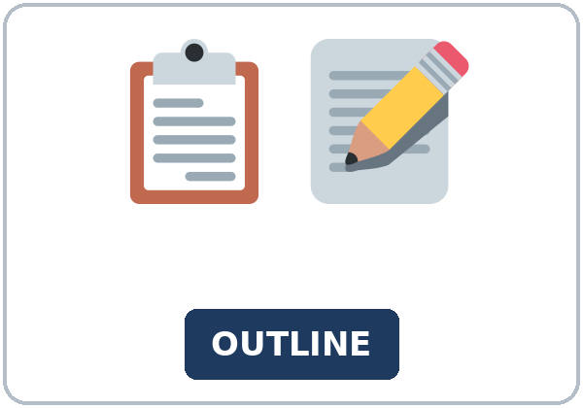
A Short Talk
Today you will:
• I can open a talk with one clear sentence
• I can give two examples
• I can close with a next step
Lesson 13 · Level 5
Notes:
Welcome learners as they arrive.
Read the three lines under Today you will.
Lesson plan: Topic; At a glance: Objectives.
Picture: Twemoji graphics by Twitter, Inc. and other contributors (https://github.com/jdecked/twemoji), CC BY 4.0 (https://creativecommons.org/licenses/by/4.0/); resized and combined, with signs and labels (images/CREDITS.md).

Slide 2
Today's
Goals
01
I can open a talk with one clear sentence
02
I can give two examples
03
I can close with a next step
By the end of class, you can do these things.
04
I can speak for about two minutes from notes
Notes:
Read each goal slowly. Learners repeat.
Lesson plan: At a glance: Objectives.

Slide 3
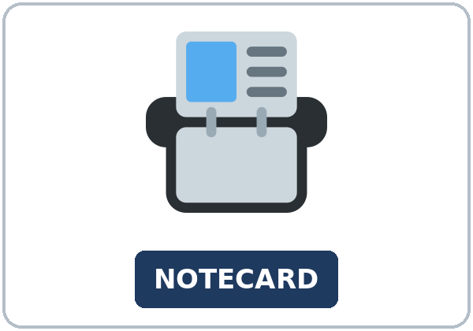
OPENING TALK · 6:00
Opening Talk
Work with a partner. A asks a card
question. B answers in about four sentences. A asks one follow-up. Then switch.
sentences. A asks one follow-up. Then
switch.
Notes:
Step 1 · 6:00–6:06 · Opening Talk.
Work with a partner.
Lesson plan: Step 1; Opening Talk page.
Picture: Twemoji graphics by Twitter, Inc. and other contributors (https://github.com/jdecked/twemoji), CC BY 4.0 (https://creativecommons.org/licenses/by/4.0/); resized and combined, with signs and labels (images/CREDITS.md).

Slide 4
Opening Talk
Cards
01
Work with a partner. A asks a card question. B answers in about four
02
sentences. A asks one follow-up. Then switch.
Work with a partner. A asks a card question. B
answers in about four sentences. A asks one follow-up. Then switch.
Notes:
Each click shows the next card.
A asks. B answers. Then switch.
Lesson plan: Step 1; Opening Talk page.

Slide 5
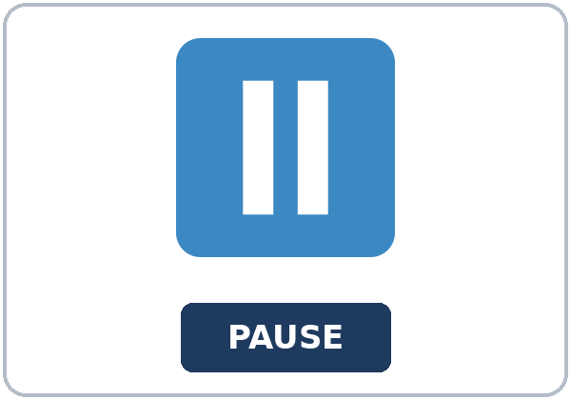

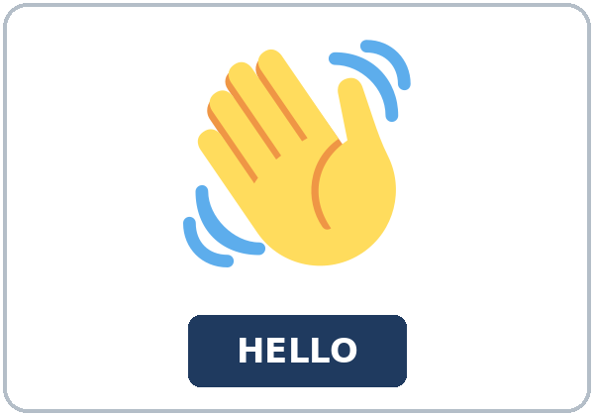
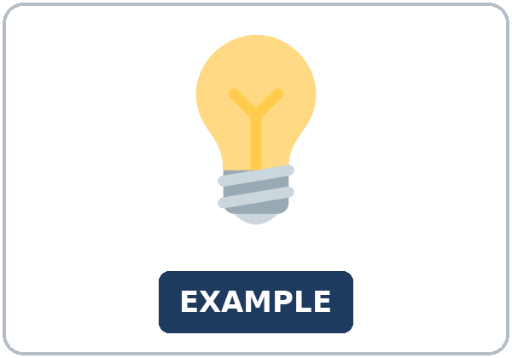
Look. Listen.
Repeat.
New Words
★ outline
★ notecard
★ pause
★ eye contact
★ introduction
★ example
Notes:
Step 2 · 6:06–6:12 · New Words.
Point to each picture. Learners repeat. ★ = most important.
Lesson plan: Step 2; New Words page.
Pictures: Twemoji graphics by Twitter, Inc. and other contributors (https://github.com/jdecked/twemoji), CC BY 4.0 (https://creativecommons.org/licenses/by/4.0/); resized and combined, with signs and labels (images/CREDITS.md).

Slide 6

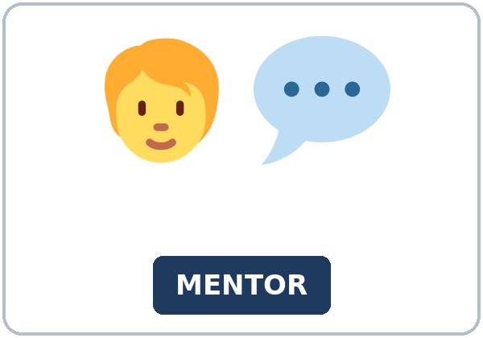
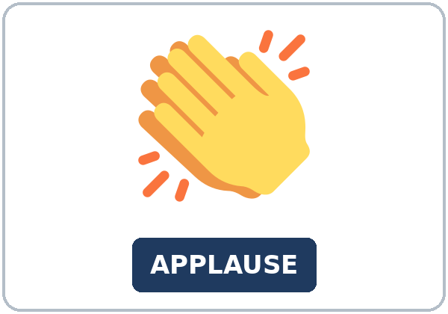
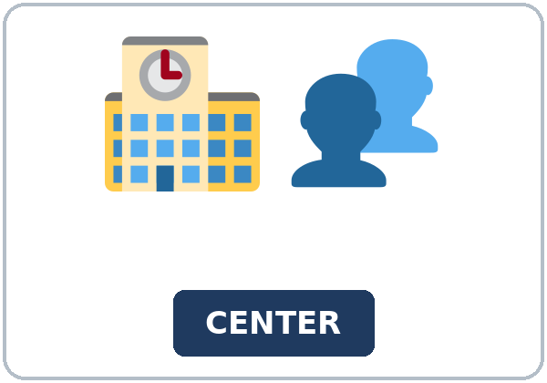

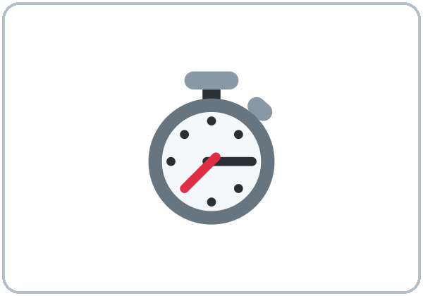
Partner game:
Say it in a sentence
More New Words
★ conclusion
★ mentor
★ applause
★ community center
achievement
stopwatch
Notes:
A points to a picture. B names it and uses it in one sentence. Then switch.
Lesson plan: Step 2; New Words page; Partner game.
Pictures: Twemoji graphics by Twitter, Inc. and other contributors (https://github.com/jdecked/twemoji), CC BY 4.0 (https://creativecommons.org/licenses/by/4.0/); resized and combined, with signs and labels (images/CREDITS.md).

Slide 7
Check the Meaning
Look at the picture. Answer the question.
1
2
3
Does the introduction name the point?
Does each example need a detail?
Is a conclusion a new story?
Yes.
Yes.
No.
Notes:
The answers are hidden. Ask, then click.
1. Yes.
2. Yes.
3. No.
Lesson plan: Step 2: Check the Meaning.
Pictures: Twemoji graphics by Twitter, Inc. and other contributors (https://github.com/jdecked/twemoji), CC BY 4.0 (https://creativecommons.org/licenses/by/4.0/); resized and combined, with signs and labels (images/CREDITS.md).

Slide 8
Before You
Listen for:
Listen
Listen. What is her main point?
Imani, a former learner, gives a short talk at a practice night: what she has been learning, one hard moment, one person who helped, and her next step.
- Play 1 → Task A.
01
Audio: about 1:47. It plays once.
Narrator
02
Imani
Play 1: Task A
03
Mr. Gordon
Notes:
Step 3 · 6:12–6:32 · Listening. Play 1 is Task A. Play 2 is Tasks B and C. A third play is fine.
Imani, a former learner, gives a short talk at a practice night: what she has been learning, one hard moment, one person who helped, and her next step.
The script says going to and want to. Learners only need to recognize gonna and wanna.
Lesson plan: Step 3; Listening page.
Picture: Twemoji graphics by Twitter, Inc. and other contributors (https://github.com/jdecked/twemoji), CC BY 4.0 (https://creativecommons.org/licenses/by/4.0/); resized and combined, with signs and labels (images/CREDITS.md).

Slide 9
Listen. What is her main point?
Listening A
1.
a. the loudest applause
b. speaking up at work
c. a forgotten notecard
Notes:
Click to circle b.
Lesson plan: Step 3; Listening Task A; Answer key.

Slide 10
B. Listen again. Circle the answers.
Listening B
1. "My point is simple" is the
introduction
example
conclusion
2. The hard moment is an
introduction
example
conclusion
3. The mentor's question is an
introduction
example
conclusion
4. The next step is the
introduction
example
conclusion
5. She is going to practice with
a stopwatch
a microphone
a whiteboard
6. Applause is for
finishing
the longest story
a perfect memory
Notes:
Click to circle each answer: 1 introduction • 2 example • 3 example • 4 conclusion • 5 a stopwatch • 6 finishing
Lesson plan: Step 3; Listening Task B; Answer key.

Slide 11
Listen again.
Listen again. Write the four
Listening C
1
First: ______
Introduction
2
Second: ______
Example 1
Write the missing words.
Then check together.
3
Third: ______
Example 2
4
Fourth: ______
Conclusion
Notes:
Click to show each answer: 1 Introduction • 2 Example 1 • 3 Example 2 • 4 Conclusion
Lesson plan: Step 3; Listening Task C; Answer key.

Slide 12
Hear it: gonna and wanna are short forms
Hear It,
Say It
Say it: use the full forms
I've been learning to speak up at work.
I want to give two examples.
gonna and wanna are short forms. This listening uses the full forms.
You can say going to and want to.
Say each line two times.
I'm going to practice with a stopwatch.
I am not going to memorize the talk.
Notes:
gonna and wanna are short forms. This listening uses the full forms. Say each line two times.
Lesson plan: Step 3: Hear it, say it.

Slide 13
Grammar Box 1
introduction
THE INTRODUCTION
IT NAMES THE POINT
I've been learning to speak up at work.
That is my point.
A mentor helped me.
That is part of the point.
I want to give two examples.
Then the examples start.
Notes:
Grammar Box 1: introduction. Each click shows the answer side.
Lesson plan: Step 4; Grammar Box 1.
Picture: Twemoji graphics by Twitter, Inc. and other contributors (https://github.com/jdecked/twemoji), CC BY 4.0 (https://creativecommons.org/licenses/by/4.0/); resized and combined, with signs and labels (images/CREDITS.md).

Slide 14
Grammar Box 2
two examples
THE EXAMPLE
A DETAIL
Example 1
By the time I finished my first month, I had learned to pause.
The hard moment
I wish I had looked up sooner, so next time I will make eye contact.
Example 2
My mentor asked one question.
Notes:
Grammar Box 2: two examples. Each click shows the answer side.
Lesson plan: Step 4; Grammar Box 2.
Picture: Twemoji graphics by Twitter, Inc. and other contributors (https://github.com/jdecked/twemoji), CC BY 4.0 (https://creativecommons.org/licenses/by/4.0/); resized and combined, with signs and labels (images/CREDITS.md).

Slide 15
Grammar Box 3
conclusion
THE CONCLUSION
NOT A NEW STORY
Repeat the point in new words.
I can speak from notes.
Add a next step.
I'm going to practice one talk a week.
Stop.
Applause is for finishing.
Notes:
Grammar Box 3: conclusion. Each click shows the answer side.
Lesson plan: Step 4; Grammar Box 3.
Picture: Twemoji graphics by Twitter, Inc. and other contributors (https://github.com/jdecked/twemoji), CC BY 4.0 (https://creativecommons.org/licenses/by/4.0/); resized and combined, with signs and labels (images/CREDITS.md).

Slide 16
Grammar Box 4
review sentences, not a
REVIEW
ONE SENTENCE
I've been learning…
I've been learning to speak up at work.
By the time I finished…, I had…
By the time I finished my first month, I had learned to pause.
I wish I had…, so next time I will…
I wish I had looked up sooner, so next time I will make eye contact.
I'm going to…
I'm going to practice with a stopwatch.
Notes:
Grammar Box 4: review sentences, not a new tense. Each click shows the answer side.
Lesson plan: Step 4; Grammar Box 4.
Picture: Twemoji graphics by Twitter, Inc. and other contributors (https://github.com/jdecked/twemoji), CC BY 4.0 (https://creativecommons.org/licenses/by/4.0/); resized and combined, with signs and labels (images/CREDITS.md).

Slide 17
Practice A
Write.
Practice A
1
My point is simple. I've been learning to speak up. ______
Introduction
2
By the time I finished my first month, I had learned to pause. ______
Example
3
My mentor asked one question. ______
Example
Write the missing word.
Pairs: check your answers.
4
I can speak from notes, and my next step is one talk a week. ______
Conclusion
5
I'm going to practice with a stopwatch. ______
Conclusion
6
I wish I had looked up sooner, so next time I will make eye contact. ______
Example
Notes:
Click to show each answer: 1 Introduction • 2 Example • 3 Example • 4 Conclusion • 5 Conclusion • 6 Example
Lesson plan: Step 4; Grammar Practice A; Answer key.

Slide 18
Circle the correct words.
Practice B
1. The introduction ______ .
names the point
tells a new story
2. Each example ______ .
has a detail
has no detail
3. The conclusion ______ .
is a new story
repeats the point
4. Next step: ______ practice.
I'm going to
I gonna
5. By the time I finished, I ______ to pause.
had learned
have learn
6. I've been ______ to speak up.
learning
learn
Notes:
Click to circle each answer: 1 names the point • 2 has a detail • 3 repeats the point • 4 I'm going to • 5 had learned • 6 learning
Lesson plan: Step 4; Grammar Practice B; Answer key.

Slide 19
Common Mistakes
Don't say
Say
Start with the example and never say the point.
Start with the introduction. It names the point.
A conclusion that is a new story.
The conclusion repeats the point and adds a next step.
I gonna practice.
I'm going to practice.
Notes:
Read Don't say, then Say. Learners try first. Then click.
Lesson plan: Grammar: Common mistakes.
Picture: Twemoji graphics by Twitter, Inc. and other contributors (https://github.com/jdecked/twemoji), CC BY 4.0 (https://creativecommons.org/licenses/by/4.0/); resized and combined, with signs and labels (images/CREDITS.md).

Slide 20
Pair Check
A says.
01
Then switch.
A says "introduction," "example," or "conclusion." B says what that part must do.
B answers.
02
Then switch.
Notes:
A says "introduction," "example," or "conclusion." B says what that part must do. Then switch. ---
Break · 6:45–7:00.
Lesson plan: Step 4: Pair check.
Picture: Twemoji graphics by Twitter, Inc. and other contributors (https://github.com/jdecked/twemoji), CC BY 4.0 (https://creativecommons.org/licenses/by/4.0/); resized and combined, with signs and labels (images/CREDITS.md).

Slide 21
Talk Time
Talk Time
Work together.
Partners.
7:00–7:18
1
Partners.
2
Partners.
3
Partners.
Notes:
Round 1.
Lesson plan: Step 5; Talk Time.
Picture: Twemoji graphics by Twitter, Inc. and other contributors (https://github.com/jdecked/twemoji), CC BY 4.0 (https://creativecommons.org/licenses/by/4.0/); resized and combined, with signs and labels (images/CREDITS.md).

Slide 22
Talk Time
Talk Time
Pairs.
Groups of 3.
7:00–7:18
1
Groups of 3.
2
Groups of 3.
3
Groups of 3.
Notes:
Round 2.
Lesson plan: Step 5; Talk Time.
Picture: Twemoji graphics by Twitter, Inc. and other contributors (https://github.com/jdecked/twemoji), CC BY 4.0 (https://creativecommons.org/licenses/by/4.0/); resized and combined, with signs and labels (images/CREDITS.md).

Slide 23
Read.
Answer.
Read &
Write
1
What is her main point?
She has been learning to speak up at work
2
What happened in example 1?
She did not look up
Read the page.
Answer the questions.
3
Who helped her?
Her mentor
4
What is her next step?
One short talk a week
5
What does the conclusion do?
It repeats the point and adds a next step
Notes:
Step 6 · 7:18–7:25 · Read & Write.
Click to show each answer: 1 She has been learning to speak up at work • 2 She did not look up • 3 Her mentor • 4 One short talk a week • 5 It repeats the point and adds a next step
Lesson plan: Step 6; Read & Write page; Answer key.

Slide 24
Before You Go 7:25–7:30
01
Exit ticket
02
Homework
Write your introduction and your conclusion only.
Name: Date:
You will say the examples in the rehearsal.
Give this page to your teacher.
About 20–25 minutes.
1. Label the part: Introduction, Example, or Conclusion.
2. Finish your outline, then the talk in 12–16 sentences.
3. Say your introduction aloud to a friend. One time is enough.
4. Review: write I'm going to and your next step.
Bring it next week!
Notes:
Step 7 · 7:25–7:30 · Exit ticket and homework. Never skip the exit ticket.
Write your introduction and your conclusion only.
Lesson plan: Step 7; Exit Ticket page; Homework page.
Picture: Twemoji graphics by Twitter, Inc. and other contributors (https://github.com/jdecked/twemoji), CC BY 4.0 (https://creativecommons.org/licenses/by/4.0/); resized and combined, with signs and labels (images/CREDITS.md).

Slide 25
Goodbye! See You Next Week!
Now you can:
• I can open a talk with one clear sentence
• I can give two examples
• I can close with a next step
Lesson 13 · Level 5
Notes:
Read the three Now you can lines.
Homework is about 20–25 minutes. Bring it next week.
Lesson plan: At a glance: Objectives; Step 7.
Picture: Twemoji graphics by Twitter, Inc. and other contributors (https://github.com/jdecked/twemoji), CC BY 4.0 (https://creativecommons.org/licenses/by/4.0/); resized and combined, with signs and labels (images/CREDITS.md).

Slide 26
Credits
Pictures
Vocabulary pictures use Twemoji graphics by Twitter, Inc. and other contributors (https://github.com/jdecked/twemoji), licensed under CC BY 4.0 (https://creativecommons.org/licenses/by/4.0/). The graphics were resized and combined, and signs and labels were added.
Names and story
Imani and Mr. Gordon are invented names. The listening story is invented.
Audio and font
Audio: synthetic voices made with Chatterbox TTS (MIT License), cloned from short synthetic reference clips made with Kokoro-82M (Apache License 2.0). No recordings of real people were used. Each file carries an inaudible Perth watermark marking it as AI-generated. Font: Lexend Deca (OFL 1.1).
© 2026 the authors. The authors license this deck under CC BY-NC-SA 4.0.
Notes:
Credits. You don't need to read this slide in class.
Pictures: Twemoji graphics by Twitter, Inc. and other contributors, CC BY 4.0; the file-by-file list is in images/CREDITS.md.
Audio: synthetic voices, computer-generated (Chatterbox TTS cloned from Kokoro-82M reference clips). No recordings of real people. The names and the story are invented.
Course materials: © 2026 the authors, licensed under CC BY-NC-SA 4.0 (https://creativecommons.org/licenses/by-nc-sa/4.0/).
Lesson plan: Picture Credits. Picture list: images/CREDITS.md.

