Slide 1
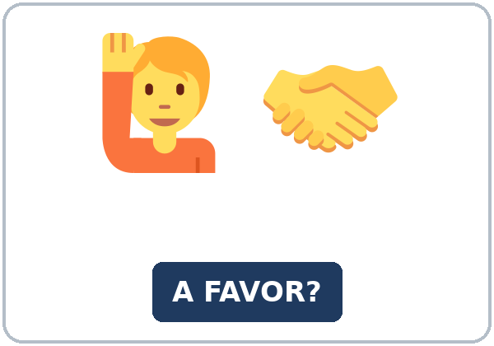
Would You Mind…?
Today you will:
• Ask for a favor
• Say yes or no politely
• Ask permission
Lesson 5 · Level 4
Notes:
Welcome learners as they arrive.
Point to the title and read it: "Would you mind…?" Say: "Tonight we ask a neighbor or a coworker for a favor: the mail, the plants, a spare key, a shift. All favors, keys, and addresses are invented."
Read the three lines under "Today you will". Give one quick example of each: "Would you mind getting my mail?" • "No, not at all." / "Sorry, I can't, because…" • "Do you mind if I open the window?"
Invented details: all favor cards, keys, names, and addresses are invented. Learners never share real addresses or where they keep a key.
Lesson plan: Topic; At a glance: Objectives; Teacher notes.
Picture: Twemoji graphics by Twitter, Inc. and other contributors (https://github.com/jdecked/twemoji), CC BY 4.0 (https://creativecommons.org/licenses/by/4.0/); resized and combined, with signs and labels (images/CREDITS.md).

Slide 2
Today's
Goals
01
I can ask for a favor with Would you mind…?
02
I can answer No, not at all (= "Yes, I'll help") or say no politely, with a reason and another idea.
03
I can ask permission with Do you mind if I…?
By the end of class, you can do these five things.
Every goal is a good goal.
04
I can ask a coworker to switch a shift and confirm it in a short text.
05
I can write a note to a neighbor (5–8 sentences) asking for a favor while I'm away.
Notes:
Read each goal slowly. Learners repeat.
Goal 1: Would you mind getting my mail? Goal 2: No, not at all. I'll do it. / Sorry, I can't. I'll be away. Why don't you ask Lina? Goal 3: Do you mind if I open the window?
Goal 4: the Shift Switch Text in Talk Time. Goal 5: the note in Read & Write.
Lesson plan: At a glance: Objectives.

Slide 3

OPENING TALK · 6:00
Opening Talk
A asks a card question.
I sit all day at work. Any ideas?
B answers in 3 sentences.
A asks one follow-up.
Why?
Then switch.
Notes:
Step 1 · 6:00–6:08 · Opening Talk + Homework Check · 8 min. Pairs (7 pairs + 1 trio with 15 learners; 3–4 pairs with 7–8).
Before class, write on the board: suggestions: Why don't you…? / You could… / It's a good idea to…
Model with one learner: you say, "I sit all day at work. Any ideas?" The learner gives a suggestion. Then you ask, "Why is that a good idea?" Help them say 3 sentences. (Click to show the follow-up.)
Opening Talk (5 min): learners open the Opening Talk page. A asks a card question; B answers in 3 sentences (the answer, a reason, a detail); A asks one follow-up. Switch after each card. The cards are on the next slide.
If behind: one card only.
Lesson plan: Step 1; Opening Talk page.
Picture: Twemoji graphics by Twitter, Inc. and other contributors (https://github.com/jdecked/twemoji), CC BY 4.0 (https://creativecommons.org/licenses/by/4.0/); resized and combined, with signs and labels (images/CREDITS.md).

Slide 4
Opening Talk
Cards
01
I sit all day at work. Any ideas?
02
I'm always tired in the afternoon. What can I do?
B answers in 3 sentences: the answer, a reason, and a detail.
Follow-ups:
Why? Have you ever tried it? How long have you…?
03
What's a good idea for a healthy lunch?
04
How often is it a good idea to get a checkup?
05
Homework check: Lesson 4, items 1 and 3.
Notes:
Step 1, continued. The four cards from the Opening Talk page. Each click shows the next card.
A asks a card question. B answers in 3 sentences. A asks one follow-up question (follow-ups on the right). Then switch. Pairs write the partner's name and one good idea from Homework item 3.
Homework Check (3 min, last click): pairs compare Homework item 1 (for / since and suggestions) and read their 3 good ideas (item 3) to each other. Then they fill in the box on the Opening Talk page. Walk around. Write 2 common errors on the board (often You could to try (→ You could try) and I have a cough since Sunday (→ I've had a cough since Sunday)) and correct them together. Also put up 2 corrections from last week's exit tickets.
Lesson plan: Step 1; Opening Talk page: cards, follow-ups; Homework check.

Slide 5
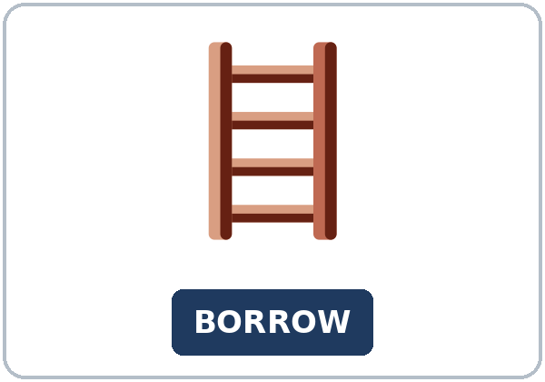
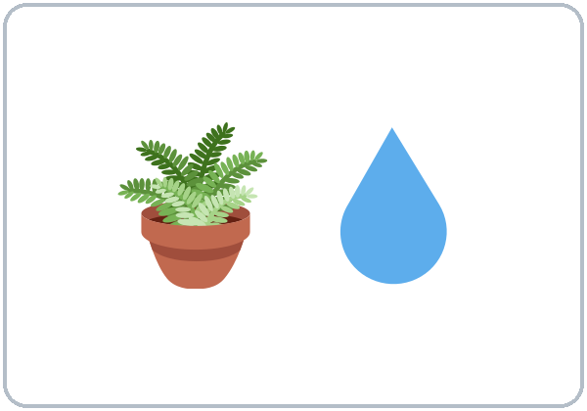
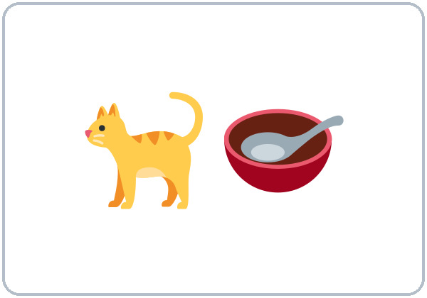

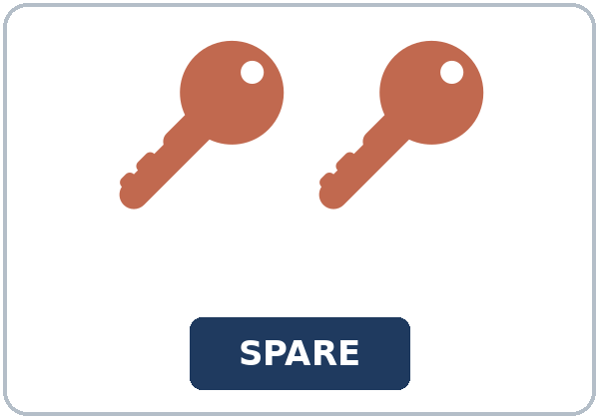
Look. Listen.
Repeat.
New Words
★ favor
★ borrow
★ water the plants
★ feed the cat
★ get the mail
★ spare key
Notes:
Step 2 · 6:08–6:15 · New Words · 7 min (this slide and the next). Whole class, then pairs.
Point to each picture and say the word. Learners repeat once. ★ = the most important words. Each click shows the next word.
Show the hard words: favor (help you ask for); borrow (take and give back) vs. lend (give and get back); water the plants, feed the cat, get the mail (mime each); spare key (an extra key: show two keys).
If behind: teach the ★ words only.
Lesson plan: Step 2; Key vocabulary; New Words page.
Pictures: Twemoji graphics by Twitter, Inc. and other contributors (https://github.com/jdecked/twemoji), CC BY 4.0 (https://creativecommons.org/licenses/by/4.0/); resized and combined, with signs and labels (images/CREDITS.md).

Slide 6

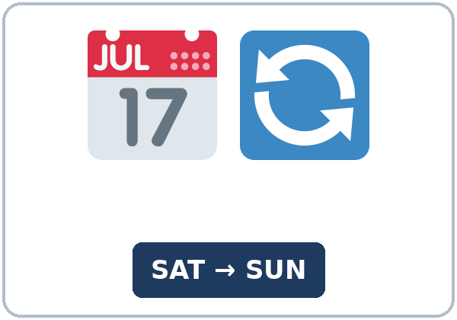
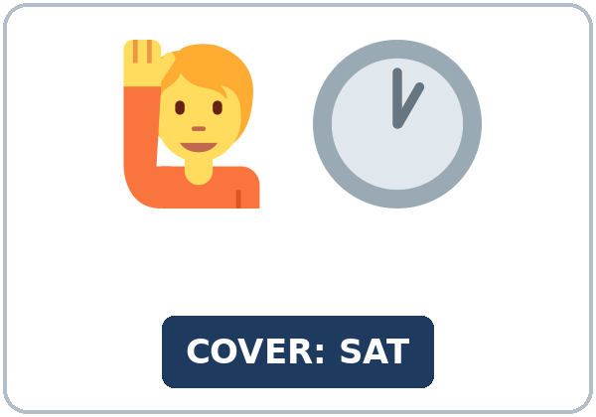
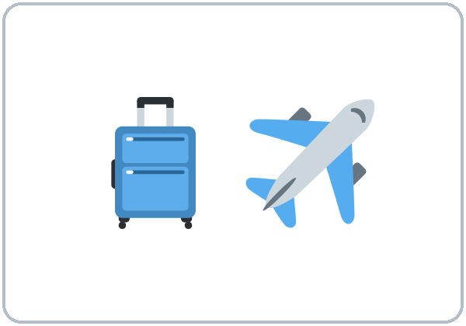
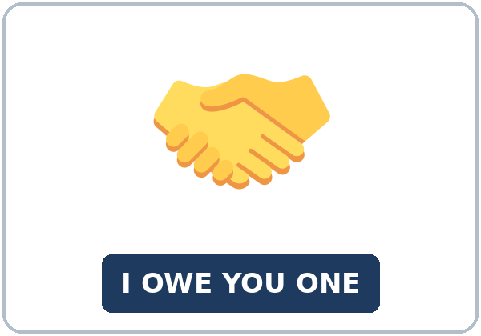
Partner game:
Favor or no favor?
More New Words
★ package
★ switch shifts
★ cover a shift
★ be away
owe (someone)
thank-you note
Notes:
Step 2, continued. Point to each picture and say the word. Learners repeat once.
Show the hard words: package; switch shifts (you take my Friday, I take your Sunday) vs. cover a shift (you work my shift); be away (not at home); owe (I owe you one = I'll help you next time); thank-you note.
Partner game (2 min): A points to a picture and asks, "Would you mind getting the mail?" B gives a thumbs-up and says, "No, not at all," or says, "Sorry, I can't, because…" Switch. 15 learners: finish with a quick team round (3 teams; you say a clue, the first team with the word gets a point). 7–8: 2 teams. 5 or fewer: one team against the clock.
My Words: "Write any word you want in your language on the My Words page. It's your personal list. It's optional." Learners do it at home.
If behind: teach the ★ words only.
Lesson plan: Step 2; New Words page; Partner game; My Words page.
Pictures: Twemoji graphics by Twitter, Inc. and other contributors (https://github.com/jdecked/twemoji), CC BY 4.0 (https://creativecommons.org/licenses/by/4.0/); resized and combined, with signs and labels (images/CREDITS.md).

Slide 7
Check the Meaning
Look at the picture. Answer the question.
1
2
3
If I borrow your pen, do I give it back?
If you cover my shift, who works?
Is a spare key the first key or an extra key?
yes
you do
an extra key
Notes:
Step 2 · Check meaning · 1 min. Whole class.
The answers are hidden. Ask each question and wait for the class to answer. Then click to show the answer. Each click shows one answer, in order: 1, 2, 3.
1. "If I borrow your pen, do I give it back?" (yes) • 2. "If you cover my shift, who works?" (you do) • 3. "Is a spare key the first key or an extra key?" (an extra key)
Lesson plan: Step 2: Check meaning.
Pictures: Twemoji graphics by Twitter, Inc. and other contributors (https://github.com/jdecked/twemoji), CC BY 4.0 (https://creativecommons.org/licenses/by/4.0/); resized and combined, with signs and labels (images/CREDITS.md).

Slide 8
Before You
Listen for:
Listen
What favors do they ask for?
Patricia is going away for a week. First, she talks to her neighbor, Mr. Wilson. Then, at work, her coworker Omar asks her for a favor.
Play 2: Tasks B and C.
01
Audio (about 1:47): coming soon.
Patricia
02
Mr. Wilson
Play 1: Task A
03
Omar
Notes:
Step 3 · 6:15–6:30 · Listening + "Hear it, say it" · 15 min (slides 8 to 12). Individuals, then pairs check.
Before you listen (2 min). Say: "Patricia is going away for a week. First, she talks to her neighbor, Mr. Wilson. Then, at work, her coworker Omar asks her for a favor. Listen: what favors do they ask for?"
There are three people: Patricia, Mr. Wilson (her neighbor), and Omar (her coworker). A narrator starts and ends the listening. Each click highlights the next person.
The audio (about 1:47) is coming soon. When it is ready, it plays the conversation once; press play again for play 2. Until then, read the listening script (at the end of these notes) with a volunteer.
No speaker? Read the script with a volunteer at a natural, friendly speed, two times. The script says going to and want to. People often say gonna and wanna; learners only need to recognize those words.
Audio: the listening audio for this lesson (about 1:47) is coming soon. It will use computer-generated voices (Chatterbox TTS cloned from synthetic Kokoro-82M reference clips); no recordings of real people. Until it is ready, read the listening script (in the notes of the Before You Listen slide) with a volunteer. The names and the story are invented.
Lesson plan: Step 3; Listening script; Listening page.
Picture: Twemoji graphics by Twitter, Inc. and other contributors (https://github.com/jdecked/twemoji), CC BY 4.0 (https://creativecommons.org/licenses/by/4.0/); resized and combined, with signs and labels (images/CREDITS.md).
Listening script (the audio is coming soon; until then, read it aloud with a volunteer at a normal, friendly speed):
Narrator: Lesson five. Patricia is going away for a week. First, she talks to her neighbor, Mr. Wilson.
Patricia: Hi, Mr. Wilson. Could I ask you a favor?
Mr. Wilson: Of course, Patricia. What is it?
Patricia: I'm going to be away next week. I'm visiting my sister. Would you mind getting my mail?
Mr. Wilson: No, not at all. I'm home all week.
Patricia: Thank you! And would you mind watering my plants? Just two times, on Tuesday and Friday.
Mr. Wilson: No problem. Where will the key be?
Patricia: I'm going to give you my spare key tonight. Oh, and would you mind feeding my cat, too?
Mr. Wilson: Sure, I'll do it. I love cats. Do you mind if I put your packages inside, too?
Patricia: No, go ahead. That's very kind.
Mr. Wilson: Have a good trip. Don't worry about anything.
Narrator: The next day, at work, Patricia talks to her coworker, Omar.
Omar: Hey, Patricia. Would you mind covering my Saturday shift? My son has a soccer game.
Patricia: Oh, I'm sorry, I can't. I'll be away on Saturday. I want to help, but I can't.
Omar: Oh, right. You told me.
Patricia: Why don't you ask Lina? She wants more hours this month.
Omar: Good idea. Do you mind if I tell her you suggested it?
Patricia: No, not at all. But ask the supervisor first, OK?
Omar: Sure. Thanks, Patricia. I owe you one.
Patricia: You're welcome. Good luck with the game!
Narrator: That's the end of the listening.

Slide 9
Listen. What favors do they ask for?
Circle.
Listening A
a. get the mail, water the plants, feed the cat, and cover a shift
b. borrow a ladder and switch shifts
c. pick up a package and lend a car
Notes:
Play 1 → Task A (the main idea). Pairs compare. Check together.
Click to circle the answer: a (get the mail, water the plants, feed the cat, and cover a shift).
Then read Tasks B and C together (1 min) so learners know what to listen for.
Lesson plan: Step 3; Listening Task A; Answer key.

Slide 10
Listen again. Yes or no, and why?
Circle the answer.
Listening B
1. The mail: Mr. Wilson says
yes
no
2. The plants: water them on
Tuesday and Friday
Monday and Thursday
3. The key: Patricia will give him
her spare key
her car key
4. The packages: Mr. Wilson can put them
inside
at the office
5. The Saturday shift: Patricia says
yes
no
6. Why? She
will be away
has a soccer game
Notes:
Play 2 → Tasks B and C. Pairs compare. Then show the answers.
Click to circle each answer (one click per item, 1 to 6): 1 yes • 2 Tuesday and Friday • 3 her spare key • 4 inside • 5 no • 6 will be away.
Lesson plan: Step 3; Listening Task B; Answer key.

Slide 11
Listen again.
Write the missing word: an -ing word or if.
Listening C
1
Would you mind ____ my mail?
getting
2
And would you mind ____ my plants?
watering
3
Oh, and would you mind ____ my cat, too?
feeding
Write an -ing word or if.
Pairs: compare your answers.
Then check together.
4
Do you mind ____ I put your packages inside, too?
if
5
Would you mind ____ my Saturday shift?
covering
6
Do you mind ____ I tell her you suggested it?
if
Notes:
Task C (play 2). Click to show each answer (one click per item, 1 to 6): 1 getting, 2 watering, 3 feeding, 4 if, 5 covering, 6 if.
If behind: do Task C together on the board, reading the lines yourself.
Lesson plan: Step 3; Listening Task C; Answer key.

Slide 12
Hear it: gonna = going to, wanna = want to
Hear It,
Say It
Say it: smoothly, with a friendly rise
I'm going to be away next week.
I want to help, but I can't.
gonna and wanna are short forms. This listening uses the full forms.
Say it smoothly, with a friendly rise.
Say each line two times.
Would you mind getting my mail?
Do you mind if I open the window? No, not at all!
Notes:
"Hear it, say it" (3 min). Point to the script lines. gonna = going to: "I'm going to be away next week." wanna = want to: "I want to help, but I can't." You can say going to and want to.
Then practice Would you mind…? and Do you mind if I…? said smoothly, with a friendly rise. Answer with a thumbs-up: No, not at all! The class repeats the two lines twice.
Reductions: the listening says going to and want to. People often say gonna and wanna. Learners only need to recognize the short forms.
Lesson plan: Step 3: "Hear it, say it"; Listening page: Hear it, say it; Teacher notes.

Slide 13
Grammar Box 1
Would you mind + -ing?
QUESTION
ANSWER
Would you mind getting my mail?
No, not at all. I'll do it.
Sorry, I can't. I'll be away too.
Would you mind covering my shift?
No, not at all. I'm free on Saturday.
Would you mind lending me a ladder?
No problem. You can borrow mine.
Notes:
Step 4 · 6:30–6:45 · Grammar Q&A · 15 min (slides 13 to 20). Whole class, then pairs. Show the Grammar page. The left side is the question. The right side is the answer.
Show it (2 min): give a learner your key. Say, "I'm going to be away. Would you mind getting my mail?" Show a thumbs-up and help the learner say, "No, not at all." Write: Would you mind + -ing? → No = "No problem. I'll do it." Then ask, "Do you mind if I open the window?" Help them say, "No, go ahead."
Box 1: read across: Would you mind getting my mail? → No, not at all. I'll do it. / Sorry, I can't. Each click shows the answer side of one row.
No = yes: practice the answer first, with a thumbs-up: No, not at all! Learners often say Yes and mean "I'll help." Smile and model it again.
Lesson plan: Step 4; Grammar Box 1; Teacher notes.
Picture: Twemoji graphics by Twitter, Inc. and other contributors (https://github.com/jdecked/twemoji), CC BY 4.0 (https://creativecommons.org/licenses/by/4.0/); resized and combined, with signs and labels (images/CREDITS.md).

Slide 14
Grammar Box 2
permission: Do you mind if I…?
QUESTION
ANSWER
Do you mind if I open the window?
No, go ahead. It's hot in here.
Do you mind if I leave early today?
Sorry, we need you until 5:00.
Do you mind if I switch my Friday shift?
No, not at all. Ask the supervisor first.
Notes:
Box 2: permission: Do you mind if I…? → No, go ahead. Each click shows the answer side of one row.
Rule of thumb (read it aloud): After Would you mind, use -ing (getting, covering). After Do you mind if I, use the base verb (open, leave). The answer No means "No problem. I'll help." / "Yes, you can."
Lesson plan: Step 4; Grammar Box 2; Rule of thumb.
Picture: Twemoji graphics by Twitter, Inc. and other contributors (https://github.com/jdecked/twemoji), CC BY 4.0 (https://creativecommons.org/licenses/by/4.0/); resized and combined, with signs and labels (images/CREDITS.md).

Slide 15
Grammar Box 3
saying yes, saying no
YOU CAN HELP (say no!)
YOU CAN'T HELP (be polite)
No, not at all.
No problem.
Sure, I'll do it.
Sorry, I can't, because…
+ another idea: Why don't you ask Lina?
Notes:
Box 3: saying yes and saying no politely. Click to show the right side.
Saying no: model sorry + a reason + another idea. A polite no is a good answer.
Lesson plan: Step 4; Grammar Box 3; Teacher notes.
Picture: Twemoji graphics by Twitter, Inc. and other contributors (https://github.com/jdecked/twemoji), CC BY 4.0 (https://creativecommons.org/licenses/by/4.0/); resized and combined, with signs and labels (images/CREDITS.md).

Slide 16
Grammar Box 4
how polite?
SAY
WHEN? · EXAMPLE
Can you…?
a small favor, a friend
Can you pass the salt?
Could you…?
more polite
Could you help me with this box?
Would you mind …ing?
the most polite; a bigger favor
Would you mind feeding my cat for a week?
Notes:
Box 4: how polite? Each click shows one row.
Questions and answers (2 min): Q: Someone asks Would you mind helping me? I want to help. Do I say yes? A: No! Say No, not at all. Mind asks "Is it a problem?" No = no problem. • Q: Would you mind to get or Would you mind getting? A: After mind, use -ing: Would you mind getting my mail? • Q: How do I say no politely? A: Say sorry, give a reason, and offer an idea: Sorry, I can't. I'll be away. Why don't you ask Lina?
Check questions: "Would you mind helping me? You want to help. Do you say yes or no?" (No, not at all.) • "Would you mind to get or getting?" (getting) • "Do you mind if I leaving or if I leave?" (if I leave).
Lesson plan: Step 4; Grammar Box 4; Questions and answers.
Picture: Twemoji graphics by Twitter, Inc. and other contributors (https://github.com/jdecked/twemoji), CC BY 4.0 (https://creativecommons.org/licenses/by/4.0/); resized and combined, with signs and labels (images/CREDITS.md).

Slide 17
Practice A
Write the correct form of the verb.
Practice A
1
Would you mind ____ my plants? (water)
watering
2
Do you mind if I ____ the window? (open)
open
3
Would you mind ____ the cat on Sunday? (feed)
feeding
Write the correct form of the verb.
Pairs: check your answers.
4
Would you mind ____ shifts with me? (switch)
switching
5
Do you mind if I ____ your ladder? (borrow)
borrow
6
Would you mind ____ my packages? (get)
getting
Notes:
Practice A and B (3 min): learners write, then pairs check. Go over the answers.
Click to show each answer (one click per item, 1 to 6): 1 watering, 2 open, 3 feeding, 4 switching, 5 borrow, 6 getting.
Lesson plan: Step 4; Grammar Practice A; Answer key.

Slide 18
Circle the correct words.
Practice B
1. Would you mind ____ my shift?
covering
to cover
2. A: Would you mind helping me? B: ____ I'll help.
No, not at all.
Yes, I do.
3. Do you mind if I ____ early?
leave
leaving
4. Could I borrow your pen? I forgot ____.
mine
my
5. Sorry, I can't. I ____ away.
'll be
be
6. I'd like ____ my Friday shift.
to switch
switching
Notes:
Practice B. Learners circle the correct words. Pairs check.
Click to circle each answer (one click per item, 1 to 6): 1 covering, 2 No, not at all., 3 leave, 4 mine, 5 'll be, 6 to switch.
Lesson plan: Step 4; Grammar Practice B; Answer key.

Slide 19
Common Mistakes
Don't say
Say
Would you mind to get my mail?
Would you mind getting my mail?
Yes, I mind. I'll help you.
No, not at all. I'll help you.
Do you mind if I using your phone?
Do you mind if I use your phone?
Can I borrow your?
Can I borrow yours?
I like to switch my shift.
I'd like to switch my shift.
Notes:
Common mistakes. Read the table together: "Don't say… Say…". Read a line from Don't say. Ask: "What's the right way?" Learners try first. Then click to show the right form. Each click shows one line, in order 1 to 5.
mind + -ing: Would you mind getting…? But Do you mind if I + the base verb: Do you mind if I leave…?
Learners can read the contrast tip on their Grammar page on their own; it is optional. You never need to read, translate, or explain it.
Lesson plan: Grammar: Common mistakes; Teacher notes.
Picture: Twemoji graphics by Twitter, Inc. and other contributors (https://github.com/jdecked/twemoji), CC BY 4.0 (https://creativecommons.org/licenses/by/4.0/); resized and combined, with signs and labels (images/CREDITS.md).

Slide 20
Pair Check
A asks a favor.
01
A asks a favor from the pictures. Then switch.
A: Would you mind getting my mail?
B answers.
02
B: No, not at all.
Or: Sorry, I can't, because…
Notes:
Pair check (last 3 min of Step 4). Pairs.
A asks a favor from the pictures with Would you mind…? B answers with a thumbs-up and No, not at all, or Sorry, I can't, because… Switch. 15 learners: swap partners once. 5 or fewer: you join one pair.
If behind: skip the pair check. Talk Time practices it.
Break · 6:45–7:00 · 15 min. Write on the board: Would you mind + -ing? → No, not at all. (= I'll help) / Sorry, I can't, because… • Do you mind if I…? → No, go ahead.
Lesson plan: Step 4: Pair check; Break.
Picture: Twemoji graphics by Twitter, Inc. and other contributors (https://github.com/jdecked/twemoji), CC BY 4.0 (https://creativecommons.org/licenses/by/4.0/); resized and combined, with signs and labels (images/CREDITS.md).

Slide 21
Talk Time
Favor Exchange
Mingle.
Ask three people.
7:00–7:15
1
Take a favor card and a "my week" card.
Would you mind getting my mail?
2
Answer and give a reason.
Sorry, I can't, because…
3
Offer another idea. Write who said yes.
Why don't you ask Ana?
Notes:
Step 5 · 7:00–7:15 · Talk Time: Favor Exchange + Shift Switch Text · 15 min.
Model it first (1 min): hold up a favor card and ask a learner, "Would you mind getting my mail next week?" Help them check their "my week" card and answer, "No, not at all," or "Sorry, I can't, because I'll be away. Why don't you ask Ana?" Say: "Answer, give a reason, and offer an idea."
Round 1 (7 min): Favor Exchange (mingle). Each learner has a favor card and a "my week" card. Ask three people. Each person answers No, not at all or Sorry, I can't, because… and offers another idea. Write who said yes. Each click shows the next step.
15 learners: a whole-room mingle for round 1. 7–8 learners: two lines face each other; move one place each round. 5 or fewer: a circle for round 1: each person asks the person on the left.
Invented details: all favor cards, keys, names, and addresses are invented. Learners never share real addresses or where they keep a key.
Lesson plan: Step 5; Talk Time: Favor Exchange; Teacher notes.
Picture: Twemoji graphics by Twitter, Inc. and other contributors (https://github.com/jdecked/twemoji), CC BY 4.0 (https://creativecommons.org/licenses/by/4.0/); resized and combined, with signs and labels (images/CREDITS.md).

Slide 22
Talk Time
Shift Switch Text
Pairs.
Write a 3-sentence text.
7:00–7:15
1
Write a text to a coworker.
Thanks for switching shifts with me!
2
Confirm the day, the time, and thanks.
I'll work your… • You'll work my…
3
Read it to another pair.
Ask your supervisor first.
Notes:
Round 2 (6 min): Shift Switch Text (pairs). Pairs write a 3-sentence text that confirms a shift switch (the day, the time, thanks). Then they read it to another pair. Remind them: "Ask your supervisor first." Each click shows the next step.
Example: "Hi, Omar. Thanks for switching shifts with me! I'll work your Sunday shift (9:00–5:00), and you'll work my Friday shift (2:00–10:00). I've told Ms. Diaz, and she says it's OK."
15 learners: pairs for round 2. 7–8 learners: pairs. 5 or fewer: pairs (you join if there is an odd number).
Shift switches: every employer has its own rules. Add "Ask your supervisor first." It is printed on the Shift Switch Text page.
Every answer needs a reason; every partner asks a follow-up. Walk around and listen. Note 2 good sentences to praise and 1 common error for next week.
If behind: round 1 only.
Lesson plan: Step 5; Talk Time: Shift Switch Text; Teacher notes.
Picture: Twemoji graphics by Twitter, Inc. and other contributors (https://github.com/jdecked/twemoji), CC BY 4.0 (https://creativecommons.org/licenses/by/4.0/); resized and combined, with signs and labels (images/CREDITS.md).

Slide 23
Read the notice.
Answer the questions.
Read &
Write
1
Where will all packages go?
To the new package room next to the mailroom.
2
When must you pick up a package?
Within 5 days.
Maple Court Apartments:
a notice + a note to a neighbor.
Pairs: answer together.
3
What must a neighbor show?
Your text with the code.
4
When will Tomás be away?
From June 10 to June 17.
5
Where will the spare key be?
In an envelope under Ms. Lee's door (on Sunday).
Notes:
Step 6 · 7:15–7:25 · Read & Write: A building notice + a neighbor's note · 10 min. Pairs read, then individual writing.
Read (4 min): learners read the notice about packages and the note on the Read & Write page and answer the questions. Say: "Read fast first. Then find the answers." Pairs answer questions 1–5 together.
Check (1 min): click to show each answer (one click per question, 1 to 5): 1 To the new package room next to the mailroom. • 2 Within 5 days. • 3 Your text with the code. • 4 From June 10 to June 17. • 5 In an envelope under Ms. Lee's door (on Sunday).
Write (5 min): learners write a note to a neighbor (5–8 sentences) asking for a favor while they're away: the dates, what to do, where the key is, thanks, and an offer to help back. Show the example. Invented details are fine. Learners start in class and finish at home (Homework item 2).
If behind: questions 1–5 only; the writing becomes homework.
Lesson plan: Step 6; Read & Write page; Answer key.

Slide 24
Before You Go 7:25–7:30
01
Exit ticket
02
Homework
Ask a classmate for a favor with Would you mind…?
1. Your question (Would you mind…?).
2. Their answer.
3. The reason, with because.
Give it to me at the door.
About 15–20 minutes.
1. Write the question or answer.
2. Finish your note (Read & Write C).
3. Write 3 favors and polite answers.
4. Review: Lesson 4.
Bring it next week!
Notes:
Step 7 · 7:25–7:30 · Exit Ticket + Homework · 5 min · NEVER SKIP.
Exit ticket (3 min): learners open the Exit Ticket page and answer in 3 sentences with a reason: Ask a classmate for a favor with Would you mind…? Example on the board: Would you mind helping me with my homework? No, not at all. I'm asking because the last question is hard. With 5 or fewer, a learner can say it to you first and then write it.
Collect the pages. After class, sort them into ✓ / almost / not yet. Start next week with 2 corrections on the board (no names).
Homework (2 min): open the Homework page. Do item 1 together (you / mind / feed / my cat? → Would you mind feeding my cat?). Say: "About 15–20 minutes. Finish your Read & Write writing at home."
Homework items: 1 write the question or answer with the words • 2 finish the note from Read & Write C and check it with the list in D • 3 write 3 favors you could ask a neighbor or a coworker, and a polite answer for each one • 4 review (Lesson 4): write one word.
Lesson plan: Step 7; Exit Ticket page; Homework page.
Picture: Twemoji graphics by Twitter, Inc. and other contributors (https://github.com/jdecked/twemoji), CC BY 4.0 (https://creativecommons.org/licenses/by/4.0/); resized and combined, with signs and labels (images/CREDITS.md).

Slide 25
Goodbye! See You Next Week!
Now you can:
• Ask for a favor
• Say yes or no politely
• Ask permission
Lesson 5 · Level 4
Notes:
Read the title: "Goodbye! See you next week!" Learners repeat.
Read the three "Now you can" lines. Ask one learner: "Would you mind getting my mail?" Wait for a thumbs-up and "No, not at all."
Lesson plan: At a glance: Objectives; Step 7.
Picture: Twemoji graphics by Twitter, Inc. and other contributors (https://github.com/jdecked/twemoji), CC BY 4.0 (https://creativecommons.org/licenses/by/4.0/); resized and combined, with signs and labels (images/CREDITS.md).

Slide 26
Credits
Pictures
Vocabulary pictures use Twemoji graphics by Twitter, Inc. and other contributors (https://github.com/jdecked/twemoji), licensed under CC BY 4.0 (https://creativecommons.org/licenses/by/4.0/). The graphics were resized and combined, and signs and labels were added.
Names and story
Patricia, Mr. Wilson, Omar, Lina, Ana, Ms. Diaz, Tomás, Ms. Lee, and Mr. Ruiz are invented names. The listening story is invented.
Audio and font
Audio (coming soon): synthetic voices made with Chatterbox TTS (MIT License), cloned from short synthetic reference clips made with Kokoro-82M (Apache License 2.0). No recordings of real people. Each file will carry an inaudible Perth watermark marking it as AI-generated. Font: Lexend Deca (OFL 1.1).
© 2026 the authors. The authors license this deck under CC BY-NC-SA 4.0.
Notes:
Credits. You don't need to read this slide in class.
Pictures: Twemoji graphics by Twitter, Inc. and other contributors, CC BY 4.0; the file-by-file list is in images/CREDITS.md.
Audio: the listening audio for this lesson (about 1:47) is coming soon. It will use computer-generated voices (Chatterbox TTS cloned from synthetic Kokoro-82M reference clips); no recordings of real people. Until it is ready, read the listening script (in the notes of the Before You Listen slide) with a volunteer. The names and the story are invented.
Course materials: © 2026 the authors, licensed under CC BY-NC-SA 4.0 (https://creativecommons.org/licenses/by-nc-sa/4.0/).
Lesson plan: Picture Credits. Picture list: images/CREDITS.md.

