Slide 1
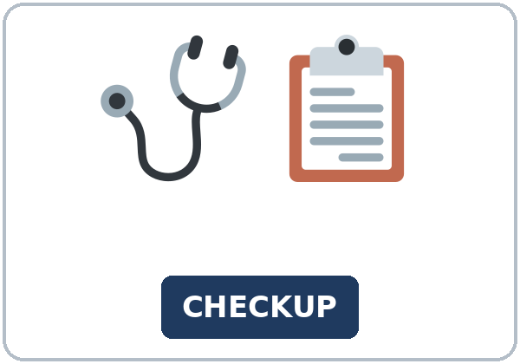
How Long Have You Had It?
Today you will:
• Say how long you've had a symptom
• Answer health history questions
• Make a suggestion
Lesson 4 · Level 4
Notes:
Welcome learners as they arrive.
Point to the title and read it: "How long have you had it?" Say: "Tonight we talk about health: a health history form, a clinic visit, the dentist, and an insurance card. Everything is invented."
Read the three lines under "Today you will". Give one quick example of each: "I've had a cough since Sunday." • "Have you ever had surgery?" • "Why don't you call the clinic?"
Keep health invented and mild. All patients and symptoms are invented. Never ask learners about their own health, medicines, or insurance. If a learner shares something, thank them and move on.
Lesson plan: Topic; At a glance: Objectives; Teacher notes.
Picture: Twemoji graphics by Twitter, Inc. and other contributors (https://github.com/jdecked/twemoji), CC BY 4.0 (https://creativecommons.org/licenses/by/4.0/); resized and combined, with signs and labels (images/CREDITS.md).

Slide 2
Today's
Goals
01
I can describe a symptom and say how long I've had it (for / since).
02
I can answer health history questions (Have you ever had…?).
03
I can make a suggestion with Why don't you…? / You could… / It's a good idea to…
By the end of class, you can do these five things.
Every goal is a good goal.
04
I can find key information on an insurance card and a clinic letter (copay, deductible).
05
I can write an email to a friend (5–8 sentences) with suggestions and reasons.
Notes:
Read each goal slowly. Learners repeat.
Goal 1: I've had a rash since Monday. Goal 2: Have you ever had surgery? Yes, I had knee surgery in 2018. Goal 3: Why don't you call the clinic?
Goal 4: the clinic letter and the insurance card in Read & Write. Goal 5: the email in Read & Write.
Lesson plan: At a glance: Objectives.

Slide 3

OPENING TALK · 6:00
Opening Talk
A asks a card question.
Have you done your laundry yet this week?
B answers in 3 sentences.
A asks one follow-up.
When did you do it?
Then switch.
Notes:
Step 1 · 6:00–6:08 · Opening Talk + Homework Check · 8 min. Pairs (7 pairs + 1 trio with 15 learners; 3–4 pairs with 7–8).
Before class, write on the board: Have you… yet? and already / just
Model with one learner: you ask, "Have you done your laundry yet this week?" The learner answers with already or not yet. Then you ask, "When did you do it?" Help them say 3 sentences. (Click to show the follow-up.)
Opening Talk (5 min): learners open the Opening Talk page. A asks a card question; B answers in 3 sentences (the answer, a reason, a detail); A asks one follow-up. Switch after each card. The cards are on the next slide.
If behind: one card only.
Lesson plan: Step 1; Opening Talk page.
Picture: Twemoji graphics by Twitter, Inc. and other contributors (https://github.com/jdecked/twemoji), CC BY 4.0 (https://creativecommons.org/licenses/by/4.0/); resized and combined, with signs and labels (images/CREDITS.md).

Slide 4
Opening Talk
Cards
01
Have you done your laundry yet this week?
02
What have you already done today?
B answers in 3 sentences: the answer, a reason, and a detail.
Follow-ups:
When did you…? What haven't you done yet? Why?
03
Have you paid your bills yet this month?
04
Have you cooked dinner yet today?
05
Homework check: Lesson 3, items 1 and 3.
Notes:
Step 1, continued. The four cards from the Opening Talk page. Each click shows the next card.
A asks a card question. B answers in 3 sentences. A asks one follow-up question (follow-ups on the right). Then switch. Pairs write the partner's name and one thing they've already done.
Homework Check (3 min, last click): pairs compare Homework item 1 (already / yet / just sentences) and read their to-do list (item 3) to each other. Then they fill in the box on the Opening Talk page. Walk around. Write 2 common errors on the board (often I've finished it yesterday (→ I finished it yesterday) and Have you yet…? (→ yet at the end)) and correct them together. Also put up 2 corrections from last week's exit tickets.
Lesson plan: Step 1; Opening Talk page: cards, follow-ups; Homework check.

Slide 5
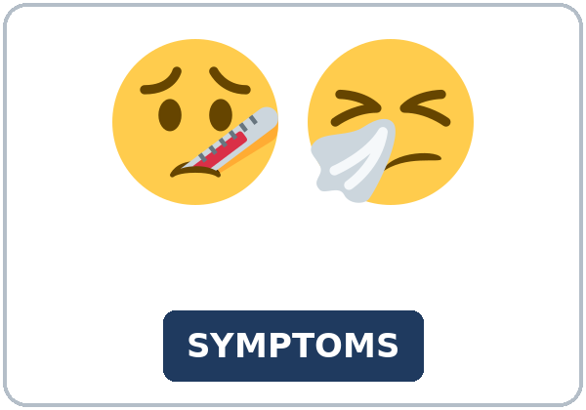
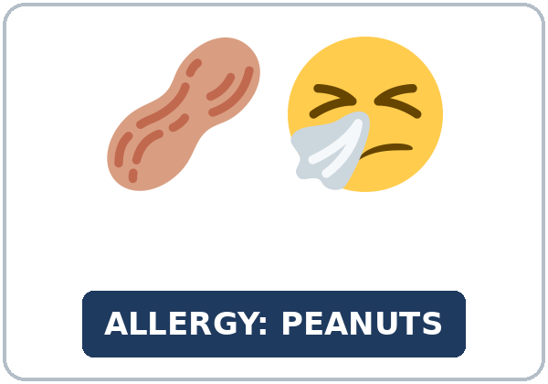
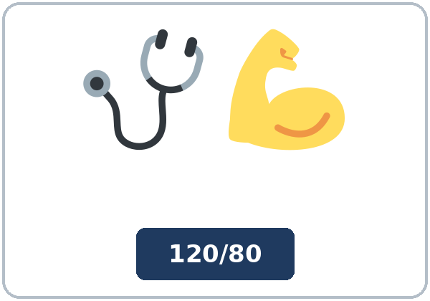
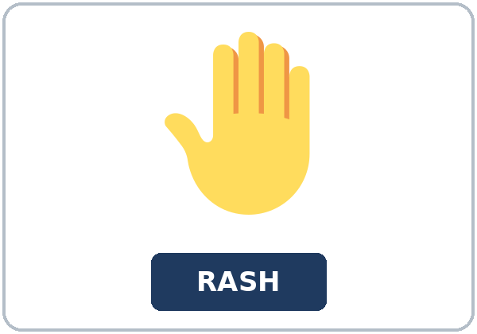
Look. Listen.
Repeat.
New Words
★ checkup
★ health history
★ symptom
★ allergy
★ blood pressure
★ rash
Notes:
Step 2 · 6:08–6:15 · New Words · 7 min (this slide and the next). Whole class, then pairs.
Point to each picture and say the word. Learners repeat once. ★ = the most important words. Each click shows the next word.
Show the hard words: checkup (a visit when you are well); health history (a form: your past illnesses, surgery, allergies); symptom (what you feel: a cough, a rash); allergy (I'm allergic to peanuts); blood pressure (mime the arm cuff: 120 over 80).
If behind: teach the ★ words only.
Lesson plan: Step 2; Key vocabulary; New Words page.
Pictures: Twemoji graphics by Twitter, Inc. and other contributors (https://github.com/jdecked/twemoji), CC BY 4.0 (https://creativecommons.org/licenses/by/4.0/); resized and combined, with signs and labels (images/CREDITS.md).

Slide 6

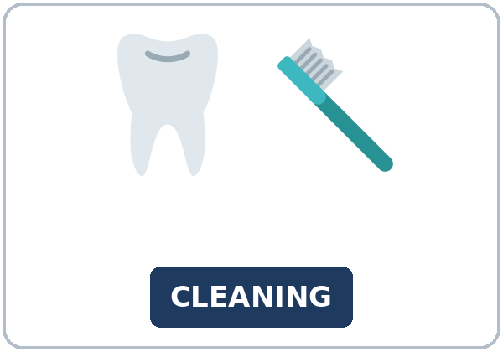
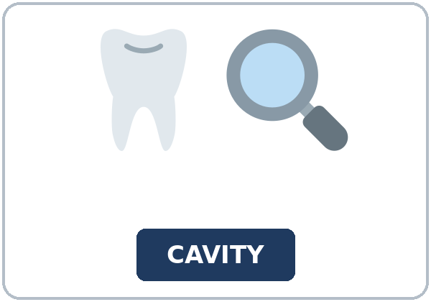

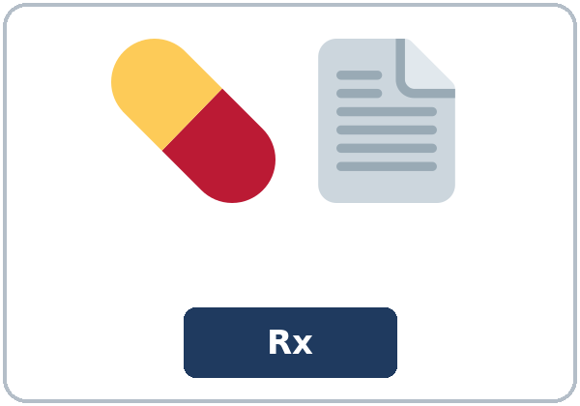
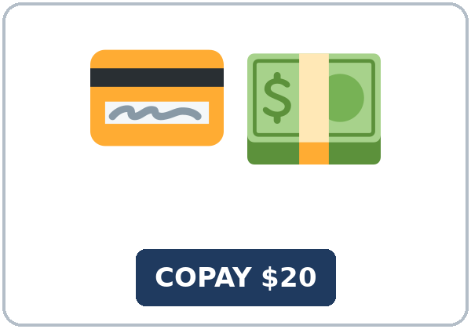
Partner game:
Symptom or suggestion?
More New Words
★ dizzy
★ teeth cleaning
★ cavity
★ flu shot
★ prescription
copay
Notes:
Step 2, continued. Point to each picture and say the word. Learners repeat once.
Show the hard words: dizzy (mime the room turning); teeth cleaning and cavity (a hole in a tooth); flu shot; prescription (paper from the doctor for medicine); copay (the money you pay at each visit).
Partner game (2 min): A points to a picture and says a problem, for example, "I've had a rash since Monday." B gives a suggestion: "Why don't you call the clinic?" Switch. 15 learners: finish with a quick team round (3 teams; you say a clue, the first team with the word gets a point). 7–8: 2 teams. 5 or fewer: one team against the clock.
My Words: "Write any word you want in your language on the My Words page. It's your personal list. It's optional." Learners do it at home.
If behind: teach the ★ words only.
Lesson plan: Step 2; New Words page; Partner game; My Words page.
Pictures: Twemoji graphics by Twitter, Inc. and other contributors (https://github.com/jdecked/twemoji), CC BY 4.0 (https://creativecommons.org/licenses/by/4.0/); resized and combined, with signs and labels (images/CREDITS.md).

Slide 7
Check the Meaning
Look at the picture. Answer the question.
1
2
3
Do you get a checkup when you are sick or when you are well?
Is a cough a symptom?
Do you pay a copay at the clinic or at home?
when you are well; it's every year
yes
at the clinic
Notes:
Step 2 · Check meaning · 1 min. Whole class.
The answers are hidden. Ask each question and wait for the class to answer. Then click to show the answer. Each click shows one answer, in order: 1, 2, 3.
1. "Do you get a checkup when you are sick or when you are well?" (when you are well; it's every year) • 2. "Is a cough a symptom?" (yes) • 3. "Do you pay a copay at the clinic or at home?" (at the clinic)
Lesson plan: Step 2: Check meaning.
Pictures: Twemoji graphics by Twitter, Inc. and other contributors (https://github.com/jdecked/twemoji), CC BY 4.0 (https://creativecommons.org/licenses/by/4.0/); resized and combined, with signs and labels (images/CREDITS.md).

Slide 8
Before You
Listen for:
Listen
Why is Amina at the clinic?
Amina is at a clinic for back pain. First, Daniel, the medical assistant, asks her health history questions. Then, at checkout, she talks to Ms. Park, the receptionist.
Play 2: Tasks B and C.
01
Audio (about 2:07): coming soon.
Amina
02
Daniel
Play 1: Task A
03
Ms. Park
Notes:
Step 3 · 6:15–6:30 · Listening + "Hear it, say it" · 15 min (slides 8 to 12). Individuals, then pairs check.
Before you listen (2 min). Say: "Amina is at a clinic. First, Daniel, the medical assistant, asks her some questions. Then she talks to Ms. Park, the receptionist. Listen: why is Amina at the clinic?"
There are three people: Amina, Daniel (the medical assistant), and Ms. Park (the receptionist). A narrator starts and ends the listening. Each click highlights the next person.
The audio (about 2:07) is coming soon. When it is ready, it plays the conversation once; press play again for play 2. Until then, read the listening script (at the end of these notes) with a volunteer.
No speaker? Read the script with a volunteer at a natural, friendly speed, two times. The script says going to and want to. People often say gonna and wanna; learners only need to recognize those words.
Audio: the listening audio for this lesson (about 2:07) is coming soon. It will use computer-generated voices (Chatterbox TTS cloned from synthetic Kokoro-82M reference clips); no recordings of real people. Until it is ready, read the listening script (in the notes of the Before You Listen slide) with a volunteer. The names and the story are invented.
Lesson plan: Step 3; Listening script; Listening page.
Picture: Twemoji graphics by Twitter, Inc. and other contributors (https://github.com/jdecked/twemoji), CC BY 4.0 (https://creativecommons.org/licenses/by/4.0/); resized and combined, with signs and labels (images/CREDITS.md).
Listening script (the audio is coming soon; until then, read it aloud with a volunteer at a normal, friendly speed):
Narrator: Lesson four. Amina is at a clinic. First, she talks to Daniel, the medical assistant.
Daniel: Hi, Amina. I'm Daniel. I'm going to ask you a few questions for your health history. What brings you in today?
Amina: My lower back hurts. It isn't very bad, but it hasn't stopped.
Daniel: I'm sorry to hear that. How long have you had the back pain?
Amina: I've had it for about two weeks. It started when I moved some heavy boxes.
Daniel: OK. Have you ever had back problems before?
Amina: No, never. This is the first time.
Daniel: Have you ever had surgery?
Amina: Yes, I had knee surgery in 2018.
Daniel: Thank you. Do you have any allergies?
Amina: Yes, I'm allergic to penicillin. I get a rash.
Daniel: I'll write that down. Have you tried anything for the pain?
Amina: I've used a heating pad a few times. It helps a little.
Daniel: Have you felt dizzy?
Amina: No, I haven't.
Daniel: Good. Now let me check your blood pressure. It's one eighteen over seventy-six. That's fine. The doctor's going to see you in a few minutes.
Narrator: Later, at checkout, Amina talks to Ms. Park, the receptionist.
Ms. Park: Hi, Amina. Your copay today is twenty dollars.
Amina: OK. Here's my new insurance card. I've had it since January.
Ms. Park: Thank you. Also, you haven't had a teeth cleaning for a year, and you haven't had a checkup since last spring. It's a good idea to get one every six months.
Amina: You're right. I want to make an appointment with the dentist.
Ms. Park: Why don't you call the dental office tomorrow? Here's the number. And you could get a flu shot here next week.
Amina: Good idea. Thank you!
Narrator: That's the end of the listening.

Slide 9
Listen. Why is Amina at the clinic?
Circle.
Listening A
Amina:
a. for a flu shot
b. for back pain
c. for a teeth cleaning
Notes:
Play 1 → Task A (the main idea). Pairs compare. Check together.
Click to circle the answer: b (for back pain).
Then read Tasks B and C together (1 min) so learners know what to listen for.
Lesson plan: Step 3; Listening Task A; Answer key.

Slide 10
Listen again. Complete Amina's form.
Circle the answer.
Listening B
1. Symptom:
a rash
back pain
a cough
2. How long?
two days
about two weeks
since January
3. Back problems before?
yes
no
4. Allergy:
peanuts
penicillin
none
5. Dizzy?
yes
no
6. Copay today:
$10
$20
$40
Notes:
Play 2 → Tasks B and C. Pairs compare. Then show the answers.
Click to circle each answer (one click per item, 1 to 6): 1 back pain • 2 about two weeks • 3 no • 4 penicillin • 5 no • 6 $20.
Lesson plan: Step 3; Listening Task B; Answer key.

Slide 11
Listen again.
Write for, since, or ever.
Listening C
1
I've had it ____ about two weeks.
for
2
Have you ____ had back problems before?
ever
3
Have you ____ had surgery?
ever
Words: for, since, ever
Pairs: compare your answers.
Then check together.
4
I've had it ____ January.
since
5
Also, you haven't had a teeth cleaning ____ a year
for
6
and you haven't had a checkup ____ last spring.
since
Notes:
Task C (play 2). Click to show each answer (one click per item, 1 to 6): 1 for, 2 ever, 3 ever, 4 since, 5 for, 6 since.
If behind: do Task C together on the board, reading the lines yourself.
Lesson plan: Step 3; Listening Task C; Answer key.

Slide 12
Hear it: gonna = going to, wanna = want to
Hear It,
Say It
Say it: a suggestion, and the stress
The doctor's going to see you in a few minutes.
I want to make an appointment.
gonna and wanna are short forms. This listening uses the full forms.
Why don't you…? Your voice goes down.
Say each line two times.
Why don't you call the clinic?
I've had a RASH since MONday.
Notes:
"Hear it, say it" (3 min). Point to the script lines. gonna = going to: "The doctor's going to see you in a few minutes." wanna = want to: "I want to make an appointment." You can say going to and want to.
Then practice Why don't you…? as one smooth group with falling intonation (a suggestion, not a real question), and the stress: I've had a RASH since MONday. The class repeats the two lines twice.
Reductions: the listening says going to and want to. People often say gonna and wanna. Learners only need to recognize the short forms.
Lesson plan: Step 3: "Hear it, say it"; Listening page: Hear it, say it; Teacher notes.

Slide 13
Grammar Box 1
How long…? / Have you ever…?
QUESTION
ANSWER
How long have you had this rash?
I've had it for three days.
I've had it since Monday.
How long has your back hurt?
It's hurt for about two weeks.
Have you ever had surgery?
No, never. / Yes, I have. I had knee surgery in 2018.
Have you tried anything for it?
Yes, I have. I've used a heating pad.
Notes:
Step 4 · 6:30–6:45 · Grammar Q&A · 15 min (slides 13 to 20). Whole class, then pairs. Show the Grammar page. The left side is the question. The right side is the answer.
Show it (2 min): say, "I have a cough. It started on Sunday. Today is Thursday." Write: I've had a cough since Sunday. I've had it for four days. Then hold your back: "My back hurts." Point to a learner and help them say, "Why don't you call the clinic?" Write three suggestions on the board.
Box 1: read across: How long have you had this rash? → I've had it for three days. and Have you ever had surgery? → Yes, I had knee surgery in 2018. Each click shows the answer side of one row.
for / since: for + a length of time (three days); since + a start (Monday, January). With a finished time (in 2018), use the simple past.
Lesson plan: Step 4; Grammar Box 1; Teacher notes: for / since.
Picture: Twemoji graphics by Twitter, Inc. and other contributors (https://github.com/jdecked/twemoji), CC BY 4.0 (https://creativecommons.org/licenses/by/4.0/); resized and combined, with signs and labels (images/CREDITS.md).

Slide 14
Grammar Box 2
a problem → a suggestion
PROBLEM
SUGGESTION
My back hurts. What can I do?
Why don't you call the clinic?
I sit all day at work. Any ideas?
You could take a short walk at lunch.
I haven't had a checkup for two years.
It's a good idea to get one every year.
My tooth has hurt since Friday.
You should see a dentist soon.
Notes:
Box 2: a problem → a suggestion. Read a problem; the class answers with the suggestion. Each click shows the suggestion side of one row.
Rule of thumb (read it aloud): Use have / has + past participle + for / since for a problem that started in the past and is still true. After Why don't you, You could, It's a good idea to, and should, use the base verb (call, try, get).
Lesson plan: Step 4; Grammar Box 2; Rule of thumb.
Picture: Twemoji graphics by Twitter, Inc. and other contributors (https://github.com/jdecked/twemoji), CC BY 4.0 (https://creativecommons.org/licenses/by/4.0/); resized and combined, with signs and labels (images/CREDITS.md).

Slide 15
Grammar Box 3
how to say a symptom
SAY
EXAMPLES
I have / I've had + a noun
a rash, a cough, a backache, a sore throat
→ I've had a cough since Sunday.
My ___ hurts / has hurt
My back hurts. My tooth has hurt for a week.
I feel / I've felt + a word
dizzy, tired → I've felt tired for three days.
Notes:
Box 3: how to say a symptom. Each click shows the examples of one row.
Lesson plan: Step 4; Grammar Box 3.
Picture: Twemoji graphics by Twitter, Inc. and other contributors (https://github.com/jdecked/twemoji), CC BY 4.0 (https://creativecommons.org/licenses/by/4.0/); resized and combined, with signs and labels (images/CREDITS.md).

Slide 16
Grammar Box 4
strong or soft?
SAY
HOW STRONG? · EXAMPLE
You should…
strong advice
You should see a doctor.
It's a good idea to…
a general idea (good for everyone)
It's a good idea to get a flu shot every year.
Why don't you…? / You could…
a soft idea; the person chooses
Why don't you try a heating pad? You could stretch.
Notes:
Box 4: strong or soft? Each click shows one row.
Questions and answers (2 min): Q: Can I say I have a rash since Monday? A: No. It started in the past and is still true: I've had a rash since Monday. • Q: Is Why don't you call the clinic? a real question? A: No. It's a suggestion. Answer: Good idea. / Thanks, I will. Your voice goes down at the end. • Q: You could to try or You could try? A: After could, use the base verb: You could try a heating pad.
Check questions: "I have a rash since Monday. Right or wrong?" (wrong: I've had a rash since Monday.) • "You could to try or You could try?" (You could try) • "Is Why don't you call? a real question?" (no, it's a suggestion).
Lesson plan: Step 4; Grammar Box 4; Questions and answers.
Picture: Twemoji graphics by Twitter, Inc. and other contributors (https://github.com/jdecked/twemoji), CC BY 4.0 (https://creativecommons.org/licenses/by/4.0/); resized and combined, with signs and labels (images/CREDITS.md).

Slide 17
Practice A
Write the correct form of the verb.
Practice A
1
How long have you ____ the cough? (have)
had
2
Why don't you ____ the clinic? (call)
call
3
I've ____ dizzy since this morning. (feel)
felt
Write the correct form of the verb.
Pairs: check your answers.
4
You could ____ some easy stretches. (try)
try
5
It's a good idea to ____ a flu shot every year. (get)
get
6
Have you ever ____ surgery? (have)
had
Notes:
Practice A and B (3 min): learners write, then pairs check. Go over the answers.
Click to show each answer (one click per item, 1 to 6): 1 had, 2 call, 3 felt, 4 try, 5 get, 6 had.
Lesson plan: Step 4; Grammar Practice A; Answer key.

Slide 18
Circle the correct words.
Practice B
1. I ____ a rash since Saturday.
've had
have
2. You could ____ a heating pad.
try
to try
3. ____ call the dentist?
Why don't you
Why you don't
4. My tooth has hurt ____ a week.
for
since
5. I ____ knee surgery in 2018.
had
've had
6. It's a good idea ____ a checkup.
to get
get
Notes:
Practice B. Learners circle the correct words. Pairs check.
Click to circle each answer (one click per item, 1 to 6): 1 've had, 2 try, 3 Why don't you, 4 for, 5 had, 6 to get.
Lesson plan: Step 4; Grammar Practice B; Answer key.

Slide 19
Common Mistakes
Don't say
Say
I have a rash since Monday.
I've had a rash since Monday.
You could to call the clinic.
You could call the clinic.
Why you don't try a heating pad?
Why don't you try a heating pad?
It's a good idea get a checkup.
It's a good idea to get a checkup.
I've had surgery in 2018.
I had surgery in 2018.
Notes:
Common mistakes. Read the table together: "Don't say… Say…". Read a line from Don't say. Ask: "What's the right way?" Learners try first. Then click to show the right form. Each click shows one line, in order 1 to 5.
Learners can read the contrast tip on their Grammar page on their own; it is optional. You never need to read, translate, or explain it.
Lesson plan: Grammar: Common mistakes; Teacher notes.
Picture: Twemoji graphics by Twitter, Inc. and other contributors (https://github.com/jdecked/twemoji), CC BY 4.0 (https://creativecommons.org/licenses/by/4.0/); resized and combined, with signs and labels (images/CREDITS.md).

Slide 20
Pair Check
A says a problem.
01
A says a problem from Box 2. Then switch.
A: My back hurts. What can I do?
B gives a suggestion.
02
B: Why don't you… / You could…
A: Good idea.
Notes:
Pair check (last 3 min of Step 4). Pairs.
A says a problem from Box 2. B gives a suggestion with Why don't you… / You could… A says, "Good idea." Switch. 15 learners: swap partners once. 5 or fewer: you join one pair.
If behind: skip the pair check. Talk Time practices it.
Break · 6:45–7:00 · 15 min. Write on the board: How long have you had it? → I've had it for… / since… • Why don't you…? / You could… / It's a good idea to…
Lesson plan: Step 4: Pair check; Break.
Picture: Twemoji graphics by Twitter, Inc. and other contributors (https://github.com/jdecked/twemoji), CC BY 4.0 (https://creativecommons.org/licenses/by/4.0/); resized and combined, with signs and labels (images/CREDITS.md).

Slide 21
Talk Time
Clinic Intake
Pairs.
Sit back to back.
7:00–7:15
1
A is the medical assistant.
What brings you in today?
2
B chooses a symptom card and answers.
I've had it for three days.
3
A writes short notes. Then switch.
I'm sorry to hear that.
Notes:
Step 5 · 7:00–7:15 · Talk Time: Clinic Intake + Good Idea Circle · 15 min.
Model it first (1 min): sit back to back with a learner. You are the medical assistant: "What brings you in today?" The learner reads a symptom card: "I have a rash on my arm." You ask, "How long have you had it?" Then switch: the learner asks you. Say: "Answer, then add one more detail."
Round 1 (7 min): Clinic Intake (pairs, back to back). A is the medical assistant and asks the 8 form questions; B chooses a symptom card and answers (invented answers). A writes short notes. Then switch, with a new card. Each click shows the next step.
Form questions: 1. What brings you in today? 2. How long have you had it? 3. Have you ever had this before? 4. Have you tried anything for it? 5. Do you have any allergies? 6. Have you ever had surgery? 7. Have you had a flu shot this year? 8. When was your last checkup?
15 learners: pairs for round 1. 7–8 learners: pairs for round 1. 5 or fewer: pairs (you join if there is an odd number).
Keep health invented and mild. All patients and symptoms are invented. Never ask learners about their own health, medicines, or insurance. If a learner shares something, thank them and move on.
Lesson plan: Step 5; Talk Time: Clinic Intake; Teacher notes.
Picture: Twemoji graphics by Twitter, Inc. and other contributors (https://github.com/jdecked/twemoji), CC BY 4.0 (https://creativecommons.org/licenses/by/4.0/); resized and combined, with signs and labels (images/CREDITS.md).

Slide 22
Talk Time
Good Idea Circle
Circles of 5.
One person reads a problem card.
7:00–7:15
1
One person reads a problem card.
I sit all day at work.
2
Two people each give a suggestion.
Why don't you…? • You could…
3
The first person chooses one and says why.
Good idea. I'm going to… because…
Notes:
Round 2 (6 min): Good Idea Circle (circles of 5). One learner reads a problem card. The next two learners each give a suggestion. The first learner chooses one and says why: "Good idea. I'm going to… because…" Then the next learner reads a card. Each click shows the next step.
Example: A: I sit all day at work. B: Why don't you take a short walk at lunch? C: You could stand up every hour. A: Good idea. I'm going to walk at lunch because I like being outside.
15 learners: 3 circles of 5 for round 2. 7–8 learners: one circle for round 2. 5 or fewer: in round 2, make one circle; you add problem cards and suggest first.
Real health questions: say, "For a real health question, ask your doctor or pharmacist. In an emergency, call 911." It is printed on the Good Idea Circle page.
Every answer needs a reason; every partner asks a follow-up. Walk around and listen. Note 2 good sentences to praise and 1 common error for next week.
If behind: round 1 only.
Lesson plan: Step 5; Talk Time: Good Idea Circle; Teacher notes.
Picture: Twemoji graphics by Twitter, Inc. and other contributors (https://github.com/jdecked/twemoji), CC BY 4.0 (https://creativecommons.org/licenses/by/4.0/); resized and combined, with signs and labels (images/CREDITS.md).

Slide 23
Read the letter.
Answer the questions.
Read &
Write
1
When did Carmen have her last checkup?
In March 2025.
2
How often is it a good idea to get a teeth cleaning?
Every six months.
Riverside Family Clinic:
a letter + an insurance card.
Pairs: answer together.
3
What three things should she bring?
Her insurance card, a photo ID, and a list of her medicines.
4
What is her copay for a doctor visit?
$20.
5
How much is her deductible?
$1,000.
Notes:
Step 6 · 7:15–7:25 · Read & Write: A clinic letter + an insurance card · 10 min. Pairs read, then individual writing.
Read (4 min): learners read the letter from the clinic and the insurance card on the Read & Write page and answer the questions. Point to copay and deductible on the card. Say: "Read fast first. Then find the answers." Pairs answer questions 1–5 together.
Check (1 min): click to show each answer (one click per question, 1 to 5): 1 In March 2025. • 2 Every six months. • 3 Her insurance card, a photo ID, and a list of her medicines. • 4 $20. • 5 $1,000.
Insurance: stay at "read the card; know copay and deductible." A copay is what you pay at each visit; a deductible is what you pay first in a year before the plan pays more. Don't explain plans or prices.
Write (5 min): learners write an email to a friend (5–8 sentences). The friend has had a backache for a week. Ask how long, give two suggestions with reasons, and say what to bring to the clinic. Show the example. Invented details are fine. Learners start in class and finish at home (Homework item 2).
If behind: questions 1–5 only; the writing becomes homework.
Lesson plan: Step 6; Read & Write page; Answer key; Teacher notes: Insurance.

Slide 24
Before You Go 7:25–7:30
01
Exit ticket
02
Homework
A friend has had a backache for a week.
1. Ask how long (How long have you…?).
2. A suggestion (Why don't you… / You could…).
3. A reason, with because.
Give it to me at the door.
About 15–20 minutes.
1. Write the sentence. Use the words.
2. Finish your email (Read & Write C).
3. Write 3 good ideas to stay healthy.
4. Review: already, yet, or just.
Bring it next week!
Notes:
Step 7 · 7:25–7:30 · Exit Ticket + Homework · 5 min · NEVER SKIP.
Exit ticket (3 min): learners open the Exit Ticket page and answer in 3 sentences with a reason: A friend has had a backache for a week. What do you say? Example on the board: How long have you had it? Why don't you call the clinic? It's a good idea because a week is a long time. With 5 or fewer, a learner can say it to you first and then write it.
Collect the pages. After class, sort them into ✓ / almost / not yet. Start next week with 2 corrections on the board (no names).
Homework (2 min): open the Homework page. Do item 1 together (she / have / a rash / ___ / three days → She's had a rash for three days.). Say: "About 15–20 minutes. Finish your Read & Write writing at home."
Homework items: 1 write the sentence with the words • 2 finish the email from Read & Write C and check it with the list in D • 3 write 3 good ideas to stay healthy (It's a good idea to… / You could… / Why don't you…?) and give a reason • 4 review (Lesson 3): already, yet, or just.
Lesson plan: Step 7; Exit Ticket page; Homework page.
Picture: Twemoji graphics by Twitter, Inc. and other contributors (https://github.com/jdecked/twemoji), CC BY 4.0 (https://creativecommons.org/licenses/by/4.0/); resized and combined, with signs and labels (images/CREDITS.md).

Slide 25
Goodbye! See You Next Week!
Now you can:
• Say how long you've had a symptom
• Answer health history questions
• Make a suggestion
Lesson 4 · Level 4
Notes:
Read the title: "Goodbye! See you next week!" Learners repeat.
Read the three "Now you can" lines. Say to one learner: "I sit all day at work." Wait for a suggestion (Why don't you…? / You could…).
Real health questions: say, "For a real health question, ask your doctor or pharmacist. In an emergency, call 911." It is printed on the Good Idea Circle page.
Lesson plan: At a glance: Objectives; Step 7; Teacher notes.
Picture: Twemoji graphics by Twitter, Inc. and other contributors (https://github.com/jdecked/twemoji), CC BY 4.0 (https://creativecommons.org/licenses/by/4.0/); resized and combined, with signs and labels (images/CREDITS.md).

Slide 26
Credits
Pictures
Vocabulary pictures use Twemoji graphics by Twitter, Inc. and other contributors (https://github.com/jdecked/twemoji), licensed under CC BY 4.0 (https://creativecommons.org/licenses/by/4.0/). The graphics were resized and combined, and signs and labels were added.
Names and story
Amina, Daniel, Ms. Park, Carmen Lopez, Rosa, and Marta are invented names. The listening story is invented.
Audio and font
Audio (coming soon): synthetic voices made with Chatterbox TTS (MIT License), cloned from short synthetic reference clips made with Kokoro-82M (Apache License 2.0). No recordings of real people. Each file will carry an inaudible Perth watermark marking it as AI-generated. Font: Lexend Deca (OFL 1.1).
© 2026 the authors. The authors license this deck under CC BY-NC-SA 4.0.
Notes:
Credits. You don't need to read this slide in class.
Pictures: Twemoji graphics by Twitter, Inc. and other contributors, CC BY 4.0; the file-by-file list is in images/CREDITS.md.
Audio: the listening audio for this lesson (about 2:07) is coming soon. It will use computer-generated voices (Chatterbox TTS cloned from synthetic Kokoro-82M reference clips); no recordings of real people. Until it is ready, read the listening script (in the notes of the Before You Listen slide) with a volunteer. The names and the story are invented.
Course materials: © 2026 the authors, licensed under CC BY-NC-SA 4.0 (https://creativecommons.org/licenses/by-nc-sa/4.0/).
Lesson plan: Picture Credits. Picture list: images/CREDITS.md.

