Slide 1
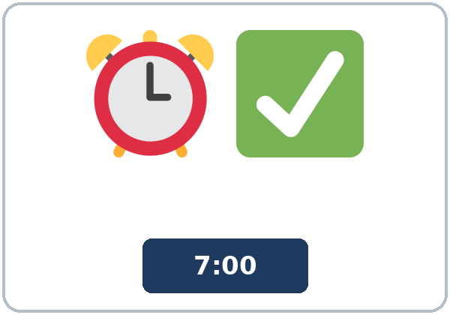
Too Early or On Time?
Today you will:
• Say too early, too late, or on time
• Use too and enough
• Explain a workplace rule
Lesson 7 · Level 4
Notes:
Welcome learners as they arrive.
Point to the title and read it: "Too Early or On Time?" Say: "Expectations at work and in the community: being on time, dress codes and safety rules, invitations (RSVP, what to bring), and comparing customs respectfully. Learners use too and enough, too much / too many, and must / mustn't / don't have to. The company, the rules, and the people are invented."
Read the three lines under "Today you will".
Describe, don't judge: customs vary inside every country, including the U.S., and inside every family. No place is "better." Model It's different and I like both.
Lesson plan: Topic; At a glance: Objectives; Teacher notes.
Picture: Twemoji graphics by Twitter, Inc. and other contributors (https://github.com/jdecked/twemoji), CC BY 4.0 (https://creativecommons.org/licenses/by/4.0/); resized and combined, with signs and labels (images/CREDITS.md).

Slide 2
Today's
Goals
01
I can say what is too early, too late, or on time.
02
I can use too + adjective and adjective + enough (too casual, safe enough).
03
I can use too much / too many / enough + a noun.
By the end of class, you can do these five things.
Every goal is a good goal.
04
I can explain a workplace rule with must / mustn't / don't have to.
05
I can compare customs politely and write first-week tips for a new coworker (5–8 sentences).
Notes:
Read each goal slowly. Learners repeat.
Lesson plan: At a glance: Objectives.

Slide 3
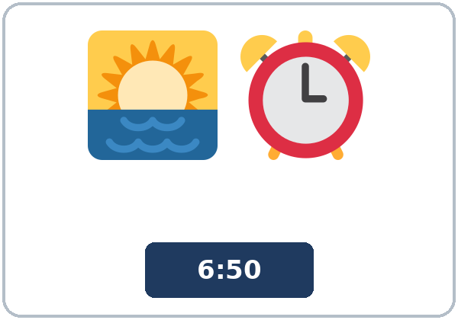
OPENING TALK · 6:00
Opening Talk
A asks a card question.
What would you do if you found $50 at work?
B answers in 3 sentences.
A asks one follow-up.
Why?
Then switch.
Notes:
Step 1 · 6:00–6:08 · Opening Talk + Homework Check · 8 min. Pairs (7 pairs + 1 trio with 15 learners; 3–4 pairs with 7–8).
Before class, write on the board: imaginary situations: What would you do if…? / If I had…, I'd…
Model with one learner: you say, "What would you do if you found $50 at work?" The learner answers with If I found…, I'd… Then you ask, "Why?" Help them say 3 sentences. (Click to show the follow-up.)
Opening Talk (5 min): learners open the Opening Talk page. A asks a card question; B answers in 3 sentences (the answer, a reason, a detail); A asks one follow-up. Switch after each card. The cards are on the next slide.
If behind: one card only.
Lesson plan: Step 1; Opening Talk page.
Picture: Twemoji graphics by Twitter, Inc. and other contributors (https://github.com/jdecked/twemoji), CC BY 4.0 (https://creativecommons.org/licenses/by/4.0/); resized and combined, with signs and labels (images/CREDITS.md).

Slide 4
Opening Talk
Cards
01
What would you do if you found $50 at work?
02
What would you do if you had a free week?
B answers in 3 sentences: the answer, a reason, and a detail.
Follow-ups:
Why? Would you tell anyone? What would your family do?
03
If you had a magic wand, what would you do?
04
What would you do if a cashier gave you too much change?
05
Homework check: Lesson 6, items 1 and 3.
Notes:
Step 1, continued. The four cards from the Opening Talk page. Each click shows the next card.
A asks a card question. B answers in 3 sentences. A asks one follow-up question (follow-ups on the right). Then switch.
Homework Check (3 min, last click): Pairs compare Homework item 1 (If I had…, I'd…) and read their 3 dreams (item 3) to each other. Then they fill in the box on the Opening Talk page. Walk around. Write 2 common errors on the board (often If I would have time… (→ If I had time…) and If I found $50, I will… (→ I'd…)) and correct them together. Also put up 2 corrections from last week's exit tickets.
Lesson plan: Step 1; Opening Talk page: cards, follow-ups; Homework check.

Slide 5
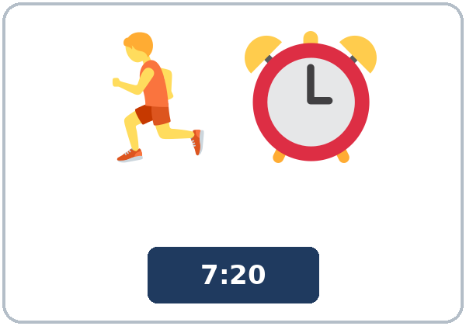
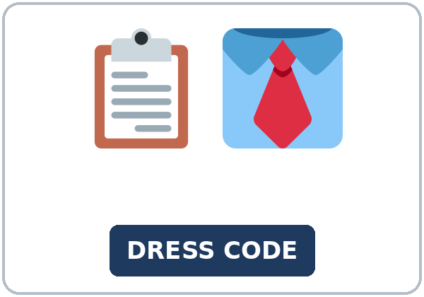
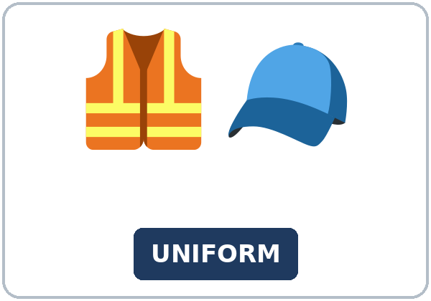
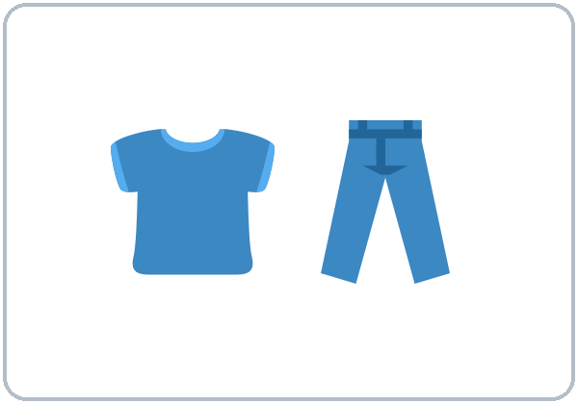
Look. Listen.
Repeat.
New Words
★ on time
★ early
★ late
★ dress code
★ uniform
★ casual
Notes:
Step 2 · 6:08–6:15 · New Words · 7 min (this slide and the next). Whole class, then pairs.
Point to each picture and say the word. Learners repeat once. ★ = the most important words. Each click shows the next word.
Show the hard words: on time, early, late (draw a clock: 6:50, 7:00, 7:20); dress code (the rules about clothes); uniform; casual (T-shirt, jeans) vs. formal (a shirt and tie); closed-toe shoes (point to a sneaker, then mime a sandal: "no"); name badge; invitation (a party card); RSVP (tell the host "yes" or "no"); host (the person who has the party).
If behind: teach the ★ words only.
Lesson plan: Step 2; Key vocabulary; New Words page.
Pictures: Twemoji graphics by Twitter, Inc. and other contributors (https://github.com/jdecked/twemoji), CC BY 4.0 (https://creativecommons.org/licenses/by/4.0/); resized and combined, with signs and labels (images/CREDITS.md).

Slide 6
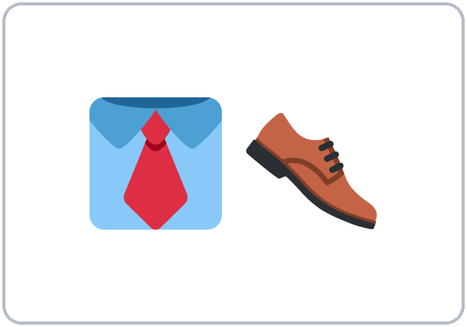
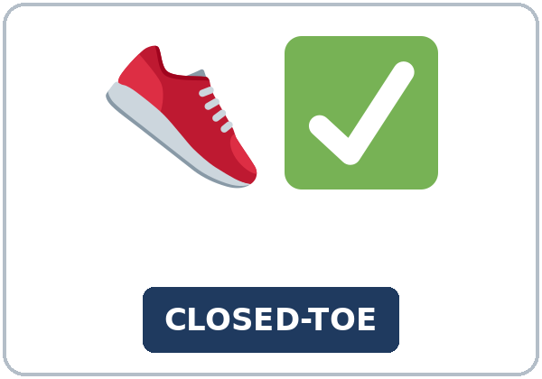
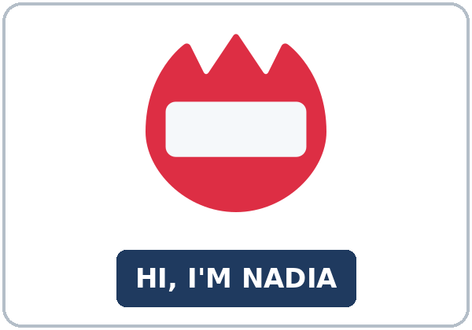
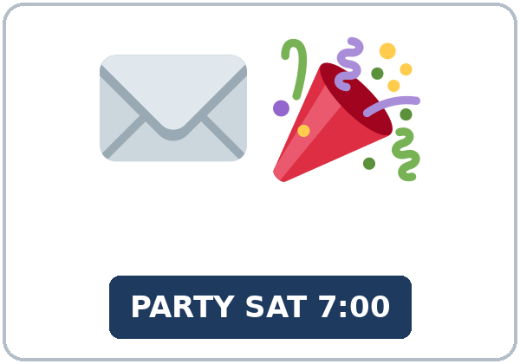
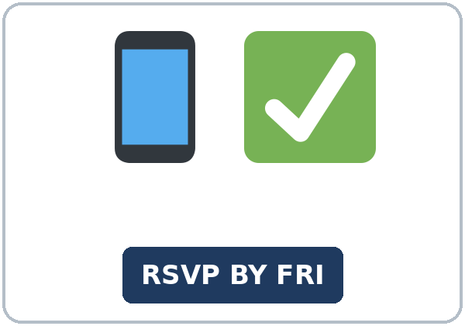
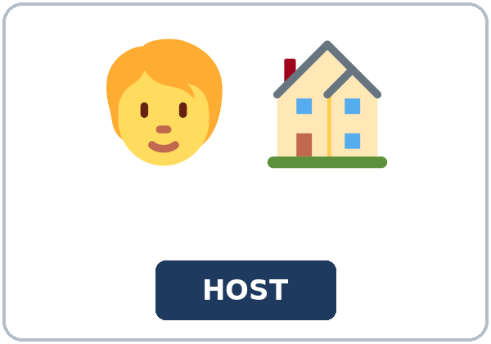
Partner game:
Too, enough, or OK?
More New Words
★ formal
★ closed-toe shoes
★ name badge
★ invitation
★ RSVP
host
Notes:
Step 2, continued. Point to each picture and say the word. Learners repeat once.
Partner game (2 min): A points to a picture and asks, "Are sandals OK for the kitchen?" B answers with too or enough and a rule: "No, they aren't safe enough. You must wear closed-toe shoes." Switch. 15 learners: finish with a quick team round (3 teams; you say a clue, the first team with the word gets a point). 7–8: 2 teams. 5 or fewer: one team against the clock.
My Words: "Write any word you want in your language on the My Words page. It's your personal list. It's optional." Learners do it at home.
If behind: teach the ★ words only.
Lesson plan: Step 2; New Words page; Partner game; My Words page.
Pictures: Twemoji graphics by Twitter, Inc. and other contributors (https://github.com/jdecked/twemoji), CC BY 4.0 (https://creativecommons.org/licenses/by/4.0/); resized and combined, with signs and labels (images/CREDITS.md).

Slide 7
Check the Meaning
Look at the picture. Answer the question.
1
2
3
Is a T-shirt casual or formal?
Are sandals closed-toe shoes?
If an invitation says RSVP by Friday, what do you do?
casual
no
tell the host by Friday
Notes:
Step 2 · Check meaning · 1 min. Whole class.
The answers are hidden. Ask each question and wait for the class to answer. Then click to show the answer. Each click shows one answer, in order: 1, 2, 3.
1. "Is a T-shirt casual or formal?" (casual) • 2. "Are sandals closed-toe shoes?" (no) • 3. "If an invitation says RSVP by Friday, what do you do?" (tell the host by Friday)
Lesson plan: Step 2: Check meaning.
Pictures: Twemoji graphics by Twitter, Inc. and other contributors (https://github.com/jdecked/twemoji), CC BY 4.0 (https://creativecommons.org/licenses/by/4.0/); resized and combined, with signs and labels (images/CREDITS.md).

Slide 8
Before You
Listen for:
Listen
What are they talking about?
It's Nadia's first week at a bakery. She asks her coworker, Carmen, about the rules. Then the supervisor, Mr. Brooks, comes in.
Play 2: Tasks B and C.
01
Audio (about 1:50): coming soon.
Nadia
02
Carmen
Play 1: Task A
03
Mr. Brooks
Notes:
Step 3 · 6:15–6:30 · Listening + "Hear it, say it" · 15 min (slides 8 to 12). Individuals, then pairs check.
Before you listen (2 min). Say: "It's Nadia's first week at a bakery. She asks her coworker, Carmen, about the rules. Then the supervisor, Mr. Brooks, comes in. Listen: what are they talking about?"
There are 3 people: Nadia, Carmen and Mr. Brooks. A narrator starts and ends the listening. Each click highlights the next person.
The audio (about 1:50) is coming soon. When it is ready, it plays the conversation once; press play again for play 2. Until then, read the listening script (at the end of these notes) with a volunteer.
No speaker? Read the script with a volunteer at a natural, friendly speed, two times. The script says going to and want to. People often say gonna and wanna; learners only need to recognize those words.
Audio: the listening audio for this lesson (about 1:50) is coming soon. It will use computer-generated voices (Chatterbox TTS cloned from synthetic Kokoro-82M reference clips); no recordings of real people. Until it is ready, read the listening script (in the notes of the Before You Listen slide) with a volunteer. The names and the story are invented.
Lesson plan: Step 3; Listening script; Listening page.
Picture: Twemoji graphics by Twitter, Inc. and other contributors (https://github.com/jdecked/twemoji), CC BY 4.0 (https://creativecommons.org/licenses/by/4.0/); resized and combined, with signs and labels (images/CREDITS.md).
Listening script (the audio is coming soon; until then, read it aloud with a volunteer at a normal, friendly speed):
Narrator: Lesson seven. It's Nadia's first week at a bakery. She asks her coworker, Carmen, some questions.
Nadia: Carmen, can I ask you a few questions? I'm still learning the rules.
Carmen: Sure, Nadia. What do you want to know?
Nadia: My shift starts at seven. Is six fifty-five early enough?
Carmen: Yes, that's perfect. Here, on time means five minutes early. Seven ten is too late.
Nadia: OK. And what about the uniform? Do I have to wear the hat?
Carmen: Yes, you must wear the hat and the apron in the kitchen. But you don't have to wear them in the break room.
Nadia: Got it. What about my phone?
Carmen: You mustn't use your phone in the kitchen. You can use it on your break.
Nadia: And are these shoes OK? They're new.
Carmen: Hmm, those are sandals. They aren't safe enough for the kitchen.
Mr. Brooks: Carmen's right. Good morning, Nadia. I'm Mr. Brooks, the supervisor. You must wear closed-toe shoes. The trays are too hot, and the floor is sometimes wet.
Nadia: I'm sorry. I didn't know. I'm going to buy some today.
Mr. Brooks: That's OK. For today, there are extra shoes in the office. Maybe they're too big, but they're safe.
Nadia: Thank you. Is there anything else?
Mr. Brooks: Just one more thing. If you're going to be late, you must call me before your shift.
Carmen: Don't worry, Nadia. Everyone makes mistakes in the first week. There's too much to remember!
Nadia: That's true. Thanks, both of you.
Narrator: That's the end of the listening.

Slide 9
Listen. What are they talking about?
Circle.
Listening A
a. the rules at work
b. a party invitation
c. a job interview
Notes:
Play 1 → Task A (the main idea). Pairs compare. Check together.
Click to circle the answer: a (the rules at work).
Then read Tasks B and C together (1 min) so learners know what to listen for.
Lesson plan: Step 3; Listening Task A; Answer key.

Slide 10
Listen again.
Check the rules.
Circle the answer.
Listening B
1. On time means
five minutes early
exactly seven o'clock
2. In the kitchen, you ____ wear the hat and the apron.
must
don't have to
3. In the break room, you ____ wear them.
must
don't have to
4. You ____ use your phone in the kitchen.
must
mustn't
5. You ____ wear closed-toe shoes.
must
don't have to
6. If you're going to be late, you must
call Mr. Brooks
text Carmen
Notes:
Play 2 → Tasks B and C. Pairs compare. Then show the answers.
Click to circle each answer (one click per item, 1 to 6): 1 five minutes early • 2 must • 3 don't have to • 4 mustn't • 5 must • 6 call Mr. Brooks.
Lesson plan: Step 3; Listening Task B; Answer key.

Slide 11
Listen again.
Write the missing word: too, enough, or much.
Listening C
1
Is six fifty-five early ____?
enough
2
Seven ten is ____ late.
too
3
They aren't safe ____ for the kitchen.
enough
Write the missing word: too, enough, or much.
Pairs: compare your answers.
Then check together.
4
The trays are ____ hot, and the floor is sometimes wet.
too
5
Maybe they're ____ big, but they're safe.
too
6
There's too ____ to remember!
much
Notes:
Task C (play 2). Click to show each answer (one click per item, 1 to 6): 1 enough, 2 too, 3 enough, 4 too, 5 too, 6 much.
If behind: do Task C together on the board, reading the lines yourself.
Lesson plan: Step 3; Listening Task C; Answer key.

Slide 12
Hear it: gonna = going to, wanna = want to
Hear It,
Say It
Say it: too / two / to, and the stress
What do you want to know?
I'm going to buy some today.
gonna and wanna are short forms. This listening uses the full forms.
too, two, and to sound the same.
Say each line two times.
too • two • to
TOO late • not eNOUGH
Notes:
"Hear it, say it" (3 min): Point to the script lines. wanna = want to: "What do you want to know?" gonna = going to: "I'm going to buy some today." Then practice too / two / to (the same sound) and the stress in TOO late and not eNOUGH. The class repeats the two lines twice.
Reductions: the listening says going to and want to. People often say gonna and wanna. Learners only need to recognize the short forms.
Lesson plan: Step 3: "Hear it, say it"; Listening page: Hear it, say it; Teacher notes.

Slide 13
Grammar Box 1
too + adjective, adjective + enough
QUESTION
ANSWER
Are jeans OK for the interview?
No, they're too casual. They aren't formal enough.
Is 6:55 early enough?
Yes, it's early enough. That's perfect.
Is 7:10 OK for a 7:00 shift?
No, it's too late. Come at 6:55.
Are sandals safe enough?
No, they aren't safe enough. Wear closed-toe shoes.
Notes:
Step 4 · 6:30–6:45 · Grammar Q&A · 15 min (slides 13 to 20). Whole class, then pairs. Show the Grammar page. The left side is the question. The right side is the answer.
Show it (2 min): draw a clock at 7:10. Say, "My shift starts at 7:00. 7:10 is too late." Draw 6:55: "6:55 is early enough." Write: too = more than OK (a problem); enough = OK. Then show a sandal or mime one: "In a kitchen, you must wear closed-toe shoes. You mustn't wear sandals. You don't have to wear a tie."
Box 1: read across: Are jeans OK for the interview? → No, they're too casual. / They aren't formal enough. Each click shows the answer side of one row.
Lesson plan: Step 4; Grammar Box 1.
Picture: Twemoji graphics by Twitter, Inc. and other contributors (https://github.com/jdecked/twemoji), CC BY 4.0 (https://creativecommons.org/licenses/by/4.0/); resized and combined, with signs and labels (images/CREDITS.md).

Slide 14
Grammar Box 2
too much / too many / enough + a noun
QUESTION
ANSWER
Do you have enough time?
No, I have too much work. I don't have enough time.
Are there enough chairs?
No, there are too many people. We need more chairs.
Do we have enough food?
Yes, we have enough food. Don't buy more.
Notes:
Box 2: too much / too many / enough + a noun. Each click shows the answer side of one row.
Rule of thumb (read it aloud): too = more than OK (a problem). enough = OK. enough goes after an adjective (early enough) and before a noun (enough time). too many + things you can count; too much + things you can't count.
Lesson plan: Step 4; Grammar Box 2; Rule of thumb.
Picture: Twemoji graphics by Twitter, Inc. and other contributors (https://github.com/jdecked/twemoji), CC BY 4.0 (https://creativecommons.org/licenses/by/4.0/); resized and combined, with signs and labels (images/CREDITS.md).

Slide 15
Grammar Box 3
must / mustn't / don't have to
SAY
MEANING · EXAMPLE
must
it's a rule; do it
You must wear closed-toe shoes.
mustn't
it's against the rules; don't do it
You mustn't use your phone in the kitchen.
don't have to
it's not necessary; you choose
You don't have to wear a tie.
Notes:
Box 3: must / mustn't / don't have to. Each click shows the answer side of one row.
Lesson plan: Step 4; Grammar Box 3.
Picture: Twemoji graphics by Twitter, Inc. and other contributors (https://github.com/jdecked/twemoji), CC BY 4.0 (https://creativecommons.org/licenses/by/4.0/); resized and combined, with signs and labels (images/CREDITS.md).

Slide 16
Grammar Box 4
comparing customs
TO SAY
EXAMPLE
In my hometown…, but here…
In my hometown, guests usually bring food, but here people often ask the host first.
usually / often / sometimes
People usually arrive on time for work.
describe; don't judge
It's different. I like both.
Notes:
Box 4: comparing customs. Each click shows the answer side of one row.
Questions and answers (2 min): Q: enough early or early enough? A: After an adjective: early enough. Before a noun: enough time. • Q: Are mustn't and don't have to the same? A: No! mustn't = don't do it (it's a rule). don't have to = not necessary (you can if you want). • Q: too much or too many? A: too many + things you can count (people, chairs). too much + things you can't count (work, time, noise).
Check questions: "enough early or early enough?" (early enough) • "too much people or too many people?" (too many people) • "Is a tie a rule here?" (no) "So: You mustn't wear a tie or You don't have to wear a tie?" (don't have to).
Lesson plan: Step 4; Grammar Box 4; Questions and answers.
Picture: Twemoji graphics by Twitter, Inc. and other contributors (https://github.com/jdecked/twemoji), CC BY 4.0 (https://creativecommons.org/licenses/by/4.0/); resized and combined, with signs and labels (images/CREDITS.md).

Slide 17
Practice A
Write too, much, many, or enough.
Practice A
1
7:10 is ____ late for a 7:00 shift.
too
2
The room isn't big ____ for 30 people.
enough
3
There are too ____ cars in the parking lot.
many
Write too, much, many, or enough.
Pairs: check your answers.
4
I have too ____ work today.
much
5
We don't have ____ chairs.
enough
6
Jeans are ____ casual for an interview.
too
Notes:
Practice A and B (3 min): learners write, then pairs check. Go over the answers.
Click to show each answer (one click per item, 1 to 6): 1 too, 2 enough, 3 many, 4 much, 5 enough, 6 too.
Lesson plan: Step 4; Grammar Practice A; Answer key.

Slide 18
Circle the correct words.
Practice B
1. You ____ smoke in the building. (It's a rule.)
mustn't
don't have to
2. It's Friday. You ____ wear a tie. (It's not necessary.)
mustn't
don't have to
3. Is 6:55 ____?
early enough
enough early
4. There are too ____ people here.
many
much
5. I don't have ____.
enough time
time enough
6. Sandals ____ for the kitchen.
aren't safe enough
are too safe
Notes:
Practice B. Learners circle the correct words. Pairs check.
Click to circle each answer (one click per item, 1 to 6): 1 mustn't, 2 don't have to, 3 early enough, 4 many, 5 enough time, 6 aren't safe enough.
Lesson plan: Step 4; Grammar Practice B; Answer key.

Slide 19
Common Mistakes
Don't say
Say
It's enough big.
It's big enough.
There are too much people.
There are too many people.
You don't have to use your phone on the floor. (It's a rule.)
You mustn't use your phone on the floor.
You must to wear a badge.
You must wear a badge.
I have too many work.
I have too much work.
Notes:
Common mistakes. Read the table together: "Don't say… Say…". Read a line from Don't say. Ask: "What's the right way?" Learners try first. Then click to show the right form. Each click shows one line, in order 1 to 5.
Learners can read the contrast tip on their Grammar page on their own; it is optional. You never need to read, translate, or explain it.
Lesson plan: Grammar: Common mistakes; Teacher notes.
Picture: Twemoji graphics by Twitter, Inc. and other contributors (https://github.com/jdecked/twemoji), CC BY 4.0 (https://creativecommons.org/licenses/by/4.0/); resized and combined, with signs and labels (images/CREDITS.md).

Slide 20
Pair Check
A asks.
01
A points to a picture and asks. Then switch.
A: Are sandals OK for the kitchen?
B answers with a rule.
02
B: No, they aren't safe enough.
You must wear closed-toe shoes.
Notes:
Pair check (last 3 min of Step 4). Pairs.
A points to a picture and asks, "Are sandals OK for the kitchen?" B answers with too or enough and a rule with must / mustn't. Switch. 15 learners: swap partners once. 5 or fewer: you join one pair.
If behind: skip the pair check. Talk Time practices it.
Break · 6:45–7:00 · 15 min. Write on the board: too late / early enough • too much work / too many people / enough time • must / mustn't (a rule) / don't have to (not necessary)
Lesson plan: Step 4: Pair check; Break.
Picture: Twemoji graphics by Twitter, Inc. and other contributors (https://github.com/jdecked/twemoji), CC BY 4.0 (https://creativecommons.org/licenses/by/4.0/); resized and combined, with signs and labels (images/CREDITS.md).

Slide 21
Talk Time
Customs Compare
Groups.
Read a question card.
7:00–7:15
1
One person reads a question card.
When do people arrive in your hometown?
2
Each person answers.
In my hometown…, but here…
3
Write 2 sentences.
No place is "better."
Notes:
Step 5 · 7:00–7:15 · Talk Time: Customs Compare + Dress Code Check · 15 min.
Model it first (1 min): read a card: "A party starts at 7:00. When do people arrive in your hometown?" Help a learner say, "In my hometown, people usually arrive at 8:00, but here many people arrive at 7:15." Say: "Describe; don't judge. No place is better."
Round 1 (7 min): Customs Compare (groups). One person reads a question card. Each person answers. The group writes 2 sentences with In my hometown…, but here… No place is "better." Each click shows the next step.
15 learners: 5 groups of 3 for round 1; then pairs. 7–8 learners: 2 groups for round 1; then pairs. 5 or fewer: one group for round 1; then pairs (you join if there is an odd number).
Lesson plan: Step 5; Talk Time: Customs Compare.
Picture: Twemoji graphics by Twitter, Inc. and other contributors (https://github.com/jdecked/twemoji), CC BY 4.0 (https://creativecommons.org/licenses/by/4.0/); resized and combined, with signs and labels (images/CREDITS.md).

Slide 22
Talk Time
Dress Code Check
Pairs.
Read the rule card.
7:00–7:15
1
Read the rule card.
too casual • not safe enough • OK
2
For each worker, say what is wrong.
Number 1: sandals aren't safe enough.
3
Then say the rule.
You must… • You mustn't…
Notes:
Round 2 (6 min): Dress Code Check (pairs). Pairs read the rule card and the 6 workers. For each worker, they say too casual, not safe enough, or OK, and the rule with must / mustn't / don't have to. Each click shows the next step.
15 learners: 5 groups of 3 for round 1; then pairs. 7–8 learners: 2 groups for round 1; then pairs. 5 or fewer: one group for round 1; then pairs (you join if there is an odd number).
Every answer needs a reason; every partner asks a follow-up. Walk around and listen. Note 2 good sentences to praise and 1 common error for next week.
If behind: round 1 only.
Lesson plan: Step 5; Talk Time: Dress Code Check.
Picture: Twemoji graphics by Twitter, Inc. and other contributors (https://github.com/jdecked/twemoji), CC BY 4.0 (https://creativecommons.org/licenses/by/4.0/); resized and combined, with signs and labels (images/CREDITS.md).

Slide 23
Read fast first.
Answer the questions.
Read &
Write
1
When should you arrive?
5 to 10 minutes before your shift.
2
What must you do if you're going to be late?
Call your supervisor at least one hour before your shift.
SUNRISE BAKERY · Employee Handbook, page 4 (invented company)
Pairs: answer together.
3
Is a text OK? Why or why not?
No. A text is not enough.
4
Do front counter workers have to wear a hat?
No, but they must wear a name badge.
5
Where can you use your phone?
In the break room.
Notes:
Step 6 · 7:15–7:25 · Read & Write: An employee handbook page · 10 min. Pairs read, then individual writing.
Read (4 min): Learners read the handbook page on the Read & Write page and answer the questions. Say: "Read fast first. Then find the answers." Pairs answer questions 1–5 together.
Check (1 min): click to show each answer (one click per question, 1 to 5): 1 5 to 10 minutes before your shift. • 2 Call your supervisor at least one hour before your shift. • 3 No. A text is not enough. • 4 No, but they must wear a name badge. • 5 In the break room.
Write (5 min): Learners write "Tips for your first week" for a new coworker (5–8 sentences) with must, don't have to, too, and enough. Show the example. Writing check 2: collect this writing and write one strength and one fix. Learners start in class and finish at home (Homework item 2).
If behind: questions 1–5 only; the writing becomes homework.
Lesson plan: Step 6; Read & Write page; Answer key.

Slide 24
Before You Go 7:25–7:30
01
Exit ticket
02
Homework
What is one custom here that is different from your hometown (or another place you know)?
1. Here (Here, people…).
2. There (In my hometown, people…).
3. What you think, with because.
Give it to me at the door.
About 15–20 minutes.
1. Write the sentence.
2. Finish your writing from Read & Write C (your tips).
3. Write 3 rules from a job, a school, or a place you know.
4. Review (Lesson 6).
Bring it next week!
Notes:
Step 7 · 7:25–7:30 · Exit Ticket + Homework · 5 min · NEVER SKIP.
Exit ticket (3 min): learners open the Exit Ticket page and answer in 3 sentences with a reason: What is one custom here that is different from your hometown (or another place you know)? Example on the board: Here, people usually arrive on time for a doctor's appointment. In my hometown, people often arrive a little late. I like the custom here because I don't wait a long time. With 5 or fewer, a learner can say it to you first and then write it.
Collect the pages. After class, sort them into ✓ / almost / not yet. Start next week with 2 corrections on the board (no names).
Homework (2 min): open the Homework page. Do item 1 together (item 1: 6:55 / early / for a 7:00 shift? (enough) → Is 6:55 early enough for a 7:00 shift?). Say: "About 15–20 minutes. Finish your Read & Write writing at home."
Homework items: 1. Write the sentence. Use the words. • 2. Finish your writing from Read & Write C (your tips). Read it one more time. Check ✓ the list in D. • 3. Write 3 rules from a job, a school, or a place you know. Use must, mustn't, or don't have to. Then write why. • 4. Review (Lesson 6). Write one word.
Writing check 2 (Week 7): collect the first-week tips. Write one strength and one fix on each. Learners keep them in their writing folder.
Week 8 is the midterm. It covers Lessons 1–7. Remind learners to bring their workbook.
Lesson plan: Step 7; Exit Ticket page; Homework page.
Picture: Twemoji graphics by Twitter, Inc. and other contributors (https://github.com/jdecked/twemoji), CC BY 4.0 (https://creativecommons.org/licenses/by/4.0/); resized and combined, with signs and labels (images/CREDITS.md).

Slide 25
Goodbye! See You Next Week!
Now you can:
• Say too early, too late, or on time
• Use too and enough
• Explain a workplace rule
Lesson 7 · Level 4
Notes:
Read the title: "Goodbye! See you next week!" Learners repeat.
Read the three "Now you can" lines.
Lesson plan: At a glance: Objectives; Step 7.
Picture: Twemoji graphics by Twitter, Inc. and other contributors (https://github.com/jdecked/twemoji), CC BY 4.0 (https://creativecommons.org/licenses/by/4.0/); resized and combined, with signs and labels (images/CREDITS.md).

Slide 26
Credits
Pictures
Vocabulary pictures use Twemoji graphics by Twitter, Inc. and other contributors (https://github.com/jdecked/twemoji), licensed under CC BY 4.0 (https://creativecommons.org/licenses/by/4.0/). The graphics were resized and combined, and signs and labels were added.
Names and story
Nadia, Carmen, and Mr. Brooks are invented names. The listening story is invented.
Audio and font
Audio (coming soon): synthetic voices made with Chatterbox TTS (MIT License), cloned from short synthetic reference clips made with Kokoro-82M (Apache License 2.0). No recordings of real people. Each file will carry an inaudible Perth watermark marking it as AI-generated. Font: Lexend Deca (OFL 1.1).
© 2026 the authors. The authors license this deck under CC BY-NC-SA 4.0.
Notes:
Credits. You don't need to read this slide in class.
Pictures: Twemoji graphics by Twitter, Inc. and other contributors, CC BY 4.0; the file-by-file list is in images/CREDITS.md.
Audio: the listening audio for this lesson (about 1:50) is coming soon. It will use computer-generated voices (Chatterbox TTS cloned from synthetic Kokoro-82M reference clips); no recordings of real people. Until it is ready, read the listening script (in the notes of the Before You Listen slide) with a volunteer. The names and the story are invented.
Course materials: © 2026 the authors, licensed under CC BY-NC-SA 4.0 (https://creativecommons.org/licenses/by-nc-sa/4.0/).
Lesson plan: Picture Credits. Picture list: images/CREDITS.md.

