Slide 1

Where Are You From?
Today you will:
• Say where you are from
• Ask: Where are you from?
• Say your age: I'm 35.
Lesson 2 · Level 1
Notes:
Welcome everyone. Smile and say: "Hello! Welcome back to English class."
Point to the title. Read it slowly: "Where are you from?" Learners repeat.
Point to yourself and say: "I'm from ___." (a real or practice place). Point to the map and the flags.
Read the three lines, one at a time. Learners repeat each one. Keep it short. Show and smile.
Source: Level1_Lesson2.md, Lesson 2 (Topic; At a glance: Objectives).
Picture: Twemoji graphics by Twitter, Inc. and other contributors (https://github.com/jdecked/twemoji), CC BY 4.0 (https://creativecommons.org/licenses/by/4.0/); resized and combined on a card with a drawn border (see images/CREDITS.md).

Slide 2
Today's
Goals
01
I can say where I'm from.
I'm from ___. · What city?
02
I can ask: Where are you from?
Tonight you learn these five things.
Listen. Repeat.
Progress Check at 7:25!
03
I can say: Yes, he is. No, he isn't.
04
I can say my age: I'm 35.
05
I can say and write 0 to 20.
Notes:
Click once for each line. Read it slowly. Learners repeat.
1: Point to yourself: "I'm from Mexico. I'm from Guadalajara." (or your own place). Ask: "What city?"
2: Ask one learner: "Where are you from?" Wait for the answer.
3: Point to a learner: "Is he from Honduras?" Answer: "Yes, he is." or "No, he isn't."
4: Say: "I'm 35." (a real or practice age). Not "I have 35 years."
5: Point to the numbers 0-20 on the board.
Say: "At 7:25 we check. 'Not yet' is OK."
Source: Level1_Lesson2.md, Lesson 2 (At a glance: Objectives; Progress Check, Part D).

Slide 3
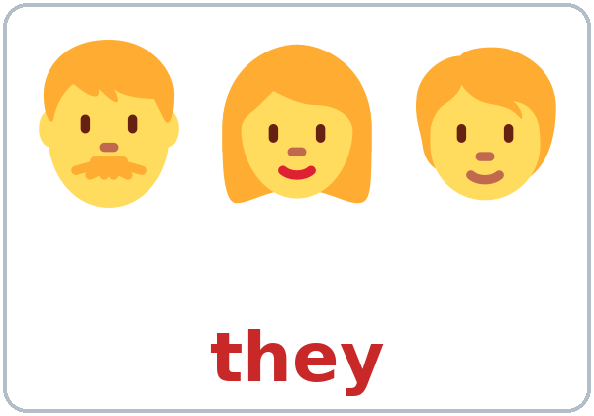
WARM-UP · 6:00
Hello + Review
What's your name?
How do you spell it?
A: How are you?
B: I'm fine, thanks.
And you?
Notes:
Time: 6:00-6:10 (10 minutes). Pairs, then new pairs. 15 learners: 7 pairs + 1 group of 3. 7-8 learners: 3-4 pairs. Late arrivals join any pair.
Before class: write on the board: What's your name? How do you spell it? How are you? Are you a student?
Model with one learner: "Hello! What's your name?" "Rosa." "How do you spell it?" "R-O-S-A." "How are you?" "I'm fine, thanks. And you?"
Click 1: A asks "How are you?" Click 2: B answers "I'm fine, thanks. And you?"
Do: pairs use the Hello + Review page. A asks the 4 questions (the last one is "Are you a student?" "Yes, I am."); B answers. Then switch. Then find a new partner and do it again.
Help phrases: "Can you repeat, please?" "I don't understand."
Homework check (last 3 minutes): partners show each other their Lesson 1 homework. Walk around and look. Collect any Lesson 1 Progress Checks that were not done.
New learners: give them a name tag and pair them with a strong partner.
If you are behind: one partner only.
Source: Level1_Lesson2.md, Lesson 2 (Step 1: Hello + Review; Student Pages: Hello + Review).
Picture: Twemoji graphics by Twitter, Inc. and other contributors (https://github.com/jdecked/twemoji), CC BY 4.0 (https://creativecommons.org/licenses/by/4.0/); resized and combined on a card with a drawn border (see images/CREDITS.md).

Slide 4
How We
Work
01
Listen.
02
Repeat.
Class: 6:00–7:30
Break: 6:45–7:00
Model it. Check it. Then go.
Pairs: turn to a neighbor.
03
Point. Circle.
04
Write.
05
Partner. Group.
Notes:
Time: about 1 minute, before New Words. Whole class.
Click once for each row. Say each word and do the action. Learners copy your gesture.
Hand to your ear: "Listen." Point to your mouth: "Repeat." Point and mime a circle: "Point. Circle." Mime writing: "Write." Point to two people: "Partner." Point to 3-4 people: "Group."
Use the same short words every time. Say less, show more.
Instruction rule: model it (do it with one learner while everyone watches), check it (ask: "Listen or write?"), then go.
Pairs: turn to a neighbor; with an odd number, make one group of 3. Groups: 3-4 learners. Mingle: everyone stands and talks to many classmates.
Point to the clock: class 6:00-7:30, break 6:45-7:00.
Source: Level1_Lesson2.md (How to Use This Plan: Instruction rule, Grouping toolkit; Clock-time plan).

Slide 5





Look. Listen.
Repeat.
New Words
★ country
★ city
★ Mexico
★ Guatemala
★ Honduras
★ El Salvador
Notes:
Time: 6:10-6:20 (10 minutes, with the next slide). Whole class, then pairs.
★ = the most important words. Teach these first.
Click once for each word. Point to the picture and say the word. Learners repeat 2 times.
Point to a country on the world map, then to the flag: "Mexico. This is a country."
country / city: "Mexico is a country. Guadalajara is a city." Then: "Honduras: country. Tegucigalpa: city."
Stress the strong part: MEX-i-co, gua-te-MA-la, hon-DU-ras, el SAL-va-dor.
Learners from other countries: write their country on the board and say it together. Every country is welcome.
If you are behind: teach the ★ words only.
Source: Level1_Lesson2.md, Lesson 2 (Key vocabulary; Step 2: New Words; Student Pages: New Words).
Picture: Twemoji graphics by Twitter, Inc. and other contributors (https://github.com/jdecked/twemoji), CC BY 4.0 (https://creativecommons.org/licenses/by/4.0/); resized and combined on a card with a drawn border (see images/CREDITS.md).

Slide 6


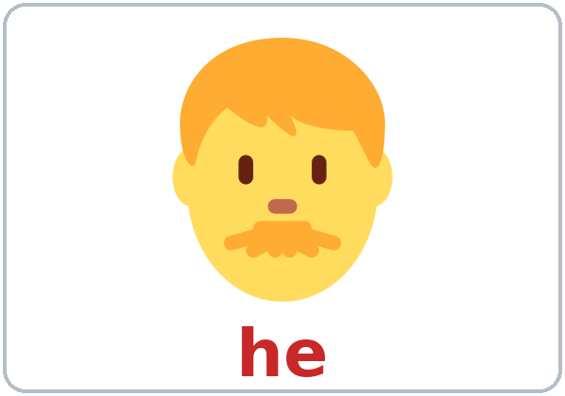
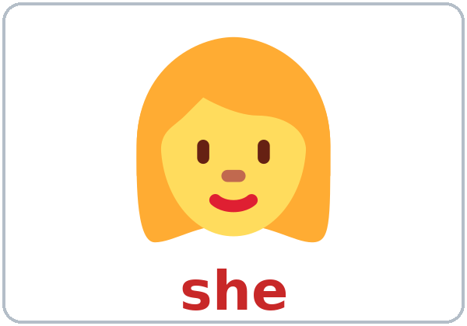
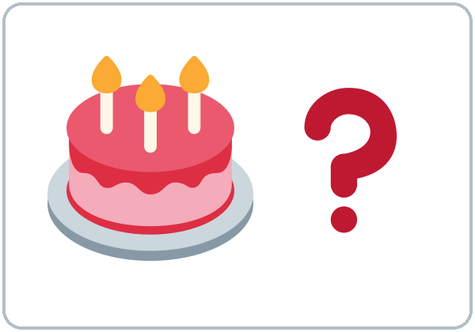
Partner game:
A points. B says.
More New Words
Colombia
★ the United States
★ he
★ she
★ they
★ How old?
Notes:
Click once for each word. Point to the picture and say the word. Learners repeat 2 times.
Stress: co-LOM-bi-a, the u-NI-ted STATES. Say "the United States" (or "the U.S."). Other countries have no "the".
he / she / they: point to a man in the room: "he." A woman: "she." A group: "they." Learners point as you say the word (fast, like a game).
How old?: point to the cake. "How old? ... 12. 20. 35." Hold up fingers.
Partner game (4 minutes): A points to a picture, B says the word. Then switch. Then: A points to a classmate, B says he or she.
Pairs: 15 learners = 7 pairs + 1 group of 3. 7-8 learners = 3-4 pairs.
If you are behind: teach the ★ words only. Colombia stays on the page for home study.
Source: Level1_Lesson2.md, Lesson 2 (Key vocabulary; Step 2: New Words; Student Pages: New Words, Partner game; Teacher notes: the United States).
Picture: Twemoji graphics by Twitter, Inc. and other contributors (https://github.com/jdecked/twemoji), CC BY 4.0 (https://creativecommons.org/licenses/by/4.0/); resized and combined on a card with a drawn border (see images/CREDITS.md).

Slide 7
Picture Check
Look at the picture. What's the word?
1
2
3
_________
_________
_________
Honduras
she
How old?
Notes:
Quick check of the new words (about 2 minutes). Whole class.
Point to picture 1. Ask: "What's this?" Wait. Learners say the word. Then click to show it. Learners repeat 2 times.
Do the same with pictures 2 and 3. Answers: 1 Honduras, 2 she, 3 How old?
For 2, point to a woman in the room: "she." For 3, hold up fingers: "How old? 12."
Source: Level1_Lesson2.md, Lesson 2 (Key vocabulary; Step 2: New Words).
Picture: Twemoji graphics by Twitter, Inc. and other contributors (https://github.com/jdecked/twemoji), CC BY 4.0 (https://creativecommons.org/licenses/by/4.0/); resized and combined on a card with a drawn border (see images/CREDITS.md).

Slide 8
Before You
Say it!
Listen
Where are you from?
Rosa and Marco are new students. It's the break.
What city?
01
How old is he?
Listen 1: Where from?
02
Listen 2: Yes or No?
Listen and repeat.
03
Listen 3: How old?
Notes:
Time: 6:20-6:32 for all of Listening (Tasks A, B, C). Learners work alone, then check with a partner.
Before you listen (1 minute): say: "This is Rosa. This is Marco. They are new students. It's the break." Point to the flags on Task A: "Where are they from? Listen."
Click once for each listen: Listen 1 = Task A (where from?), Listen 2 = Task B (Yes or No), Listen 3 = Task C (how old?).
The audio (L1_L2_listening.mp3, about 1:17) plays the conversation once. Press play again for the next listen. No speaker? Read the script with a volunteer, slowly.
Say it (2 minutes, after Task C): read "Where are you from?" and "How old is he?" The class repeats each line 2 times. Then pairs ask and answer each other.
If you are behind: play the audio 2 times, not 3.
Source: Level1_Lesson2.md, Lesson 2 (Step 3: Listening + Say it; Listening script; Student Pages: Listening).
Picture: Twemoji graphics by Twitter, Inc. and other contributors (https://github.com/jdecked/twemoji), CC BY 4.0 (https://creativecommons.org/licenses/by/4.0/); resized and combined on a card with a drawn border (see images/CREDITS.md).

Slide 9
Listening A
1. Rosa
a
b
c
d
Listen. Where are they from? Write the letter.
2. Marco
a
b
c
d
3. Marco's friends
a
b
c
d
a. Mexico
b. El Salvador
4. The teacher
a
b
c
d
c. the United States
d. Honduras
Notes:
Listen 1 (Task A). Learners work alone, then check with a partner.
Point to the 4 flags and say: "a, Mexico. b, El Salvador. c, the United States. d, Honduras." Learners repeat.
Say: "Listen. Where are they from? Write the letter." Play the audio. Then: "Show your partner."
Click once for each answer (4 clicks): 1 Rosa b (El Salvador), 2 Marco a (Mexico), 3 Marco's friends d (Honduras), 4 the teacher c (the United States).
Script lines: Marco: "I'm from Mexico." Rosa: "I'm from El Salvador." Marco: "They're from Honduras." Marco: "She's from the United States."
Source: Level1_Lesson2.md, Lesson 2 (Step 3: Listening; Listening script; Answer key: Listening Task A; Student Pages: Listening A).
Picture: Twemoji graphics by Twitter, Inc. and other contributors (https://github.com/jdecked/twemoji), CC BY 4.0 (https://creativecommons.org/licenses/by/4.0/); resized and combined on a card with a drawn border (see images/CREDITS.md).

Slide 10
Listen again.
Yes or No? Check ✓.
Listening B
1. Marco is from Mexico.
Yes
No
2. Rosa is from Mexico.
Yes
No
3. Marco's friends are from Honduras.
Yes
No
4. The teacher is from Mexico.
Yes
No
Notes:
Listen 2 (Task B). Learners work alone, then check with a partner.
Say: "Listen again. Yes or No?" Read the 4 sentences first. Play the audio. Then: "Show your partner."
Click once for each answer (4 clicks): 1 Yes, 2 No (Rosa is from El Salvador), 3 Yes, 4 No (the teacher is from the United States).
After each No, say the right sentence: "No, she isn't. She's from El Salvador." The class repeats.
Source: Level1_Lesson2.md, Lesson 2 (Step 3: Listening; Answer key: Listening Task B; Student Pages: Listening B).

Slide 11
Listening C
C
Listen again.
How old is Rosa's son?
1
Rosa's son is ___ years old.
12
Show your partner.
Then say it: listen and repeat 2 times.
2
He's ___ years old.
twelve
Say it: Where are you from?
Say it: How old is he?
Notes:
Listen 3 (Task C). Learners write the number. Then: "Show your partner."
Click 1: 12. Click 2: twelve. Rosa says: "He's twelve years old." Hold up 10 fingers, then 2.
Say it (2 minutes): read "Where are you from?" and "How old is he?" The class repeats each line 2 times. Then pairs ask and answer each other.
Age is optional: learners can use a practice age.
If you are behind: play the audio 2 times in total, and do Task C together on the board.
Source: Level1_Lesson2.md, Lesson 2 (Step 3: Listening + Say it; Answer key: Listening Task C; Student Pages: Listening C, Say it; Teacher notes: Age is optional).

Slide 12
Grammar Box 1
Where are you from?
QUESTION
ANSWER
Where are you from?
I'm from Mexico.
Where is he from?
He's from Guatemala.
Where are they from?
They're from Honduras.
What city?
Guadalajara.
Notes:
Time: 6:32-6:45 for all of Grammar. Whole class, then pairs.
Point left: "Question." Point right: "Answer." The left side is the question. The right side is the answer.
Read a question. Wait. Click to show the answer. The class reads it. Do all 4 rows (4 clicks).
Then point to a learner: "Where is he from?" Class: "He's from..." Ask "Where are you from?" to 2-3 learners. Any country or city is OK.
Other answers on the page: "She's from Colombia." "San Salvador."
Source: Level1_Lesson2.md, Lesson 2 (Step 4: Grammar Q&A; Student Pages: Grammar Box 1).
Picture: Twemoji graphics by Twitter, Inc. and other contributors (https://github.com/jdecked/twemoji), CC BY 4.0 (https://creativecommons.org/licenses/by/4.0/); resized and combined on a card with a drawn border (see images/CREDITS.md).

Slide 13
Grammar Box 2
Is she from Mexico?
QUESTION
ANSWER
Is
he / she
from Mexico?
Yes, he / she is.
No, he / she isn't.
Are
you / they
from Mexico?
Yes, I am. / Yes, they are.
No, I'm not. / No, they aren't.
Notes:
Part of Grammar Q&A (6:32-6:45). Whole class.
Point left: "Question." Point right: "Answer." Read the question in row 1. Wait. Click to show the answers. Do row 2 the same way (2 clicks).
Ask about learners in the room: "Is Rosa from Mexico?" "No, she isn't. She's from Guatemala."
Stress the short answers: Yes, she IS. No, she ISN'T. Never "Yes, she's." ("No, she's not." is also correct; the page teaches "isn't".)
Check questions: "Is he from Mexico? No, he ___." (isn't)
Source: Level1_Lesson2.md, Lesson 2 (Step 4: Grammar Q&A; Student Pages: Grammar Box 2; Teacher notes: Short answers).
Picture: Twemoji graphics by Twitter, Inc. and other contributors (https://github.com/jdecked/twemoji), CC BY 4.0 (https://creativecommons.org/licenses/by/4.0/); resized and combined on a card with a drawn border (see images/CREDITS.md).

Slide 14
Grammar Boxes 3 + 4
How old are you?
How old are you?
I'm
= I am
I'm 35.
I'm 35 years old.
How old is he? / she?
He's
= He is
He's 12.
She's 9.
Notes:
Part of Grammar Q&A (6:32-6:45). Whole class.
Box 4: ask "How old are you?" Answer for yourself (a real or a practice age). Click 1: "I'm 35." Write I'm 35. on the board. Then write "I have 35 years" and draw a big X on it.
Read "How old is he?" Click 2: "He's 12." "She's 9." The class repeats.
Box 3 (2 minutes): point to the big words: I'm = I am. He's = He is. Read the long form; the class reads the short form. Write: I -> am. he, she, it -> is. you, we, they -> are.
Other short forms on the page: you're, she's, it's, we're, they're; not: I'm not, he isn't, they aren't.
Age is optional. Say: "You can say a practice age."
Source: Level1_Lesson2.md, Lesson 2 (Step 4: Grammar Q&A; Student Pages: Grammar Boxes 3 and 4; Questions and answers; Teacher notes).
Picture: Twemoji graphics by Twitter, Inc. and other contributors (https://github.com/jdecked/twemoji), CC BY 4.0 (https://creativecommons.org/licenses/by/4.0/); resized and combined on a card with a drawn border (see images/CREDITS.md).

Slide 15
Write am, is, or are.
Use one word.
am, is,
or are?
1
I ____ from Honduras.
am
2
She ____ from Colombia.
is
I: am
he, she, it: is
you, we, they: are
Pairs: check your answers.
3
Where ____ you from?
are
4
____ he from Mexico?
Yes, he ____.
Is / is
5
They ___ from El Salvador.
are
Notes:
Part of Grammar (6:32-6:45). Learners write alone first.
Say: "Write am, is, or are." Do number 1 together. Pairs check: "Show your partner."
Click once for each answer: 1 am, 2 is, 3 are, 4 Is / is, 5 are. (Page item 6, "How old ___ you? I'm 30.", is are.)
Check questions: "She ___ from Colombia." (is) "Where ___ they from?" (are)
Pair drill (last 3-4 minutes): A asks from the left side of the grammar boxes about B or a classmate; B answers from the right side. Then switch.
If you are behind: skip the pair drill. It becomes homework, and Talk Time practices the same questions.
Source: Level1_Lesson2.md, Lesson 2 (Step 4: Grammar Q&A; Student Pages: Practice; Answer key: Grammar practice).

Slide 16
Common Mistakes
Don't say
Say
Is from Mexico.
She's from Mexico.
I have 35 years.
I'm 35.
Where you are from?
Where are you from?
Yes, she's.
Yes, she is.
Notes:
Use this slide after the grammar boxes, or any time you hear these mistakes.
Read the left side. Ask: "OK?" Shake your head: "No." Click to show the right answer. The class repeats it 2 times (4 clicks).
The big mistake this week: English always needs the person. Listen for "Is from Mexico" and give back "She's from Mexico."
The second big mistake: "I have 35 years" -> "I'm 35."
Also on the page: "She are from Peru." -> "She is from Peru." "I'm from mexico." -> "I'm from Mexico." (capital M).
Correct by saying the right form clearly. The learner repeats. Learners can read the Spanish note on their Grammar page; you don't need to explain it.
Source: Level1_Lesson2.md, Lesson 2 (Student Pages: Common mistakes; Teacher notes: The big mistake this week).
Picture: Twemoji graphics by Twitter, Inc. and other contributors (https://github.com/jdecked/twemoji), CC BY 4.0 (https://creativecommons.org/licenses/by/4.0/); resized and combined on a card with a drawn border (see images/CREDITS.md).

Slide 17
Talk Time
Class Map
Ask your partner.
Then tell a group.
7:00–7:10
1
Where are you from?
What city?
2
Write it.
Name, country, city.
3
This is ___.
He's / She's from ___.
Notes:
Time: 7:00-7:10 (10 minutes). Pairs, then groups of 3-4. 7-8 learners: pairs, then one group (the whole class).
Model with one learner: "Where are you from?" "Honduras." "What city?" "San Pedro Sula." Write it in the table on the board. Then turn to the class: "This is Marco. He's from Honduras. He's from San Pedro Sula."
Click once for each step.
Part 1 (3 minutes): pairs interview each other and write the partner's name, country, and city on the Talk Time page.
Part 2 (4 minutes): each pair joins another pair. Each learner introduces the partner: "This is ___. He's / She's from ___." The group asks one question: "What city?" or "Is she from ___?"
Part 3 (2 minutes): each learner puts a sticky note with their name on the world map (or you write the names on the board under each country).
Any country or city is OK. Never ask how or why someone came here.
Baseline snapshot: while groups talk, call about 5 learners you didn't check in Week 1, one at a time, for 2 minutes. Use the checklist in the answer key.
If you are behind: skip Part 3.
Source: Level1_Lesson2.md, Lesson 2 (Step 5: Talk Time: Class Map; Student Pages: Talk Time; Teacher notes: Countries and privacy).
Picture: Twemoji graphics by Twitter, Inc. and other contributors (https://github.com/jdecked/twemoji), CC BY 4.0 (https://creativecommons.org/licenses/by/4.0/); resized and combined on a card with a drawn border (see images/CREDITS.md).

Slide 18
Before You Go 7:10–7:15
01
Exit ticket
02
Homework
Say one sentence:
I'm from ___.
Or write it on paper.
1. Write about you.
2. Write am, is, or are.
3. Write the country.
4. Ask a friend. Write.
5. Spell your name.
Bring it next week!
Notes:
Time: 7:10-7:15 (5 minutes). Never skip this step.
Exit ticket: each learner says one sentence to you at the door ("I'm from ___." or "This is ___. She's from ___.") or writes one sentence on a slip. Copying from the grammar box is fine.
Homework (10 minutes): open the Homework page. Do item 1 together. Point to each instruction so learners know what to do at home.
Say: "Bring it next week!"
Source: Level1_Lesson2.md, Lesson 2 (Step 6: Exit Ticket + Homework; Student Pages: Homework).
Picture: Twemoji graphics by Twitter, Inc. and other contributors (https://github.com/jdecked/twemoji), CC BY 4.0 (https://creativecommons.org/licenses/by/4.0/); resized and combined on a card with a drawn border (see images/CREDITS.md).

Slide 19
Letters & Numbers · 7:15
Tricky Numbers
Numbers 0–20
0 1 2 3 4 5
6 7 8 9 10
11 12 13 14 15
16 17 18 19 20
NUMBER · SAY IT
TIP
3
three
th: tongue between teeth
7
seven
v: teeth on lip, not b
12
twelve
not "twenty"
13–19
thir-TEEN
say TEEN strong
20
TWEN-ty
say TWEN strong
Notes:
Time: 7:15-7:25 (10 minutes). Whole class, then pairs. Write 0-20 on the board (or use number cards) before class.
See it (2 minutes): point to each number, 0 to 20, and say it once. Hold up fingers for 0-10.
Say it (3 minutes): learners repeat 0-10, then 11-20.
Tricky numbers: say each one 3 times. Click to show the tip. Spend the most time on 3 (th: tongue between the teeth), 13-19 (stress the end: thir-TEEN), 12 / 20 (twelve, twenty), and 7 (v, not b).
Quick check (1 minute): say a number; learners hold up fingers or point on the page.
Learners who can't read or write yet: they say the numbers with everyone, hold up fingers, and point instead of circle.
If you are behind: do Tasks A and B only.
Source: Level1_Lesson2.md, Lesson 2 (Letters & Numbers step; Student Pages: Letters & Numbers A, Tricky numbers).

Slide 20
Listen to the teacher.
Circle the number.
Numbers: Task B
1.
2
12
20
2.
3
13
8
3.
5
15
9
4.
7
11
17
5.
20
12
2
Notes:
Task B (3 minutes). Learners listen and circle on their page.
Say each number 2 times, slowly: 1 twelve, 2 three, 3 fifteen, 4 seven, 5 twenty.
Click once for each answer (5 clicks): 1 12, 2 3, 3 15, 4 7, 5 20. Learners check their page.
Task C: read the 3 ages, 2 times each: 1 "He's 9." 2 "She's 14." 3 "They're 18 and 20." Learners write numbers, not words.
Task D: learners write "maria is from colombia." again with capital letters: Maria is from Colombia.
Task E (pairs): A says a number from 0 to 20; B writes it. A checks. Switch.
Learners who can't read or write yet: they point instead of circle. A helper, if you have one, sits with them.
Source: Level1_Lesson2.md, Lesson 2 (Letters & Numbers step; Answer key: Letters & Numbers Tasks B-D; Student Pages: Letters & Numbers B-E).

Slide 21
Progress Check 7:25
D. I can…
😀 🙂 😐
Check one face.
Match the question
Answer
1. Where are you from?
c. I'm from Honduras.
2. Is she from Mexico?
d. No, she isn't.
3. How old is he?
a. He's 12.
4. Where are they from?
b. They're from Colombia.
Notes:
Time: 7:25-7:30 (5 minutes). Learners work alone. Open the Progress Check page.
Part A: read the 5 numbers slowly, 2 times each: 1 13, 2 6, 3 20, 4 11, 5 17. Learners circle.
Part B (this slide): learners match each question to an answer on their page. Then click once for each answer: 1 c, 2 d, 3 a, 4 b.
Part C: learners write am, is, or are (1 am, 2 is, 3 are).
Part D: read each "I can..." line aloud and point to the 3 faces: 😀 "I can do it." 🙂 "A little." 😐 "Not yet." Learners check one.
Score: A /5 + B /4 + C /3 = /12. This is not a test grade. It shows who needs help with numbers (Part A) and with am / is / are (Parts B and C). Collect the pages, or check them at the start of Week 3.
If you are behind: do the Progress Check in Week 3 at 6:00, while learners arrive.
Source: Level1_Lesson2.md, Lesson 2 (Progress Check step; Answer key: Progress Check Parts A-C, scoring; Student Pages: Progress Check).

Slide 22
Great Work! See You Next Week!
Now you can:
• Say where you are from
• Ask: Where are you from?
• Say your age: I'm 35.
Lesson 2 · Level 1
Notes:
Wave and say: "Great work! See you next week!" Learners answer: "See you!" or "Bye!"
Read the three lines. Learners repeat. Ask one or two learners: "Where are you from?"
Remind them: "Homework. Bring it next week!"
Looking ahead: Lesson 3 adds his / her and numbers to 100.
Source: Level1_Lesson2.md, Lesson 2 (Objectives; Step 6; Teacher notes: Looking ahead).
Picture: Twemoji graphics by Twitter, Inc. and other contributors (https://github.com/jdecked/twemoji), CC BY 4.0 (https://creativecommons.org/licenses/by/4.0/); resized and combined on a card with a drawn border (see images/CREDITS.md).

Slide 23
Credits
Pictures
Vocabulary pictures use Twemoji graphics by Twitter, Inc. and other contributors (https://github.com/jdecked/twemoji), licensed under CC BY 4.0 (https://creativecommons.org/licenses/by/4.0/). The graphics were resized and combined on cards, and labels were added.
Other small pictures (the faces on the Progress Check) are standard emoji characters shown with the computer's emoji font.
Names
Rosa, Marco, and Maria are invented names. Learners can use a practice age.
Audio and font
Audio: synthetic voices (Narrator, Rosa, Marco) made with Chatterbox TTS (Resemble AI, MIT License), cloned from short synthetic clips made with Kokoro-82M (Apache 2.0); no recordings of real people were used. Each file carries an inaudible Perth watermark. Font: Lexend Deca (OFL 1.1).
© 2026 the authors. The authors license this deck under CC BY-NC-SA 4.0.
Notes:
This slide is for the record. You don't need to show it in class.
Pictures: 12 vocabulary cards (country, city, Mexico, Guatemala, Honduras, El Salvador, Colombia, the United States, he, she, they, How old?) made from Twemoji graphics, CC BY 4.0. The file-by-file list is in images/CREDITS.md.
Audio: L1_L2_listening.mp3 (about 1:17), synthetic voices made with Chatterbox TTS (MIT License), cloned from short reference clips made with Kokoro-82M (Apache 2.0). No recordings of real people. Names in the script are invented.
Source: Level1_Lesson2.md (Picture Credits); images/CREDITS.md; audio/README.md.

