Slide 1
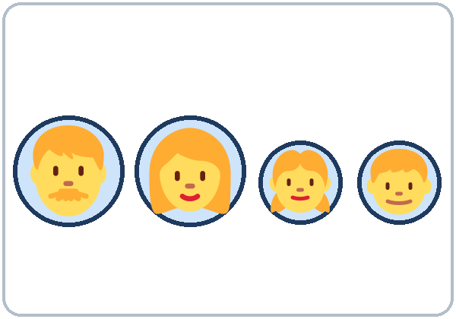
This Is My Family
Today you will:
• Name family members
• Say: This is my son.
• Ask: Do you have kids?
Lesson 4 · Level 1
Notes:
Welcome. Say: "Today: family." Point to the picture and say: "This is a family."
Say at the start: "You can talk about your family or Ana's family." Ana's family is the picture-card family. Every activity works with it.
Family can be a sensitive topic. Some learners have family far away or have lost family members. Never ask a learner to talk about their own family.
Class plan: 6:00 Hello + Review, 6:10 New Words, 6:20 Listening, 6:32 Grammar, 6:45 Break, 7:00 Talk Time, 7:10 Exit Ticket + Homework, 7:15 Letters & Numbers, 7:25 Progress Check.
Source: level1_curriculum/lesson4/Level1_Lesson4.md (At a glance, Clock-time plan, Teacher notes).
Pictures: Twemoji graphics by Twitter, Inc. and other contributors (https://github.com/jdecked/twemoji), CC BY 4.0 (https://creativecommons.org/licenses/by/4.0/); resized and combined with drawn parts (see images/CREDITS.md).

Slide 2
Today's
Goals
01
I can name family members.
mother, father, son, daughter…
02
I can say: This is my brother.
Tonight you learn these things.
Short sounds: dad, mom, son, kids
Progress Check at 7:25!
03
I can ask: Who's this? How old is he?
04
I can answer: Yes, I do. / No, I don't.
05
I can say: Ana's husband.
Notes:
Click to show each goal, one at a time. Read it aloud. Learners repeat.
Goal 1: point to people in the room or in a picture: mother, father, son, daughter.
Goal 4: nod for "Yes, I do." Shake your head for "No, I don't."
Goal 5: Ana's husband = the husband of Ana. You will practice this in Grammar Box 3.
Letters & Numbers at 7:15: short vowel sounds in family words (dad, mom, son, kids) and plural -s.
Source: level1_curriculum/lesson4/Level1_Lesson4.md (At a glance: Objectives).

Slide 3
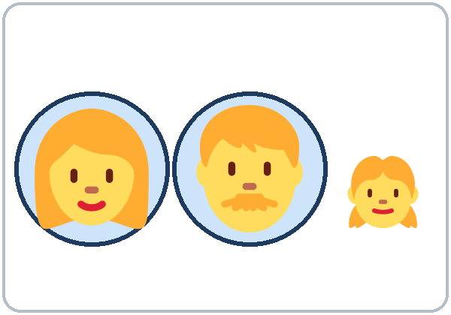
WARM-UP · 6:00
Hello + Review
What's your phone number?
What's your address?
A: What's her name?
B: Her name is Rosa.
Where is she from?
Notes:
Pairs. Review of last week's questions. 15 learners: 7 pairs + 1 group of 3. 7–8 learners: 3–4 pairs. Late arrivals join any pair.
Model with one learner: "What's your phone number?" Learner: "555-0163." Then: "Can you repeat, please?"
Point to another learner: "What's her name?" Click: "Her name is Rosa." Then ask: "Where is she from?"
Practice numbers (555-01__) are fine. Partners switch, then find a new partner.
Last 3 minutes: homework check. Partners show each other last week's homework. Look at item 2 (my / his / her / our / their).
If behind: one partner only.
Source: level1_curriculum/lesson4/Level1_Lesson4.md (Step 1: Hello + Review).
Pictures: Twemoji graphics by Twitter, Inc. and other contributors (https://github.com/jdecked/twemoji), CC BY 4.0 (https://creativecommons.org/licenses/by/4.0/); resized and combined with drawn parts (see images/CREDITS.md).

Slide 4
How We
Work
01
Listen.
02
Repeat.
Class: 6:00–7:30
Break: 6:45–7:00
Model it. Check it. Then go.
Your family or Ana's family. You choose.
03
Point. Circle.
04
Write.
05
Partner. Group.
Notes:
Click to show each class word. Say it and do the action. Learners repeat.
Use these same short words all night: Listen. Repeat. Point. Circle. Write. Partner. Group.
Instruction rule: model it (do it with one learner while everyone watches), check it (ask: "Listen or write?"), then go.
Say: "You can talk about your family or Ana's family. You choose." Don't ask who chooses what.
Pairs: turn to a neighbor. With an odd number, make one group of 3.
Source: level1_curriculum/lesson4/Level1_Lesson4.md (How to Use This Plan; Teacher notes).

Slide 5
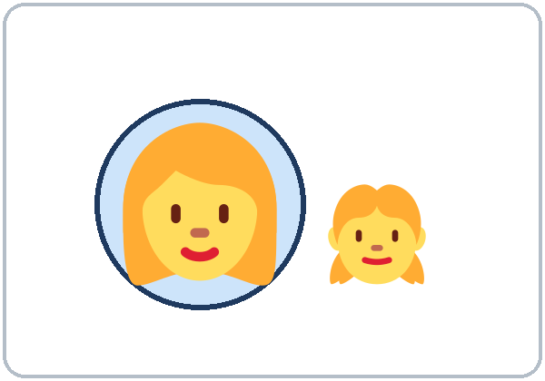
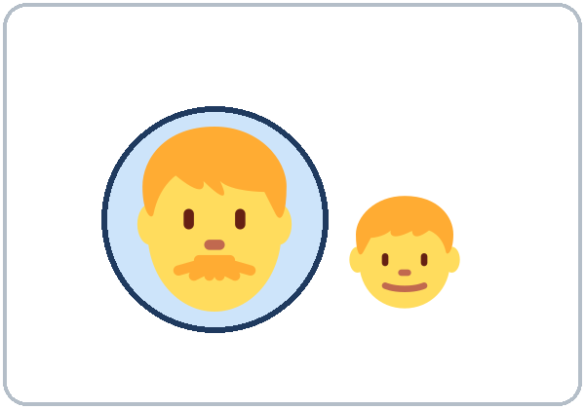
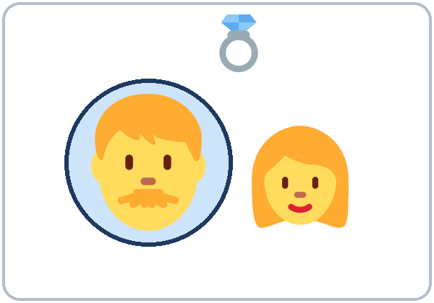
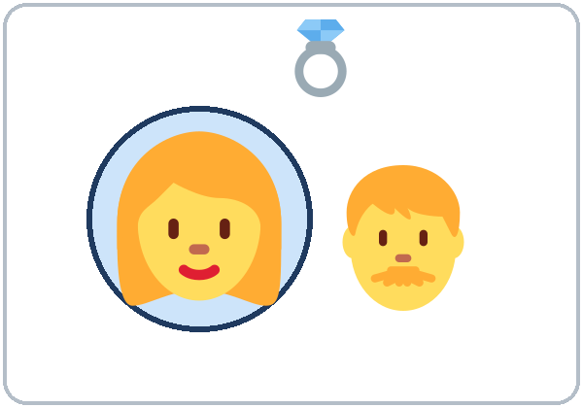
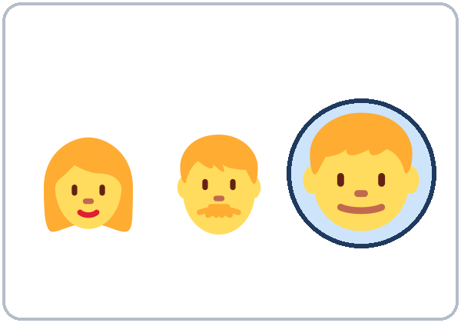
Look. Listen.
Repeat.
New Words
★ mother
★ father
★ parents
family
★ husband
★ wife
★ son
Notes:
Say first: "Today: family. You can talk about your family or Ana's family."
Click to show each picture. Point and say the word. Learners repeat 2 times. The person in the blue circle is the word.
Draw a simple family tree on the board (stick figures are fine). Point: "This is the mother. This is the father. They are the parents."
husband / wife: point to the ring.
parents = mother and father only (2 people). All the people = my family.
★ = most important words. If behind: teach the ★ words only.
Source: level1_curriculum/lesson4/Level1_Lesson4.md (Step 2: New Words; Student Pages: New Words).
Pictures: Twemoji graphics by Twitter, Inc. and other contributors (https://github.com/jdecked/twemoji), CC BY 4.0 (https://creativecommons.org/licenses/by/4.0/); resized and combined with drawn parts (see images/CREDITS.md).

Slide 6

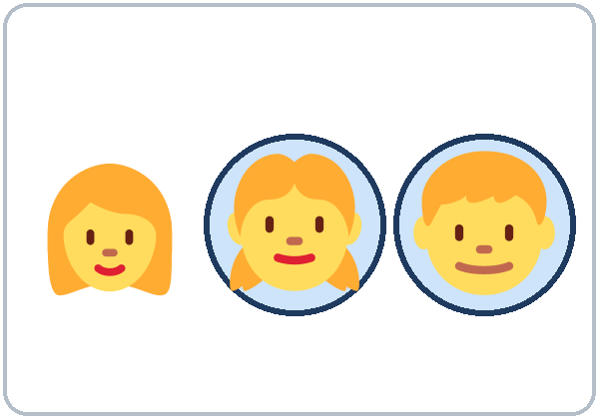
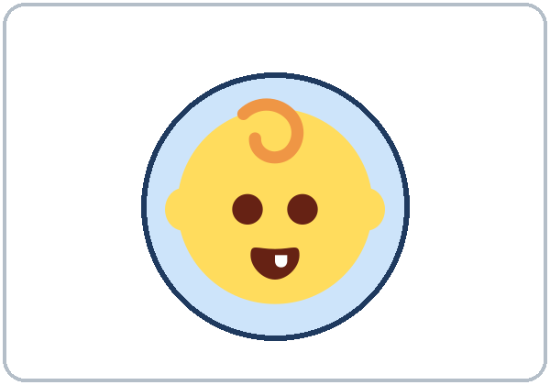
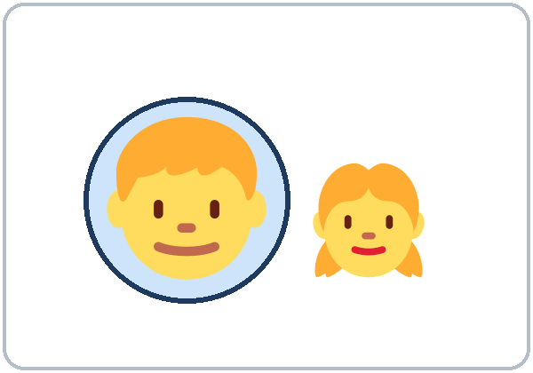
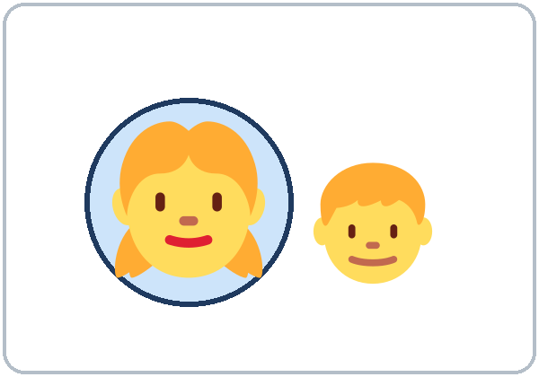
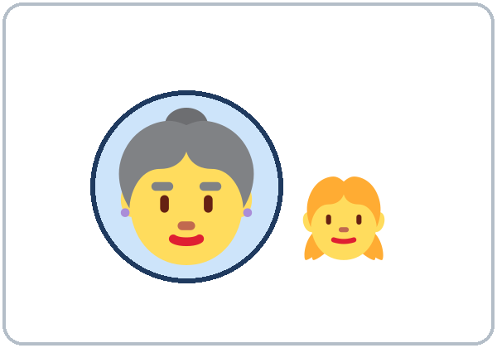
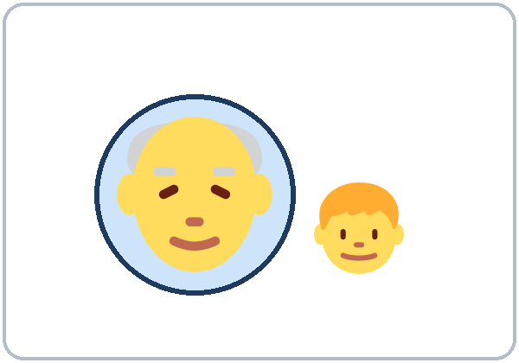
Partner game:
A points. B says.
More New Words
★ daughter
★ children (kids)
baby
brother
sister
grandmother
grandfather
Notes:
Click to show each picture. Say the word. Learners repeat 2 times.
kids = children: write "kids = children" on the board. "Kids" is everyday English. Also write: 1 child → 2 children.
Pairs (4 min): A points to a picture, B says the word. Then switch. Then A says a word, B points.
★ = most important words.
Source: level1_curriculum/lesson4/Level1_Lesson4.md (Step 2: New Words; Student Pages: New Words).
Pictures: Twemoji graphics by Twitter, Inc. and other contributors (https://github.com/jdecked/twemoji), CC BY 4.0 (https://creativecommons.org/licenses/by/4.0/); resized and combined with drawn parts (see images/CREDITS.md).

Slide 7
Picture Check
Look at the picture. What's the word?
1
2
3
_________
_________
_________
grandmother
daughter
husband
Notes:
Point to picture 1. Ask: "What's the word?" Learners say it. Click to show the answer: grandmother.
Picture 2: click to show daughter. Picture 3: click to show husband (point to the ring).
The person in the blue circle is the word. Learners say each word 2 times.
Source: level1_curriculum/lesson4/Level1_Lesson4.md (Student Pages: New Words).
Pictures: Twemoji graphics by Twitter, Inc. and other contributors (https://github.com/jdecked/twemoji), CC BY 4.0 (https://creativecommons.org/licenses/by/4.0/); resized and combined with drawn parts (see images/CREDITS.md).

Slide 8
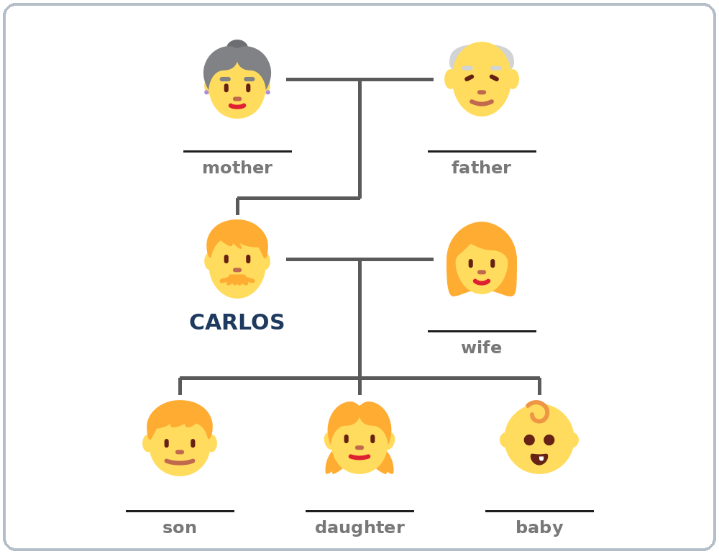
Before You
Say it!
Listen
Who's this?
Carlos shows Kim photos of his family.
This is my wife.
01
Do you have kids?
Listen 1: 1, 2, 3, 4.
02
Listen 2: The tree.
Listen and repeat.
03
Listen 3: Numbers.
Notes:
Before you listen (1 min). Say: "This is Carlos. This is Kim. Carlos has photos of his family on his phone."
Hold up your phone and pretend to show photos: "This is my wife… This is my son…"
Click to show each listen. Listen 1: Task A (point, then write 1, 2, 3, 4). Listen 2: Task B (names on the tree). Listen 3: Task C (numbers).
The audio L1_L4_listening.mp3 (about 1:17) plays the conversation once. Press play again for the next listen. Pairs compare after each task.
No speaker? Read the script with a volunteer.
Voices: Narrator, Kim, Carlos. Synthetic voices made with Chatterbox TTS (MIT), cloned from short synthetic clips made with Kokoro-82M (Apache 2.0); no recordings of real people.
Source: level1_curriculum/lesson4/Level1_Lesson4.md (Step 3: Listening; Listening script); audio/README.md.
Pictures: Twemoji graphics by Twitter, Inc. and other contributors (https://github.com/jdecked/twemoji), CC BY 4.0 (https://creativecommons.org/licenses/by/4.0/); resized and combined with drawn parts (see images/CREDITS.md).

Slide 9
Listening A
Listen. Point to the person. Write 1, 2, 3, 4.
a
_____
b
_____
c
_____
d
_____
2
4
1
3
Notes:
Listen 1. Learners point to each person they hear. Then they write 1, 2, 3, 4 under the pictures in the order they hear them.
Pairs compare: "Show your partner." Then click to show the answers in order: wife 1 (c), son 2 (a), daughter 3 (d), baby 4 (b).
Answer key: a son 2, b baby 4, c wife 1, d daughter 3.
Source: level1_curriculum/lesson4/Level1_Lesson4.md (Step 3: Listening; Answer key, Listening Task A).
Pictures: Twemoji graphics by Twitter, Inc. and other contributors (https://github.com/jdecked/twemoji), CC BY 4.0 (https://creativecommons.org/licenses/by/4.0/); resized and combined with drawn parts (see images/CREDITS.md).

Slide 10
Listening B
Carlos's family tree.
Write the names.
Pairs: show your partner.
Carmen
Pedro
Elena
Names
Elena · Daniel
Sofia · Leo
Carmen · Pedro
Daniel
Sofia
Leo
Notes:
Listen 2 (Task B). Learners write the names on Carlos's family tree. The names are in the box.
Pairs compare: "Show your partner." Then click to show each name, in the order of the audio: wife Elena, son Daniel, daughter Sofia, baby Leo, then his parents: mother Carmen, father Pedro.
Answer key: mother Carmen, father Pedro, wife Elena, son Daniel, daughter Sofia, baby Leo.
Carlos's parents are in Colombia.
Source: level1_curriculum/lesson4/Level1_Lesson4.md (Listening script; Answer key, Listening Task B).
Pictures: Twemoji graphics by Twitter, Inc. and other contributors (https://github.com/jdecked/twemoji), CC BY 4.0 (https://creativecommons.org/licenses/by/4.0/); resized and combined with drawn parts (see images/CREDITS.md).

Slide 11
Listen again. Write the number.
How many? How old?
Listening C
1
Carlos has ____ children.
3
2
Daniel is ____.
10
How many?
How old?
Pairs: show your partner.
3
Sofia is ____.
6
4
Kim has ____ kids.
0
5
Kim has ____ brothers.
2
Notes:
Listen 3 (Task C). Learners write the numbers: how many children, and ages.
Pairs compare. Then click to show each answer: 1) 3 (three children), 2) 10, 3) 6, 4) 0 (Kim: "No, I don't."), 5) 2 (two brothers).
If behind: do Task C together.
Source: level1_curriculum/lesson4/Level1_Lesson4.md (Answer key, Listening Task C).

Slide 12
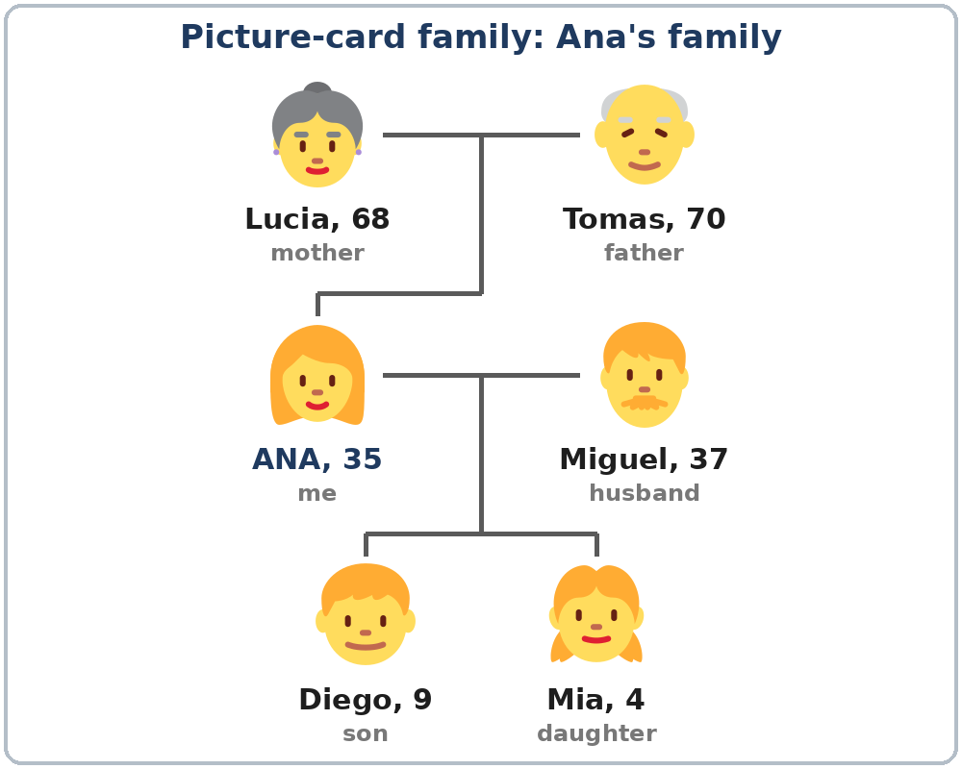
Grammar Box 1
Who's this?
QUESTION
ANSWER
Who's this?
This is my mother. Her name is Lucia.
Who's this?
This is my son. His name is Diego.
How old is she?
She's 68.
How old is he?
He's 9.
Notes:
Show the Grammar page. The left side is the question. The right side is the answer. Point left, then right.
Point to the picture-card family (Ana's family). Ask: "Who's this?" Learners answer. Click to show: "This is my mother. Her name is Lucia."
A man → his. A woman → her. (The same as last week.)
Click for each answer. Ana's family: Lucia 68 (mother), Tomas 70 (father), Miguel 37 (husband), Diego 9 (son), Mia 4 (daughter).
Ages: learners don't have to say their own age or their family's ages.
Source: level1_curriculum/lesson4/Level1_Lesson4.md (Step 4: Grammar Q&A, Box 1; Talk Time: Picture-Card Family).
Pictures: Twemoji graphics by Twitter, Inc. and other contributors (https://github.com/jdecked/twemoji), CC BY 4.0 (https://creativecommons.org/licenses/by/4.0/); resized and combined with drawn parts (see images/CREDITS.md).

Slide 13
Grammar Box 2
Do you have kids?
Optional
Are you married?
Yes, I am. / No, I'm not.
You don't have to answer.
QUESTION
ANSWER
Do
you have kids?
Yes, I do. I have two.
No, I don't.
Do
you have brothers
or sisters?
Yes, I do. I have one sister.
No, I don't.
Notes:
Box 2 is the key point. Ask: "Do you have kids?" Nod: "Yes, I do." Shake your head: "No, I don't."
Write on the board: Yes, I do. ✓ / Yes, I have. ✗. Then add the number: "Yes, I do. I have two."
Click to show each answer.
OPTIONAL: Are you married? Yes, I am. / No, I'm not. Learners don't have to answer. Do not ask this question to a learner in front of the class. Never ask "Where is your husband?" or "Why don't you have kids?"
Accept "No, I don't" and move on.
Source: level1_curriculum/lesson4/Level1_Lesson4.md (Step 4: Grammar Box 2; Grammar page; Teacher notes).

Slide 14
Grammar Boxes 3 + 4
Ana's husband
Ana → Ana's husband
Carlos's
= CAR-los-iz
Carlos's wife / kids
Kim's brothers
one → two
sons
1 son → 2 sons
a baby → two babies
a child → two children
Notes:
Box 3: hold up a learner's pen: "This is Maria's pen." Then: "Ana's husband" = the husband of Ana.
Names that end in s add 's too: Carlos's. Say "CAR-los-iz".
Box 4: one son → two sons. Clap on the -s. Point to children and babies: these are different (child → children, baby → babies).
Click to show the examples.
Check questions: "Do you have kids?" (Yes, I do. / No, I don't.) • point to a boy: "___ name is Daniel." (His) • "Ana has a husband. He's ___ husband." (Ana's)
Source: level1_curriculum/lesson4/Level1_Lesson4.md (Step 4: Grammar Boxes 3 and 4).
Pictures: Twemoji graphics by Twitter, Inc. and other contributors (https://github.com/jdecked/twemoji), CC BY 4.0 (https://creativecommons.org/licenses/by/4.0/); resized and combined with drawn parts (see images/CREDITS.md).

Slide 15
Write do, don't, his, her, or 's.
Use one word.
do, don't,
his, her, 's?
1
Do you have kids?
Yes, I ____.
do
2
Do you have brothers?
No, I ____.
don't
Short answer: do / don't
a man: his
a woman: her
Pairs: check your answers.
3
This is my sister.
____ name is Ana.
Her
4
This is my father.
____ name is Tomas.
His
5
Elena is Carlos____ wife.
's
Notes:
Learners write one word on each line. Then pairs check.
Click to show each answer: 1 do, 2 don't, 3 Her, 4 His, 5 Carlos's.
Pair drill (last 3–4 min): A asks from the left side about the picture-card family (Who's this? How old is he?); B answers from the right side. Then switch.
If behind: skip the pair drill. It becomes homework, and Talk Time practices the same questions.
Source: level1_curriculum/lesson4/Level1_Lesson4.md (Grammar: Practice; Answer key, Grammar practice).

Slide 16
Common Mistakes
Don't say
Say
Yes, I have.
Yes, I do. (I have two.)
You have kids?
Do you have kids?
the husband of Ana
Ana's husband
My sister… His name is Ana.
My sister… Her name is Ana.
I have two son.
I have two sons.
I have many parents in Mexico.
I have a big family in Mexico.
Notes:
Read each "Don't say" line. Shake your head. Click to show the correct line. Learners repeat it.
The big mistake this week: "Yes, I have." The short answer uses do: Yes, I do. / No, I don't. Then learners can add the number: I have two. Correct by nodding and saying "Yes, I do."
his / her: point to the person in the picture: "A woman… her."
parents = mother and father only. For all the people, say my family.
Source: level1_curriculum/lesson4/Level1_Lesson4.md (Grammar: Common mistakes; Teacher notes).
Pictures: Twemoji graphics by Twitter, Inc. and other contributors (https://github.com/jdecked/twemoji), CC BY 4.0 (https://creativecommons.org/licenses/by/4.0/); resized and combined with drawn parts (see images/CREDITS.md).

Slide 17
PAIR WORK · ANA'S FAMILY
Who's this?
A asks. B answers.
Then switch.
A: Who's this?
B: This is my son.
His name is Diego. He's 9.
Notes:
Pair drill with the picture-card family. You can be Ana. Point to a person.
A asks: "Who's this?" "How old is he / she?" B answers: "This is my son. His name is Diego. He's 9." Then switch.
Model first with one learner. Click to show the answer line.
Other examples: "This is my mother. Her name is Lucia. She's 68." "I have two kids."
Strong learners add 's and a question: "How old is Ana's son?" New learners use only "This is my ___." and point.
Source: level1_curriculum/lesson4/Level1_Lesson4.md (Step 4: pair drill; Talk Time: Picture-Card Family; Teacher notes).
Pictures: Twemoji graphics by Twitter, Inc. and other contributors (https://github.com/jdecked/twemoji), CC BY 4.0 (https://creativecommons.org/licenses/by/4.0/); resized and combined with drawn parts (see images/CREDITS.md).

Slide 18
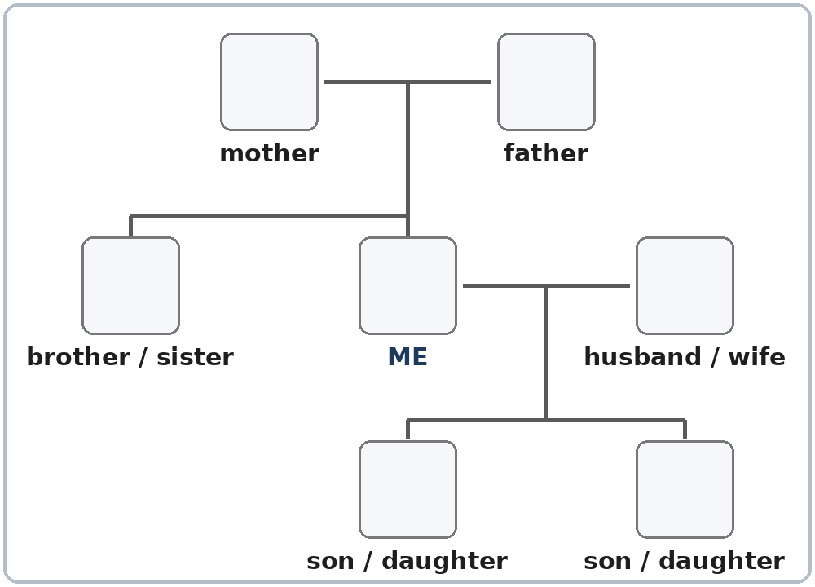
Talk Time
My Family Tree
Groups of 3.
You choose the family.
7:00–7:10
1
Write names on the tree.
Or use Ana's family.
2
Say 3 sentences.
This is my ___. Her name is ___.
3
The group asks 1 question.
Who's this? How old is he?
Notes:
Groups of 3. 15 learners: 5 groups. 7–8 learners: 2 groups of 3 + 1 pair (or 2 groups of 4).
Say again: "Your family or Ana's family. You choose." Don't ask who chooses what.
Model (2 min): fill in the board tree with your family or an invented family. Say 3 sentences: "This is my sister. Her name is Laura. She's 30." A learner asks you one question: "How old is he?"
Part 1 (3 min): each learner fills in the blank tree (names, ages if they want), or uses Ana's family. Learners who can't write yet can draw faces or point.
Part 2 (5 min): each person shows the tree and says 3 sentences (This is my ___. His / Her name is ___. He's / She's ___.). The others ask one question each (Who's this? How old is he? Do you have kids?).
Fast groups: one sentence with 's: "Rosa's son is 12." If behind: 2 sentences each, skip the questions.
Source: level1_curriculum/lesson4/Level1_Lesson4.md (Step 5: Talk Time).
Pictures: Twemoji graphics by Twitter, Inc. and other contributors (https://github.com/jdecked/twemoji), CC BY 4.0 (https://creativecommons.org/licenses/by/4.0/); resized and combined with drawn parts (see images/CREDITS.md).

Slide 19
Before You Go 7:10–7:15
01
Exit ticket
02
Homework
Say one sentence:
This is my son.
His name is ___.
Or write:
Do you have kids?
Yes, I do. / No, I don't.
1. Write 3 sentences.
2. Write do or don't.
3. Write 's.
4. Ask: Do you have kids?
5. Write a phone number.
Bring it next week!
Notes:
Exit ticket (never skip): each learner says one sentence about a family member (or a person in Ana's family): "This is my son. His name is…"
Or learners write "Yes, I do." / "No, I don't." for "Do you have kids?". Copying is fine.
Homework (10 minutes): open the Homework page. Do item 1 together (the first sentence). Point to each instruction.
Homework: 1) 3 sentences about your family or Ana's family; 2) do / don't; 3) 's (Carlos's son, Kim's brothers, Rosa's daughter); 4) ask a family member or a friend: Do you have kids? Do you have brothers or sisters?; 5) review: a phone number (a practice number is OK).
Homework answers: item 2: 1 do, 2 don't, 3 do, 4 don't.
Source: level1_curriculum/lesson4/Level1_Lesson4.md (Step 6: Exit Ticket + Homework; Student Pages: Homework).
Pictures: Twemoji graphics by Twitter, Inc. and other contributors (https://github.com/jdecked/twemoji), CC BY 4.0 (https://creativecommons.org/licenses/by/4.0/); resized and combined with drawn parts (see images/CREDITS.md).

Slide 20
Letters & Numbers · 7:15
Short sounds
Say them short!
dad · mom
son · kids
son = letter o,
sound u (but)
SOUND
SAY
a (dad)
dad · has · man · family
o (mom)
mom · not · job · stop
u sound (son)
son · mother · brother · but
i (kids)
kids · sister · six · this
Notes:
Letters & Numbers (10 min). Whole class, then pairs. Use the Letters & Numbers page, Task A.
See it (1 min): point to the 4 columns: a (dad), o (mom), u sound (son), i (kids). Click to show each row.
Say it (3 min): say each row. Learners repeat. The vowels are short: say them quickly.
son, mother, brother: the letter is o, but the sound is u (like but).
Quick check (1 min): say "dad" or "kids"… learners point to the row. Partners: A points to a word, B reads it. Switch.
Task C (one → two): brothers, sisters, sons, daughters, parents (child → children, no -s). Task D: copy "This is my mom." "This is my dad." Point to the capital T and the period.
Learners who can't read or write yet say the words with everyone and point. If behind: do Tasks A and B only.
Source: level1_curriculum/lesson4/Level1_Lesson4.md (Letters & Numbers; Answer key, Task C).

Slide 21
Listen to the teacher.
Circle the word.
Letters: Task B
1.
mom
man
2.
dad
did
3.
kids
cats
4.
has
his
5.
big
bag
Notes:
Task B. Say each word 2 times: 1 mom, 2 dad, 3 kids, 4 his, 5 big. Learners circle the word they hear.
Then click to show each answer circle. Pairs check.
Answer key: 1 mom, 2 dad, 3 kids, 4 his, 5 big.
Source: level1_curriculum/lesson4/Level1_Lesson4.md (Answer key, Letters & Numbers Task B).

Slide 22
Progress Check 7:25
D. I can…
😀 🙂 😐
Check one face.
B. Match the question
Answer
1. Who's this?
c. This is my son.
2. Do you have kids?
d. Yes, I do. I have two.
3. How old is he?
a. He's ten.
4. What's his name?
b. His name is Daniel.
Notes:
Progress Check (5 min). Individuals. Open the Progress Check page.
Part A: read the 5 words slowly, 2 times each: 1 father, 2 daughter, 3 wife, 4 brother, 5 grandmother. Learners circle.
Parts B and C: learners match and write on their own. Help with the instructions only. Click to show the Part B answers when you check together: 1 c, 2 d, 3 a, 4 b.
Part C answers: 1 Her, 2 His, 3 Ana's.
Part D: read each "I can…" line and point to the 3 faces: 😀 "I can do it." 🙂 "A little." 😐 "Not yet." Learners check one.
Score: A /5 + B /4 + C /3 = /12. This is not a test grade. Collect the pages. If behind: do it in Week 5 at 6:00.
Source: level1_curriculum/lesson4/Level1_Lesson4.md (Progress Check; Answer key).

Slide 23
Great Work! See You Next Week!
Now you can:
• Say: This is my son.
• Ask: Do you have kids?
• Say: Ana's husband
Lesson 4 · Level 1
Notes:
Say: "Great work! See you next week!" Remind learners: bring the homework next week.
Collect the Progress Check pages (or check them at the start of Week 5).
Looking ahead: Lesson 5 (jobs) uses do again: "Do you work at night?"
Source: level1_curriculum/lesson4/Level1_Lesson4.md (Teacher notes: Looking ahead).
Pictures: Twemoji graphics by Twitter, Inc. and other contributors (https://github.com/jdecked/twemoji), CC BY 4.0 (https://creativecommons.org/licenses/by/4.0/); resized and combined with drawn parts (see images/CREDITS.md).

Slide 24
Credits
Pictures
Vocabulary pictures and family trees use Twemoji graphics by Twitter, Inc. and other contributors (https://github.com/jdecked/twemoji), licensed under CC BY 4.0 (https://creativecommons.org/licenses/by/4.0/). The graphics were resized and combined, and highlight circles, family-tree lines, boxes, and labels were added. Labels on the pictures use the DejaVu Sans font.
Other small pictures (the faces on the Progress Check) are standard emoji characters shown with the computer's emoji font.
Names
All names and ages (Carlos, Kim, Ana, and their families) are invented.
Audio and font
Audio: synthetic voices (Narrator, Kim, Carlos) made with Chatterbox TTS (Resemble AI, MIT License), cloned from short synthetic clips made with Kokoro-82M (Apache 2.0); no recordings of real people were used. Each file carries an inaudible Perth watermark. Font: Lexend Deca (OFL 1.1).
© 2026 the authors. The authors license this deck under CC BY-NC-SA 4.0.
Notes:
Credits for the pictures, audio, and font.
Pictures: Twemoji (CC BY 4.0), https://github.com/jdecked/twemoji. Audio: Chatterbox TTS (MIT) voices cloned from short synthetic Kokoro-82M (Apache 2.0) clips; no recordings of real people.
Sources: Level1_Lesson4.md (Picture Credits), images/CREDITS.md, audio/README.md.

