Slide 1
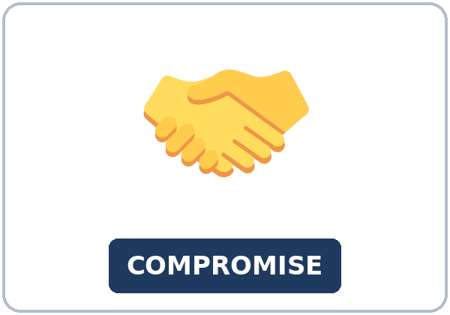
Can We Meet in the Middle?
Today you will:
• I can say what they need and ask what the other person needs
• I can offer a middle idea
• I can explain a result with so… that or such… that
Lesson 10 · Level 5
Notes:
Welcome learners as they arrive.
Read the three lines under Today you will.
Lesson plan: Topic; At a glance: Objectives.
Picture: Twemoji graphics by Twitter, Inc. and other contributors (https://github.com/jdecked/twemoji), CC BY 4.0 (https://creativecommons.org/licenses/by/4.0/); resized and combined, with signs and labels (images/CREDITS.md).

Slide 2
Today's
Goals
01
I can say what they need and ask what the other person needs
02
I can offer a middle idea
03
I can explain a result with so… that or such… that
By the end of class, you can do these things.
04
I can use work out, call off, or give in in a real sentence
Notes:
Read each goal slowly. Learners repeat.
Lesson plan: At a glance: Objectives.

Slide 3

OPENING TALK · 6:00
Opening Talk
Work with a partner. A asks a card
question. B answers in about four sentences. A asks one follow-up. Then switch.
sentences. A asks one follow-up. Then
switch.
Notes:
Step 1 · 6:00–6:06 · Opening Talk.
Work with a partner.
Lesson plan: Step 1; Opening Talk page.
Picture: Twemoji graphics by Twitter, Inc. and other contributors (https://github.com/jdecked/twemoji), CC BY 4.0 (https://creativecommons.org/licenses/by/4.0/); resized and combined, with signs and labels (images/CREDITS.md).

Slide 4
Opening Talk
Cards
01
Work with a partner. A asks a card question. B answers in about four
02
sentences. A asks one follow-up. Then switch.
Work with a partner. A asks a card question. B
answers in about four sentences. A asks one follow-up. Then switch.
Notes:
Each click shows the next card.
A asks. B answers. Then switch.
Lesson plan: Step 1; Opening Talk page.

Slide 5


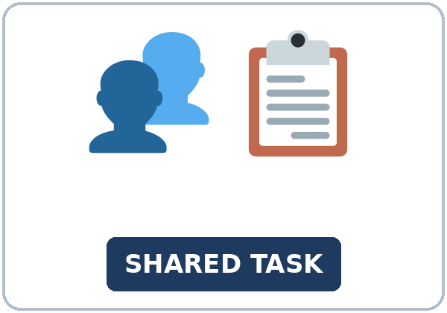

Look. Listen.
Repeat.
New Words
★ compromise
★ offer
★ counteroffer
★ priority
★ shared task
★ solution
Notes:
Step 2 · 6:06–6:12 · New Words.
Point to each picture. Learners repeat. ★ = most important.
Lesson plan: Step 2; New Words page.
Pictures: Twemoji graphics by Twitter, Inc. and other contributors (https://github.com/jdecked/twemoji), CC BY 4.0 (https://creativecommons.org/licenses/by/4.0/); resized and combined, with signs and labels (images/CREDITS.md).

Slide 6
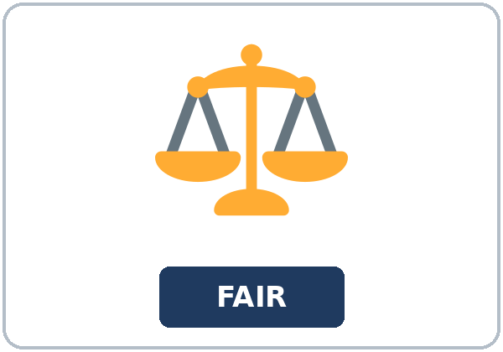

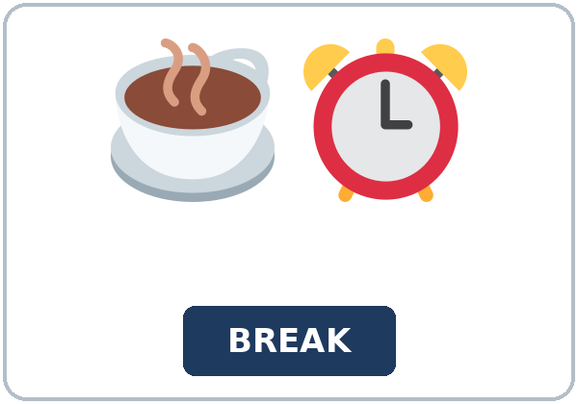



Partner game:
Say it in a sentence
More New Words
★ fairness
★ sticky note
★ break time
★ swap
whiteboard
middle
Notes:
A points to a picture. B names it and uses it in one sentence. Then switch.
Lesson plan: Step 2; New Words page; Partner game.
Pictures: Twemoji graphics by Twitter, Inc. and other contributors (https://github.com/jdecked/twemoji), CC BY 4.0 (https://creativecommons.org/licenses/by/4.0/); resized and combined, with signs and labels (images/CREDITS.md).

Slide 7
Check the Meaning
Look at the picture. Answer the question.
1
2
3
Is a compromise one person winning?
Does give in take an object here?
Which is right: so busy that, or so busy so?
No. A middle idea.
No.
so busy that
Notes:
The answers are hidden. Ask, then click.
1. No. A middle idea.
2. No.
3. *so busy that*
Lesson plan: Step 2: Check the Meaning.
Pictures: Twemoji graphics by Twitter, Inc. and other contributors (https://github.com/jdecked/twemoji), CC BY 4.0 (https://creativecommons.org/licenses/by/4.0/); resized and combined, with signs and labels (images/CREDITS.md).

Slide 8
Before You
Listen for:
Listen
Listen. What is the problem?
Camila and Jon both need Saturday.
| 6:12–6:32 | Listening (play 1 Task A, play 2 Tasks B and C) + Hear
01
Audio (about 2:30): coming soon.
Ms. Nguyen
02
Camila
Play 1: Task A
03
Jon
Notes:
Step 3 · 6:12–6:32 · Listening. Play 1 is Task A. Play 2 is Tasks B and C. A third play is fine.
Camila and Jon both need Saturday.
The script says going to and want to. Learners only need to recognize gonna and wanna.
Lesson plan: Step 3; Listening page.
Picture: Twemoji graphics by Twitter, Inc. and other contributors (https://github.com/jdecked/twemoji), CC BY 4.0 (https://creativecommons.org/licenses/by/4.0/); resized and combined, with signs and labels (images/CREDITS.md).
Listening script (the audio is coming soon; until then, read it aloud with a volunteer at a normal, friendly speed):
Narrator: Lesson ten. Camila and Jon share a Saturday job. They both want the day off. Ms. Nguyen asks them to work it out before she calls the shift off.
Ms. Nguyen: I don't want to call the shift off. The week was so busy that we need Saturday. Please meet in the middle.
Camila: I want to take the morning off. I have a class, and that class is my priority.
Jon: I hear you. I have a family visit in the afternoon. I was going to ask for the whole day too.
Ms. Nguyen: Say the other person's idea before you offer yours.
Camila: Jon, you need the afternoon for a family visit. I need the morning for my class.
Jon: Yes. What if we split the day? I can take the morning if you take the afternoon.
Camila: That is a fair offer. My class ends at noon. What if we swap at twelve? That is my counteroffer.
Jon: Your counteroffer works. The week was so busy that we split Saturday.
Camila: And it was such a long shift that we shared it. The week is too full for one person.
Jon: The visit is so important that I need the afternoon. This solution is about fairness.
Camila: My class is so important that I need the morning. We didn't give in. We found the middle.
Jon: I'll write the shared task on a sticky note and put it on the whiteboard.
Camila: We each get a break time. I'm going to come in at noon.
Ms. Nguyen: Read the compromise, please. I want to hear it.
Jon: I'm going to work the morning. Camila is going to work the afternoon. We swap at twelve.
Camila: Noon is such a clear time that nobody has to guess.
Ms. Nguyen: You worked it out. I'm not going to call it off. Thank you for the compromise.
Narrator: That's the end of the listening.

Slide 9
Listen. What is the problem?
Listening A
1.
a. Camila wants a new job
b. Both need Saturday off
c. The store is closed
Notes:
Click to circle b.
Lesson plan: Step 3; Listening Task A; Answer key.

Slide 10
B. Listen again. Circle the answers.
Listening B
1. Camila's priority
a morning class
an afternoon visit
a second job
2. Jon's limit
a morning class
an afternoon visit
the whiteboard
3. They swap at
ten
twelve
four
4. The shift was
so short
such a long shift
too easy
5. They write the plan on
a sticky note
a napkin
a menu
6. Ms. Nguyen is going to
call it off
not call it off
give in
Notes:
Click to circle each answer: 1 a morning class • 2 an afternoon visit • 3 twelve • 4 such a long shift • 5 a sticky note • 6 not call it off
Lesson plan: Step 3; Listening Task B; Answer key.

Slide 11
Listen again.
Listen again. Write so or su
Listening C
1
The week was ______ busy that we split Saturday.
so
2
It was ______ a long shift that we shared it.
such
3
The visit is ______ important that I need the afternoon.
so
Write the missing words.
Then check together.
4
Noon is ______ a clear time that nobody has to guess.
such
5
The week was ______ busy that we need Saturday.
so
6
My class is ______ important that I need the morning.
so
Notes:
Click to show each answer: 1 so • 2 such • 3 so • 4 such • 5 so • 6 so
Lesson plan: Step 3; Listening Task C; Answer key.

Slide 12
Hear it: gonna and wanna are short forms
Hear It,
Say It
Say it: use the full forms
I want to take the morning off.
I was going to ask for the whole day too.
gonna and wanna are short forms. This listening uses the full forms.
You can say going to and want to.
Say each line two times.
I'm going to work the morning.
What if WE split the day?
Notes:
gonna and wanna are short forms. This listening uses the full forms. Say each line two times.
Lesson plan: Step 3: Hear it, say it.

Slide 13
Grammar Box 1
a middle idea
YOU CAN SAY
A MIDDLE IDEA
What if we split the day?
I can take the morning if you take the afternoon.
Let's meet in the middle.
We can swap at twelve.
Say the other idea first.
You need the afternoon. I need the morning.
Notes:
Grammar Box 1: a middle idea. Each click shows the answer side.
Lesson plan: Step 4; Grammar Box 1.
Picture: Twemoji graphics by Twitter, Inc. and other contributors (https://github.com/jdecked/twemoji), CC BY 4.0 (https://creativecommons.org/licenses/by/4.0/); resized and combined, with signs and labels (images/CREDITS.md).

Slide 14
Grammar Box 2
so… that / such… that
PATTERN
EXAMPLE
so + adjective + that
The week was so busy that we split Saturday.
such + a + adjective + noun + that
It was such a long shift that we shared it.
so + adjective + that
The visit is so important that Jon needs the afternoon.
such + a + adjective + noun + that
Noon is such a clear time that nobody has to guess.
Notes:
Grammar Box 2: so… that / such… that. Each click shows the answer side.
Lesson plan: Step 4; Grammar Box 2.
Picture: Twemoji graphics by Twitter, Inc. and other contributors (https://github.com/jdecked/twemoji), CC BY 4.0 (https://creativecommons.org/licenses/by/4.0/); resized and combined, with signs and labels (images/CREDITS.md).

Slide 15
Grammar Box 3
work out, call off, give
REVIEW
A REAL SENTENCE
work it out
We can work it out.
call it off
She is not going to call it off.
call the shift off
Noun after, or it in the middle: call it off.
give in
We didn't give in. No object.
Notes:
Grammar Box 3: work out, call off, give in (review). Each click shows the answer side.
Lesson plan: Step 4; Grammar Box 3.
Picture: Twemoji graphics by Twitter, Inc. and other contributors (https://github.com/jdecked/twemoji), CC BY 4.0 (https://creativecommons.org/licenses/by/4.0/); resized and combined, with signs and labels (images/CREDITS.md).

Slide 16
Grammar Box 4
don't mix them
DON'T MIX THEM
SAY
so + adjective + that
The week was so busy that we split Saturday.
such a + adjective + noun
It was such a long shift that we shared it.
too + adjective + for
The week is too full for one person.
Notes:
Grammar Box 4: don't mix them. Each click shows the answer side.
Lesson plan: Step 4; Grammar Box 4.
Picture: Twemoji graphics by Twitter, Inc. and other contributors (https://github.com/jdecked/twemoji), CC BY 4.0 (https://creativecommons.org/licenses/by/4.0/); resized and combined, with signs and labels (images/CREDITS.md).

Slide 17
Practice A
Write.
Practice A
1
The week was ______ busy that we split Saturday.
so
2
It was ______ a long shift that we shared it.
such
3
The week is ______ full for one person.
too
Write the missing word.
Pairs: check your answers.
4
The class is ______ important that she needs the morning.
so
5
It was ______ a fair plan that they both said yes.
such
6
We can work ______.
it out
Notes:
Click to show each answer: 1 so • 2 such • 3 too • 4 so • 5 such • 6 it out
Lesson plan: Step 4; Grammar Practice A; Answer key.

Slide 18
Circle the correct words.
Practice B
1. The week was ______ busy that we split it.
so
such
2. It was ______ a long shift.
so
such
3. Work ______ .
it out
out it
4. Call ______ .
it off
off it
5. We didn't ______ .
give in
give in the argument
6. The week is ______ full for one person.
too
such
Notes:
Click to circle each answer: 1 so • 2 such • 3 it out • 4 it off • 5 give in • 6 too
Lesson plan: Step 4; Grammar Practice B; Answer key.

Slide 19
Common Mistakes
Don't say
Say
The week was so busy so we split it.
The week was so busy that we split it.
It was so long shift.
It was such a long shift.
Give in the argument.
Give in. No object here.
Work out it.
Work it out.
Notes:
Read Don't say, then Say. Learners try first. Then click.
Lesson plan: Grammar: Common mistakes.
Picture: Twemoji graphics by Twitter, Inc. and other contributors (https://github.com/jdecked/twemoji), CC BY 4.0 (https://creativecommons.org/licenses/by/4.0/); resized and combined, with signs and labels (images/CREDITS.md).

Slide 20
Pair Check
A says.
01
Then switch.
A says a need: "I need the morning for a class." B says it back, then offers: "You need
B answers.
02
What if I take the afternoon?" Then switch.
Notes:
A says a need: "I need the morning for a class." B says it back, then offers: "You need the morning. What if I take the afternoon?" Then switch. ---
Break · 6:45–7:00.
Lesson plan: Step 4: Pair check.
Picture: Twemoji graphics by Twitter, Inc. and other contributors (https://github.com/jdecked/twemoji), CC BY 4.0 (https://creativecommons.org/licenses/by/4.0/); resized and combined, with signs and labels (images/CREDITS.md).

Slide 21
Talk Time
Talk Time
Pairs.
Pairs.
7:00–7:18
1
Pairs.
2
Pairs.
3
Pairs.
Notes:
Round 1.
Lesson plan: Step 5; Talk Time.
Picture: Twemoji graphics by Twitter, Inc. and other contributors (https://github.com/jdecked/twemoji), CC BY 4.0 (https://creativecommons.org/licenses/by/4.0/); resized and combined, with signs and labels (images/CREDITS.md).

Slide 22
Talk Time
Talk Time
Pairs.
Groups of 3.
7:00–7:18
1
Groups of 3.
2
Groups of 3.
3
Groups of 3.
Notes:
Round 2.
Lesson plan: Step 5; Talk Time.
Picture: Twemoji graphics by Twitter, Inc. and other contributors (https://github.com/jdecked/twemoji), CC BY 4.0 (https://creativecommons.org/licenses/by/4.0/); resized and combined, with signs and labels (images/CREDITS.md).

Slide 23
Read.
Answer.
Read &
Write
1
What is the shared task?
The Saturday shift
2
What is Camila's priority?
A morning class
Read the page.
Answer the questions.
3
When do they swap?
At noon
4
Where did they copy the plan?
On the whiteboard
5
Is Ms. Nguyen going to call the shift off?
No. She will not call it off
Notes:
Step 6 · 7:18–7:25 · Read & Write.
Click to show each answer: 1 The Saturday shift • 2 A morning class • 3 At noon • 4 On the whiteboard • 5 No. She will not call it off
Lesson plan: Step 6; Read & Write page; Answer key.

Slide 24
Before You Go 7:25–7:30
01
Exit ticket
02
Homework
Describe a small compromise.
Name: Date:
1.
Give this page to your teacher.
About 20–25 minutes.
1. Write one so… that sentence.
2. Finish your message (Read & Write).
3. Tell a friend a small compromise. Write one sentence they said.
4. Review: work it out, call it off, give in. Write one real sentence
Bring it next week!
Notes:
Step 7 · 7:25–7:30 · Exit ticket and homework. Never skip the exit ticket.
Describe a small compromise.
Lesson plan: Step 7; Exit Ticket page; Homework page.
Picture: Twemoji graphics by Twitter, Inc. and other contributors (https://github.com/jdecked/twemoji), CC BY 4.0 (https://creativecommons.org/licenses/by/4.0/); resized and combined, with signs and labels (images/CREDITS.md).

Slide 25
Goodbye! See You Next Week!
Now you can:
• I can say what they need and ask what the other person needs
• I can offer a middle idea
• I can explain a result with so… that or such… that
Lesson 10 · Level 5
Notes:
Read the three Now you can lines.
Homework is about 20–25 minutes. Bring it next week.
Lesson plan: At a glance: Objectives; Step 7.
Picture: Twemoji graphics by Twitter, Inc. and other contributors (https://github.com/jdecked/twemoji), CC BY 4.0 (https://creativecommons.org/licenses/by/4.0/); resized and combined, with signs and labels (images/CREDITS.md).

Slide 26
Credits
Pictures
Vocabulary pictures use Twemoji graphics by Twitter, Inc. and other contributors (https://github.com/jdecked/twemoji), licensed under CC BY 4.0 (https://creativecommons.org/licenses/by/4.0/). The graphics were resized and combined, and signs and labels were added.
Names and story
Ms. Nguyen, Camila, and Jon are invented names. The listening story is invented.
Audio and font
Audio (coming soon): synthetic voices made with Chatterbox TTS (MIT License), cloned from short synthetic reference clips made with Kokoro-82M (Apache License 2.0). No recordings of real people. Each file will carry an inaudible Perth watermark marking it as AI-generated. Font: Lexend Deca (OFL 1.1).
© 2026 the authors. The authors license this deck under CC BY-NC-SA 4.0.
Notes:
Credits. You don't need to read this slide in class.
Pictures: Twemoji graphics by Twitter, Inc. and other contributors, CC BY 4.0; the file-by-file list is in images/CREDITS.md.
Audio: the listening audio for this lesson (about 2:30) is coming soon. It will use computer-generated voices (Chatterbox TTS cloned from synthetic Kokoro-82M reference clips); no recordings of real people. Until it is ready, read the listening script (in the notes of the Before You Listen slide) with a volunteer. The names and the story are invented.
Course materials: © 2026 the authors, licensed under CC BY-NC-SA 4.0 (https://creativecommons.org/licenses/by-nc-sa/4.0/).
Lesson plan: Picture Credits. Picture list: images/CREDITS.md.

