Slide 1

The Room Where We Meet
Today you will:
• I can point to a thing with which and a place with where
• I can still use who for a person
• I can ask a question from the agenda
Lesson 12 · Level 5
Notes:
Welcome learners as they arrive.
Read the three lines under Today you will.
Lesson plan: Topic; At a glance: Objectives.
Picture: Twemoji graphics by Twitter, Inc. and other contributors (https://github.com/jdecked/twemoji), CC BY 4.0 (https://creativecommons.org/licenses/by/4.0/); resized and combined, with signs and labels (images/CREDITS.md).

Slide 2
Today's
Goals
01
I can point to a thing with which and a place with where
02
I can still use who for a person
03
I can ask a question from the agenda
By the end of class, you can do these things.
04
I can give an opinion with a reason and listen to one other opinion
Notes:
Read each goal slowly. Learners repeat.
Lesson plan: At a glance: Objectives.

Slide 3
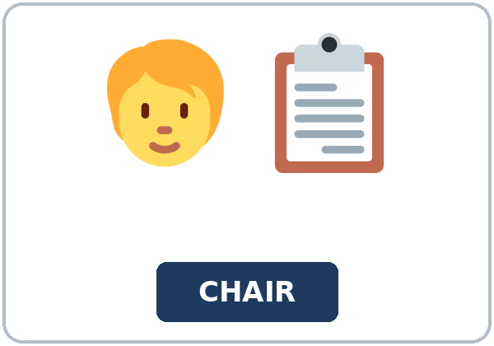
OPENING TALK · 6:00
Opening Talk
Work with a partner. A asks a card
question. B answers in about four sentences. A asks one follow-up. Then switch.
sentences. A asks one follow-up. Then
switch.
Notes:
Step 1 · 6:00–6:06 · Opening Talk.
Work with a partner.
Lesson plan: Step 1; Opening Talk page.
Picture: Twemoji graphics by Twitter, Inc. and other contributors (https://github.com/jdecked/twemoji), CC BY 4.0 (https://creativecommons.org/licenses/by/4.0/); resized and combined, with signs and labels (images/CREDITS.md).

Slide 4
Opening Talk
Cards
01
Work with a partner. A asks a card question. B answers in about four
02
sentences. A asks one follow-up. Then switch.
Work with a partner. A asks a card question. B
answers in about four sentences. A asks one follow-up. Then switch.
Notes:
Each click shows the next card.
A asks. B answers. Then switch.
Lesson plan: Step 1; Opening Talk page.

Slide 5




Look. Listen.
Repeat.
New Words
★ agenda
★ chairperson
★ minutes
★ microphone
★ handout
★ proposal
Notes:
Step 2 · 6:06–6:12 · New Words.
Point to each picture. Learners repeat. ★ = most important.
Lesson plan: Step 2; New Words page.
Pictures: Twemoji graphics by Twitter, Inc. and other contributors (https://github.com/jdecked/twemoji), CC BY 4.0 (https://creativecommons.org/licenses/by/4.0/); resized and combined, with signs and labels (images/CREDITS.md).

Slide 6

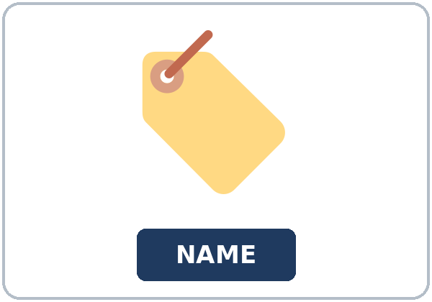
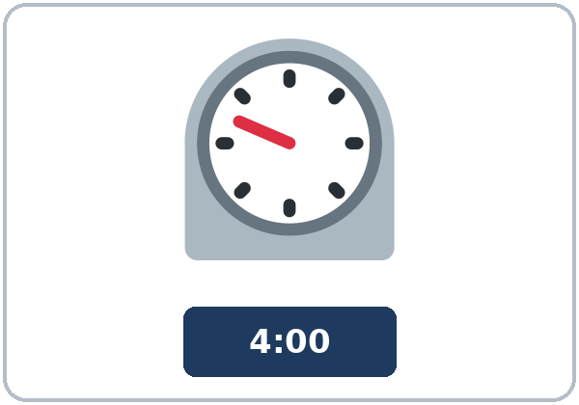
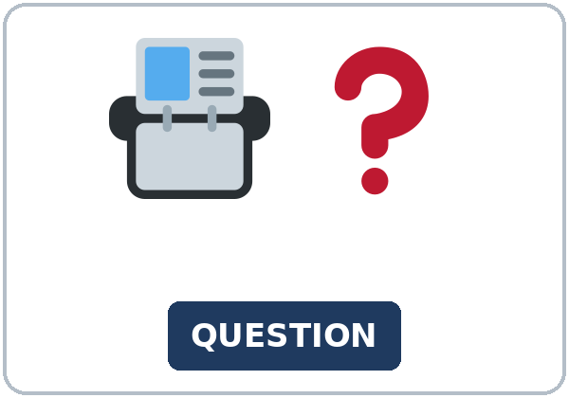

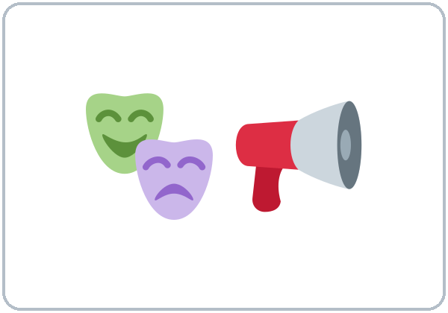
Partner game:
Say it in a sentence
More New Words
★ sign-in sheet
★ name tent
★ timer
★ question card
library
auditorium
Notes:
A points to a picture. B names it and uses it in one sentence. Then switch.
Lesson plan: Step 2; New Words page; Partner game.
Pictures: Twemoji graphics by Twitter, Inc. and other contributors (https://github.com/jdecked/twemoji), CC BY 4.0 (https://creativecommons.org/licenses/by/4.0/); resized and combined, with signs and labels (images/CREDITS.md).

Slide 7
Check the Meaning
Look at the picture. Answer the question.
1
2
3
Is which for a thing or a place?
Is where for a thing or a place?
Is who for a person?
A thing.
A place.
Yes.
Notes:
The answers are hidden. Ask, then click.
1. A thing.
2. A place.
3. Yes.
Lesson plan: Step 2: Check the Meaning.
Pictures: Twemoji graphics by Twitter, Inc. and other contributors (https://github.com/jdecked/twemoji), CC BY 4.0 (https://creativecommons.org/licenses/by/4.0/); resized and combined, with signs and labels (images/CREDITS.md).

Slide 8
Before You
Listen for:
Listen
Listen. What are they deciding?
A short library meeting.
- Play 1 → Task A.
01
Audio (about 2:35): coming soon.
Ms. Adeyemi
02
Tom
Play 1: Task A
03
Grace
Notes:
Step 3 · 6:12–6:32 · Listening. Play 1 is Task A. Play 2 is Tasks B and C. A third play is fine.
A short library meeting.
The script says going to and want to. Learners only need to recognize gonna and wanna.
Lesson plan: Step 3; Listening page.
Picture: Twemoji graphics by Twitter, Inc. and other contributors (https://github.com/jdecked/twemoji), CC BY 4.0 (https://creativecommons.org/licenses/by/4.0/); resized and combined, with signs and labels (images/CREDITS.md).
Listening script (the audio is coming soon; until then, read it aloud with a volunteer at a normal, friendly speed):
Narrator: Lesson twelve. This is a short meeting at the library. Ms. Adeyemi is the chairperson. Tom and Grace are going to talk about evening hours.
Ms. Adeyemi: Welcome. Please look at the agenda, which is on your handout. This is the room where we meet.
Tom: I want to speak about the proposal. I want later hours.
Grace: I see your point, but I want to keep the current hours. The bus I take stops early.
Ms. Adeyemi: The proposal which I read is on page 2. It says a one-month try.
Tom: The library which we use closes at six. I want it open until eight.
Grace: The stop where I catch the bus is dark after seven. That is my reason.
Ms. Adeyemi: The person who takes notes is writing the minutes. Please use the microphone when you speak.
Tom: I think a one-month try is fair. I'm going to come after work on Thursday.
Grace: I see your point, but I need a safe ride. I can try it where the evening bus still runs.
Ms. Adeyemi: Please take a question card. Tom, which hours do you want?
Tom: I want eight o'clock on Thursday only. I want to keep the change small.
Grace: I can agree to Thursday if the sign-in sheet shows how many people come.
Ms. Adeyemi: Our decision is a one-month try on Thursday, until eight. The timer says we should stop.
Tom: My name tent is on the table, so the minutes can show who spoke.
Grace: The auditorium is too big. This library room is the place where we should meet.
Ms. Adeyemi: I am going to put the decision in the minutes. Thank you for a calm meeting.
Tom: I want to ask one question. Which bus still runs at eight?
Grace: The bus where I get off stops at seven. Thursday is the only day I can try.
Ms. Adeyemi: Then Thursday is the try. We are not going to move the meeting to the auditorium.
Narrator: That's the end of the listening.

Slide 9
Listen. What are they deciding?
Listening A
1.
a. A new library building
b. Evening hours
c. The price of a bus pass
Notes:
Click to circle b.
Lesson plan: Step 3; Listening Task A; Answer key.

Slide 10
B. Listen again. Circle the answers.
Listening B
1. Tom wants
later hours
the current hours
a new bus
2. Grace wants
later hours
the current hours
no meeting
3. Grace's reason
the bus stops early
the room is cold
she wants a microphone
4. The decision
close the library
a one-month try
move to the auditorium
5. The try is on
Monday
Thursday
Sunday
6. Open until
six
seven
eight
Notes:
Click to circle each answer: 1 later hours • 2 the current hours • 3 the bus stops early • 4 a one-month try • 5 Thursday • 6 eight
Lesson plan: Step 3; Listening Task B; Answer key.

Slide 11
Listen again.
Listen again. Write which or
Listening C
1
This is the room ______ we meet.
where
2
The agenda, ______ is on your handout, lists the hours.
which
3
The proposal ______ I read is on page 2.
which
Write the missing words.
Then check together.
4
The library ______ we use closes at six.
which
5
The stop ______ I catch the bus is dark after seven.
where
6
This is the place ______ we should meet.
where
Notes:
Click to show each answer: 1 where • 2 which • 3 which • 4 which • 5 where • 6 where
Lesson plan: Step 3; Listening Task C; Answer key.

Slide 12
Hear it: gonna and wanna are short forms
Hear It,
Say It
Say it: use the full forms
This is the room where we meet.
The proposal which I read is on page 2.
gonna and wanna are short forms. This listening uses the full forms.
You can say going to and want to.
Say each line two times.
I'm going to come after work on Thursday.
I want to keep the current hours.
Notes:
gonna and wanna are short forms. This listening uses the full forms. Say each line two times.
Lesson plan: Step 3: Hear it, say it.

Slide 13
Grammar Box 1
which for a thing
WHICH + THING
NO EXTRA IT
The proposal which the chair read
is on page 2.
The library which we use
closes at six.
The agenda which is on the handout
lists the hours.
Notes:
Grammar Box 1: which for a thing. Each click shows the answer side.
Lesson plan: Step 4; Grammar Box 1.
Picture: Twemoji graphics by Twitter, Inc. and other contributors (https://github.com/jdecked/twemoji), CC BY 4.0 (https://creativecommons.org/licenses/by/4.0/); resized and combined, with signs and labels (images/CREDITS.md).

Slide 14
Grammar Box 2
where for a place
WHERE REPLACES THE
EXAMPLE
This is the room where we meet.
Not: the room which we meet.
The stop where I catch the bus
is dark after seven.
The place where we should meet
is this library room.
Notes:
Grammar Box 2: where for a place. Each click shows the answer side.
Lesson plan: Step 4; Grammar Box 2.
Picture: Twemoji graphics by Twitter, Inc. and other contributors (https://github.com/jdecked/twemoji), CC BY 4.0 (https://creativecommons.org/licenses/by/4.0/); resized and combined, with signs and labels (images/CREDITS.md).

Slide 15
Grammar Box 3
who for a person
WHO, NOT WHICH
EXAMPLE
The person who takes notes
is the secretary.
The chairperson who keeps the order
is Ms. Adeyemi.
The person who rides the bus
is Grace.
Notes:
Grammar Box 3: who for a person. Each click shows the answer side.
Lesson plan: Step 4; Grammar Box 3.
Picture: Twemoji graphics by Twitter, Inc. and other contributors (https://github.com/jdecked/twemoji), CC BY 4.0 (https://creativecommons.org/licenses/by/4.0/); resized and combined, with signs and labels (images/CREDITS.md).

Slide 16
Grammar Box 4
an opinion and a reason
YOU CAN SAY
EXAMPLE
I think…
I think a one-month try is fair.
I see your point, but…
I see your point, but I need a safe ride.
Which or where
Which idea? Where would you say it?
Notes:
Grammar Box 4: an opinion and a reason. Each click shows the answer side.
Lesson plan: Step 4; Grammar Box 4.
Picture: Twemoji graphics by Twitter, Inc. and other contributors (https://github.com/jdecked/twemoji), CC BY 4.0 (https://creativecommons.org/licenses/by/4.0/); resized and combined, with signs and labels (images/CREDITS.md).

Slide 17
Practice A
Write.
Practice A
1
This is the room ______ we meet.
where
2
The proposal ______ the chair read is on page 2.
which
3
The person ______ takes notes is the secretary.
who
Write the missing word.
Pairs: check your answers.
4
The stop ______ I catch the bus is dark after seven.
where
5
The library ______ we use closes at six.
which
6
The chairperson ______ keeps the order is Ms. Adeyemi.
who
Notes:
Click to show each answer: 1 where • 2 which • 3 who • 4 where • 5 which • 6 who
Lesson plan: Step 4; Grammar Practice A; Answer key.

Slide 18
Circle the correct words.
Practice B
1. This is the room ______ we meet.
which
where
2. The proposal ______ the chair read is on page 2.
which
where
3. The person ______ takes notes is the secretary.
which
who
4. Don't add ______ after which the chair read.
it
which
5. Where replaces ______ .
there
it
6. I see your point, ______ I need a safe ride.
but
because
Notes:
Click to circle each answer: 1 where • 2 which • 3 who • 4 it • 5 there • 6 but
Lesson plan: Step 4; Grammar Practice B; Answer key.

Slide 19
Common Mistakes
Don't say
Say
The room which we meet.
The room where we meet.
The proposal which the chair read it.
The proposal which the chair read.
The person which takes notes.
The person who takes notes.
The room where we meet there.
The room where we meet.
Notes:
Read Don't say, then Say. Learners try first. Then click.
Lesson plan: Grammar: Common mistakes.
Picture: Twemoji graphics by Twitter, Inc. and other contributors (https://github.com/jdecked/twemoji), CC BY 4.0 (https://creativecommons.org/licenses/by/4.0/); resized and combined, with signs and labels (images/CREDITS.md).

Slide 20
Pair Check
A says.
01
Then switch.
A says "room," "proposal," or "person." B makes one sentence with where, which, or who.
B answers.
02
Then switch.
Notes:
A says "room," "proposal," or "person." B makes one sentence with where, which, or who. Then switch. ---
Break · 6:45–7:00.
Lesson plan: Step 4: Pair check.
Picture: Twemoji graphics by Twitter, Inc. and other contributors (https://github.com/jdecked/twemoji), CC BY 4.0 (https://creativecommons.org/licenses/by/4.0/); resized and combined, with signs and labels (images/CREDITS.md).

Slide 21
Talk Time
Talk Time
Groups.
Groups of 4.
7:00–7:18
1
Groups of 4.
2
Groups of 4.
3
Groups of 4.
Notes:
Round 1.
Lesson plan: Step 5; Talk Time.
Picture: Twemoji graphics by Twitter, Inc. and other contributors (https://github.com/jdecked/twemoji), CC BY 4.0 (https://creativecommons.org/licenses/by/4.0/); resized and combined, with signs and labels (images/CREDITS.md).

Slide 22
Talk Time
Talk Time
Groups.
The chair keeps the order.
7:00–7:18
1
The chair keeps the order.
2
The chair keeps the order.
3
The chair keeps the order.
Notes:
Round 2.
Lesson plan: Step 5; Talk Time.
Picture: Twemoji graphics by Twitter, Inc. and other contributors (https://github.com/jdecked/twemoji), CC BY 4.0 (https://creativecommons.org/licenses/by/4.0/); resized and combined, with signs and labels (images/CREDITS.md).

Slide 23
Read.
Answer.
Read &
Write
1
What are they deciding?
Evening hours
2
Who is the chairperson?
Ms. Adeyemi
Read the page.
Answer the questions.
3
What does Tom want?
Later hours, until eight on Thursday
4
Why does Grace want the current hours?
The bus stops early
5
Where is the meeting?
In the room where we meet
Notes:
Step 6 · 7:18–7:25 · Read & Write.
Click to show each answer: 1 Evening hours • 2 Ms. Adeyemi • 3 Later hours, until eight on Thursday • 4 The bus stops early • 5 In the room where we meet
Lesson plan: Step 6; Read & Write page; Answer key.

Slide 24
Before You Go 7:25–7:30
01
Exit ticket
02
Homework
Which idea do you support, and where would you say it?
Name: Date:
Four sentences with which or where, a reason, and one polite phrase.
Give this page to your teacher.
About 20–25 minutes.
1. Write where.
2. Finish your comment for the chair (Read & Write).
3. Ask one which or where question at home. Write it.
4. Review: write one sentence with who for a person.
Bring it next week!
Notes:
Step 7 · 7:25–7:30 · Exit ticket and homework. Never skip the exit ticket.
Which idea do you support, and where would you say it?
Lesson plan: Step 7; Exit Ticket page; Homework page.
Picture: Twemoji graphics by Twitter, Inc. and other contributors (https://github.com/jdecked/twemoji), CC BY 4.0 (https://creativecommons.org/licenses/by/4.0/); resized and combined, with signs and labels (images/CREDITS.md).

Slide 25
Goodbye! See You Next Week!
Now you can:
• I can point to a thing with which and a place with where
• I can still use who for a person
• I can ask a question from the agenda
Lesson 12 · Level 5
Notes:
Read the three Now you can lines.
Homework is about 20–25 minutes. Bring it next week.
Lesson plan: At a glance: Objectives; Step 7.
Picture: Twemoji graphics by Twitter, Inc. and other contributors (https://github.com/jdecked/twemoji), CC BY 4.0 (https://creativecommons.org/licenses/by/4.0/); resized and combined, with signs and labels (images/CREDITS.md).

Slide 26
Credits
Pictures
Vocabulary pictures use Twemoji graphics by Twitter, Inc. and other contributors (https://github.com/jdecked/twemoji), licensed under CC BY 4.0 (https://creativecommons.org/licenses/by/4.0/). The graphics were resized and combined, and signs and labels were added.
Names and story
Ms. Adeyemi, Tom, and Grace are invented names. The listening story is invented.
Audio and font
Audio (coming soon): synthetic voices made with Chatterbox TTS (MIT License), cloned from short synthetic reference clips made with Kokoro-82M (Apache License 2.0). No recordings of real people. Each file will carry an inaudible Perth watermark marking it as AI-generated. Font: Lexend Deca (OFL 1.1).
© 2026 the authors. The authors license this deck under CC BY-NC-SA 4.0.
Notes:
Credits. You don't need to read this slide in class.
Pictures: Twemoji graphics by Twitter, Inc. and other contributors, CC BY 4.0; the file-by-file list is in images/CREDITS.md.
Audio: the listening audio for this lesson (about 2:35) is coming soon. It will use computer-generated voices (Chatterbox TTS cloned from synthetic Kokoro-82M reference clips); no recordings of real people. Until it is ready, read the listening script (in the notes of the Before You Listen slide) with a volunteer. The names and the story are invented.
Course materials: © 2026 the authors, licensed under CC BY-NC-SA 4.0 (https://creativecommons.org/licenses/by-nc-sa/4.0/).
Lesson plan: Picture Credits. Picture list: images/CREDITS.md.

