Slide 1
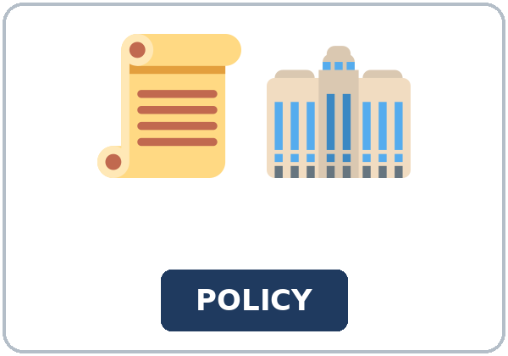
Unless You Call First
Today you will:
• I can explain unless in their own words
• I can say what is allowed as long as something else is true
• I can contrast with even though
Lesson 4 · Level 5
Notes:
Welcome learners as they arrive.
Read the three lines under Today you will.
- Say this once: "This lesson is not legal advice.
Lesson plan: Topic; At a glance: Objectives.
Picture: Twemoji graphics by Twitter, Inc. and other contributors (https://github.com/jdecked/twemoji), CC BY 4.0 (https://creativecommons.org/licenses/by/4.0/); resized and combined, with signs and labels (images/CREDITS.md).

Slide 2
Today's
Goals
01
I can explain unless in their own words
02
I can say what is allowed as long as something else is true
03
I can contrast with even though
By the end of class, you can do these things.
04
I can ask one polite question about a rule they do not understand
Notes:
Read each goal slowly. Learners repeat.
Lesson plan: At a glance: Objectives.

Slide 3
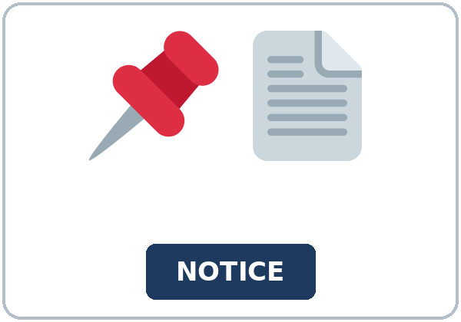
OPENING TALK · 6:00
Opening Talk
Work with a partner. A asks a
question. B answers in two or three sentences. A asks one follow-up question. Then switch.
Homework check: say one I wish I had
sentence.
Notes:
Step 1 · 6:00–6:06 · Opening Talk.
Work with a partner.
Lesson plan: Step 1; Opening Talk page.
Picture: Twemoji graphics by Twitter, Inc. and other contributors (https://github.com/jdecked/twemoji), CC BY 4.0 (https://creativecommons.org/licenses/by/4.0/); resized and combined, with signs and labels (images/CREDITS.md).

Slide 4
Opening Talk
Cards
01
What do you wish you had asked last week?
02
Have you ever read a notice on a door?
Work with a partner. A asks a question. B
answers in two or three sentences. A asks one follow-up question. Then switch.
03
What do you do before you visit an office?
04
Homework check: say one I wish I had sentence.
Notes:
Each click shows the next card.
A asks. B answers. Then switch.
Lesson plan: Step 1; Opening Talk page.

Slide 5
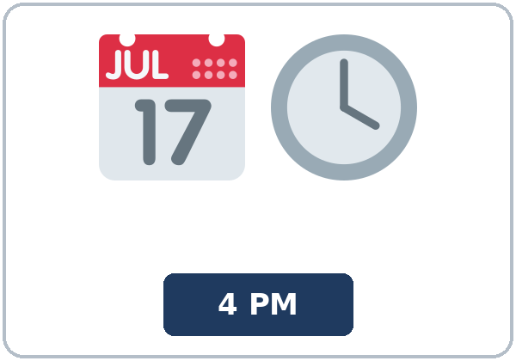
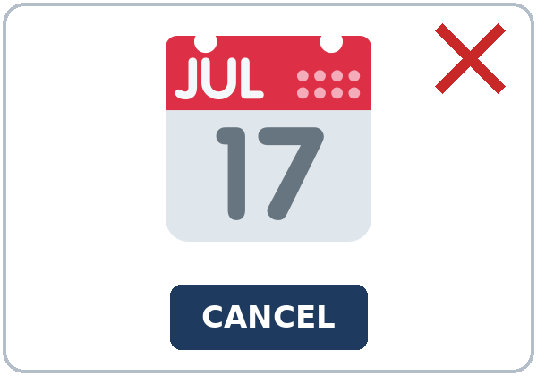
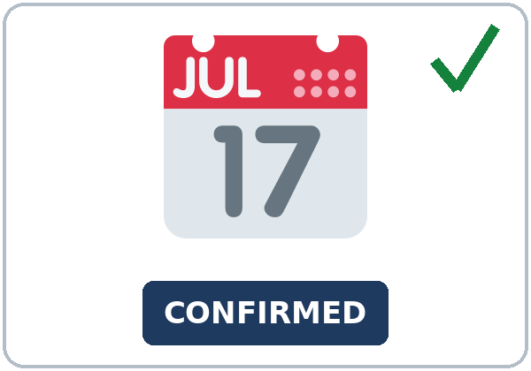
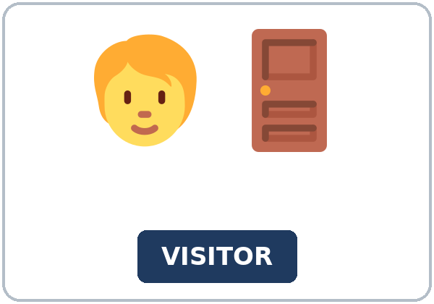
Look. Listen.
Repeat.
New Words
★ policy
★ notice
★ appointment
★ cancel
★ confirm
★ visitor
Notes:
Step 2 · 6:06–6:12 · New Words.
Point to each picture. Learners repeat. ★ = most important.
Lesson plan: Step 2; New Words page.
Pictures: Twemoji graphics by Twitter, Inc. and other contributors (https://github.com/jdecked/twemoji), CC BY 4.0 (https://creativecommons.org/licenses/by/4.0/); resized and combined, with signs and labels (images/CREDITS.md).

Slide 6
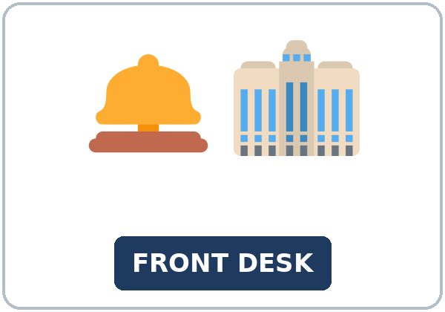
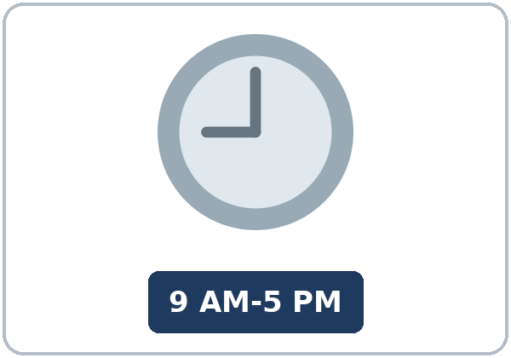


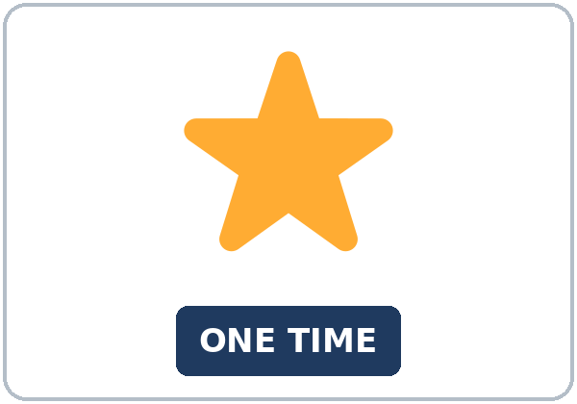

Partner game:
Point and ask.
More New Words
★ front desk
★ office hours
★ requirement
★ permission
exception
visitor badge
Notes:
A points to a picture. B names it and uses it in one sentence. Then switch.
Lesson plan: Step 2; New Words page; Partner game.
Pictures: Twemoji graphics by Twitter, Inc. and other contributors (https://github.com/jdecked/twemoji), CC BY 4.0 (https://creativecommons.org/licenses/by/4.0/); resized and combined, with signs and labels (images/CREDITS.md).

Slide 7
Check the Meaning
Look at the picture. Answer the question.
1
2
3
Does unless mean if or if not?
What must a visitor wear?
Where do you ask about a rule?
if not
a visitor badge
the front desk
Notes:
The answers are hidden. Ask, then click.
1. if not
2. a visitor badge
3. the front desk
Lesson plan: Step 2: Check the Meaning.
Pictures: Twemoji graphics by Twitter, Inc. and other contributors (https://github.com/jdecked/twemoji), CC BY 4.0 (https://creativecommons.org/licenses/by/4.0/); resized and combined, with signs and labels (images/CREDITS.md).

Slide 8
Before You
Listen for:
Listen
Listen. Can Andre go in now?
Andre did not call first.
| 6:12–6:32 | Listening: play 1 (Task A), play 2 (Tasks B and C) +
01
Audio (about 2:15): coming soon.
Helen
02
Andre
Play 1: Task A
03
Mei
Notes:
Step 3 · 6:12–6:32 · Listening. Play 1 is Task A. Play 2 is Tasks B and C. A third play is fine.
Andre did not call first.
The script says going to and want to. Learners only need to recognize gonna and wanna.
Lesson plan: Step 3; Listening page.
Picture: Twemoji graphics by Twitter, Inc. and other contributors (https://github.com/jdecked/twemoji), CC BY 4.0 (https://creativecommons.org/licenses/by/4.0/); resized and combined, with signs and labels (images/CREDITS.md).
Listening script (the audio is coming soon; until then, read it aloud with a volunteer at a normal, friendly speed):
Narrator: Lesson four. Andre is at the front desk. He wants to go to a meeting, but he did not call first.
Helen: Good afternoon. Do you have an appointment?
Andre: I want to go to the four o'clock meeting. I did not call this morning.
Helen: I'm sorry. You can't go in unless you call first. That rule is on the notice.
Andre: Even though I am on time?
Helen: Even though you are on time, you still need to confirm.
Andre: What do I have to do?
Helen: You have to sign the book, and you must wear a visitor badge.
Andre: Is there an exception if I already have permission?
Helen: Permission is not the same as an appointment. Unless you confirm, the desk cannot make an exception.
Helen: The requirement is on the door. Please read the policy before you sit down.
Mei: Hi, Andre. You can wait as long as the four o'clock group finishes on time.
Andre: What happens unless they finish?
Mei: Then the room is closed. If you call first next time, they will hold the room.
Helen: You can bring a guest as long as you tell the front desk.
Andre: I am going to call tomorrow. Can I cancel today's meeting?
Helen: Yes. I can cancel it, or you can wait. Office hours end at five.
Andre: What happens unless I call tomorrow too?
Mei: Call during office hours, from nine to five. Then they can confirm the room.
Andre: I'll wait. Thank you for explaining the policy.
Narrator: That's the end of the listening.

Slide 9
Listen. Can Andre go in now?
Listening A
1.
a. Yes, he can go in
b. No, not unless he calls
c. The office is closed
Notes:
Click to circle b.
Lesson plan: Step 3; Listening Task A; Answer key.

Slide 10
B. Listen again. True or false? Circle.
Listening B
1. He called this morning.
true
false
2. He must wear a visitor badge.
true
false
3. He can wait as long as the group finishes.
true
false
4. A guest is OK if he tells the desk.
true
false
5. Office hours end at four.
true
false
6. Even though he is on time, he must confirm.
true
false
Notes:
Click to circle each answer: 1 false • 2 true • 3 true • 4 true • 5 false • 6 true
Lesson plan: Step 3; Listening Task B; Answer key.

Slide 11
Listen again.
Listen again. Write unless,
Listening C
1
You can't go in ______ you call first.
unless
2
______ you are on time, you still need to confirm.
Even though
3
You can wait ______ the group finishes on time.
as long as
Write the missing words.
Then check together.
4
You can bring a guest ______ you tell the front desk.
as long as
5
______ you confirm, the desk cannot make an exception.
Unless
6
The room is closed ______ they finish on time.
unless
Notes:
Click to show each answer: 1 unless • 2 Even though • 3 as long as • 4 as long as • 5 Unless • 6 unless
Lesson plan: Step 3; Listening Task C; Answer key.

Slide 12
Hear it: gonna and wanna are short forms
Hear It,
Say It
Say it: use the full forms
I want to go to the four o'clock meeting.
I am going to call tomorrow.
gonna and wanna are short forms. This listening uses the full forms.
You can say going to and want to.
Say each line two times.
You can't go in unless you call first.
You can wait as long as the group finishes.
Notes:
gonna and wanna are short forms. This listening uses the full forms. Say each line two times.
Lesson plan: Step 3: Hear it, say it.

Slide 13
Grammar Box 1
unless means if not
SENTENCE
MEANING
You can't go in unless you sign the book.
if you do not sign
You can't go in unless you call first.
if you do not call
Unless you confirm, they will not hold the room.
present verb after unless
Notes:
Grammar Box 1: unless means if not. Each click shows the answer side.
Lesson plan: Step 4; Grammar Box 1.
Picture: Twemoji graphics by Twitter, Inc. and other contributors (https://github.com/jdecked/twemoji), CC BY 4.0 (https://creativecommons.org/licenses/by/4.0/); resized and combined, with signs and labels (images/CREDITS.md).

Slide 14
Grammar Box 2
as long as
SENTENCE
MEANING
You can bring a guest as long as you tell the desk.
only if you tell them
You can wait as long as the group finishes on time.
only if that stays true
As long as you call first, they will hold the room.
present verb, same as if
Notes:
Grammar Box 2: as long as. Each click shows the answer side.
Lesson plan: Step 4; Grammar Box 2.
Picture: Twemoji graphics by Twitter, Inc. and other contributors (https://github.com/jdecked/twemoji), CC BY 4.0 (https://creativecommons.org/licenses/by/4.0/); resized and combined, with signs and labels (images/CREDITS.md).

Slide 15
Grammar Box 3
even though
SENTENCE
MEANING
Even though the office is busy, you still need an appointment.
the result happens anyway
Even though you are on time, you still need to confirm.
on time does not change the rule
Even though you have permission, you still sign the book.
permission is not enough
Notes:
Grammar Box 3: even though. Each click shows the answer side.
Lesson plan: Step 4; Grammar Box 3.
Picture: Twemoji graphics by Twitter, Inc. and other contributors (https://github.com/jdecked/twemoji), CC BY 4.0 (https://creativecommons.org/licenses/by/4.0/); resized and combined, with signs and labels (images/CREDITS.md).

Slide 16
Grammar Box 4
have to, must, and if
SENTENCE
MEANING
You have to sign the book.
a requirement
You must wear the visitor badge.
a requirement
If you call first, they will hold the room.
if + present, then will
Notes:
Grammar Box 4: have to, must, and if. Each click shows the answer side.
Lesson plan: Step 4; Grammar Box 4.
Picture: Twemoji graphics by Twitter, Inc. and other contributors (https://github.com/jdecked/twemoji), CC BY 4.0 (https://creativecommons.org/licenses/by/4.0/); resized and combined, with signs and labels (images/CREDITS.md).

Slide 17
Practice A
Write.
Practice A
1
You can't go in ______ you sign the book.
unless
2
You can bring a guest ______ you tell the front desk.
as long as
3
______ the office is busy, you still need an appointment.
Even though
Write the missing word.
Pairs: check your answers.
4
______ you call first, they will not hold the room.
Unless
5
You still sign the book ______ you have permission.
even though
6
They will hold the room ______ you confirm.
as long as
Notes:
Click to show each answer: 1 unless • 2 as long as • 3 Even though • 4 Unless • 5 even though • 6 as long as
Lesson plan: Step 4; Grammar Practice A; Answer key.

Slide 18
Circle the correct words.
Practice B
1. Unless you ______ first, you can't go in.
call
will call
2. As long as you ______ the desk, you can bring a guest.
tell
will tell
3. Even though he is on time, he ______ confirm.
still must
doesn't
4. You ______ wear the visitor badge.
must
must to
5. If you call first, they ______ the room.
hold
will hold
6. You have to sign ______ you already have permission.
unless
even though
Notes:
Click to circle each answer: 1 call • 2 tell • 3 still must • 4 must • 5 will hold • 6 even though
Lesson plan: Step 4; Grammar Practice B; Answer key.

Slide 19
Common Mistakes
Don't say
Say
Unless you will call, they will not hold the room.
Unless you call, they will not hold the room.
As long as you will tell them, you can bring a guest.
As long as you tell them, you can bring a guest.
Even though the office is busy, but you need an appointment.
Even though the office is busy, you still need an appointment.
You must to wear the badge.
You must wear the visitor badge.
If you will call first, they will hold the room.
If you call first, they will hold the room.
Notes:
Read Don't say, then Say. Learners try first. Then click.
Lesson plan: Grammar: Common mistakes.
Picture: Twemoji graphics by Twitter, Inc. and other contributors (https://github.com/jdecked/twemoji), CC BY 4.0 (https://creativecommons.org/licenses/by/4.0/); resized and combined, with signs and labels (images/CREDITS.md).

Slide 20
Pair Check
A says.
01
Work with a partner.
| Strip | Word | |---|---| | 1.
B answers.
02
You can't go in unless you call first.
Notes:
| Strip | Word | |---|---| | 1. You can't go in unless you call first. | <br | | 2. You can wait as long as the group finishes on time. | <br | | 3. Even though you are on time, you still need to confirm. | <br | | 4.
Break · 6:45–7:00.
Lesson plan: Step 4: Pair check.
Picture: Twemoji graphics by Twitter, Inc. and other contributors (https://github.com/jdecked/twemoji), CC BY 4.0 (https://creativecommons.org/licenses/by/4.0/); resized and combined, with signs and labels (images/CREDITS.md).

Slide 21
Talk Time
Talk Time
Groups.
Match each strip to unless, as long as, or even though.
7:00–7:18
1
Match each strip to unless, as long as, or
even though.
2
Match each strip to unless, as long as, or even though.
3
Match each strip to unless, as long as, or even though.
Notes:
Round 1.
Lesson plan: Step 5; Talk Time.
Picture: Twemoji graphics by Twitter, Inc. and other contributors (https://github.com/jdecked/twemoji), CC BY 4.0 (https://creativecommons.org/licenses/by/4.0/); resized and combined, with signs and labels (images/CREDITS.md).

Slide 22
Talk Time
Talk Time
Work together.
A is the front desk.
7:00–7:18
1
A is the front desk.
2
Then switch.
3
Then switch.
Notes:
Round 2.
Lesson plan: Step 5; Talk Time.
Picture: Twemoji graphics by Twitter, Inc. and other contributors (https://github.com/jdecked/twemoji), CC BY 4.0 (https://creativecommons.org/licenses/by/4.0/); resized and combined, with signs and labels (images/CREDITS.md).

Slide 23
Read.
Answer.
Read &
Write
1
Go in without calling first?
No. Call first
2
What must a visitor wear?
A visitor badge
Read the page.
Answer the questions.
3
When can you bring a guest?
Tell the front desk first
4
What are the office hours?
Nine to five
5
Who explains a rule?
The front desk
Notes:
Step 6 · 7:18–7:25 · Read & Write.
Click to show each answer: 1 No. Call first • 2 A visitor badge • 3 Tell the front desk first • 4 Nine to five • 5 The front desk
Lesson plan: Step 6; Read & Write page; Answer key.

Slide 24
Before You Go 7:25–7:30
01
Exit ticket
02
Homework
Explain one rule from tonight.
Name: Date:
Sentence 1: the rule • Sentence 2: unless or as long as • Sentence 3: an
Give this page to your teacher.
About 20–25 minutes.
1. Write three sentences: one with unless, one with as long as, and
2. Finish your 6-sentence note from Read & Write C. Use unless once
3. Write one polite question about a class rule. Do not write about a
4. Review. Write have to or must.
Bring it next week!
Notes:
Step 7 · 7:25–7:30 · Exit ticket and homework. Never skip the exit ticket.
Explain one rule from tonight.
Lesson plan: Step 7; Exit Ticket page; Homework page.
Picture: Twemoji graphics by Twitter, Inc. and other contributors (https://github.com/jdecked/twemoji), CC BY 4.0 (https://creativecommons.org/licenses/by/4.0/); resized and combined, with signs and labels (images/CREDITS.md).

Slide 25
Goodbye! See You Next Week!
Now you can:
• I can explain unless in their own words
• I can say what is allowed as long as something else is true
• I can contrast with even though
Lesson 4 · Level 5
Notes:
Read the three Now you can lines.
Homework is about 20–25 minutes. Bring it next week.
Lesson plan: At a glance: Objectives; Step 7.
Picture: Twemoji graphics by Twitter, Inc. and other contributors (https://github.com/jdecked/twemoji), CC BY 4.0 (https://creativecommons.org/licenses/by/4.0/); resized and combined, with signs and labels (images/CREDITS.md).

Slide 26
Credits
Pictures
Vocabulary pictures use Twemoji graphics by Twitter, Inc. and other contributors (https://github.com/jdecked/twemoji), licensed under CC BY 4.0 (https://creativecommons.org/licenses/by/4.0/). The graphics were resized and combined, and signs and labels were added.
Names and story
Helen, Andre, and Mei are invented names. The listening story is invented.
Audio and font
Audio (coming soon): synthetic voices made with Chatterbox TTS (MIT License), cloned from short synthetic reference clips made with Kokoro-82M (Apache License 2.0). No recordings of real people. Each file will carry an inaudible Perth watermark marking it as AI-generated. Font: Lexend Deca (OFL 1.1).
© 2026 the authors. The authors license this deck under CC BY-NC-SA 4.0.
Notes:
Credits. You don't need to read this slide in class.
Pictures: Twemoji graphics by Twitter, Inc. and other contributors, CC BY 4.0; the file-by-file list is in images/CREDITS.md.
Audio: the listening audio for this lesson (about 2:15) is coming soon. It will use computer-generated voices (Chatterbox TTS cloned from synthetic Kokoro-82M reference clips); no recordings of real people. Until it is ready, read the listening script (in the notes of the Before You Listen slide) with a volunteer. The names and the story are invented.
Course materials: © 2026 the authors, licensed under CC BY-NC-SA 4.0 (https://creativecommons.org/licenses/by-nc-sa/4.0/).
Lesson plan: Picture Credits. Picture list: images/CREDITS.md.

