Slide 1
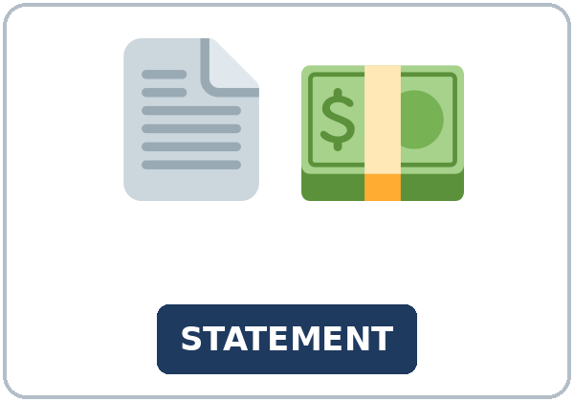
It Was Posted on Tuesday
Today you will:
• I can say what is done with is or are and was or were plus a participle.
• I can add by when the doer matters.
• I can find the amount due, the due date, and one charge.
Lesson 5 · Level 5
Notes:
Welcome learners as they arrive.
Read the three lines under Today you will.
This lesson is not financial advice.
Lesson plan: Topic; At a glance: Objectives.
Picture: Twemoji graphics by Twitter, Inc. and other contributors (https://github.com/jdecked/twemoji), CC BY 4.0 (https://creativecommons.org/licenses/by/4.0/); resized and combined, with signs and labels (images/CREDITS.md).

Slide 2
Today's
Goals
01
I can say what is done with is or are and was or were plus a participle.
02
I can add by when the doer matters.
03
I can find the amount due, the due date, and one charge.
By the end of class, you can do these things.
04
I can write a three-line budget with invented numbers.
Notes:
Read each goal slowly. Learners repeat.
Lesson plan: At a glance: Objectives.

Slide 3
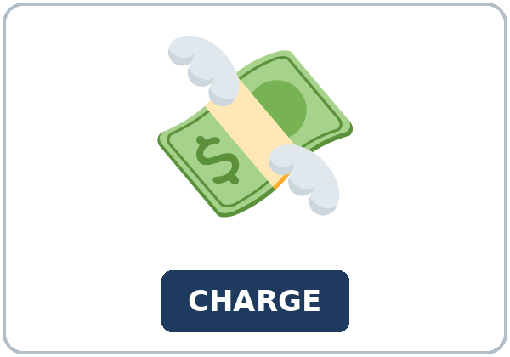
OPENING TALK · 6:00
Opening Talk
Work with a partner. Ask about a
mild regret from last week. Then switch.
Homework check: read one sentence from
your note.
Notes:
Step 1 · 6:00–6:06 · Opening Talk.
Work with a partner.
Lesson plan: Step 1; Opening Talk page.
Picture: Twemoji graphics by Twitter, Inc. and other contributors (https://github.com/jdecked/twemoji), CC BY 4.0 (https://creativecommons.org/licenses/by/4.0/); resized and combined, with signs and labels (images/CREDITS.md).

Slide 4
Opening Talk
Cards
01
Say one I wish I had sentence from Lesson 3.
02
Say one next step you wrote.
Work with a partner. Ask about a mild regret
from last week. Then switch.
03
Which wish was about now?
04
Homework check: read one sentence from your note.
Notes:
Each click shows the next card.
A asks. B answers. Then switch.
Lesson plan: Step 1; Opening Talk page.

Slide 5
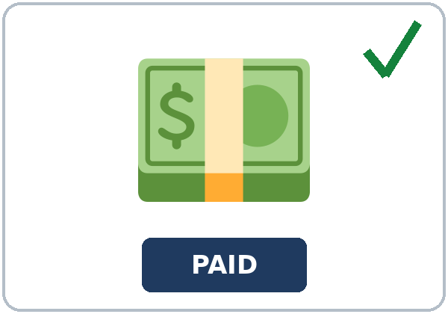
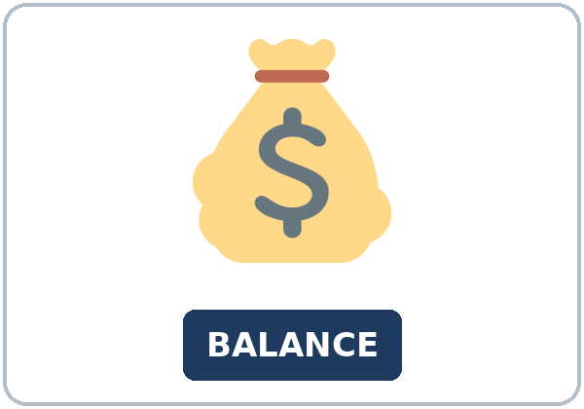
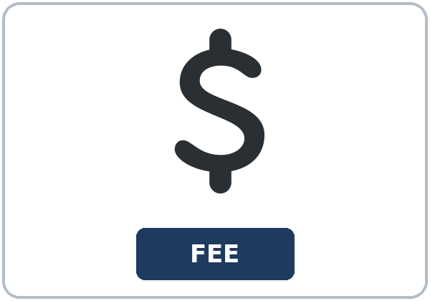
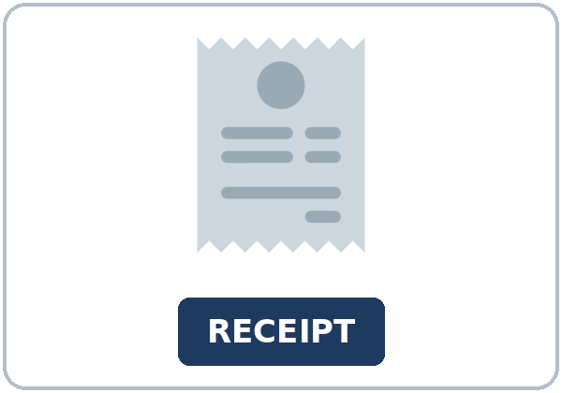
Look. Listen.
Repeat.
New Words
★ statement
★ charge
★ payment
★ balance
★ fee
★ receipt
Notes:
Step 2 · 6:06–6:12 · New Words.
Point to each picture. Learners repeat. ★ = most important.
Lesson plan: Step 2; New Words page.
Pictures: Twemoji graphics by Twitter, Inc. and other contributors (https://github.com/jdecked/twemoji), CC BY 4.0 (https://creativecommons.org/licenses/by/4.0/); resized and combined, with signs and labels (images/CREDITS.md).

Slide 6
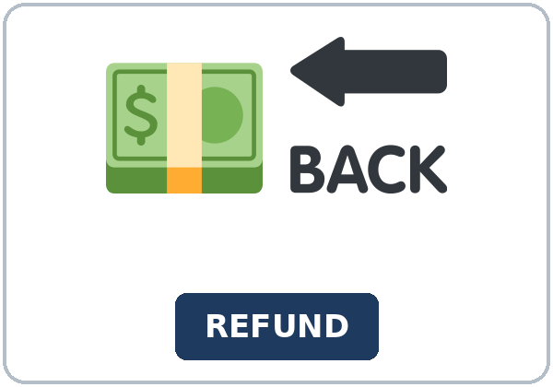
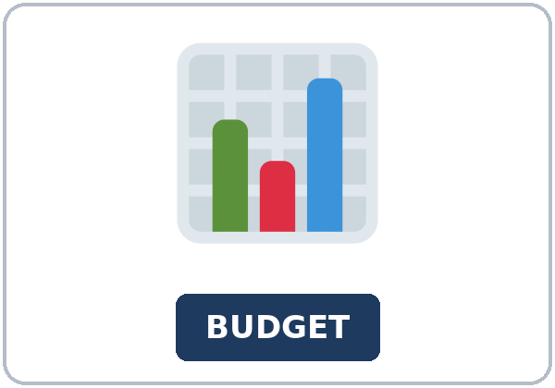
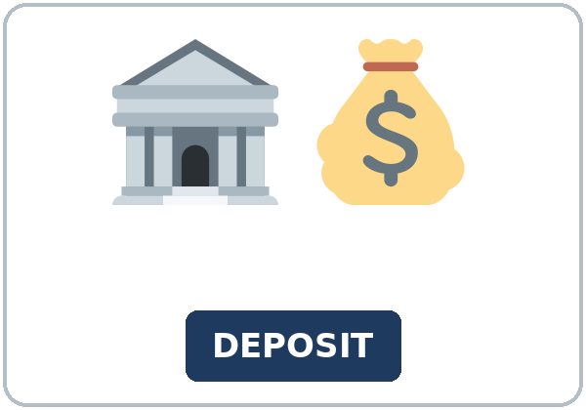
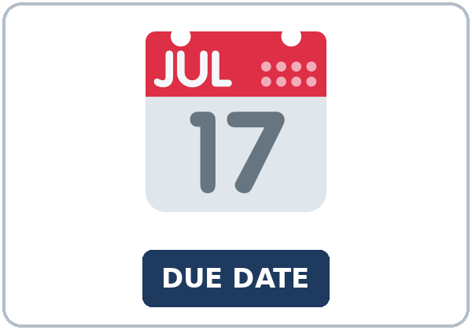
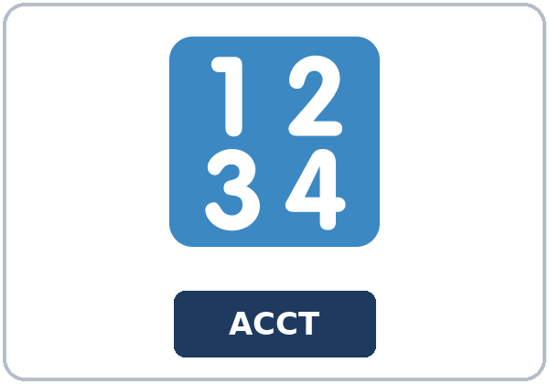
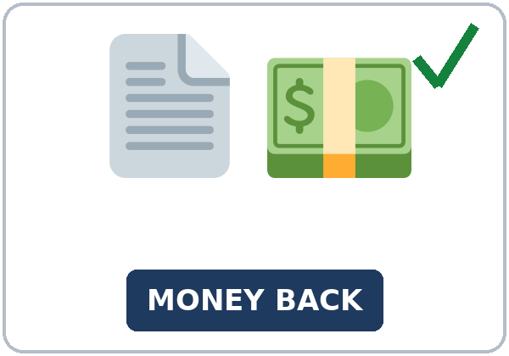
Partner game:
Point and say the word
More New Words
★ refund
★ budget
★ deposit
★ due date
account number
credit
Notes:
A points to a picture. B names it and uses it in one sentence. Then switch.
Lesson plan: Step 2; New Words page; Partner game.
Pictures: Twemoji graphics by Twitter, Inc. and other contributors (https://github.com/jdecked/twemoji), CC BY 4.0 (https://creativecommons.org/licenses/by/4.0/); resized and combined, with signs and labels (images/CREDITS.md).

Slide 7
Check the Meaning
Look at the picture. Answer the question.
1
2
3
Is a statement a bill you can read?
What do you keep to show you paid?
What word means money back on this page?
yes
a receipt
credit
Notes:
The answers are hidden. Ask, then click.
1. yes
2. a receipt
3. credit
Lesson plan: Step 2: Check the Meaning.
Pictures: Twemoji graphics by Twitter, Inc. and other contributors (https://github.com/jdecked/twemoji), CC BY 4.0 (https://creativecommons.org/licenses/by/4.0/); resized and combined, with signs and labels (images/CREDITS.md).

Slide 8
Before You
Listen for:
Listen
Listen. Why is he calling?
Diego calls customer service about a statement.
| 6:12–6:32 | Listening.
01
Audio (about 2:20): coming soon.
Narrator
02
Diego
Play 1: Task A
03
Ms. Brooks
Notes:
Step 3 · 6:12–6:32 · Listening. Play 1 is Task A. Play 2 is Tasks B and C. A third play is fine.
Diego calls customer service about a statement.
The script says going to and want to. Learners only need to recognize gonna and wanna.
Lesson plan: Step 3; Listening page.
Picture: Twemoji graphics by Twitter, Inc. and other contributors (https://github.com/jdecked/twemoji), CC BY 4.0 (https://creativecommons.org/licenses/by/4.0/); resized and combined, with signs and labels (images/CREDITS.md).
Listening script (the audio is coming soon; until then, read it aloud with a volunteer at a normal, friendly speed):
Narrator: Lesson five. Diego calls Northline Phone about a practice statement. Nothing on this call is a real bill.
Diego: Hello. I want to understand my statement. A fee was added, and I am going to ask about it.
Ms. Brooks: I can help. The fee was added on Tuesday. The fee was $6.
Diego: Was the payment received?
Ms. Brooks: Yes, it was. The payment was received on Friday. It was $40.
Diego: And the credit? I want to know what that word means.
Ms. Brooks: The credit was posted by the phone company. Credit means money back. It is not a new phone.
Diego: Was the fee removed?
Ms. Brooks: No, it wasn't. The $6 was credited. That is the money back.
Diego: Are the calls listed?
Ms. Brooks: Yes, they are. They are listed on page 2. The bill is mailed on the first of the month.
Diego: What is due today?
Ms. Brooks: Nothing is due today. Due today is $0. The due date on the statement is the 20th.
Diego: Thank you. I am going to read the due date again at home. The balance is $28.
Ms. Brooks: That is right. For a real charge, call the number on your own statement. This call is practice.
Narrator: Diego writes two lines: the fee was added on Tuesday, and the payment was received on Friday.
Narrator: That's the end of the listening.

Slide 9
Listen. Why is he calling?
Listening A
1.
a. The store is closed
b. A fee was added, and a payment was posted
c. His phone was lost
Notes:
Click to circle b.
Lesson plan: Step 3; Listening Task A; Answer key.

Slide 10
B. Listen again. Circle the amount or
the day.
Listening B
1. The fee was added
on Tuesday
on Friday
in May
2. The payment was received
on Friday
on Tuesday
not yet
3. The fee was
$6
$60
$600
4. Credit on this page means
money back
a new phone
a late day
5. Due today
$0
$40
$90
Notes:
Click to circle each answer: 1 on Tuesday • 2 on Friday • 3 $6 • 4 money back • 5 $0
Lesson plan: Step 3; Listening Task B; Answer key.

Slide 11
Listen again.
Listen again. Write the pass
Listening C
1
The fee ______ on Tuesday.
was added
2
The payment ______ on Friday.
was received
3
The credit ______ by the phone company.
was posted
Write the missing words.
Then check together.
4
The bill ______ on the first of the month.
is mailed
5
The calls ______ on the statement.
are listed
6
No, the fee ______.
wasn't removed
Notes:
Click to show each answer: 1 was added • 2 was received • 3 was posted • 4 is mailed • 5 are listed • 6 wasn't removed
Lesson plan: Step 3; Listening Task C; Answer key.

Slide 12
Hear it: gonna and wanna are short forms
Hear It,
Say It
Say it: use the full forms
I want to understand this statement.
I am going to check the due date.
gonna and wanna are short forms. This listening uses the full forms.
You can say going to and want to.
Say each line two times.
The fee was added on Tuesday.
The payment was received on Friday.
Notes:
gonna and wanna are short forms. This listening uses the full forms. Say each line two times.
Lesson plan: Step 3: Hear it, say it.

Slide 13
Grammar Box 1
is, are, was, were
SENTENCE
FORM
The bill is mailed on the first.
present passive
The fee was added on Tuesday.
past passive
The payment was received on Friday.
past passive
Notes:
Grammar Box 1: is, are, was, were. Each click shows the answer side.
Lesson plan: Step 4; Grammar Box 1.
Picture: Twemoji graphics by Twitter, Inc. and other contributors (https://github.com/jdecked/twemoji), CC BY 4.0 (https://creativecommons.org/licenses/by/4.0/); resized and combined, with signs and labels (images/CREDITS.md).

Slide 14
Grammar Box 2
add by when you need the
SENTENCE
WHY
The credit was posted by the phone company.
by names the doer
The fee was added by the company.
use by when you need the name
The payment was received.
no by: start with the thing
Notes:
Grammar Box 2: add by when you need the name. Each click shows the answer side.
Lesson plan: Step 4; Grammar Box 2.
Picture: Twemoji graphics by Twitter, Inc. and other contributors (https://github.com/jdecked/twemoji), CC BY 4.0 (https://creativecommons.org/licenses/by/4.0/); resized and combined, with signs and labels (images/CREDITS.md).

Slide 15
Grammar Box 3
yes and no
QUESTION
ANSWER
Are the calls listed?
Yes, they are.
Was the fee removed?
No, it wasn't.
Was the payment received?
Yes, it was.
Notes:
Grammar Box 3: yes and no. Each click shows the answer side.
Lesson plan: Step 4; Grammar Box 3.
Picture: Twemoji graphics by Twitter, Inc. and other contributors (https://github.com/jdecked/twemoji), CC BY 4.0 (https://creativecommons.org/licenses/by/4.0/); resized and combined, with signs and labels (images/CREDITS.md).

Slide 16
Grammar Box 4
start with the thing
SAY THIS
NOT THIS IDEA
The fee is too high.
one review line
The payment was posted.
start with the thing
The company posted the payment.
active, when the person matters
Notes:
Grammar Box 4: start with the thing. Each click shows the answer side.
Lesson plan: Step 4; Grammar Box 4.
Picture: Twemoji graphics by Twitter, Inc. and other contributors (https://github.com/jdecked/twemoji), CC BY 4.0 (https://creativecommons.org/licenses/by/4.0/); resized and combined, with signs and labels (images/CREDITS.md).

Slide 17
Practice A
Write.
Practice A
1
The fee was ______ on Tuesday.
added
2
The payment was ______ on Friday.
received
3
The credit was ______ by the phone company.
posted
Write the missing word.
Pairs: check your answers.
4
The bill is ______ on the first.
mailed
5
The calls are ______.
listed
6
The fee is too ______.
high
Notes:
Click to show each answer: 1 added • 2 received • 3 posted • 4 mailed • 5 listed • 6 high
Lesson plan: Step 4; Grammar Practice A; Answer key.

Slide 18
Circle the correct words.
Practice B
1. The fee
was added
was add
2. The payment
was received
received
3. The company
posted the payment
was posted the payment
4. The credit was posted
by the phone company
for the phone company
5. Are the calls listed?
Yes, they are.
Yes, they listed.
6. Was the fee removed?
No, it wasn't.
No, it didn't.
Notes:
Click to circle each answer: 1 was added • 2 was received • 3 posted the payment • 4 by the phone company • 5 Yes, they are • 6 No, it wasn't
Lesson plan: Step 4; Grammar Practice B; Answer key.

Slide 19
Common Mistakes
Don't say
Say
The fee was add on Tuesday.
The fee was added on Tuesday.
The company was posted the payment.
The payment was posted.
The credit was posted for the company.
The credit was posted by the company.
Notes:
Read Don't say, then Say. Learners try first. Then click.
Lesson plan: Grammar: Common mistakes.
Picture: Twemoji graphics by Twitter, Inc. and other contributors (https://github.com/jdecked/twemoji), CC BY 4.0 (https://creativecommons.org/licenses/by/4.0/); resized and combined, with signs and labels (images/CREDITS.md).

Slide 20
Pair Check
A says.
01
Then switch.
A says a line from the statement.
B answers.
02
B says it again with was or were and a participle.
Notes:
A says a line from the statement. B says it again with was or were and a participle. Then switch. ---
Break · 6:45–7:00.
Lesson plan: Step 4: Pair check.
Picture: Twemoji graphics by Twitter, Inc. and other contributors (https://github.com/jdecked/twemoji), CC BY 4.0 (https://creativecommons.org/licenses/by/4.0/); resized and combined, with signs and labels (images/CREDITS.md).

Slide 21
Talk Time
Talk Time
Pairs.
Pairs.
7:00–7:18
1
Pairs.
2
What was charged?
3
When was the payment received?
Notes:
Round 1.
Lesson plan: Step 5; Talk Time.
Picture: Twemoji graphics by Twitter, Inc. and other contributors (https://github.com/jdecked/twemoji), CC BY 4.0 (https://creativecommons.org/licenses/by/4.0/); resized and combined, with signs and labels (images/CREDITS.md).

Slide 22
Talk Time
Talk Time
Pairs.
Pairs.
7:00–7:18
1
Pairs.
2
Money in, two bills, and what is left.
3
The rent was paid.
Notes:
Round 2.
Lesson plan: Step 5; Talk Time.
Picture: Twemoji graphics by Twitter, Inc. and other contributors (https://github.com/jdecked/twemoji), CC BY 4.0 (https://creativecommons.org/licenses/by/4.0/); resized and combined, with signs and labels (images/CREDITS.md).

Slide 23
Read.
Answer.
Read &
Write
1
When was the fee added?
On Tuesday
2
When was the payment received?
On Friday
Read the page.
Answer the questions.
3
How much was the fee?
$6
4
What does credit mean here?
Money back
5
What is due today?
$0
Notes:
Step 6 · 7:18–7:25 · Read & Write.
Click to show each answer: 1 On Tuesday • 2 On Friday • 3 $6 • 4 Money back • 5 $0
Lesson plan: Step 6; Read & Write page; Answer key.

Slide 24
Before You Go 7:25–7:30
01
Exit ticket
02
Homework
Explain one line from a statement.
Name: Date:
Use two passive sentences, and say one reason you would call the company.
Give this page to your teacher.
About 20–25 minutes.
1. Write two passive sentences about the practice statement.
2. Finish the note and the three-line budget. This is writing check 2.
3. Read one passive sentence to a friend.
4. Review: I wish I had. Write one sentence from Lesson 3.
Bring it next week!
Notes:
Step 7 · 7:25–7:30 · Exit ticket and homework. Never skip the exit ticket.
Explain one line from a statement.
Lesson plan: Step 7; Exit Ticket page; Homework page.
Picture: Twemoji graphics by Twitter, Inc. and other contributors (https://github.com/jdecked/twemoji), CC BY 4.0 (https://creativecommons.org/licenses/by/4.0/); resized and combined, with signs and labels (images/CREDITS.md).

Slide 25
Goodbye! See You Next Week!
Now you can:
• I can say what is done with is or are and was or were plus a participle.
• I can add by when the doer matters.
• I can find the amount due, the due date, and one charge.
Lesson 5 · Level 5
Notes:
Read the three Now you can lines.
Homework is about 20–25 minutes. Bring it next week.
Lesson plan: At a glance: Objectives; Step 7.
Picture: Twemoji graphics by Twitter, Inc. and other contributors (https://github.com/jdecked/twemoji), CC BY 4.0 (https://creativecommons.org/licenses/by/4.0/); resized and combined, with signs and labels (images/CREDITS.md).

Slide 26
Credits
Pictures
Vocabulary pictures use Twemoji graphics by Twitter, Inc. and other contributors (https://github.com/jdecked/twemoji), licensed under CC BY 4.0 (https://creativecommons.org/licenses/by/4.0/). The graphics were resized and combined, and signs and labels were added.
Names and story
Diego and Ms. Brooks are invented names. The listening story is invented.
Audio and font
Audio (coming soon): synthetic voices made with Chatterbox TTS (MIT License), cloned from short synthetic reference clips made with Kokoro-82M (Apache License 2.0). No recordings of real people. Each file will carry an inaudible Perth watermark marking it as AI-generated. Font: Lexend Deca (OFL 1.1).
© 2026 the authors. The authors license this deck under CC BY-NC-SA 4.0.
Notes:
Credits. You don't need to read this slide in class.
Pictures: Twemoji graphics by Twitter, Inc. and other contributors, CC BY 4.0; the file-by-file list is in images/CREDITS.md.
Audio: the listening audio for this lesson (about 2:20) is coming soon. It will use computer-generated voices (Chatterbox TTS cloned from synthetic Kokoro-82M reference clips); no recordings of real people. Until it is ready, read the listening script (in the notes of the Before You Listen slide) with a volunteer. The names and the story are invented.
Course materials: © 2026 the authors, licensed under CC BY-NC-SA 4.0 (https://creativecommons.org/licenses/by-nc-sa/4.0/).
Lesson plan: Picture Credits. Picture list: images/CREDITS.md.

