Slide 1
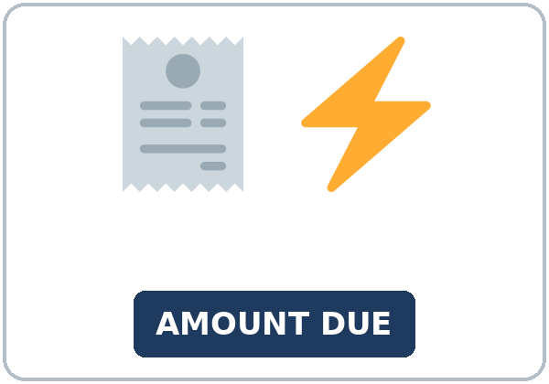
Turn It Off
Today you will:
• Use phrasal verbs: turn off, put away…
• Put it / them in the right place
• Give tips to save energy and stay safe
Lesson 10 · Level 4
Notes:
Welcome learners as they arrive.
Point to the title and read it: "Turn It Off" Say: "Saving energy and keeping a home safe: reading a utility bill, simple ways to use less electricity and water, locking up, and knowing where the fire extinguisher is. Learners give and follow home tips with separable phrasal verbs and it / them. The bill, the company, and the program are invented."
Read the three lines under "Today you will".
Safety stays simple and calm: practical tips only, no fire stories. Point to where the classroom fire extinguisher is.
Lesson plan: Topic; At a glance: Objectives; Teacher notes.
Picture: Twemoji graphics by Twitter, Inc. and other contributors (https://github.com/jdecked/twemoji), CC BY 4.0 (https://creativecommons.org/licenses/by/4.0/); resized and combined, with signs and labels (images/CREDITS.md).

Slide 2
Today's
Goals
01
I can use phrasal verbs: turn off, turn down, turn up, put on, put away, take out, throw away, shut off.
02
I can put it / them in the right place (turn it off, not turn off it).
03
I can give tips to save energy and stay safe at home (Make sure you… / Don't forget to…).
By the end of class, you can do these five things.
Every goal is a good goal.
04
I can read the main parts of a utility bill (amount due, due date, usage).
05
I can write an email (5–8 sentences) to a roommate or family member about changes at home.
Notes:
Read each goal slowly. Learners repeat.
Lesson plan: At a glance: Objectives.

Slide 3
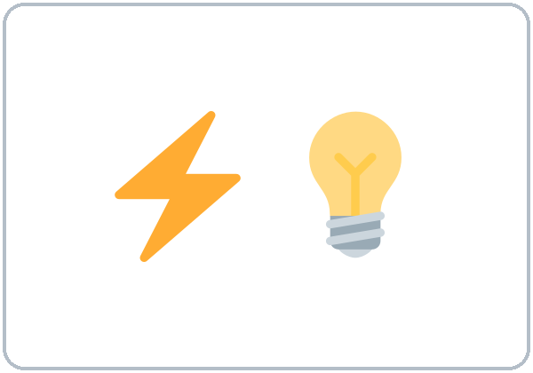
OPENING TALK · 6:00
Opening Talk
A asks a card question.
What do you think about homework for kids?
B answers in 3 sentences.
A asks one follow-up.
Do you agree?
Then switch.
Notes:
Step 1 · 6:00–6:08 · Opening Talk + Homework Check · 8 min. Pairs (7 pairs + 1 trio with 15 learners; 3–4 pairs with 7–8).
Before class, write on the board: opinions; agree / disagree politely; as … as
Model with one learner: you say, "What do you think about homework for kids?" The learner gives an opinion and a reason. Then you disagree politely: "I see your point, but…" Help them answer with 3 sentences. (Click to show the follow-up.)
Opening Talk (5 min): learners open the Opening Talk page. A asks a card question; B answers in 3 sentences (the answer, a reason, a detail); A asks one follow-up. Switch after each card. The cards are on the next slide.
If behind: one card only.
Lesson plan: Step 1; Opening Talk page.
Picture: Twemoji graphics by Twitter, Inc. and other contributors (https://github.com/jdecked/twemoji), CC BY 4.0 (https://creativecommons.org/licenses/by/4.0/); resized and combined, with signs and labels (images/CREDITS.md).

Slide 4
Opening Talk
Cards
01
What do you think about homework for kids?
02
How do you feel about a new parking lot downtown?
B answers in 3 sentences: the answer, a reason, and a detail.
Follow-ups:
Do you agree? Why? I see your point, but…
03
Is a bus as fast as a car?
04
What should change in your neighborhood?
05
Homework check: Lesson 9, items 1 and 3.
Notes:
Step 1, continued. The four cards from the Opening Talk page. Each click shows the next card.
A asks a card question. B answers in 3 sentences. A asks one follow-up question (follow-ups on the right). Then switch.
Homework Check (3 min, last click): Pairs compare Homework item 1 (as … as) and read their opinion and reasons (item 3) to each other. The partner agrees or disagrees politely. Then they fill in the box on the Opening Talk page. Walk around. Write 2 common errors on the board (often I am agree (→ I agree) and not as fast than (→ not as fast as)) and correct them together. Also put up 2 corrections from last week's exit tickets.
Lesson plan: Step 1; Opening Talk page: cards, follow-ups; Homework check.

Slide 5
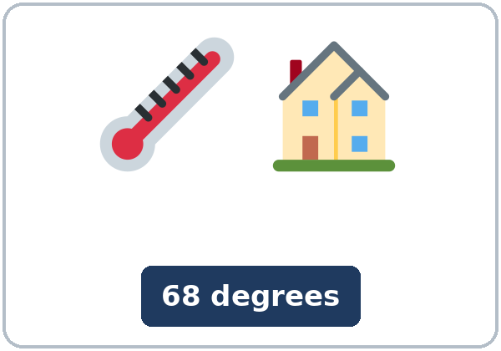

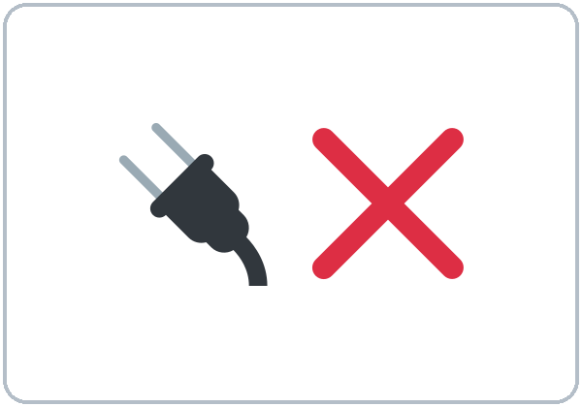
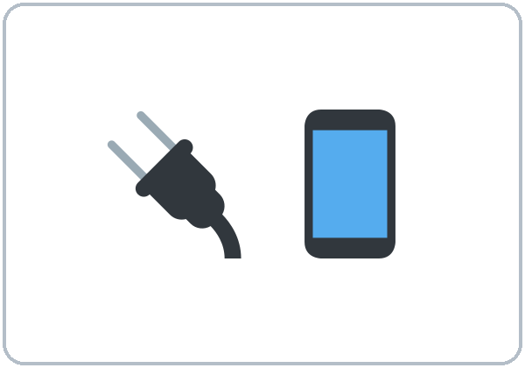
Look. Listen.
Repeat.
New Words
★ utility bill
★ electricity
★ thermostat
★ save energy
★ unplug
★ charger
Notes:
Step 2 · 6:08–6:15 · New Words · 7 min (this slide and the next). Whole class, then pairs.
Point to each picture and say the word. Learners repeat once. ★ = the most important words. Each click shows the next word.
Show the hard words: utility bill (the bill for electricity, gas, or water); electricity; thermostat (it controls the heat); save energy (use less); unplug (take the plug out); charger; outlet (point to one in the room); fan; deadbolt (a strong lock); peephole (a small hole in the door to look out); fire extinguisher; usage (how much you use).
If behind: teach the ★ words only.
Lesson plan: Step 2; Key vocabulary; New Words page.
Pictures: Twemoji graphics by Twitter, Inc. and other contributors (https://github.com/jdecked/twemoji), CC BY 4.0 (https://creativecommons.org/licenses/by/4.0/); resized and combined, with signs and labels (images/CREDITS.md).

Slide 6
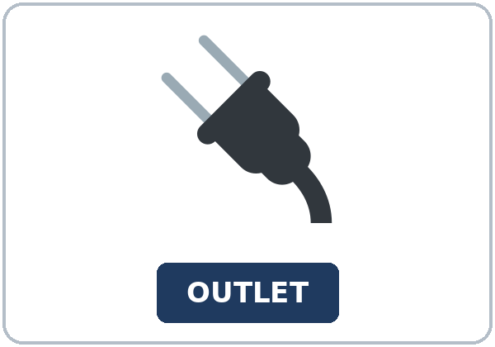
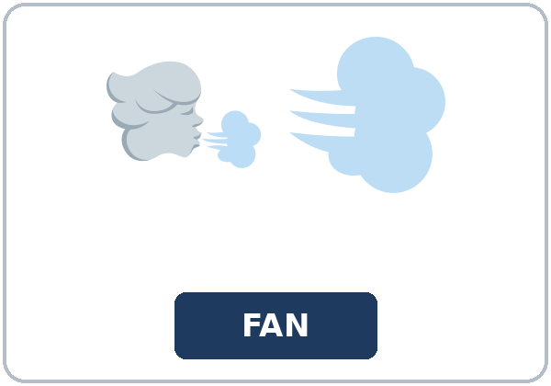
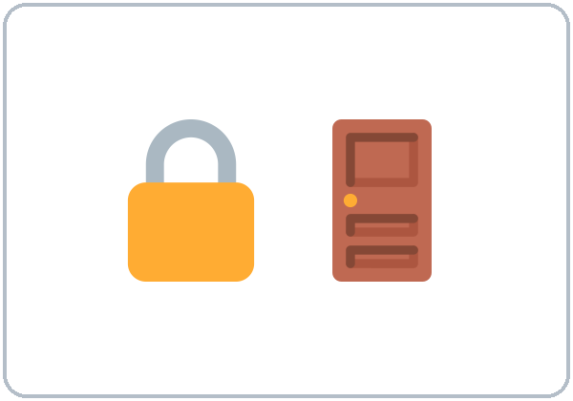

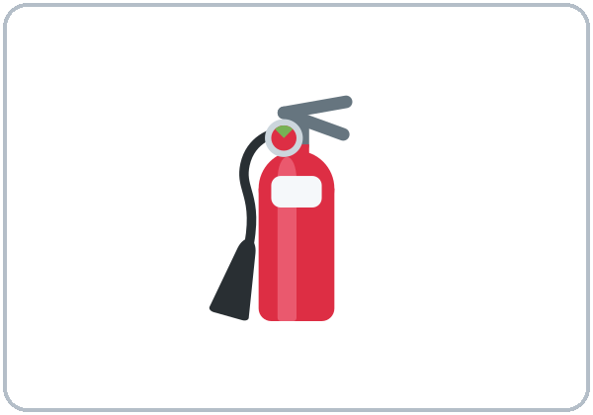
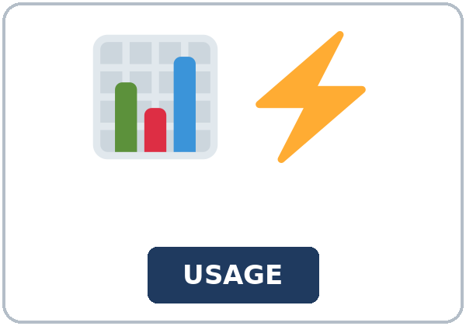
Partner game:
Turn it off!
More New Words
★ outlet
★ fan
★ deadbolt
★ peephole
★ fire extinguisher
usage
Notes:
Step 2, continued. Point to each picture and say the word. Learners repeat once.
Partner game (2 min): A points to a picture and says, "Can you unplug the charger?" B mimes and answers, "OK, I'll unplug it." Then A gives a tip: "Don't forget to lock the deadbolt." Switch. 15 learners: finish with a quick team round (3 teams; you say a clue, the first team with the word gets a point). 7–8: 2 teams. 5 or fewer: one team against the clock.
My Words: "Write any word you want in your language on the My Words page. It's your personal list. It's optional." Learners do it at home.
If behind: teach the ★ words only.
Lesson plan: Step 2; New Words page; Partner game; My Words page.
Pictures: Twemoji graphics by Twitter, Inc. and other contributors (https://github.com/jdecked/twemoji), CC BY 4.0 (https://creativecommons.org/licenses/by/4.0/); resized and combined, with signs and labels (images/CREDITS.md).

Slide 7
Check the Meaning
Look at the picture. Answer the question.
1
2
3
Do you plug a charger into an outlet or a peephole?
Is a deadbolt a lock or a light?
Does a thermostat control the heat or the water?
an outlet
a lock
the heat
Notes:
Step 2 · Check meaning · 1 min. Whole class.
The answers are hidden. Ask each question and wait for the class to answer. Then click to show the answer. Each click shows one answer, in order: 1, 2, 3.
1. "Do you plug a charger into an outlet or a peephole?" (an outlet) • 2. "Is a deadbolt a lock or a light?" (a lock) • 3. "Does a thermostat control the heat or the water?" (the heat)
Lesson plan: Step 2: Check meaning.
Pictures: Twemoji graphics by Twitter, Inc. and other contributors (https://github.com/jdecked/twemoji), CC BY 4.0 (https://creativecommons.org/licenses/by/4.0/); resized and combined, with signs and labels (images/CREDITS.md).

Slide 8
Before You
Listen for:
Listen
What is the problem?
Two roommates, Sofia and Hana, look at a high electric bill and make a plan. Then Sofia calls the electric company.
Play 2: Tasks B and C.
01
Audio: about 2:07. It plays once.
Sofia
02
Hana
Play 1: Task A
03
Paul
Notes:
Step 3 · 6:15–6:30 · Listening + "Hear it, say it" · 15 min (slides 8 to 12). Individuals, then pairs check.
Before you listen (2 min). Say: "Two roommates, Sofia and Hana, look at a high electric bill and make a plan. Then Sofia calls the electric company. Listen: what is the problem?"
There are 3 people: Sofia, Hana and Paul. A narrator starts and ends the listening. Each click highlights the next person.
The audio (L4_L10_listening.mp3, about 2:07) plays the conversation once. Press play again for play 2. A third play is fine if the class needs it.
No speaker? Read the script with a volunteer at a natural, friendly speed, two times. The script says going to and want to. People often say gonna and wanna; learners only need to recognize those words.
Audio: synthetic voices, computer-generated (Chatterbox TTS cloned from Kokoro-82M reference clips). No recordings of real people. The names and the story are invented.
Lesson plan: Step 3; Listening script; Listening page.
Picture: Twemoji graphics by Twitter, Inc. and other contributors (https://github.com/jdecked/twemoji), CC BY 4.0 (https://creativecommons.org/licenses/by/4.0/); resized and combined, with signs and labels (images/CREDITS.md).

Slide 9
Listen. What is the problem?
Circle.
Listening A
a. The electric bill is too high.
b. The heat is broken.
c. The bill is late.
Notes:
Play 1 → Task A (the main idea). Pairs compare. Check together.
Click to circle the answer: a (The electric bill is too high.).
Then read Tasks B and C together (1 min) so learners know what to listen for.
Lesson plan: Step 3; Listening Task A; Answer key.

Slide 10
Listen again.
Circle the answer.
Listening B
1. The bill this month is
$142
$90
2. They will turn ____ the heat at night.
down
up
3. Hana is going to unplug her
phone charger
TV
4. They will put on
sweaters
coats
5. The bill is due on
March 15
March 5
6. The home energy check is
free
$20
Notes:
Play 2 → Tasks B and C. Pairs compare. Then show the answers.
Click to circle each answer (one click per item, 1 to 6): 1 $142 • 2 down • 3 phone charger • 4 sweaters • 5 March 15 • 6 free.
Lesson plan: Step 3; Listening Task B; Answer key.

Slide 11
Listen again.
Write the missing word: the phrasal verb or it / them.
Listening C
1
I always forget to turn ____ off.
them
2
I'll turn ____ off.
it
3
we can turn ____ the heat at night.
down
Write the missing word: the phrasal verb or it / them.
Pairs: compare your answers.
Then check together.
4
let's put ____ sweaters
on
5
not turn ____ the heat
up
6
don't forget to turn ____ the lights
off
Notes:
Task C (play 2). Click to show each answer (one click per item, 1 to 6): 1 them, 2 it, 3 down, 4 on, 5 up, 6 off.
If behind: do Task C together on the board, reading the lines yourself.
Lesson plan: Step 3; Listening Task C; Answer key.

Slide 12
Hear it: gonna = going to
Hear It,
Say It
Say it: the stress and the linking
I'm going to unplug my phone charger.
turn it OFF • put it aWAY
gonna = going to, wanna = want to: fine in everyday talk.
Stress the small word. Link the words.
Say each line two times.
turn_it_off • take_it_out
Notes:
"Hear it, say it" (3 min): Point to the script line. gonna = going to: "I'm going to unplug my phone charger." Then practice the stress on the small word: turn it OFF, put it aWAY, and the linking: turn_it_off, take_it_out. The class repeats the two lines twice.
Reductions: the listening says going to. People often say gonna. Learners only need to recognize it.
Everyday English: people often say gonna (going to) and wanna (want to). Learners will hear them often. They are fine in casual talk; in writing, at a job interview, or in a formal email, use going to and want to. The listening uses the full forms.
Lesson plan: Step 3: "Hear it, say it"; Listening page: Hear it, say it; Teacher notes.

Slide 13
Grammar Box 1
phrasal verbs + it / them
QUESTION
ANSWER
Can you turn off the lights?
OK, I'll turn them off. (not turn off them)
Can you turn the TV down?
Sure, I'll turn it down. It's loud.
Can you take out the trash?
Yes, I'll take it out now.
Notes:
Step 4 · 6:30–6:45 · Grammar Q&A · 15 min (slides 13 to 20). Whole class, then pairs. Show the Grammar page. The left side is the question. The right side is the answer.
Show it (2 min): point to the lights and say, "Can you turn off the lights?" A learner turns them off (or mimes it). You say, "Thank you. You turned them off." Turn them on again. Write: turn off the lights / turn the lights off → turn them off. Cross out turn off them.
Box 1: read across: Can you turn off the lights? → OK, I'll turn them off. Each click shows the answer side of one row.
Lesson plan: Step 4; Grammar Box 1.
Picture: Twemoji graphics by Twitter, Inc. and other contributors (https://github.com/jdecked/twemoji), CC BY 4.0 (https://creativecommons.org/licenses/by/4.0/); resized and combined, with signs and labels (images/CREDITS.md).

Slide 14
Grammar Box 2
the past
QUESTION
ANSWER
Did you take out the trash?
Yes, I took it out this morning.
Did you put away the dishes?
No, I didn't put them away yet.
Did you shut off the water?
Yes, I shut it off before I left.
Notes:
Box 2: the past: Did you take out the trash? → Yes, I took it out. Each click shows the answer side of one row.
Rule of thumb (read it aloud): With a noun, two places are OK: turn off the TV / turn the TV off. With it / them, only the middle: turn it off (not turn off it).
Lesson plan: Step 4; Grammar Box 2; Rule of thumb.
Picture: Twemoji graphics by Twitter, Inc. and other contributors (https://github.com/jdecked/twemoji), CC BY 4.0 (https://creativecommons.org/licenses/by/4.0/); resized and combined, with signs and labels (images/CREDITS.md).

Slide 15
Grammar Box 3
8 phrasal verbs for home
VERB
MEANING · EXAMPLE
turn off / turn up / turn down
stop / more / less
Turn off the lights. Turn the heat down at night.
put on / put away
wear / put in its place
Put on a sweater. Put the dishes away.
take out / throw away
take outside / put in the trash
Take out the trash. Throw away old food.
shut off
stop (water, gas)
Shut off the water.
Notes:
Box 3: the 8 phrasal verbs. Each click shows the answer side of one row.
Lesson plan: Step 4; Grammar Box 3.
Picture: Twemoji graphics by Twitter, Inc. and other contributors (https://github.com/jdecked/twemoji), CC BY 4.0 (https://creativecommons.org/licenses/by/4.0/); resized and combined, with signs and labels (images/CREDITS.md).

Slide 16
Grammar Box 4
home tips
START
EXAMPLE
Make sure you…
Make sure you lock the deadbolt at night.
Don't forget to…
Don't forget to unplug the charger.
We use too much…
We use too much electricity.
Notes:
Box 4: Make sure you… / Don't forget to… Each click shows the answer side of one row.
Questions and answers (2 min): Q: turn off it or turn it off? A: turn it off. With it / them, the small word goes after: turn it off, put them away. • Q: Is turn off the TV OK? A: Yes. With a noun, both are OK: turn off the TV and turn the TV off. • Q: turn down or turn off? A: turn down = less. turn off = stop. Turn down the heat. Turn off the lights.
Check questions: "turn off it or turn it off?" (turn it off) • "Is turn the TV off OK?" (yes) • "It's too loud. Turn it up or turn it down?" (turn it down).
Lesson plan: Step 4; Grammar Box 4; Questions and answers.
Picture: Twemoji graphics by Twitter, Inc. and other contributors (https://github.com/jdecked/twemoji), CC BY 4.0 (https://creativecommons.org/licenses/by/4.0/); resized and combined, with signs and labels (images/CREDITS.md).

Slide 17
Practice A
Write one word.
Practice A
1
The lights are on. Please turn ____ off.
them
2
It's hot. Can you turn ____ the fan?
up
3
Did you take out the trash? Yes, I took ____ out.
it
Write one word.
Pairs: check your answers.
4
It's cold. Put ____ a sweater.
on
5
Make ____ you lock the deadbolt.
sure
6
Don't ____ to unplug the charger.
forget
Notes:
Practice A and B (3 min): learners write, then pairs check. Go over the answers.
Click to show each answer (one click per item, 1 to 6): 1 them, 2 up, 3 it, 4 on, 5 sure, 6 forget.
Lesson plan: Step 4; Grammar Practice A; Answer key.

Slide 18
Circle the correct words.
Practice B
1. Turn ____, please.
it off
off it
2. Can you ____ the old milk?
throw away
throw on
3. It's late. Please turn ____ the music.
down
up
4. I ____ yesterday.
put them away
put away them
5. Don't forget ____ the door.
to lock
lock
6. We use too ____ water.
much
many
Notes:
Practice B. Learners circle the correct words. Pairs check.
Click to circle each answer (one click per item, 1 to 6): 1 it off, 2 throw away, 3 down, 4 put them away, 5 to lock, 6 much.
Lesson plan: Step 4; Grammar Practice B; Answer key.

Slide 19
Common Mistakes
Don't say
Say
Turn off it.
Turn it off.
I put away them.
I put them away.
Close the light.
Turn off the light.
Open the TV.
Turn on the TV.
Don't forget lock the door.
Don't forget to lock the door.
Notes:
Common mistakes. Read the table together: "Don't say… Say…". Read a line from Don't say. Ask: "What's the right way?" Learners try first. Then click to show the right form. Each click shows one line, in order 1 to 5.
Learners can read the contrast tip on their Grammar page on their own; it is optional. You never need to read, translate, or explain it.
Lesson plan: Grammar: Common mistakes; Teacher notes.
Picture: Twemoji graphics by Twitter, Inc. and other contributors (https://github.com/jdecked/twemoji), CC BY 4.0 (https://creativecommons.org/licenses/by/4.0/); resized and combined, with signs and labels (images/CREDITS.md).

Slide 20
Pair Check
A gives an instruction.
01
A points to a picture. Then switch.
A: Can you unplug the charger?
B mimes and answers.
02
B: OK, I'll unplug it.
A: Don't forget to lock the deadbolt.
Notes:
Pair check (last 3 min of Step 4). Pairs.
A points to a picture and says, "Can you unplug the charger?" B mimes and answers, "OK, I'll unplug it." A says, "Don't forget to lock the deadbolt." Switch. 15 learners: swap partners once. 5 or fewer: you join one pair.
If behind: skip the pair check. Talk Time practices it.
Break · 6:45–7:00 · 15 min. Write on the board: Can you turn off the lights? → OK, I'll turn them off. • Did you take out the trash? → Yes, I took it out. • Make sure you lock the deadbolt.
Lesson plan: Step 4: Pair check; Break.
Picture: Twemoji graphics by Twitter, Inc. and other contributors (https://github.com/jdecked/twemoji), CC BY 4.0 (https://creativecommons.org/licenses/by/4.0/); resized and combined, with signs and labels (images/CREDITS.md).

Slide 21
Talk Time
Energy Detective
Pairs.
Read a problem card.
7:00–7:15
1
A reads a problem and gives an instruction.
Turn them off, please.
2
B mimes and answers with it or them.
OK, I'll turn them off.
3
Then switch: B uses Apartment B.
Unplug it. • Put it away.
Notes:
Step 5 · 7:00–7:15 · Talk Time: Energy Detective + Home Tips · 15 min.
Model it first (1 min): read the first problem on the Apartment A card: "The lights are on in an empty room." Say to a learner, "Turn them off, please." The learner mimes and says, "OK, I'll turn them off." Do one more: "The window is open, and the heat is on." (Close it. Turn the heat down.)
Round 1 (7 min): Energy Detective (pairs). A reads a problem from the Apartment A card and gives an instruction (Turn them off. Close it. Put it away.). B mimes and answers with it / them. Then switch to the Apartment B card. Each click shows the next step.
15 learners: pairs for round 1; then 5 groups of 3. 7–8 learners: pairs; then 2 groups. 5 or fewer: pairs; then one poster together.
Lesson plan: Step 5; Talk Time: Energy Detective.
Picture: Twemoji graphics by Twitter, Inc. and other contributors (https://github.com/jdecked/twemoji), CC BY 4.0 (https://creativecommons.org/licenses/by/4.0/); resized and combined, with signs and labels (images/CREDITS.md).

Slide 22
Talk Time
Home Tips
Groups of 3.
Write 5 tips.
7:00–7:15
1
Write 5 tips to save energy or stay safe.
Turn down the heat at night.
2
Use Make sure you… and Don't forget to…
Make sure you lock the deadbolt.
3
Present them in 1 minute.
Unplug the charger when the phone is full.
Notes:
Round 2 (6 min): Home Tips (groups of 3). Groups write 5 tips to save energy or stay safe (Turn down the heat at night. Unplug the charger.) and present them in 1 minute. Each click shows the next step.
15 learners: pairs for round 1; then 5 groups of 3. 7–8 learners: pairs; then 2 groups. 5 or fewer: pairs; then one poster together.
Every answer needs a reason; every partner asks a follow-up. Walk around and listen. Note 2 good sentences to praise and 1 common error for next week.
If behind: round 1 only.
Lesson plan: Step 5; Talk Time: Home Tips.
Picture: Twemoji graphics by Twitter, Inc. and other contributors (https://github.com/jdecked/twemoji), CC BY 4.0 (https://creativecommons.org/licenses/by/4.0/); resized and combined, with signs and labels (images/CREDITS.md).

Slide 23
Read fast first.
Answer the questions.
Read &
Write
1
How much is the bill?
$142.00.
2
When is it due?
March 15.
CITY POWER · A bill + a flyer (invented)
Pairs: answer together.
3
What happens if you pay late?
There is a $10 late fee.
4
What is a good temperature at night in winter?
68 degrees.
5
What should you do before you open the door?
Look through the peephole.
Notes:
Step 6 · 7:15–7:25 · Read & Write: A utility bill + a "Save energy, stay safe" flyer · 10 min. Pairs read, then individual writing.
Read (4 min): Learners read the invented bill and the flyer on the Read & Write page and answer the questions. Say: "Read fast first. Then find the answers." Pairs answer questions 1–5 together.
Check (1 min): click to show each answer (one click per question, 1 to 5): 1 $142.00. • 2 March 15. • 3 There is a $10 late fee. • 4 68 degrees. • 5 Look through the peephole.
Write (5 min): Learners write an email (5–8 sentences) to a roommate or family member: what to change at home and why. Show the example. Check for 2 phrasal verbs and one it or them. Learners start in class and finish at home (Homework item 2).
If behind: questions 1–5 only; the writing becomes homework.
Lesson plan: Step 6; Read & Write page; Answer key.

Slide 24
Before You Go 7:25–7:30
01
Exit ticket
02
Homework
What can people do at home to save energy or stay safe?
1. A tip with a phrasal verb.
2. A tip with it or them.
3. A reason, with because.
Give it to me at the door.
About 15–20 minutes.
1. Write the sentence.
2. Finish your writing from Read & Write C (your email).
3. Look around your home.
4. Review (Lesson 9).
Bring it next week!
Notes:
Step 7 · 7:25–7:30 · Exit Ticket + Homework · 5 min · NEVER SKIP.
Exit ticket (3 min): learners open the Exit Ticket page and answer in 3 sentences with a reason: What can people do at home to save energy or stay safe? Example on the board: Turn off the lights when you leave a room. Unplug your charger and put it away. Make sure you lock the deadbolt at night, because it keeps your home safe. With 5 or fewer, a learner can say it to you first and then write it.
Collect the pages. After class, sort them into ✓ / almost / not yet. Start next week with 2 corrections on the board (no names).
Homework (2 min): open the Homework page. Do item 1 together (item 1: turn down / the heat (it) → Turn it down.). Say: "About 15–20 minutes. Finish your Read & Write writing at home."
Homework items: 1. Write the sentence. Use it or them. • 2. Finish your writing from Read & Write C (your email). Read it one more time. Check ✓ the list in D. • 3. Look around your home. Write 3 things you can do to save energy or stay safe. • 4. Review (Lesson 9). Write one word.
Lesson plan: Step 7; Exit Ticket page; Homework page.
Picture: Twemoji graphics by Twitter, Inc. and other contributors (https://github.com/jdecked/twemoji), CC BY 4.0 (https://creativecommons.org/licenses/by/4.0/); resized and combined, with signs and labels (images/CREDITS.md).

Slide 25
Goodbye! See You Next Week!
Now you can:
• Use phrasal verbs: turn off, put away…
• Put it / them in the right place
• Give tips to save energy and stay safe
Lesson 10 · Level 4
Notes:
Read the title: "Goodbye! See you next week!" Learners repeat.
Read the three "Now you can" lines.
Lesson plan: At a glance: Objectives; Step 7.
Picture: Twemoji graphics by Twitter, Inc. and other contributors (https://github.com/jdecked/twemoji), CC BY 4.0 (https://creativecommons.org/licenses/by/4.0/); resized and combined, with signs and labels (images/CREDITS.md).

Slide 26
Credits
Pictures
Vocabulary pictures use Twemoji graphics by Twitter, Inc. and other contributors (https://github.com/jdecked/twemoji), licensed under CC BY 4.0 (https://creativecommons.org/licenses/by/4.0/). The graphics were resized and combined, and signs and labels were added.
Names and story
Sofia Ruiz, Hana, and Paul are invented names. The listening story is invented.
Audio and font
Audio: synthetic voices made with Chatterbox TTS (MIT License), cloned from short synthetic reference clips made with Kokoro-82M (Apache License 2.0). No recordings of real people were used. Each file carries an inaudible Perth watermark marking it as AI-generated. Font: Lexend Deca (OFL 1.1).
© 2026 the authors. The authors license this deck under CC BY-NC-SA 4.0.
Notes:
Credits. You don't need to read this slide in class.
Pictures: Twemoji graphics by Twitter, Inc. and other contributors, CC BY 4.0; the file-by-file list is in images/CREDITS.md.
Audio: synthetic voices, computer-generated (Chatterbox TTS cloned from Kokoro-82M reference clips). No recordings of real people. The names and the story are invented.
Course materials: © 2026 the authors, licensed under CC BY-NC-SA 4.0 (https://creativecommons.org/licenses/by-nc-sa/4.0/).
Lesson plan: Picture Credits. Picture list: images/CREDITS.md.

