Slide 1
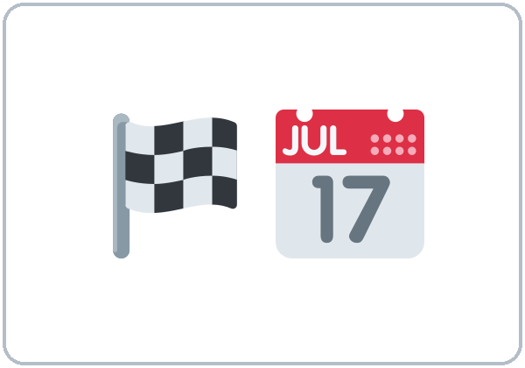
My Story So Far
Today you will:
• Tell events in order
• Talk about the future with when / after
• Talk about past ability
Lesson 13 · Level 4
Notes:
Welcome learners as they arrive.
Point to the title and read it: "My Story So Far" Say: "Personal growth and the graduation talk: learners look back at their own learning (when they started, what was hard, what they can do now) and look forward to the next step. They tell a short story with time clauses (before / after / when), past ability (couldn't / was able to), and the past continuous. Every story is the learner's choice; "my life in this class" is always enough. All names are invented."
Read the three lines under "Today you will".
Stories are the learner's choice. "My life in this class" or "my job" is always enough. Never ask about migration journeys, family separation, or other hard events. If a learner shares something hard, thank them and move on.
Lesson plan: Topic; At a glance: Objectives; Teacher notes.
Picture: Twemoji graphics by Twitter, Inc. and other contributors (https://github.com/jdecked/twemoji), CC BY 4.0 (https://creativecommons.org/licenses/by/4.0/); resized and combined, with signs and labels (images/CREDITS.md).

Slide 2
Today's
Goals
01
I can tell events in order with before / after / when and use a comma when the time clause comes first.
02
I can use the present after when / after for the future (After I finish this class, I'll…).
03
I can talk about past ability with couldn't / was able to.
By the end of class, you can do these five things.
Every goal is a good goal.
04
I can make a 5-event timeline of my learning and tell it to a group.
05
I can write an email (5–8 sentences) to my teacher about my story so far, the start of my graduation talk.
Notes:
Read each goal slowly. Learners repeat.
Lesson plan: At a glance: Objectives.

Slide 3
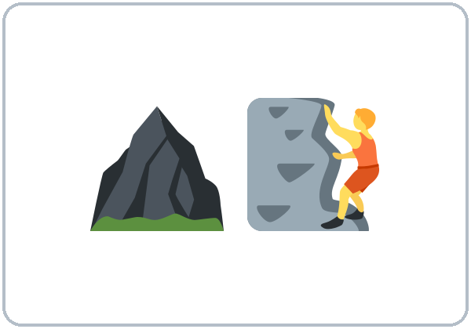
OPENING TALK · 6:00
Opening Talk
A asks a card question.
What is one warning sign of a scam?
B answers in 3 sentences.
A asks one follow-up.
Why?
Then switch.
Notes:
Step 1 · 6:00–6:08 · Opening Talk + Homework Check · 8 min. Pairs (7 pairs + 1 trio with 15 learners; 3–4 pairs with 7–8).
Before class, write on the board: who / that; warning signs
Model with one learner: you say, "Tell me one warning sign of a scam." The learner answers with who / that (A caller who asks for gift cards.). Then you ask, "What should you do?" Help them say 3 sentences. (Click to show the follow-up.)
Opening Talk (5 min): learners open the Opening Talk page. A asks a card question; B answers in 3 sentences (the answer, a reason, a detail); A asks one follow-up. Switch after each card. The cards are on the next slide.
If behind: one card only.
Lesson plan: Step 1; Opening Talk page.
Picture: Twemoji graphics by Twitter, Inc. and other contributors (https://github.com/jdecked/twemoji), CC BY 4.0 (https://creativecommons.org/licenses/by/4.0/); resized and combined, with signs and labels (images/CREDITS.md).

Slide 4
Opening Talk
Cards
01
What is one warning sign of a scam?
02
What should you do with a text that asks for your PIN?
B answers in 3 sentences: the answer, a reason, and a detail.
Follow-ups:
Why? What should you do?
03
Who can you call to check a bill?
04
Is it a scam? "You won a prize! Pay $20 to get it."
05
Homework check: Lesson 12, items 1 and 3.
Notes:
Step 1, continued. The four cards from the Opening Talk page. Each click shows the next card.
A asks a card question. B answers in 3 sentences. A asks one follow-up question (follow-ups on the right). Then switch.
Homework Check (3 min, last click): Pairs compare Homework item 1 (who / that) and read their 3 warning signs (item 3) to each other. Then they fill in the box on the Opening Talk page. Walk around. Write 2 common errors on the board (often a man who he called (→ a man who called) and a text who said (→ a text that said)) and correct them together. Also put up 2 corrections from last week's exit tickets.
Lesson plan: Step 1; Opening Talk page: cards, follow-ups; Homework check.

Slide 5
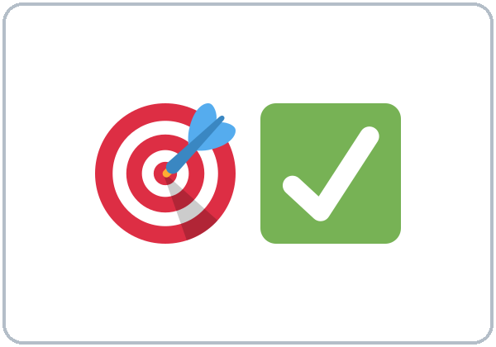
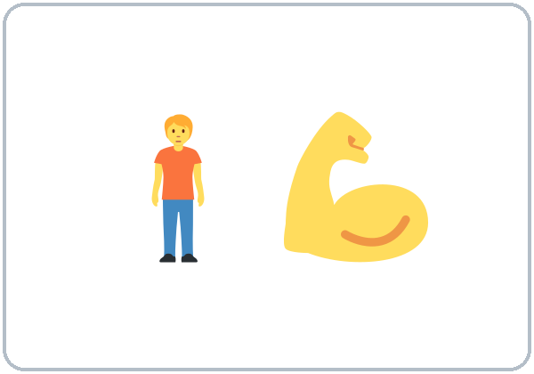
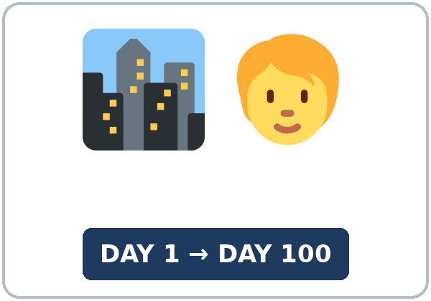
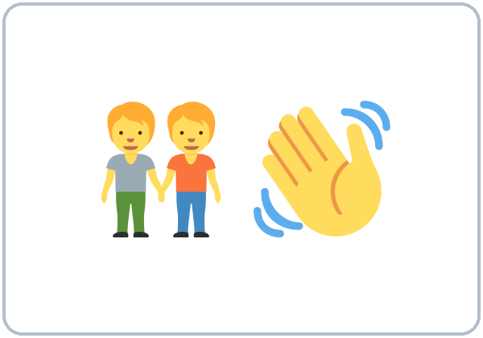
Look. Listen.
Repeat.
New Words
★ milestone
★ challenge
★ succeed
★ confident
★ get used to
★ make friends
Notes:
Step 2 · 6:08–6:15 · New Words · 7 min (this slide and the next). Whole class, then pairs.
Point to each picture and say the word. Learners repeat once. ★ = the most important words. Each click shows the next word.
Show the hard words: milestone (an important step in your life); challenge (something hard); succeed (do it well, get what you wanted); confident (sure you can do it); get used to (something new becomes normal); make friends; be able to (can); support (help, be there for someone); celebrate (have a party, say "great job!"); timeline (events in order on a line); speech (a talk to many people); audience (the people who listen).
If behind: teach the ★ words only.
Lesson plan: Step 2; Key vocabulary; New Words page.
Pictures: Twemoji graphics by Twitter, Inc. and other contributors (https://github.com/jdecked/twemoji), CC BY 4.0 (https://creativecommons.org/licenses/by/4.0/); resized and combined, with signs and labels (images/CREDITS.md).

Slide 6
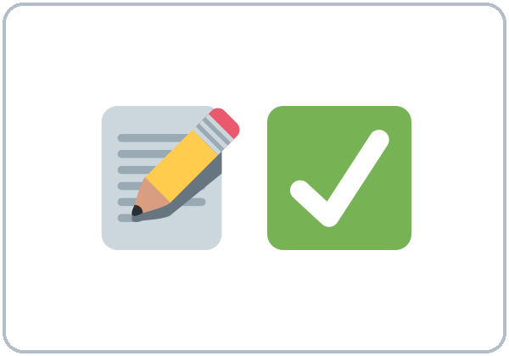
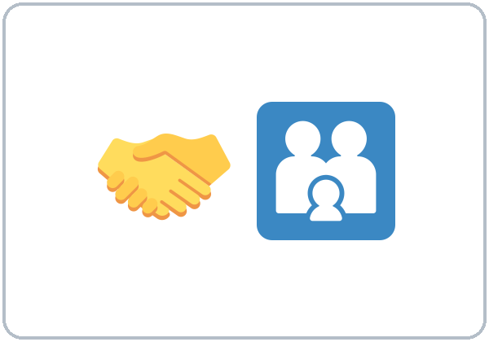
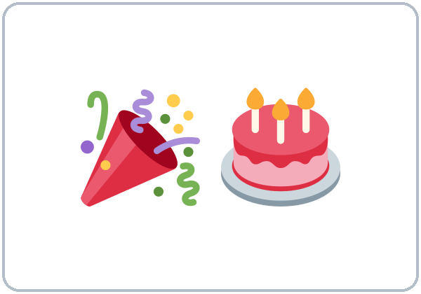
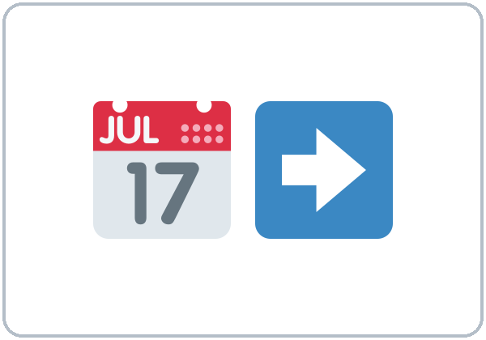
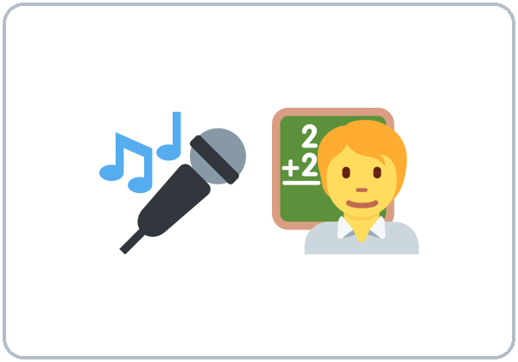
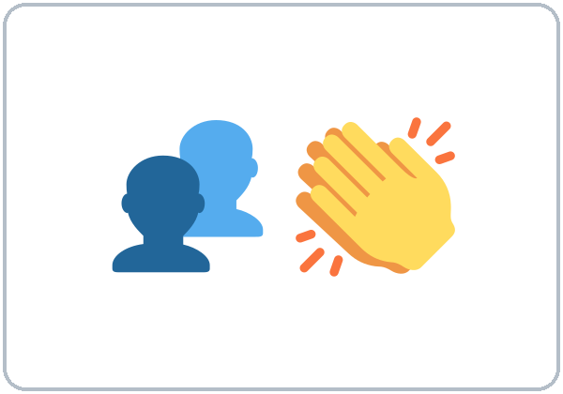
Partner game:
When did you…?
More New Words
★ be able to
★ support
★ celebrate
★ timeline
★ speech
audience
Notes:
Step 2, continued. Point to each picture and say the word. Learners repeat once.
Partner game (2 min): A points to a picture and asks, "When did you make friends here?" B answers with a time clause: "When I started this class, I made friends." Switch. 15 learners: finish with a quick team round (3 teams; you say a clue, the first team with the word gets a point). 7–8: 2 teams. 5 or fewer: one team against the clock.
My Words: "Write any word you want in your language on the My Words page. It's your personal list. It's optional." Learners do it at home.
If behind: teach the ★ words only.
Lesson plan: Step 2; New Words page; Partner game; My Words page.
Pictures: Twemoji graphics by Twitter, Inc. and other contributors (https://github.com/jdecked/twemoji), CC BY 4.0 (https://creativecommons.org/licenses/by/4.0/); resized and combined, with signs and labels (images/CREDITS.md).

Slide 7
Check the Meaning
Look at the picture. Answer the question.
1
2
3
Is a challenge easy or hard?
When you are confident, are you sure or not sure?
Do you celebrate a milestone or a problem?
hard
sure
a milestone
Notes:
Step 2 · Check meaning · 1 min. Whole class.
The answers are hidden. Ask each question and wait for the class to answer. Then click to show the answer. Each click shows one answer, in order: 1, 2, 3.
1. "Is a challenge easy or hard?" (hard) • 2. "When you are confident, are you sure or not sure?" (sure) • 3. "Do you celebrate a milestone or a problem?" (a milestone)
Lesson plan: Step 2: Check meaning.
Pictures: Twemoji graphics by Twitter, Inc. and other contributors (https://github.com/jdecked/twemoji), CC BY 4.0 (https://creativecommons.org/licenses/by/4.0/); resized and combined, with signs and labels (images/CREDITS.md).

Slide 8
Before You
Listen for:
Listen
What is her main message?
Mariana was a learner here. Now she is giving a short talk at graduation. Then her old teacher, Mr. Hill, asks her two questions.
Play 2: Tasks B and C.
01
Audio (about 1:54): coming soon.
Narrator
02
Mariana
Play 1: Task A
03
Mr. Hill
Notes:
Step 3 · 6:15–6:30 · Listening + "Hear it, say it" · 15 min (slides 8 to 12). Individuals, then pairs check.
Before you listen (2 min). Say: "Mariana was a learner here. Now she is giving a short talk at graduation. Then her old teacher, Mr. Hill, asks her two questions. Listen: what is her main message?"
There are two people: Mariana and Mr. Hill. A narrator starts and ends the listening. Each click highlights the next voice.
The audio (about 1:54) is coming soon. When it is ready, it plays the conversation once; press play again for play 2. Until then, read the listening script (at the end of these notes) with a volunteer.
No speaker? Read the script with a volunteer at a natural, friendly speed, two times. Say gonna and wanna where the script has them.
Audio: the listening audio for this lesson (about 1:54) is coming soon. It will use computer-generated voices (Chatterbox TTS cloned from synthetic Kokoro-82M reference clips); no recordings of real people. Until it is ready, read the listening script (in the notes of the Before You Listen slide) with a volunteer. The names and the story are invented.
Lesson plan: Step 3; Listening script; Listening page.
Picture: Twemoji graphics by Twitter, Inc. and other contributors (https://github.com/jdecked/twemoji), CC BY 4.0 (https://creativecommons.org/licenses/by/4.0/); resized and combined, with signs and labels (images/CREDITS.md).
Listening script (the audio is coming soon; until then, read it aloud with a volunteer at a normal, friendly speed):
Narrator: Lesson thirteen. Mariana was a learner at this school. Now she is giving a short talk at graduation. Then her old teacher, Mr. Hill, asks her two questions.
Mariana: Good evening, everyone. My name is Mariana. When I started English classes here, I couldn't understand the bus driver, and I was afraid to talk on the phone.
Mariana: The first year was hard. I was working at a restaurant at night, and I was always tired. But my classmates helped me, and I made friends.
Mariana: After I finished Level 2, I got a new job at a hotel. Before I started that job, I practiced my interview with my teacher. Last year, I was able to call the clinic by myself for the first time. That was a big milestone for me.
Mariana: Now I can talk to guests at work, and I help my kids with their homework. I'm more confident.
Mariana: What's next? After I finish Level 5, I'm gonna take a training class to be a front desk manager. My advice to you is simple: come to class, and don't be afraid to make mistakes. Thank you.
Mr. Hill: Thank you, Mariana. That was wonderful. Can I ask you two questions?
Mariana: Of course.
Mr. Hill: What was the biggest challenge for you?
Mariana: Getting used to the phone. When I called someone, I couldn't understand them very well. Now it's easy for me.
Mr. Hill: And what helped you the most?
Mariana: My classmates. When I was tired, they supported me. After class ended, we often studied together. And we celebrated every small success.
Mr. Hill: Thank you. Everyone, let's celebrate Mariana!
Narrator: That's the end of the listening.

Slide 9
Listen. What is Mariana's main message?
Circle.
Listening A
a. Come to class, and don't be afraid to make mistakes.
b. Hotel jobs are easy.
c. Level 5 is too hard.
Notes:
Play 1 → Task A (the main idea). Pairs compare. Check together.
Click to circle the answer: a (Come to class, and don't be afraid to make mistakes.).
Then read Tasks B and C together (1 min) so learners know what to listen for.
Lesson plan: Step 3; Listening Task A; Answer key.

Slide 10
Listen again.
Her story in order: circle the answer.
Listening B
1. First, when she started, she couldn't understand the
bus driver
teacher
2. Then, in her first year, she worked at a ____ at night.
restaurant
hotel
3. After Level 2, she got a job at a
hotel
clinic
4. Last year, she called the ____ by herself.
clinic
school
5. Next, after Level 5, she's going to take a
training class
vacation
6. Her biggest challenge was
the phone
the bus
Notes:
Play 2 → Tasks B and C. Pairs compare. Then show the answers.
Click to circle each answer (one click per item, 1 to 6): 1 bus driver • 2 restaurant • 3 hotel • 4 clinic • 5 training class • 6 the phone.
Lesson plan: Step 3; Listening Task B; Answer key.

Slide 11
Listen again.
Write before, after, or when.
Listening C
1
____ I started English classes here, I couldn't understand the bus driver
When
2
____ I finished Level 2, I got a new job at a hotel.
After
3
____ I started that job, I practiced my interview with my teacher.
Before
Write before, after, or when.
Pairs: compare your answers.
Then check together.
4
____ I called someone, I couldn't understand them very well.
When
5
____ I was tired, they supported me.
When
6
____ class ended, we often studied together.
After
Notes:
Task C (play 2). Click to show each answer (one click per item, 1 to 6): 1 When, 2 After, 3 Before, 4 When, 5 When, 6 After.
If behind: do Task C together on the board, reading the lines yourself.
Lesson plan: Step 3; Listening Task C; Answer key.

Slide 12
Hear it: gonna = going to
Hear It,
Say It
Say it: the pause and the stress
I'm gonna take a training class.
When I started, (pause) I couldn't understand the bus driver.
You will hear gonna.
Pause at the comma. Stress the key words.
Say each line two times.
NOW I can…
NEXT…
Notes:
"Hear it, say it" (3 min): Point to the script line. gonna = going to: "I'm gonna take a training class." Then practice the pause at the comma: When I started, (pause) I couldn't understand the bus driver. Stress the key words: NOW I can…, NEXT… The class repeats the two lines twice.
Reductions: the listening has gonna. Learners need to understand it; they can always say going to.
Lesson plan: Step 3: "Hear it, say it"; Listening page: Hear it, say it; Teacher notes.

Slide 13
Grammar Box 1
before / after / when
QUESTION
ANSWER
What did you do after you finished school?
After I finished school, I worked in a store.
How did you feel when you started this job?
When I started this job, I didn't know anyone.
What couldn't you do before this class?
Before I started this class, I couldn't fill out a form.
What will you do after you finish this class?
After I finish this class, I'll take Level 5.
Notes:
Step 4 · 6:30–6:45 · Grammar Q&A · 15 min (slides 13 to 20). Whole class, then pairs. Show the Grammar page. The left side is the question. The right side is the answer.
Show it (2 min): draw a line on the board with 2 events: I finished school. → I got a job. Say, "After I finished school, I got a job." Point to the comma. Then: "I got a job after I finished school." No comma. Then the future: "After I finish this class, I'll take Level 5." Cross out When I will finish.
Box 1: read across: What did you do after you finished school? → After I finished school, I worked in a store. Each click shows the answer side of one row.
Lesson plan: Step 4; Grammar Box 1.
Picture: Twemoji graphics by Twitter, Inc. and other contributors (https://github.com/jdecked/twemoji), CC BY 4.0 (https://creativecommons.org/licenses/by/4.0/); resized and combined, with signs and labels (images/CREDITS.md).

Slide 14
Grammar Box 2
couldn't / was able to; was …ing
QUESTION
ANSWER
Could you understand the bus driver?
No, I couldn't. Now I can.
Were you able to call the clinic?
Yes, I was able to call by myself last month.
What were you doing when you met your friend?
I was working at a restaurant when I met her.
Notes:
Box 2: couldn't / was able to, past continuous. Each click shows the answer side of one row.
Rule of thumb (read it aloud): before / after / when + a full sentence (I started, I finished). The time part can come first (with a comma) or second (no comma). For the future, use the present after when / after / before: After I finish this class, I'll take Level 5.
Lesson plan: Step 4; Grammar Box 2; Rule of thumb.
Picture: Twemoji graphics by Twitter, Inc. and other contributors (https://github.com/jdecked/twemoji), CC BY 4.0 (https://creativecommons.org/licenses/by/4.0/); resized and combined, with signs and labels (images/CREDITS.md).

Slide 15
Grammar Box 3
the comma
TIME PART FIRST: comma
TIME PART SECOND: no comma
When I started, I didn't know anyone.
I didn't know anyone when I started.
After I finish this class, I'll take Level 5.
I'll take Level 5 after I finish this class.
Notes:
Box 3: the comma. Each click shows the answer side of one row.
Lesson plan: Step 4; Grammar Box 3.
Picture: Twemoji graphics by Twitter, Inc. and other contributors (https://github.com/jdecked/twemoji), CC BY 4.0 (https://creativecommons.org/licenses/by/4.0/); resized and combined, with signs and labels (images/CREDITS.md).

Slide 16
Grammar Box 4
the talk frame
PART
SAY
Then
When I started…, I couldn't…
What was hard
It was hard because… But I've…
Now
Now I can… I'm more confident.
Next
After I finish…, I'll… because…
Notes:
Box 4: the talk frame. Each click shows the answer side of one row.
Questions and answers (2 min): Q: When I will finish or When I finish? A: When I finish this class, I'll take Level 5. Use the present after when / after / before, like after if. • Q: Do I need a comma? A: Time part first: comma. After I finished school, I worked. Time part second: no comma. I worked after I finished school. • Q: couldn't or wasn't able to? A: Both are OK: I couldn't drive. / I wasn't able to drive. For one success in the past, use was able to: I was able to call the clinic.
Check questions: "Time clause first: comma or no comma?" (comma) • "When I will finish or When I finish?" (When I finish) • "Last month, I could call the clinic one time, or I was able to call?" (I was able to call).
Lesson plan: Step 4; Grammar Box 4; Questions and answers.
Picture: Twemoji graphics by Twitter, Inc. and other contributors (https://github.com/jdecked/twemoji), CC BY 4.0 (https://creativecommons.org/licenses/by/4.0/); resized and combined, with signs and labels (images/CREDITS.md).

Slide 17
Practice A
Write one word.
Practice A
1
____ I started this job, I didn't know anyone.
When
2
Before I came here, I ____ speak English. (can't)
couldn't
3
After I finish this class, I ____ take Level 5.
will
Write one word.
Pairs: check your answers.
4
Last month, I was ____ to call the clinic by myself.
able
5
I was ____ at a store when I met my friend. (work)
working
6
When I ____ this class, I'll celebrate. (finish / will finish)
finish
Notes:
Practice A and B (3 min): learners write, then pairs check. Go over the answers.
Click to show each answer (one click per item, 1 to 6): 1 When, 2 couldn't, 3 will, 4 able, 5 working, 6 finish.
Lesson plan: Step 4; Grammar Practice A; Answer key.

Slide 18
Circle the correct words.
Practice B
1. When I ____ the class, I'll look for a new job.
finish
will finish
2. ____ I worked in a store.
After I finished school,
After I finished school
3. Before I started class, I ____ read the bus schedule.
couldn't
can't
4. I ____ fill out the form by myself.
was able to
could to
5. I used to ____ at night, but now I work days.
work
working
6. I've ____ many friends in this class.
made
make
Notes:
Practice B. Learners circle the correct words. Pairs check.
Click to circle each answer (one click per item, 1 to 6): 1 finish, 2 After I finished school,, 3 couldn't, 4 was able to, 5 work, 6 made.
Lesson plan: Step 4; Grammar Practice B; Answer key.

Slide 19
Common Mistakes
Don't say
Say
When I will finish, I'll call you.
When I finish, I'll call you.
Before I came here I couldn't drive.
Before I came here, I couldn't drive.
I could to fill out the form.
I was able to fill out the form.
After finish class, I go home.
After I finish class, I go home.
I was work when I met her.
I was working when I met her.
Notes:
Common mistakes. Read the table together: "Don't say… Say…". Read a line from Don't say. Ask: "What's the right way?" Learners try first. Then click to show the right form. Each click shows one line, in order 1 to 5.
Learners can read the contrast tip on their Grammar page on their own; it is optional. You never need to read, translate, or explain it.
Lesson plan: Grammar: Common mistakes; Teacher notes.
Picture: Twemoji graphics by Twitter, Inc. and other contributors (https://github.com/jdecked/twemoji), CC BY 4.0 (https://creativecommons.org/licenses/by/4.0/); resized and combined, with signs and labels (images/CREDITS.md).

Slide 20
Pair Check
A asks.
01
A points to a picture and asks. Then switch.
A: When did you make friends here?
B answers with a time clause.
02
B: When I started this class,
I made friends.
Notes:
Pair check (last 3 min of Step 4). Pairs.
A points to a picture and asks, "When did you make friends here?" B answers with a time clause: "When I started this class, I made friends." Switch. 15 learners: swap partners once. 5 or fewer: you join one pair.
If behind: skip the pair check. Talk Time practices it.
Break · 6:45–7:00 · 15 min. Write on the board: When I started, I couldn't… • After I finished…, I… • Now I can… • After I finish this class, I'll…
Lesson plan: Step 4: Pair check; Break.
Picture: Twemoji graphics by Twitter, Inc. and other contributors (https://github.com/jdecked/twemoji), CC BY 4.0 (https://creativecommons.org/licenses/by/4.0/); resized and combined, with signs and labels (images/CREDITS.md).

Slide 21
Talk Time
Story Timeline
Alone, then pairs.
Your life in this class is enough.
7:00–7:15
1
Write 5 events on the timeline.
When I started this class, I couldn't…
2
Tell a partner with when / before / after.
After I practiced with my partner, I…
3
Your partner asks one question.
After I finish this class, I'll…
Notes:
Step 5 · 7:00–7:15 · Talk Time: Story Timeline + Talk Rehearsal · 15 min.
Model it first (1 min): show your own 5-event timeline on the board and tell it in 1 minute: "When I started teaching, I was nervous. After I taught my first class, I felt better…" Then model a feedback card: "One thing I liked: your timeline was clear. One tip: speak a little slower."
Round 1 (7 min): Story Timeline (pairs). Each learner writes 5 events from their own learning on the timeline (their choice; "my life in this class" is enough). They tell the timeline to a partner with when / before / after. The partner asks one question. Each click shows the next step.
15 learners: pairs; then groups of 3. 7–8 learners: pairs; then groups of 3 (or 2 groups of 4). 5 or fewer: each learner tells the whole group; you give the feedback cards.
Model first: tell your own 1-minute story with the talk frame before learners start. Reading from paper is OK, today and at graduation.
Lesson plan: Step 5; Talk Time: Story Timeline.
Picture: Twemoji graphics by Twitter, Inc. and other contributors (https://github.com/jdecked/twemoji), CC BY 4.0 (https://creativecommons.org/licenses/by/4.0/); resized and combined, with signs and labels (images/CREDITS.md).

Slide 22
Talk Time
Talk Rehearsal
Groups of 3.
Tell your story (1–2 minutes).
7:00–7:15
1
Use the talk frame.
Then → What was hard → Now → Next
2
The two listeners fill in a feedback card.
Now I can…
3
Then switch.
After I finish…, I'll… because…
Notes:
Round 2 (6 min): Talk Rehearsal (groups of 3). Each learner tells their story (1–2 minutes) with the talk frame. The two listeners fill in a feedback card. Switch. Each click shows the next step.
15 learners: pairs; then groups of 3. 7–8 learners: pairs; then groups of 3 (or 2 groups of 4). 5 or fewer: each learner tells the whole group; you give the feedback cards.
Every answer needs a reason; every partner asks a follow-up. Walk around and listen. Note 2 good sentences to praise and 1 common error for next week.
If behind: round 1 only.
Lesson plan: Step 5; Talk Time: Talk Rehearsal.
Picture: Twemoji graphics by Twitter, Inc. and other contributors (https://github.com/jdecked/twemoji), CC BY 4.0 (https://creativecommons.org/licenses/by/4.0/); resized and combined, with signs and labels (images/CREDITS.md).

Slide 23
Read fast first.
Answer the questions.
Read &
Write
1
When he came to the city, what couldn't he do?
He couldn't read the bus schedule.
2
How did he hear about the classes?
His neighbor told him.
RIVERSIDE ADULT LEARNING · Class Newsletter (invented)
Pairs: answer together.
3
What did he do after his shift?
He came to class.
4
What was he able to do last month?
He filled out a job application online.
5
What will he do when he finishes Level 4?
He's going to take a forklift training class.
Notes:
Step 6 · 7:15–7:25 · Read & Write: A learner story · 10 min. Pairs read, then individual writing.
Read (4 min): Learners read the invented story on the Read & Write page, mark the time words, and answer the questions. Say: "Read fast first. Then find the answers." Pairs answer questions 1–5 together.
Check (1 min): click to show each answer (one click per question, 1 to 5): 1 He couldn't read the bus schedule. • 2 His neighbor told him. • 3 He came to class. • 4 He filled out a job application online. • 5 He's going to take a forklift training class.
Write (5 min): Learners write an email (5–8 sentences) to their teacher about their story so far, with when / before / after. Show the example. This is the start of their graduation talk (Homework item 3). Learners start in class and finish at home (Homework item 2).
If behind: questions 1–5 only; the writing becomes homework.
Lesson plan: Step 6; Read & Write page; Answer key.

Slide 24
Before You Go 7:25–7:30
01
Exit ticket
02
Homework
Write about one change in your life.
1. When it happened, with When….
2. What you couldn't do before.
3. What you can do now, with a reason (because).
Give it to me at the door.
About 15–20 minutes.
1. Write the sentence.
2. Finish your writing from Read & Write C (your email).
3. Finish your graduation talk (12–15 sentences, about 2 minutes).
4. Review (Lesson 12).
Bring it next week!
Notes:
Step 7 · 7:25–7:30 · Exit Ticket + Homework · 5 min · NEVER SKIP.
Exit ticket (3 min): learners open the Exit Ticket page and answer in 3 sentences with a reason: Write about one change in your life. Example on the board: When I started this class, I couldn't talk on the phone in English. I was afraid to call the clinic. Now I can call by myself, because I practiced every week. With 5 or fewer, a learner can say it to you first and then write it.
Collect the pages. After class, sort them into ✓ / almost / not yet. Start next week with 2 corrections on the board (no names).
Homework (2 min): open the Homework page. Do item 1 together (item 1: after / I / finish / work, / I / come / to class (past) → After I finished work, I came to class.). Say: "About 15–20 minutes. Finish your Read & Write writing at home."
Homework items: 1. Write the sentence. Use a comma after the time part. • 2. Finish your writing from Read & Write C (your email). Read it one more time. Check ✓ the list in D. • 3. Finish your graduation talk (12–15 sentences, about 2 minutes). Start with your email from Read & Write. Bring it next week. • 4. Review (Lesson 12). Write one word.
Writing check 5 (the graduation talk): the Read & Write email (5–8 sentences) is the first draft. Learners finish the full talk at home (Homework item 3, 12–15 sentences, about 2 minutes). Collect it next week and give one or two tips.
Next weeks: Week 15 is the final exam; Week 16 is graduation, where learners can give their talk.
Lesson plan: Step 7; Exit Ticket page; Homework page.
Picture: Twemoji graphics by Twitter, Inc. and other contributors (https://github.com/jdecked/twemoji), CC BY 4.0 (https://creativecommons.org/licenses/by/4.0/); resized and combined, with signs and labels (images/CREDITS.md).

Slide 25
Goodbye! See You Next Week!
Now you can:
• Tell events in order
• Talk about the future with when / after
• Talk about past ability
Lesson 13 · Level 4
Notes:
Read the title: "Goodbye! See you next week!" Learners repeat.
Read the three "Now you can" lines.
Lesson plan: At a glance: Objectives; Step 7.
Picture: Twemoji graphics by Twitter, Inc. and other contributors (https://github.com/jdecked/twemoji), CC BY 4.0 (https://creativecommons.org/licenses/by/4.0/); resized and combined, with signs and labels (images/CREDITS.md).

Slide 26
Credits
Pictures
Vocabulary pictures use Twemoji graphics by Twitter, Inc. and other contributors (https://github.com/jdecked/twemoji), licensed under CC BY 4.0 (https://creativecommons.org/licenses/by/4.0/). The graphics were resized and combined, and signs and labels were added.
Names and story
Mariana, Mr. Hill, and Tomás R. are invented names. The listening story is invented.
Audio and font
Audio (coming soon): synthetic voices made with Chatterbox TTS (MIT License), cloned from short synthetic reference clips made with Kokoro-82M (Apache License 2.0). No recordings of real people. Each file will carry an inaudible Perth watermark marking it as AI-generated. Font: Lexend Deca (OFL 1.1).
© 2026 the authors. The authors license this deck under CC BY-NC-SA 4.0.
Notes:
Credits. You don't need to read this slide in class.
Pictures: Twemoji graphics by Twitter, Inc. and other contributors, CC BY 4.0; the file-by-file list is in images/CREDITS.md.
Audio: the listening audio for this lesson (about 1:54) is coming soon. It will use computer-generated voices (Chatterbox TTS cloned from synthetic Kokoro-82M reference clips); no recordings of real people. Until it is ready, read the listening script (in the notes of the Before You Listen slide) with a volunteer. The names and the story are invented.
Course materials: © 2026 the authors, licensed under CC BY-NC-SA 4.0 (https://creativecommons.org/licenses/by-nc-sa/4.0/).
Lesson plan: Picture Credits. Picture list: images/CREDITS.md.

