Slide 1
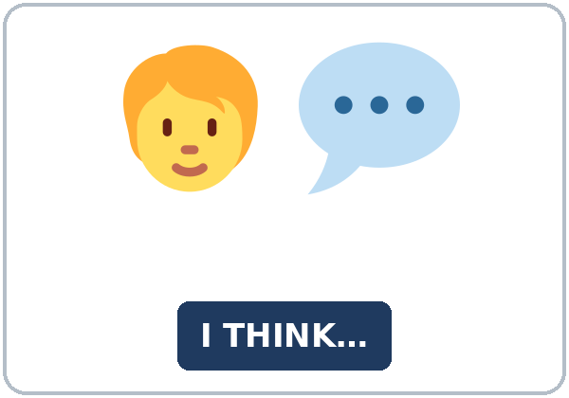
I See Your Point
Today you will:
• Give an opinion
• Ask for someone's opinion
• Agree and disagree politely
Lesson 9 · Level 4
Notes:
Welcome learners as they arrive.
Point to the title and read it: "I See Your Point" Say: "Giving, asking for, and politely disagreeing with an opinion at a neighborhood meeting about an empty lot (a playground, a parking lot, or a community garden), and writing a short opinion paragraph. Learners use opinion phrases, as … as / not as … as, and paragraph words. All places, people, and plans are invented and local."
Read the three lines under "Today you will".
Local and practical: topics stay with parks, parking, store hours, bus stops, and homework. No elections or political parties.
Lesson plan: Topic; At a glance: Objectives; Teacher notes.
Picture: Twemoji graphics by Twitter, Inc. and other contributors (https://github.com/jdecked/twemoji), CC BY 4.0 (https://creativecommons.org/licenses/by/4.0/); resized and combined, with signs and labels (images/CREDITS.md).

Slide 2
Today's
Goals
01
I can give an opinion with a reason.
02
I can ask for someone's opinion (What do you think about…? / How do you feel about…?).
03
I can agree and disagree politely (I agree. / I see your point, but…).
By the end of class, you can do these five things.
Every goal is a good goal.
04
I can compare two ideas with as … as / not as … as.
05
I can write an opinion paragraph (5–8 sentences) with First… Also… That's why…
Notes:
Read each goal slowly. Learners repeat.
Lesson plan: At a glance: Objectives.

Slide 3

OPENING TALK · 6:00
Opening Talk
A asks a card question.
Do you know when the library opens?
B answers in 3 sentences.
A asks one follow-up.
Are you sure, or is it maybe?
Then switch.
Notes:
Step 1 · 6:00–6:08 · Opening Talk + Homework Check · 8 min. Pairs (7 pairs + 1 trio with 15 learners; 3–4 pairs with 7–8).
Before class, write on the board: might / may / could; Do you know where…?
Model with one learner: you say, "Do you know when the library opens?" The learner answers with a fact or I'm not sure. It might… Then you ask, "What might change in this city next year?" Help them say 3 sentences. (Click to show the follow-up.)
Opening Talk (5 min): learners open the Opening Talk page. A asks a card question; B answers in 3 sentences (the answer, a reason, a detail); A asks one follow-up. Switch after each card. The cards are on the next slide.
If behind: one card only.
Lesson plan: Step 1; Opening Talk page.
Picture: Twemoji graphics by Twitter, Inc. and other contributors (https://github.com/jdecked/twemoji), CC BY 4.0 (https://creativecommons.org/licenses/by/4.0/); resized and combined, with signs and labels (images/CREDITS.md).

Slide 4
Opening Talk
Cards
01
Do you know when the library opens?
02
What might change in this city next year?
B answers in 3 sentences: the answer, a reason, and a detail.
Follow-ups:
Are you sure, or is it maybe? How do you know? Why?
03
Do you know where the nearest bus stop is?
04
Will it rain this weekend?
05
Homework check: Lesson 8, items 1 and 3.
Notes:
Step 1, continued. The four cards from the Opening Talk page. Each click shows the next card.
A asks a card question. B answers in 3 sentences. A asks one follow-up question (follow-ups on the right). Then switch.
Homework Check (3 min, last click): Pairs compare Homework item 1 (might and Do you know…?) and read their 3 changes (item 3) to each other. Then they fill in the box on the Opening Talk page. Walk around. Write 2 common errors on the board (often It might rains (→ It might rain) and Do you know where is the bank? (→ where the bank is)) and correct them together. Also put up 2 corrections from last week's exit tickets.
Lesson plan: Step 1; Opening Talk page: cards, follow-ups; Homework check.

Slide 5
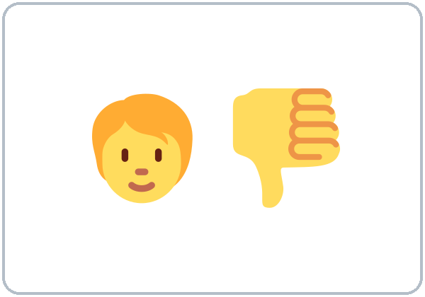

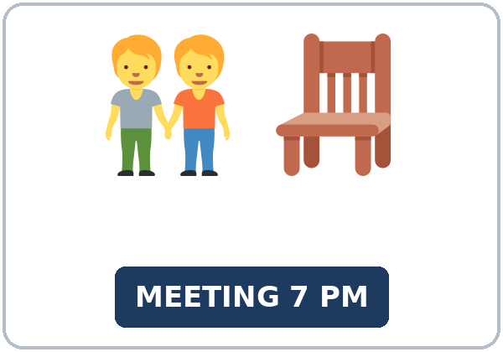

Look. Listen.
Repeat.
New Words
★ opinion
★ agree
★ disagree
★ point (I see your point)
★ community meeting
★ empty lot
Notes:
Step 2 · 6:08–6:15 · New Words · 7 min (this slide and the next). Whole class, then pairs.
Point to each picture and say the word. Learners repeat once. ★ = the most important words. Each click shows the next word.
Show the hard words: opinion (what you think); agree (thumbs-up) and disagree (thumbs-down, with a smile); I see your point (I understand you); community meeting; empty lot (land with nothing on it); community garden, parking lot, playground; survey (questions for many people); vote (raise your hand); advantage (a plus) and disadvantage (a minus).
If behind: teach the ★ words only.
Lesson plan: Step 2; Key vocabulary; New Words page.
Pictures: Twemoji graphics by Twitter, Inc. and other contributors (https://github.com/jdecked/twemoji), CC BY 4.0 (https://creativecommons.org/licenses/by/4.0/); resized and combined, with signs and labels (images/CREDITS.md).

Slide 6
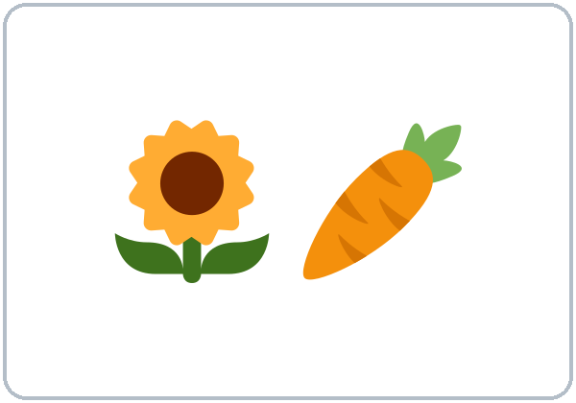

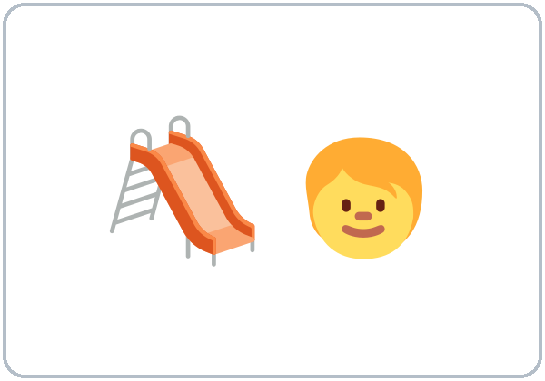


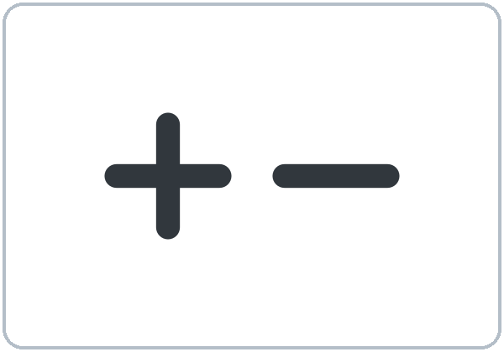
Partner game:
What do you think?
More New Words
★ community garden
★ parking lot
★ playground
★ survey
★ vote (raise your hand)
advantage / disadvantage
Notes:
Step 2, continued. Point to each picture and say the word. Learners repeat once.
Partner game (2 min): A points to a picture and asks, "What do you think about a community garden?" B gives an opinion and a reason. A says, "I agree," or "I see your point, but…" Switch. 15 learners: finish with a quick team round (3 teams; you say a clue, the first team with the word gets a point). 7–8: 2 teams. 5 or fewer: one team against the clock.
My Words: "Write any word you want in your language on the My Words page. It's your personal list. It's optional." Learners do it at home.
If behind: teach the ★ words only.
Lesson plan: Step 2; New Words page; Partner game; My Words page.
Pictures: Twemoji graphics by Twitter, Inc. and other contributors (https://github.com/jdecked/twemoji), CC BY 4.0 (https://creativecommons.org/licenses/by/4.0/); resized and combined, with signs and labels (images/CREDITS.md).

Slide 7
Check the Meaning
Look at the picture. Answer the question.
1
2
3
Is an empty lot full or empty?
If you agree, do you say That's true or That's wrong?
Is a survey for one person or many people?
empty
That's true
many people
Notes:
Step 2 · Check meaning · 1 min. Whole class.
The answers are hidden. Ask each question and wait for the class to answer. Then click to show the answer. Each click shows one answer, in order: 1, 2, 3.
1. "Is an empty lot full or empty?" (empty) • 2. "If you agree, do you say That's true or That's wrong?" (That's true) • 3. "Is a survey for one person or many people?" (many people)
Lesson plan: Step 2: Check meaning.
Pictures: Twemoji graphics by Twitter, Inc. and other contributors (https://github.com/jdecked/twemoji), CC BY 4.0 (https://creativecommons.org/licenses/by/4.0/); resized and combined, with signs and labels (images/CREDITS.md).

Slide 8
Before You
Listen for:
Listen
What are they deciding?
Neighbors are at a community meeting. Mrs. Okafor is the leader. Ray and Lin give their opinions about the empty lot on Cedar Street.
Play 2: Tasks B and C.
01
Audio (about 1:48): coming soon.
Mrs. Okafor
02
Ray
Play 1: Task A
03
Lin
Notes:
Step 3 · 6:15–6:30 · Listening + "Hear it, say it" · 15 min (slides 8 to 12). Individuals, then pairs check.
Before you listen (2 min). Say: "Neighbors are at a community meeting. Mrs. Okafor is the leader. Ray and Lin give their opinions about the empty lot on Cedar Street. Listen: what are they deciding?"
There are 3 people: Mrs. Okafor, Ray and Lin. A narrator starts and ends the listening. Each click highlights the next person.
The audio (about 1:48) is coming soon. When it is ready, it plays the conversation once; press play again for play 2. Until then, read the listening script (at the end of these notes) with a volunteer.
No speaker? Read the script with a volunteer at a natural, friendly speed, two times. Say gonna and wanna where the script has them.
Audio: the listening audio for this lesson (about 1:48) is coming soon. It will use computer-generated voices (Chatterbox TTS cloned from synthetic Kokoro-82M reference clips); no recordings of real people. Until it is ready, read the listening script (in the notes of the Before You Listen slide) with a volunteer. The names and the story are invented.
Lesson plan: Step 3; Listening script; Listening page.
Picture: Twemoji graphics by Twitter, Inc. and other contributors (https://github.com/jdecked/twemoji), CC BY 4.0 (https://creativecommons.org/licenses/by/4.0/); resized and combined, with signs and labels (images/CREDITS.md).
Listening script (the audio is coming soon; until then, read it aloud with a volunteer at a normal, friendly speed):
Narrator: Lesson nine. Neighbors are at a community meeting. They are talking about the empty lot on Cedar Street.
Mrs. Okafor: Good evening, everyone. Thank you for coming. Tonight we wanna talk about the empty lot on Cedar Street. The city says we can choose a plan. Ray, what do you think about it?
Ray: Thanks, Mrs. Okafor. In my opinion, we need a parking lot. There aren't enough parking spaces on our street. I drive around for twenty minutes every night.
Mrs. Okafor: That's true. Parking is a big problem. Lin, how do you feel about it?
Lin: I see your point, Ray, but I'm not sure I agree. I think a community garden is a better idea.
Ray: A garden? Why?
Lin: First, a garden isn't as expensive as a parking lot. Also, if we had a garden, families would grow vegetables, and kids would spend more time outside.
Ray: That's a good idea, but a garden is a lot of work. Who's gonna take care of it?
Lin: I'd help, and I think many neighbors would help too.
Mrs. Okafor: Ray, do you agree with that?
Ray: Well, I agree that a garden is nice. But for me, parking is as important as a garden.
Mrs. Okafor: OK. Those are two good ideas. Let's do a survey. We'll ask every neighbor on Cedar Street.
Lin: I agree. That's fair.
Ray: Yes, that's a good plan. I'll help with the survey.
Mrs. Okafor: Great. We'll vote at the next meeting, on May twelfth. Thank you, everyone.
Narrator: That's the end of the listening.

Slide 9
Listen. What are they deciding?
Circle.
Listening A
a. what to do with the empty lot
b. when to have a street party
c. where to put a new bus stop
Notes:
Play 1 → Task A (the main idea). Pairs compare. Check together.
Click to circle the answer: a (what to do with the empty lot).
Then read Tasks B and C together (1 min) so learners know what to listen for.
Lesson plan: Step 3; Listening Task A; Answer key.

Slide 10
Listen again.
Match the person, the opinion, and the reason.
Circle the answer.
Listening B
1. Ray wants
a parking lot
a community garden
2. Ray's reason: there ____ on the street.
aren't enough parking spaces
are too many trees
3. Lin wants
a parking lot
a community garden
4. Lin's first reason: a garden ____ a parking lot.
isn't as expensive as
is more expensive than
5. Ray's question: who's going to ____?
take care of it
pay for it
6. The plan: they will
do a survey
build the garden
Notes:
Play 2 → Tasks B and C. Pairs compare. Then show the answers.
Click to circle each answer (one click per item, 1 to 6): 1 a parking lot • 2 aren't enough parking spaces • 3 a community garden • 4 isn't as expensive as • 5 take care of it • 6 do a survey.
Lesson plan: Step 3; Listening Task B; Answer key.

Slide 11
Listen again.
Write the missing word in the polite phrase.
Listening C
1
In my ____, we need a parking lot.
opinion
2
how do you ____ about it?
feel
3
I see your ____, Ray, but I'm not sure I agree.
point
Write the missing word in the polite phrase.
Pairs: compare your answers.
Then check together.
4
That's a good ____, but a garden is a lot of work.
idea
5
Well, I ____ that a garden is nice.
agree
6
I agree. That's ____.
fair
Notes:
Task C (play 2). Click to show each answer (one click per item, 1 to 6): 1 opinion, 2 feel, 3 point, 4 idea, 5 agree, 6 fair.
If behind: do Task C together on the board, reading the lines yourself.
Lesson plan: Step 3; Listening Task C; Answer key.

Slide 12
Hear it: gonna = going to, wanna = want to
Hear It,
Say It
Say it: a polite but…, and the stress
Tonight we wanna talk about the empty lot.
Who's gonna take care of it?
You will hear gonna and wanna.
Your voice goes down on point.
Say each line two times.
I see your POINT, but…
It isn't as EXpensive.
Notes:
"Hear it, say it" (3 min): Point to the script lines. wanna = want to: "Tonight we wanna talk about the empty lot." gonna = going to: "Who's gonna take care of it?" Then practice I see your POINT, but… (the voice goes down on point, then a short pause) and the stress in It isn't as EXpensive. The class repeats the two lines twice.
Reductions: the listening has gonna and wanna. Learners need to understand them; they can always say going to and want to.
Lesson plan: Step 3: "Hear it, say it"; Listening page: Hear it, say it; Teacher notes.

Slide 13
Grammar Box 1
asking for and giving an opinion
QUESTION
ANSWER
What do you think about the empty lot?
I think we need a playground.
How do you feel about a parking lot?
In my opinion, it's a good idea.
What's your opinion about the bus stop?
I'm not sure, but maybe it's too far.
Notes:
Step 4 · 6:30–6:45 · Grammar Q&A · 15 min (slides 13 to 20). Whole class, then pairs. Show the Grammar page. The left side is the question. The right side is the answer.
Show it (2 min): say, "In my opinion, summer is the best season." Ask a learner, "Do you agree?" Model two answers: a thumbs-up, "I agree. That's true," and a smile, "I see your point, but I like fall." Write: something positive first, then but. Then draw two prices: "A garden is $2,000. A parking lot is $20,000. A garden isn't as expensive as a parking lot."
Box 1: read across: What do you think about the empty lot? → I think we need a playground. Each click shows the answer side of one row.
Lesson plan: Step 4; Grammar Box 1.
Picture: Twemoji graphics by Twitter, Inc. and other contributors (https://github.com/jdecked/twemoji), CC BY 4.0 (https://creativecommons.org/licenses/by/4.0/); resized and combined, with signs and labels (images/CREDITS.md).

Slide 14
Grammar Box 2
agreeing and disagreeing politely
QUESTION
ANSWER
Do you agree with Ray?
Yes, I agree with him. That's true. Parking is a problem.
Do you agree with Lin?
I see your point, but a garden is a lot of work.
Do you agree about the survey?
I'm not sure I agree, because it takes a long time.
Notes:
Box 2: agreeing and disagreeing politely. Each click shows the answer side of one row.
Rule of thumb (read it aloud): To disagree politely, say something positive first: I see your point, but… / That's a good idea, but… Say I agree (not I am agree) and I don't agree (not I am not agree).
Lesson plan: Step 4; Grammar Box 2; Rule of thumb.
Picture: Twemoji graphics by Twitter, Inc. and other contributors (https://github.com/jdecked/twemoji), CC BY 4.0 (https://creativecommons.org/licenses/by/4.0/); resized and combined, with signs and labels (images/CREDITS.md).

Slide 15
Grammar Box 3
as … as / not as … as
SAY
MEANING · EXAMPLE
as important as
the same
A playground is as important as parking.
not as expensive as
less
A garden isn't as expensive as a parking lot.
more … than (review)
more
A parking lot is more expensive than a garden.
Notes:
Box 3: as … as / not as … as. Each click shows the answer side of one row.
Lesson plan: Step 4; Grammar Box 3.
Picture: Twemoji graphics by Twitter, Inc. and other contributors (https://github.com/jdecked/twemoji), CC BY 4.0 (https://creativecommons.org/licenses/by/4.0/); resized and combined, with signs and labels (images/CREDITS.md).

Slide 16
Grammar Box 4
an opinion paragraph
PART
WORDS · EXAMPLE
topic sentence
In my opinion, / I think
In my opinion, the lot should be a playground.
reason 1 and reason 2
First, … Also, …
First, kids need a safe place to play. Also, it isn't as expensive as a parking lot.
example
For example,
For example, the nearest park is two miles away.
closing
That's why
That's why I think a playground is the best plan.
Notes:
Box 4: the words in an opinion paragraph. Each click shows the answer side of one row.
Questions and answers (2 min): Q: I am agree or I agree? A: I agree. agree is a verb, so there is no am. The negative is I don't agree. • Q: How do I disagree politely? A: Say something positive first: I see your point, but… or That's a good idea, but… • Q: not as expensive as or not as expensive than? A: Use as … as: A garden isn't as expensive as a parking lot.
Check questions: "I am agree or I agree?" (I agree) • "Which is more polite: That's wrong or I see your point, but…?" (I see your point, but…) • "not as expensive as or not as expensive than?" (as … as).
Lesson plan: Step 4; Grammar Box 4; Questions and answers.
Picture: Twemoji graphics by Twitter, Inc. and other contributors (https://github.com/jdecked/twemoji), CC BY 4.0 (https://creativecommons.org/licenses/by/4.0/); resized and combined, with signs and labels (images/CREDITS.md).

Slide 17
Practice A
Write one word.
Practice A
1
I ____ with you. That's true.
agree
2
A garden isn't ____ expensive as a parking lot.
as
3
What do you ____ about the new bus stop?
think
Write one word.
Pairs: check your answers.
4
I see your ____, but I'm not sure.
point
5
In my ____, we need more trees.
opinion
6
If we ____ a playground, kids would play outside more. (have)
had
Notes:
Practice A and B (3 min): learners write, then pairs check. Go over the answers.
Click to show each answer (one click per item, 1 to 6): 1 agree, 2 as, 3 think, 4 point, 5 opinion, 6 had.
Lesson plan: Step 4; Grammar Practice A; Answer key.

Slide 18
Circle the correct words.
Practice B
1. ____ with Lin.
I agree
I am agree
2. A playground is as important ____ parking.
as
than
3. ____ it's a lot of work. (polite)
That's a good idea, but
That's wrong, and
4. How do you ____ about the plan?
feel
think
5. A garden isn't as ____ as a parking lot.
expensive
more expensive
6. If we had a garden, families ____ grow vegetables.
would
will
Notes:
Practice B. Learners circle the correct words. Pairs check.
Click to circle each answer (one click per item, 1 to 6): 1 I agree, 2 as, 3 That's a good idea, but, 4 feel, 5 expensive, 6 would.
Lesson plan: Step 4; Grammar Practice B; Answer key.

Slide 19
Common Mistakes
Don't say
Say
I am agree.
I agree.
I am not agree.
I don't agree.
A garden isn't as expensive than parking.
A garden isn't as expensive as parking.
What do you think the plan?
What do you think about the plan?
No, that's wrong. (in a meeting)
I see your point, but I'm not sure.
Notes:
Common mistakes. Read the table together: "Don't say… Say…". Read a line from Don't say. Ask: "What's the right way?" Learners try first. Then click to show the right form. Each click shows one line, in order 1 to 5.
Learners can read the contrast tip on their Grammar page on their own; it is optional. You never need to read, translate, or explain it.
Lesson plan: Grammar: Common mistakes; Teacher notes.
Picture: Twemoji graphics by Twitter, Inc. and other contributors (https://github.com/jdecked/twemoji), CC BY 4.0 (https://creativecommons.org/licenses/by/4.0/); resized and combined, with signs and labels (images/CREDITS.md).

Slide 20
Pair Check
A asks.
01
A points to a picture and asks. Then switch.
A: What do you think about a playground for the lot?
B gives an opinion and a reason.
02
B: In my opinion… because…
A: I agree. / I see your point, but…
Notes:
Pair check (last 3 min of Step 4). Pairs.
A points to a picture and asks, "What do you think about a playground for the lot?" B gives an opinion and a reason. A agrees or disagrees politely. Switch. 15 learners: swap partners once. 5 or fewer: you join one pair.
If behind: skip the pair check. Talk Time practices it.
Break · 6:45–7:00 · 15 min. Write on the board: What do you think about…? → In my opinion… • I agree. / I see your point, but… • A garden isn't as expensive as a parking lot.
Lesson plan: Step 4: Pair check; Break.
Picture: Twemoji graphics by Twitter, Inc. and other contributors (https://github.com/jdecked/twemoji), CC BY 4.0 (https://creativecommons.org/licenses/by/4.0/); resized and combined, with signs and labels (images/CREDITS.md).

Slide 21
Talk Time
Community Meeting
Groups of 4.
Take a role card.
7:00–7:15
1
Give your opinion with 2 reasons.
In my opinion, the lot should be a playground.
2
The others agree or disagree politely.
I see your point, but…
3
Then choose one plan.
That's true, but…
Notes:
Step 5 · 7:00–7:15 · Talk Time: Community Meeting + Opinion Lines · 15 min.
Model it first (1 min): take the parent role card. Say, "In my opinion, the lot should be a playground. First, kids need a safe place to play." Ask a learner with the store owner card, "Do you agree?" Help them say, "I see your point, but customers can't find parking." Say: "Polite language is the goal, not winning."
Round 1 (7 min): Community Meeting (groups of 4). Each person has a role card with a plan and 2 reasons. Each person gives an opinion; the others agree or disagree politely. The group chooses one plan and writes 3 reasons. Each click shows the next step.
15 learners: 4 groups (one of 3) for round 1; then whole-room lines. 7–8 learners: 2 groups for round 1; then lines. 5 or fewer: one group for round 1: you take a role card. Then lines.
Lesson plan: Step 5; Talk Time: Community Meeting.
Picture: Twemoji graphics by Twitter, Inc. and other contributors (https://github.com/jdecked/twemoji), CC BY 4.0 (https://creativecommons.org/licenses/by/4.0/); resized and combined, with signs and labels (images/CREDITS.md).

Slide 22
Talk Time
Opinion Lines
Listen to the statement.
Stand by a sign.
7:00–7:15
1
Stand by AGREE, NOT SURE, or DISAGREE.
I agree because…
2
Say why.
I'm not sure.
3
Answer someone on another side.
I see your point, but…
Notes:
Round 2 (6 min): Opinion Lines (whole room). Read a statement. Learners stand by the AGREE, NOT SURE, or DISAGREE sign and explain. Someone on another side answers with I see your point, but… Each click shows the next step.
15 learners: 4 groups (one of 3) for round 1; then whole-room lines. 7–8 learners: 2 groups for round 1; then lines. 5 or fewer: one group for round 1: you take a role card. Then lines.
Every answer needs a reason; every partner asks a follow-up. Walk around and listen. Note 2 good sentences to praise and 1 common error for next week.
If behind: round 1 only.
Lesson plan: Step 5; Talk Time: Opinion Lines.
Picture: Twemoji graphics by Twitter, Inc. and other contributors (https://github.com/jdecked/twemoji), CC BY 4.0 (https://creativecommons.org/licenses/by/4.0/); resized and combined, with signs and labels (images/CREDITS.md).

Slide 23
Read fast first.
Answer the questions.
Read &
Write
1
When is the meeting?
Thursday, May 12, at 7:00 p.m.
2
What does Maria want?
A playground.
CEDAR STREET NEIGHBORS · A flyer + two letters (invented)
Pairs: answer together.
3
What is Maria's first reason?
Kids don't have a safe place to play.
4
Does Ray agree with Maria?
No. He sees her point, but he isn't sure he agrees.
5
What could go next to the parking lot?
Two benches and a small garden.
Notes:
Step 6 · 7:15–7:25 · Read & Write: A meeting flyer + two letters · 10 min. Pairs read, then individual writing.
Read (4 min): Learners read the flyer and the two letters on the Read & Write page and answer the questions. Say: "Read fast first. Then find the answers." Pairs answer questions 1–5 together.
Check (1 min): click to show each answer (one click per question, 1 to 5): 1 Thursday, May 12, at 7:00 p.m. • 2 A playground. • 3 Kids don't have a safe place to play. • 4 No. He sees her point, but he isn't sure he agrees. • 5 Two benches and a small garden.
Write (5 min): Learners write an opinion paragraph (5–8 sentences) about the empty lot: a topic sentence, two reasons (First… Also…), an example, and a closing (That's why…). Show the example. Writing check 3: collect this paragraph and write one strength and one fix. Learners start in class and finish at home (Homework item 2).
If behind: questions 1–5 only; the writing becomes homework.
Lesson plan: Step 6; Read & Write page; Answer key.

Slide 24
Before You Go 7:25–7:30
01
Exit ticket
02
Homework
Which is better for an empty lot: a playground or a parking lot?
1. Your opinion (In my opinion, …).
2. A reason, with because.
3. I see the other point, but….
Give it to me at the door.
About 15–20 minutes.
1. Write the sentence or question.
2. Finish your writing from Read & Write C (your paragraph).
3. What should change in your neighborhood? Write your opinion and 3 reasons.
4. Review (Lesson 8).
Bring it next week!
Notes:
Step 7 · 7:25–7:30 · Exit Ticket + Homework · 5 min · NEVER SKIP.
Exit ticket (3 min): learners open the Exit Ticket page and answer in 3 sentences with a reason: Which is better for an empty lot: a playground or a parking lot? Example on the board: In my opinion, a playground is better. Kids need a safe place to play because the park is far. I see the other point, but parking isn't as important as kids. With 5 or fewer, a learner can say it to you first and then write it.
Collect the pages. After class, sort them into ✓ / almost / not yet. Start next week with 2 corrections on the board (no names).
Homework (2 min): open the Homework page. Do item 1 together (item 1: playground / important / parking (as … as) → A playground is as important as parking.). Say: "About 15–20 minutes. Finish your Read & Write writing at home."
Homework items: 1. Write the sentence or question. Use the words. • 2. Finish your writing from Read & Write C (your paragraph). Read it one more time. Check ✓ the list in D. • 3. What should change in your neighborhood? Write your opinion and 3 reasons. • 4. Review (Lesson 8). Write one word.
Writing check 3 (Week 10): collect the opinion paragraph. Write one strength and one fix on each. Learners keep them in their writing folder.
Lesson plan: Step 7; Exit Ticket page; Homework page.
Picture: Twemoji graphics by Twitter, Inc. and other contributors (https://github.com/jdecked/twemoji), CC BY 4.0 (https://creativecommons.org/licenses/by/4.0/); resized and combined, with signs and labels (images/CREDITS.md).

Slide 25
Goodbye! See You Next Week!
Now you can:
• Give an opinion
• Ask for someone's opinion
• Agree and disagree politely
Lesson 9 · Level 4
Notes:
Read the title: "Goodbye! See you next week!" Learners repeat.
Read the three "Now you can" lines.
Lesson plan: At a glance: Objectives; Step 7.
Picture: Twemoji graphics by Twitter, Inc. and other contributors (https://github.com/jdecked/twemoji), CC BY 4.0 (https://creativecommons.org/licenses/by/4.0/); resized and combined, with signs and labels (images/CREDITS.md).

Slide 26
Credits
Pictures
Vocabulary pictures use Twemoji graphics by Twitter, Inc. and other contributors (https://github.com/jdecked/twemoji), licensed under CC BY 4.0 (https://creativecommons.org/licenses/by/4.0/). The graphics were resized and combined, and signs and labels were added.
Names and story
Mrs. Okafor, Ray, Lin, and Maria are invented names. The listening story is invented.
Audio and font
Audio (coming soon): synthetic voices made with Chatterbox TTS (MIT License), cloned from short synthetic reference clips made with Kokoro-82M (Apache License 2.0). No recordings of real people. Each file will carry an inaudible Perth watermark marking it as AI-generated. Font: Lexend Deca (OFL 1.1).
© 2026 the authors. The authors license this deck under CC BY-NC-SA 4.0.
Notes:
Credits. You don't need to read this slide in class.
Pictures: Twemoji graphics by Twitter, Inc. and other contributors, CC BY 4.0; the file-by-file list is in images/CREDITS.md.
Audio: the listening audio for this lesson (about 1:48) is coming soon. It will use computer-generated voices (Chatterbox TTS cloned from synthetic Kokoro-82M reference clips); no recordings of real people. Until it is ready, read the listening script (in the notes of the Before You Listen slide) with a volunteer. The names and the story are invented.
Course materials: © 2026 the authors, licensed under CC BY-NC-SA 4.0 (https://creativecommons.org/licenses/by-nc-sa/4.0/).
Lesson plan: Picture Credits. Picture list: images/CREDITS.md.

