Slide 1
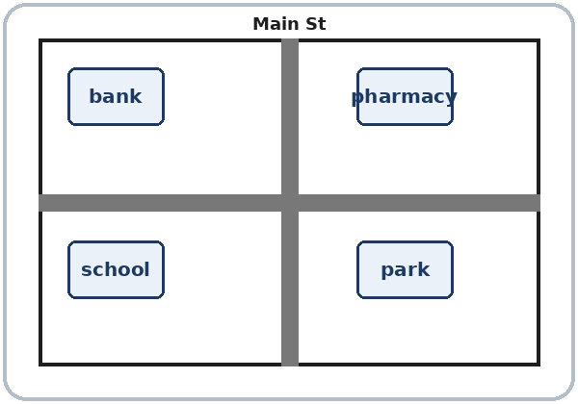
Around Town
Today you will:
• Ask: Where's the bank?
• Say: It's next to the store.
• Say: Go straight. Turn left.
Lesson 11 · Level 1
Notes:
Welcome. Say: "Today: places in town." Point to the map: "Bank. Pharmacy. Park. School."
Before class: print the Student Pages (number expected + 3 spares), one set of picture cards per group of 3–4, the map for Talk Time and Real-World Reading, and the left / right cards. Have the phone + small speaker and L1_L11_listening.mp3 ready. Prep time: 30 min.
Streets are invented (Main Street). Homework uses a map on paper or a phone; do not ask learners to walk alone.
Left / right: stand with the class, all facing the same way, before you mime.
Class plan: 6:00 Hello + Review, 6:10 New Words, 6:20 Listening, 6:32 Grammar, 6:45 Break, 7:00 Talk Time, 7:10 Exit Ticket + Homework, 7:15 Real-World Reading, 7:25 Progress Check.
Source: level1_curriculum/lesson11/Level1_Lesson11.md (At a glance, Clock-time plan, Teacher notes).
Pictures: Twemoji graphics by Twitter, Inc. and other contributors (https://github.com/jdecked/twemoji), CC BY 4.0 (https://creativecommons.org/licenses/by/4.0/); resized, labels added. Corner, left, right, the map, and the signs are drawn in code (see lesson11/images/CREDITS.md).

Slide 2
Today's
Goals
01
I can name places in town.
bank, pharmacy, park, school
02
I can ask: Where's the…?
Tonight you learn these things.
Places in town
Go straight. Turn left.
Progress Check at 7:25!
03
I can say next to, across from, between.
04
I can give simple directions.
05
I can read a map and signs.
Notes:
Click to show each goal, one at a time. Read it aloud. Learners repeat.
Goal 1: places in town: bank, pharmacy, school, hospital, bus stop, store, park, restaurant, street, corner.
Goal 2: "Where's the bank?" "It's on Main Street."
Goal 3: "It's next to / across from / between…"
Goal 4: "Go straight. Turn left. Turn right." Understand a short directions dialogue.
Goal 5: read a simple map and street signs (EXIT, ONE WAY, PUSH) at 7:15.
Source: level1_curriculum/lesson11/Level1_Lesson11.md (At a glance: Objectives).

Slide 3
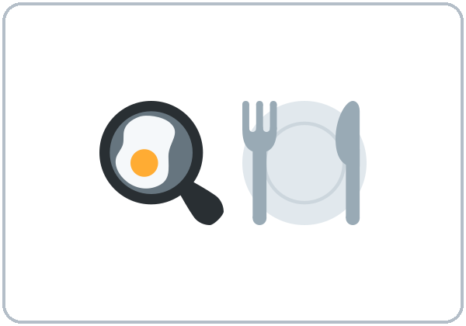
WARM-UP · 6:00
Hello + Review
How many bedrooms are there?
Is there a sofa in your home?
A: Is there a kitchen?
B: Yes, there is.
No, there isn't.
Notes:
Pairs. 15 learners: 7 pairs + 1 group of 3. 7–8 learners: 3–4 pairs. Late arrivals join any pair.
Before class, write on the board: Is there a kitchen? Where's the bank? Go straight.
Model with one learner: "Is there a kitchen?" "Yes, there is." Then mime: "Turn left."
Click to show the A question. Click again for the B answers. Pairs use the Hello + Review page: 1 Is there a kitchen in your home? 2 How many bedrooms are there? There are ___. 3 Is there a sofa in your home? Switch. Then find a new partner.
Homework check (last 3 min): partners show last week's homework. Walk around and look.
New learners: pair them with a strong partner. If behind: one partner only.
Source: level1_curriculum/lesson11/Level1_Lesson11.md (Step 1: Hello + Review; Student Pages: Hello + Review).
Review picture: the kitchen from Lesson 10 (lesson10/images/L1_L10_kitchen.png). Twemoji graphics by Twitter, Inc. and other contributors (https://github.com/jdecked/twemoji), CC BY 4.0 (https://creativecommons.org/licenses/by/4.0/); resized and combined (see lesson10/images/CREDITS.md).

Slide 4
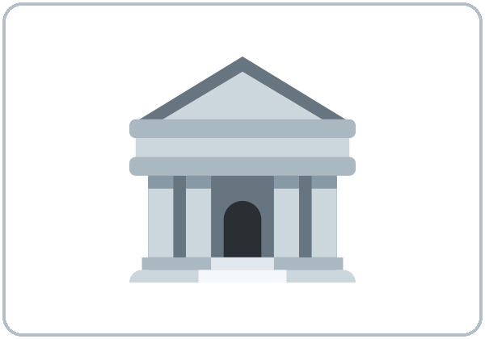

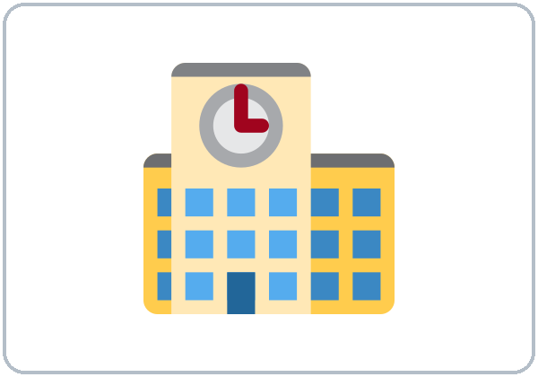
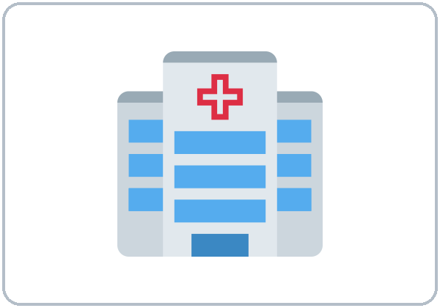
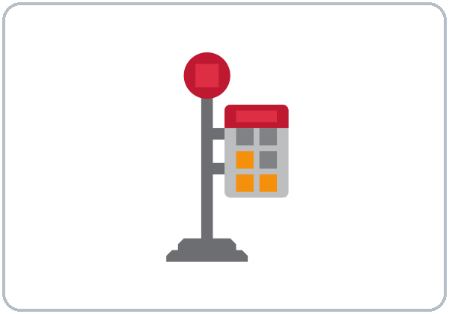
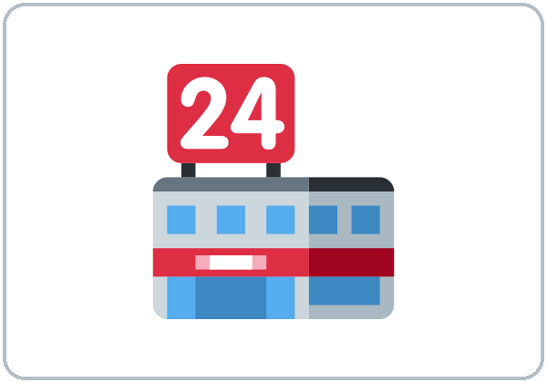
Look. Listen.
Repeat.
New Words
★ bank
★ pharmacy
★ school
★ hospital
★ bus stop
★ store
Notes:
Point to the places on the map: "Bank. Pharmacy. Park. School."
Click to show each picture. Point and say the word. Learners repeat 2 times. ★ words 2 more times.
★ = most important words (as on the New Words page). If behind: teach the ★ words only.
Source: level1_curriculum/lesson11/Level1_Lesson11.md (Step 2: New Words; Student Pages: New Words).
Pictures: Twemoji graphics by Twitter, Inc. and other contributors (https://github.com/jdecked/twemoji), CC BY 4.0 (https://creativecommons.org/licenses/by/4.0/); resized, labels added. Corner, left, right, the map, and the signs are drawn in code (see lesson11/images/CREDITS.md).

Slide 5
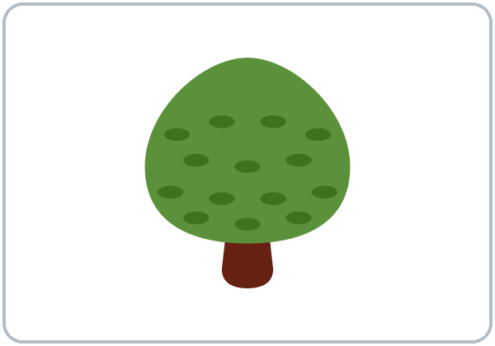
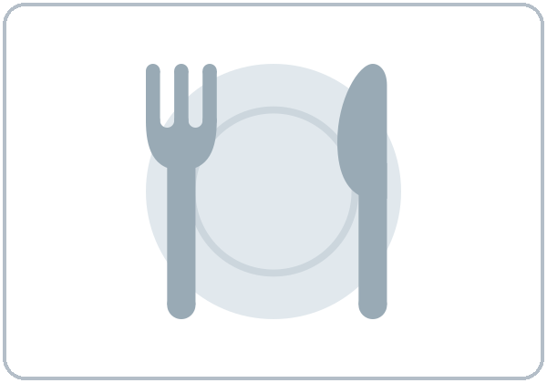
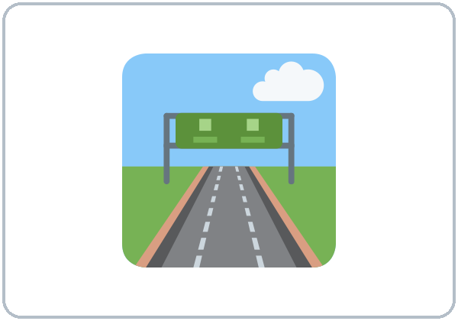
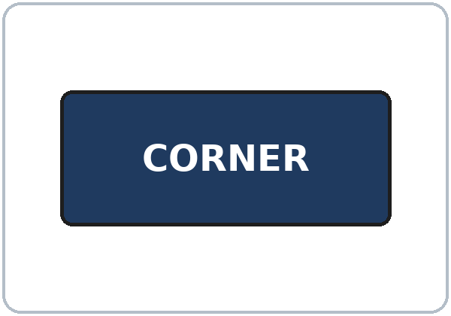
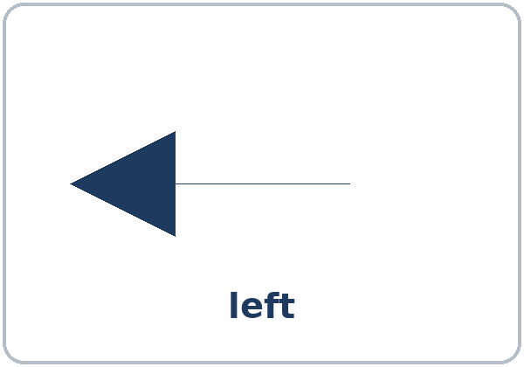
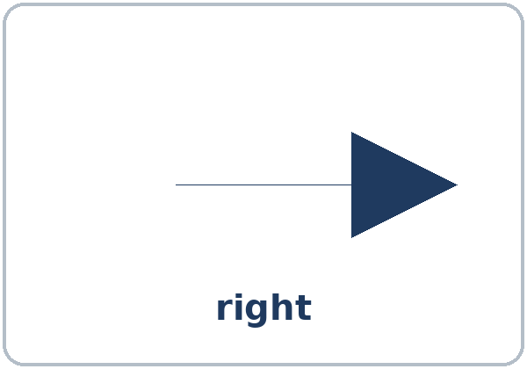
Partners:
A points. B says.
More New Words
★ park
restaurant
★ street
★ corner
★ left
★ right
Notes:
Mime: "Go straight. Turn left. Turn right." Stand with the class, all facing the same way.
Click to show each picture. Say the word. Learners repeat 2 times.
Pairs (4 min): A points to a picture, B says the word. Then A asks "Where's the ___?" B answers with next to / across from.
★ = most important words. restaurant has no ★ on the New Words page. If behind: teach the ★ words only.
Source: level1_curriculum/lesson11/Level1_Lesson11.md (Step 2: New Words; Student Pages: New Words).
Pictures: Twemoji graphics by Twitter, Inc. and other contributors (https://github.com/jdecked/twemoji), CC BY 4.0 (https://creativecommons.org/licenses/by/4.0/); resized, labels added. Corner, left, right, the map, and the signs are drawn in code (see lesson11/images/CREDITS.md).

Slide 6
Before You Listen
Say it!
Go straight two blocks.
Ana asks for the pharmacy.
It's next to the bank.
01
Turn left at the corner.
Listen 1: Where is it?
02
Listen 2: The street.
Listen and repeat.
03
Listen 3: The directions.
Notes:
Before you listen (1 min). Say: "Ana is on the street. She asks Marco for directions to the pharmacy."
Click to show each listen. Listen 1: Task A (circle: turn left or right, next to, across from). Listen 2: Task B (write the street name). Listen 3: Task C (check the directions you hear).
Say it!: read each line. Learners repeat: "Go straight two blocks." "It's next to the bank."
The audio L1_L11_listening.mp3 (about 1:10) plays the conversation once. Press play again for the next listen. Pairs compare after each task. Write answers on the board.
No speaker? Read the script with a volunteer. Streets are invented (Main Street).
Voices: Narrator, Ana, Marco. Synthetic voices made with Chatterbox TTS (MIT), copied from short reference clips made with Kokoro-82M (Apache 2.0); no recordings of real people.
If behind: play 2 times; do Task C together.
Source: level1_curriculum/lesson11/Level1_Lesson11.md (Step 3: Listening; Listening script).
Pictures: Twemoji graphics by Twitter, Inc. and other contributors (https://github.com/jdecked/twemoji), CC BY 4.0 (https://creativecommons.org/licenses/by/4.0/); resized, labels added. Corner, left, right, the map, and the signs are drawn in code (see lesson11/images/CREDITS.md).

Slide 7
Listen. Circle.
Ana asks for the pharmacy.
Listening A
1
Turn:
left right
left
2
Next to the:
bank school
bank
Circle: one word.
Pairs: show your partner.
3
Across from the:
park hospital
park
Notes:
Listen 1 (Task A). Learners circle: 1 turn left or right; 2 the pharmacy is next to the bank or the school; 3 the pharmacy is across from the park or the hospital.
Pairs compare. Then click to show each answer: 1 left, 2 bank, 3 park.
In the audio: "Then turn left at the corner. It's next to the bank." "It's across from the park."
Source: level1_curriculum/lesson11/Level1_Lesson11.md (Step 3: Listening; Student Pages: Listening A; Answer key; Listening script).

Slide 8
Listen again. Write. Check.
The street and the directions.
Listening B + C
B. The street name:
____________
Main Street
1
B: write the street.
C: check ✓ the directions.
Pairs: show your partner.
C. Check ✓:
Go straight
Turn left
Turn right
✓ Go straight
✓ Turn left
2
Notes:
Listen 2 (Task B): learners write the street name. Listen 3 (Task C): learners check the directions they hear.
Pairs compare. Then click to show each answer.
Task B: Main Street ("It's on Main Street.").
Task C: Go straight ✓ ("Go straight two blocks.") and Turn left ✓ ("Then turn left at the corner."). Turn right is not in the audio.
Also from the audio: the pharmacy is near the school (yes); the school is between the park and the store.
Say it with a partner (page D): "Excuse me. Where's the pharmacy?" "Go straight two blocks. Turn left. It's next to the bank." "Thank you!" "You're welcome."
If behind: play the audio 2 times, and do Task C together.
Source: level1_curriculum/lesson11/Level1_Lesson11.md (Step 3: Listening; Student Pages: Listening B, C, D; Answer key).

Slide 9
Grammar Boxes 1 + 2
Where's the…?
QUESTION
ANSWER
Excuse me, where's the bank?
It's on Main Street.
Where's the bank?
It's next to the pharmacy.
Where's the park?
It's across from the bank.
Where's the store?
It's between the bank
and the school.
Notes:
Show the Grammar page. Left = question. Right = answer. Point left, then right.
Box 1: "Excuse me, where's the bank?" Click: "It's on Main Street." / "It's next to the pharmacy."
Box 2: "Where's the park?" Click: "It's across from the bank." "Where's the store?" Click: "It's between the bank and the school."
Use 3 learners or 3 chairs to show next to, across from, and between.
Where is or Where's? Both OK. Where's = Where is (fast speech).
Check question: "The pharmacy is ___ the bank." (next to)
Source: level1_curriculum/lesson11/Level1_Lesson11.md (Step 4: Grammar Q&A, Boxes 1–2; Grammar Boxes 1 and 2; Questions and answers).
Pictures: Twemoji graphics by Twitter, Inc. and other contributors (https://github.com/jdecked/twemoji), CC BY 4.0 (https://creativecommons.org/licenses/by/4.0/); resized, labels added. Corner, left, right, the map, and the signs are drawn in code (see lesson11/images/CREDITS.md).

Slide 10
Grammar Box 3
Directions
Go:
straight
+ Go
Go straight.
Go straight two blocks.
Turn:
left / right
+ Turn
Turn left. Turn right.
It's on your left.
Notes:
Box 3: mime each one. "Go straight." Click. "Turn left. Turn right. It's on your left." Click.
Stand with the class, all facing the same way. Learners point and say: left, right, straight.
Turn left (not Turn to the left in this class).
Check question: "Turn ___ at the corner." (left)
Source: level1_curriculum/lesson11/Level1_Lesson11.md (Step 4: Grammar Q&A, Box 3; Grammar Box 3; Questions and answers; Teacher notes).
Pictures: Twemoji graphics by Twitter, Inc. and other contributors (https://github.com/jdecked/twemoji), CC BY 4.0 (https://creativecommons.org/licenses/by/4.0/); resized, labels added. Corner, left, right, the map, and the signs are drawn in code (see lesson11/images/CREDITS.md).

Slide 11
Grammar Box 4
You ask.
Helper answers.
Then switch.
How do I get there?
Excuse me. Where's the pharmacy?
Go straight two blocks. Turn left.
It's on Main Street.
Notes:
Box 4: "Excuse me. Where's the pharmacy?" Click: "It's on Main Street."
Right box: "How do I get there?" Click: "Go straight two blocks. Turn left."
Pairs: A asks, B is the helper. Then switch.
Pair drill (last 3–4 min): A asks Where's the…? B answers from the map; then A gives one direction. If behind: skip the pair drill; Talk Time practices the same language.
Source: level1_curriculum/lesson11/Level1_Lesson11.md (Step 4: Grammar Q&A, pair drill; Grammar Box 4).
Pictures: Twemoji graphics by Twitter, Inc. and other contributors (https://github.com/jdecked/twemoji), CC BY 4.0 (https://creativecommons.org/licenses/by/4.0/); resized, labels added. Corner, left, right, the map, and the signs are drawn in code (see lesson11/images/CREDITS.md).

Slide 12
Grammar Box 5
near / on the street
Questions and answers
on Main Street (not in)
Turn left. (not to the left)
Where's = Where is
DON'T SAY
SAY
1
It's nearly the school.
It's near the school.
2
It's in Main Street.
It's on Main Street.
Notes:
Box 5: read each DON'T SAY line. Shake your head. Click to show the SAY line. Learners repeat it.
It's near the school (not nearly). It's on Main Street (not in Main Street).
Side card: on or in the street? on Main Street. Turn left: no "to the". Where's = Where is.
Big mistake this week: in the left / mixing next to and across from. Mime and point.
Source: level1_curriculum/lesson11/Level1_Lesson11.md (Grammar Box 5; Questions and answers; Teacher notes).

Slide 13
Write: next to, across from, between, left, right.
Look at the map and Grammar Boxes 1–3.
next to, across from?
1
The bank is
____ the store.
across from
2
The park is
____ the school.
across from
next to · across from
between · left · right
Pairs: check your answers.
3
The pharmacy is ____
the bank and the restaurant.
between
4
Turn ____ at the corner.
left
5
Go straight.
Then turn ____.
left
Notes:
Learners write next to, across from, between, left, or right. Then pairs check.
Click to show each answer: 1 across from (next to is also OK), 2 across from, 3 between, 4 left, 5 left (right is also OK).
Line 6 on the page: learners write one direction (answers will vary).
Source: level1_curriculum/lesson11/Level1_Lesson11.md (Grammar: Practice; Answer key: Grammar practice).

Slide 14
Common Mistakes
Don't say
Say
in Main Street
on Main Street
Turn to the left.
Turn left.
It's near of the bank.
It's next to the bank.
Notes:
Read each "Don't say" line. Shake your head. Click to show the correct line. Learners repeat it.
in Main Street → on Main Street. Turn to the left → Turn left. It's near of the bank → It's next to the bank.
Spanish speakers: Turn left (no "to the"); on Main Street (not in); next to = al lado de. Learners can read the Spanish note on their Grammar page.
Source: level1_curriculum/lesson11/Level1_Lesson11.md (Grammar: Common mistakes; Teacher notes).
Pictures: Twemoji graphics by Twitter, Inc. and other contributors (https://github.com/jdecked/twemoji), CC BY 4.0 (https://creativecommons.org/licenses/by/4.0/); resized, labels added. Corner, left, right, the map, and the signs are drawn in code (see lesson11/images/CREDITS.md).

Slide 15
Talk Time
Where's the…?
A–B pairs.
A has the map.
7:00–7:10
1
B asks:
Where's the bank?
2
A answers from the map:
It's next to / across from…
3
B writes.
Ask about 3 places.
Notes:
Part 1 (5 min). A–B pairs with the map. Student A has the map and answers: It's next to / across from / between… Student B asks about 3 places and writes: Where's the bank? Where's the pharmacy? Where's the school?
Click to show each step. Then switch.
Learners who can't read yet: they point on the map and say the place names.
If behind: one round only.
Source: level1_curriculum/lesson11/Level1_Lesson11.md (Step 5: Talk Time, Part 1; Student Pages: Talk Time A and B; Teacher notes).
Pictures: Twemoji graphics by Twitter, Inc. and other contributors (https://github.com/jdecked/twemoji), CC BY 4.0 (https://creativecommons.org/licenses/by/4.0/); resized, labels added. Corner, left, right, the map, and the signs are drawn in code (see lesson11/images/CREDITS.md).

Slide 16
TALK TIME · PART 2
A says:
Go straight.
Turn left. / Turn right.
Draw the route:
school → pharmacy
Then: switch.
Directions
B asks the way.
A gives directions.
B: How do I get there?
A: Go straight. Turn left.
Notes:
Part 2 (4 min). B asks for directions to one place; A says "Go straight… Turn…" Then switch.
Model it: "How do I get there?" Click: "Go straight. Turn left."
Page E: draw the route from the school to the pharmacy (simple arrows OK).
If behind: half of Talk Time only.
Source: level1_curriculum/lesson11/Level1_Lesson11.md (Step 5: Talk Time, Part 2; Student Pages: Talk Time B and E).

Slide 17
Before You Go 7:10–7:15
01
Exit ticket
02
Homework
Say:
Where's the ___?
Or say:
Go straight.
Turn left.
1. next to, across from…
2. Write directions.
3. A map: 3 places.
4. Ask: Where's the store?
5. There is… / There are…
Bring it next week!
Notes:
Exit ticket (never skip): each learner says "Where's the ___?" or "Go straight / Turn left."
Homework (10 minutes): open the Homework page. Do item 1, line 1 together. Point to each instruction.
Homework: 1) write with next to, across from, or between; 2) write directions (2–3 short sentences); 3) look at a map (paper or phone) and write 3 places; do not walk alone for this homework; 4) ask a family member "Where's the store?" and write the answer in English if you can; 5) review: write There is… or There are… about your home (Lesson 10).
Source: level1_curriculum/lesson11/Level1_Lesson11.md (Step 6: Exit Ticket + Homework; Student Pages: Homework; Teacher notes).
Pictures: Twemoji graphics by Twitter, Inc. and other contributors (https://github.com/jdecked/twemoji), CC BY 4.0 (https://creativecommons.org/licenses/by/4.0/); resized, labels added. Corner, left, right, the map, and the signs are drawn in code (see lesson11/images/CREDITS.md).

Slide 18
Read the Map
1
What is next to the bank?
pharmacy
2
What is across from the park?
pharmacy
Real-World Reading
Task A: answer.
Notes:
Real-World Reading (10 min). Whole class, then pairs. Use the Real-World Reading page.
See it (2 min), Task A: find the places on the map. Learners answer.
Then click to show each answer: 1 pharmacy (next to the bank), 2 pharmacy (across from the park), as in the answer key.
Hear it (2 min): say "Turn left"; learners point to the LEFT picture.
Learners who can't read yet: they point on the map and say place names.
Source: level1_curriculum/lesson11/Level1_Lesson11.md (Real-World Reading step; Student Pages: Real-World Reading A; Listening script).
Pictures: Twemoji graphics by Twitter, Inc. and other contributors (https://github.com/jdecked/twemoji), CC BY 4.0 (https://creativecommons.org/licenses/by/4.0/); resized, labels added. Corner, left, right, the map, and the signs are drawn in code (see lesson11/images/CREDITS.md).

Slide 19
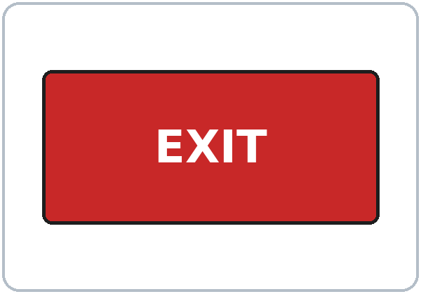
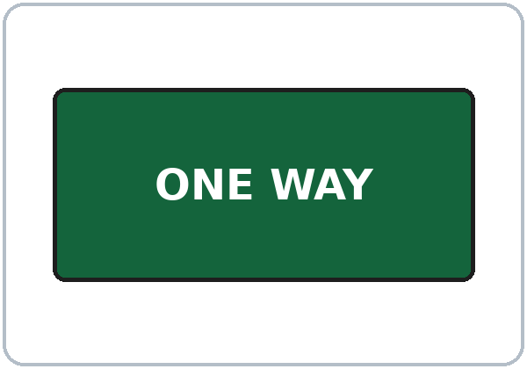
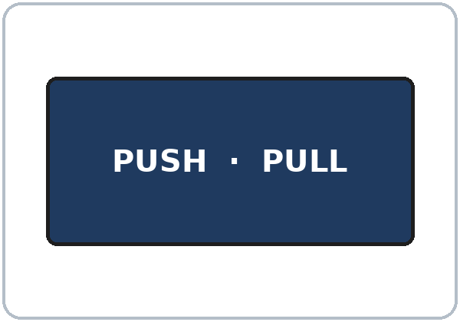
Signs. Match.
What does the sign say?
Signs
1
EXIT
b. leave this way
2
ONE WAY
c. cars go one way
a. push the door
b. leave this way
c. cars go one way
3
PUSH
a. push the door
Notes:
Read it (4 min), Task B: signs. Point to each sign picture and read it. Learners match each sign to a, b, or c.
Then click to show each answer: EXIT → b leave this way; ONE WAY → c cars go one way; PUSH → a push the door.
If behind: do Tasks A and B only.
Source: level1_curriculum/lesson11/Level1_Lesson11.md (Real-World Reading step; Student Pages: Real-World Reading B).
Pictures: Twemoji graphics by Twitter, Inc. and other contributors (https://github.com/jdecked/twemoji), CC BY 4.0 (https://creativecommons.org/licenses/by/4.0/); resized, labels added. Corner, left, right, the map, and the signs are drawn in code (see lesson11/images/CREDITS.md).

Slide 20
Real-World Reading · Tasks C + D
Circle the Word
Go straight
two blocks.
C: circle.
D: A says, B points.
READ
CIRCLE
Go straight / Go left
Go straight two blocks.
Turn left / Turn park
Turn left at the corner.
Notes:
Task C: read each line. Learners circle the correct word. Click to show each answer: 1 Go straight (two blocks), 2 Turn left (at the corner).
Task D (pairs): A gives a direction; B points on the map. Then switch.
Source: level1_curriculum/lesson11/Level1_Lesson11.md (Real-World Reading step; Student Pages: Real-World Reading C and D).

Slide 21
Progress Check 7:25
D. I can…
😀 🙂 😐
Check one face.
B. Match the question
Answer
1. Where's the bank?
c. It's next to the store.
2. How do I get there?
d. Go straight two blocks.
3. Where's the pharmacy?
b. It's across from the park.
4. Go straight. Then…
a. Turn left.
Notes:
Progress Check (5 min). Individuals. Open the Progress Check page.
Part A: read each word slowly, 2 times: 1 bank, 2 left, 3 park, 4 pharmacy, 5 school. Learners circle.
Parts B and C: learners match and write on their own. Help with the instructions only. Click to show the Part B answers when you check together: 1 c, 2 d, 3 b, 4 a.
Part C answers: 1 across from, 2 between, 3 next to.
Part D: read each "I can…" line and point to the 3 faces. Learners check one.
Score: A /5 + B /4 + C /3 = /12. Not a test grade. Collect if you want. If behind: do it next week at 6:00.
Source: level1_curriculum/lesson11/Level1_Lesson11.md (Progress Check step; Student Pages: Progress Check; Answer key).

Slide 22
Great Work! See You Next Week!
Now you can:
• Ask: Where's the bank?
• Say: It's across from the park.
• Say: Go straight. Turn left.
Lesson 11 · Level 1
Notes:
Say: "Great work! See you next week!" Remind learners: bring the homework next week. Homework uses a map on paper or a phone; no walking alone.
Collect the Progress Check pages if you want.
Source: level1_curriculum/lesson11/Level1_Lesson11.md (At a glance: Objectives; Teacher notes).
Pictures: Twemoji graphics by Twitter, Inc. and other contributors (https://github.com/jdecked/twemoji), CC BY 4.0 (https://creativecommons.org/licenses/by/4.0/); resized, labels added. Corner, left, right, the map, and the signs are drawn in code (see lesson11/images/CREDITS.md).

Slide 23
Credits
Pictures
Pictures use Twemoji graphics by Twitter, Inc. and other contributors (https://github.com/jdecked/twemoji), licensed under CC BY 4.0 (https://creativecommons.org/licenses/by/4.0/). The graphics were resized and labels were added. The corner, left, and right cards, the street map, and the EXIT, ONE WAY, and PUSH signs are drawn in code. Labels use the DejaVu Sans font. The review picture (the kitchen) is from Lesson 10.
Other small pictures (the faces on the Progress Check) are standard emoji characters shown with the computer's emoji font.
Names
All names and places on the slides (Ana, Marco, Main Street, the map) are invented.
Audio and font
Audio: synthetic voices (Narrator, Ana, Marco) made with Chatterbox TTS (Resemble AI, MIT License), copied from short reference clips made with Kokoro-82M (Apache 2.0); no recordings of real people were used. Each file carries an inaudible Perth watermark. Font: Lexend Deca (OFL 1.1).
© 2026 the authors. The authors license this deck under CC BY-NC-SA 4.0.
Notes:
Credits for the pictures, audio, and font.
Pictures: Twemoji (CC BY 4.0), https://github.com/jdecked/twemoji; resized, labels added; corner, left, right, map, and signs drawn in code. Review picture (kitchen) from Lesson 10. Audio: Chatterbox TTS (MIT) voices copied from short Kokoro-82M (Apache 2.0) reference clips; no recordings of real people.
Sources: Level1_Lesson11.md (Picture Credits), lesson11/images/CREDITS.md, lesson11/audio/README.md.

