Slide 1
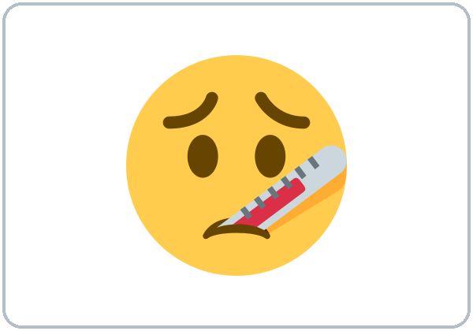
I Don't Feel Well
Today you will:
• Say: I feel sick.
• Ask: Where does it hurt?
• Say: Call 911. (practice)
Lesson 12 · Level 1
Notes:
Welcome. Say: "Today: I feel sick. Body parts. Getting help." Mime "I feel sick."
Before class: print the Student Pages (number expected + 3 spares), one set of picture cards per group of 3–4, body-part picture cards, the emergency card and medicine label, mini whiteboards or scrap paper. Have the phone + small speaker and L1_L12_listening.mp3 ready. Prep time: 30 min.
Practice only. Never ask learners to share real medical details. If a learner starts a real medical story, stop gently and return to the picture. The 911 dialogue is not a real emergency.
Class plan: 6:00 Hello + Review, 6:10 New Words, 6:20 Listening, 6:32 Grammar, 6:45 Break, 7:00 Talk Time, 7:10 Exit Ticket + Homework, 7:15 Real-World Reading, 7:25 Progress Check.
Source: level1_curriculum/lesson12/Level1_Lesson12.md (At a glance, Clock-time plan, How to Use This Plan).
Pictures: Twemoji graphics by Twitter, Inc. and other contributors (https://github.com/jdecked/twemoji), CC BY 4.0 (https://creativecommons.org/licenses/by/4.0/); resized, labels added. Back, stomach, the medicine label, and the emergency card are drawn in code (see lesson12/images/CREDITS.md).

Slide 2
Today's
Goals
01
I can name body parts.
head, stomach, arm, leg, hand
02
I can say: I feel sick. / I'm hurt.
Tonight you learn these things.
Body parts
Getting help
Progress Check at 7:25!
03
I can ask: Are you OK? Where does it hurt?
04
I can say: Call 911. Sit down.
05
I can read a medicine label and a card.
Notes:
Click to show each goal, one at a time. Read it aloud. Learners repeat.
Goal 1: name basic body parts.
Goal 2: say "How do you feel? I feel sick. / I'm hurt."
Goal 3: ask "Are you OK? What's wrong? Where does it hurt?"
Goal 4: use help commands: "Call 911. Sit down. Go to the doctor."
Goal 5: read a simple medicine label and emergency card (7:15).
Source: level1_curriculum/lesson12/Level1_Lesson12.md (At a glance: Objectives).

Slide 3
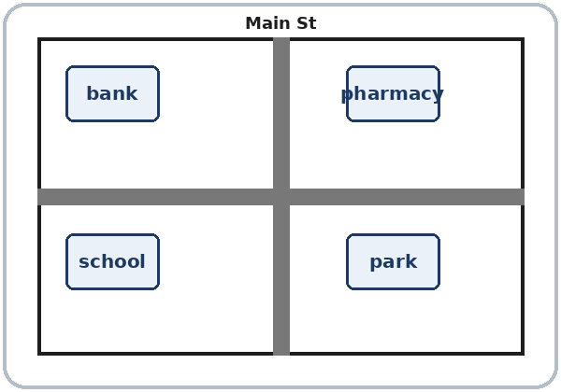
WARM-UP · 6:00
Hello + Review
Where's the pharmacy?
Turn left or turn right?
A: Where's the pharmacy?
B: It's next to the bank.
A: How do you feel?
B: I feel sick.
Notes:
Pairs. 15 learners: 7 pairs + 1 group of 3. 7–8 learners: 3–4 pairs. Late arrivals join any pair.
Before class, write on the board: Where's the pharmacy? How do you feel? Are you OK?
Model with one learner: "Where's the pharmacy?" → "It's next to the bank." Then "How do you feel?" → "I feel sick."
Click to show the A question. Click again for the answers. Pairs use the Hello + Review page: 1 Where's the pharmacy? → It's ___. 2 Turn left or turn right? 3 Where's the pharmacy? → It's ___. Switch. Then find a new partner.
Homework check (last 3 min): partners show last week's homework. Walk around and look.
New learners: pair them with a strong partner. If behind: one partner only.
Source: level1_curriculum/lesson12/Level1_Lesson12.md (Step 1: Hello + Review; Student Pages: Hello + Review).
Review picture: the street map from Lesson 11 (lesson11/images/L1_L11_map.png), drawn in code for the curriculum (see lesson11/images/CREDITS.md).

Slide 4
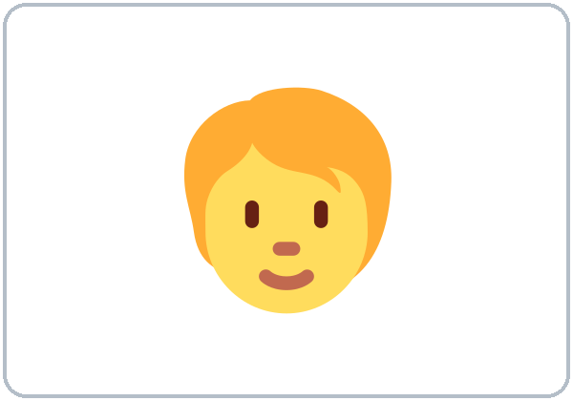
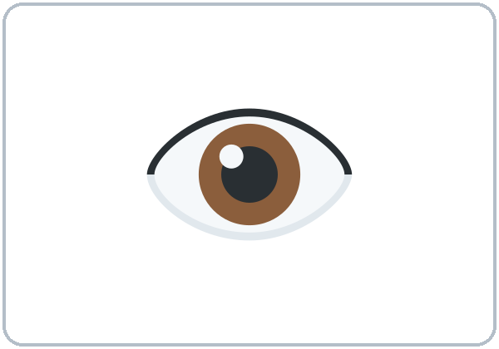
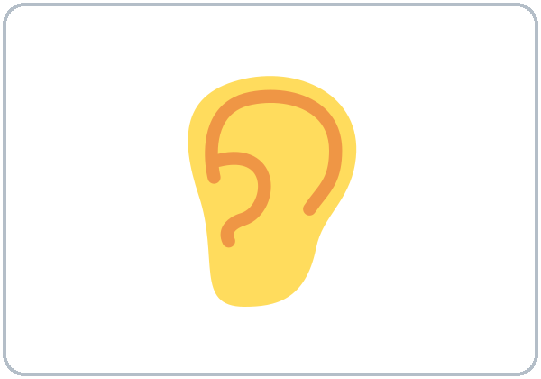



Look. Listen.
Repeat.
New Words
★ head
eye
ear
mouth
★ arm
★ hand
Notes:
Point to the body pictures: "Head. Stomach. Arm. Leg." Point to your own head, eye, ear, mouth, arm, hand.
Click to show each picture. Point and say the word. Learners repeat 2 times. ★ words 2 more times.
★ = most important words (as on the New Words page). eye, ear, and mouth have no ★. If behind: teach the ★ words only.
Source: level1_curriculum/lesson12/Level1_Lesson12.md (Step 2: New Words; Student Pages: New Words).
Pictures: Twemoji graphics by Twitter, Inc. and other contributors (https://github.com/jdecked/twemoji), CC BY 4.0 (https://creativecommons.org/licenses/by/4.0/); resized, labels added. Back, stomach, the medicine label, and the emergency card are drawn in code (see lesson12/images/CREDITS.md).

Slide 5
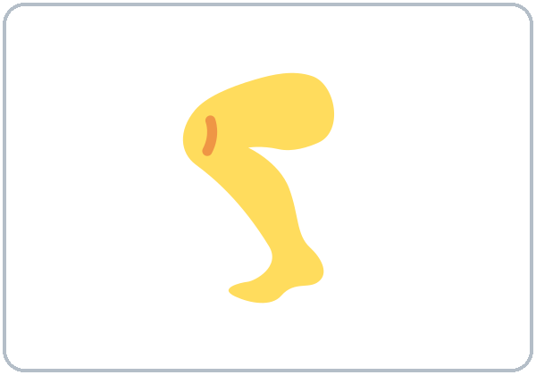
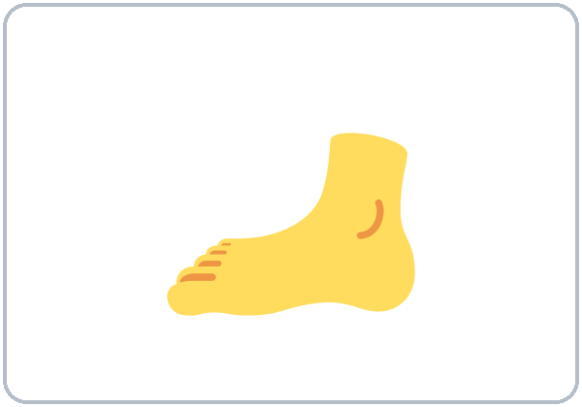
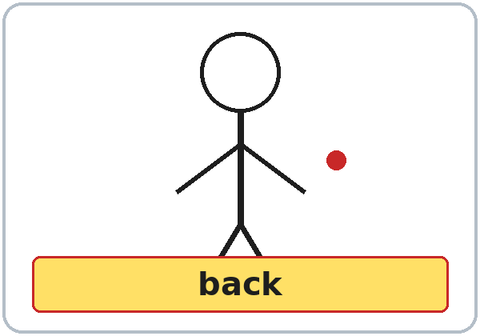
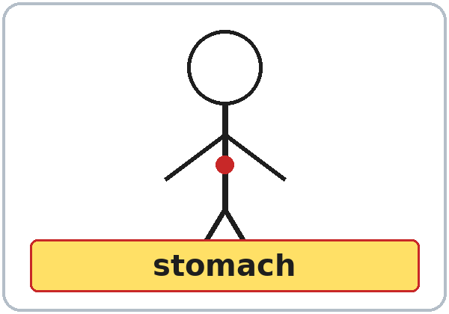
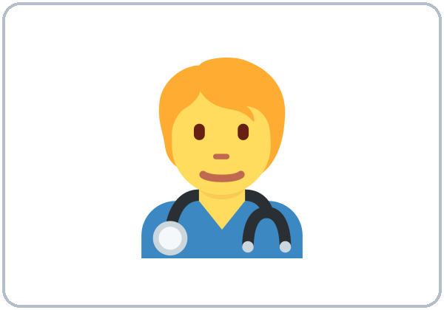
Partners:
A points. B says.
More New Words
★ leg
★ foot
★ back
★ stomach
★ sick
★ doctor
Notes:
Mime: "I feel sick. It hurts here." Point to your stomach.
Click to show each picture. Say the word. Learners repeat 2 times.
Pairs (4 min): A points to a picture, B says the word. Then A asks "Are you OK?" B answers "No, I'm not. I feel sick."
★ = most important words. If behind: teach the ★ words only.
Source: level1_curriculum/lesson12/Level1_Lesson12.md (Step 2: New Words; Student Pages: New Words).
Pictures: Twemoji graphics by Twitter, Inc. and other contributors (https://github.com/jdecked/twemoji), CC BY 4.0 (https://creativecommons.org/licenses/by/4.0/); resized, labels added. Back, stomach, the medicine label, and the emergency card are drawn in code (see lesson12/images/CREDITS.md).

Slide 6
Before You Listen
Say it!
I feel sick.
Part 1: Rosa and Marco at work.
Part 2: practice only.
Where does it hurt?
01
It hurts here.
Listen 1: How does he feel?
02
Listen 2: The address.
Listen and repeat.
03
Listen 3: What Rosa says.
Notes:
Before you listen (1 min). Say: "Part one: Rosa and Marco are at work. Part two: practice only — a call to 9 1 1. Not a real emergency."
Click to show each listen. Listen 1: Task A (how Marco feels; where it hurts). Listen 2: Task B (write the address number). Listen 3: Task C (check what Rosa says).
Say it!: class repeats: "I feel sick." "Where does it hurt?" "It hurts here."
The audio L1_L12_listening.mp3 (about 1:10) plays the conversation once. Press play again for the next listen. Pairs compare after each task. Write answers on the board.
No speaker? Read the script with a volunteer. Say "practice only" before you play part two.
Voices: Narrator, Rosa, Marco, Operator, Ana. Synthetic voices made with Chatterbox TTS (MIT), copied from short reference clips made with Kokoro-82M (Apache 2.0); no recordings of real people.
If behind: play 2 times; do Task C together.
Source: level1_curriculum/lesson12/Level1_Lesson12.md (Step 3: Listening; Listening script).
Pictures: Twemoji graphics by Twitter, Inc. and other contributors (https://github.com/jdecked/twemoji), CC BY 4.0 (https://creativecommons.org/licenses/by/4.0/); resized, labels added. Back, stomach, the medicine label, and the emergency card are drawn in code (see lesson12/images/CREDITS.md).

Slide 7
Listen. Circle. Write.
Part 1: Marco. Part 2: practice only.
Listening A + B
1
Marco feels:
sick tired
sick
2
It hurts:
head stomach arm
stomach
A: circle one word.
B: write the number.
Pairs: show your partner.
3
Part 2: the number.
____ Pine Street
210
Notes:
Listen 1 (Task A). Learners circle: 1 Marco feels sick or tired; 2 it hurts: head, stomach, or arm.
Listen 2 (Task B, part two, practice only): learners write the address number.
Pairs compare. Then click to show each answer: 1 sick, 2 stomach, 3 210 (210 Pine Street).
In the audio: "No, I'm not. I feel sick." "It hurts here. My stomach." "Two ten Pine Street."
The address is invented (210 Pine Street). Part two is practice only — not a real emergency.
Source: level1_curriculum/lesson12/Level1_Lesson12.md (Step 3: Listening; Student Pages: Listening A and B; Answer key; Teacher notes).

Slide 8
Listen again. Check. Say.
What does Rosa say?
Listening C + D
C. Check ✓:
Sit down Go home
Call the doctor
Call 911
✓ Sit down
✓ Go home
✓ Call the doctor
1
C: check ✓ what Rosa says.
D: A asks. B answers.
Pairs: then switch.
D. A asks:
Are you OK?
Where does it hurt?
No, I'm not.
I feel sick.
Here. My stomach.
2
Notes:
Listen 3 (Task C): learners check what Rosa says. Pairs compare. Then click to show the answer.
Task C: Sit down ✓, Go home ✓, Call the doctor ✓ ("Sit down. Do you need water?" "OK. Go home. Call the doctor."). Rosa does not say "Call 911" (as in the answer key).
Part two of the audio (practice only): Ana says "It hurts here. My arm." The address is 210 Pine Street. The operator says "Help is coming."
Task D (practice only — not a real emergency): A asks "Are you OK?" "Where does it hurt?" Click to show B's answers: "No, I'm not. I feel sick." "Here. My stomach." Then switch.
If behind: play the audio 2 times, and do Task C together.
Source: level1_curriculum/lesson12/Level1_Lesson12.md (Step 3: Listening; Student Pages: Listening C and D; Answer key; Listening script).

Slide 9
Grammar Boxes 1 + 2
How do you feel?
QUESTION
ANSWER
How do you feel?
I feel sick. / tired.
Are you OK?
No, I'm not. I'm sick.
What's wrong?
I'm hurt.
Where does it hurt?
It hurts here.
(point)
Notes:
Show the Grammar page. Left = question. Right = answer. Point left, then right.
Box 1: "How do you feel?" Click: "I feel sick. / I feel tired." "Are you OK?" Click: "No, I'm not. I'm sick."
Box 2: "What's wrong?" Click: "I'm hurt." "Where does it hurt?" Click: "It hurts here." Point to a picture, not to a real problem.
Check question: "I ___ sick." (feel / am)
Level 1 says "It hurts here" + point. "My head hurts" is for Level 2.
Source: level1_curriculum/lesson12/Level1_Lesson12.md (Step 4: Grammar Q&A, Boxes 1–3; Grammar Boxes 1 and 2; Teacher notes).
Pictures: Twemoji graphics by Twitter, Inc. and other contributors (https://github.com/jdecked/twemoji), CC BY 4.0 (https://creativecommons.org/licenses/by/4.0/); resized, labels added. Back, stomach, the medicine label, and the emergency card are drawn in code (see lesson12/images/CREDITS.md).

Slide 10
Grammar Box 3
Help Commands
Say:
Call 911.
Sit down.
Call 911.
Sit down.
Say:
Go to
the doctor.
Go to the doctor.
I need help. / a doctor.
Notes:
Box 3 (help commands): say each one and mime. "Call 911." "Sit down." Click. "Go to the doctor." "I need help. / I need a doctor." Click.
Learners repeat each command 2 times.
Call 911 (not "Call to 911").
Check question: "Call ___" (911)
Practice only: this is not a real emergency.
Source: level1_curriculum/lesson12/Level1_Lesson12.md (Step 4: Grammar Q&A, Box 4; Grammar Box 3; Common mistakes).
Pictures: Twemoji graphics by Twitter, Inc. and other contributors (https://github.com/jdecked/twemoji), CC BY 4.0 (https://creativecommons.org/licenses/by/4.0/); resized, labels added. Back, stomach, the medicine label, and the emergency card are drawn in code (see lesson12/images/CREDITS.md).

Slide 11
Grammar Box 5
I need…
Partner answers.
Then switch.
What do you need?
Do you need a doctor?
I need help. / water.
I need to go home.
Yes. I need a doctor.
Notes:
Box 5: I need… + a doctor. / help. / water. Example: I need to go home.
"Do you need a doctor?" Click: "Yes. I need a doctor." (as in the audio).
Right box: "What do you need?" Click: "I need help. / I need water. / I need to go home."
Pair drill (last 3–4 min): A mimes a body part; B asks "Where does it hurt?" A points: "Here. My ___." If behind: skip the pair drill; Talk Time practices the same language.
Source: level1_curriculum/lesson12/Level1_Lesson12.md (Step 4: Grammar Q&A, pair drill; Grammar Box 5; Listening script).
Pictures: Twemoji graphics by Twitter, Inc. and other contributors (https://github.com/jdecked/twemoji), CC BY 4.0 (https://creativecommons.org/licenses/by/4.0/); resized, labels added. Back, stomach, the medicine label, and the emergency card are drawn in code (see lesson12/images/CREDITS.md).

Slide 12
Questions and answers
I'm sick. / It hurts here.
Real problems in class?
No. Use the pictures.
Point and say Here.
NOT TODAY
SAY TODAY
1
I have sick.
I'm sick. I'm tired.
2
My head hurts.
It hurts here. (point)
Notes:
Read each left line. Click to show the right line. Learners repeat it.
Line 1: "I'm sick or I have sick?" Say "I'm sick. I'm tired. I'm cold." (not "I have sick").
Line 2: "Do we say My head hurts in Level 1?" Learners may hear it. In this lesson, say "It hurts here" and point. Level 2 practices "My ___ hurts".
Side card: "Do I say real medical problems in class?" No. Use the pictures. Point and say "Here."
Practice only. Never ask learners to share real medical details. If a learner starts a real medical story, stop gently and return to the picture.
Source: level1_curriculum/lesson12/Level1_Lesson12.md (Grammar: Questions and answers; Teacher notes).

Slide 13
Write feel, hurts, OK, or Call.
Look at Grammar Boxes 1–3.
Practice
1
How do you ____?
feel
2
Are you ____?
OK
feel · hurts
OK · Call
Pairs: check your answers.
3
It ____ here.
hurts
4
____ 911.
Call
5
I ____ sick.
feel
Notes:
Learners write feel, hurts, OK, or Call. Then pairs check.
Click to show each answer: 1 feel, 2 OK, 3 hurts, 4 Call, 5 feel.
Line 6 on the page: learners write one sentence (answers will vary).
Source: level1_curriculum/lesson12/Level1_Lesson12.md (Grammar: Practice; Answer key: Grammar practice).

Slide 14
Common Mistakes
Don't say
Say
I have sick.
I'm sick.
I have hungry.
I'm hungry.
Call to 911.
Call 911.
Notes:
Read each "Don't say" line. Shake your head. Click to show the correct line. Learners repeat it.
I have sick → I'm sick. I have hungry → I'm hungry. Call to 911 → Call 911.
Spanish speakers: I'm sick / I'm tired / I'm cold (no "I have…"). My head hurts = Me duele la cabeza (Level 2 practices it). Learners can read the Spanish note on their Grammar page.
Tip for speakers of other languages: read the grammar boxes left to right. Copy one question and one answer.
Source: level1_curriculum/lesson12/Level1_Lesson12.md (Grammar: Common mistakes).
Pictures: Twemoji graphics by Twitter, Inc. and other contributors (https://github.com/jdecked/twemoji), CC BY 4.0 (https://creativecommons.org/licenses/by/4.0/); resized, labels added. Back, stomach, the medicine label, and the emergency card are drawn in code (see lesson12/images/CREDITS.md).

Slide 15
Talk Time
Are you OK?
A–B pairs.
B mimes sick or hurt.
7:00–7:10
1
A asks:
Are you OK? What's wrong?
2
B points:
Here. My ___.
3
A asks:
Where does it hurt?
Notes:
Part 1 (4 min). Pairs. B mimes sick or hurt. A asks: "Are you OK? What's wrong? Where does it hurt?" B points: "Here. My ___." Then switch.
Click to show each step. A can also say: "Sit down." "Do you need water?"
Learners who can't write yet: they point to body pictures and say "Here."
Practice only. Never ask learners to share real medical details. If a learner starts a real medical story, stop gently and return to the picture. If behind: one round only.
Source: level1_curriculum/lesson12/Level1_Lesson12.md (Step 5: Talk Time, Part 1; Student Pages: Talk Time A and B; Teacher notes).
Pictures: Twemoji graphics by Twitter, Inc. and other contributors (https://github.com/jdecked/twemoji), CC BY 4.0 (https://creativecommons.org/licenses/by/4.0/); resized, labels added. Back, stomach, the medicine label, and the emergency card are drawn in code (see lesson12/images/CREDITS.md).

Slide 16
TALK TIME · PART 2
Caller: It hurts here.
My ______.
Operator: What's the address?
Caller: ______ Street.
Use the card. Then switch.
911 Practice
Practice only.
Not a real call.
Operator: 911. What's your emergency?
Caller: I need help. I'm hurt.
Notes:
Part 2 (5 min). Groups of 3: practice 911 role play from the emergency card. This is not a real call. Switch roles.
Model it: "911. What's your emergency?" Click: "I need help. I'm hurt."
Then: "It hurts here. My ___." "What's the address?" Learners read the street from the card (practice address: 210 Pine St).
Remind: in a real emergency, call 911. Today is practice only.
Practice only. Never ask learners to share real medical details. If a learner starts a real medical story, stop gently and return to the picture. If behind: half of Talk Time only.
Source: level1_curriculum/lesson12/Level1_Lesson12.md (Step 5: Talk Time, Part 2; Student Pages: Talk Time B + 911 practice).

Slide 17
Before You Go 7:10–7:15
01
Exit ticket
02
Homework
Say:
I feel sick.
Or say:
It hurts here.
Call 911.
1. Write the body part.
2. Unscramble.
3. Copy the card.
4. Ask: How do you feel?
5. Write one direction.
Bring it next week!
Notes:
Exit ticket (never skip): each learner says "I feel sick." or "It hurts here." or "Call 911."
Homework (10 minutes): open the Homework page. Do item 1, line 1 together. Point to each instruction.
Homework: 1) write the body part (head, arm, stomach, leg); 2) unscramble: feel / I / sick; you / Are / OK; hurts / It / here; 3) copy the emergency card: write your name and a phone number you choose to share (or invent); 4) ask a family member "How do you feel?" and write the answer; 5) review: write one direction (Lesson 11).
Source: level1_curriculum/lesson12/Level1_Lesson12.md (Step 6: Exit Ticket + Homework; Student Pages: Homework).
Pictures: Twemoji graphics by Twitter, Inc. and other contributors (https://github.com/jdecked/twemoji), CC BY 4.0 (https://creativecommons.org/licenses/by/4.0/); resized, labels added. Back, stomach, the medicine label, and the emergency card are drawn in code (see lesson12/images/CREDITS.md).

Slide 18
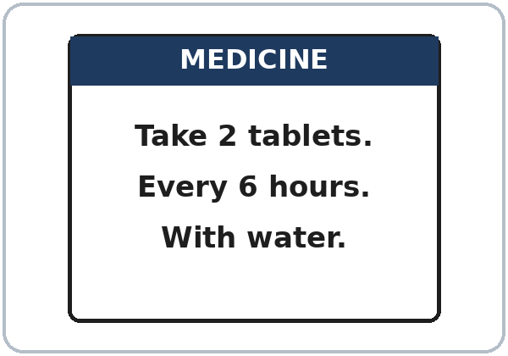
Medicine Label
1
How often?
Every 6 hours
2
Take with?
water
Real-World Reading
Task A: answer.
Invented label.
Notes:
Real-World Reading (10 min). Whole class, then pairs. Use the Real-World Reading page. The label is invented.
See it (2 min), Task A: point to the dose and the times on the medicine label: "Take 2 tablets. Every 6 hours. With water."
Ask: "How often?" "Take with?" Learners find the answer on the label. Then click to show each answer: 1 Every 6 hours. 2 water ("With water.").
Hear it (2 min): say "Take with water"; learners point.
Learners who can't read yet: they point to the pictures and say key words with everyone.
Source: level1_curriculum/lesson12/Level1_Lesson12.md (Real-World Reading step; Student Pages: Real-World Reading A).
Pictures: Twemoji graphics by Twitter, Inc. and other contributors (https://github.com/jdecked/twemoji), CC BY 4.0 (https://creativecommons.org/licenses/by/4.0/); resized, labels added. Back, stomach, the medicine label, and the emergency card are drawn in code (see lesson12/images/CREDITS.md).

Slide 19
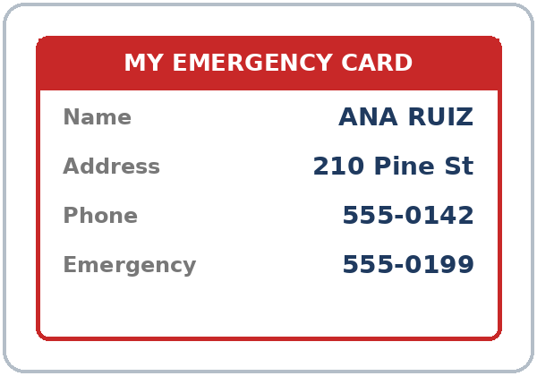
Emergency card. Answer.
Look at the card.
Emergency Card
1
Name:
ANA RUIZ
2
Phone:
555-0142
Real-World Reading
Task B: answer.
Notes:
Read it (4 min), Task B: look at the emergency card. Learners find the name and the phone.
Then click to show each answer: Name: ANA RUIZ. Phone: 555-0142. (The card also shows Address: 210 Pine St and Emergency: 555-0199.)
All names, addresses, and phone numbers are invented.
If behind: do Tasks A and B only.
Source: level1_curriculum/lesson12/Level1_Lesson12.md (Real-World Reading step; Student Pages: Real-World Reading B).
Pictures: Twemoji graphics by Twitter, Inc. and other contributors (https://github.com/jdecked/twemoji), CC BY 4.0 (https://creativecommons.org/licenses/by/4.0/); resized, labels added. Back, stomach, the medicine label, and the emergency card are drawn in code (see lesson12/images/CREDITS.md).

Slide 20
Real-World Reading · Tasks C + D
In an Emergency
Practice
ideas.
C: circle.
D: A reads, B repeats.
READ
CIRCLE
Call 911 / Sit down
✓ Call 911 ✓ Sit down
Go to the doctor /
Run away from help
✓ Go to the doctor
Notes:
Task C: read each choice. Learners circle what you do in an emergency (practice ideas).
Click to show each answer: Call 911 ✓, Sit down ✓, Go to the doctor ✓. "Run away from help" is not a good idea: do not circle it (answer key).
Task D (pairs): A reads one line from the medicine label ("Take 2 tablets." "Every 6 hours." "With water."); B repeats. Then switch.
Source: level1_curriculum/lesson12/Level1_Lesson12.md (Real-World Reading step; Student Pages: Real-World Reading C and D).

Slide 21
Progress Check 7:25
D. I can…
😀 🙂 😐
Check one face.
B. Match the question
Answer
1. How do you feel?
b. I feel sick.
2. Are you OK?
a. No, I'm not.
3. Where does it hurt?
c. Here.
4. What do you need?
d. I need a doctor.
Notes:
Progress Check (5 min). Individuals. Open the Progress Check page.
Part A: read each word slowly, 2 times: 1 sick, 2 head, 3 doctor, 4 arm, 5 stomach. Learners circle.
Parts B and C: learners match and write on their own. Help with the instructions only. Click to show the Part B answers when you check together: 1 b, 2 a, 3 c, 4 d.
Part C answers: 1 feel (I feel sick.), 2 hurts (It hurts here.), 3 Call (Call 911.).
Part D: read each "I can…" line and point to the 3 faces. Learners check one.
Score: A /5 + B /4 + C /3 = /12. Not a test grade. Collect if you want. If behind: do it next week at 6:00.
Source: level1_curriculum/lesson12/Level1_Lesson12.md (Progress Check step; Student Pages: Progress Check; Answer key).

Slide 22
Great Work! See You Next Week!
Now you can:
• Say: I feel sick.
• Ask: Where does it hurt?
• Say: Call 911. (practice)
Lesson 12 · Level 1
Notes:
Say: "Great work! See you next week!" Remind learners: bring the homework next week.
Remind: today's 911 call was practice only. In a real emergency, call 911.
Collect the Progress Check pages if you want.
Source: level1_curriculum/lesson12/Level1_Lesson12.md (At a glance: Objectives; Student Pages).
Pictures: Twemoji graphics by Twitter, Inc. and other contributors (https://github.com/jdecked/twemoji), CC BY 4.0 (https://creativecommons.org/licenses/by/4.0/); resized, labels added. Back, stomach, the medicine label, and the emergency card are drawn in code (see lesson12/images/CREDITS.md).

Slide 23
Credits
Pictures
Pictures use Twemoji graphics by Twitter, Inc. and other contributors (https://github.com/jdecked/twemoji), licensed under CC BY 4.0 (https://creativecommons.org/licenses/by/4.0/). The graphics were resized and combined, and drawings and labels were added. The back and stomach cards, the medicine label, and the emergency card are drawn in code. Labels use the DejaVu Sans font. The review picture (the street map) is from Lesson 11.
Other small pictures (the faces on the Progress Check) are standard emoji characters shown with the computer's emoji font.
Names
All names, addresses, and phone numbers on the slides (Rosa, Marco, Ana, Ana Ruiz, 210 Pine Street) are invented.
Audio and font
Audio: synthetic voices (Narrator, Rosa, Marco, Operator, Ana) made with Chatterbox TTS (Resemble AI, MIT License), copied from short reference clips made with Kokoro-82M (Apache 2.0); no recordings of real people were used. Each file carries an inaudible Perth watermark. Font: Lexend Deca (OFL 1.1).
© 2026 the authors. The authors license this deck under CC BY-NC-SA 4.0.
Notes:
Credits for the pictures, audio, and font.
Pictures: Twemoji (CC BY 4.0), https://github.com/jdecked/twemoji; resized, labels added; back, stomach, medicine label, and emergency card drawn in code. Review picture (street map) from Lesson 11. Audio: Chatterbox TTS (MIT) voices copied from short Kokoro-82M (Apache 2.0) reference clips; no recordings of real people.
Sources: Level1_Lesson12.md (Picture Credits), lesson12/images/CREDITS.md, lesson12/audio/README.md.

