Slide 1
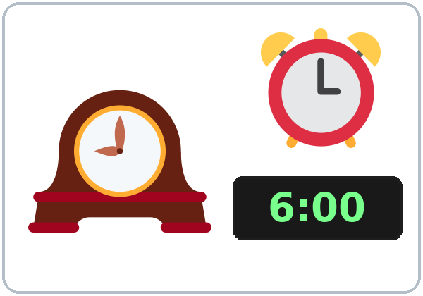
What Time Is It?
Today you will:
• Ask: What time is it?
• Say: It's six thirty.
• Say the days of the week.
Lesson 6 · Level 1
Notes:
Welcome. Say: "Today: time and days." Point to the clock: "What time is it?"
Bring a clock you can move. A paper plate with two paper hands and a pin works well. Teach :00 and :30 first, then :15 and :45.
Teach in English. Show, point, and gesture. Say less, show more.
Class plan: 6:00 Hello + Review, 6:10 New Words, 6:20 Listening, 6:32 Grammar, 6:45 Break, 7:00 Talk Time, 7:10 Exit Ticket + Homework, 7:15 Letters & Numbers, 7:25 Progress Check.
Source: level1_curriculum/lesson6/Level1_Lesson6.md (At a glance, How to Use This Plan, Clock-time plan).
Pictures: Twemoji graphics by Twitter, Inc. and other contributors (https://github.com/jdecked/twemoji), CC BY 4.0 (https://creativecommons.org/licenses/by/4.0/); resized and combined with drawn parts (see lesson6/images/CREDITS.md).

Slide 2
Today's
Goals
01
I can ask and tell the time.
It's six thirty. (6:30)
02
I can say the days of the week.
Tonight you learn these things.
Times: 6:15, 6:30, 6:45
Days: Mon., Tue., Wed.
Progress Check at 7:25!
03
I can use at 6:00, on Monday, in the morning.
04
I can ask: Is it open on Sunday?
05
I can say when I work.
Notes:
Click to show each goal, one at a time. Read it aloud. Learners repeat.
Goal 1: move the class clock. "What time is it?" "It's six thirty."
Goal 3: at + a time (at 6:00), on + a day (on Monday), in + the morning.
Goal 5: learners who don't work can say: "English class is on Monday, at 6:00."
Letters & Numbers at 7:15: writing times, short day names (Mon., Tue.), and a store-hours sign.
Source: level1_curriculum/lesson6/Level1_Lesson6.md (At a glance: Objectives).

Slide 3
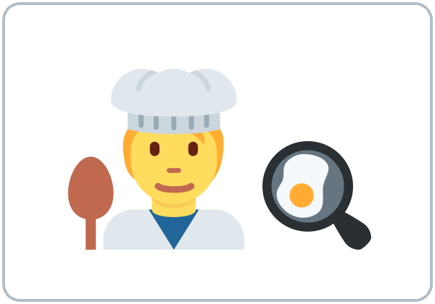
WARM-UP · 6:00
Hello + Review
What do you do?
Where do you work?
A: Do you work at night?
B: Yes, I do.
No, I don't.
Notes:
Pairs. Review of last week (jobs). 15 learners: 7 pairs + 1 group of 3. 7–8 learners: 3–4 pairs. Late arrivals join any pair.
Before class, write on the board: What do you do? Where do you work? Do you work at night? and the 3 "everyone" answers: I'm a student. I'm a homemaker. I don't work now.
Model with one learner: "What do you do?" "I'm a cashier." "Where do you work?" "I work at a store."
Click to show the A question. Click again for the B answers. Partners switch, then find a new partner. Help: "Can you repeat, please?" "How do you spell it?"
Last 3 minutes: homework check. Partners show each other the Lesson 5 homework. Look at item 2 (a / an).
New learners: pair them with a strong partner. If behind: one partner only.
Source: level1_curriculum/lesson6/Level1_Lesson6.md (Step 1: Hello + Review; Student Pages: Hello + Review).
Review picture: the cook from Lesson 5 (lesson5/images/L1_L5_cook.png). Pictures: Twemoji graphics by Twitter, Inc. and other contributors (https://github.com/jdecked/twemoji), CC BY 4.0 (https://creativecommons.org/licenses/by/4.0/); resized and combined with drawn parts (see lesson6/images/CREDITS.md).

Slide 4
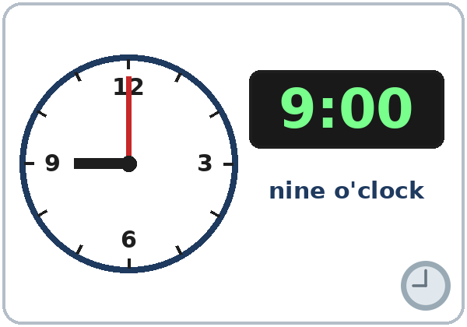
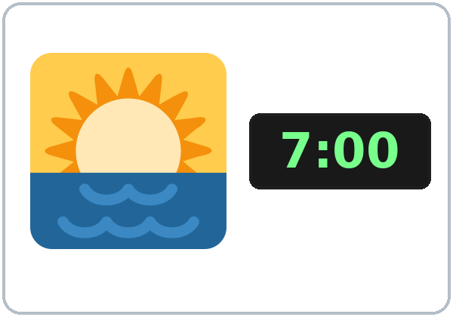
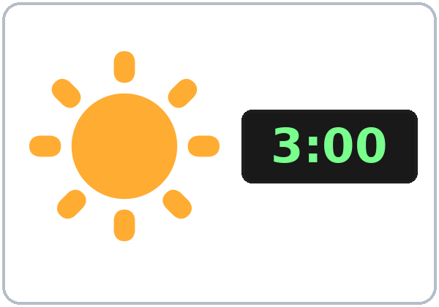
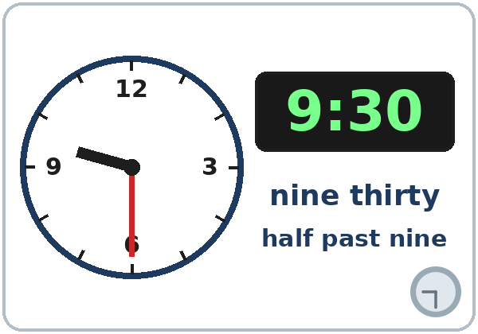
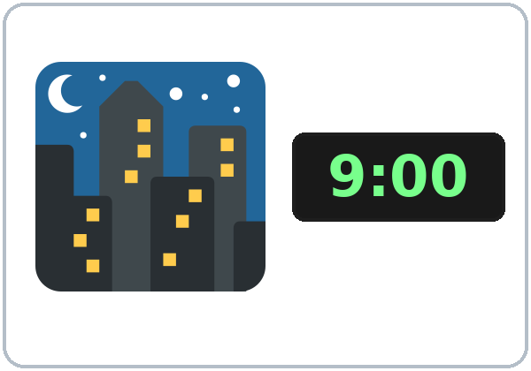
Look. Listen.
Repeat.
New Words
★ clock
★ o'clock
★ morning
★ afternoon
★ thirty
(half past)
★ evening / night
Notes:
Show the class clock. Set it to 9:00: "What time is it? It's nine o'clock." Move it to 9:30: "It's nine thirty." Write on the board: 9:00 = nine o'clock, 9:30 = nine thirty = half past nine.
Click to show each picture. Point and say the word. Learners repeat 2 times.
morning / afternoon / evening: move your arm like the sun (low, high, gone).
Say "It's six o'clock", never "They are six".
★ = most important words. If behind: teach :00 and :30 only.
Source: level1_curriculum/lesson6/Level1_Lesson6.md (Step 2: New Words; Student Pages: New Words).
Pictures: Twemoji graphics by Twitter, Inc. and other contributors (https://github.com/jdecked/twemoji), CC BY 4.0 (https://creativecommons.org/licenses/by/4.0/); resized and combined with drawn parts (see lesson6/images/CREDITS.md).

Slide 5
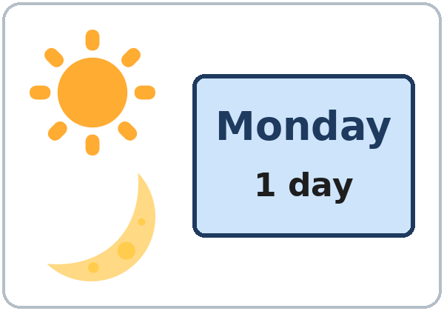
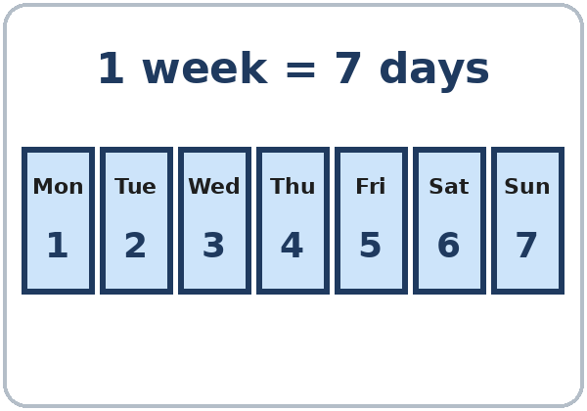
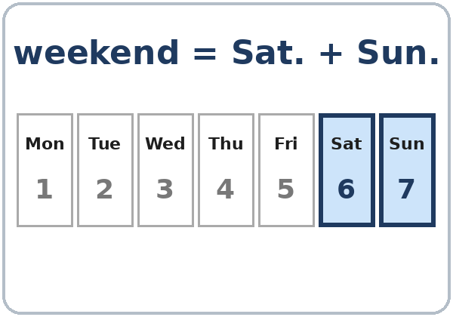


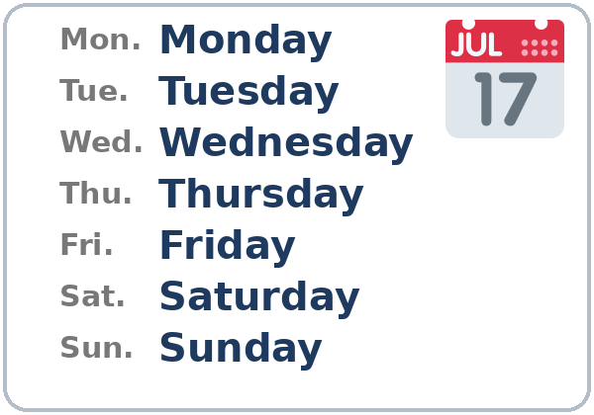
Partners:
A points. B says.
More New Words
★ day
★ week
★ weekend
★ open
★ closed
days of the week
Notes:
Click to show each picture. Say the word. Learners repeat 2 times.
Days: say Monday to Sunday. Learners repeat. Then: "Week = 7 days. Weekend = Saturday and Sunday."
open / closed: point to the signs. "The store is open." "The store is closed."
Pairs (4 min): A sets a time on the class clock (or draws hands on paper), B says it. Then A points to a picture, B says the word.
★ = most important words.
Source: level1_curriculum/lesson6/Level1_Lesson6.md (Step 2: New Words; Student Pages: New Words).
Pictures: Twemoji graphics by Twitter, Inc. and other contributors (https://github.com/jdecked/twemoji), CC BY 4.0 (https://creativecommons.org/licenses/by/4.0/); resized and combined with drawn parts (see lesson6/images/CREDITS.md).

Slide 6
Before You Listen
Say it!
What time is the English class?
Kim calls a laundromat. Then she calls a school.
It's at six o'clock.
01
Is the school open on Friday?
Listen 1: The times.
02
Listen 2: The days.
Listen and repeat.
03
Listen 3: Write.
Notes:
Before you listen (1 min). Say: "Kim calls a laundromat." Mime washing clothes. "She hears a message. Then she calls a school." Hold up your phone.
Click to show each listen. Listen 1: Task A (circle the time). Listen 2: Task B (check the days). Listen 3: Task C (write the times and the word).
Say it!: read each line. Learners repeat.
The audio L1_L6_listening.mp3 (about 1:00) plays the message and the call once. Press play again for the next listen. Pairs compare after each task.
No speaker? Read the script with a volunteer (one person reads the message and the receptionist; the other reads Kim).
Voices: Narrator, store message, Receptionist, Kim. Synthetic voices made with Chatterbox TTS (MIT), copied from short reference clips made with Kokoro-82M (Apache 2.0); no recordings of real people.
Source: level1_curriculum/lesson6/Level1_Lesson6.md (Step 3: Listening; Listening script).
Pictures: Twemoji graphics by Twitter, Inc. and other contributors (https://github.com/jdecked/twemoji), CC BY 4.0 (https://creativecommons.org/licenses/by/4.0/); resized and combined with drawn parts (see lesson6/images/CREDITS.md).

Slide 7
Listen. Circle the time.
Kim calls a laundromat and a school.
Listening A
The laundromat opens at…
7:00 8:00 9:00
1
7:00
The laundromat closes at…
7:00 9:00 10:00
2
9:00
Circle: one time
Pairs: show your partner.
The English class is at…
6:00 6:30 7:00
3
6:00
Notes:
Listen 1 (Task A). Learners circle one time on each line.
Pairs compare: "Show your partner." Then click to show each answer: 1 7:00, 2 9:00, 3 6:00.
The message: open Monday to Saturday, from seven in the morning to nine at night. The English class is at six o'clock.
Source: level1_curriculum/lesson6/Level1_Lesson6.md (Step 3: Listening; Student Pages: Listening A; Answer key, Listening Task A).

Slide 8
Listen again. Check the days. Write.
B: the days. C: the times and a word.
Listening B + C
1
B. The laundromat
is open on…
Mon.–Sat.
2
B. The English class
is on…
Mon., Wed.
B: check the days.
C: write.
Pairs: show your partner.
3
C. On Friday, the school is
open from ___ to ___.
9:00–3:00
4
C. The school is closed
on the ___.
weekend
Notes:
Listen 2 (Task B): learners check the days on their page. Listen 3 (Task C): learners write the times and the word.
Pairs compare. Then click to show each answer.
Task B: the laundromat is open Mon., Tue., Wed., Thu., Fri., Sat. (not Sun.). The English class is on Mon. and Wed.
Task C: 1 from 9:00 to 3:00, 2 weekend.
If behind: play the audio 2 times, and do Task C together.
Source: level1_curriculum/lesson6/Level1_Lesson6.md (Step 3: Listening; Answer key, Listening Tasks B and C).

Slide 9
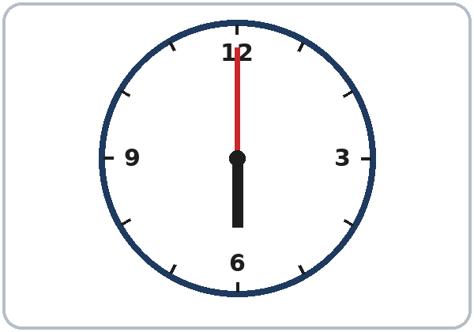
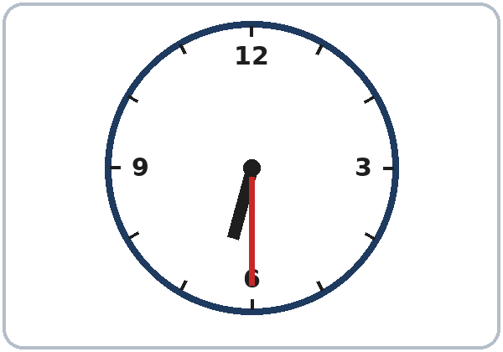
Grammar Box 1
What time is it?
QUESTION
ANSWER
What time is it?
It's 6:00.
six o'clock
What time is it?
It's 6:30.
six thirty
What time is it?
It's 6:15.
six fifteen
What time is it?
It's 6:45.
six forty-five
Notes:
Show the Grammar page. The left side is the question. The right side is the answer. Point left, then right.
Move the class clock: 6:00, 6:30, 6:15, 6:45. Ask "What time is it?" The class answers "It's…" each time. Click to show each answer.
Teach :00 and :30 first. :15 and :45 are said as numbers: six fifteen, six forty-five. (Quarter past / quarter to is Level 2; accept it if a learner knows it.)
The big mistake: "They are six." In English: It's six o'clock. Tap the clock: "It's six."
Source: level1_curriculum/lesson6/Level1_Lesson6.md (Step 4: Grammar Q&A, Box 1; Teacher notes).
Pictures: drawn in code for this curriculum (see lesson6/images/CREDITS.md).

Slide 10
Grammar Box 2
What time is class?
What time is class?
at
+ a time
It's at 6:00.
It's at 7:30.
What day is class?
on
+ a day
It's on Monday.
on Monday and Wednesday.
Notes:
Draw 3 boxes on the board: at 6:00 (a clock), on Monday (a calendar), in the morning (a sun).
Ask: "What time is class?" Click: "It's at 6:00." Say: "at + time."
Ask: "What day is class?" Click: "It's on Monday." Say: "on + day." Say on Monday, not the Monday.
Check questions: "Class is ___ 6:00." (at) "Class is ___ Monday." (on)
Source: level1_curriculum/lesson6/Level1_Lesson6.md (Step 4: Grammar Q&A, Boxes 2 and 4; Grammar Box 2; Teacher notes).
Pictures: Twemoji graphics by Twitter, Inc. and other contributors (https://github.com/jdecked/twemoji), CC BY 4.0 (https://creativecommons.org/licenses/by/4.0/); resized and combined with drawn parts (see lesson6/images/CREDITS.md).

Slide 11
Grammar Box 3
When do you work?
Grammar Box 4
at 6:00 · at night
on Monday · on the weekend
in the morning · in the evening
QUESTION
ANSWER
When
do you work?
On Monday and Tuesday.
In the morning.
When
is English
class?
On Monday,
at 6:00.
Notes:
Box 3: ask "When do you work?" Click: "On Monday and Tuesday. In the morning."
Learners who don't work: "When is English class?" Click: "On Monday, at 6:00."
Box 4 (top right): at + a time, on + a day, in + the morning / the afternoon / the evening. Say once: at night (not in the night).
Check question: "I work ___ the morning." (in)
Don't ask about real work hours if a learner doesn't offer them. "English class is on Monday at 6:00" is always a good answer.
Source: level1_curriculum/lesson6/Level1_Lesson6.md (Step 4: Grammar Q&A, Boxes 3 and 4; Teacher notes).

Slide 12
Grammar Box 5
Point to the sign.
Ask. Your partner answers.
Then switch.
Is it open on Monday?
What time is it open?
Is the store open on Sunday?
Yes, it is.
From 9:00 to 5:00.
No, it isn't. It's closed.
Notes:
Point to the CLOSED sign: "Is the store open on Sunday?" Click: "No, it isn't. It's closed."
Right box: "Is it open on Monday?" "What time is it open?" Click: "Yes, it is. From 9:00 to 5:00."
Say closed, not close: "The store is closed."
Pair drill (last 3–4 min): A asks from the left side of the Grammar page; B answers from the right side. Then switch.
If behind: skip the pair drill. It becomes homework, and Talk Time practices the same questions.
Source: level1_curriculum/lesson6/Level1_Lesson6.md (Step 4: Grammar Q&A, Box 5; pair drill).
Pictures: Twemoji graphics by Twitter, Inc. and other contributors (https://github.com/jdecked/twemoji), CC BY 4.0 (https://creativecommons.org/licenses/by/4.0/); resized and combined with drawn parts (see lesson6/images/CREDITS.md).

Slide 13
Write at, on, or in.
Use one word.
at, on, in?
1
Class is ____ 6:00.
at
2
Class is ____ Monday and Wednesday.
on
at 6:00
on Monday
in the morning
Pairs: check your answers.
3
I work ____ the morning.
in
4
I work ____ night.
at
5
The store is closed ____ Sunday.
on
Notes:
Learners write at, on, or in on each line. Then pairs check.
Click to show each answer: 1 at, 2 on, 3 in, 4 at, 5 on.
Say: "at + time. on + day. in + the morning." Line 4 is the exception: at night.
Source: level1_curriculum/lesson6/Level1_Lesson6.md (Grammar: Practice; Answer key, Grammar practice).

Slide 14
Common Mistakes
Don't say
Say
They are six.
It's six.
Class is in 6:00.
Class is at 6:00.
I work the Monday.
I work on Monday.
I work in the night.
I work at night.
monday
Monday (capital letter)
The store is close.
The store is closed.
Notes:
Read each "Don't say" line. Shake your head. Click to show the correct line. Learners repeat it.
The big mistake this week: "They are six." Spanish says "Son las seis." In English: It's six o'clock. Tap the clock: "It's six."
at 6:00, on Monday (not the Monday), in the morning, but at night.
Days always start with a capital letter: Monday. Say closed, not close.
Source: level1_curriculum/lesson6/Level1_Lesson6.md (Grammar: Common mistakes; Teacher notes).
Pictures: Twemoji graphics by Twitter, Inc. and other contributors (https://github.com/jdecked/twemoji), CC BY 4.0 (https://creativecommons.org/licenses/by/4.0/); resized and combined with drawn parts (see lesson6/images/CREDITS.md).

Slide 15
Talk Time
Schedule Gap
A–B pairs.
Don't show your page.
7:00–7:10
1
A asks:
Is the library open on Monday?
2
B answers:
Yes, it is. / No, it isn't.
3
A asks: What time is it open?
B: From ___ to ___.
Notes:
A–B pairs. Give half the class the Student A page and half the Student B page. Partners don't show their pages.
Model with one learner (you are A): "Is the library open on Monday?" "No, it isn't." "Is it open on Tuesday?" "Yes, it is." "What time is it open?" "From 10:00 to 6:00." Write it in an empty table on the board.
Click to show each step. Part 1 (6 min): A asks about B's 3 places and writes the days and times. Then B asks about A's places. Check (1 min): partners show their pages and compare.
Answer key: Clinic Mon.–Fri. 8:00–5:00. Store every day 7:00–10:00. Laundromat Mon.–Sat. 6:00–9:00. Library Tue.–Sat. 10:00–6:00. Restaurant every day 11:00–9:00. Bank Mon.–Fri. 9:00–4:00.
With an odd number, two Bs share one A. Learners who can't read or write yet ask the questions while a partner writes, or they point to the days.
Source: level1_curriculum/lesson6/Level1_Lesson6.md (Step 5: Talk Time, Part 1; Student Pages: Talk Time A and B; Answer key).
Pictures: Twemoji graphics by Twitter, Inc. and other contributors (https://github.com/jdecked/twemoji), CC BY 4.0 (https://creativecommons.org/licenses/by/4.0/); resized and combined with drawn parts (see lesson6/images/CREDITS.md).

Slide 16
TALK TIME · PART 2
Or ask:
When do you study?
When is English class?
I work on ___ and ___,
in the ___.
I don't work now. English class is on ___, at ___.
When Do You Work?
Ask your partner.
Say one sentence.
A: When do you work?
B: On Monday and Friday,
in the morning.
Notes:
Part 2 (3 min). New question: "When do you work?" (or "When do you study? When is English class?").
Model it: "When do you work?" Click: "On Monday and Friday, in the morning."
Each learner says one sentence: "I work on Monday and Friday, in the morning." / "I don't work now. English class is on ___, at 6:00."
Strong learners can add from… to…: "I work from 8:00 to 4:00." Don't ask about real hours if a learner doesn't offer them.
If behind: skip Part 2.
Source: level1_curriculum/lesson6/Level1_Lesson6.md (Step 5: Talk Time, Part 2; Teacher notes).

Slide 17
Before You Go 7:10–7:15
01
Exit ticket
02
Homework
Say the time:
It's seven fifteen.
Or write:
Class is on ___,
at ___.
1. Write about your week.
2. Write at, on, or in.
3. Write the time.
4. Ask: What time is it?
5. Write about a job.
Bring it next week!
Notes:
Exit ticket (never skip): set the class clock to a time. Each learner says the time ("It's seven fifteen.") or writes one sentence: Class is on ___, at ___. Copying is fine.
Homework (10 minutes): open the Homework page. Do item 1 together (the first line). Point to each instruction.
Homework: 1) English class is on ___, at ___. I work on ___ (or I don't work now); 2) at, on, or in; 3) write the time with numbers; 4) ask a family member or a friend 3 times: What time is it?; 5) review: I'm a / an ___ (or My mother is a / an ___).
Homework answers: item 2: 1 on, 2 at, 3 in, 4 on, 5 at. Item 3: 1 7:00, 2 8:30, 3 4:15, 4 5:45.
Source: level1_curriculum/lesson6/Level1_Lesson6.md (Step 6: Exit Ticket + Homework; Student Pages: Homework; Answer key).
Pictures: drawn in code for this curriculum (see lesson6/images/CREDITS.md).

Slide 18
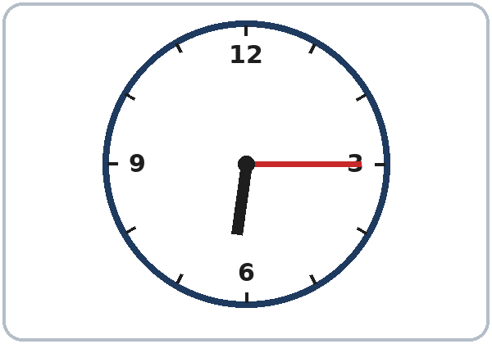
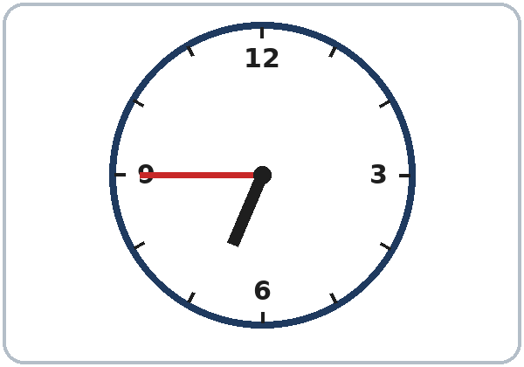
Letters & Numbers: Task A
Look. Listen. Say the time.
1
_____
2
_____
3
_____
4
_____
6:00
6:15
6:30
6:45
6 : 30 the hour : the minutes
Notes:
Letters & Numbers (10 min). Whole class, then pairs. Use the Letters & Numbers page.
Task A (2 min): point to each clock. Say: six o'clock, six fifteen, six thirty, six forty-five. Learners repeat. Click to show each time.
Show the : (two dots) between the hour and the minutes.
7:15 and 7:50 sound alike. Say "fif-TEEN" and "FIF-ty" with a clap, as in Lesson 3.
Learners who can't read or write yet: they say the times with everyone and point to the clocks.
Source: level1_curriculum/lesson6/Level1_Lesson6.md (Letters & Numbers, Task A; Teacher notes).
Pictures: drawn in code for this curriculum (see lesson6/images/CREDITS.md).

Slide 19
Listen. Write the time.
Use numbers.
Write the
Time
1
___ : ___
7:30
2
___ : ___
8:00
Listen: 2 times.
Pairs: A says a time.
B writes it.
3
___ : ___
9:15
4
___ : ___
10:45
Notes:
Task B (3 min). Say each time 2 times: 1 7:30, 2 8:00, 3 9:15, 4 10:45. Learners write them with numbers.
Then click to show each answer.
Partners: A says a time, B writes it. Switch.
If behind: do Tasks A and B only.
Source: level1_curriculum/lesson6/Level1_Lesson6.md (Letters & Numbers, Task B; Answer key, Letters & Numbers Task B).

Slide 20
Letters & Numbers · Task C
Days of the Week
Capital letter:
Monday
Short form:
Mon.
3 letters + .
Day
Short form
Monday · Tuesday
Mon. · Tue.
Wednesday · Thursday
Wed. · Thu.
Friday · Saturday
Fri. · Sat.
Sunday
Sun.
Notes:
Task C (2 min). Days start with a capital letter: Monday. The short form is 3 letters + a period: Mon.
Read each day. Learners repeat. Click to show each short form: Mon., Tue., Wed., Thu., Fri., Sat., Sun. Learners write them.
AM / PM: say once on the next slide. Signs use them; learners don't need to say them.
Learners who can't read or write yet: in Task C they copy Mon. and Sat. only. A helper, if you have one, sits with them.
Source: level1_curriculum/lesson6/Level1_Lesson6.md (Letters & Numbers, Task C; Answer key, Task C; Teacher notes).

Slide 21
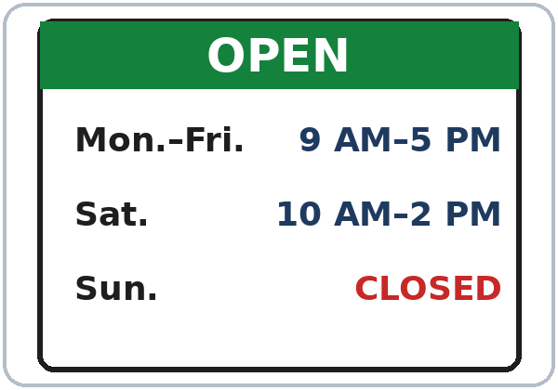
Read the Sign
1
The store is open on Saturday.
Yes
2
The store is open on Sunday.
No
3
Monday: ___ to ___
9:00–5:00
Circle Yes or No.
AM = morning.
PM = afternoon and night.
Notes:
Task D (2 min). Read the sign together. Say: "AM = morning. PM = afternoon and night."
Read each line. Learners circle Yes or No and write the time. Then click to show each answer: 1 Yes, 2 No, 3 9:00 (9 AM) to 5:00 (5 PM).
Learners who can't read yet: read the sign aloud for them and let them answer by pointing.
If behind: do Tasks A and B only (skip this slide).
Source: level1_curriculum/lesson6/Level1_Lesson6.md (Letters & Numbers, Task D; Answer key, Task D).
Picture: the store-hours sign is drawn in code; the hours are invented (see lesson6/images/CREDITS.md).

Slide 22
Progress Check 7:25
D. I can…
😀 🙂 😐
Check one face.
B. Match the question
Answer
1. What time is it?
c. It's 7:30.
2. What day is class?
a. It's on Monday.
3. Is the bank open on Sunday?
d. No, it isn't. It's closed.
4. What time is it open?
b. From 9:00 to 5:00.
Notes:
Progress Check (5 min). Individuals. Open the Progress Check page.
Part A: read the 5 times slowly, 2 times each: 1 6:30, 2 7:15, 3 3:00, 4 9:45, 5 11:30. Learners circle.
Parts B and C: learners match and write on their own. Help with the instructions only. Click to show the Part B answers when you check together: 1 c, 2 a, 3 d, 4 b.
Part C answers: 1 at, 2 on, 3 in.
Part D: read each "I can…" line and point to the 3 faces: 😀 "I can do it." 🙂 "A little." 😐 "Not yet." Learners check one.
Score: A /5 + B /4 + C /3 = /12. This is not a test grade. Part A shows who can hear times; Part C shows at / on / in. Collect the pages. If behind: do it in Week 7 at 6:00, while learners arrive.
Source: level1_curriculum/lesson6/Level1_Lesson6.md (Progress Check; Answer key).

Slide 23
Great Work! See You Next Week!
Now you can:
• Ask: What time is it?
• Say: Class is at 6:00.
• Ask: Is it open on Sunday?
Lesson 6 · Level 1
Notes:
Say: "Great work! See you next week!" Remind learners: bring the homework next week.
Collect the Progress Check pages (or check them at the start of Week 7).
Looking ahead: Lesson 7 (money and clothes) uses numbers again for prices (It's $12) and this / these.
Source: level1_curriculum/lesson6/Level1_Lesson6.md (Teacher notes: Looking ahead).
Pictures: drawn in code for this curriculum (see lesson6/images/CREDITS.md).

Slide 24
Credits
Pictures
Vocabulary pictures use Twemoji graphics by Twitter, Inc. and other contributors (https://github.com/jdecked/twemoji), licensed under CC BY 4.0 (https://creativecommons.org/licenses/by/4.0/). The graphics were resized and combined, and clock faces, digital clocks, week strips, OPEN / CLOSED signs, and labels were added. The four clock faces and the store-hours sign are drawn in code. Labels on the pictures use the DejaVu Sans font. The review picture (the cook) is from Lesson 5.
Other small pictures (the faces on the Progress Check) are standard emoji characters shown with the computer's emoji font.
Names
All names, places, and hours on the slides (Kim, the laundromat, the school, the store) are invented.
Audio and font
Audio: synthetic voices (Narrator, store message, Receptionist, Kim) made with Chatterbox TTS (Resemble AI, MIT License), copied from short reference clips made with Kokoro-82M (Apache 2.0); no recordings of real people were used. Each file carries an inaudible Perth watermark. Font: Lexend Deca (OFL 1.1).
© 2026 the authors. The authors license this deck under CC BY-NC-SA 4.0.
Notes:
Credits for the pictures, audio, and font.
Pictures: Twemoji (CC BY 4.0), https://github.com/jdecked/twemoji. Clock faces and the store-hours sign drawn in code. Review picture (cook) from Lesson 5. Audio: Chatterbox TTS (MIT) voices copied from short Kokoro-82M (Apache 2.0) reference clips; no recordings of real people.
Sources: Level1_Lesson6.md (Picture Credits), lesson6/images/CREDITS.md.

