Slide 1
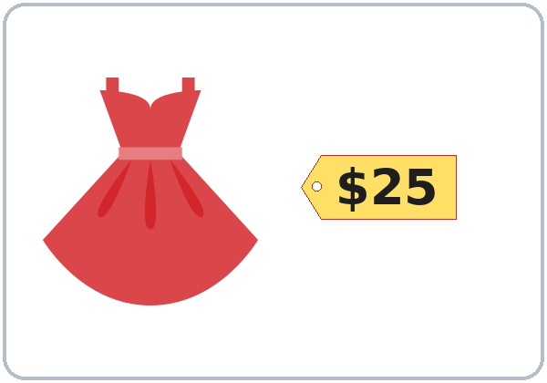
How Much Is It?
Today you will:
• Ask: How much is this shirt?
• Say: It's $12. They're $30.
• Pay and check your change.
Lesson 7 · Level 1
Notes:
Welcome. Say: "Today: money and clothes." Point to the price tag: "How much is it? It's $25."
Bring 2 or 3 real clothes you can hold up (a shirt or a jacket, a pair of shoes), and put one far away on a chair (for that / those).
Before class: print the play-money page (one per pair), cut it, and put each pair's money in an envelope.
Money is private. Use only play money and the prices on the pages. Never ask what learners earn, spend, or pay.
Teach in English. Show, point, and gesture. Say less, show more.
Class plan: 6:00 Hello + Review, 6:10 New Words, 6:20 Listening, 6:32 Grammar, 6:45 Break, 7:00 Talk Time, 7:10 Exit Ticket + Homework, 7:15 Letters & Numbers, 7:25 Progress Check.
Source: level1_curriculum/lesson7/Level1_Lesson7.md (At a glance, How to Use This Plan, Clock-time plan).
Pictures: Twemoji graphics by Twitter, Inc. and other contributors (https://github.com/jdecked/twemoji), CC BY 4.0 (https://creativecommons.org/licenses/by/4.0/); resized, recolored, and combined with drawn parts (see lesson7/images/CREDITS.md).

Slide 2
Today's
Goals
01
I can ask the price.
How much is this shirt?
02
I can say prices: It's $12.
Tonight you learn these things.
Clothes and colors
Cash or credit card?
Progress Check at 7:25!
03
I can use this, that, these, those.
04
I can say a blue shirt, black shoes.
05
I can pay and check my change.
Notes:
Click to show each goal, one at a time. Read it aloud. Learners repeat.
Goal 1: hold up a shirt. "How much is this shirt?" Goal 2: "It's $12." Say "twelve dollars".
Goal 3: this / that = one thing; these / those = two or more. Near = this / these. Far = that / those.
Goal 4: the color comes before the thing: a blue shirt, black shoes.
Goal 5: "Cash or credit card? Cash, please. Here's $20. Your change is $5."
Letters & Numbers at 7:15: reading prices ($4.99 = "four ninety-nine"), this / these sounds, and a receipt.
Source: level1_curriculum/lesson7/Level1_Lesson7.md (At a glance: Objectives).

Slide 3
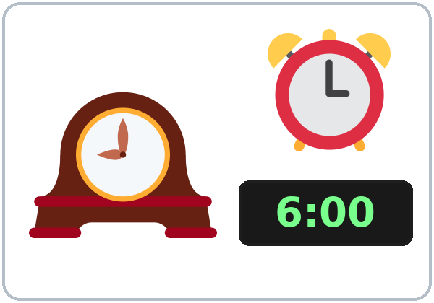
WARM-UP · 6:00
Hello + Review
What time is it?
What time is English class?
A: Is the store open on Sunday?
B: Yes, it is.
No, it isn't. It's closed.
Notes:
Pairs. Review of last week (time and days). 15 learners: 7 pairs + 1 group of 3. 7–8 learners: 3–4 pairs. Late arrivals join any pair.
Before class, write on the board: What time is it? What time is class? What day is class? Is the store open on Sunday?
Model with one learner: "What time is it?" "It's six o'clock." "What day is class?" "It's on Monday."
Click to show the A question. Click again for the B answers. Partners switch, then find a new partner. Help: "Can you repeat, please?" "How do you spell it?"
Last 3 minutes: homework check. Partners show each other the Lesson 6 homework. Look at item 2 (at / on / in).
New learners: pair them with a strong partner. They can do the Lesson 1–6 Progress Checks at home. If behind: one partner only.
Source: level1_curriculum/lesson7/Level1_Lesson7.md (Step 1: Hello + Review; Student Pages: Hello + Review).
Review picture: the clock from Lesson 6 (lesson6/images/L1_L6_clock.png). Twemoji graphics by Twitter, Inc. and other contributors (https://github.com/jdecked/twemoji), CC BY 4.0 (https://creativecommons.org/licenses/by/4.0/); resized and combined with drawn parts (see lesson6/images/CREDITS.md).

Slide 4
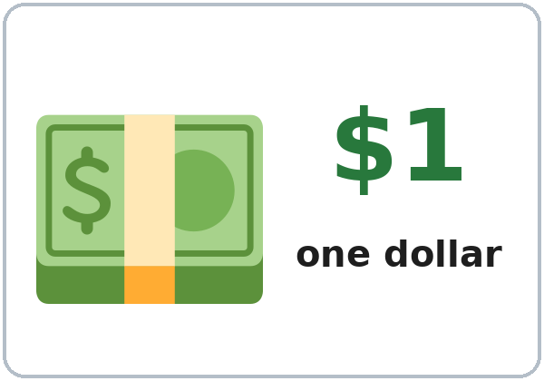
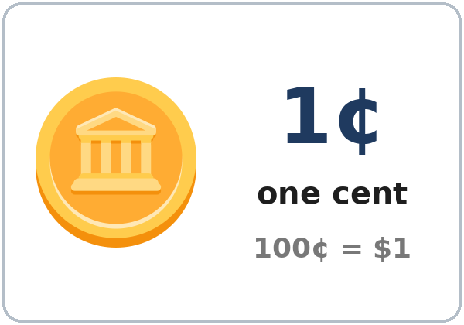
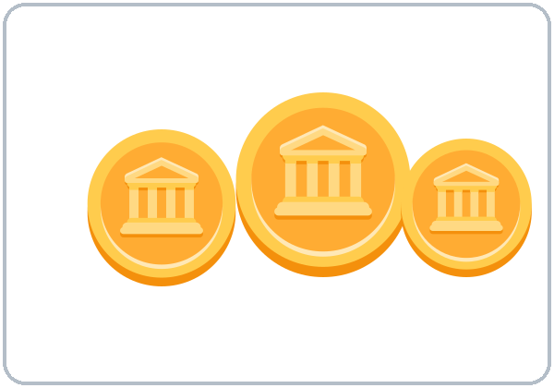
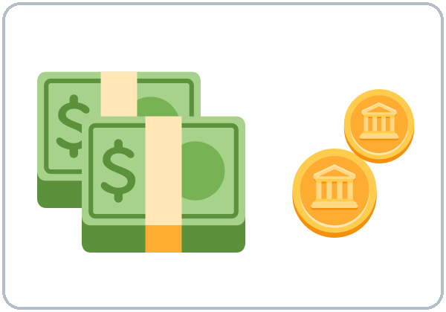
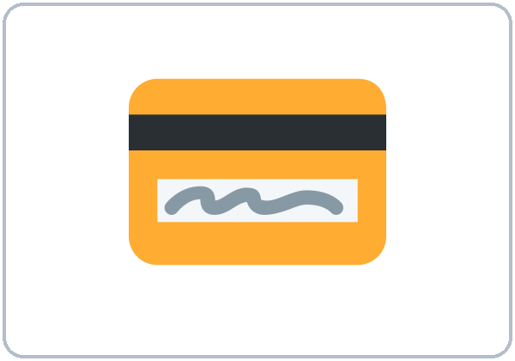
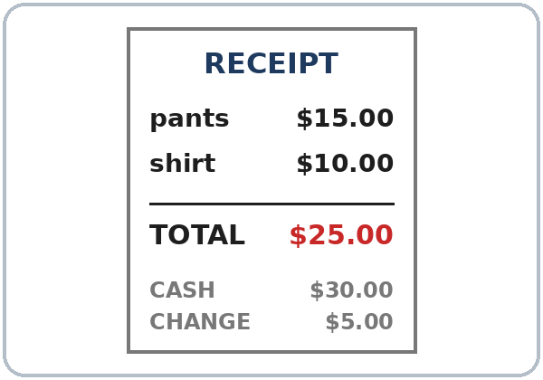
Look. Listen.
Repeat.
New Words
★ dollar
★ cent
coin
★ cash
★ credit card
receipt
Notes:
Click to show each picture. Point and say the word. Learners repeat 2 times.
cash: show the play money. credit card: mime paying with a card.
Write on the board: 100 cents = 1 dollar (100¢ = $1).
★ = most important words. If behind: teach the ★ words only.
Source: level1_curriculum/lesson7/Level1_Lesson7.md (Step 2: New Words; Student Pages: New Words).
Pictures: Twemoji graphics by Twitter, Inc. and other contributors (https://github.com/jdecked/twemoji), CC BY 4.0 (https://creativecommons.org/licenses/by/4.0/); resized, recolored, and combined with drawn parts (see lesson7/images/CREDITS.md). The receipt is drawn in code.

Slide 5
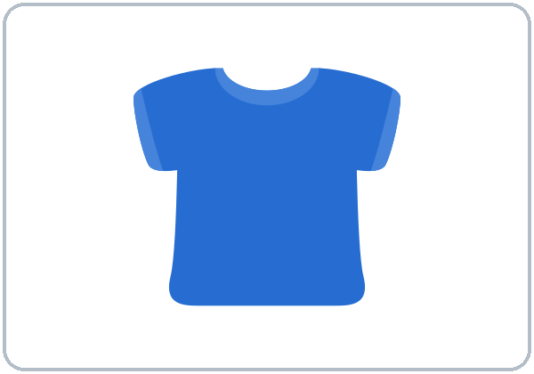
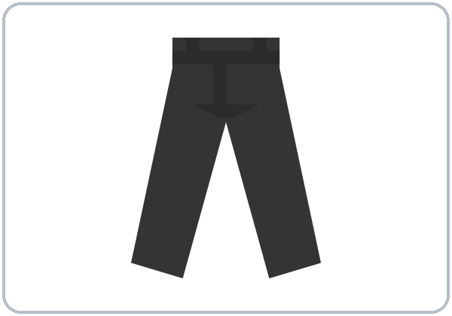
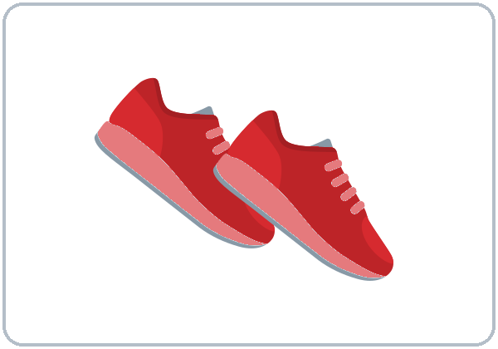
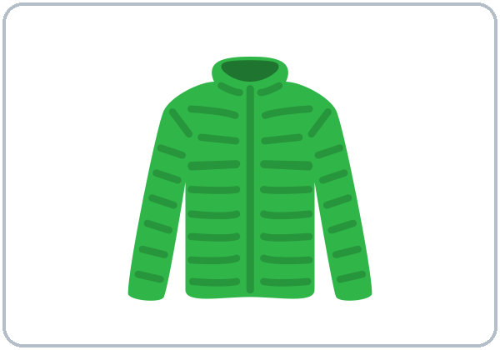
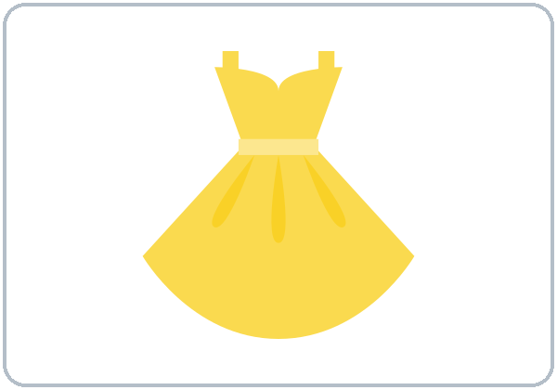
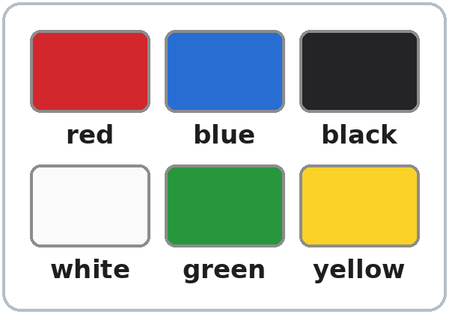
Partners:
A points. B says.
More New Words
★ shirt
★ pants
★ shoes
★ jacket
★ dress
colors
Notes:
Hold up a real shirt: "This is a shirt. It's blue." Hold up shoes: "Shoes. Two shoes." Point to colors in the room: "Red. Black. White."
Click to show each picture. Say the word. Learners repeat 2 times.
pants, shoes: say "pants" and hold up 2 fingers. One thing, but the word is always plural.
colors: red, blue, black, white, green, yellow.
Pairs (4 min): A points to a picture, B says the word. Then A says a color, B points to something in the room with that color.
★ = most important words. If behind: teach the ★ words only.
Source: level1_curriculum/lesson7/Level1_Lesson7.md (Step 2: New Words; Student Pages: New Words).
Pictures: Twemoji graphics by Twitter, Inc. and other contributors (https://github.com/jdecked/twemoji), CC BY 4.0 (https://creativecommons.org/licenses/by/4.0/); resized, recolored, and combined with drawn parts (see lesson7/images/CREDITS.md). The color swatches are drawn in code.

Slide 6
Before You Listen
Say it!
How much is this shirt?
Ana is at a clothing store.
Cash or credit card?
01
Can I have the receipt, please?
Listen 1: The colors.
02
Listen 2: The prices.
Listen and repeat.
03
Listen 3: Check and write.
Notes:
Before you listen (1 min). Say: "Ana is at a clothing store. She asks: How much is it?" Point to the shirts and shoes in Task A.
Click to show each listen. Listen 1: Task A (circle the shirt and the shoes). Listen 2: Task B (write the 2 prices). Listen 3: Task C (check the total, cash or card, and write the change).
Say it!: read each line. Learners repeat.
The audio L1_L7_listening.mp3 (about 1:10) plays the conversation once. Press play again for the next listen. Pairs compare after each task.
No speaker? Read the script with a volunteer. Say the prices as words: twelve dollars, thirty dollars.
Voices: Narrator, Cashier, Ana. Synthetic voices made with Chatterbox TTS (MIT), copied from short reference clips made with Kokoro-82M (Apache 2.0); no recordings of real people.
Source: level1_curriculum/lesson7/Level1_Lesson7.md (Step 3: Listening; Listening script).
Pictures: Twemoji graphics by Twitter, Inc. and other contributors (https://github.com/jdecked/twemoji), CC BY 4.0 (https://creativecommons.org/licenses/by/4.0/); resized, recolored, and combined with drawn parts (see lesson7/images/CREDITS.md).

Slide 7
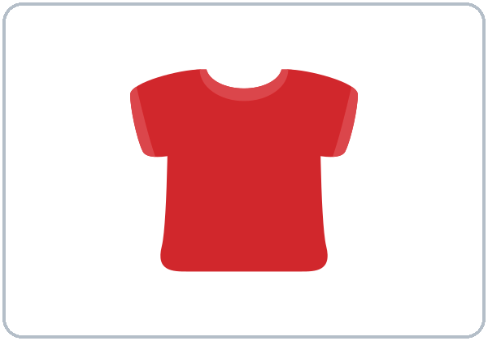
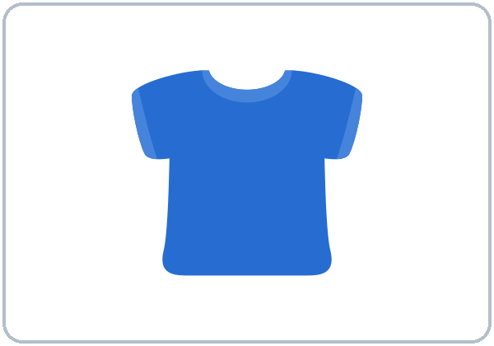
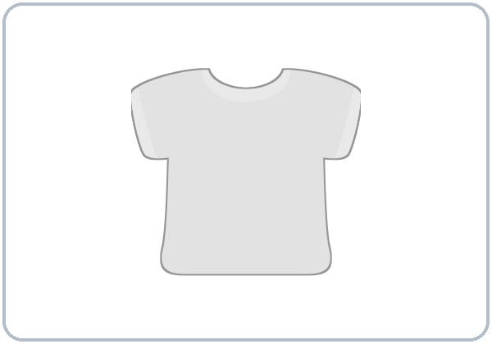
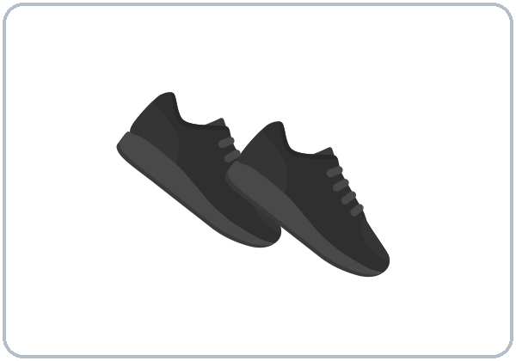
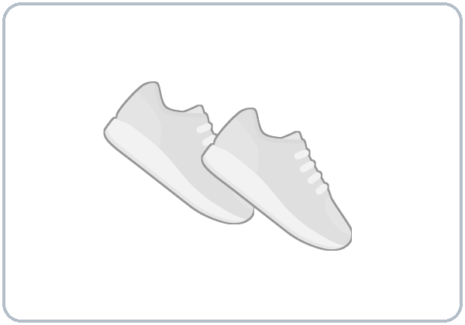
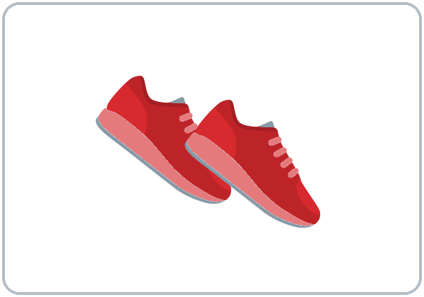
Listen. Circle what she buys.
Ana is at a clothing store.
Listening A
the shirt
1
b blue
a red
b blue
c white
Circle: a, b, or c
Pairs: show your partner.
the shoes
2
a black
a black
b white
c red
Notes:
Listen 1 (Task A). Learners circle the color of the shirt and the shoes Ana buys.
Pairs compare: "Show your partner." Then click to show each answer: the shirt b (blue), the shoes a (black).
In the audio: "Do you have this shirt in red?" "No, sorry. Only blue and white." "OK, blue is good."
Source: level1_curriculum/lesson7/Level1_Lesson7.md (Step 3: Listening; Student Pages: Listening A; Answer key, Listening Task A).
Pictures: Twemoji graphics by Twitter, Inc. and other contributors (https://github.com/jdecked/twemoji), CC BY 4.0 (https://creativecommons.org/licenses/by/4.0/); resized, recolored, and combined with drawn parts (see lesson7/images/CREDITS.md).

Slide 8
Listen again. Write. Check.
B: the prices. C: check or write.
Listening B + C
1
B. The shirt is $___.
The shoes are $___.
$12 · $30
2
C. The total is:
$32 $42 $52
$42
B: write the prices.
C: check or write.
Pairs: show your partner.
3
C. Ana pays with:
cash a credit card
cash
4
C. Her change is $___.
Asks for: a bag the receipt
$8 · receipt
Notes:
Listen 2 (Task B): learners write the 2 prices. Listen 3 (Task C): learners check the total, cash or card, and write the change.
Pairs compare. Then click to show each answer.
Task B: 1 the shirt is $12, 2 the shoes are $30.
Task C: 1 the total is $42, 2 Ana pays with cash, 3 her change is $8, 4 Ana asks for the receipt.
If behind: play the audio 2 times, and do Task C together.
Source: level1_curriculum/lesson7/Level1_Lesson7.md (Step 3: Listening; Answer key, Listening Tasks B and C).

Slide 9
Grammar Boxes 1 + 2
How much is it?
QUESTION
ANSWER
How much is this shirt?
It's $12.
twelve dollars
How much is that dress?
It's $25.
twenty-five dollars
How much are these shoes?
They're $30.
thirty dollars
How much are those pants?
They're $18.
eighteen dollars
Notes:
Show the Grammar page. The left side is the question. The right side is the answer. Point left, then right.
Box 1: hold up the shirt: "How much is this shirt?" Click: "It's $12." Box 2: hold up the shoes: "How much are these shoes?" Click: "They're $30."
Click to show each answer. Learners repeat the question and the answer.
Write on the board: one → is / it's. two or more → are / they're. Pants and shoes always use are.
Say prices as words: $12 = "twelve dollars". Not "How much cost this?"
Source: level1_curriculum/lesson7/Level1_Lesson7.md (Step 4: Grammar Q&A, Boxes 1–2; Grammar Boxes 1 and 2; Teacher notes).
Pictures: Twemoji graphics by Twitter, Inc. and other contributors (https://github.com/jdecked/twemoji), CC BY 4.0 (https://creativecommons.org/licenses/by/4.0/); resized, recolored, and combined with drawn parts (see lesson7/images/CREDITS.md).

Slide 10
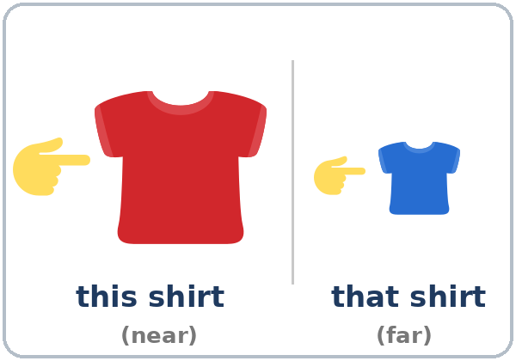
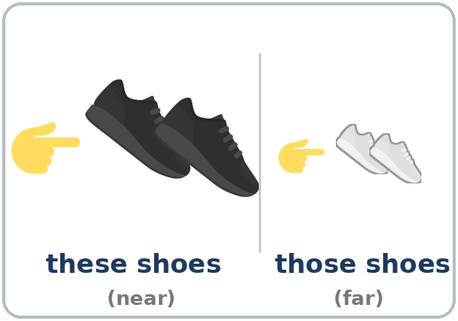
Grammar Box 3
this, that, these, those
One thing: near or far?
is
+ this / that
this shirt (near)
that shirt (far)
Two or more: near or far?
are
+ these / those
these shoes (near)
those shoes (far)
Notes:
Box 3 (the key point). Stand next to the shirt: "this shirt." Walk away and point to the far chair: "that shirt."
Same with shoes: "these shoes… those shoes." Learners point near and far as they say the words.
Ask "One thing: near or far?" Click to show this shirt / that shirt. Ask "Two or more?" Click to show these shoes / those shoes.
One thing → is / this / that. Two or more → are / these / those. Near → this / these. Far → that / those.
Source: level1_curriculum/lesson7/Level1_Lesson7.md (Step 4: Grammar Q&A, Box 3; Grammar Box 3; Teacher notes).
Pictures: Twemoji graphics by Twitter, Inc. and other contributors (https://github.com/jdecked/twemoji), CC BY 4.0 (https://creativecommons.org/licenses/by/4.0/); resized, recolored, and combined with drawn parts (see lesson7/images/CREDITS.md). Near / far lines and labels are drawn in code.

Slide 11
Grammar Box 4
Color + Noun
Colors
red · blue · black
white · green · yellow
Colors never add -s.
DON'T SAY
SAY
1
a shirt blue
a blue shirt
color first
2
blacks shoes
black shoes
colors: no -s
Notes:
Box 4: write a shirt blue on the board and cross it out. Write a blue shirt. Then black shoes (yes) and blacks shoes (no): colors never take -s.
Read each DON'T SAY line. Shake your head. Click to show the SAY line. Learners repeat it.
The big mistake this week: Spanish says una camisa azul. In English the color comes first: a blue shirt. Correct by pointing at the word order on the board. Learners can read the Spanish note on their Grammar page.
Check question: "shirt / red / a" (a red shirt).
Source: level1_curriculum/lesson7/Level1_Lesson7.md (Step 4: Grammar Q&A, Box 4; Grammar Box 4; Teacher notes).

Slide 12
Grammar Box 5
Cashier asks.
Shopper answers.
Then switch.
Your change is $8.
That's $42. Cash or credit card?
Thank you. Can I have the receipt, please?
Cash, please. Here's $50.
Notes:
Box 5: model paying with play money: "That's $8." Give $10. "Your change is $2."
Read the cashier line: "That's $42. Cash or credit card?" Click: "Cash, please. Here's $50." Another answer: "Credit card, please."
Right box: "Your change is $8." Click: "Thank you. Can I have the receipt, please?"
Pairs: A is the cashier, B is the shopper. Then switch. Use the play money.
Pair drill (last 3–4 min): A points to a picture on the New Words page and asks; B invents a price. Then switch. If behind: skip the pair drill; it becomes homework.
Source: level1_curriculum/lesson7/Level1_Lesson7.md (Step 4: Grammar Q&A, Box 5 and pair drill; Grammar Box 5).
Pictures: Twemoji graphics by Twitter, Inc. and other contributors (https://github.com/jdecked/twemoji), CC BY 4.0 (https://creativecommons.org/licenses/by/4.0/); resized, recolored, and combined with drawn parts (see lesson7/images/CREDITS.md).

Slide 13
Write is, are, this, or these.
Then put the words in order.
is, are, this, these?
1
How much ____ this jacket?
is
2
How much ____ these pants?
are
one: is · this
two or more: are · these
Pairs: check your answers.
3
How much is ____ dress? (near, one)
this
4
How much are ____ shoes? (near, two)
these
5
shirt / red / a
a red shirt
Notes:
Learners write is, are, this, or these on lines 1–4, and put the words in order on line 5. Then pairs check.
Click to show each answer: 1 is, 2 are, 3 this, 4 these, 5 a red shirt.
Say: "One thing: is, this. Two or more: are, these." Pants always use are.
Source: level1_curriculum/lesson7/Level1_Lesson7.md (Grammar: Practice; Answer key, Grammar practice).

Slide 14
Common Mistakes
Don't say
Say
How much is these shoes?
How much are these shoes?
How much cost this?
How much is this?
a shirt blue
a blue shirt
blacks shoes
black shoes
this shoes
these shoes
Notes:
Read each "Don't say" line. Shake your head. Click to show the correct line. Learners repeat it.
is / are: one thing → How much is this shirt? Two or more → How much are these shoes? Not "How much cost this?"
The color comes first: a blue shirt. Colors never take -s: black shoes, not blacks shoes.
this shoes → these shoes: shoes are two or more.
Source: level1_curriculum/lesson7/Level1_Lesson7.md (Grammar: Common mistakes; Teacher notes).
Pictures: Twemoji graphics by Twitter, Inc. and other contributors (https://github.com/jdecked/twemoji), CC BY 4.0 (https://creativecommons.org/licenses/by/4.0/); resized, recolored, and combined with drawn parts (see lesson7/images/CREDITS.md).

Slide 15
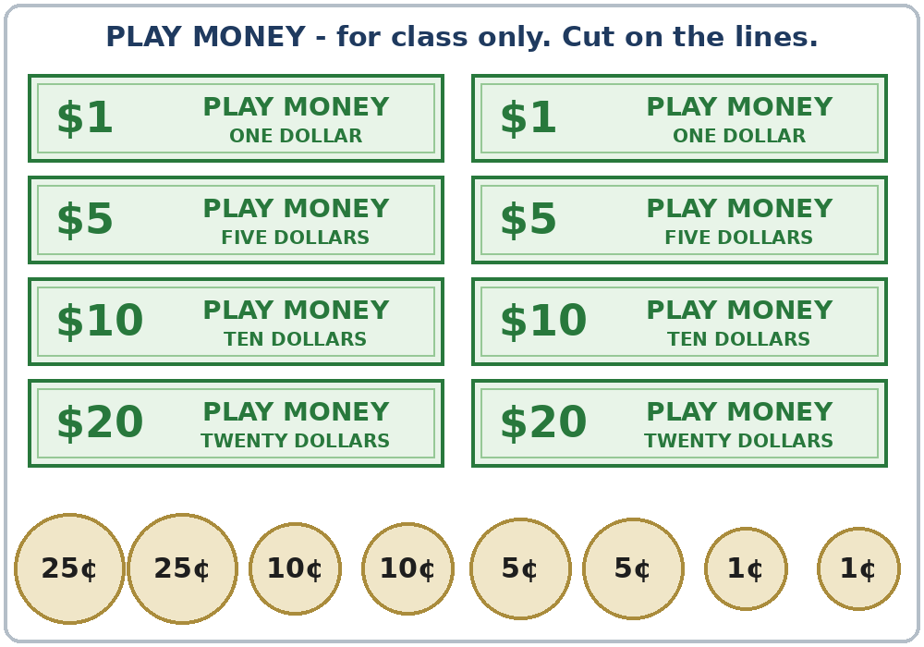
Talk Time
Store Role Play
A = cashier. B = shopper.
Don't show your page.
7:00–7:10
1
B asks:
How much is this red dress?
2
A answers:
It's $25.
3
B pays: Here's $30.
A: Your change is $5.
Notes:
A–B pairs. Give half the class the Student A page and half the Student B page, and each pair one envelope of play money. Partners don't show their pages.
Model with one learner (you are the shopper): point to the dress. "How much is this red dress?" "It's $25." "OK. Here's $30." "Your change is $5." Write the price and the change on the board.
Click to show each step. Part 1 (4 min): A is the cashier (Store 1, with prices). B is the shopper: B gets the play money, asks the price of the 3 things, writes the prices, buys one thing, pays, and checks the change.
Answer key, Store 1: red dress $25, black pants $18, white shoes $35.
With an odd number, two Bs share one A (one is the shopper, one helps count the money). Learners who can't read or write yet are good cashiers: they say the price from the tag and count the play money.
Play money only, never real money.
Source: level1_curriculum/lesson7/Level1_Lesson7.md (Step 5: Talk Time; Student Pages: Talk Time A and B, Play Money; Answer key).
Pictures: drawn in code for this curriculum, no outside source (see lesson7/images/CREDITS.md). The play money is marked PLAY MONEY and does not copy any real bill or coin.

Slide 16
TALK TIME · PART 2
Then say:
Here's $___.
My change is $___.
Fast pairs: buy 2 things.
Say the total: That's $43.
Check: Are the prices the same?
Store 2: Switch
A is the shopper.
B is the cashier.
A: How much is this green jacket?
B: It's $40.
Notes:
Part 2 (4 min): switch. B is the cashier (Store 2). A is the shopper.
Model it: "How much is this green jacket?" Click: "It's $40."
A asks the prices, writes them, buys one thing, pays, and checks the change: "Here's $___. My change is $___."
Answer key, Store 2: green jacket $40, yellow shirt $9, blue pants $22.
Check (2 min): partners show their pages. Are the prices the same?
Fast pairs: buy 2 things and say the total: "That's $43." Strong learners can add: "Do you have this in ___?" New learners use only "How much is this?" and point.
If behind: one round only (Part 1). Collect the play money at the end.
Source: level1_curriculum/lesson7/Level1_Lesson7.md (Step 5: Talk Time, Part 2, Check, Fast pairs; Answer key; Teacher notes).

Slide 17
Before You Go 7:10–7:15
01
Exit ticket
02
Homework
Ask:
How much is this ___?
How much are these ___?
Or write:
a red dress
1. Write is or are.
2. Put the words in order.
3. Write 3 price tags.
4. Say prices at home.
5. Class day and time.
Bring it next week!
Notes:
Exit ticket (never skip): hold up a picture or a real item. Each learner asks "How much is this ___?" / "How much are these ___?" or writes one color + noun (a red dress). Copying is fine.
Homework (10 minutes): open the Homework page. Do item 1 together (the first line). Point to each instruction.
Homework: 1) write is or are; 2) put the words in order; 3) look at 3 price tags in a store (or in an ad) and write them; 4) say the prices to a family member or a friend: "It's four ninety-nine."; 5) review: English class is on ___, at ___.
Homework answers: item 1: 1 is, 2 are, 3 are, 4 is. Item 2: 1 a green jacket, 2 black shoes, 3 a white dress.
Collect the play money for next time.
Source: level1_curriculum/lesson7/Level1_Lesson7.md (Step 6: Exit Ticket + Homework; Student Pages: Homework; Answer key).
Pictures: Twemoji graphics by Twitter, Inc. and other contributors (https://github.com/jdecked/twemoji), CC BY 4.0 (https://creativecommons.org/licenses/by/4.0/); resized, recolored, and combined with drawn parts (see lesson7/images/CREDITS.md).

Slide 18
Letters & Numbers · Task A
Say the Prices
$4.99
four ninety-nine
The dot is a period.
After the dot: cents.
WRITE
SAY
$4.99
four ninety-nine
$12.50
twelve fifty
$20.00
twenty dollars
$0.25 (25¢)
twenty-five cents
Notes:
Letters & Numbers (10 min). Whole class, then pairs. Use the Letters & Numbers page.
Task A, see it (2 min): point to each price and say it. Learners repeat. Click to show each way to say it.
$4.99 = "four ninety-nine"; $12.50 = "twelve fifty"; $20.00 = "twenty dollars"; $0.25 = "twenty-five cents". People don't say the word dollars or cents in $4.99.
The dot is a period; the numbers after it are cents.
Partners: A says a price from Task A, B points to it. Switch.
Learners who can't read or write yet: they say the prices with everyone and point.
Source: level1_curriculum/lesson7/Level1_Lesson7.md (Letters & Numbers, Task A; Teacher notes: Saying prices).

Slide 19
Listen. Circle the price.
The teacher says it 2 times.
Circle the Price
1
$4.99 $9.49
$4.99
2
$13 $30
$13
Listen: 2 times.
Pairs: A says a price.
B points to it.
3
$15.50 $50.15
$15.50
4
$16 $60
$60
5
$2.25 $2.52
$2.25
Notes:
Task B, hear it (2 min). Say each price 2 times: 1 $4.99 ("four ninety-nine"), 2 $13 ("thirteen dollars"), 3 $15.50 ("fifteen fifty"), 4 $60 ("sixty dollars"), 5 $2.25 ("two twenty-five"). Learners circle.
Then click to show each answer.
-teen / -ty matter again: $13 or $30? Say "thir-TEEN" and "THIR-ty" with a clap.
If behind: do Tasks A and B only.
Source: level1_curriculum/lesson7/Level1_Lesson7.md (Letters & Numbers, Task B; Answer key, Letters & Numbers Task B; Teacher notes).

Slide 20
Letters & Numbers · Task C
this or these?
short i (like six)
i
short
this shirt
it is · six
long ee (like three)
ee
long
these shoes
they're green · three
Notes:
Task C, say it (2 min): this has a short i (like six); these has a long ee (like three). Smile wide for ee.
Click to show each group. Say the pairs; learners repeat: this shirt / these shoes, it is / they're green, six / three.
Many learners say this and these the same. Don't over-correct; the grammar (is / are) helps listeners understand.
Source: level1_curriculum/lesson7/Level1_Lesson7.md (Letters & Numbers, Task C; Teacher notes).
Pictures: Twemoji graphics by Twitter, Inc. and other contributors (https://github.com/jdecked/twemoji), CC BY 4.0 (https://creativecommons.org/licenses/by/4.0/); resized, recolored, and combined with drawn parts (see lesson7/images/CREDITS.md).

Slide 21
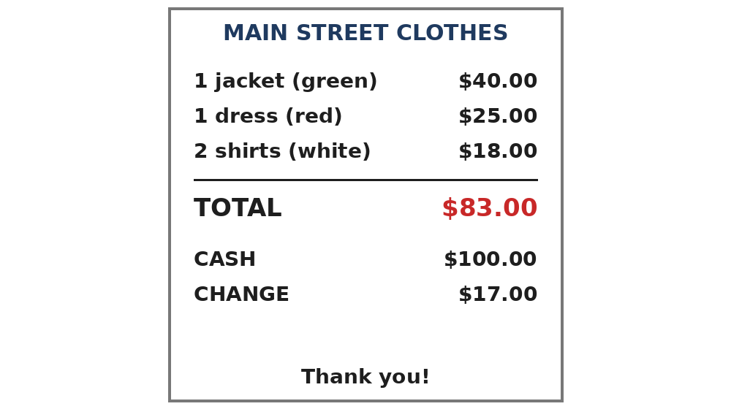
Read the Receipt
1
The jacket is $___.
$40.00
2
The total is $___.
$83.00
3
The change is $___.
$17.00
Read. Write the price.
Find the TOTAL.
Notes:
Task D, read it (3 min): read the receipt together. Learners answer the 3 questions.
Then click to show each answer: 1 $40.00, 2 $83.00, 3 $17.00.
Learners who can't read or write yet: they find and circle the TOTAL. A helper, if you have one, sits with them.
If behind: do Tasks A and B only (skip this slide).
Source: level1_curriculum/lesson7/Level1_Lesson7.md (Letters & Numbers, Task D; Answer key, Letters & Numbers Task D).
Pictures: drawn in code for this curriculum, no outside source (see lesson7/images/CREDITS.md). The store name and prices are invented.

Slide 22
Progress Check 7:25
D. I can…
😀 🙂 😐
Check one face.
B. Match the question
Answer
1. How much is this shirt?
c. It's $12.
2. How much are these shoes?
a. They're $30.
3. Cash or credit card?
d. Cash, please.
4. What color is the shirt?
b. It's blue.
Notes:
Progress Check (5 min). Individuals. Open the Progress Check page.
Part A: read the 5 prices slowly, 2 times each: 1 $12, 2 $40, 3 $5.99 ("five ninety-nine"), 4 $18, 5 $70. Learners circle.
Parts B and C: learners match and write on their own. Help with the instructions only. Click to show the Part B answers when you check together: 1 c, 2 a, 3 d, 4 b.
Part C answers: 1 are, 2 is, 3 a red dress.
Part D: read each "I can…" line and point to the 3 faces: 😀 "I can do it." 🙂 "A little." 😐 "Not yet." Learners check one.
Score: A /5 + B /4 + C /3 = /12. This is not a test grade. Part A shows who can hear prices (and -teen / -ty); Part C shows is / are and color + noun. Collect the pages.
Week 8 is the midterm. If behind: do the Progress Check in Week 8 at 6:00, before the midterm.
Source: level1_curriculum/lesson7/Level1_Lesson7.md (Progress Check; Answer key).

Slide 23
Great Work! See You Next Week!
Now you can:
• Ask: How much is this shirt?
• Say: a blue shirt, black shoes.
• Pay: Cash, please. Here's $20.
Lesson 7 · Level 1
Notes:
Say: "Great work! See you next week!" Remind learners: bring the homework next week.
Collect the Progress Check pages and the play money.
Looking ahead: Week 8 is the midterm (Lessons 1–7). Lesson 8 (food) uses How much is…? again and adds I like… / I don't like….
Source: level1_curriculum/lesson7/Level1_Lesson7.md (Teacher notes: Looking ahead; At a glance: Objectives).
Pictures: Twemoji graphics by Twitter, Inc. and other contributors (https://github.com/jdecked/twemoji), CC BY 4.0 (https://creativecommons.org/licenses/by/4.0/); resized, recolored, and combined with drawn parts (see lesson7/images/CREDITS.md).

Slide 24
Credits
Pictures
Pictures use Twemoji graphics by Twitter, Inc. and other contributors (https://github.com/jdecked/twemoji), licensed under CC BY 4.0 (https://creativecommons.org/licenses/by/4.0/). The graphics were resized and combined, the clothes were recolored to match the color words, and price tags, color swatches, near / far labels, and other labels were added. The receipts and the play-money page are drawn in code; the play money is marked PLAY MONEY and does not copy any real bill or coin. Labels on the pictures use the DejaVu Sans font. The review picture (the clock) is from Lesson 6.
Other small pictures (the faces on the Progress Check) are standard emoji characters shown with the computer's emoji font.
Names
All names, prices, and stores on the slides (Ana, the clothing store, Store 1, Store 2) are invented.
Audio and font
Audio: synthetic voices (Narrator, Cashier, Ana) made with Chatterbox TTS (Resemble AI, MIT License), copied from short reference clips made with Kokoro-82M (Apache 2.0); no recordings of real people were used. Each file carries an inaudible Perth watermark. Font: Lexend Deca (OFL 1.1).
© 2026 the authors. The authors license this deck under CC BY-NC-SA 4.0.
Notes:
Credits for the pictures, audio, and font.
Pictures: Twemoji (CC BY 4.0), https://github.com/jdecked/twemoji; clothes recolored. Receipts, color swatches, price tags, and the play money drawn in code. Review picture (clock) from Lesson 6. Audio: Chatterbox TTS (MIT) voices copied from short Kokoro-82M (Apache 2.0) reference clips; no recordings of real people.
Sources: Level1_Lesson7.md (Picture Credits), lesson7/images/CREDITS.md.

