Slide 1
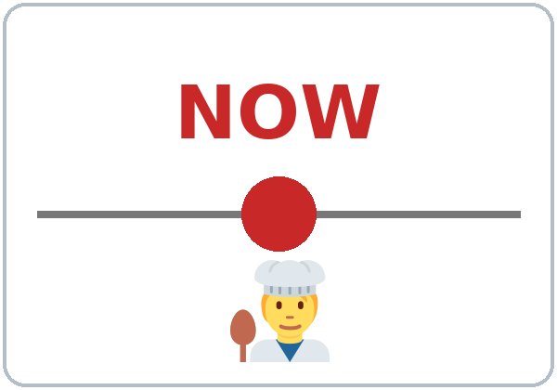
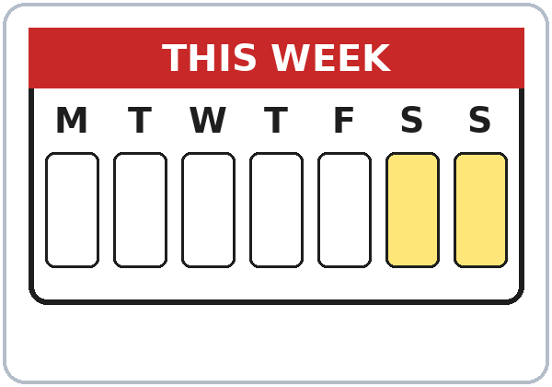
Making Plans
Today you will:
• Talk about plans: going to
• Say fixed plans: I'm working…
• Invite: Would you like to…?
• Say yes or no politely
Lesson 11 (Week 12)
Notes:
Welcome back. Read the goals together; learners repeat.
Objectives: talk about future plans with be going to; use the present continuous for fixed plans (I'm working on Saturday); invite with Would you like to…? / Do you want to…?; accept or decline politely with a reason.
Source: Level2_Curriculum_v5_public.md, Lesson 11 (At a glance).
Picture: Twemoji graphics by Twitter, Inc. and other contributors (https://github.com/jdecked/twemoji), CC BY 4.0 (https://creativecommons.org/licenses/by/4.0/); resized and combined.

Slide 2
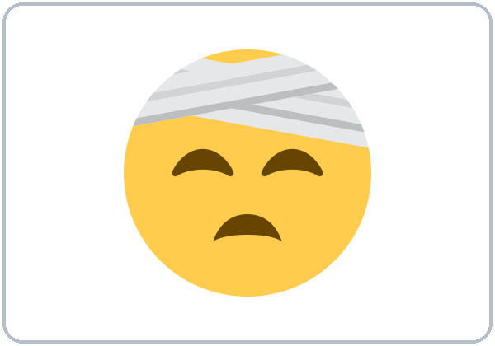
OPENING TALK · 6:00
Warm-Up
A acts a problem.
B gives advice.
What's the matter?
You should …
Notes:
Step 1 · 6:00–6:10 · Opening Talk + Homework Check. Pairs (same partner for both parts).
Minutes 0–5 (review Lesson 10): A acts a health problem; B asks What's the matter? and gives advice with should. Switch. Each click shows one prompt.
Source: Level2_Curriculum_v5_public.md, Lesson 11 (Step 1).
Picture: Twemoji graphics by Twitter, Inc. and other contributors (https://github.com/jdecked/twemoji), CC BY 4.0 (https://creativecommons.org/licenses/by/4.0/); resized and combined.

Slide 3
Homework
Check
HW
Homework check
Read your appointment call.
1
I have ___ cold.
a
should + verb:
no to, no -s.
2
You should ___. (rest)
rest
3
My feet ___. (hurt)
hurt
4
You ___ go to work.
shouldn't
Notes:
Step 1, minutes 5–10: partners read their homework appointment call as a role play.
Each click shows one answer. The lines review Lesson 10 (Grammar Boxes 1–3; Common mistakes).
Teacher: write 2 corrected sentences on the board (often should to). If behind: collect the homework.
Source: Level2_Curriculum_v5_public.md, Lesson 11 (Step 1); Lesson 10 Homework.

Slide 4
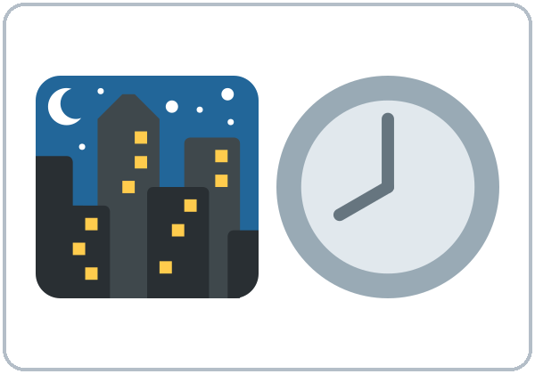
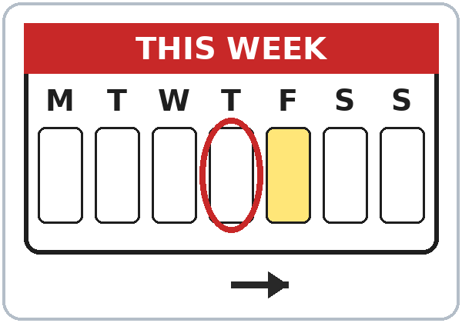
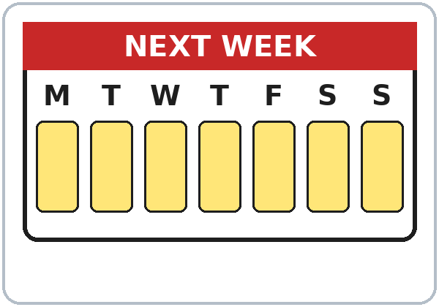

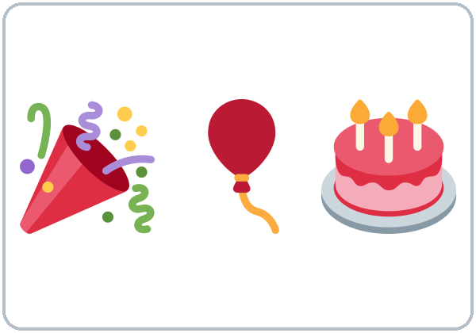
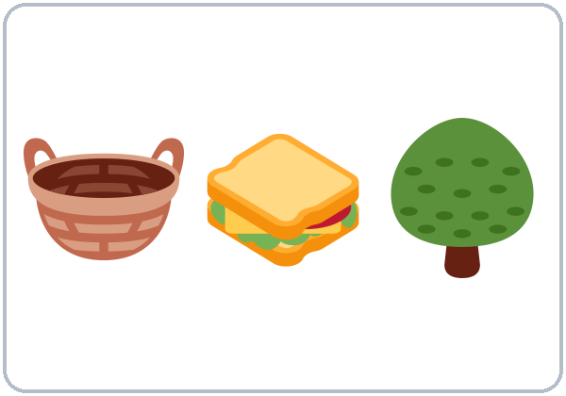
When?
Now → next
New Words
tonight
tomorrow
this weekend
next week
go to
the movies
have a party
have a picnic
Notes:
Step 2 · 6:10–6:18 · New Words (pairs). Point, say, repeat twice. Each click shows one word.
Star words here: tonight, tomorrow, this weekend, next week, have a party.
"When?": draw a line on the board: now → tonight → tomorrow → this weekend → next week. Learners say an activity for each time.
If behind: teach the star words only.
Source: Level2_Curriculum_v5_public.md, Lesson 11 (Step 2; Student Page 11 New Words).
Picture: Twemoji graphics by Twitter, Inc. and other contributors (https://github.com/jdecked/twemoji), CC BY 4.0 (https://creativecommons.org/licenses/by/4.0/); resized and combined.

Slide 5


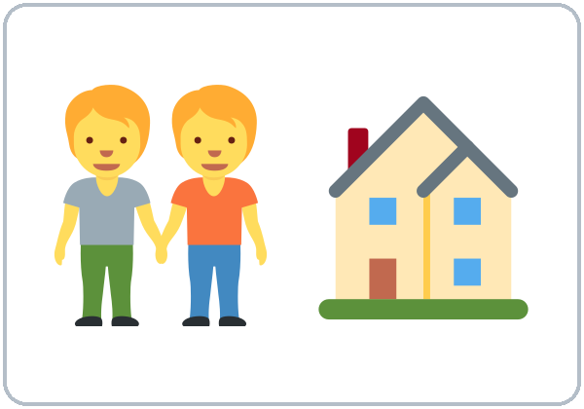



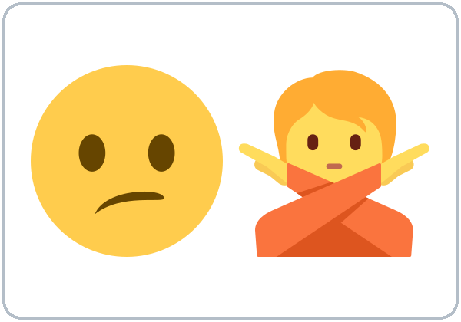
I'd love to!
Sorry, I can't.
More New Words
go to
the beach
watch a game
visit friends
invite
free
(not busy)
I'd love to!
Sorry, I can't.
Notes:
New Words, part 2. Each click shows one word. Star words here: invite, free (not busy), Sorry, I can't.
Learners can decline any real invitation in class. Practice invitations are always "pretend."
Source: Level2_Curriculum_v5_public.md, Lesson 11 (Step 2; Student Page 11; Teacher notes).
Picture: Twemoji graphics by Twitter, Inc. and other contributors (https://github.com/jdecked/twemoji), CC BY 4.0 (https://creativecommons.org/licenses/by/4.0/); resized and combined.

Slide 6
Kim is going to have ...
Listening A
01
a party
a picnic
a dinner
Listen. Circle the answer.
The picnic is on ...
02
Friday
Saturday
Sunday
It starts at ...
03
2:00
4:00
12:00
Carlos is going to bring ...
04
a salad
a cake
a ball
Notes:
Step 3 · 6:18–6:30 · Listening + "Say it" (L11_listening.mp3, about 1:30). Audio: L11_listening.mp3 (about 1:30). The audio plays once, play again if needed. Audio coming soon: until it is ready, read the script with a volunteer learner.
Before you listen: "Kim calls Carlos. She invites him. Does he say yes?" Take 2 guesses.
Listen 1 → Task A (circle). Each click circles one answer.
Answer key: 1 a picnic; 2 Saturday; 3 2:00; 4 a ball.
Source: Level2_Curriculum_v5_public.md, Lesson 11 (Step 3; Answer key).
Picture: Twemoji graphics by Twitter, Inc. and other contributors (https://github.com/jdecked/twemoji), CC BY 4.0 (https://creativecommons.org/licenses/by/4.0/); resized and combined.

Slide 7
Listen again.
True or False?
Listening B
1. The picnic is at Lake Park.
True
False
2. Carlos is free on Saturday morning.
True
False
He's working.
3. Rosa is going to come to the picnic.
True
False
She's visiting her mother.
4. Kim invites Carlos to the movies.
True
False
5. Carlos is free on Sunday.
True
False
He's helping his brother.
Notes:
Listen 2 → Task B (true / false). Each click circles one answer and shows the correction. The audio plays once, play again if needed.
Answer key: 1 T; 2 F (he's working in the morning); 3 F (she's going to visit her mother); 4 T; 5 F (he's helping his brother).
Source: Level2_Curriculum_v5_public.md, Lesson 11 (Step 3; Answer key).

Slide 8
Listening C
C
Listen again.
Write the missing word.
1
We're ____ to have a picnic.
going
Yes: I'd love to!
No: Sorry, I can't. + a reason
2
I'd ____ to! What time?
love
3
Sorry, I ____.
can't
4
I'm ____ my brother on Sunday.
helping
Notes:
Listen 3 → Task C (fill in). Each click fills one blank. The audio plays once, play again if needed.
Answer key: going; love; can't; helping.
"Say it" (1–2 min): the class repeats "Would you like to come?" and "I'd love to!" / "Sorry, I can't."
If behind: skip the third play; do Task C together.
Source: Level2_Curriculum_v5_public.md, Lesson 11 (Step 3; Answer key).

Slide 9
What are you
Answers
going to do?
I'm going to visit friends.
She's going to rest.
Plans: am / is / are.
They're going to watch a game.
What
are
you going to do?
What
is
she going to do?
+ going to + verb
What
are
they going to do?
Notes:
Step 4 · 6:30–6:45 · Grammar: going to + invitations. Say: "For plans: am / is / are + going to + verb. I'm going to visit my mother. For fixed plans with a time, we also say I'm working on Saturday."
Grammar Box 1: each click highlights are / is / are. Add a time: tonight? this weekend? tomorrow?
Q: How do I make going to? am / is / are + going to + base verb: I'm going to visit my mother. She's going to rest.
Source: Level2_Curriculum_v5_public.md, Lesson 11 (Step 4; Grammar Box 1; Questions and answers).
Picture: Twemoji graphics by Twitter, Inc. and other contributors (https://github.com/jdecked/twemoji), CC BY 4.0 (https://creativecommons.org/licenses/by/4.0/); resized and combined.

Slide 10
Grammar Box 2
Are you going to ...?
QUESTION
ANSWER
Are
you going to work tomorrow?
Yes, I am.
No, I'm not.
Is
she going to come?
Yes, she is.
No, she isn't.
Are
they going to call?
Yes, they are.
No, they aren't.
Notes:
Grammar Box 2: Are you going to…? Each click highlights Are / Is and its answers.
More from the box: Are you going to cook tonight? Is he going to call?
Source: Level2_Curriculum_v5_public.md, Lesson 11 (Grammar Box 2).
Picture: Twemoji graphics by Twitter, Inc. and other contributors (https://github.com/jdecked/twemoji), CC BY 4.0 (https://creativecommons.org/licenses/by/4.0/); resized and combined.

Slide 11
Grammar Box 3 · Invitations
Would You
Like to ...?
INVITE
ACCEPT / DECLINE
Would you like to come?
I'd love to!
What time?
Do you want to go out?
Sorry, I can't.
I'm working.
Notes:
Grammar Box 3: Invitations. Click 1 and click 2 highlight one pair each.
Say: "Would you like to…? (polite) / Do you want to…? (friendly). Accept: I'd love to! / Sure! Decline: Sorry, I can't. + a reason."
More from the box: Would you like to go to the movies / have a picnic / watch a game on Saturday? Do you want to visit friends / have dinner tonight? Sorry, I can't. I'm visiting my mother.
Q: How do I say no politely? Sorry, I can't. + a reason. Maybe add Thanks for asking!
Source: Level2_Curriculum_v5_public.md, Lesson 11 (Grammar Box 3; Questions and answers).
Picture: Twemoji graphics by Twitter, Inc. and other contributors (https://github.com/jdecked/twemoji), CC BY 4.0 (https://creativecommons.org/licenses/by/4.0/); resized and combined.

Slide 12
Common Mistakes
Don't say
Say
I going to work.
I'm going to work.
I go to visit my mother tomorrow.
I'm going to visit my mother tomorrow.
She is going to visits.
She is going to visit.
Notes:
Common mistakes (part 1). Each click shows the correct sentence.
Plans need three parts: am / is / are + going to + verb. Write the correct form on the board. Learners can read the note on their Grammar page; you don't need to explain it.
Source: Level2_Curriculum_v5_public.md, Lesson 11 (Common mistakes; Teacher notes).
Picture: Twemoji graphics by Twitter, Inc. and other contributors (https://github.com/jdecked/twemoji), CC BY 4.0 (https://creativecommons.org/licenses/by/4.0/); resized and combined.

Slide 13
Fix These Mistakes
Don't say
Say
Would you like come?
Would you like to come?
No, I can't.
Sorry, I can't. I'm working.
Are you free in Saturday?
Are you free on Saturday?
Notes:
Common mistakes (part 2). Each click shows the correct sentence.
No, I can't. is too short. Add Sorry and a reason.
Source: Level2_Curriculum_v5_public.md, Lesson 11 (Common mistakes).
Picture: Twemoji graphics by Twitter, Inc. and other contributors (https://github.com/jdecked/twemoji), CC BY 4.0 (https://creativecommons.org/licenses/by/4.0/); resized and combined.

Slide 14
Quick Check
Plans and invitations
1
2
3
She ___ going to cook.
Is "I going to work" OK?
Would you like ___? (come)
is
No: I'm going to
to come
Notes:
Step 4 check questions. Learners answer; each click shows one answer.
Answers: is · No: I'm going to work · to come.
Short "Yes / No / Reason" (last 5 min): A invites; B accepts or declines with a reason. If behind: skip it.
Source: Level2_Curriculum_v5_public.md, Lesson 11 (Step 4 Check).

Slide 15
Grammar Box 4 · Fixed plans
What Are You Doing?
What are you doing?
Sat
I'm working
on Saturday.
And on Sunday?
Sun
I'm helping
my brother.
Notes:
Grammar Box 4: Fixed plans (present continuous). Click 1 and click 2 show one row each.
Q: going to or -ing for the future? Both are OK for plans. -ing is common for fixed plans with a time: I'm working on Saturday.
Pronunciation (If time ①): going to → "gonna" in fast speech. Learners recognize it; in writing, use going to.
Teacher note: will is not taught here. If learners use it for offers (I'll bring a salad), accept it.
Source: Level2_Curriculum_v5_public.md, Lesson 11 (Grammar Box 4; Questions and answers; Teacher notes).
Picture: Twemoji graphics by Twitter, Inc. and other contributors (https://github.com/jdecked/twemoji), CC BY 4.0 (https://creativecommons.org/licenses/by/4.0/); resized and combined.

Slide 16
Talk Time
Weekend Planner
Accept or decline with a reason.
7:00–7:10
1
Write 2 plans.
Leave other times free.
2
Invite classmates.
Would you like to …?
3
Write the plan + name.
On Sunday I'm going to …
Notes:
Step 5 · 7:00–7:10 · Talk Time: Weekend Planner Mingle. Mingle: everyone. Each click shows one step.
Do (2 min): learners write 2 plans in their planner and leave the other times free.
Mingle (6 min): invite classmates to fill free times: Are you free on Saturday afternoon? Would you like to have a picnic? Accept or decline with a reason. Write the plan + name.
Report (2 min): "On Sunday I'm going to watch a game with Marco." If behind: skip the report.
Source: Level2_Curriculum_v5_public.md, Lesson 11 (Step 5).
Picture: Twemoji graphics by Twitter, Inc. and other contributors (https://github.com/jdecked/twemoji), CC BY 4.0 (https://creativecommons.org/licenses/by/4.0/); resized and combined.

Slide 17
Before You Go
01
Exit ticket
02
Homework
Write one going to
sentence about this
weekend. Write one
invitation.
Write 5 plans with
going to. Write an
invitation text and
two answers: one yes,
one no + a reason.
Notes:
Step 6 · 7:10–7:15 · Exit Ticket + Homework. NEVER SKIP.
Exit ticket: one going to sentence about this weekend and one invitation.
Homework (10 minutes): 1. Write 5 plans for this weekend or next week with going to. 2. Write an invitation text message to a friend and two answers: one yes, one no with a reason. 3. Bonus: ask a family member: What are you going to do this weekend? Write the answer.
Source: Level2_Curriculum_v5_public.md, Lesson 11 (Step 6; Student Page 11 Homework).
Picture: Twemoji graphics by Twitter, Inc. and other contributors (https://github.com/jdecked/twemoji), CC BY 4.0 (https://creativecommons.org/licenses/by/4.0/); resized and combined.

Slide 18
Credits
Pictures
Vocabulary pictures use Twemoji graphics by Twitter, Inc. and other contributors (https://github.com/jdecked/twemoji), licensed under CC BY 4.0 (https://creativecommons.org/licenses/by/4.0/). The graphics were resized and combined, and arrows, calendars, clocks, and labels were added.
This deck
© 2026 the authors. The authors license this deck under CC BY-NC-SA 4.0.
Audio and font
Audio: Chatterbox TTS (Resemble AI, MIT); AI voices with a Perth watermark. Font: Lexend Deca (OFL 1.1). Provided as-is, without warranty.
Notes:
Credits. Lesson content: Level 2 Adult ESL Curriculum v5, public edition, Lesson 11.
Image credit line copied exactly from images/CREDITS.md. Deck notice: © 2026 the authors; the authors license this deck under CC BY-NC-SA 4.0 (Section 7.2).
Audio and font credits: Chatterbox TTS (Resemble AI, MIT; Perth watermark), Lexend Deca (SIL OFL 1.1).

