Slide 1

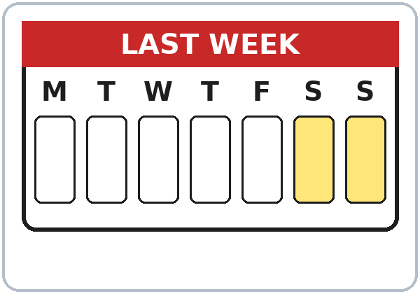
Last Weekend
Today you will:
• Ask: How was your weekend?
• Use was / were
• Tell about last weekend (-ed)
• Say -ed three ways
Lesson 5 (Week 5)
Notes:
Welcome back. Read the goals together; learners repeat.
Objectives: ask and answer How was…? / Was it…? / Were you…?; use was / were / wasn't / weren't; tell about last weekend with 8 or more regular past verbs (-ed); pronounce the three -ed endings /t/ /d/ /ɪd/.
Source: Level2_Curriculum_v5_public.md, Lesson 5 (At a glance).
Picture: Twemoji graphics by Twitter, Inc. and other contributors (https://github.com/jdecked/twemoji), CC BY 4.0 (https://creativecommons.org/licenses/by/4.0/); resized and combined.

Slide 2
OPENING TALK · 6:00
Warm-Up
Same partner.
Review Lesson 4.
What are you doing right now?
What is your family doing at 8 PM?
Notes:
Step 1 · 6:00–6:10 · Opening Talk + Homework Check. Pairs (same partner for both parts). Late arrivals join a pair.
Minutes 0–5: these questions review Lesson 4. Each click shows one question.
Source: Level2_Curriculum_v5_public.md, Lesson 5 (Step 1).
Picture: Twemoji graphics by Twitter, Inc. and other contributors (https://github.com/jdecked/twemoji), CC BY 4.0 (https://creativecommons.org/licenses/by/4.0/); resized and combined.

Slide 3
Homework
Check
HW
Homework check
Read your 3 photos in words.
1
I ____ cooking now.
am
Listen for am / is / are
+ verb -ing.
2
He ____ watching TV.
is
3
They ____ eating.
are
4
Dad is ____. (work)
working
Notes:
Step 1, minutes 5–10: partners read their 3 homework "photos in words." The listener checks for am / is / are + -ing.
Each click shows one answer. The lines review Lesson 4 (homework model and Grammar Box 1).
Teacher: walk around; write only 2 corrected sentences on the board. If behind: collect the homework; return it next week with one correction each.
Source: Level2_Curriculum_v5_public.md, Lesson 5 (Step 1); Lesson 4 Homework.

Slide 4
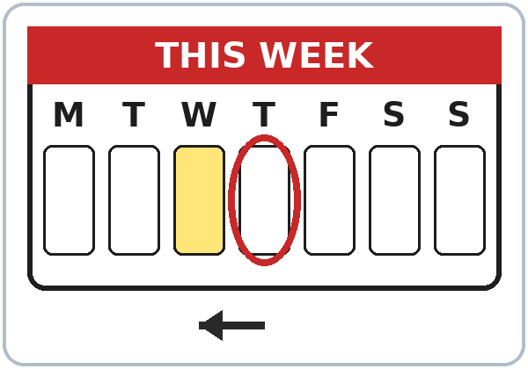
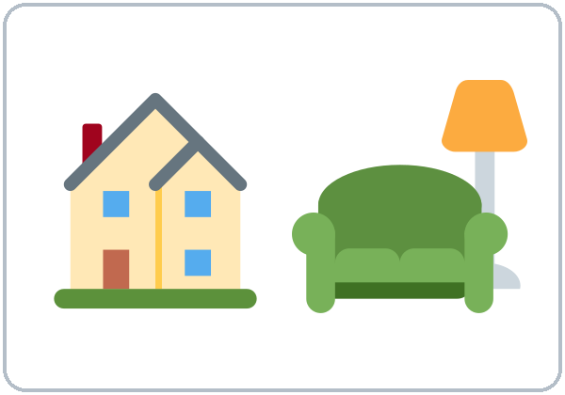
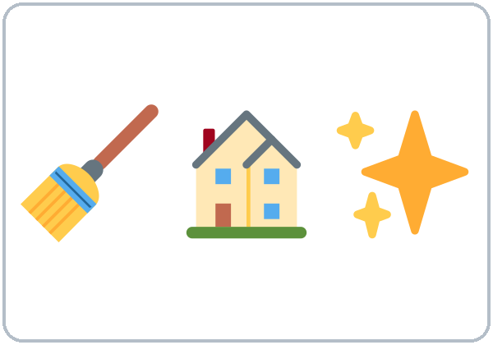
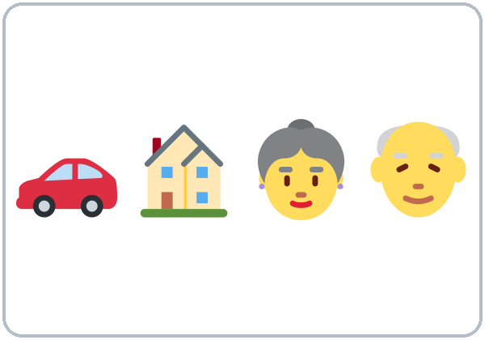


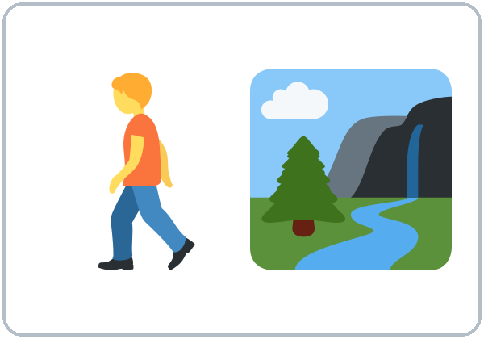
Yesterday or
every day?
New Words
last weekend
yesterday
stayed home
cleaned
the house
visited family
watched
a movie
cooked
walked
(in the park)
Notes:
Step 2 · 6:10–6:18 · New Words (pairs). Point, say, repeat twice. Stress that the words are past: Yesterday I cleaned. Each click shows one word.
Star words here: last weekend, yesterday, stayed home, cleaned the house, visited family, watched a movie.
Yesterday or every day? Say a sentence (I cleaned the house. / I clean the house.). Learners point behind them (past) or down (every day).
If behind: teach the star words only.
Source: Level2_Curriculum_v5_public.md, Lesson 5 (Step 2; Student Page 5 New Words).
Picture: Twemoji graphics by Twitter, Inc. and other contributors (https://github.com/jdecked/twemoji), CC BY 4.0 (https://creativecommons.org/licenses/by/4.0/); resized and combined.

Slide 5
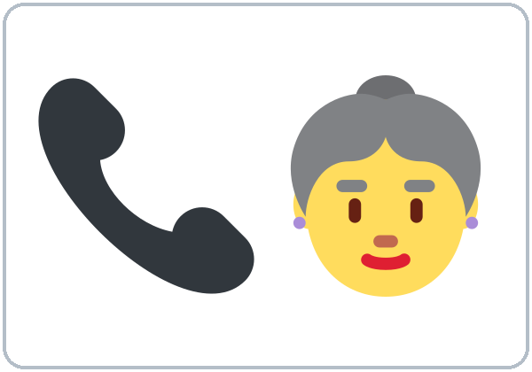

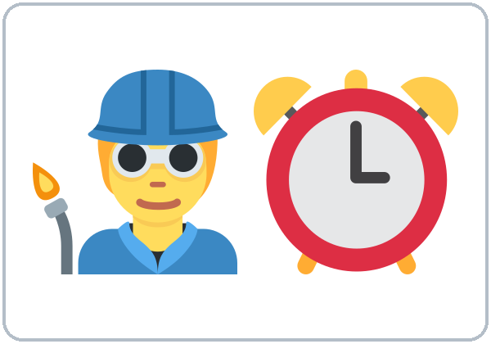
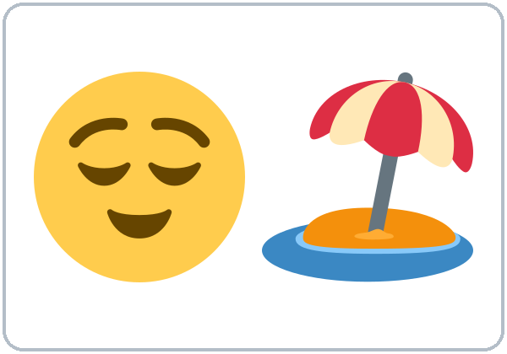


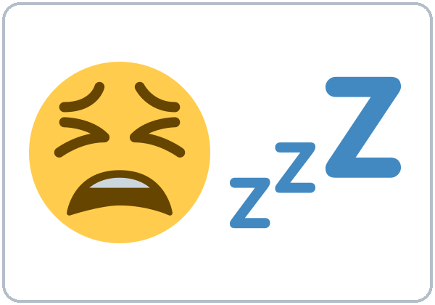
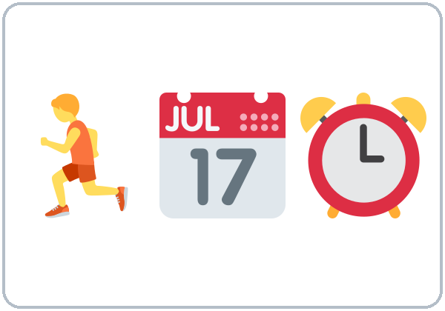
Point behind
you: past!
More New Words
called
(my mom)
listened
to music
worked
relaxed
fun
boring
tired
busy
Notes:
New Words, part 2. Each click shows one word. Star words here: worked, tired.
fun / boring describe the weekend or the movie: It was boring. tired / busy describe the person: I was tired.
Source: Level2_Curriculum_v5_public.md, Lesson 5 (Step 2; Student Page 5).
Picture: Twemoji graphics by Twitter, Inc. and other contributors (https://github.com/jdecked/twemoji), CC BY 4.0 (https://creativecommons.org/licenses/by/4.0/); resized and combined.

Slide 6
Listen. Who did it?
Circle the name.
Listening A
1. visited his sister
Marco
Kim
2. worked all day
Marco
Kim
3. played soccer
Marco
Kim
4. cleaned the house
Marco
Kim
5. watched a movie
Marco
Kim
6. cooked a big lunch
Marco
Kim
Notes:
Step 3 · 6:18–6:30 · Listening + "Say it" (L5_listening.mp3, about 1:30). Audio: L5_listening.mp3 (about 1:30). The audio plays once, play again if needed. Audio coming soon: until it is ready, read the script with a volunteer learner.
Before you listen: "It's Monday. Kim and Marco talk about the weekend. Who had a good weekend?" Take 2 guesses.
Listen 1 → Task A (who did it?). On the Student Page learners check ✓ Marco or Kim. Each click circles one answer.
Answer key: visited his sister = Marco; worked all day = Kim; played soccer = Marco; cleaned the house = Kim; watched a movie = Kim; cooked a big lunch = Marco.
Source: Level2_Curriculum_v5_public.md, Lesson 5 (Step 3; Answer key).
Picture: Twemoji graphics by Twitter, Inc. and other contributors (https://github.com/jdecked/twemoji), CC BY 4.0 (https://creativecommons.org/licenses/by/4.0/); resized and combined.

Slide 7
Marco's weekend was ...
Listening B
01
great
boring
terrible
Listen again. Circle.
Kim's weekend was ...
02
fun
boring
great
Kim's movie was ...
03
good
funny
terrible
She stopped it after ...
04
10
20
30 minutes
Notes:
Listen 2 → Task B (circle). Each click circles one answer. The audio plays once, play again if needed.
Answer key: 1 great; 2 boring; 3 terrible; 4 20 minutes.
Source: Level2_Curriculum_v5_public.md, Lesson 5 (Step 3; Answer key).
Picture: Twemoji graphics by Twitter, Inc. and other contributors (https://github.com/jdecked/twemoji), CC BY 4.0 (https://creativecommons.org/licenses/by/4.0/); resized and combined.

Slide 8
Listening C
C
Listen again.
Write the missing word.
1
It ____ great, thanks.
was
Kim says I cleaned the house.
Today or before?
2
We ____ a big lunch together.
cooked
3
____ you tired this morning?
Were
4
On Sunday, I ____ the house.
cleaned
Notes:
Listen 3 → Task C (fill in). Each click fills one blank. The audio plays once, play again if needed.
Answer key: was; cooked; Were; cleaned.
Ask: "Kim says I cleaned the house. Is that today or before?" (before = past)
"Say it" (1–2 min): the class repeats "How was your weekend?" and "It was great!"
If behind: skip the third play; do Task C together (teacher reads the 4 lines).
Source: Level2_Curriculum_v5_public.md, Lesson 5 (Step 3; Answer key).

Slide 9
Grammar Box 1
How was ...?
Was it ...?
QUESTION
ANSWER
How
was your weekend?
It was great.
It was boring.
Was
it fun?
Yes, it was.
No, it wasn't.
Notes:
Step 4 · 6:30–6:45 · Grammar: was / were + regular past. Say: "For the past, am and is become was. Are becomes were. Most other verbs add -ed, the same for everyone."
Grammar Box 1: read across the question side, then the answer side. Click 1 and click 2 highlight one row each.
More from the box: How was the party / the movie? Was the food good / expensive?
Source: Level2_Curriculum_v5_public.md, Lesson 5 (Step 4; Grammar Box 1).
Picture: Twemoji graphics by Twitter, Inc. and other contributors (https://github.com/jdecked/twemoji), CC BY 4.0 (https://creativecommons.org/licenses/by/4.0/); resized and combined.

Slide 10
Grammar Box 2
Were you ...?
QUESTION
ANSWER
Were
you busy?
Yes, I was.
No, I wasn't.
Was
she tired?
Yes, she was.
No, she wasn't.
Were
they at home?
Yes, they were.
No, they weren't.
Notes:
Grammar Box 2: Were you…? Each click highlights one helper and its answers: Were, Was, Were.
Q: When do I use was and were? They are the past of be. am / is → was. are → were. I'm tired today. → I was tired yesterday.
Q&A routine: a learner reads the Q → the class guesses → read the A → board example.
Source: Level2_Curriculum_v5_public.md, Lesson 5 (Grammar Box 2; Questions and answers).
Picture: Twemoji graphics by Twitter, Inc. and other contributors (https://github.com/jdecked/twemoji), CC BY 4.0 (https://creativecommons.org/licenses/by/4.0/); resized and combined.

Slide 11
What did
Answers
you do?
I cleaned the house.
She watched a movie.
Answer with -ed.
He visited family.
What
did
you do?
What
did
she do?
... last weekend?
What
did
he do?
Notes:
Grammar Box 3: What did you do? Each click highlights did. Add a time: … last weekend? / … on Saturday? / … yesterday?
Q: What does What did you do? mean? It asks about activities in the past. Answer with an -ed verb: I cleaned the house.
Teacher note: What did you do? is a fixed question today. Lesson 6 explains did fully. Don't teach it yet.
Q: Do I add -s for he or she in the past? No. The past is the same for everyone: I worked. She worked. They worked.
Source: Level2_Curriculum_v5_public.md, Lesson 5 (Grammar Box 3; Questions and answers; Teacher notes).
Picture: Twemoji graphics by Twitter, Inc. and other contributors (https://github.com/jdecked/twemoji), CC BY 4.0 (https://creativecommons.org/licenses/by/4.0/); resized and combined.

Slide 12
Common Mistakes
Don't say
Say
I was clean the house.
I cleaned the house.
She were tired.
She was tired.
We was busy.
We were busy.
Notes:
Common mistakes (part 1). Each click shows the correct sentence.
I was clean the house: was is not a past marker for other verbs. Write the correct form on the board. Learners can read the note on their Grammar page; you don't need to explain it.
Source: Level2_Curriculum_v5_public.md, Lesson 5 (Common mistakes; Teacher notes).
Picture: Twemoji graphics by Twitter, Inc. and other contributors (https://github.com/jdecked/twemoji), CC BY 4.0 (https://creativecommons.org/licenses/by/4.0/); resized and combined.

Slide 13
Fix These Mistakes
Don't say
Say
Yesterday I work.
Yesterday I worked.
I studyed.
I studied.
The movie was bored.
The movie was boring.
Notes:
Common mistakes (part 2). Each click shows the correct sentence.
Spelling: most verbs +ed; ends in e +d (dance → danced); consonant + y → -ied (study → studied); short verb: double (stop → stopped).
boring = the thing (the movie); bored = the person feels it.
Source: Level2_Curriculum_v5_public.md, Lesson 5 (Common mistakes; Questions and answers; Teacher notes).
Picture: Twemoji graphics by Twitter, Inc. and other contributors (https://github.com/jdecked/twemoji), CC BY 4.0 (https://creativecommons.org/licenses/by/4.0/); resized and combined.

Slide 14
Quick Check
was, were, or -ed?
1
2
3
She ___ tired.
They ___ at home.
Yesterday I ___ TV. (watch)
was
were
watched
Notes:
Step 4 check questions. Learners answer; each click shows one answer.
Answers: was · were · watched.
Short Weekend Chain (last 5 min): pairs take turns: On Saturday, I cleaned the house. / On Saturday, you cleaned the house, and I visited my sister… If behind: skip the Weekend Chain.
Source: Level2_Curriculum_v5_public.md, Lesson 5 (Step 4 Check).

Slide 15
Sentences · was and were
Was or Were?
I / He / She / It
was
I was busy.
I wasn't busy.
You / We / They
were
They were busy.
They weren't busy.
Notes:
Sentences with was and were. Click 1 and click 2 show one row each.
Pronunciation (If time ①): three -ed sounds. /t/ worked, walked, cooked; /d/ played, called, stayed; /ɪd/ visited, waited, needed. The extra syllable comes only after t or d. Hold up 1 finger for /t/, 2 for /d/, 3 for /ɪd/.
Source: Level2_Curriculum_v5_public.md, Lesson 5 (Sentences: was and were; If time).
Picture: Twemoji graphics by Twitter, Inc. and other contributors (https://github.com/jdecked/twemoji), CC BY 4.0 (https://creativecommons.org/licenses/by/4.0/); resized and combined.

Slide 16
Talk Time
Weekend Mingle
Then report to the class.
7:00–7:10
1
Talk to 5 people.
How was your weekend?
2
Ask: What did you do?
It was fun. I visited my family.
3
Write a name + activity.
Ana visited her family.
Notes:
Step 5 · 7:00–7:10 · Talk Time: Weekend Mingle. Mingle: talk to 5 people (15 learners) / everyone (7–8). Each click shows one step.
Model: "How was your weekend?" "It was fun. I visited my family. How about you?" Learners write each person's name and one activity in a box on the Weekend Mingle sheet.
Report (last 3 min): "Ana visited her family. Marco worked. Two people cleaned the house."
Privacy: learners can tell the truth or make it up. If behind: learners talk to 3 people; skip the report.
Source: Level2_Curriculum_v5_public.md, Lesson 5 (Step 5).
Picture: Twemoji graphics by Twitter, Inc. and other contributors (https://github.com/jdecked/twemoji), CC BY 4.0 (https://creativecommons.org/licenses/by/4.0/); resized and combined.

Slide 17
Before You Go
01
Exit ticket
02
Homework
Write 2 sentences
about yesterday:
one with was / were,
one with an -ed verb.
Write 6 sentences
about last weekend:
3 with was / were,
3 with -ed verbs.
Ask a friend: How
was your weekend?
Notes:
Step 6 · 7:10–7:15 · Exit Ticket + Homework. NEVER SKIP.
Exit ticket: one sentence with was or were and one sentence with an -ed verb about yesterday.
Homework (10 minutes): 1. Write 6 sentences about your last weekend: 3 with was / were and 3 with -ed verbs (On Saturday I was tired. I cleaned the house…). 2. Ask a family member or friend: How was your weekend? Write their answer in English. 3. Bonus: circle every -ed and say each one aloud. Explain it and do item 1 together.
Source: Level2_Curriculum_v5_public.md, Lesson 5 (Step 6; Student Page 5 Homework).
Picture: Twemoji graphics by Twitter, Inc. and other contributors (https://github.com/jdecked/twemoji), CC BY 4.0 (https://creativecommons.org/licenses/by/4.0/); resized and combined.

Slide 18
Credits
Pictures
Vocabulary pictures use Twemoji graphics by Twitter, Inc. and other contributors (https://github.com/jdecked/twemoji), licensed under CC BY 4.0 (https://creativecommons.org/licenses/by/4.0/). The graphics were resized and combined, and arrows, calendars, clocks, and labels were added.
This deck
© 2026 the authors. The authors license this deck under CC BY-NC-SA 4.0.
Audio and font
Audio: Chatterbox TTS (Resemble AI, MIT); AI voices with a Perth watermark. Font: Lexend Deca (OFL 1.1). Provided as-is, without warranty.
Notes:
Credits. Lesson content: Level 2 Adult ESL Curriculum v5, public edition, Lesson 5.
Image credit line copied exactly from images/CREDITS.md. Deck notice: © 2026 the authors; the authors license this deck under CC BY-NC-SA 4.0 (Section 7.2).
Audio and font credits: Chatterbox TTS (Resemble AI, MIT; Perth watermark), Lexend Deca (SIL OFL 1.1).

