Slide 1

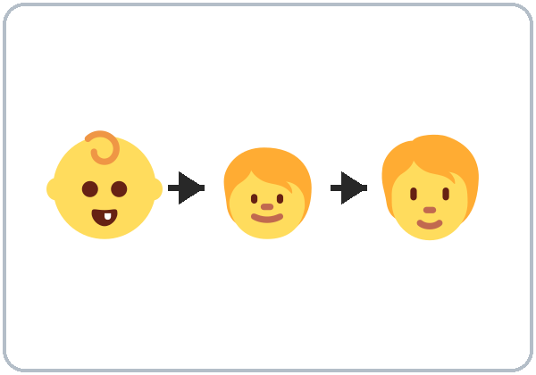
My Story
Today you will:
• Use 12–15 irregular past verbs
• Ask: Did you…? When did you…?
• Say didn't + verb
• Tell your story with ago
Lesson 6 (Week 6)
Notes:
Welcome back. Read the goals together; learners repeat.
Objectives: use 12–15 common irregular past verbs (went, got, had, met, felt…); ask and answer Did you…? and Wh- questions in the past; say didn't + verb; use ago (five years ago); tell a short life story with 6 or more past sentences.
Source: Level2_Curriculum_v5_public.md, Lesson 6 (At a glance).
Picture: Twemoji graphics by Twitter, Inc. and other contributors (https://github.com/jdecked/twemoji), CC BY 4.0 (https://creativecommons.org/licenses/by/4.0/); resized and combined.

Slide 2
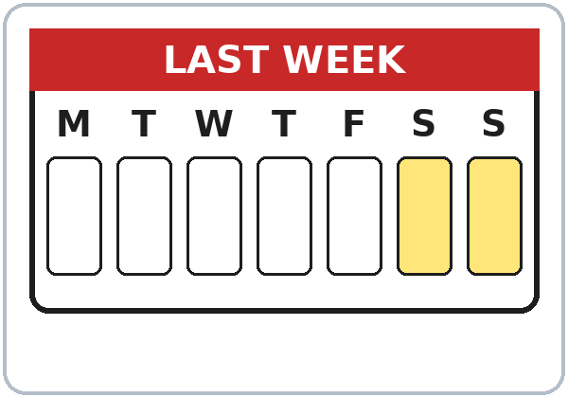
OPENING TALK · 6:00
Warm-Up
Same partner.
Review Lesson 5.
How was your weekend?
Was it fun? What did you do?
Notes:
Step 1 · 6:00–6:10 · Opening Talk + Homework Check. Pairs (same partner for both parts).
Minutes 0–5: these questions review Lesson 5. Each click shows one question.
Source: Level2_Curriculum_v5_public.md, Lesson 6 (Step 1).
Picture: Twemoji graphics by Twitter, Inc. and other contributors (https://github.com/jdecked/twemoji), CC BY 4.0 (https://creativecommons.org/licenses/by/4.0/); resized and combined.

Slide 3
Homework
Check
HW
Homework check
Read your 6 sentences.
1
On Saturday I ___ tired.
was
Hands up for every
was / were and -ed.
2
We ___ busy.
were
3
I ___ the house. (clean)
cleaned
4
She ___ TV. (watch)
watched
Notes:
Step 1, minutes 5–10: partners read their 6 homework sentences. The listener raises a hand at every was / were and every -ed.
Each click shows one answer. The lines review Lesson 5 (homework model, Grammar Boxes).
Teacher: note 2 common errors for the board. If behind: collect the homework.
Source: Level2_Curriculum_v5_public.md, Lesson 6 (Step 1); Lesson 5 Homework.

Slide 4
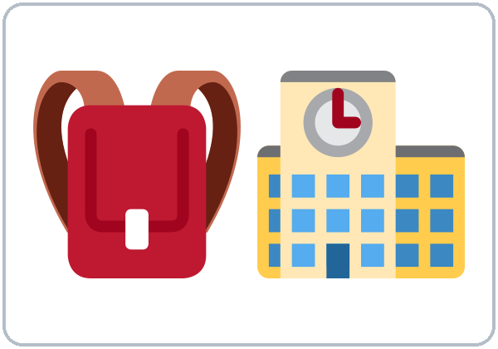


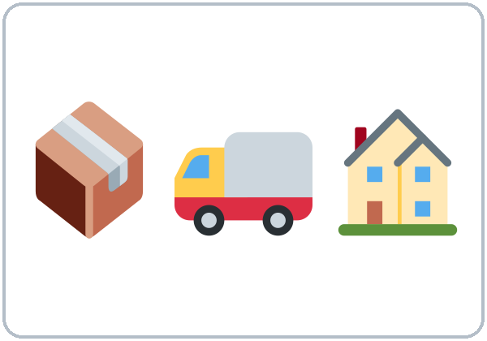

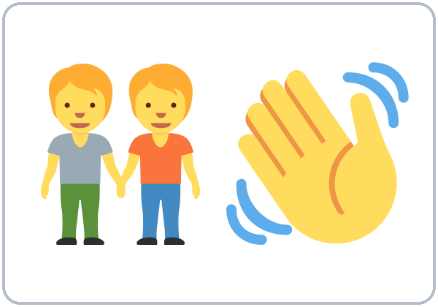
Life in
order
New Words
grew up
went to school
got a job
first job
moved
(to a new city)
found an
apartment
met
(a friend)
Notes:
Step 2 · 6:10–6:18 · New Words (pairs). Point, say, repeat twice. Each click shows one word.
Star words here: grew up, went to school, got a job, moved (to a new city), met (a friend).
Life in Order: pairs put the life-event words in a typical order (grew up → went to school → got a job…). Many orders are OK.
If behind: teach the star words only.
Source: Level2_Curriculum_v5_public.md, Lesson 6 (Step 2; Student Page 6 New Words).
Picture: Twemoji graphics by Twitter, Inc. and other contributors (https://github.com/jdecked/twemoji), CC BY 4.0 (https://creativecommons.org/licenses/by/4.0/); resized and combined.

Slide 5
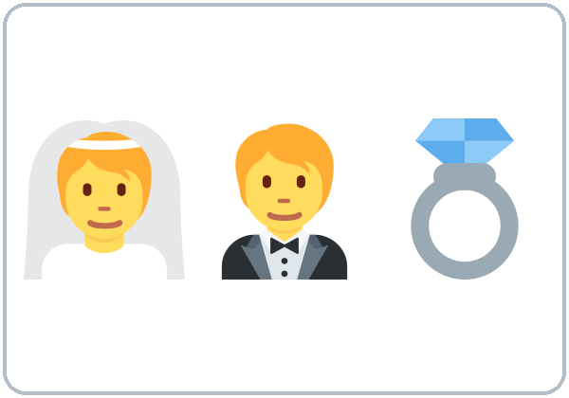

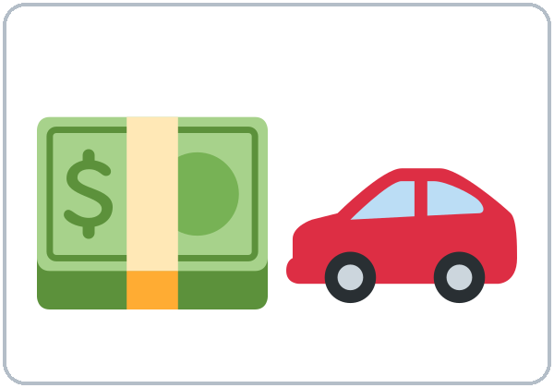



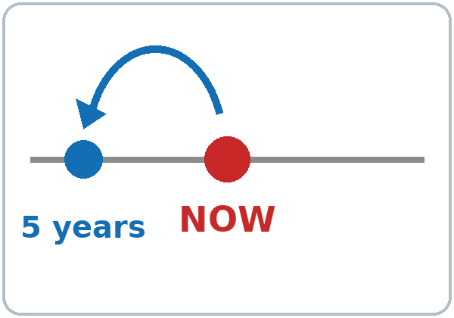
Many orders
are OK.
More New Words
got married
had a baby
bought
(a car)
learned
(English)
felt nervous
felt happy
ago
(5 years ago)
Notes:
New Words, part 2. Each click shows one word. Star words here: felt nervous, felt happy, ago (5 years ago).
Privacy: life-story activities always allow invented answers. Never ask about immigration status, documents, or why someone left a country.
Source: Level2_Curriculum_v5_public.md, Lesson 6 (Step 2; Student Page 6; Teacher notes).
Picture: Twemoji graphics by Twitter, Inc. and other contributors (https://github.com/jdecked/twemoji), CC BY 4.0 (https://creativecommons.org/licenses/by/4.0/); resized and combined.

Slide 6
Listen. Put Ana's story
in order. Write 1–5.
Listening A
Order
She got married.
5
She moved to this city.
2
She grew up in a small town.
1
She got her first job.
3
She met her husband.
4
Notes:
Step 3 · 6:18–6:30 · Listening + "Say it" (L6_listening.mp3, about 1:30). Audio: L6_listening.mp3 (about 1:30). The audio plays once, play again if needed. Audio coming soon: until it is ready, read the script with a volunteer learner.
Before you listen: "Sam talks to Ana about her life. What questions does he ask?" Write 2 guesses.
Listen 1 → Task A (put the events in order). Each click shows one number.
Answer key: 1 grew up in a small town; 2 moved to this city; 3 got her first job; 4 met her husband; 5 got married.
Source: Level2_Curriculum_v5_public.md, Lesson 6 (Step 3; Answer key).

Slide 7
Listen again.
True or False?
Listening B
1. Ana grew up in a big city.
True
False
A small town.
2. She moved here eight years ago.
True
False
3. She spoke English very well.
True
False
She knew 3 words.
4. Her first job was in a coffee shop.
True
False
5. Ana has a little girl.
True
False
A little boy.
Notes:
Listen 2 → Task B (true / false). Each click circles one answer and shows the correction. The audio plays once, play again if needed.
Answer key: 1 F (a small town); 2 T; 3 F (she knew three words); 4 T; 5 F (a little boy).
Source: Level2_Curriculum_v5_public.md, Lesson 6 (Step 3; Answer key).

Slide 8
Listening C
C
Listen again.
Write the missing word.
1
I ____ up in a small town by the sea.
grew
Ana says I grew up.
What is the present?
2
I ____ here eight years ago.
moved
3
No, I ____. I only knew three words.
didn't
4
I ____ nervous every day.
felt
Notes:
Listen 3 → Task C (fill in). Each click fills one blank. The audio plays once, play again if needed.
Answer key: grew; moved; didn't; felt.
Ask: "Ana says I grew up. What is the present?" (grow up)
"Say it" (1–2 min): the class repeats "When did you move here?" and "I moved here eight years ago."
If behind: skip the third play; do Task C together.
Source: Level2_Curriculum_v5_public.md, Lesson 6 (Step 3; Answer key).

Slide 9
Grammar Box 1
Did you ...?
QUESTION
ANSWER
Did
you grow up in a city?
Yes, I did.
No, I didn't.
Did
she move here?
Yes, she did.
No, she didn't.
Did
they work there?
Yes, they did.
No, they didn't.
Notes:
Step 4 · 6:30–6:45 · Grammar: irregular past, did, ago. Say: "Some verbs don't use -ed. We learn them one by one: go → went, get → got. For questions and no, use did / didn't + the base verb."
Grammar Box 1: each click highlights Did and its answers.
The "one past" rule (like the "one -s" rule): with did / didn't, the main verb is not past: Did you go? not Did you went?
Source: Level2_Curriculum_v5_public.md, Lesson 6 (Step 4; Grammar Box 1; Questions and answers).
Picture: Twemoji graphics by Twitter, Inc. and other contributors (https://github.com/jdecked/twemoji), CC BY 4.0 (https://creativecommons.org/licenses/by/4.0/); resized and combined.

Slide 10
Where did
Answers
you grow up?
I grew up in a small town.
I moved here in 2019.
Then: did + base verb.
I felt nervous.
Where
did
you grow up?
When
did
you move here?
Not: Did you went?
How
did
you feel?
Notes:
Grammar Box 2: Where…? When…? How…? Each click highlights did.
More from the box: Where did you go to school? When did you get your first job? I got my first job five years ago.
Q: How do I make a question in the past? Use did at the front: Did you move here? Where did you grow up?
Q: Can I use did with was / were? No. Were you nervous? (not Did you were nervous?)
Source: Level2_Curriculum_v5_public.md, Lesson 6 (Grammar Box 2; Questions and answers).
Picture: Twemoji graphics by Twitter, Inc. and other contributors (https://github.com/jdecked/twemoji), CC BY 4.0 (https://creativecommons.org/licenses/by/4.0/); resized and combined.

Slide 11
Grammar Box 3 · ago
How Long Ago?
QUESTION
ANSWER
When
did you move here?
Five years ago.
When
did you start your job?
Two months ago.
Notes:
Grammar Box 3: ago. Click 1 and click 2 highlight one row each.
Q: Where does ago go? After the time: five years ago, two weeks ago.
More from the box: How long ago did you move here / start your job? Two / five / ten days / months / years ago.
Source: Level2_Curriculum_v5_public.md, Lesson 6 (Grammar Box 3; Questions and answers).
Picture: Twemoji graphics by Twitter, Inc. and other contributors (https://github.com/jdecked/twemoji), CC BY 4.0 (https://creativecommons.org/licenses/by/4.0/); resized and combined.

Slide 12
Common Mistakes
Don't say
Say
Did you went to school?
Did you go to school?
I didn't went.
I didn't go.
I goed to the store.
I went to the store.
Notes:
Common mistakes (part 1). Each click shows the correct sentence.
Did you went? uses two past forms. Write the correct form on the board. Learners can read the note on their Grammar page; you don't need to explain it.
Source: Level2_Curriculum_v5_public.md, Lesson 6 (Common mistakes; Teacher notes).
Picture: Twemoji graphics by Twitter, Inc. and other contributors (https://github.com/jdecked/twemoji), CC BY 4.0 (https://creativecommons.org/licenses/by/4.0/); resized and combined.

Slide 13
Fix These Mistakes
Don't say
Say
Ago five years.
Five years ago.
She get married in 2020.
She got married in 2020.
Did you were nervous?
Were you nervous?
Notes:
Common mistakes (part 2). Each click shows the correct sentence.
Ago goes after the time. Teach about 15 irregular verbs only (the list on the Grammar page).
Source: Level2_Curriculum_v5_public.md, Lesson 6 (Common mistakes; Teacher notes).
Picture: Twemoji graphics by Twitter, Inc. and other contributors (https://github.com/jdecked/twemoji), CC BY 4.0 (https://creativecommons.org/licenses/by/4.0/); resized and combined.

Slide 14
Quick Check
The one past rule
1
2
3
Did you ___ to school here? (go)
I ___ my wife in 2015. (meet)
Ago five years or five years ago?
go
met
five years ago
Notes:
Step 4 check questions. Learners answer; each click shows one answer.
Answers: go · met · five years ago.
Short Memory Game (last 5 min): pairs turn over verb cards and match go – went, get – got… If behind: skip the Memory Game.
Source: Level2_Curriculum_v5_public.md, Lesson 6 (Step 4 Check).

Slide 15
Sentences · positive and negative
Did and Didn't
Regular verbs
-ed
I moved here.
I didn't move here.
Irregular verbs
went
She went to school.
She didn't go to school.
Notes:
Positive and negative sentences. Click 1 and click 2 show one row each.
Common irregular verbs: go → went, have → had, get → got, come → came, make → made, take → took, meet → met, find → found, feel → felt, buy → bought, leave → left, know → knew, grow up → grew up, see → saw, eat → ate.
Pronunciation (If time ①): "Did you" → "didja." Learners only need to recognize the fast form.
Source: Level2_Curriculum_v5_public.md, Lesson 6 (Common irregular verbs; Sentences; If time).
Picture: Twemoji graphics by Twitter, Inc. and other contributors (https://github.com/jdecked/twemoji), CC BY 4.0 (https://creativecommons.org/licenses/by/4.0/); resized and combined.

Slide 16
Talk Time
Timeline Interview
Then switch. You can make it up.
7:00–7:10
1
Draw 4 events.
grew up, moved, first job…
2
Ask your partner.
When did you…? Did you…?
3
Report one fact.
Rosa moved here 6 years ago.
Notes:
Step 5 · 7:00–7:10 · Talk Time: Timeline Interview. Pairs, then groups of 4 (15) / one group (7–8). Each click shows one step.
Do (3 min): each learner draws a timeline with 4 events (true or invented). Interview (5 min): the partner asks When did you…? Did you…? How did you feel? Then switch.
Report (2 min): one fact about the partner: "Rosa moved here six years ago. She felt nervous."
Privacy: learners choose what to share and can make it up. If behind: pairs only; skip the report.
Source: Level2_Curriculum_v5_public.md, Lesson 6 (Step 5).
Picture: Twemoji graphics by Twitter, Inc. and other contributors (https://github.com/jdecked/twemoji), CC BY 4.0 (https://creativecommons.org/licenses/by/4.0/); resized and combined.

Slide 17
Before You Go
01
Exit ticket
02
Homework
Write one sentence
with an irregular
verb and ago.
Draw a timeline of
your life (5 points).
Write your story in
6–8 sentences: 4
irregular verbs + ago.
Notes:
Step 6 · 7:10–7:15 · Exit Ticket + Homework. NEVER SKIP.
Exit ticket: one sentence with an irregular verb and ago.
Homework (15 minutes): 1. Draw a timeline of your life with 5 points (true or invented). 2. Write your story in 6–8 sentences with at least 4 irregular verbs and ago (I grew up in… I moved here six years ago…). 3. Bonus: ask a family member 3 questions with Did you…? or When did you…? Do the first timeline point together.
Source: Level2_Curriculum_v5_public.md, Lesson 6 (Step 6; Student Page 6 Homework).
Picture: Twemoji graphics by Twitter, Inc. and other contributors (https://github.com/jdecked/twemoji), CC BY 4.0 (https://creativecommons.org/licenses/by/4.0/); resized and combined.

Slide 18
Credits
Pictures
Vocabulary pictures use Twemoji graphics by Twitter, Inc. and other contributors (https://github.com/jdecked/twemoji), licensed under CC BY 4.0 (https://creativecommons.org/licenses/by/4.0/). The graphics were resized and combined, and arrows, calendars, clocks, and labels were added.
This deck
© 2026 the authors. The authors license this deck under CC BY-NC-SA 4.0.
Audio and font
Audio: Chatterbox TTS (Resemble AI, MIT); AI voices with a Perth watermark. Font: Lexend Deca (OFL 1.1). Provided as-is, without warranty.
Notes:
Credits. Lesson content: Level 2 Adult ESL Curriculum v5, public edition, Lesson 6.
Image credit line copied exactly from images/CREDITS.md. Deck notice: © 2026 the authors; the authors license this deck under CC BY-NC-SA 4.0 (Section 7.2).
Audio and font credits: Chatterbox TTS (Resemble AI, MIT; Perth watermark), Lexend Deca (SIL OFL 1.1).

