Slide 1


The Best Place in Town
Today you will:
• Name 10+ places in town
• Ask: Where's the best…?
• Say the cheapest, the best
• Recommend places
Lesson 8 (Week 9)
Notes:
Welcome back after the midterm. Read the goals together; learners repeat.
Objectives: name 10 or more places in town; ask Where's the best…? Is there a… near here?; use superlatives: the cheapest, the biggest, the most expensive, the best; recommend places in their neighborhood.
Source: Level2_Curriculum_v5_public.md, Lesson 8 (At a glance).
Picture: Twemoji graphics by Twitter, Inc. and other contributors (https://github.com/jdecked/twemoji), CC BY 4.0 (https://creativecommons.org/licenses/by/4.0/); resized and combined.

Slide 2
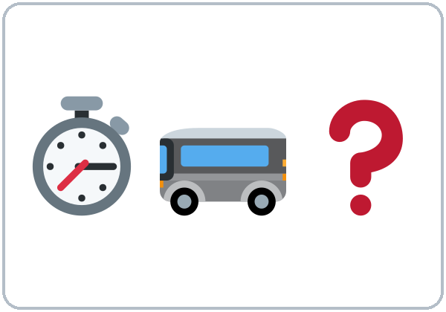
OPENING TALK · 6:00
Warm-Up
Same partner.
Review Week 8.
How was the midterm?
Was it easy or difficult?
Notes:
Step 1 · 6:00–6:10 · Opening Talk + Homework Check. Pairs (same partner for both parts).
Minutes 0–5 (review Week 8): partners ask How was the midterm? Was it easy or difficult? How do you get to class? (Lesson 7 review). Each click shows one question.
Source: Level2_Curriculum_v5_public.md, Lesson 8 (Step 1).
Picture: Twemoji graphics by Twitter, Inc. and other contributors (https://github.com/jdecked/twemoji), CC BY 4.0 (https://creativecommons.org/licenses/by/4.0/); resized and combined.

Slide 3
After the
Midterm
HW
Midterm check
Share one goal.
1
The car is ___. (fast)
faster
Share one goal from
your can-do self-check.
2
The bus is ___. (cheap)
cheaper
3
A bike is ___. (good)
better
4
It ___ 20 minutes.
takes
Notes:
Step 1, minutes 5–10: partners share one goal from their midterm can-do self-check. Return the midterm score sheets.
Each click shows one answer. The lines review Lesson 7 (comparatives, How long does it take?).
Teacher: praise one strength from the speaking interviews for the whole class. If behind: return score sheets at the break instead.
Source: Level2_Curriculum_v5_public.md, Lesson 8 (Step 1); Lesson 7 Grammar.

Slide 4
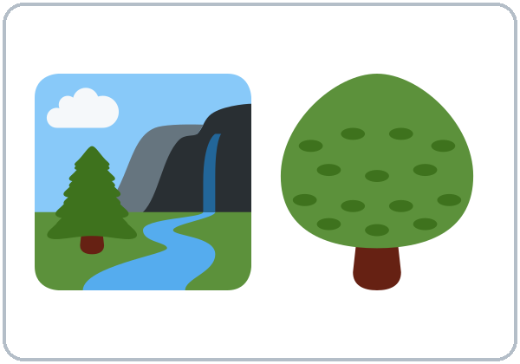

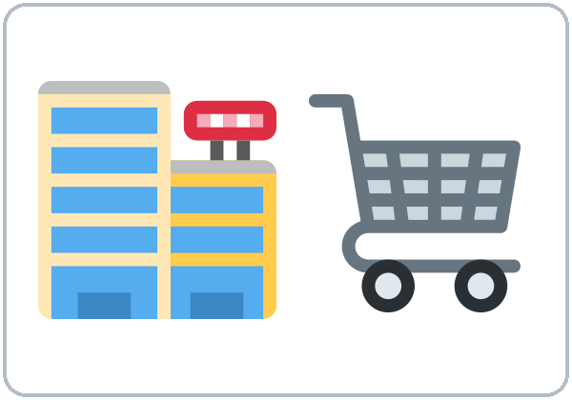
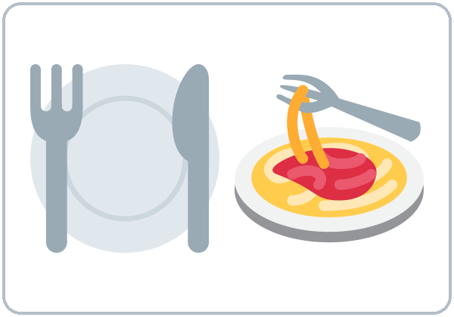

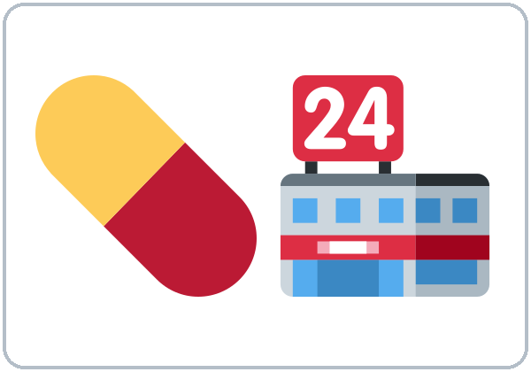
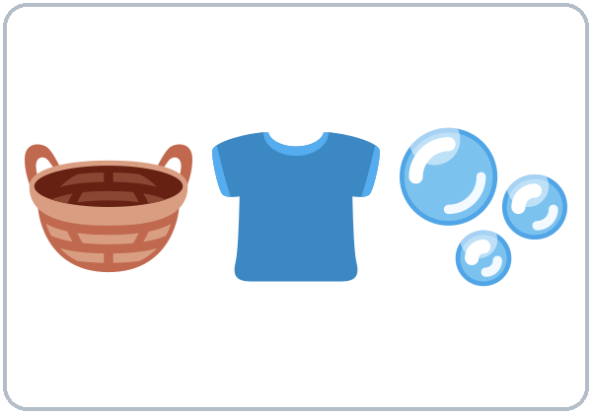
What can you
do there?
New Words
park
library
supermarket
restaurant
clinic
pharmacy
laundromat
Notes:
Step 2 · 6:10–6:18 · New Words (pairs). Point, say, repeat twice. Each click shows one word.
Star words here: park, library, supermarket, clinic, pharmacy.
What can you do there? Say an action (buy medicine, send a letter, wash clothes). Pairs point to the place.
If behind: teach the star words only.
Source: Level2_Curriculum_v5_public.md, Lesson 8 (Step 2; Student Page 8 New Words).
Picture: Twemoji graphics by Twitter, Inc. and other contributors (https://github.com/jdecked/twemoji), CC BY 4.0 (https://creativecommons.org/licenses/by/4.0/); resized and combined.

Slide 5
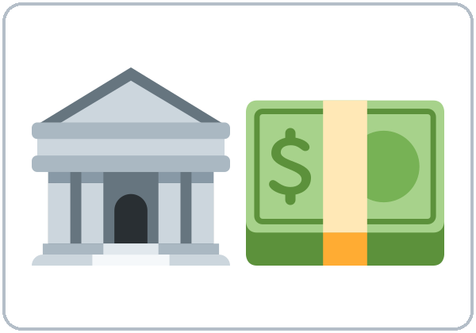

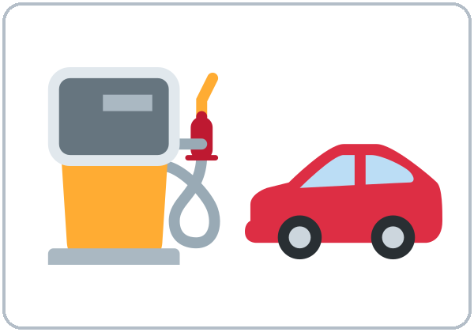
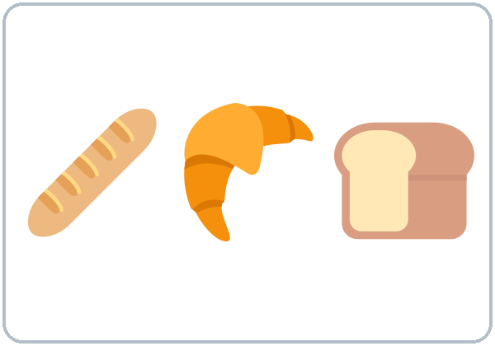
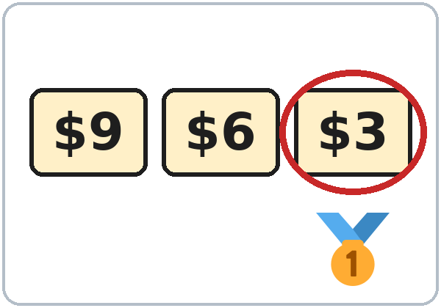
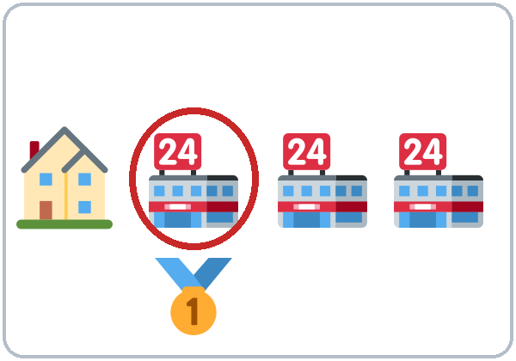
Send a
letter?
More New Words
bank
post office
gas station
bakery
the best
the cheapest
the closest
Notes:
New Words, part 2. Each click shows one word. Star words here: bank, the best, the cheapest.
Send a letter? → post office. Wash clothes? → laundromat. Buy medicine? → pharmacy.
Source: Level2_Curriculum_v5_public.md, Lesson 8 (Step 2; Student Page 8).
Picture: Twemoji graphics by Twitter, Inc. and other contributors (https://github.com/jdecked/twemoji), CC BY 4.0 (https://creativecommons.org/licenses/by/4.0/); resized and combined.

Slide 6
supermarket
Yes
Listening A
pharmacy
Yes
Listen. Check the places.
post office
No
bank
Yes
library
No
restaurant
Yes
park
Yes
Notes:
Step 3 · 6:18–6:30 · Listening + "Say it" (L8_listening.mp3, about 1:35). Audio: L8_listening.mp3 (about 1:35). The audio plays once, play again if needed. Audio coming soon: until it is ready, read the script with a volunteer learner.
Before you listen: "Kim is new in the neighborhood. She asks Rosa for help. What places does she need?" Take 2 guesses.
Listen 1 → Task A (check the places). Each click shows Yes or No.
Answer key: ✓ supermarket, pharmacy, restaurant, park, bank (bank = next to the pharmacy). ✗ library, post office.
The listening places are invented. Learners can recommend real local places in Talk Time.
Source: Level2_Curriculum_v5_public.md, Lesson 8 (Step 3; Answer key; Teacher notes).
Picture: Twemoji graphics by Twitter, Inc. and other contributors (https://github.com/jdecked/twemoji), CC BY 4.0 (https://creativecommons.org/licenses/by/4.0/); resized and combined.

Slide 7
Listen again.
Match. It's ...
Listening B
1. Fresh Market
c. the biggest
2. Value Foods
a. the cheapest
3. The Sunny Kitchen
d. the best restaurant
4. Lake Park
b. the most beautiful park
Notes:
Listen 2 → Task B (match). Each click shows one answer. The audio plays once, play again if needed.
Answer key: Fresh Market = the biggest; Value Foods = the cheapest; The Sunny Kitchen = the best restaurant; Lake Park = the most beautiful.
Source: Level2_Curriculum_v5_public.md, Lesson 8 (Step 3; Answer key).

Slide 8
Listening C
C
Listen again.
Write the missing word.
1
Value Foods is the ____.
cheapest
Two things: cheaper.
Three or more: the cheapest.
2
The ____ one is on Pine Street.
closest
3
I think The Sunny Kitchen is the ____.
best
4
Lake Park is the ____ beautiful park in town.
most
Notes:
Listen 3 → Task C (fill in). Each click fills one blank. The audio plays once, play again if needed.
Answer key: cheapest; closest; best; most.
"Say it" (1–2 min): the class repeats "Where's the best supermarket?" and "It's the cheapest in town."
If behind: skip the third play; do Task C together.
Source: Level2_Curriculum_v5_public.md, Lesson 8 (Step 3; Answer key).

Slide 9
Grammar Box 1
Where's the
Best ...?
QUESTION
ANSWER
Where's the best bank?
It's on Lake Street.
Where's the closest park?
It's next to the library.
Notes:
Step 4 · 6:30–6:45 · Grammar: superlatives + Is there…? Say: "Two things: cheaper than. Three or more: the cheapest. Short words add -est; long words use the most."
Board: cheap → cheaper → the cheapest; expensive → more expensive → the most expensive; good → better → the best.
Grammar Box 1: click 1 and click 2 highlight one pair each. More: Where's the best / the cheapest / the closest supermarket / pharmacy / restaurant? It's on Main Street. It's next to the bank.
Source: Level2_Curriculum_v5_public.md, Lesson 8 (Step 4; Grammar Box 1).
Picture: Twemoji graphics by Twitter, Inc. and other contributors (https://github.com/jdecked/twemoji), CC BY 4.0 (https://creativecommons.org/licenses/by/4.0/); resized and combined.

Slide 10
What's the
Answers
best ...?
I think ___ is the best.
I think ___ is the cheapest.
Add: in town?
What's
the best
restaurant?
What's
the cheapest
store?
the + -est
What's
the best
park?
Notes:
Grammar Box 2: What's the … in town? Each click highlights the superlative.
Q: Do I always say the? Yes. It's the best. (not It's best restaurant.)
Q: Short or long word? Short: the cheapest. Long: the most expensive. Never both: not the most cheapest.
Source: Level2_Curriculum_v5_public.md, Lesson 8 (Grammar Box 2; Questions and answers).
Picture: Twemoji graphics by Twitter, Inc. and other contributors (https://github.com/jdecked/twemoji), CC BY 4.0 (https://creativecommons.org/licenses/by/4.0/); resized and combined.

Slide 11
Grammar Box 3
Is there ...?
QUESTION
ANSWER
Is
there a bank near here?
Yes, there is.
No, there isn't.
Is
there a clinic near here?
Yes, there is.
No, there isn't.
Are
there any parks near here?
Yes, there are.
No, there aren't.
Notes:
Grammar Box 3: Is there…? Are there…? Each click highlights Is / Are and its answers.
Q: How do I ask if a place is near? Is there a bank near here? (one) • Are there any parks near here? (two or more)
Source: Level2_Curriculum_v5_public.md, Lesson 8 (Grammar Box 3; Questions and answers).
Picture: Twemoji graphics by Twitter, Inc. and other contributors (https://github.com/jdecked/twemoji), CC BY 4.0 (https://creativecommons.org/licenses/by/4.0/); resized and combined.

Slide 12
Common Mistakes
Don't say
Say
It's the more cheap.
It's the cheapest.
It's the most cheapest.
It's the cheapest.
It's best restaurant.
It's the best restaurant.
Notes:
Common mistakes (part 1). Each click shows the correct sentence.
Write the correct form on the board. Learners can read the note on their Grammar page; you don't need to explain it.
Source: Level2_Curriculum_v5_public.md, Lesson 8 (Common mistakes; Teacher notes).
Picture: Twemoji graphics by Twitter, Inc. and other contributors (https://github.com/jdecked/twemoji), CC BY 4.0 (https://creativecommons.org/licenses/by/4.0/); resized and combined.

Slide 13
Fix These Mistakes
Don't say
Say
Have a pharmacy near here?
Is there a pharmacy near here?
There is two banks.
There are two banks.
The more good park.
The best park.
Notes:
Common mistakes (part 2). Each click shows the correct sentence.
Special words: good → the best, bad → the worst, far → the farthest.
Source: Level2_Curriculum_v5_public.md, Lesson 8 (Common mistakes; Questions and answers).
Picture: Twemoji graphics by Twitter, Inc. and other contributors (https://github.com/jdecked/twemoji), CC BY 4.0 (https://creativecommons.org/licenses/by/4.0/); resized and combined.

Slide 14
Quick Check
Two or more than two?
1
2
3
It's ___ store in town. (big)
the most cheap or the cheapest?
Have a bank near here?
the biggest
the cheapest
Is there a bank?
Notes:
Step 4 check questions. Learners answer; each click shows one answer.
Answers: the biggest · the cheapest · Is there a bank near here?
Short "Class Records" (last 5 min): pairs ask 2 questions and find a "record": Who has the longest trip? Who has the biggest family? If behind: skip it.
Source: Level2_Curriculum_v5_public.md, Lesson 8 (Step 4 Check).

Slide 15
Two or more than two?
Cheaper or Cheapest?
Two things
-er
cheaper than
more expensive than
Three or more
-est
the cheapest
the most expensive
Notes:
Two or more than two? Click 1 and click 2 show one row each.
More from the table: big → bigger than → the biggest; easy → easier than → the easiest; good → better than → the best; bad → worse than → the worst; far → farther than → the farthest.
Pronunciation (If time ①): th /ð/ in the, there, this, that: tongue between the teeth. Is there a → "Iz-there-a."
Source: Level2_Curriculum_v5_public.md, Lesson 8 (Two or more than two?; If time).
Picture: Twemoji graphics by Twitter, Inc. and other contributors (https://github.com/jdecked/twemoji), CC BY 4.0 (https://creativecommons.org/licenses/by/4.0/); resized and combined.

Slide 16
Talk Time
Neighborhood Guide
Use real places or invent them.
7:00–7:10
1
Make a poster.
The best ___ in town
2
Add 1–2 places.
name + why it's the best
3
Share one place.
The best park is Lake Park.
Notes:
Step 5 · 7:00–7:10 · Talk Time: Neighborhood Guide. Groups of 3–4 (15) / two groups (7–8). Each click shows one step.
Do (7 min): groups make a poster: "The best ___ in our neighborhood." Each learner adds 1–2 places: name, street, why it's the best (It's the cheapest. It's the closest.).
Share (3 min): groups present one place: "The best park is Lake Park. It's on Lake Street. It's the biggest."
If behind: one place per group; skip sharing.
Source: Level2_Curriculum_v5_public.md, Lesson 8 (Step 5).
Picture: Twemoji graphics by Twitter, Inc. and other contributors (https://github.com/jdecked/twemoji), CC BY 4.0 (https://creativecommons.org/licenses/by/4.0/); resized and combined.

Slide 17
Before You Go
01
Exit ticket
02
Homework
Write one sentence:
The best ___ in my
neighborhood is ___.
It's the ___-est.
Write 5 sentences
about the best places
in your neighborhood.
Write 2 questions:
Is there…? Are there…?
Notes:
Step 6 · 7:10–7:15 · Exit Ticket + Homework. NEVER SKIP.
Exit ticket: The best ___ in my neighborhood is ___. It's ___ (superlative).
Homework (10 minutes): 1. Write 5 sentences about the best places in your neighborhood (The best park is… It's the biggest…). 2. Write 2 questions with Is there…? or Are there…? and answer them. 3. Bonus: ask a friend or neighbor: What's the best restaurant in town? Write the answer.
Source: Level2_Curriculum_v5_public.md, Lesson 8 (Step 6; Student Page 8 Homework).
Picture: Twemoji graphics by Twitter, Inc. and other contributors (https://github.com/jdecked/twemoji), CC BY 4.0 (https://creativecommons.org/licenses/by/4.0/); resized and combined.

Slide 18
Credits
Pictures
Vocabulary pictures use Twemoji graphics by Twitter, Inc. and other contributors (https://github.com/jdecked/twemoji), licensed under CC BY 4.0 (https://creativecommons.org/licenses/by/4.0/). The graphics were resized and combined, and arrows, calendars, clocks, and labels were added.
This deck
© 2026 the authors. The authors license this deck under CC BY-NC-SA 4.0.
Audio and font
Audio: Chatterbox TTS (Resemble AI, MIT); AI voices with a Perth watermark. Font: Lexend Deca (OFL 1.1). Provided as-is, without warranty.
Notes:
Credits. Lesson content: Level 2 Adult ESL Curriculum v5, public edition, Lesson 8.
Image credit line copied exactly from images/CREDITS.md. Deck notice: © 2026 the authors; the authors license this deck under CC BY-NC-SA 4.0 (Section 7.2).
Audio and font credits: Chatterbox TTS (Resemble AI, MIT; Perth watermark), Lexend Deca (SIL OFL 1.1).

