Slide 1
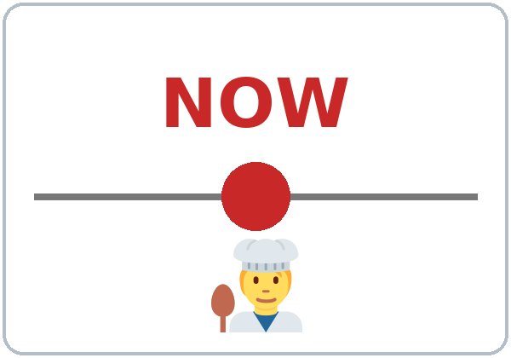
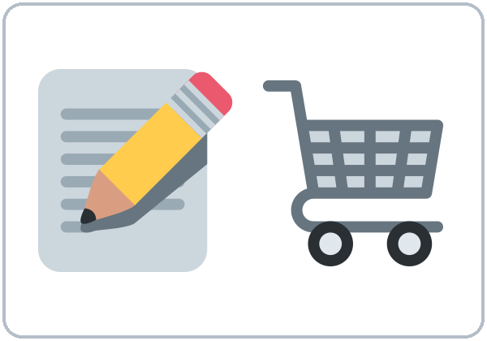
Food and Shopping
Today you will:
• Name 15+ foods and drinks
• Use some / any, How much / many
• Order: I'd like… / Can I have…?
• Ask and say prices
Lesson 9 (Week 10)
Notes:
Welcome back. Read the goals together; learners repeat.
Objectives: name 15 or more food and drink items; use some / any and How much / How many; order in a restaurant with I'd like… / Can I have…?; ask and say prices.
Source: Level2_Curriculum_v5_public.md, Lesson 9 (At a glance).
Picture: Twemoji graphics by Twitter, Inc. and other contributors (https://github.com/jdecked/twemoji), CC BY 4.0 (https://creativecommons.org/licenses/by/4.0/); resized and combined.

Slide 2
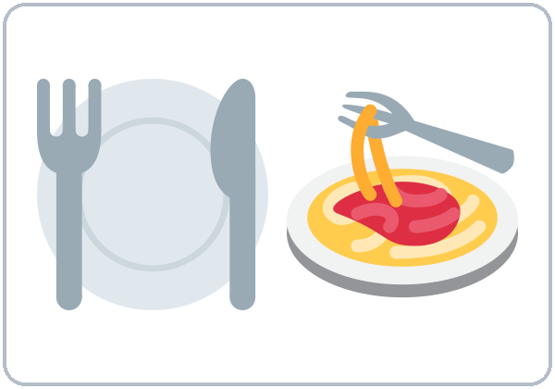
OPENING TALK · 6:00
Warm-Up
Same partner.
Review Lesson 8.
What's the best restaurant in your neighborhood?
Is there a pharmacy near your home?
Notes:
Step 1 · 6:00–6:10 · Opening Talk + Homework Check. Pairs (same partner for both parts).
Minutes 0–5 (review Lesson 8): partners ask What's the best restaurant / park in your neighborhood? Is there a pharmacy near your home? Each click shows one question.
Source: Level2_Curriculum_v5_public.md, Lesson 9 (Step 1).
Picture: Twemoji graphics by Twitter, Inc. and other contributors (https://github.com/jdecked/twemoji), CC BY 4.0 (https://creativecommons.org/licenses/by/4.0/); resized and combined.

Slide 3
Homework
Check
HW
Homework check
Read your 5 sentences.
1
It's the ___. (cheap)
cheapest
Listen for the
+ -est.
2
It's the ___. (big)
biggest
3
It's the ___ park. (good)
best
4
___ there a bank?
Is
Notes:
Step 1, minutes 5–10: partners read their 5 homework sentences. The listener checks for the + -est.
Each click shows one answer. The lines review Lesson 8 (Grammar Boxes 1–3).
Teacher: write 2 corrected sentences on the board. If behind: collect the homework.
Source: Level2_Curriculum_v5_public.md, Lesson 9 (Step 1); Lesson 8 Homework.

Slide 4
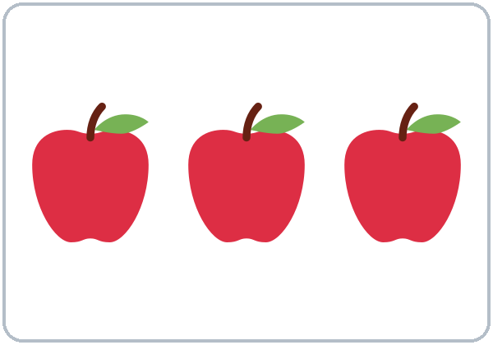
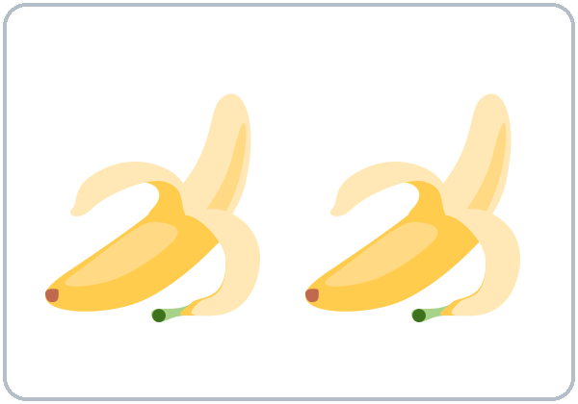
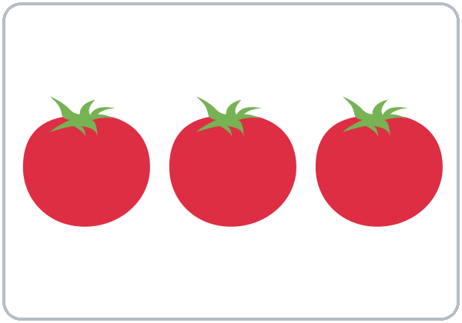
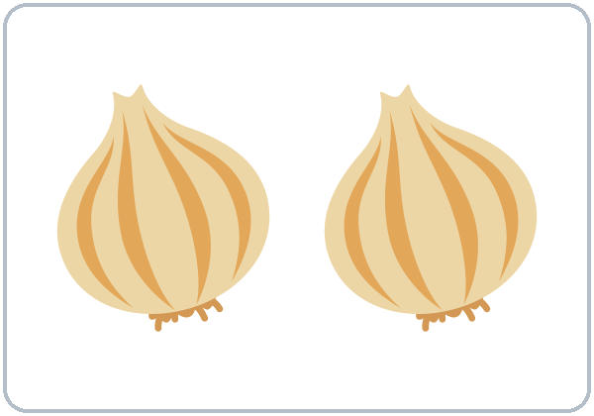
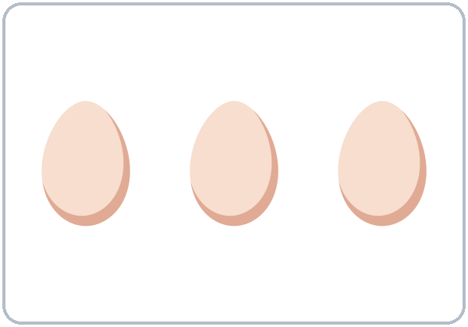
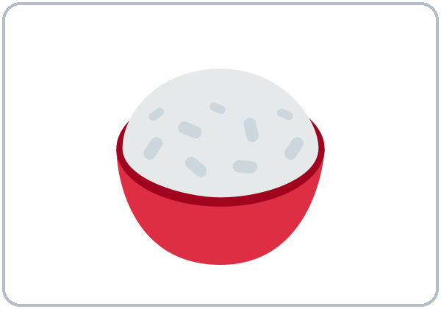
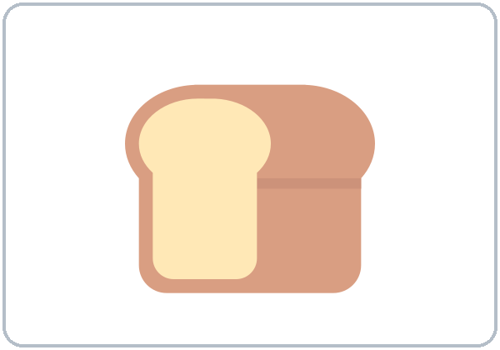
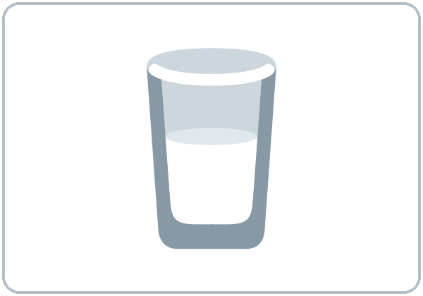
Can you
count it?
New Words
apples
bananas
tomatoes
onions
eggs
rice
bread
milk
Notes:
Step 2 · 6:10–6:18 · New Words (pairs). Point, say, repeat twice. Each click shows one word.
Star words here: eggs, rice, bread, milk.
Can you count it? Say a food. Learners hold up fingers if you can count it (apples, eggs) or make a "pile" with both hands if you can't (rice, milk, water).
If behind: teach the star words only.
Source: Level2_Curriculum_v5_public.md, Lesson 9 (Step 2; Student Page 9 New Words).
Picture: Twemoji graphics by Twitter, Inc. and other contributors (https://github.com/jdecked/twemoji), CC BY 4.0 (https://creativecommons.org/licenses/by/4.0/); resized and combined.

Slide 5
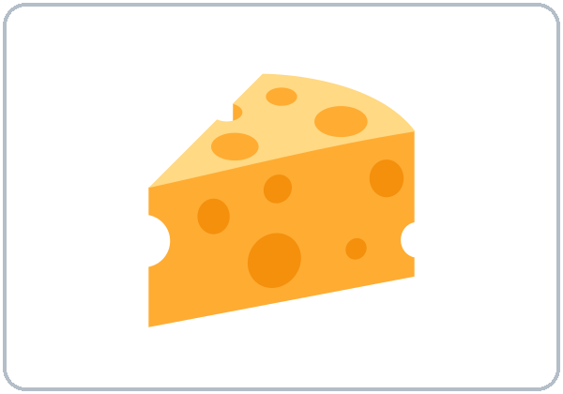
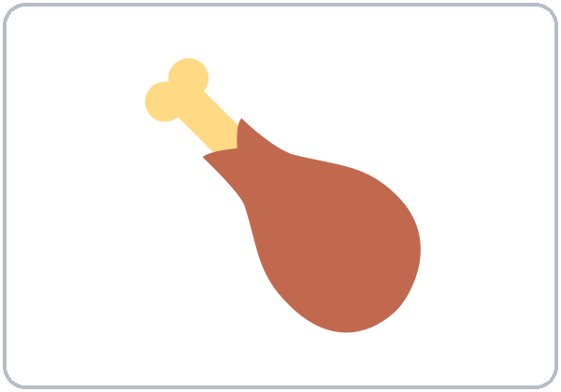
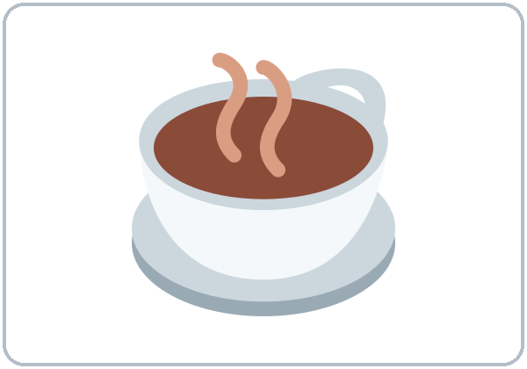

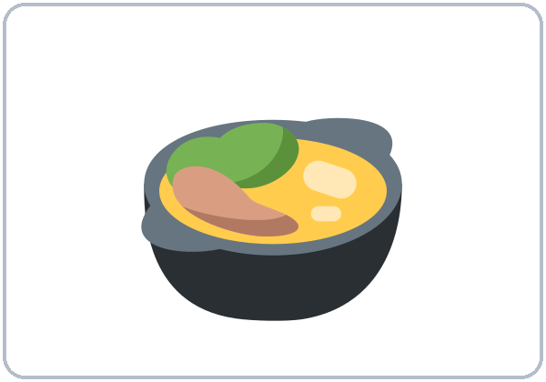
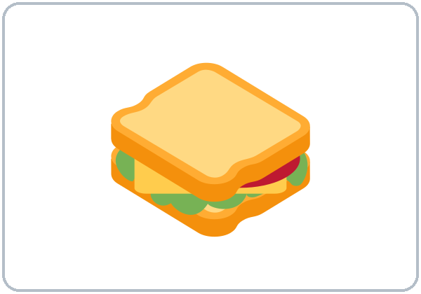
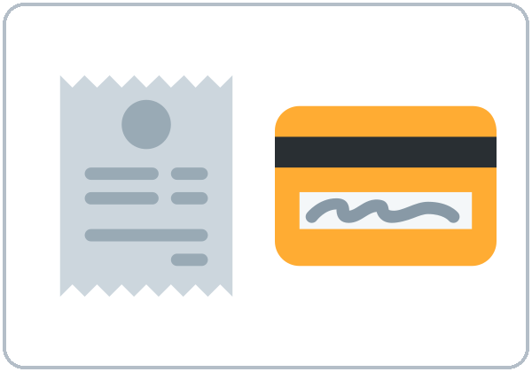
Fingers or
a pile?
More New Words
cheese
chicken
coffee
water
soup
sandwich
shopping list
the check
(the bill)
Notes:
New Words, part 2. Each click shows one word. Star words here: chicken, water, shopping list, the check (the bill).
Menus and prices are invented. Learners can talk about any food from their culture.
Source: Level2_Curriculum_v5_public.md, Lesson 9 (Step 2; Student Page 9; Teacher notes).
Picture: Twemoji graphics by Twitter, Inc. and other contributors (https://github.com/jdecked/twemoji), CC BY 4.0 (https://creativecommons.org/licenses/by/4.0/); resized and combined.

Slide 6
Listening A
soup
water
Yes
Yes
Listen. What do they order?
fish
No
coffee
Yes
sandwich
Yes
eggs
No
salad
Yes
cheese
No
bread
Yes
milk
Yes
Notes:
Step 3 · 6:18–6:30 · Listening + "Say it" (L9_listening.mp3, about 1:35). Audio: L9_listening.mp3 (about 1:35). The audio plays once, play again if needed. Audio coming soon: until it is ready, read the script with a volunteer learner.
Before you listen: "Sam and Ana are in a restaurant. What do they order?" Take 2 guesses.
Listen 1 → Task A (check the food). Each click shows Yes or No.
Answer key: ✓ soup, bread, sandwich, salad, water, coffee, milk. ✗ fish, eggs, cheese.
Source: Level2_Curriculum_v5_public.md, Lesson 9 (Step 3; Answer key).
Picture: Twemoji graphics by Twitter, Inc. and other contributors (https://github.com/jdecked/twemoji), CC BY 4.0 (https://creativecommons.org/licenses/by/4.0/); resized and combined.

Slide 7
Listen again.
Circle the answer.
Listening B
1. Ana orders ...
chicken soup
fish
a salad
2. They don't have any ...
chicken
fish
bread
3. Ana wants water with ...
ice
no ice
lemon
4. Sam wants ... sugars.
one
two
three
5. The total is ...
$14.50
$24.15
$24.50
Notes:
Listen 2 → Task B (circle). Each click circles one answer. The audio plays once, play again if needed.
Answer key: 1 chicken soup; 2 fish; 3 no ice; 4 two; 5 $24.50.
Prices: $24.50 = "twenty-four fifty."
Source: Level2_Curriculum_v5_public.md, Lesson 9 (Step 3; Answer key; Questions and answers).

Slide 8
Listening C
C
Listen again.
Write the missing words.
1
____ the chicken soup.
I'd like
I'd like = I want.
It is more polite.
2
Sorry, we don't have ____ fish today.
any
3
____ ____ have a chicken sandwich?
Can I
4
Can we have the ____, please?
check
Notes:
Listen 3 → Task C (fill in). Each click fills one blank. The audio plays once, play again if needed.
Answer key: I'd like; any; Can I; check.
"Say it" (1–2 min): the class repeats "I'd like the chicken soup, please." and "Can I have the check?"
If behind: skip the third play; do Task C together.
Source: Level2_Curriculum_v5_public.md, Lesson 9 (Step 3; Answer key).

Slide 9
Grammar Box 1 · Ordering
I'd like ...
Can I have ...?
YOU SAY
THE SERVER SAYS
I'd like the soup, please.
Sure.
Anything to drink?
Can I have some water?
Of course.
Anything else?
Notes:
Step 4 · 6:30–6:45 · Grammar: some / any, How much / many, I'd like. Grammar Box 1: Ordering. Click 1 and click 2 highlight one pair each.
Say: "I'd like = I want (polite)." I'd like the soup / a sandwich / a coffee, please. Can I have some water / some bread / the check, please?
Teacher note: a coffee / a water are common in restaurants (= a cup / a glass). Accept them in role plays.
Source: Level2_Curriculum_v5_public.md, Lesson 9 (Step 4; Grammar Box 1; Teacher notes).
Picture: Twemoji graphics by Twitter, Inc. and other contributors (https://github.com/jdecked/twemoji), CC BY 4.0 (https://creativecommons.org/licenses/by/4.0/); resized and combined.

Slide 10
Grammar Box 2
Do you have any ...?
QUESTION
ANSWER
any
fish?
Sorry, we don't
have any today.
any
bread?
Yes, we have some.
any
milk?
Yes, we have some.
Notes:
Grammar Box 2: Do you have any…? Each click highlights any and its answer. Read: Do you have any fish? Sorry, we don't have any today.
Q: Some or any? some in positive sentences: I need some eggs. any in questions and negatives: Do you have any milk? We don't have any fish.
Source: Level2_Curriculum_v5_public.md, Lesson 9 (Grammar Box 2; Questions and answers).
Picture: Twemoji graphics by Twitter, Inc. and other contributors (https://github.com/jdecked/twemoji), CC BY 4.0 (https://creativecommons.org/licenses/by/4.0/); resized and combined.

Slide 11
How many?
Answers
How much?
Six eggs.
A little rice.
It's $3.50.
Count it? many
How
many
eggs?
How
much
rice?
Money: How much?
How
much
is it?
Notes:
Grammar Boxes 3 and 4: How many? How much? Prices. Each click highlights many / much.
Say: "Some foods we can count: one egg, two eggs. Some we can't: rice, milk. Count → How many. Can't count → How much. Money → How much."
Prices: How much is the soup? It's $3.50. How much are the apples? They're $4.00 a pound. $3.50 = "three fifty" or "three dollars and fifty cents."
Source: Level2_Curriculum_v5_public.md, Lesson 9 (Grammar Boxes 3–4; Questions and answers).
Picture: Twemoji graphics by Twitter, Inc. and other contributors (https://github.com/jdecked/twemoji), CC BY 4.0 (https://creativecommons.org/licenses/by/4.0/); resized and combined.

Slide 12
Common Mistakes
Don't say
Say
How many milk?
How much milk?
How many money?
How much money?
I want a coffee.
I'd like a coffee, please.
Notes:
Common mistakes (part 1). Each click shows the correct sentence.
I want a coffee sounds too direct. Write the correct form on the board. Learners can read the note on their Grammar page; you don't need to explain it.
Source: Level2_Curriculum_v5_public.md, Lesson 9 (Common mistakes; Teacher notes).
Picture: Twemoji graphics by Twitter, Inc. and other contributors (https://github.com/jdecked/twemoji), CC BY 4.0 (https://creativecommons.org/licenses/by/4.0/); resized and combined.

Slide 13
Fix These Mistakes
Don't say
Say
Do you have some fish?
Do you have any fish?
I need two breads.
I need some bread.
We don't have some eggs.
We don't have any eggs.
Notes:
Common mistakes (part 2). Each click shows the correct sentence.
Do you have some fish? is OK, but any is more common in questions. Q: Can I say breads or rices? No. Say some bread, a loaf of bread, a bag of rice.
Source: Level2_Curriculum_v5_public.md, Lesson 9 (Common mistakes; Questions and answers).
Picture: Twemoji graphics by Twitter, Inc. and other contributors (https://github.com/jdecked/twemoji), CC BY 4.0 (https://creativecommons.org/licenses/by/4.0/); resized and combined.

Slide 14
Quick Check
much, many, or any?
1
2
3
How ___ eggs?
How ___ milk?
Do you have ___ bread?
many
much
any
Notes:
Step 4 check questions. Learners answer; each click shows one answer.
Answers: many · much · any. Also ask: "I want a coffee or I'd like a coffee?" (I'd like = more polite)
Short "Shopping List" (last 5 min): A dictates a list; B writes it and asks How many? How much? If behind: skip it.
Source: Level2_Curriculum_v5_public.md, Lesson 9 (Step 4 Check).

Slide 15
Count or no count?
Many or Much?
Count: How many?
many
an egg, six eggs
an apple, two apples
No count: How much?
much
rice, milk, water
bread, cheese
Notes:
Count or no count? Click 1 and click 2 show one row each.
Tip: count it on your fingers? → How many. Can't count it? → How much.
Pronunciation (If time ①): short /ɪ/ chicken, fish, milk, chip; long /i/ cheese, eat, beans, cheap. Then prices: fifteen vs. fifty (fif-TEEN, FIF-ty).
Source: Level2_Curriculum_v5_public.md, Lesson 9 (Count or no count?; If time).
Picture: Twemoji graphics by Twitter, Inc. and other contributors (https://github.com/jdecked/twemoji), CC BY 4.0 (https://creativecommons.org/licenses/by/4.0/); resized and combined.

Slide 16
Talk Time
Restaurant Role Play
Use the menu card. Say the total.
7:00–7:10
1
Groups of 3.
1 server + 2 customers
2
Ready to order?
I'd like the soup, please.
3
Switch every 3 minutes.
Sorry, we don't have any ___.
Notes:
Step 5 · 7:00–7:10 · Talk Time: Restaurant Role Play. Groups of 3: 1 server + 2 customers (15: 5 groups; 7–8: 2 groups + teacher). Each click shows one step.
Model with a volunteer (1 min): "Are you ready to order?" "Yes. I'd like the soup, please." "Anything to drink?"
Do: each group uses a menu card. The server takes the order and says the total. Switch roles every 3 minutes. Challenge: the server says "Sorry, we don't have any ___ today." The customer chooses again.
Diet and allergies: let learners say I don't eat ___ without explaining why. If behind: one round only.
Source: Level2_Curriculum_v5_public.md, Lesson 9 (Step 5; Teacher notes).
Picture: Twemoji graphics by Twitter, Inc. and other contributors (https://github.com/jdecked/twemoji), CC BY 4.0 (https://creativecommons.org/licenses/by/4.0/); resized and combined.

Slide 17
Before You Go
01
Exit ticket
02
Homework
Write one order:
I'd like… or
Can I have…?
Write one question:
How much / many…?
Write your shopping
list (6 eggs, some
rice…). Write a
restaurant talk
(4–6 lines).
Notes:
Step 6 · 7:10–7:15 · Exit Ticket + Homework. NEVER SKIP.
Exit ticket: write one restaurant order (I'd like… / Can I have…?) and one How much / How many question.
Homework (10 minutes): 1. Write your shopping list for this week with numbers and amounts (6 eggs, some rice, 2 pounds of apples…). 2. Write a restaurant conversation (4–6 lines): you and a server. 3. Bonus: at a store, read 3 prices in English. Write them in words ($2.99 = two ninety-nine).
Source: Level2_Curriculum_v5_public.md, Lesson 9 (Step 6; Student Page 9 Homework).
Picture: Twemoji graphics by Twitter, Inc. and other contributors (https://github.com/jdecked/twemoji), CC BY 4.0 (https://creativecommons.org/licenses/by/4.0/); resized and combined.

Slide 18
Credits
Pictures
Vocabulary pictures use Twemoji graphics by Twitter, Inc. and other contributors (https://github.com/jdecked/twemoji), licensed under CC BY 4.0 (https://creativecommons.org/licenses/by/4.0/). The graphics were resized and combined, and arrows, calendars, clocks, and labels were added.
This deck
© 2026 the authors. The authors license this deck under CC BY-NC-SA 4.0.
Audio and font
Audio: Chatterbox TTS (Resemble AI, MIT); AI voices with a Perth watermark. Font: Lexend Deca (OFL 1.1). Provided as-is, without warranty.
Notes:
Credits. Lesson content: Level 2 Adult ESL Curriculum v5, public edition, Lesson 9.
Image credit line copied exactly from images/CREDITS.md. Deck notice: © 2026 the authors; the authors license this deck under CC BY-NC-SA 4.0 (Section 7.2).
Audio and font credits: Chatterbox TTS (Resemble AI, MIT; Perth watermark), Lexend Deca (SIL OFL 1.1).

