Slide 1
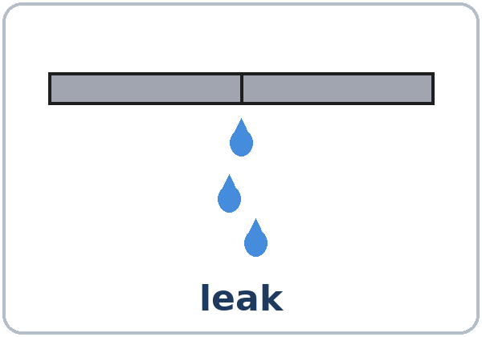
Something's Wrong
Today you will:
• Say what's wrong in a home
• Use something / anything / nothing
• Ask for a repair and set a time
Lesson 12 · Level 3
Notes:
Welcome learners as they arrive.
Point to the title and read it: "Something's wrong." Say: "Tonight we talk about problems in a home and how to ask for a repair."
Read the three lines under "Today you will". Give one quick example of each: "The sink is leaking." • "Is anything wrong? No, nothing is wrong." • "Can you send someone on Tuesday?"
Keep it practical and invented (important): never ask about learners' real rent, landlord, or living situation. Use the cards and invented apartments. Tenant rights are a Level 5 topic; if a learner asks, point to the local resources on the "Keep practicing" sheet.
Lesson plan: Topic; At a glance: Objectives; Teacher notes.
Picture: Twemoji graphics by Twitter, Inc. and other contributors (https://github.com/jdecked/twemoji), CC BY 4.0 (https://creativecommons.org/licenses/by/4.0/); resized and combined, with speech bubbles, signs, and labels (images/CREDITS.md).

Slide 2
Today's
Goals
01
I can say what's wrong in a home.
02
I can use something / anything / nothing.
03
I can ask for a repair and set a time.
By the end of class, you can do these five things.
The apartments are invented.
We check at 7:25!
04
I can use one negative only.
05
I can read and write a maintenance request.
Notes:
Read each goal slowly. Learners repeat.
Goal 1: Something is wrong with the heater. The sink is leaking. Goal 2: something / anything / nothing and someone / anyone / no one. Goal 3: Can you send someone? Is anyone home on Tuesday?
Goal 4: I didn't see anything. (not I didn't see nothing) Goal 5: read a maintenance request and write a short one (3–5 sentences).
"We check at 7:25" = the Progress Check. It is not a test grade.
Lesson plan: At a glance: Objectives.

Slide 3
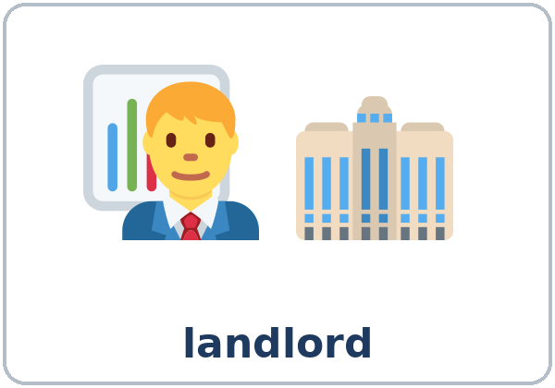
OPENING TALK · 6:00
Opening Talk
A asks a card question.
What was the last movie you saw? How was it?
B answers with 2–3 sentences.
A asks one follow-up.
How did you feel at the end?
Then switch.
Notes:
Step 1 · 6:00–6:10 · Opening Talk + Homework Check · 10 min. Pairs (7 pairs + 1 trio with 15 learners; 3–4 pairs with 7–8).
Before class, write on the board: How was it? It was… -ing / I was… -ed
Model with one learner: "What was the last movie you saw? How was it?" → (answer) → "How did you feel at the end?" (Click to show the follow-up.)
Opening Talk (6 min): learners open the Opening Talk page. A asks a card question; B answers with 2–3 sentences; A asks one follow-up. Switch after each card. The cards are on the next slide.
If behind: one card only, then the homework check.
Lesson plan: Step 1; Opening Talk page.
Picture: Twemoji graphics by Twitter, Inc. and other contributors (https://github.com/jdecked/twemoji), CC BY 4.0 (https://creativecommons.org/licenses/by/4.0/); resized and combined, with speech bubbles, signs, and labels (images/CREDITS.md).

Slide 4
Opening Talk
Cards
01
What was the last movie you saw? How was it?
02
What's a relaxing place in your town?
Work with a partner. Then switch.
Follow-ups:
How did you feel? Why? Who were you with?
03
What was the most exciting day this year?
04
What's boring for you? Why?
05
Homework check: Lesson 11, item 2.
Notes:
Step 1, continued. The four cards from the Opening Talk page. Each click shows the next card.
A asks a card question. B answers with 2–3 sentences. A asks one follow-up question (follow-ups on the right). Then switch.
Homework Check (4 min, last click): partners read their Lesson 11 Homework item 2 to each other. The partner asks one question about it. Walk around. Write 2 common errors on the board (often I was boring or It was excited) and correct them together.
Lesson plan: Step 1; Opening Talk page: cards, follow-ups, homework check.

Slide 5

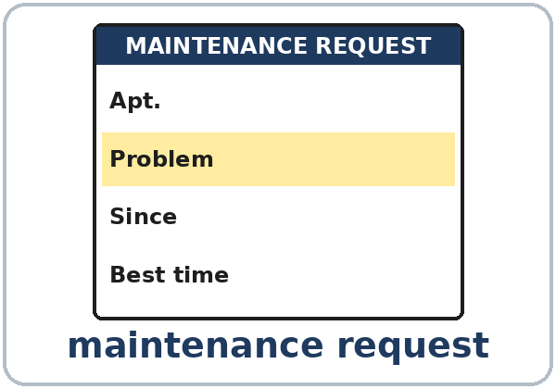
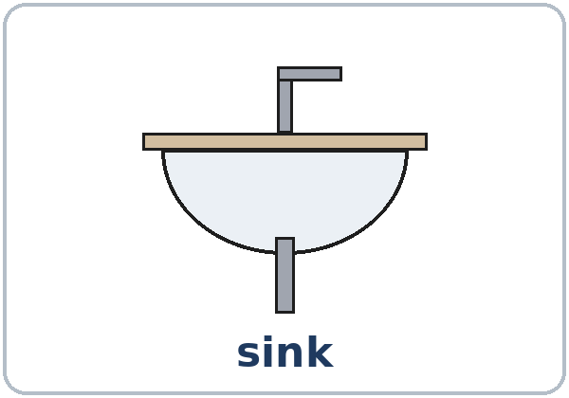
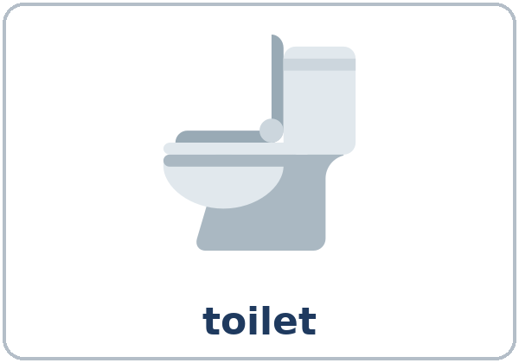
Look. Listen.
Repeat.
New Words
★ landlord
★ repair person
★ maintenance request
★ leak
★ sink
★ toilet
Notes:
Step 2 · 6:10–6:18 · New Words · 8 min (this slide and the next). Whole class, then pairs.
Point to each picture and say the word. Learners repeat once. ★ = the most important words. Each click shows the next word.
Show landlord and repair person: "The landlord owns the building. The repair person fixes things." Mime water drops from a leak.
If behind: teach the ★ words only.
Lesson plan: Step 2; Key vocabulary; New Words page.
Pictures: Twemoji graphics by Twitter, Inc. and other contributors (https://github.com/jdecked/twemoji), CC BY 4.0 (https://creativecommons.org/licenses/by/4.0/); resized and combined, with speech bubbles, signs, and labels (images/CREDITS.md).

Slide 6
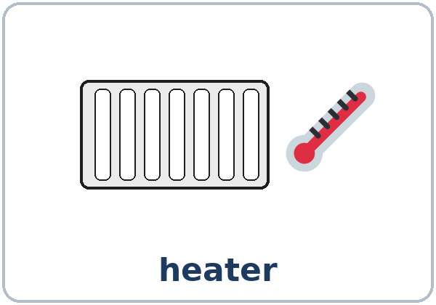

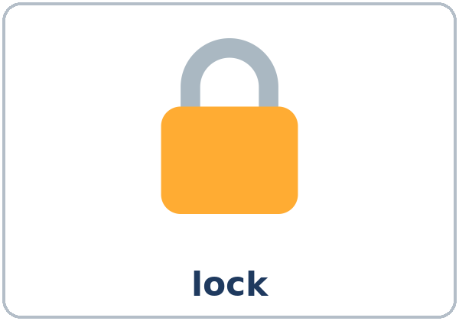
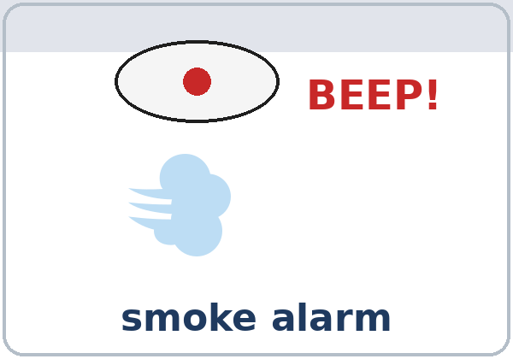


Partner game:
A says. B points.
More New Words
★ heater
★ light bulb
★ lock
★ smoke alarm
mouse
cockroach
Notes:
Step 2, continued. Point to each picture and say the word. Learners repeat once. Mime: try a door with a broken lock; cover your ears for a smoke alarm: "Beep! Beep!"
Partner game (2 min): A says a word. B points to the picture and makes a sentence (A: sink. B: The sink is leaking. Something is wrong with it.). Switch.
If behind: teach the ★ words only.
Lesson plan: Step 2; New Words page; Partner game.
Pictures: Twemoji graphics by Twitter, Inc. and other contributors (https://github.com/jdecked/twemoji), CC BY 4.0 (https://creativecommons.org/licenses/by/4.0/); resized and combined, with speech bubbles, signs, and labels (images/CREDITS.md).

Slide 7
Check the Meaning
Look at the picture. Answer the question.
1
2
3
Water is coming from the pipe. It's a…?
The room is cold. What's wrong?
You write about a problem on a…?
leak
the heater
maintenance request
Notes:
Step 2 · Check meaning · 1 min. Whole class.
The answers are hidden. Ask each question and wait for the class to answer. Then click to show the answer. Each click shows one answer, in order: 1, 2, 3.
1. "Water is coming from the pipe. It's a…?" (leak) • 2. "The room is cold. What's wrong?" (the heater) • 3. "You write about a problem on a…?" (maintenance request)
Lesson plan: Step 2: Check meaning.
Pictures: Twemoji graphics by Twitter, Inc. and other contributors (https://github.com/jdecked/twemoji), CC BY 4.0 (https://creativecommons.org/licenses/by/4.0/); resized and combined, with speech bubbles, signs, and labels (images/CREDITS.md).

Slide 8
Before You
Listen for:
Listen
What problems does Sara have?
Sara lives in an apartment. She's calling the building office. Mr. Grant is the building manager.
What day? What time?
01
Audio: about 1:16. It plays once.
Narrator
02
Sara
Play 1: Task A
03
Mr. Grant
Notes:
Step 3 · 6:18–6:30 · Listening + "Say it" · 12 min (slides 8 to 12). Individuals, then pairs check.
Before you listen (1 min). Say: "Sara lives in an apartment. She's calling the building office. What problems does she have? Listen."
There are three voices: a Narrator, Sara, and Mr. Grant (the building manager). Each click highlights the next voice.
The audio (L3_L12_listening.mp3, about 1:16) plays the conversation once. Press play again for play 2. A third play is fine if the class needs it.
No speaker? Read the script with a volunteer at a normal, friendly speed.
Audio: synthetic voices, computer-generated (Chatterbox TTS cloned from Kokoro-82M reference clips). No recordings of real people. The names and the story are invented.
Lesson plan: Step 3; Listening script; Listening page.
Picture: Twemoji graphics by Twitter, Inc. and other contributors (https://github.com/jdecked/twemoji), CC BY 4.0 (https://creativecommons.org/licenses/by/4.0/); resized and combined, with speech bubbles, signs, and labels (images/CREDITS.md).

Slide 9
Listen. What problems does Sara have?
Check ✓.
Listening A
the kitchen sink
✓
✗
the toilet
✓
✗
the heater
✓
✗
the lock
✓
✗
a mouse
✓
✗
Notes:
Play 1 → Task A (which problems?). Pairs compare. Check together.
Click to circle each answer (one click per item, top to bottom): ✓ the kitchen sink (it's leaking) • ✗ the toilet • ✓ the heater (it doesn't work) • ✗ the lock • ✗ a mouse.
Then read Tasks B and C together (1 min) so learners know what to listen for.
Lesson plan: Step 3; Listening Task A; Answer key.

Slide 10
Listen again.
Circle.
Listening B
1
Apartment: 4B / 4D
4B
2
Water on the floor: a little / a lot
a little
Pairs: compare your answers.
Then check together.
3
The heater screen is: black / blue
black
4
Day: Monday / Tuesday
Tuesday
5
Time: 9:00 / 3:00
3:00
Notes:
Play 2 → Tasks B and C. Pairs compare. Then show the answers.
Click to show each answer (one click per item, 1 to 5): 1 4B • 2 a little water • 3 black • 4 Tuesday • 5 3:00.
Lesson plan: Step 3; Listening Task B; Answer key.

Slide 11
Listen again.
Write the word.
Listening C
1
____ is wrong with my kitchen sink.
Something
2
Is there ____ water on the floor?
any
3
And there's ____ else. The heater doesn't work.
something
Words: something, anything, any, someone, anyone, no one
Pairs: compare your answers.
Then check together.
4
No, I don't see ____.
anything
5
I'll send ____ tomorrow morning.
someone
6
Is ____ home at nine?
anyone
7
No, ____ is home in the morning.
no one
Notes:
Task C (play 2). Click to show each answer (one click per item, 1 to 7): 1 Something, 2 any, 3 something, 4 anything, 5 someone, 6 anyone, 7 no one.
If behind: do Task C together on the board, reading the lines yourself.
Lesson plan: Step 3; Listening Task C; Answer key.

Slide 12
Say it: stress and th
Say It
The class repeats each line.
SOMEthing · ANyone · NO one
thing (not ting)
Stress the first part.
thing: tongue between the teeth (not ting).
Say each line two times.
Something is wrong with my sink.
Notes:
"Say it" (2 min). Say: "Stress the first part: SOMEthing, ANyone, NO one." Then thing: tongue between the teeth, th (not ting).
The class repeats each word twice, then the line in the box.
Lesson plan: Step 3: "Say it"; Listening page: Say it.

Slide 13
Grammar Box 1
Is anything wrong?
QUESTION
ANSWER
Is anything wrong?
Yes, something is wrong with the heater. / with the sink.
No, nothing is wrong. It's fine.
Is anything wrong with the lock?
Yes. It doesn't close. The door is open.
Notes:
Step 4 · 6:30–6:45 · Grammar Q&A · 15 min (slides 13 to 21). Whole class, then pairs. Show the Grammar page. The left side is the question. The right side is the answer.
Show it (2 min): look into an empty cup: "Is there anything in it? No, there isn't anything. There's nothing in it." Look at the door: "Is anyone at the door? No, no one is there."
Boxes 1, 2, and 3 (5 min): read a question from the left; the class answers from the right. Each click shows the answer side of one row.
Something is wrong with… is the most useful sentence today. Practice it with many nouns.
Lesson plan: Step 4; Grammar Box 1; Teacher notes.
Picture: Twemoji graphics by Twitter, Inc. and other contributors (https://github.com/jdecked/twemoji), CC BY 4.0 (https://creativecommons.org/licenses/by/4.0/); resized and combined, with speech bubbles, signs, and labels (images/CREDITS.md).

Slide 14
Grammar Box 2
Is anyone home?
QUESTION
ANSWER
Is anyone home on Tuesday?
Yes, someone is home after 3:00.
No, no one is home. We work all day.
Can you send someone today?
I'll send someone tomorrow morning.
Notes:
Box 2: Is anyone home? Each click shows the answer side of one row.
Review: If it gets worse, I'll call you (Lesson 6) and I'll send someone (Lesson 5). Accept both; don't teach them again.
Lesson plan: Step 4; Grammar Box 2; Teacher notes: Review.
Picture: Twemoji graphics by Twitter, Inc. and other contributors (https://github.com/jdecked/twemoji), CC BY 4.0 (https://creativecommons.org/licenses/by/4.0/); resized and combined, with speech bubbles, signs, and labels (images/CREDITS.md).

Slide 15
Grammar Box 3
Did you see anything?
QUESTION
ANSWER
Did you see anything?
No, I didn't see anything. (= I saw nothing.)
Did anyone call?
No, no one called.
Yes, someone called at 2:00.
Notes:
Box 3: one negative only: I didn't see anything or I saw nothing (not I didn't see nothing). Each click shows the answer side of one row.
Lesson plan: Step 4; Grammar Box 3; Teacher notes: One negative only.
Picture: Twemoji graphics by Twitter, Inc. and other contributors (https://github.com/jdecked/twemoji), CC BY 4.0 (https://creativecommons.org/licenses/by/4.0/); resized and combined, with speech bubbles, signs, and labels (images/CREDITS.md).

Slide 16
Grammar Box 4
some- / any- / no-
WHERE?
THINGS · PEOPLE · EXAMPLE
+ sentence
something · someone
Something is wrong.
question
anything · anyone
Is anyone home?
with not
not… anything · not… anyone
I didn't see anything.
alone
nothing · no one
No one is home.
Notes:
Box 4 (2 min): the table: some- in + sentences, any- in questions and with not, no- alone. Each click shows one row.
Point to the one-negative rule: I didn't see anything = I saw nothing.
Check questions: "Is ___ wrong?" (anything) • "Yes, ___ is wrong with the sink." (something) • "No, ___ is home." (no one) • "I didn't hear ___." (anything)
Lesson plan: Step 4; Grammar Box 4; Teacher notes: The rule in one line.
Picture: Twemoji graphics by Twitter, Inc. and other contributors (https://github.com/jdecked/twemoji), CC BY 4.0 (https://creativecommons.org/licenses/by/4.0/); resized and combined, with speech bubbles, signs, and labels (images/CREDITS.md).

Slide 17
Practice A
Write the word.
Practice A
1
____ is wrong with my toilet.
Something
2
Is ____ wrong with the light?
anything
3
The box is empty. There's ____ in it.
nothing
Words: something, anything, nothing, someone, anyone, no one
Pairs: check your answers.
4
I can hear ____ at the door.
someone
5
Is ____ home on Friday?
anyone
6
____ is home. We're at work.
No one
Notes:
Practice A and B (3 min): learners write, then pairs check. Go over the answers.
Click to show each answer (one click per item, 1 to 6): 1 Something, 2 anything, 3 nothing, 4 someone, 5 anyone, 6 No one.
Lesson plan: Step 4; Grammar Practice A; Answer key.

Slide 18
Circle the right word.
Practice B
1. I didn't hear ____.
anything
nothing
2. Can you send ____ today?
someone
anyone
3. Is ____ wrong with the heater?
something
anything
4. There's ____ in the fridge.
nothing
anything
5. Did ____ call?
anyone
no one
Notes:
Practice B. Learners circle the right word. Pairs check.
Click to circle each answer (one click per item, 1 to 5): 1 anything, 2 someone, 3 anything, 4 nothing, 5 anyone.
Lesson plan: Step 4; Grammar Practice B; Answer key.

Slide 19
Common Mistakes
Don't say
Say
I didn't see nothing.
I didn't see anything.
Anything is wrong with the sink.
Something is wrong with the sink.
No one is not home.
No one is home.
Is some one home?
Is anyone home?
Notes:
Common mistakes (never skip this table). Read a line from Don't say. Ask: "What's the right way?" Learners try first. Then click to show the right form. Each click shows one line, in order 1 to 4.
1 and 3: one negative only • 2: + sentences use some- • 4: questions use any-, and someone is one word. Is something wrong? is OK in real life, but teach anything first.
Say the right form clearly; the learner repeats. Learners can read the Spanish note and the tip on their Grammar page themselves; you don't need to explain them.
Lesson plan: Grammar: Common mistakes; Teacher notes: Typical mistakes.
Picture: Twemoji graphics by Twitter, Inc. and other contributors (https://github.com/jdecked/twemoji), CC BY 4.0 (https://creativecommons.org/licenses/by/4.0/); resized and combined, with speech bubbles, signs, and labels (images/CREDITS.md).

Slide 20
Pair Drill
A points and asks.
01
A points to a picture on the New Words page. B answers.
A: Is anything wrong with the ____?
B answers.
02
B: Yes, something is wrong with it. It's…
B: No, nothing is wrong.
Notes:
Pair drill (last 2 min of Step 4). Pairs.
A points to a picture on the New Words page: "Is anything wrong with the ___?" B answers: Yes, something is wrong with it. It's… or No, nothing is wrong. Switch.
If behind: skip the pair drill. Talk Time practices it.
Lesson plan: Step 4: Pair drill.
Picture: Twemoji graphics by Twitter, Inc. and other contributors (https://github.com/jdecked/twemoji), CC BY 4.0 (https://creativecommons.org/licenses/by/4.0/); resized and combined, with speech bubbles, signs, and labels (images/CREDITS.md).

Slide 21
Talk Time
The Repair Call
Round 1: back to back.
A = tenant. B = manager.
7:00–7:12
1
A calls and says what's wrong.
Something is wrong with my toilet. It's leaking.
2
B asks one question.
Is there any water on the floor?
3
Agree on an open day and time.
Is anyone home on Monday at 4:00?
Notes:
Step 5 · 7:00–7:12 · Talk Time: The Repair Call · 12 min. Round 1 is back to back.
Round 1 (7 min): A is a tenant with a Tenant Card; B is the building manager with the Repair Schedule. A calls: says what's wrong and since when. B asks one question (Is there any water on the floor?) and finds an open time when someone is home. They agree on a day and time; B writes it in the schedule. Switch roles with a new card. Each click shows the next step.
Model with one learner (1 min): you are the tenant with card 1: "Hi, this is apartment 3A. Something is wrong with my toilet. It's leaking." The manager: "Is anyone home on Monday at 4:00?" → "Yes, someone is home after 3."
Possible open times: card 1 → Mon 4:00 or Tue 4:00 • card 2 → Tue 9:00 or Fri 1:00 • card 3 → Thu 9:00 or Thu 1:00 • card 4 → Mon 1:00, Mon 4:00, or Fri 1:00. The conversations will vary.
Keep it practical and invented (important): never ask about learners' real rent, landlord, or living situation. Use the cards and invented apartments. Tenant rights are a Level 5 topic; if a learner asks, point to the local resources on the "Keep practicing" sheet.
Lesson plan: Step 5; Talk Time: The Repair Call; Answer key.
Picture: Twemoji graphics by Twitter, Inc. and other contributors (https://github.com/jdecked/twemoji), CC BY 4.0 (https://creativecommons.org/licenses/by/4.0/); resized and combined, with speech bubbles, signs, and labels (images/CREDITS.md).

Slide 22
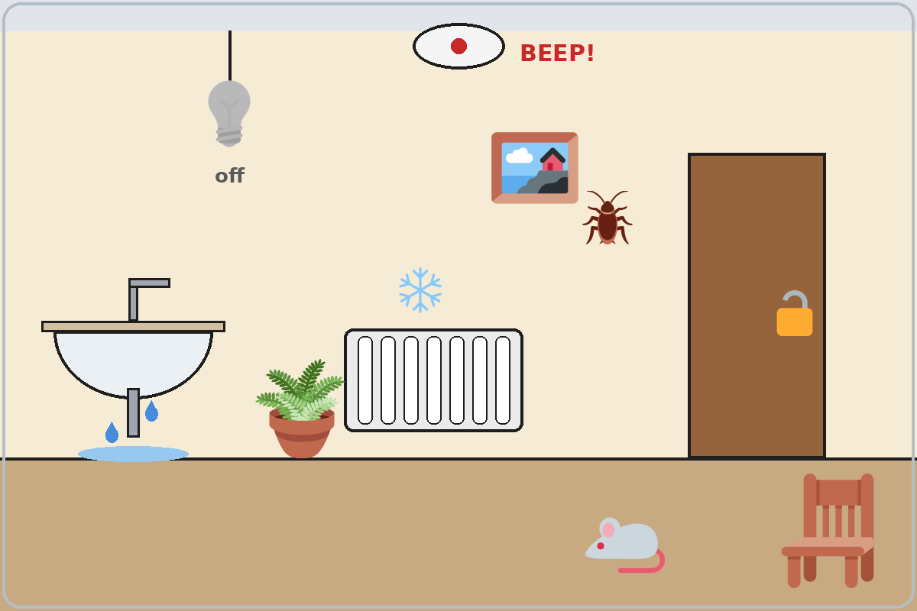
Talk Time
Find Something
Round 2: pairs.
Find 7 problems.
7:00–7:12
1
Look at the apartment picture.
Find 7 problems.
2
There's something wrong with the…
There's a… on the…
3
Say what is OK, too.
There isn't anything wrong with the chair.
Notes:
Round 2, Find Something (4 min): pairs look at the apartment picture and find 7 problems. The first pair to find all 7 wins. Each click shows the next step.
7 problems: the smoke alarm is beeping • the light bulb is out (off) • the sink is leaking • the heater doesn't work (it's cold) • the door lock is open / broken • a cockroach on the wall • a mouse on the floor. (Nothing is wrong with the plant, the chair, or the picture.)
If behind: Round 1 only.
Lesson plan: Step 5; Talk Time: Find Something; Answer key.
Picture: Twemoji graphics by Twitter, Inc. and other contributors (https://github.com/jdecked/twemoji), CC BY 4.0 (https://creativecommons.org/licenses/by/4.0/); resized and combined, with speech bubbles, signs, and labels (images/CREDITS.md).

Slide 23
Before You Go 7:12–7:17
01
Exit ticket
02
Homework
Write two sentences:
1. One with something / anything / nothing or someone / anyone / no one.
2. One with if or so:
No one is home in the morning, so please come at 3.
Give it to me at the door.
About 15 minutes.
1. Write it again with something….
2. 3 sentences: what's OK and what's wrong.
3. Practice a repair call.
4. Review: one -ing and one -ed word.
Bring it next week!
Notes:
Step 6 · 7:12–7:17 · Exit Ticket + Homework · 5 min · NEVER SKIP.
Exit ticket: each learner writes two sentences on a slip: one with something / anything / nothing or someone / anyone / no one (Something is wrong with my heater.), and one with if or so (No one is home in the morning, so please come at 3.). Collect at the door.
Homework: open the Homework page. Do item 1 together (one sentence on the board). Say: "About 15 minutes. Bring it next week."
Homework items: 1 write the sentence again with something, anything, nothing, someone, anyone, or no one • 2 look around your home (or imagine an apartment): 3 sentences, what's OK and what's wrong • 3 with a family member, practice a repair call; write the day and time you agreed on • 4 review (Lesson 11): 2 sentences about a TV show or an event, one -ing word and one -ed word.
Read & Write (7:17–7:25, on the Student Pages): a request form and Ken's note; questions 1–5; then a 3–5 sentence maintenance request. Say: "Invent the apartment, the problem, and a 555 number." If behind: questions 1–5 only; the request becomes homework.
Lesson plan: Step 6; Homework page; Read & Write step.
Picture: Twemoji graphics by Twitter, Inc. and other contributors (https://github.com/jdecked/twemoji), CC BY 4.0 (https://creativecommons.org/licenses/by/4.0/); resized and combined, with speech bubbles, signs, and labels (images/CREDITS.md).

Slide 24
Progress Check 7:25
D. I can…
😀 🙂 😐
Check one face.
I can say what's wrong in my home.
I can use something / anything / nothing.
I can ask for a repair and set a time.
I can write a short maintenance request.
A. Listen to the teacher. Circle a or b.
Answer
1. a. The sink has a problem. b. The sink is fine.
a
2. a. People are home on Monday. b. The apartment is empty on Monday.
b
3. a. I saw something. b. I saw nothing.
b
4. a. A repair person will come. b. No repair person will come.
a
Notes:
Progress Check · 7:25–7:30 · 5 min. Individuals. Open the Progress Check page.
Part A: read each sentence slowly, 2 times. Learners circle a or b. Then click to show the answer (one click per item, 1 to 4).
Say: 1 "Something is wrong with the sink." (a) • 2 "No one is home on Monday." (b) • 3 "I didn't see anything." (b) • 4 "I'll send someone on Friday." (a)
Parts B and C: learners do them alone. Walk around and help with the instructions only. B answers: 1 anything, 2 Someone, 3 anything, 4 no one. C: answers will vary (for example Something is wrong with my heater. It doesn't work. / Can you send someone on Tuesday after 3:00?).
Part D: read each "I can…" line aloud and point to the 3 faces: 😀 "I can do it." 🙂 "With a little help." 😐 "Not yet."
Scoring: A /4 + B /4 + C /2 = /10. This is not a test grade. It shows who needs more help hearing some- / any- / no- (A) and with the forms (B, C).
Collect the pages (or check them at the start of Week 14). If behind: do the Progress Check in Week 14 at 6:00, while learners arrive.
Lesson plan: Progress Check step; Progress Check page; Answer key.

Slide 25
Goodbye! See You Next Week!
Now you can:
• Say what's wrong in a home
• Use something / anything / nothing
• Ask for a repair and set a time
Lesson 12 · Level 3
Notes:
Read the title: "Goodbye! See you next week!" Learners repeat.
Read the three "Now you can" lines. Ask one learner: "Is anything wrong with the lights in this room?" and wait for an answer.
Remind learners: homework is about 15 minutes. Bring it next week.
Lesson plan: At a glance: Objectives; Step 6.
Picture: Twemoji graphics by Twitter, Inc. and other contributors (https://github.com/jdecked/twemoji), CC BY 4.0 (https://creativecommons.org/licenses/by/4.0/); resized and combined, with speech bubbles, signs, and labels (images/CREDITS.md).

Slide 26
Credits
Pictures
Vocabulary pictures use Twemoji graphics by Twitter, Inc. and other contributors (https://github.com/jdecked/twemoji), licensed under CC BY 4.0 (https://creativecommons.org/licenses/by/4.0/). The graphics were resized and combined, and speech bubbles, signs, and labels were added.
The faces on the Progress Check are standard emoji characters shown with the computer's emoji font.
Names and story
Sara, Mr. Grant, and Ken are invented names. The listening story is invented.
Audio and font
Audio: synthetic voices made with Chatterbox TTS (MIT License), cloned from short synthetic reference clips made with Kokoro-82M (Apache License 2.0). No recordings of real people were used. Each file carries an inaudible Perth watermark marking it as AI-generated. Font: Lexend Deca (OFL 1.1).
© 2026 the authors. The authors license this deck under CC BY-NC-SA 4.0.
Notes:
Credits. You don't need to read this slide in class.
Pictures: Twemoji graphics by Twitter, Inc. and other contributors, CC BY 4.0; the file-by-file list is in images/CREDITS.md.
Audio: synthetic voices, computer-generated (Chatterbox TTS cloned from Kokoro-82M reference clips). No recordings of real people. The names and the story are invented.
Course materials: © 2026 the authors, licensed under CC BY-NC-SA 4.0 (https://creativecommons.org/licenses/by-nc-sa/4.0/).
Lesson plan: Picture Credits. Picture list: images/CREDITS.md.

