Slide 1
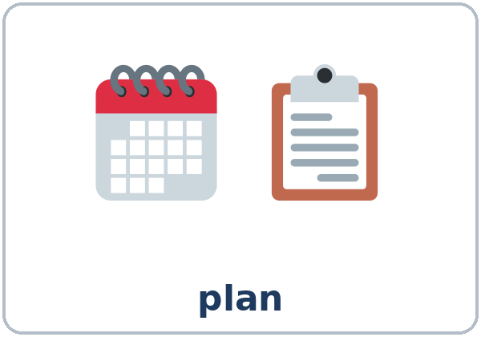
Where I'm Going
Today you will:
• Talk about a plan with going to
• Talk about hopes with hope to
• Give a short talk about your goals
Lesson 13 · Level 3
Notes:
Welcome learners as they arrive.
Point to the title and read it: "Where I'm going." Say: "Tonight we talk about our plans, our hopes, and our goals."
Read the three lines under "Today you will". Give one quick example of each: "I'm going to take a computer class." • "I hope to get my diploma." • "Then → Now → Next."
Goals are personal (important): every goal is a good goal. "Learn more English" and "help my kids" are great goals. Learners don't have to share personal details; an invented goal is fine. Don't ask about immigration status, money, or family problems.
Lesson plan: Topic; At a glance: Objectives; Teacher notes.
Picture: Twemoji graphics by Twitter, Inc. and other contributors (https://github.com/jdecked/twemoji), CC BY 4.0 (https://creativecommons.org/licenses/by/4.0/); resized and combined, with speech bubbles, signs, and labels (images/CREDITS.md).

Slide 2
Today's
Goals
01
I can talk about a plan with going to.
02
I can talk about hopes with hope to.
03
I can say what I will do first.
By the end of class, you can do these five things.
Every goal is a good goal.
We check at 7:25!
04
I can choose going to, will, or hope to.
05
I can give a 1–2 minute talk about my goals.
Notes:
Read each goal slowly. Learners repeat.
Goal 1: I'm going to take a computer class. Goal 2: I hope to get my diploma. / I hope I'll… Goal 3: First, I'll ask about classes.
Goal 4: going to (planned), will (decided now, a promise), or hope to (not sure). Goal 5: Then → Now → Next. Learners also read a community college flyer and write a graduation talk (6–8 sentences) in Read & Write.
"We check at 7:25" = the Progress Check. It is not a test grade.
Lesson plan: At a glance: Objectives.

Slide 3

OPENING TALK · 6:00
Opening Talk
A asks a card question.
What did you do this year that you're proud of?
B answers with 2–3 sentences.
A asks one follow-up.
How did you do it?
Then switch.
Notes:
Step 1 · 6:00–6:10 · Opening Talk + Homework Check · 10 min. Pairs (7 pairs + 1 trio with 15 learners; 3–4 pairs with 7–8).
Before class, write on the board: Is anything wrong? Something is wrong with… / No one is home.
Model with one learner: "What did you do this year that you're proud of?" → (answer) → "How did you do it?" (Click to show the follow-up.)
Opening Talk (6 min): learners open the Opening Talk page. A asks a card question; B answers with 2–3 sentences; A asks one follow-up. Switch after each card. The cards are on the next slide.
If behind: one card only, then the homework check.
Lesson plan: Step 1; Opening Talk page.
Picture: Twemoji graphics by Twitter, Inc. and other contributors (https://github.com/jdecked/twemoji), CC BY 4.0 (https://creativecommons.org/licenses/by/4.0/); resized and combined, with speech bubbles, signs, and labels (images/CREDITS.md).

Slide 4
Opening Talk
Cards
01
What did you do this year that you're proud of?
02
Is anything difficult for you in English? What?
Work with a partner. Then switch.
Follow-ups:
How did you do it? Why? Who helped you?
03
Something is wrong with your car. What do you do?
04
Did you learn anything new this month? What?
05
Homework check: Lesson 12, item 2.
Notes:
Step 1, continued. The four cards from the Opening Talk page. Each click shows the next card.
A asks a card question. B answers with 2–3 sentences. A asks one follow-up question (follow-ups on the right). Then switch.
Homework Check (4 min, last click): partners read their Lesson 12 Homework item 2 to each other. The partner asks one question about it. Walk around. Write 2 common errors on the board (often I didn't see nothing or Anything is wrong) and correct them together.
Lesson plan: Step 1; Opening Talk page: cards, follow-ups, homework check.

Slide 5
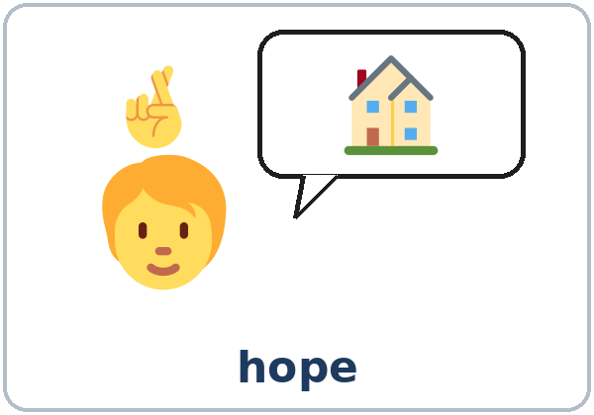
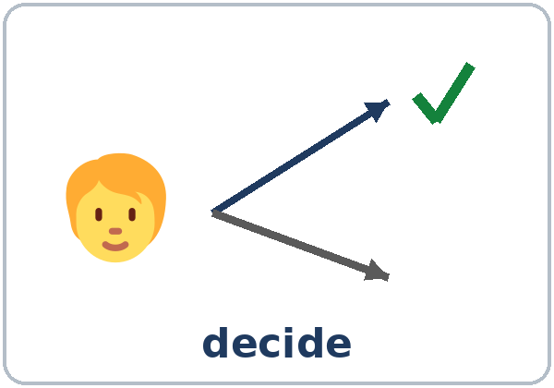
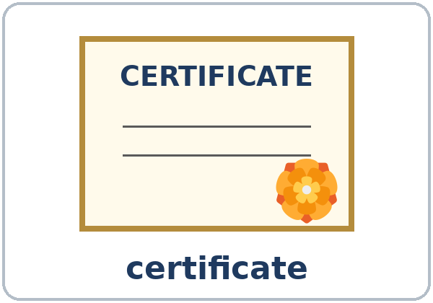
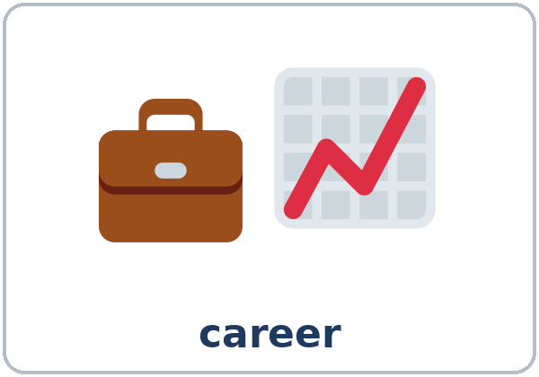
Look. Listen.
Repeat.
New Words
★ plan
★ hope
★ decide
★ diploma
★ certificate
★ career
Notes:
Step 2 · 6:10–6:18 · New Words · 8 min (this slide and the next). Whole class, then pairs.
Point to each picture and say the word. Learners repeat once. ★ = the most important words. Each click shows the next word.
Show diploma and certificate: "A diploma is from a school, like high school. A certificate is for a job skill, like a medical assistant or a forklift driver."
If behind: teach the ★ words only.
Lesson plan: Step 2; Key vocabulary; New Words page.
Pictures: Twemoji graphics by Twitter, Inc. and other contributors (https://github.com/jdecked/twemoji), CC BY 4.0 (https://creativecommons.org/licenses/by/4.0/); resized and combined, with speech bubbles, signs, and labels (images/CREDITS.md).

Slide 6
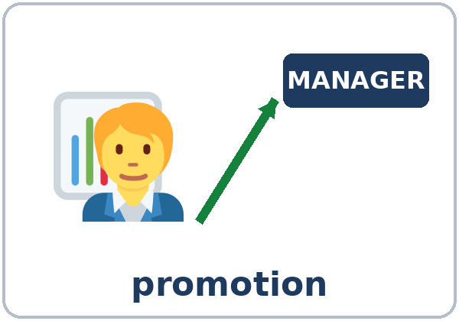
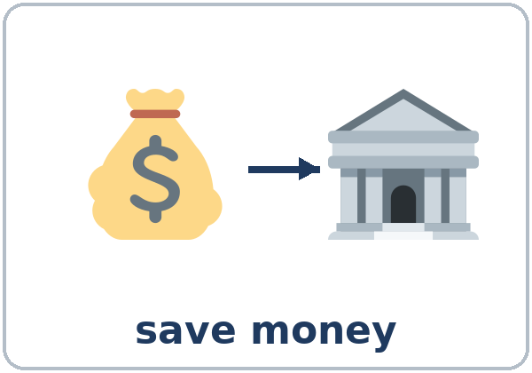
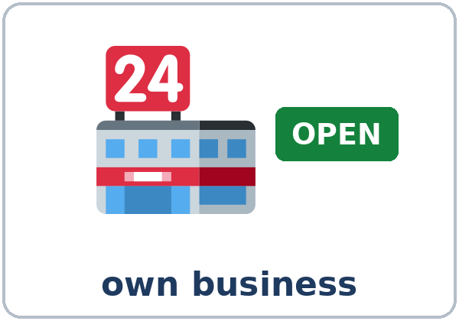
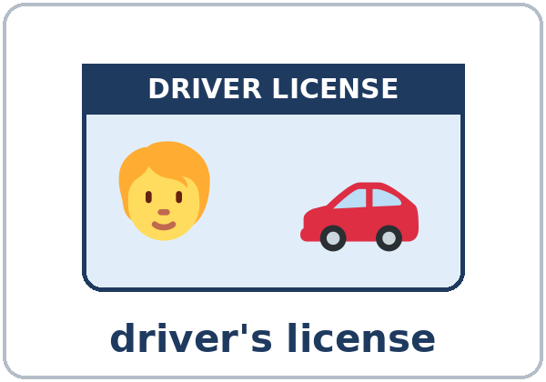
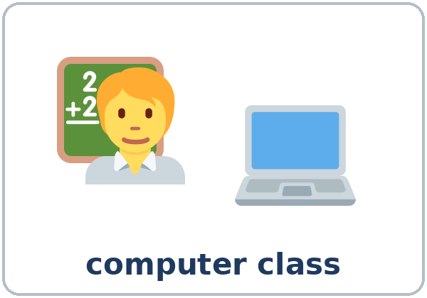

Partner game:
A says. B points.
More New Words
★ promotion
★ save money
★ own business
★ driver's license
★ computer class
community college
Notes:
Step 2, continued. Point to each picture and say the word. Learners repeat once.
Partner game (2 min): A says a word. B points to the picture and makes a sentence about a goal (A: driver's license. B: I hope to get my driver's license next year.). Switch.
If behind: teach the ★ words only.
Lesson plan: Step 2; New Words page; Partner game.
Pictures: Twemoji graphics by Twitter, Inc. and other contributors (https://github.com/jdecked/twemoji), CC BY 4.0 (https://creativecommons.org/licenses/by/4.0/); resized and combined, with speech bubbles, signs, and labels (images/CREDITS.md).

Slide 7
Check the Meaning
Look at the picture. Answer the question.
1
2
3
A better job at the same company?
Money in the bank every month?
You need it to drive a car.
promotion
save money
a driver's license
Notes:
Step 2 · Check meaning · 1 min. Whole class.
The answers are hidden. Ask each question and wait for the class to answer. Then click to show the answer. Each click shows one answer, in order: 1, 2, 3.
1. "You get a better job at the same company. It's a…?" (promotion) • 2. "You put money in the bank every month. You…?" (save money) • 3. "You need it to drive a car." (a driver's license)
Lesson plan: Step 2: Check meaning.
Pictures: Twemoji graphics by Twitter, Inc. and other contributors (https://github.com/jdecked/twemoji), CC BY 4.0 (https://creativecommons.org/licenses/by/4.0/); resized and combined, with speech bubbles, signs, and labels (images/CREDITS.md).

Slide 8
Before You
Listen for:
Listen
What is her main goal?
Sofia was a Level 3 student. Tonight she's talking to the class about her goals. Mr. Novak is the teacher.
What will she do first?
01
Audio: about 1:09. It plays once.
Narrator
02
Sofia
Play 1: Task A
03
Mr. Novak
Notes:
Step 3 · 6:18–6:30 · Listening + "Say it" · 12 min (slides 8 to 12). Individuals, then pairs check.
Before you listen (1 min). Say: "Sofia was a Level 3 student. Tonight she's visiting the class. She's talking about her goals. What is her main goal? Listen."
There are three voices: a Narrator, Sofia, and Mr. Novak (the teacher). Each click highlights the next voice.
The audio (L3_L13_listening.mp3, about 1:09) plays the talk once. Press play again for play 2. A third play is fine if the class needs it.
No speaker? Read the script with a volunteer at a normal, friendly speed.
Audio: synthetic voices, computer-generated (Chatterbox TTS cloned from Kokoro-82M reference clips). No recordings of real people. The names and the story are invented.
Lesson plan: Step 3; Listening script; Listening page.
Picture: Twemoji graphics by Twitter, Inc. and other contributors (https://github.com/jdecked/twemoji), CC BY 4.0 (https://creativecommons.org/licenses/by/4.0/); resized and combined, with speech bubbles, signs, and labels (images/CREDITS.md).

Slide 9
Listen. What is Sofia's main goal?
Circle.
Listening A
Main goal:
a. a driver's license
b. a medical assistant certificate
c. her own business
Notes:
Play 1 → Task A (her main goal). Pairs compare. Check together.
Click to circle the answer: b (a medical assistant certificate).
Then read Tasks B and C together (1 min) so learners know what to listen for.
Lesson plan: Step 3; Listening Task A; Answer key.

Slide 10
Listen again.
Number the steps. Then circle.
Listening B
1
take a computer class
3
2
came to this class
1
3
work at a clinic
5
Number the steps 1–5: Then → Now → Next.
Pairs: compare your answers.
4
works at a hotel
2
5
apply for the certificate program
4
6
The class starts in: January / June
January
7
She works at: a hotel / a clinic
a hotel
Notes:
Play 2 → Tasks B and C. Pairs compare. Then show the answers.
Click to show each answer (one click per line, top to bottom): take a computer class 3 • came to this class 1 • work at a clinic 5 • works at a hotel 2 • apply for the certificate program 4 • the computer class starts in January • she works at a hotel.
Lesson plan: Step 3; Listening Task B; Answer key.

Slide 11
Listen again.
Write the word.
Listening C
1
I ____ work at a clinic.
hope to
2
How are you ____ do that?
going to
Words: hope to, going to, 'll
Pairs: compare your answers.
Then check together.
3
First, I'm ____ take a computer class at the community college.
going to
4
After that, I____ apply for the certificate program.
'll
5
And I ____ help my kids with their homework, too.
hope to
Notes:
Task C (play 2). Click to show each answer (one click per item, 1 to 5): 1 hope to, 2 going to, 3 going to, 4 'll (I'll), 5 hope to.
If behind: do Task C together on the board, reading the lines yourself.
Lesson plan: Step 3; Listening Task C; Answer key.

Slide 12
Say it: pause and stress
Say It
The class repeats the line.
Three years ago, (pause) I came to this class.
(pause) Now (pause) I work at a hotel.
Pause after each idea.
Stress the important word.
Say the line two times.
going to → "gonna" (understand it; say going to)
Notes:
"Say it" (2 min). Say: "In a talk, pause after each idea, and stress the important word." Read the line in the box with pauses.
Then: "People often say going to as gonna. You can understand it; you don't need to say it." The class repeats the line twice.
gonna: learners will hear it everywhere. They only need to understand it; in their talk, they say going to.
Lesson plan: Step 3: "Say it"; Listening page: Say it; Teacher notes.

Slide 13
Grammar Box 1
going to (a plan)
QUESTION
ANSWER
What are you going to do next year?
I'm going to take a computer class.
Are you going to apply?
Yes, I'm going to apply in January.
When are you meeting the counselor?
I'm meeting the counselor on Monday.
Notes:
Step 4 · 6:30–6:45 · Grammar Q&A · 15 min (slides 13 to 21). Whole class, then pairs. Show the Grammar page. The left side is the question. The right side is the answer.
Show it (2 min): write three sentences on the board: I'm going to take a class in January. (planned) • OK, I'll call the college tomorrow. (decided now) • I hope to get a better job. (I want it, but I'm not sure).
Boxes 1, 2, and 3 (5 min): read a question from the left; the class answers from the right. Each click shows the answer side of one row.
Lesson plan: Step 4; Grammar Box 1.
Picture: Twemoji graphics by Twitter, Inc. and other contributors (https://github.com/jdecked/twemoji), CC BY 4.0 (https://creativecommons.org/licenses/by/4.0/); resized and combined, with speech bubbles, signs, and labels (images/CREDITS.md).

Slide 14
Grammar Box 2
hope to / I hope I'll (a hope)
QUESTION
ANSWER
What do you hope to do?
I hope to get my diploma.
I hope I'll have my own business.
What do you plan to / want to do?
I plan to / I want to save money for a car.
Notes:
Box 2. Point out: hope to + verb, but I hope I'll + verb. Both are fine. I hope I will to… is wrong. Each click shows the answer side of one row.
Lesson plan: Step 4; Grammar Box 2; Teacher notes.
Picture: Twemoji graphics by Twitter, Inc. and other contributors (https://github.com/jdecked/twemoji), CC BY 4.0 (https://creativecommons.org/licenses/by/4.0/); resized and combined, with speech bubbles, signs, and labels (images/CREDITS.md).

Slide 15
Grammar Box 3
will (decided now, a promise)
QUESTION
ANSWER
What will you do first?
First, I'll ask about classes at the community college.
Can you call them?
OK, I'll call them tomorrow.
Notes:
Box 3: will = decided now or a promise. Each click shows the answer side of one row.
Lesson plan: Step 4; Grammar Box 3.
Picture: Twemoji graphics by Twitter, Inc. and other contributors (https://github.com/jdecked/twemoji), CC BY 4.0 (https://creativecommons.org/licenses/by/4.0/); resized and combined, with speech bubbles, signs, and labels (images/CREDITS.md).

Slide 16
Grammar Box 4
Which one?
FORM
MEANING · EXAMPLE
going to
already planned
I'm going to take a class in January.
will ('ll)
decided now, or a promise
OK, I'll call the college tomorrow.
hope to / I hope I'll
I want it, but I'm not sure
I hope to get a promotion.
plan to / want to
my idea for the future
I plan to save money.
Notes:
Box 4 (2 min): which one? Read the table. Then plan to / want to / hope to + verb. Each click shows one row.
Three forms, three meanings: going to = already planned. will = decided now or a promise. hope to = you want it, but you're not sure.
Check questions: "I ___ get my diploma." (hope to) • "Next year, I'm ___ take a computer class." (going to) • "The phone is ringing. I ___ get it!" ('ll) • "I hope I ___ have my own business." ('ll)
Lesson plan: Step 4; Grammar Box 4; Teacher notes.
Picture: Twemoji graphics by Twitter, Inc. and other contributors (https://github.com/jdecked/twemoji), CC BY 4.0 (https://creativecommons.org/licenses/by/4.0/); resized and combined, with speech bubbles, signs, and labels (images/CREDITS.md).

Slide 17
Practice A
Write the word.
Practice A
1
I bought the books. I'm ____ start the class on Monday. (planned)
going to
2
The phone is ringing. I____ get it! (decided now)
'll
Words: going to, 'll, hope to
Pairs: check your answers.
3
I ____ get a promotion, but I'm not sure. (a hope)
hope to
4
She's ____ take the driving test in May. (planned)
going to
5
Don't worry. I____ help you with your talk. (a promise)
'll
Notes:
Practice A and B (3 min): learners write, then pairs check. Go over the answers.
Click to show each answer (one click per item, 1 to 5): 1 going to, 2 'll, 3 hope to, 4 going to, 5 'll.
Lesson plan: Step 4; Grammar Practice A; Answer key.

Slide 18
Circle the right words.
Practice B
1. I hope ____ my diploma.
to get
get
2. ____ call the college tomorrow.
I'll
I'll to
3. We're ____ open a small business.
going to
going
4. I plan ____ money for a car.
save
to save
5. I hope ____ have a better job.
I'll
I will to
Notes:
Practice B. Learners circle the right words. Pairs check.
Click to circle each answer (one click per item, 1 to 5): 1 to get, 2 I'll, 3 going to, 4 to save, 5 I'll.
Lesson plan: Step 4; Grammar Practice B; Answer key.

Slide 19
Common Mistakes
Don't say
Say
I hope get my diploma.
I hope to get my diploma.
I will to study English.
I will study English.
I'm going to studying.
I'm going to study.
I plan save money.
I plan to save money.
Notes:
Common mistakes (never skip this table). Read a line from Don't say. Ask: "What's the right way?" Learners try first. Then click to show the right form. Each click shows one line, in order 1 to 4.
Also typical this week: I hope I will to… (say: I hope I'll…).
Say the right form clearly; the learner repeats. Learners can read the Spanish note and the tip on their Grammar page themselves; you don't need to explain them.
Lesson plan: Grammar: Common mistakes; Teacher notes: Typical mistakes.
Picture: Twemoji graphics by Twitter, Inc. and other contributors (https://github.com/jdecked/twemoji), CC BY 4.0 (https://creativecommons.org/licenses/by/4.0/); resized and combined, with speech bubbles, signs, and labels (images/CREDITS.md).

Slide 20
Pair Drill
A asks.
01
A asks. B answers and adds one I hope to…
A: What are you going to do next year?
B answers + hope to.
02
B: I'm going to save money. I hope to buy a car.
Then switch roles.
Notes:
Pair drill (last 2 min of Step 4). Pairs.
A asks "What are you going to do next year?" B answers and adds one I hope to… (I'm going to save money. I hope to buy a car.). Switch.
If behind: skip the pair drill. Talk Time practices it.
Lesson plan: Step 4: Pair drill.
Picture: Twemoji graphics by Twitter, Inc. and other contributors (https://github.com/jdecked/twemoji), CC BY 4.0 (https://creativecommons.org/licenses/by/4.0/); resized and combined, with speech bubbles, signs, and labels (images/CREDITS.md).

Slide 21
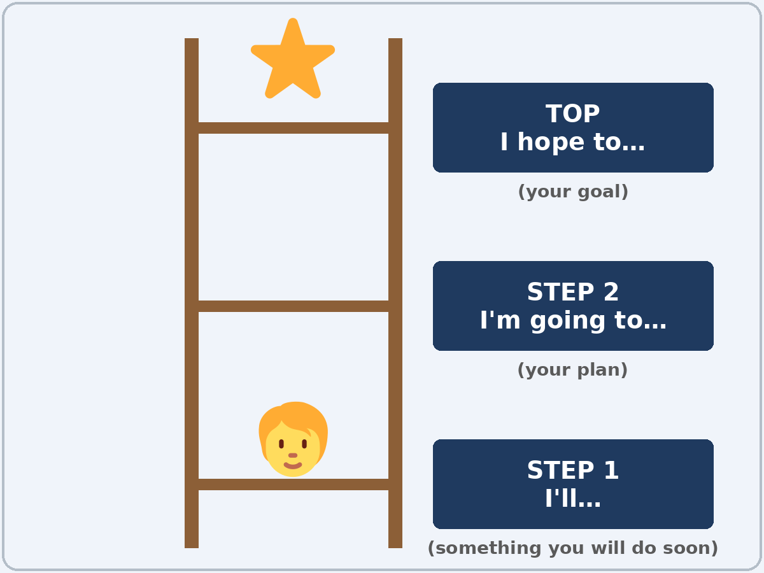
Talk Time
Goal Ladder
Pairs.
Choose one goal.
7:00–7:12
1
Fill in your ladder, bottom to top.
I'll… → I'm going to… → I hope to…
2
Explain it to your partner.
First, I'll… Then I'm going to…
3
Your partner asks 2 follow-up questions.
When? Why? Who can help you?
Notes:
Step 5 · 7:00–7:12 · Talk Time: Goal Ladder + Talk Rehearsal · 12 min.
Model your own talk first (1 min): give your 1-minute talk (Then → Now → Next, one reason). Example: "Ten years ago, I was a cook. Now I'm a volunteer teacher. Next year, I'm going to take a Spanish class, because I want to understand my neighbors. I hope to visit Mexico." Point to each part on the board as you speak.
Goal Ladder, pairs (4 min): each learner fills in the ladder on the Talk Time page for one goal (step 1: I'll…; step 2: I'm going to…; top: I hope to…). Then explains it to a partner, who asks two follow-up questions (When? Why? Who can help you? What will you do first?). Each click shows the next step.
Goals are personal (important): every goal is a good goal. "Learn more English" and "help my kids" are great goals. Learners don't have to share personal details; an invented goal is fine. Don't ask about immigration status, money, or family problems.
Lesson plan: Step 5; Talk Time: Goal Ladder; Teacher notes.
Picture: Twemoji graphics by Twitter, Inc. and other contributors (https://github.com/jdecked/twemoji), CC BY 4.0 (https://creativecommons.org/licenses/by/4.0/); resized and combined, with speech bubbles, signs, and labels (images/CREDITS.md).

Slide 22
Talk Frame
Then → Now → Next
PART
SAY
Then
… years ago, I… / When I started this class, I…
Now
Now I… / I can… in English.
Next
My main goal is to… / I'm going to… / I hope to…
Why
…because… / …so…
First step
First, I'll…
Thank you
Thank you for listening.
Notes:
Talk Rehearsal, groups of 3 (6 min): each learner gives the talk (Then → Now → Next, with a reason); reading from the frame is fine. Each click shows one part of the frame.
The 2 listeners fill in a Feedback Card: one thing I liked and one tip. About 2 minutes per speaker.
If behind: the ladder only; the rehearsal becomes homework (practice at home with a family member).
Graduation (Week 16): learners may read their talk from paper. Mixed levels: stronger learners add a reason to every step and a time (in January, next year). Newer learners use the talk frame word for word.
Lesson plan: Step 5; Talk Time: Talk Rehearsal; Teacher notes.
Picture: Twemoji graphics by Twitter, Inc. and other contributors (https://github.com/jdecked/twemoji), CC BY 4.0 (https://creativecommons.org/licenses/by/4.0/); resized and combined, with speech bubbles, signs, and labels (images/CREDITS.md).

Slide 23
Before You Go 7:12–7:17
01
Exit ticket
02
Homework
Write two sentences:
1. One with going to or hope to.
2. One with I'll and because or so:
First, I'll study the book, because the test is hard.
Give it to me at the door.
About 15 minutes.
1. Write the sentence.
2. Practice your talk 2 times.
3. Ask: What do you hope to do next year?
4. Review: something / no one.
Bring it to graduation!
Notes:
Step 6 · 7:12–7:17 · Exit Ticket + Homework · 5 min · NEVER SKIP.
Exit ticket: each learner writes two sentences on a slip: one with going to or hope to (I hope to get my driver's license.), and one with I'll and because or so (First, I'll study the book, because the test is hard.). Collect at the door.
Homework: open the Homework page. Do item 1 together (one sentence on the board). Say: "About 15 minutes. Next week is the final exam. In Week 16, you'll give your talk at graduation."
Homework items: 1 write the sentence with the words • 2 practice your talk at home 2 times; how long was it? • 3 ask a family member or a friend: What do you hope to do next year? Write the answer • 4 review (Lesson 12): 2 sentences with something, anything, someone, or no one.
Read & Write (7:17–7:25, on the Student Pages): a community college flyer; questions 1–5; pairs check; then learners start their graduation talk (6–8 sentences) with the talk frame and finish it at home. If behind: questions 1–5 only; the talk becomes homework.
Next week (Week 15) is the final exam; remind learners to bring their talk draft to graduation.
Lesson plan: Step 6; Homework page; Read & Write step; Teacher notes.
Picture: Twemoji graphics by Twitter, Inc. and other contributors (https://github.com/jdecked/twemoji), CC BY 4.0 (https://creativecommons.org/licenses/by/4.0/); resized and combined, with speech bubbles, signs, and labels (images/CREDITS.md).

Slide 24
Progress Check 7:25
D. I can…
😀 🙂 😐
Check one face.
I can talk about a plan with going to.
I can talk about hopes with hope to / I hope I'll.
I can say what I will do to reach a goal.
I can give a 1–2 minute talk about my goals.
A. Listen to the teacher. Circle a or b.
Answer
1. a. It's a plan. b. It's a hope.
a
2. a. It's a plan. b. It's a hope.
b
3. a. She planned it last week. b. She decided now.
b
4. a. It's a fixed plan. b. It's a hope.
a
Notes:
Progress Check · 7:25–7:30 · 5 min. Individuals. Open the Progress Check page.
Part A: read each sentence slowly, 2 times. Learners circle a or b. Then click to show the answer (one click per item, 1 to 4).
Say: 1 "I'm going to take a class in March." (a) • 2 "I hope to open my own business." (b) • 3 "OK, I'll call them tomorrow." (b) • 4 "I'm meeting the counselor on Monday." (a)
Parts B and C: learners do them alone. Walk around and help with the instructions only. B answers: 1 to get, 2 going to, 3 I'll, 4 to. C: answers will vary (for example I'm going to save money for a car. / I hope to get a promotion.).
Part D: read each "I can…" line aloud and point to the 3 faces: 😀 "I can do it." 🙂 "With a little help." 😐 "Not yet."
Scoring: A /4 + B /4 + C /2 = /10. This is not a test grade. It shows who needs more help hearing the future forms (A) and with the forms (B, C).
Collect the pages (or check them in Week 15 before the final). If behind: do the Progress Check in Week 15 at 6:00, before the final exam.
Lesson plan: Progress Check step; Progress Check page; Answer key.

Slide 25
Goodbye! See You Next Week!
Now you can:
• Talk about a plan with going to
• Talk about hopes with hope to
• Give a short talk about your goals
Lesson 13 · Level 3
Notes:
Read the title: "Goodbye! See you next week!" Learners repeat.
Read the three "Now you can" lines. Ask one learner: "What are you going to do next year?" and wait for an answer.
Remind learners: next week (Week 15) is the final exam. Bring your talk draft to graduation (Week 16).
Lesson plan: At a glance: Objectives; Step 6; Teacher notes.
Picture: Twemoji graphics by Twitter, Inc. and other contributors (https://github.com/jdecked/twemoji), CC BY 4.0 (https://creativecommons.org/licenses/by/4.0/); resized and combined, with speech bubbles, signs, and labels (images/CREDITS.md).

Slide 26
Credits
Pictures
Vocabulary pictures use Twemoji graphics by Twitter, Inc. and other contributors (https://github.com/jdecked/twemoji), licensed under CC BY 4.0 (https://creativecommons.org/licenses/by/4.0/). The graphics were resized and combined, and speech bubbles, signs, and labels were added.
The faces on the Progress Check are standard emoji characters shown with the computer's emoji font.
Names and story
Sofia and Mr. Novak are invented names. The listening story is invented.
Audio and font
Audio: synthetic voices made with Chatterbox TTS (MIT License), cloned from short synthetic reference clips made with Kokoro-82M (Apache License 2.0). No recordings of real people were used. Each file carries an inaudible Perth watermark marking it as AI-generated. Font: Lexend Deca (OFL 1.1).
© 2026 the authors. The authors license this deck under CC BY-NC-SA 4.0.
Notes:
Credits. You don't need to read this slide in class.
Pictures: Twemoji graphics by Twitter, Inc. and other contributors, CC BY 4.0; the file-by-file list is in images/CREDITS.md.
Audio: synthetic voices, computer-generated (Chatterbox TTS cloned from Kokoro-82M reference clips). No recordings of real people. The names and the story are invented.
Course materials: © 2026 the authors, licensed under CC BY-NC-SA 4.0 (https://creativecommons.org/licenses/by-nc-sa/4.0/).
Lesson plan: Picture Credits. Picture list: images/CREDITS.md.

