Slide 1
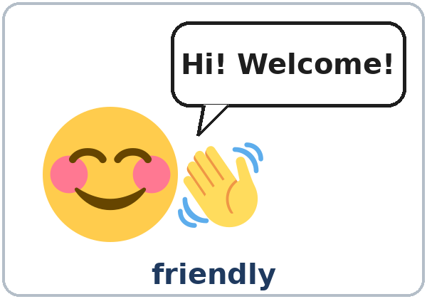
Who's Who?
Today you will:
• Describe how someone looks
• Describe someone's personality
• Use me, him, her, us, them
Lesson 2 · Level 3
Notes:
Welcome learners as they arrive.
Point to the title and read it: "Who's who?" Say: "Tonight we describe people: how they look and what they are like."
Read the three lines under "Today you will". Give one quick example of each: "She's tall. She has curly hair." (looks) • "He's friendly and funny." (personality) • "I work with her." (object pronoun).
Kind words only: tonight we talk about hair, height, glasses, beards, clothes, and personality. Never weight, skin color, or age.
Lesson plan: Topic; At a glance: Objectives; Teacher notes: Kind words only.
Picture: Twemoji graphics by Twitter, Inc. and other contributors (https://github.com/jdecked/twemoji), CC BY 4.0 (https://creativecommons.org/licenses/by/4.0/); resized and combined, with drawn bodies, glasses, speech bubbles, and labels (images/CREDITS.md).

Slide 2
01
I can describe how someone looks.
tall · curly hair · glasses
Today's
Goals
02
I can describe someone's personality.
03
I can ask What does he look like? and What's he like?
By the end of class, you can do these six things.
Use kind words only.
We check at 7:25!
04
I can say which one: the woman with long hair.
05
I can use me, him, her, us, them.
06
I can write about a friend.
Notes:
Read each goal slowly. Learners repeat.
Goal 1: height, hair, a beard, glasses, clothes (She's tall. She has curly hair.). Goal 2: personality (He's friendly and funny.).
Goal 3: What does he look like? (looks) and What's he like? (personality). Goal 4: Which one is your sister? → The woman with long hair.
Goal 5: object pronouns me, him, her, us, them (I work with her. She always helps me.). Goal 6: read a short welcome email and write 3–4 sentences about a friend or family member.
"We check at 7:25" = the Progress Check. It is not a test grade.
Lesson plan: At a glance: Objectives; Progress Check.

Slide 3
OPENING TALK · 6:00
Opening Talk
A asks a card question.
Why are you learning English?
B answers with a reason.
A asks one follow-up.
Really? Where do you use English?
Then switch.
Notes:
Step 1 · 6:00–6:10 · Opening Talk + Homework Check · 10 min. Pairs, the same partner for both parts. 15 learners: 7 pairs + 1 group of 3. 7–8 learners: 3–4 pairs.
Before class, write on the board: Ask one follow-up question. Give a reason: because… / so…
Model with one learner: "Why are you learning English?" → (answer) → "Really? Where do you use English?" (Click to show the follow-up.)
Opening Talk (6 min): learners open the Opening Talk page. A asks a card question; B answers with a reason; A asks one follow-up. Switch after each card. The cards are on the next slide.
Late arrivals join any pair as a group of 3. If behind: one card only, then the homework check.
Lesson plan: Step 1; Opening Talk page.
Picture: Twemoji graphics by Twitter, Inc. and other contributors (https://github.com/jdecked/twemoji), CC BY 4.0 (https://creativecommons.org/licenses/by/4.0/); resized and combined, with drawn bodies, glasses, speech bubbles, and labels (images/CREDITS.md).

Slide 4
Opening Talk
Cards
01
Why are you learning English?
02
What did you do last weekend?
Work with a partner. Then switch.
Follow-ups:
Really? Why? What happened? How was it? Where? Who with? What about you?
03
Tell me about a neighbor or a coworker.
04
What are you going to do this weekend? Why?
05
Homework check: Lesson 1, item 1.
Notes:
Step 1, continued. The four cards from the Opening Talk page. Each click shows the next card.
A asks a card question. B answers with a reason. A asks one follow-up question (follow-ups on the right). Then switch.
Homework Check (4 min, last click): partners compare Lesson 1 Homework item 1 (the because answers): "My partner's answer to Why are you learning English?" Walk around. Write 2 common errors on the board and correct them together. Correct only those 2.
Lesson plan: Step 1; Opening Talk page: cards, follow-ups, homework check.

Slide 5
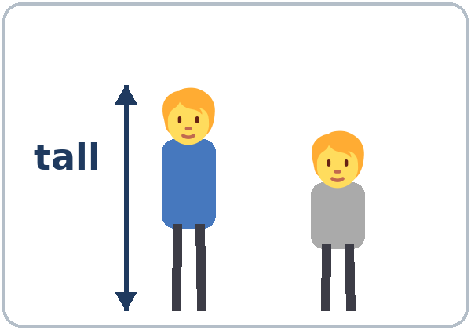
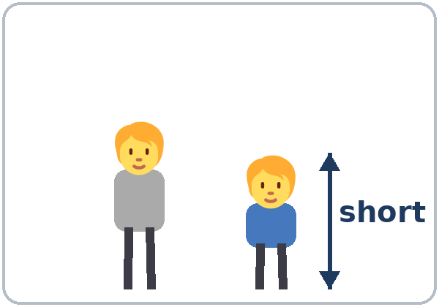
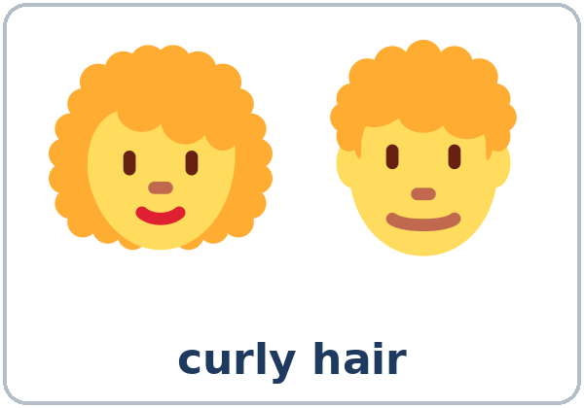
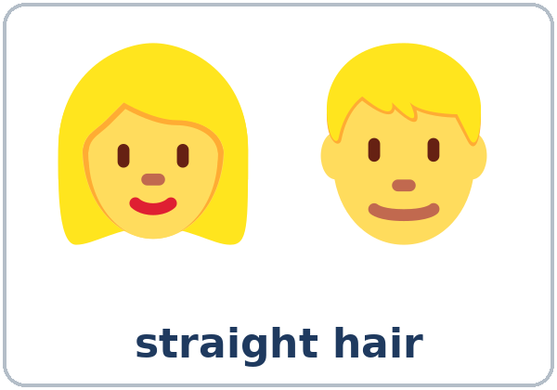
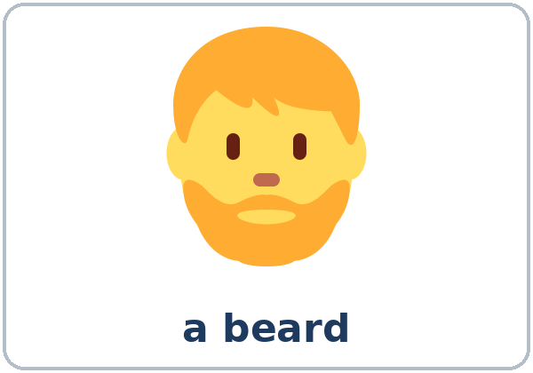
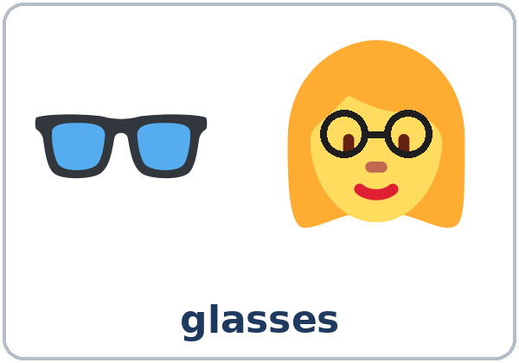
Look. Listen.
Repeat.
New Words
★ tall
★ short
★ curly hair
★ straight hair
★ beard
★ glasses
Notes:
Step 2 · 6:10–6:18 · New Words · 8 min (this slide and the next). Whole class, then pairs.
Point to each picture and say the word. Learners repeat once. ★ = the most important words. Each click shows the next word.
Use the class: "Who has glasses?" (learners with glasses raise a hand) • "Who has curly hair?"
Two groups of words: draw two columns on the board: LOOKS (tall, short, curly hair, straight hair, beard, glasses) and PERSONALITY (friendly, shy, funny, hardworking, patient, quiet).
If behind: teach the ★ words only.
Lesson plan: Step 2; Key vocabulary; New Words page.
Pictures: Twemoji graphics by Twitter, Inc. and other contributors (https://github.com/jdecked/twemoji), CC BY 4.0 (https://creativecommons.org/licenses/by/4.0/); resized and combined, with drawn bodies, glasses, speech bubbles, and labels (images/CREDITS.md).

Slide 6
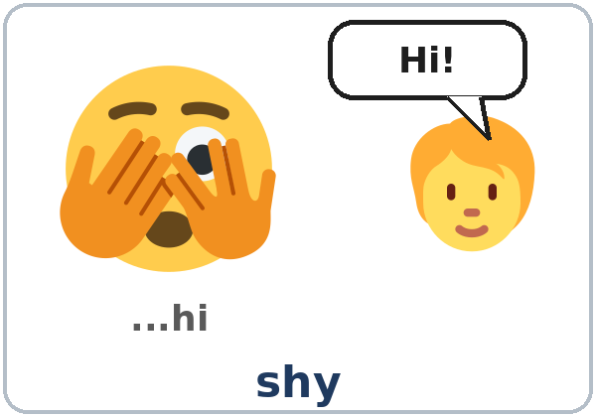
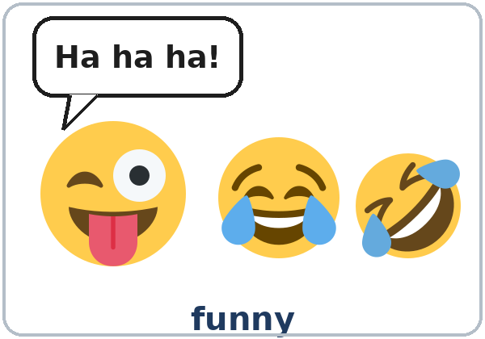
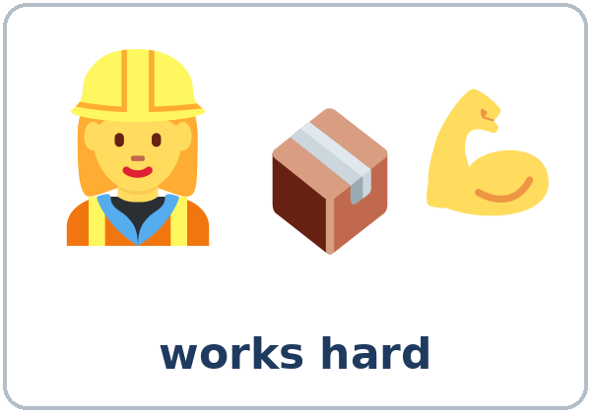
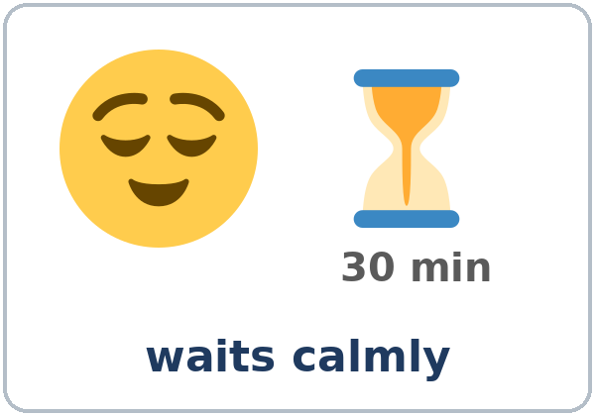

Partner game:
A says. B points.
More New Words
★ friendly
★ shy
★ funny
★ hardworking
patient
quiet
Notes:
Step 2, continued. Point to each picture and say the word. Learners repeat once.
Act out shy (look down, speak very quietly: "…hi") and patient (wait calmly, smile, look at your watch).
Learners say which column each word goes in: LOOKS or PERSONALITY. (All six words on this slide are PERSONALITY.)
Partner game (2 min): A says a word. B points to the picture and makes a sentence (My brother is tall. / My teacher is patient. / A: curly hair. B: My sister has curly hair.). Switch.
If behind: teach the ★ words only.
Lesson plan: Step 2; New Words page; Partner game.
Pictures: Twemoji graphics by Twitter, Inc. and other contributors (https://github.com/jdecked/twemoji), CC BY 4.0 (https://creativecommons.org/licenses/by/4.0/); resized and combined, with drawn bodies, glasses, speech bubbles, and labels (images/CREDITS.md).

Slide 7
Check the Meaning
Look at the picture. Answer the question.
1
2
3
Is a beard on your head or on your face?
A shy person talks a lot: yes or no?
A hardworking person works a little or a lot?
face
no
a lot
Notes:
Step 2 · Check meaning · 1 min. Whole class.
The answers are hidden. Ask each question and wait for the class to answer. Then click to show the answer. Each click shows one answer, in order: 1, 2, 3.
1. "Is a beard on your head or on your face?" (face) • 2. "A shy person talks a lot: yes or no?" (no) • 3. "A hardworking person works a little or a lot?" (a lot)
Lesson plan: Step 2: Check meaning.
Pictures: Twemoji graphics by Twitter, Inc. and other contributors (https://github.com/jdecked/twemoji), CC BY 4.0 (https://creativecommons.org/licenses/by/4.0/); resized and combined, with drawn bodies, glasses, speech bubbles, and labels (images/CREDITS.md).

Slide 8
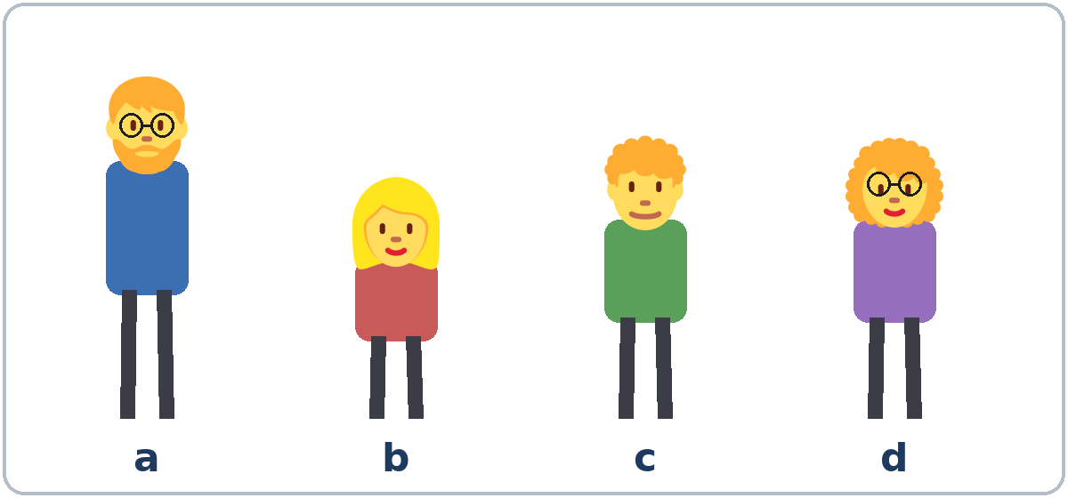
Before You
Listen for:
Listen
Who is Kevin?
It's Omar's first day at a hotel. Linda is his supervisor.
Who is Nora?
01
Audio: about 1:28. It plays once.
Narrator
02
Linda
Play 1: Task A
03
Omar
Notes:
Step 3 · 6:18–6:30 · Listening + "Say it" · 12 min (slides 8 to 12). Individuals, then pairs check.
Before you listen (1 min). Point to the picture and say: "It's Omar's first day at a hotel. His supervisor is Linda. She tells him about two coworkers, Kevin and Nora. Who is Kevin? Who is Nora? Listen."
There are three voices: a Narrator, Linda, and Omar. Each click highlights the next voice.
The audio (L3_L2_listening.mp3, about 1:28) plays the conversation once. Press play again for play 2. A third play is fine if the class needs it.
No speaker? Read the script with a volunteer at a normal, friendly speed.
Audio: synthetic voices, computer-generated (Chatterbox TTS cloned from Kokoro-82M reference clips). No recordings of real people. The names and the story are invented.
Lesson plan: Step 3; Listening script; Listening page.
Picture: Twemoji graphics by Twitter, Inc. and other contributors (https://github.com/jdecked/twemoji), CC BY 4.0 (https://creativecommons.org/licenses/by/4.0/); resized and combined, with drawn bodies, glasses, speech bubbles, and labels (images/CREDITS.md).

Slide 9
Listen. Who is it?
Write the letter: a, b, c, or d.
Listening A
1. Kevin
a
b
c
d
2. Nora
a
b
c
d
3. Sam
a
b
c
d
Notes:
Play 1 → Task A. Learners write the letter of each person. Pairs compare. Check together.
Click to circle each answer (one click per item, 1 to 3): Kevin a (tall, beard, glasses) • Nora b (short, long straight hair) • Sam c (curly hair). Person d is not in the conversation.
Then read Tasks B and C together (1 min) so learners know what to listen for.
Lesson plan: Step 3; Listening Task A; Answer key.
Picture: Twemoji graphics by Twitter, Inc. and other contributors (https://github.com/jdecked/twemoji), CC BY 4.0 (https://creativecommons.org/licenses/by/4.0/); resized and combined, with drawn bodies, glasses, speech bubbles, and labels (images/CREDITS.md).

Slide 10
Listen again. Who is it?
Check ✓ Kevin or Nora.
Listening B
1. friendly
Kevin
Nora
2. funny
Kevin
Nora
3. shy
Kevin
Nora
4. quiet
Kevin
Nora
5. hardworking
Kevin
Nora
6. patient
Kevin
Nora
Notes:
Play 2 → Tasks B and C. Pairs compare. Then show the answers.
Click to circle each answer (one click per item, 1 to 6): 1 Kevin, 2 Kevin, 3 Nora, 4 Nora, 5 Nora, 6 Nora.
Lesson plan: Step 3; Listening Task B; Answer key.

Slide 11
Listen again.
Write him, her, or them.
Listening C
1
You can ask ____ for help.
him
2
Talk to ____, and ask ____ questions.
her, her
Pairs: compare your answers.
Then check together.
3
Where can I find ____?
them
4
Come with me. I can introduce you to ____.
them
5
Let's go and say hi to ____.
him
Notes:
Task C (same play 2 as Task B). Learners write him, her, or them. Pairs compare.
Click to show each answer (one click per item, 1 to 5): 1 him, 2 her, her, 3 them, 4 them, 5 him.
If behind: do Task C together on the board, reading the lines yourself.
Lesson plan: Step 3; Listening Task C; Answer key.

Slide 12
Say it: clap on the strong part.
Say It
Say each word two times.
FRIENDly · HARDworking · PAtient
CURly · GLASSes
Clap on the strong part.
Then say it: Everyone likes him.
Everyone likes him.
Notes:
"Say it" (2 min). Read the words in the "Say it" box. Clap on the strong part: FRIENDly, HARDworking, PAtient, CURly, GLASSes.
The class repeats each word twice, then the line "Everyone likes him."
Lesson plan: Step 3: "Say it"; Listening page: Say it.

Slide 13
Grammar Box 1 · looks
What does he look like?
look like = LOOKS
QUESTION
ANSWER
What does
he / she look like?
He's / She's tall. / short.
He has / She has a beard. / glasses. / curly hair. / long, straight hair.
What do
they look like?
They're tall. / short.
They have glasses. / short hair.
Notes:
Step 4 · 6:30–6:45 · Grammar Q&A · 15 min (slides 13 to 21). Whole class, then pairs. Show the Grammar page. The left side is the question. The right side is the answer.
Boxes 1 and 2 (4 min): write on the board: look like = LOOKS and be like = PERSONALITY. Ask about a picture on the New Words page: "What does he look like?" → "He's tall. He has a beard."
Read across: A reads from the left side; B answers from the right side. Choose one part from each column. Each click shows the answer side of one row.
Lesson plan: Step 4; Grammar Box 1.
Picture: Twemoji graphics by Twitter, Inc. and other contributors (https://github.com/jdecked/twemoji), CC BY 4.0 (https://creativecommons.org/licenses/by/4.0/); resized and combined, with drawn bodies, glasses, speech bubbles, and labels (images/CREDITS.md).

Slide 14
Grammar Box 2 · personality
What's he like?
QUESTION
ANSWER
What's he / she like?
He's / She's friendly and funny. / quiet but hardworking. / very patient.
What are they like?
They're really friendly. / a little shy.
Is your boss / your teacher nice?
Yes, very nice. / Yes, really nice.
He's very kind. / She's very patient.
Notes:
Box 2: be like = PERSONALITY. Ask: "What's he like?" → "He's funny."
Read across. Each click shows the answer side of one row.
Check: "If the answer is about the body or clothes, the question is What does she look like? If it's about personality, it's What's she like?"
Lesson plan: Step 4; Grammar Box 2; Teacher notes: look like vs. be like.
Picture: Twemoji graphics by Twitter, Inc. and other contributors (https://github.com/jdecked/twemoji), CC BY 4.0 (https://creativecommons.org/licenses/by/4.0/); resized and combined, with drawn bodies, glasses, speech bubbles, and labels (images/CREDITS.md).

Slide 15
Grammar Box 3
Which one is…?
→ The… with…
QUESTION
ANSWER
Which one
is your sister?
The woman with long hair.
She's the woman with glasses.
Which one
is Kevin?
The tall man with a beard.
The man next to Sam.
Which one
is your boss?
The short man with curly hair.
The woman in the red shirt.
Notes:
Box 3 (2 min): point to the picture (the people from the Listening page). Ask: "Which one is Nora?" → "The short woman with long, straight hair." Learners ask about Kevin and Sam.
the + person + with + thing: the woman with glasses, the man with a beard. For clothes you can also say in: the man in the blue shirt.
Each click shows the answer side of one row.
Lesson plan: Step 4; Grammar Box 3; Questions and answers.
Picture: Twemoji graphics by Twitter, Inc. and other contributors (https://github.com/jdecked/twemoji), CC BY 4.0 (https://creativecommons.org/licenses/by/4.0/); resized and combined, with drawn bodies, glasses, speech bubbles, and labels (images/CREDITS.md).

Slide 16
Grammar Box 4 · object pronouns
me, him, her, us, them
BEFORE THE VERB
AFTER THE VERB (or after with, to, for)
I work here.
me · My coworker always helps me.
You are new.
you · Can I help you?
He is friendly.
him · Ask him for help.
She is patient.
her · I work with her.
We are new.
us · Linda trains us on Mondays.
They are funny.
them · I like them a lot.
Notes:
Box 4 (4 min): read the two columns: I → me, he → him, she → her, we → us, they → them.
Say: "The second word comes after the verb or after with, to, for." Read each example; the class repeats. Each click shows one row.
Check questions: "Do you know Ana? Yes, I know ___." (her) • "Ask Kevin. Ask ___." (him) • "What does she look ___?" (like) • "She has long ___." (hair, not hairs)
Lesson plan: Step 4; Grammar Box 4.
Picture: Twemoji graphics by Twitter, Inc. and other contributors (https://github.com/jdecked/twemoji), CC BY 4.0 (https://creativecommons.org/licenses/by/4.0/); resized and combined, with drawn bodies, glasses, speech bubbles, and labels (images/CREDITS.md).

Slide 17
Grammar Box 5
Questions and Answers
with object pronouns
QUESTION
ANSWER
Do you know Ana?
Yes, I work with her.
She always helps me.
Do you know Mr. Lee?
Yes, I see him every day.
He's our neighbor.
Do you like your coworkers?
Yes, I like them a lot.
They're very friendly.
Can you call us later?
Sure. I can call you at 6:00.
Notes:
Box 5: questions and answers with object pronouns. A reads a question; B reads the answer. Each click shows one answer.
Object pronouns come after the verb (I know her) and after small words like with, to, for, at (Come with me. Look at him.).
Lesson plan: Step 4; Grammar Box 5; Teacher notes: Object pronouns.
Picture: Twemoji graphics by Twitter, Inc. and other contributors (https://github.com/jdecked/twemoji), CC BY 4.0 (https://creativecommons.org/licenses/by/4.0/); resized and combined, with drawn bodies, glasses, speech bubbles, and labels (images/CREDITS.md).

Slide 18
Practice A: write the word.
me · him · her · it · us · them
Practice A
1
Ana is my neighbor. I see ____ every day.
her
2
My brothers are very funny. I love ____.
them
3
Mr. Silva is patient. Ask ____ for help.
him
Write the word.
Pairs: check your answers.
4
We're new here. Can you help ____?
us
5
I'm a little shy. Please talk to ____ slowly.
me
6
That's my phone. Can you give ____ to me?
it
Notes:
Practice A and B (3 min): learners write, then pairs check. Go over the answers.
Click to show each answer (one click per item, 1 to 6): 1 her, 2 them, 3 him, 4 us, 5 me, 6 it.
Lesson plan: Step 4; Grammar Practice A; Answer key.

Slide 19
B
Practice B
Practice B
Write look like or like.
1
What does your brother ____? He's tall, and he has a beard.
look like
2
What's your teacher ____? She's very patient.
like
look like = looks
like = personality
Pairs: check your answers.
3
What are your neighbors ____? They're friendly.
like
4
What does she ____? She has curly hair and glasses.
look like
Notes:
Practice B. Learners write look like or like. Tip: look at the answer. Body or clothes = look like. Personality = like.
Click to show each answer (one click per item, 1 to 4): 1 look like, 2 like, 3 like, 4 look like.
Lesson plan: Step 4; Grammar Practice B; Answer key; Teacher notes.

Slide 20
Common Mistakes
Don't say
Say
She has long hairs.
She has long hair.
What does she like? (about personality)
What's she like? /
What does she look like?
He is a man very tall.
He's a very tall man. / He's very tall.
two talls men
two tall men
Do you know Ana? Yes, I know.
Yes, I know her.
I work with she.
I work with her.
He help me every day.
He helps me every day.
Notes:
Common mistakes (never skip this table). Read a line from Don't say. Ask: "What's the right way?" Learners try first. Then click to show the right form. Each click shows one line, in order 1 to 7.
1: hair has no -s • 2: personality = What's she like? (looks = What does she look like?) • 3: the describing word goes before the noun • 4: adjectives never take -s • 5: add the object (her) • 6: after with, use her • 7: He helps (add -s).
Say the right form clearly; the learner repeats. Learners can read the Spanish note and the tip on their Grammar page themselves; you don't need to explain them.
Lesson plan: Grammar: Common mistakes; Teacher notes: Typical mistakes.
Picture: Twemoji graphics by Twitter, Inc. and other contributors (https://github.com/jdecked/twemoji), CC BY 4.0 (https://creativecommons.org/licenses/by/4.0/); resized and combined, with drawn bodies, glasses, speech bubbles, and labels (images/CREDITS.md).

Slide 21
Pair Drill
A names a person. B describes.
01
A names a classmate. B describes the person. Kind words only.
A: (a classmate's name)
B: She's tall. She has curly hair.
A asks: What's she like?
02
B: She's friendly and funny.
Then switch roles.
Notes:
Pair drill (last 2 min of Step 4). Pairs.
A names a person in the class (only names!). B describes how the person looks, and A asks What's he / she like? B answers only with kind words. Then switch.
Real classmates: learners describe classmates only with the New Words. If a learner seems uncomfortable, describe people in the pictures instead.
If behind: skip the pair drill. Talk Time practices it.
Lesson plan: Step 4: Pair drill; Teacher notes: Kind words only, Real classmates.
Picture: Twemoji graphics by Twitter, Inc. and other contributors (https://github.com/jdecked/twemoji), CC BY 4.0 (https://creativecommons.org/licenses/by/4.0/); resized and combined, with drawn bodies, glasses, speech bubbles, and labels (images/CREDITS.md).

Slide 22
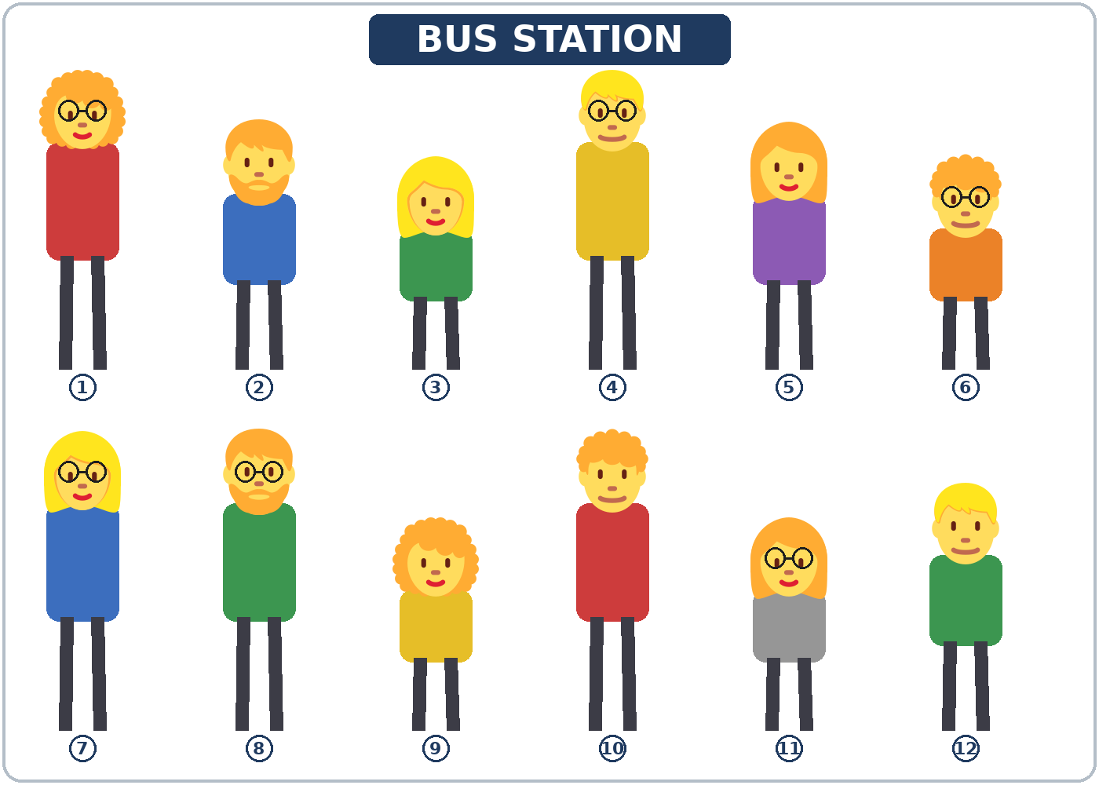
Talk Time
Pick Them Up
Pairs. A has a card.
Don't show it!
7:00–7:12
1
A: Can you pick up my cousin?
B: What does she look like?
2
A describes the person.
She's tall. She has glasses.
3
B says the number.
Is that her? Number 7?
Notes:
Step 5 · 7:00–7:12 · Talk Time: Pick Them Up · 12 min. Pairs, then groups of 3. 15 learners: 7 pairs + 1 group of 3 (two people share the A cards). 7–8 learners: 3–4 pairs. 5 or fewer: one group; take turns describing.
Round 1 (7 min): each pair has the crowd picture (people 1–12) and two piles of cards. A takes an A card and doesn't show it. A: "Can you pick up my cousin at the bus station?" B: "What does she look like?" A describes the person (height, hair, glasses or a beard, the shirt color). B points and says the number. A: "Yes, that's her!" or "No, she has glasses." Then B asks one follow-up: "What's she like?" A invents an answer. Switch: B takes a B card. (Each click shows the next step.)
Model with one learner (1 min): card A1 (person 7) and the model dialogue: "She's tall, and she has long, straight hair and glasses. She's wearing a blue shirt." → "Is that her? Number 7?" → "Yes, that's her!" → "What's she like?" → "She's really friendly, but she's a little shy at first."
Answers (the number B should point to): A1 Lisa = 7 • A2 Pedro = 8 • A3 Ana = 9 • A4 Tom = 6 • B1 Julia = 1 • B2 Mr. Park = 2 • B3 Rosa = 11 • B4 Leo = 10. The personality answers are invented.
Round 2 (4 min): groups of 3. Each learner describes a person they admire, personality only, with one reason (My aunt is very patient, because she never gets angry.). The others ask one follow-up question each.
Writing: after round 1, learners write 2 of the people they found in the table on the Talk Time page. Baseline snapshot: call about 5 learners (the ones you didn't talk to in Week 1) for 2 minutes each.
If behind: round 1 only.
Lesson plan: Step 5; Talk Time pages; Answer key.
Picture: Twemoji graphics by Twitter, Inc. and other contributors (https://github.com/jdecked/twemoji), CC BY 4.0 (https://creativecommons.org/licenses/by/4.0/); resized and combined, with drawn bodies, glasses, speech bubbles, and labels (images/CREDITS.md).

Slide 23
Before You Go 7:12–7:17
01
Exit ticket
02
Homework
Write two sentences:
1. How a person looks.
2. What the person is like, with because or so:
My brother is funny, so everyone likes him.
Give it to me at the door.
About 15 minutes.
1. Describe a person.
2. Write him, her, us, or them.
3. Ask about a favorite teacher.
4. Write because or so.
Bring it next week!
Notes:
Step 6 · 7:12–7:17 · Exit Ticket + Homework · 5 min · NEVER SKIP.
Exit ticket: each learner writes two sentences on a slip about a friend or family member: one about how the person looks and one about what the person is like, with because or so (My brother is funny, so everyone likes him.). Collect at the door.
Homework: open the Homework page. Do item 1 together (describe one person on the board with the class). Say: "About 15 minutes. Bring it next week."
Homework items: 1 describe a friend or family member (2 sentences about looks, 2 about personality); 2 write him, her, us, or them; 3 ask a family member or friend "What was your favorite teacher like?" and one follow-up; 4 review (Lesson 1): write because or so.
Read & Write (7:17–7:25, on the Student Pages): a welcome email; questions 1–5; then 3–4 sentences about a friend or family member.
Lesson plan: Step 6; Homework page; Read & Write step.
Picture: Twemoji graphics by Twitter, Inc. and other contributors (https://github.com/jdecked/twemoji), CC BY 4.0 (https://creativecommons.org/licenses/by/4.0/); resized and combined, with drawn bodies, glasses, speech bubbles, and labels (images/CREDITS.md).

Slide 24
Progress Check 7:25
D. I can…
😀 🙂 😐
Check one face.
I can describe how someone looks.
I can describe someone's personality.
I can ask What does he look like? What's he like?
I can use me, him, her, us, them.
A. Listen to the teacher. Circle a or b.
Answer
1. a. a tall man with a beard
b. a short man with glasses
a
2. a. She's shy. b. She's patient.
b
3. a. the woman with curly hair
b. the woman with straight hair
a
4. a. He's quiet and shy.
b. He's funny and friendly.
b
Notes:
Progress Check · 7:25–7:30 · 5 min. Individuals. Open the Progress Check page.
Part A: read each sentence slowly, 2 times. Learners circle a or b. Then click to show the answer (one click per item, 1 to 4).
Say: 1 "My brother is tall, and he has a beard." (a) • 2 "My neighbor never gets angry. She's very patient." (b) • 3 "Which one is your sister? The woman with curly hair." (a) • 4 "What's your coworker like? He's funny and friendly." (b)
Parts B and C: learners do them alone. Walk around and help with the instructions only. B answers: 1 look like, 2 him, 3 them, 4 us. C: answers will vary (for example She's short, and she has long hair. / She's very friendly.).
Part D: read each "I can…" line aloud and point to the 3 faces: 😀 "I can do it." 🙂 "With a little help." 😐 "Not yet."
Scoring: A /4 + B /4 + C /2 = /10. This is not a test grade. It shows who needs more help with look like / be like (A, B1, C) and with object pronouns (B2–B4).
Collect the pages (or check them at the start of Week 3). If behind: do the Progress Check in Week 3 at 6:00, while learners arrive.
Lesson plan: Progress Check step; Progress Check page; Answer key.

Slide 25
Goodbye! See You Next Week!
Now you can:
• Describe how someone looks
• Describe someone's personality
• Use me, him, her, us, them
Lesson 2 · Level 3
Notes:
Read the title: "Goodbye! See you next week!" Learners repeat.
Read the three "Now you can" lines. Point to one picture and ask: "What does he look like? What's he like?"
Remind learners: homework is about 15 minutes. Bring it next week.
Lesson plan: At a glance: Objectives; Step 6.
Picture: Twemoji graphics by Twitter, Inc. and other contributors (https://github.com/jdecked/twemoji), CC BY 4.0 (https://creativecommons.org/licenses/by/4.0/); resized and combined, with drawn bodies, glasses, speech bubbles, and labels (images/CREDITS.md).

Slide 26
Credits
Pictures
Vocabulary pictures use Twemoji graphics by Twitter, Inc. and other contributors (https://github.com/jdecked/twemoji), licensed under CC BY 4.0 (https://creativecommons.org/licenses/by/4.0/). The graphics were resized and combined, and bodies, glasses, speech bubbles, signs, and labels were added.
The faces on the Progress Check are standard emoji characters shown with the computer's emoji font.
Names and story
Omar, Linda, Kevin, Nora, Sam, Ana, Mr. Lee, Mr. Silva, and Lisa are invented names. The listening story is invented.
Audio and font
Audio: synthetic voices made with Chatterbox TTS (MIT License), cloned from short synthetic reference clips made with Kokoro-82M (Apache License 2.0). No recordings of real people were used. Each file carries an inaudible Perth watermark marking it as AI-generated. Font: Lexend Deca (OFL 1.1).
© 2026 the authors. The authors license this deck under CC BY-NC-SA 4.0.
Notes:
Credits. You don't need to read this slide in class.
Pictures: Twemoji graphics by Twitter, Inc. and other contributors, CC BY 4.0; the file-by-file list is in images/CREDITS.md.
Audio: synthetic voices, computer-generated (Chatterbox TTS cloned from Kokoro-82M reference clips). No recordings of real people. The names and the story are invented.
Course materials: © 2026 the authors, licensed under CC BY-NC-SA 4.0 (https://creativecommons.org/licenses/by-nc-sa/4.0/).
Lesson plan: Picture Credits. Picture list: images/CREDITS.md.

