Slide 1
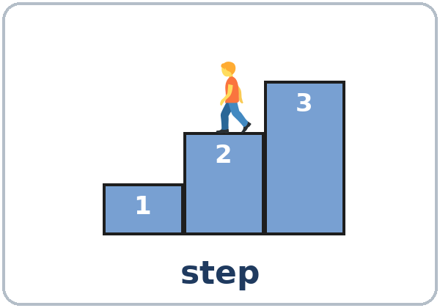
Step by Step
Today you will:
• Give instructions in order
• Ask How do I…? What do I do next?
• Give a warning with Don't…
Lesson 10 · Level 3
Notes:
Welcome learners as they arrive.
Point to the title and read it: "Step by step." Say: "Tonight we give and follow instructions: at work, at home, and on a phone."
Read the three lines under "Today you will". Give one quick example of each: "First, plug it in. Then, turn it on." • "How do I log in? What do I do next?" • "Don't open the door. It's hot."
The medicine label is invented (important): it is for reading practice only. Tell learners to ask a pharmacist or a doctor about real medicine. Don't give medical advice, and don't ask learners about their own medicines.
Lesson plan: Topic; At a glance: Objectives; Teacher notes.
Picture: Twemoji graphics by Twitter, Inc. and other contributors (https://github.com/jdecked/twemoji), CC BY 4.0 (https://creativecommons.org/licenses/by/4.0/); resized and combined, with speech bubbles, signs, and labels (images/CREDITS.md).

Slide 2
01
I can give instructions in order.
First… Next… Then… Finally…
Today's
Goals
02
I can follow spoken instructions.
03
I can ask How do I…? What do I do next?
By the end of class, you can do these six things.
First, next, then, finally!
We check at 7:25!
04
I can give a warning with Don't….
05
I can read a medicine label (invented).
06
I can write 4 steps for a task I know.
Notes:
Read each goal slowly. Learners repeat.
Goal 1: first, next, then, after that, finally. Goal 2: follow spoken instructions and number the steps. Goal 3: How do I…? What do I do next? What do I do after that?
Goal 4: Don't… and Don't forget to… Goal 5: read a medicine label (invented) and answer questions about it. Goal 6: write 4 steps for a task they know.
"We check at 7:25" = the Progress Check. It is not a test grade.
Lesson plan: At a glance: Objectives.

Slide 3
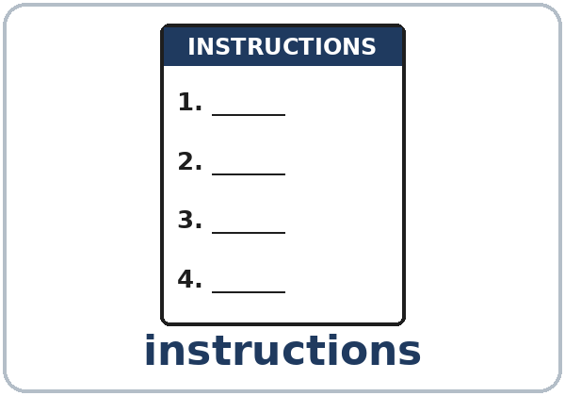
OPENING TALK · 6:00
Opening Talk
A asks a card question.
What are you good at?
B answers with 2–3 sentences.
A asks one follow-up.
Can you give me an example?
Then switch.
Notes:
Step 1 · 6:00–6:10 · Opening Talk + Homework Check · 10 min. Pairs (7 pairs + 1 trio with 15 learners; 3–4 pairs with 7–8).
Before class, write on the board: I'm good at… / I'm interested in… / I don't mind… + -ing
Model with one learner: "What are you good at?" → (answer) → "Can you give me an example?" (Click to show the follow-up.)
Opening Talk (6 min): learners open the Opening Talk page. A asks a card question; B answers with 2–3 sentences; A asks one follow-up. Switch after each card. The cards are on the next slide.
If behind: one card only, then the homework check.
Lesson plan: Step 1; Opening Talk page.
Picture: Twemoji graphics by Twitter, Inc. and other contributors (https://github.com/jdecked/twemoji), CC BY 4.0 (https://creativecommons.org/licenses/by/4.0/); resized and combined, with speech bubbles, signs, and labels (images/CREDITS.md).

Slide 4
Opening Talk
Cards
01
What are you good at? Give an example.
02
What are you interested in learning?
Work with a partner. Then switch.
Follow-ups:
Can you give me an example? Why? Where did you learn that?
03
What job do you enjoy (or would you enjoy)? Why?
04
What work don't you mind doing? What work do you hate?
05
Homework check: Lesson 9, item 2.
Notes:
Step 1, continued. The four cards from the Opening Talk page. Each click shows the next card.
A asks a card question. B answers with 2–3 sentences. A asks one follow-up question (follow-ups on the right). Then switch.
Homework Check (4 min, last click): partners read their Lesson 9 Homework item 2 (Tell me about yourself) to each other. The partner asks one question about it. Walk around. Write 2 common errors on the board (often good at cook or interested on) and correct them together.
Lesson plan: Step 1; Opening Talk page: cards, follow-ups, homework check.

Slide 5
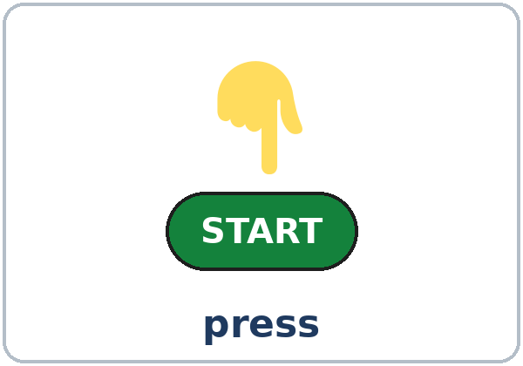
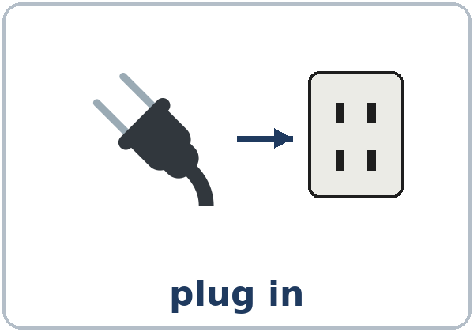
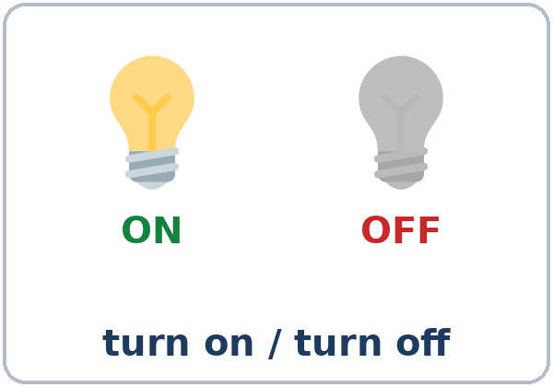
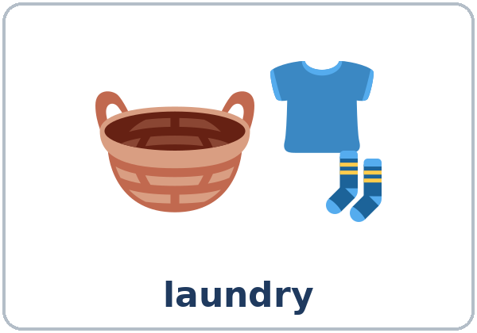
Look. Listen.
Repeat.
New Words
★ instructions
★ step
★ press
★ plug in
★ turn on / turn off
★ laundry
Notes:
Step 2 · 6:10–6:18 · New Words · 8 min (this slide and the next). Whole class, then pairs.
Point to each picture and say the word. Learners repeat once. ★ = the most important words. Each click shows the next word.
Mime each action: press a button, plug in a cord, turn on a light, turn it off, put on safety goggles. Show step: count on your fingers: "Step 1, step 2, step 3."
If behind: teach the ★ words only.
Lesson plan: Step 2; Key vocabulary; New Words page.
Pictures: Twemoji graphics by Twitter, Inc. and other contributors (https://github.com/jdecked/twemoji), CC BY 4.0 (https://creativecommons.org/licenses/by/4.0/); resized and combined, with speech bubbles, signs, and labels (images/CREDITS.md).

Slide 6
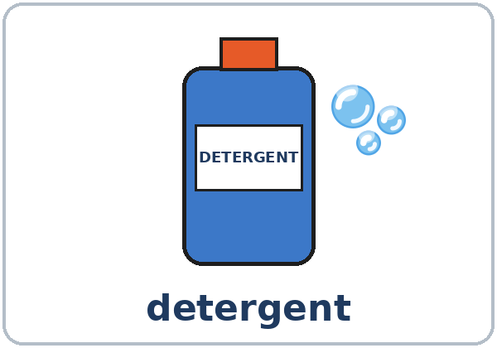

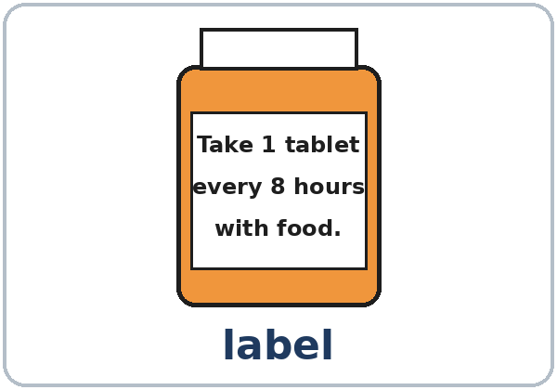

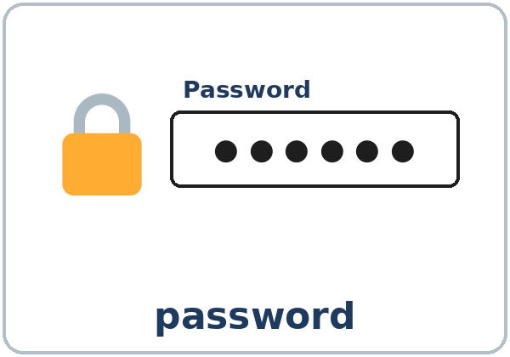
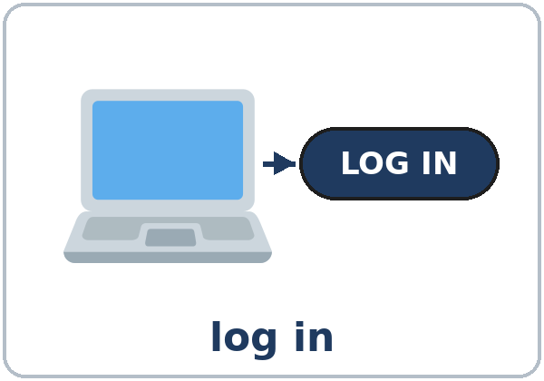
Partner game:
A says. B points.
More New Words
★ detergent
★ safety goggles
★ label
★ tablet (medicine)
★ password
log in
Notes:
Step 2, continued. Point to each picture and say the word. Learners repeat once.
Partner game (2 min): A says a word. B points to the picture and mimes it or makes a sentence (A: press. B: (points, mimes) Press START.). Switch.
If behind: teach the ★ words only.
Lesson plan: Step 2; New Words page; Partner game.
Pictures: Twemoji graphics by Twitter, Inc. and other contributors (https://github.com/jdecked/twemoji), CC BY 4.0 (https://creativecommons.org/licenses/by/4.0/); resized and combined, with speech bubbles, signs, and labels (images/CREDITS.md).

Slide 7
Check the Meaning
Look at the picture. Answer the question.
1
2
3
You wash clothes with…?
On a medicine bottle, you read the…?
Before you log in, you type your…?
detergent
label
password
Notes:
Step 2 · Check meaning · 1 min. Whole class.
The answers are hidden. Ask each question and wait for the class to answer. Then click to show the answer. Each click shows one answer, in order: 1, 2, 3.
1. "You wash clothes with…?" (detergent) • 2. "On a medicine bottle, you read the…?" (label) • 3. "Before you log in, you type your…?" (password)
Lesson plan: Step 2: Check meaning.
Pictures: Twemoji graphics by Twitter, Inc. and other contributors (https://github.com/jdecked/twemoji), CC BY 4.0 (https://creativecommons.org/licenses/by/4.0/); resized and combined, with speech bubbles, signs, and labels (images/CREDITS.md).

Slide 8
Before You
Listen for:
Listen
What machine is it?
Maria is a new worker at a supermarket. Her coworker Tom is teaching her to use a machine.
What are the steps?
01
Audio: about 1:15. It plays once.
Narrator
02
Tom
Play 1: Task A
03
Maria
Notes:
Step 3 · 6:18–6:30 · Listening + "Say it" · 12 min (slides 8 to 12). Individuals, then pairs check.
Before you listen (1 min). Say: "Maria is a new worker at a supermarket. Her coworker Tom is teaching her to use a machine. What machine is it? Listen."
There are three voices: a Narrator, Tom, and Maria. Each click highlights the next voice.
The audio (about 1:15) is coming soon. When it is ready, it plays the conversation once; press play again for play 2. Until then, read the listening script (at the end of these notes) with a volunteer.
No speaker? Read the script with a volunteer at a normal, friendly speed.
Audio: the listening audio for this lesson (about 1:15) is coming soon. It will use computer-generated voices (Chatterbox TTS cloned from synthetic Kokoro-82M reference clips); no recordings of real people. Until it is ready, read the listening script (in the notes of the Before You Listen slide) with a volunteer. The names and the story are invented.
Lesson plan: Step 3; Listening script; Listening page.
Picture: Twemoji graphics by Twitter, Inc. and other contributors (https://github.com/jdecked/twemoji), CC BY 4.0 (https://creativecommons.org/licenses/by/4.0/); resized and combined, with speech bubbles, signs, and labels (images/CREDITS.md).
Listening script (the audio is coming soon; until then, read it aloud with a volunteer at a normal, friendly speed):
Narrator: Lesson ten. Listening. Maria is a new worker at a supermarket. Her coworker Tom is teaching her to use a machine. Listen.
Tom: Hi, Maria. Welcome to the team! Today I'm going to show you the floor cleaning machine. It's easy.
Maria: Great. How do I start?
Tom: First, put on your safety goggles. Then, fill the tank with water.
Maria: Why do I need goggles?
Tom: Because the detergent can hurt your eyes. Next, add one cup of detergent. Not more!
Maria: One cup. Got it. What do I do after that?
Tom: After that, plug it in and turn it on. A green light comes on.
Maria: And then I just push it?
Tom: Right. Push it slowly. Don't leave it alone when it's on.
Maria: What do I do when I finish?
Tom: Finally, turn it off, unplug it, and empty the tank.
Maria: Thanks, Tom. Can I try it now?
Tom: Sure. Press the start button, and let's go. I'll walk with you.
Narrator: That's the end of the listening.

Slide 9
Listen. What machine is it?
Circle.
Listening A
What machine is it?
a. a washing machine
b. a coffee machine
c. a floor cleaning machine
1
c
Pairs: compare your answers.
Then check together.
Notes:
Play 1 → Task A (what machine?). Pairs compare. Check together.
Click to show the answer: c (a floor cleaning machine).
Then read Tasks B and C together (1 min) so learners know what to listen for.
Lesson plan: Step 3; Listening Task A; Answer key.

Slide 10
Listen again.
Number the steps 1–5. Then circle.
Listening B
add detergent
3
put on safety goggles
1
turn it off and empty the tank
5
Number the steps 1–5.
Then circle.
Pairs: check together.
fill the tank with water
2
plug it in and turn it on
4
How much detergent? one cup / two cups
The light is: red / green
+
one cup, green
Notes:
Play 2 → Tasks B and C. Pairs compare. Then show the answers.
Click to show each answer (one click per line, top to bottom): add detergent 3 • put on safety goggles 1 • turn it off and empty the tank 5 • fill the tank with water 2 • plug it in and turn it on 4 • How much detergent? one cup • The light is green.
Lesson plan: Step 3; Listening Task B; Answer key.

Slide 11
Listen again.
Write the sequence word.
Listening C
1
____, put on your safety goggles.
First
2
____, fill the tank with water.
Then
Pairs: compare your answers.
Then check together.
3
____, add one cup of detergent.
Next
4
____, plug it in and turn it on.
After that
5
____, turn it off, unplug it, and empty the tank.
Finally
Notes:
Task C (play 2). Click to show each answer (one click per item, 1 to 5): 1 First, 2 Then, 3 Next, 4 After that, 5 Finally.
If behind: do Task C together on the board, reading the lines yourself.
Lesson plan: Step 3; Listening Task C; Answer key.

Slide 12
Say it: th and pauses
Say It
The class repeats each line two times.
Then, push it slowly.
The third step
th: your tongue between your teeth.
then, the: use your voice.
third: no voice.
First… (pause) Next… (pause) Then…
Notes:
"Say it" (2 min). Say: "For th in then and the, put your tongue between your teeth, and use your voice." Then third: the same tongue, no voice.
Pause a little after each step. The class repeats each line in the box twice.
Lesson plan: Step 3: "Say it"; Listening page: Say it.

Slide 13
Grammar Box 1
How do I…?
QUESTION
ANSWER
How do I use this machine?
First, put in the clothes.
Next, add the detergent.
Then, press START.
How do I log in?
First, type your password.
Notes:
Step 4 · 6:30–6:45 · Grammar Q&A · 15 min (slides 13 to 20). Whole class, then pairs. Show the Grammar page. The left side is the question. The right side is the answer.
Show it (2 min): make a cup of tea in mime and say each step: "First, boil the water. Next, put the tea bag in the cup. Then, add the water. After that, wait 3 minutes. Finally, drink it!" Hold up one finger for each step.
Boxes 1 and 2 (4 min): read a question from the left; the class answers from the right. Each click shows the answer side of one row. Point out: no you and no -s in an instruction (Press START).
Review: You have to / You need to also give instructions: You need to plug it in first. Accept it; don't teach it again.
Lesson plan: Step 4; Grammar Box 1; Teacher notes: Instructions have no you and no -s.
Picture: Twemoji graphics by Twitter, Inc. and other contributors (https://github.com/jdecked/twemoji), CC BY 4.0 (https://creativecommons.org/licenses/by/4.0/); resized and combined, with speech bubbles, signs, and labels (images/CREDITS.md).

Slide 14
Grammar Box 2
What do I do next?
after that · finally
QUESTION
ANSWER
What do I do
next? / after that?
After that, wait 30 minutes.
What do I do
at the end?
Finally, take out the clothes.
Notes:
Box 2: What do I do next? Each click shows the answer side of one row.
Sequence words: first (step 1), next / then / after that (the middle steps, in any order), finally (the last step). A comma after each one is fine but not important.
Lesson plan: Step 4; Grammar Box 2; Teacher notes: Sequence words.
Picture: Twemoji graphics by Twitter, Inc. and other contributors (https://github.com/jdecked/twemoji), CC BY 4.0 (https://creativecommons.org/licenses/by/4.0/); resized and combined, with speech bubbles, signs, and labels (images/CREDITS.md).

Slide 15
Grammar Box 3
Don't…
QUESTION
ANSWER
Can I open the door now?
No. Don't open the door. It's hot.
Anything else?
Don't forget to take your card.
Notes:
Box 3 (2 min): warnings: Don't + verb, Don't forget to + verb. Each click shows the answer side of one row.
Don't forget to… is a friendly reminder: Don't forget to take your card.
Lesson plan: Step 4; Grammar Box 3; Teacher notes: Don't forget to.
Picture: Twemoji graphics by Twitter, Inc. and other contributors (https://github.com/jdecked/twemoji), CC BY 4.0 (https://creativecommons.org/licenses/by/4.0/); resized and combined, with speech bubbles, signs, and labels (images/CREDITS.md).

Slide 16
Grammar Box 4
Sequence Words
STEP
SEQUENCE WORD
STEP 1
First, put on your goggles.
STEP 2
Next, fill the tank.
STEP 3
Then, / After that, plug it in.
LAST STEP
Finally, turn it off.
Notes:
Box 4 (1 min): the five sequence words, in order. Say them; the class repeats. Each click shows one step.
Check questions: "___, put on your goggles. (step 1)" (First) • "___, turn it off. (the last step)" (Finally) • "Don't ___ (open) the door." (open) • "How ___ I log in?" (do)
Lesson plan: Step 4; Grammar Box 4.
Picture: Twemoji graphics by Twitter, Inc. and other contributors (https://github.com/jdecked/twemoji), CC BY 4.0 (https://creativecommons.org/licenses/by/4.0/); resized and combined, with speech bubbles, signs, and labels (images/CREDITS.md).

Slide 17
Practice A: making tea
First · Next · Then · After that · Finally
Practice A
1
____, boil the water.
First
2
____, put a tea bag in the cup.
Next
Making tea.
Pairs: check your answers.
3
____, add the hot water.
Then
4
____, wait 3 minutes.
After that
5
____, take out the tea bag and drink it.
Finally
Notes:
Practice A and B (3 min): learners write, then pairs check. Go over the answers.
Click to show each answer (one click per item, 1 to 5): 1 First, 2 Next, 3 Then, 4 After that, 5 Finally.
Lesson plan: Step 4; Grammar Practice A; Answer key.

Slide 18
Circle the right words.
Practice B
1. ____ the green button.
Press
You presses
2. ____ the door.
No open
Don't open
3. How ____ I log in?
do
does
4. Don't forget ____ your receipt.
take
to take
5. ____ the light, please.
Turn off
Turns off
Notes:
Practice B. Learners circle the right words. Pairs check.
Click to circle each answer (one click per item, 1 to 5): 1 Press, 2 Don't open, 3 do, 4 to take, 5 Turn off.
Lesson plan: Step 4; Grammar Practice B; Answer key.

Slide 19
Common Mistakes
Don't say
Say
You press START.
Press START.
No open the door.
Don't open the door.
Don't forget take your card.
Don't forget to take your card.
Final, turn it off.
Finally, turn it off.
Notes:
Common mistakes (never skip this table). Read a line from Don't say. Ask: "What's the right way?" Learners try first. Then click to show the right form. Each click shows one line, in order 1 to 4.
1: instructions have no you and no -s • 2: negative = Don't + verb • 3: Don't forget to + verb • 4: Finally (not Final).
Say the right form clearly; the learner repeats. Learners can read the Spanish note and the tip on their Grammar page themselves; you don't need to explain them.
Lesson plan: Grammar: Common mistakes; Teacher notes: Typical mistakes.
Picture: Twemoji graphics by Twitter, Inc. and other contributors (https://github.com/jdecked/twemoji), CC BY 4.0 (https://creativecommons.org/licenses/by/4.0/); resized and combined, with speech bubbles, signs, and labels (images/CREDITS.md).

Slide 20
Pair Drill
A asks.
01
A asks How do I…? B answers with 3 steps and sequence words.
A: How do I make rice?
(or tea, a sandwich)
B answers with 3 steps.
02
B: First, … Next, … Then, …
Then switch roles.
Notes:
Pair drill (last 2 min of Step 4). Pairs.
A asks "How do I make rice?" (or tea, a sandwich). B answers with 3 steps and sequence words. Switch.
If behind: skip the pair drill. Talk Time practices it.
Lesson plan: Step 4: Pair drill.
Picture: Twemoji graphics by Twitter, Inc. and other contributors (https://github.com/jdecked/twemoji), CC BY 4.0 (https://creativecommons.org/licenses/by/4.0/); resized and combined, with speech bubbles, signs, and labels (images/CREDITS.md).

Slide 21
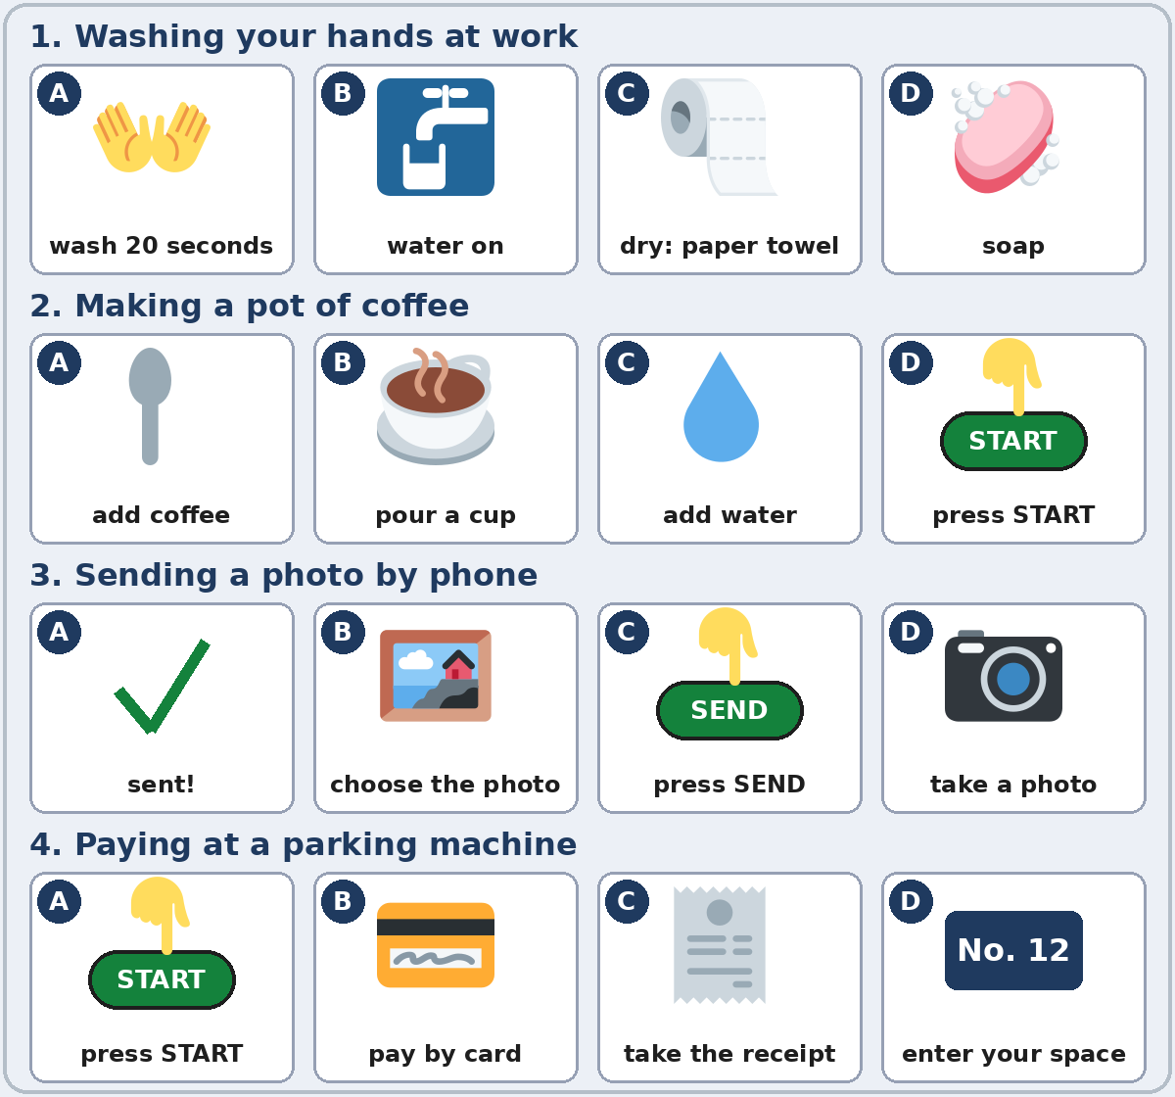
Talk Time
Teach Me in Four Steps
Pairs.
About 2 minutes per strip.
7:00–7:12
1
A chooses a strip and finds the order.
The pictures (A–D) are not in order.
2
A teaches B with sequence words.
First, turn on the water. Next, use soap…
3
B mimes and asks.
What do I do next?
Notes:
Step 5 · 7:00–7:12 · Talk Time: Teach Me in Four Steps · 12 min. Pairs.
How it works: the Talk Time page has 4 strips. In each strip, the 4 pictures (A–D) are not in order. A chooses a strip, finds the right order (writes it under the strip), and teaches B with sequence words. B mimes each step and asks What do I do next? Then switch with a new strip. Each click shows the next step.
Model with one learner (1 min): strip 1: "First, turn on the water." (point to B) "Next, use soap." (D) … The learner mimes.
Rounds (8 min): about 2 minutes per strip; each pair does all 4 strips if there is time. Walk around and listen for the sequence words. Finish (2 min): ask 2 pairs to teach one strip to the class.
The right order: strip 1 (washing hands) B, D, A, C • strip 2 (coffee) C, A, D, B • strip 3 (a photo) D, B, C, A • strip 4 (parking) A, D, B, C. The sentences learners say will vary.
Mixed levels: stronger learners add a Don't… warning to each strip. If behind: 2 strips only.
Lesson plan: Step 5; Talk Time page; Answer key.
Picture: Twemoji graphics by Twitter, Inc. and other contributors (https://github.com/jdecked/twemoji), CC BY 4.0 (https://creativecommons.org/licenses/by/4.0/); resized and combined, with speech bubbles, signs, and labels (images/CREDITS.md).

Slide 22
Before You Go 7:12–7:17
01
Exit ticket
02
Homework
Write two sentences:
1. Two steps with sequence words.
2. A warning with Don't and because or so:
Don't open the door, because the water is hot.
Give it to me at the door.
About 15 minutes.
1. Write the instruction. No you, no -s.
2. Write 4 steps for a task at home.
3. Ask: How do you make your favorite food?
4. Review: good at / interested in + -ing.
Bring it next week!
Notes:
Step 6 · 7:12–7:17 · Exit Ticket + Homework · 5 min · NEVER SKIP.
Exit ticket: each learner writes two sentences on a slip: two steps for a task with sequence words (First, open the app. Then, type your password.), and one warning with Don't and a reason with because or so (Don't open the door, because the water is hot.). Collect at the door.
Homework: open the Homework page. Do item 1 together (one sentence on the board). Say: "About 15 minutes. Bring it next week."
Homework items: 1 write the instruction, no you, no -s • 2 write 4 steps for something you do at home with First, Next, Then, Finally • 3 ask a family member or a coworker: How do you make your favorite food? Write 3 steps • 4 review (Lesson 9): 2 sentences with good at, interested in, or enjoy + -ing.
Read & Write (7:17–7:25, on the Student Pages): say first: "This label is invented. It's for reading practice only. For real medicine, always ask a pharmacist or a doctor." Questions 1–5; then 4 steps for a task they know, with one Don't. If behind: questions 1–5 only; the steps become homework.
The medicine label is invented (important): it is for reading practice only. Tell learners to ask a pharmacist or a doctor about real medicine. Don't give medical advice, and don't ask learners about their own medicines.
Lesson plan: Step 6; Homework page; Read & Write step.
Picture: Twemoji graphics by Twitter, Inc. and other contributors (https://github.com/jdecked/twemoji), CC BY 4.0 (https://creativecommons.org/licenses/by/4.0/); resized and combined, with speech bubbles, signs, and labels (images/CREDITS.md).

Slide 23
Progress Check 7:25
D. I can…
😀 🙂 😐
Check one face.
I can give instructions in order.
I can follow instructions.
I can ask How do I…? What do I do next?
I can read a medicine label.
A. Listen to the teacher. Circle a or b.
Answer
1. a. plug it in → turn it on b. turn it on → plug it in
a
2. a. Open the door. b. Don't open the door.
b
3. a. press START b. press STOP
a
4. a. This is the first step. b. This is the last step.
b
Notes:
Progress Check · 7:25–7:30 · 5 min. Individuals. Open the Progress Check page.
Part A: read each sentence slowly, 2 times. Learners circle a or b. Then click to show the answer (one click per item, 1 to 4).
Say: 1 "First, plug it in. Then, turn it on." (a) • 2 "Don't open the door." (b) • 3 "After that, press START." (a) • 4 "Finally, take your card." (b)
Parts B and C: learners do them alone. Walk around and help with the instructions only. B answers: 1 First, 2 Press, 3 Don't, 4 Finally. C: answers will vary (for example First, open the app. Next, type your password. Then, press LOG IN. / Don't forget to take your receipt.).
Part D: read each "I can…" line aloud and point to the 3 faces: 😀 "I can do it." 🙂 "With a little help." 😐 "Not yet."
Scoring: A /4 + B /4 + C /2 = /10. This is not a test grade. It shows who needs more help hearing the steps (A) and with the forms (B, C).
Collect the pages (or check them at the start of Week 12). If behind: do the Progress Check in Week 12 at 6:00, while learners arrive.
Lesson plan: Progress Check step; Progress Check page; Answer key.

Slide 24
Goodbye! See You Next Week!
Now you can:
• Give instructions in order
• Ask How do I…? What do I do next?
• Give a warning with Don't…
Lesson 10 · Level 3
Notes:
Read the title: "Goodbye! See you next week!" Learners repeat.
Read the three "Now you can" lines. Ask one learner: "How do I make tea?" and wait for steps with First, Next, Then.
Remind learners: homework is about 15 minutes. Bring it next week.
Lesson plan: At a glance: Objectives; Step 6.
Picture: Twemoji graphics by Twitter, Inc. and other contributors (https://github.com/jdecked/twemoji), CC BY 4.0 (https://creativecommons.org/licenses/by/4.0/); resized and combined, with speech bubbles, signs, and labels (images/CREDITS.md).

Slide 25
Credits
Pictures
Vocabulary pictures use Twemoji graphics by Twitter, Inc. and other contributors (https://github.com/jdecked/twemoji), licensed under CC BY 4.0 (https://creativecommons.org/licenses/by/4.0/). The graphics were resized and combined, and speech bubbles, signs, and labels were added.
The faces on the Progress Check are standard emoji characters shown with the computer's emoji font.
Names and story
Maria and Tom are invented names. The listening story is invented.
Audio and font
Audio (coming soon): synthetic voices made with Chatterbox TTS (MIT License), cloned from short synthetic reference clips made with Kokoro-82M (Apache License 2.0). No recordings of real people. Each file will carry an inaudible Perth watermark marking it as AI-generated. Font: Lexend Deca (OFL 1.1).
© 2026 the authors. The authors license this deck under CC BY-NC-SA 4.0.
Notes:
Credits. You don't need to read this slide in class.
Pictures: Twemoji graphics by Twitter, Inc. and other contributors, CC BY 4.0; the file-by-file list is in images/CREDITS.md.
Audio: the listening audio for this lesson (about 1:15) is coming soon. It will use computer-generated voices (Chatterbox TTS cloned from synthetic Kokoro-82M reference clips); no recordings of real people. Until it is ready, read the listening script (in the notes of the Before You Listen slide) with a volunteer. The names and the story are invented.
Course materials: © 2026 the authors, licensed under CC BY-NC-SA 4.0 (https://creativecommons.org/licenses/by-nc-sa/4.0/).
Lesson plan: Picture Credits. Picture list: images/CREDITS.md.

