Slide 1

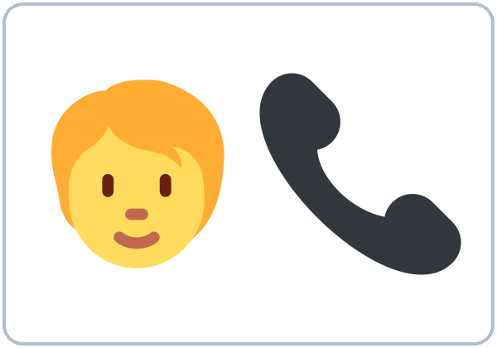
Getting Things Done
Today you will:
• Say have to / don't have to
• Ask: Can you…? Could you…?
• Ask to repeat and spell
• Leave a phone message
Lesson 12 (Week 13)
Notes:
Welcome back. Read the goals together; learners repeat.
Objectives: say what is necessary with have to / need to / don't have to; make polite requests with Can you…? / Could you…?; ask for repetition and spelling on the phone; leave a simple phone message.
Source: Level2_Curriculum_v5_public.md, Lesson 12 (At a glance).
Picture: Twemoji graphics by Twitter, Inc. and other contributors (https://github.com/jdecked/twemoji), CC BY 4.0 (https://creativecommons.org/licenses/by/4.0/); resized and combined.

Slide 2
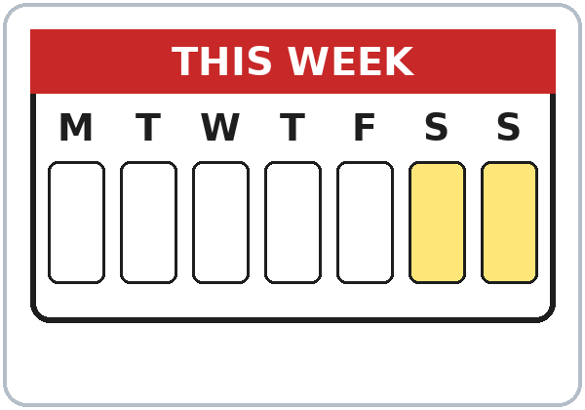
OPENING TALK · 6:00
Warm-Up
Same partner.
Review Lesson 11.
What are you going to do this weekend?
Would you like to …?
Notes:
Step 1 · 6:00–6:10 · Opening Talk + Homework Check. Pairs (same partner for both parts).
Minutes 0–5 (review Lesson 11): partners ask What are you going to do this weekend? Then A invites B; B accepts or declines with a reason. Each click shows one prompt.
Source: Level2_Curriculum_v5_public.md, Lesson 12 (Step 1).
Picture: Twemoji graphics by Twitter, Inc. and other contributors (https://github.com/jdecked/twemoji), CC BY 4.0 (https://creativecommons.org/licenses/by/4.0/); resized and combined.

Slide 3
Homework
Check
HW
Homework check
Read your invitation.
1
I'm ___ to visit friends.
going
Plans: am / is / are
+ going to + verb.
2
Would you like ___?
to come
3
Sorry, I ___. I'm busy.
can't
4
She's going to ___.
rest
Notes:
Step 1, minutes 5–10: partners read their homework invitation and answers.
Each click shows one answer. The lines review Lesson 11 (Grammar Boxes 1 and 3; Common mistakes).
Teacher: write 2 corrected sentences on the board. If behind: collect the homework.
Source: Level2_Curriculum_v5_public.md, Lesson 12 (Step 1); Lesson 11 Homework.

Slide 4
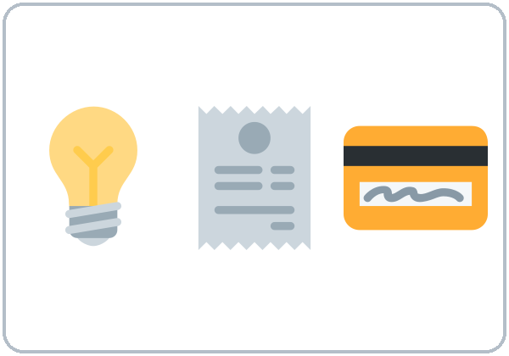
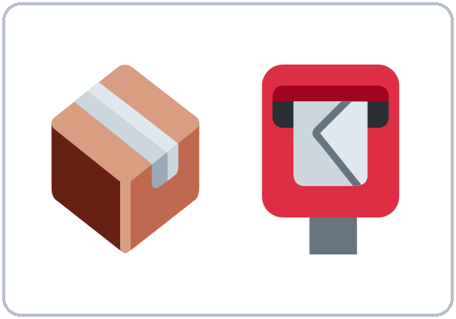
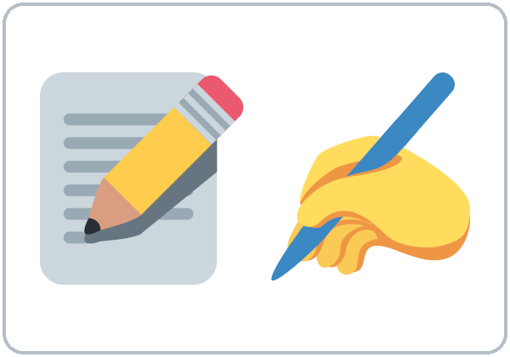
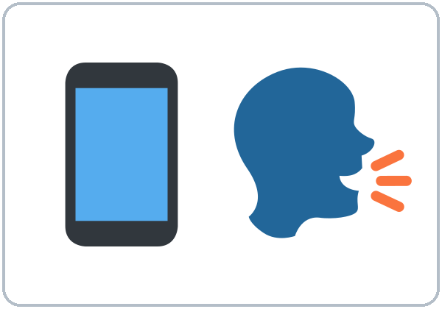
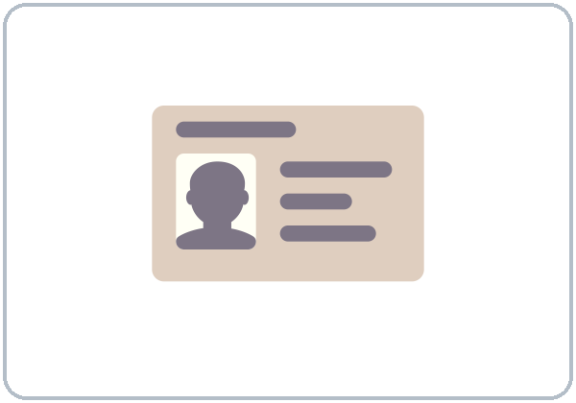

Spell
it!
New Words
pay a bill
mail a
package
fill out
a form
make a
phone call
leave a
message
ID card
receipt
Notes:
Step 2 · 6:10–6:18 · New Words (pairs). Point, say, repeat twice. Each click shows one word.
Star words here: pay a bill, fill out a form, make a phone call, leave a message.
If behind: teach the star words only; skip "Spell it!".
Source: Level2_Curriculum_v5_public.md, Lesson 12 (Step 2; Student Page 12 New Words).
Picture: Twemoji graphics by Twitter, Inc. and other contributors (https://github.com/jdecked/twemoji), CC BY 4.0 (https://creativecommons.org/licenses/by/4.0/); resized and combined.

Slide 5
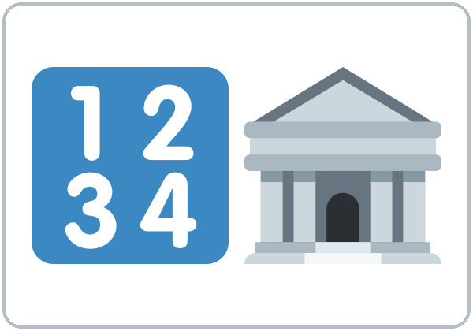
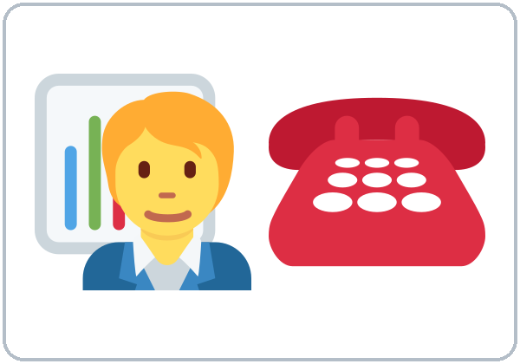

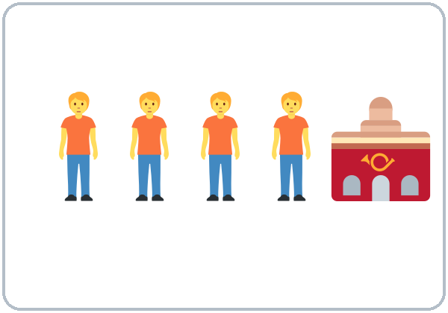
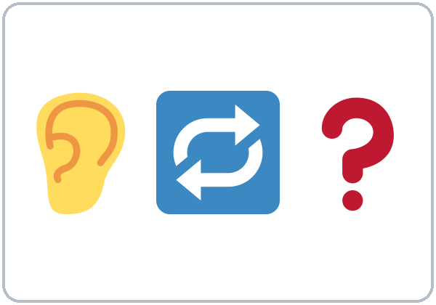

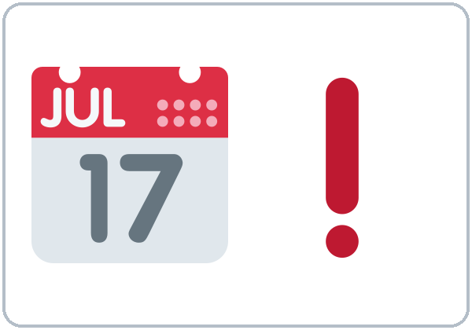
A / E / I
G / J · B / V
More New Words
account
number
customer
service
fix
(the sink)
wait in line
Could you
repeat that?
Can you
spell that?
due date
Notes:
New Words, part 2. Each click shows one word. Star words here: account number, customer service, Could you repeat that?, Can you spell that?
Spell it!: quick alphabet review: A spells their first name; B writes it. Review hard letters: A / E / I, G / J, B / V.
Source: Level2_Curriculum_v5_public.md, Lesson 12 (Step 2; Student Page 12).
Picture: Twemoji graphics by Twitter, Inc. and other contributors (https://github.com/jdecked/twemoji), CC BY 4.0 (https://creativecommons.org/licenses/by/4.0/); resized and combined.

Slide 6
Sam's bill is ...
Listening A
01
too high
too low
late
Listen. Circle the answer.
They charged him ...
02
one time
two times
three times
Sam has to pay ...
03
$15
$45
$54
He has to pay by ...
04
the 5th
the 15th
the 50th
Notes:
Step 3 · 6:18–6:30 · Listening + "Say it" (L12_listening.mp3, about 1:31). Audio: L12_listening.mp3 (about 1:31). The audio plays once, play again if needed. No speaker? Read the script with a volunteer learner.
Before you listen: "Sam calls the phone company. His bill is too high. What do they ask him?" Take 2 guesses.
Listen 1 → Task A (circle). Each click circles one answer.
Answer key: 1 too high; 2 two times; 3 $45; 4 the 15th.
City Phone, the names, and the numbers are invented.
Source: Level2_Curriculum_v5_public.md, Lesson 12 (Step 3; Answer key; Teacher notes).
Picture: Twemoji graphics by Twitter, Inc. and other contributors (https://github.com/jdecked/twemoji), CC BY 4.0 (https://creativecommons.org/licenses/by/4.0/); resized and combined.

Slide 7
Listen again.
Write the information.
Listening B
Account number:
4 7 2 9 1 6
Last name:
L - O - P - E - Z
Notes:
Listen 2 → Task B (write the numbers and letters). Each click shows one answer. The audio plays once, play again if needed.
Answer key: account number 472916; last name L-O-P-E-Z.
Privacy: never ask learners for real account numbers, bills, or ID numbers. Role cards give invented ones.
Source: Level2_Curriculum_v5_public.md, Lesson 12 (Step 3; Answer key; Teacher notes).

Slide 8
Listening C
C
Listen again.
Write the missing word.
1
Sorry, could you ____ that, please?
repeat
Phone rescue:
Could you repeat that?
2
Can you ____ that, please?
spell
3
When do I ____ to pay?
have
4
Could you ____ me a new bill, please?
send
Notes:
Listen 3 → Task C (fill in). Each click fills one blank. The audio plays once, play again if needed.
Answer key: repeat; spell; have; send.
"Say it" (1–2 min): the class repeats "Could you repeat that, please?" and "Do I have to pay today?"
If behind: skip the third play; do Task C together.
Source: Level2_Curriculum_v5_public.md, Lesson 12 (Step 3; Answer key).

Slide 9
Grammar Box 1
Do I have to ...?
QUESTION
ANSWER
Do
I have to pay today?
Yes, you do.
No, you don't.
Do
we need to fill out a form?
Yes, you do.
No, you don't.
Does
she have to work?
Yes, she does.
No, she doesn't.
Notes:
Step 4 · 6:30–6:45 · Grammar: have to / need to + Can / Could you. Say: "have to / need to = it is necessary. don't have to = not necessary (you can choose)."
Board: I have to pay. She has to pay. Do I have to pay? You don't have to pay today.
Grammar Box 1: each click highlights Do / Does and its answers.
Q: have to or has to? he / she / it → has to: She has to work. Questions: Does she have to work?
Source: Level2_Curriculum_v5_public.md, Lesson 12 (Step 4; Grammar Box 1; Questions and answers).
Picture: Twemoji graphics by Twitter, Inc. and other contributors (https://github.com/jdecked/twemoji), CC BY 4.0 (https://creativecommons.org/licenses/by/4.0/); resized and combined.

Slide 10
Grammar Box 2
Can You ...?
Could You ...?
REQUEST
ANSWER
Could you repeat that?
Sure. No problem.
Can you call me back?
Sorry, I can't.
I'm busy right now.
Notes:
Grammar Box 2: Can you…? Could you…? Click 1 and click 2 highlight one pair each.
Say: "Can you…? is friendly; Could you…? is more polite: good for phone calls, offices, and strangers."
More from the box: spell that, speak more slowly, help me, send me a new bill… please? Sure. / Of course.
Rescue phrases: Could you repeat that? Could you speak more slowly? Can you spell that?
Source: Level2_Curriculum_v5_public.md, Lesson 12 (Grammar Box 2; Questions and answers; Teacher notes).
Picture: Twemoji graphics by Twitter, Inc. and other contributors (https://github.com/jdecked/twemoji), CC BY 4.0 (https://creativecommons.org/licenses/by/4.0/); resized and combined.

Slide 11
Can I pay
Answers
by phone?
Yes, you can.
Sure. One moment, please.
Asking: Can I …?
Sorry, you can't.
Can I
pay by phone?
Can I
leave a message?
You have to come in person.
Can I
talk to a manager?
Notes:
Grammar Box 3: Can I…? Each click highlights Can I.
Answers: Yes, you can. / Sure. One moment, please. Sorry, you can't. You have to come in person.
Source: Level2_Curriculum_v5_public.md, Lesson 12 (Grammar Box 3).
Picture: Twemoji graphics by Twitter, Inc. and other contributors (https://github.com/jdecked/twemoji), CC BY 4.0 (https://creativecommons.org/licenses/by/4.0/); resized and combined.

Slide 12
Common Mistakes
Don't say
Say
I have to paying.
I have to pay.
I must to pay.
I have to pay.
She have to work.
She has to work.
Notes:
Common mistakes (part 1). Each click shows the correct sentence.
I must pay is also correct. Write the correct form on the board. Learners can read the note on their Grammar page; you don't need to explain it.
Source: Level2_Curriculum_v5_public.md, Lesson 12 (Common mistakes; Teacher notes).
Picture: Twemoji graphics by Twitter, Inc. and other contributors (https://github.com/jdecked/twemoji), CC BY 4.0 (https://creativecommons.org/licenses/by/4.0/); resized and combined.

Slide 13
Fix These Mistakes
Don't say
Say
Could you to help me?
Could you help me?
Does she has to go?
Does she have to go?
You don't have to
smoke here.
You can't smoke here.
(= not allowed)
Notes:
Common mistakes (part 2). Each click shows the correct sentence.
Q: What does don't have to mean? Not necessary. You can choose. You don't have to pay today = you can pay later. It does not mean "you can't."
Source: Level2_Curriculum_v5_public.md, Lesson 12 (Common mistakes; Questions and answers).
Picture: Twemoji graphics by Twitter, Inc. and other contributors (https://github.com/jdecked/twemoji), CC BY 4.0 (https://creativecommons.org/licenses/by/4.0/); resized and combined.

Slide 14
Quick Check
has to, don't have to, or help?
1
2
3
He ___ to work tomorrow.
Do I have to pay today? (due on the 15th)
Could you ___ me? (help / to help)
has
No, you don't.
help
Notes:
Step 4 check questions. Learners answer; each click shows one answer.
Answers: has · No, you don't have to · help (Could you help me?).
Short "Errand List" (last 5 min): pairs tell 3 things they have to do this week and 1 thing they don't have to do. If behind: skip it.
Source: Level2_Curriculum_v5_public.md, Lesson 12 (Step 4 Check).

Slide 15
have to · need to · don't have to
Necessary or Not?
Necessary
have to
I have to pay the bill.
She has to work.
Not necessary
don't
You don't have to
pay today.
Notes:
have to / need to / don't have to. Click 1 and click 2 show one row each.
need to = almost the same as have to: We need to fill out a form. He needs to call.
Pronunciation (If time ①): have to → "HAF-tuh," has to → "HAS-tuh," Could you → "COOD-juh." Then polite intonation: requests start higher and sound friendly.
Source: Level2_Curriculum_v5_public.md, Lesson 12 (have to / need to / don't have to; If time).
Picture: Twemoji graphics by Twitter, Inc. and other contributors (https://github.com/jdecked/twemoji), CC BY 4.0 (https://creativecommons.org/licenses/by/4.0/); resized and combined.

Slide 16
Talk Time
Phone Service
Write what you have to do.
7:00–7:10
1
Sit back to back.
Like a phone call.
2
Customer + agent cards.
Can you spell that?
3
Switch after 4 minutes.
New card, new problem.
Notes:
Step 5 · 7:00–7:10 · Talk Time: Phone Service Role Plays. Pairs, back to back (15) / pairs + teacher (7–8). Each click shows one step.
Do: customer card (problem + invented name + account number) and agent card. The agent asks Can you spell that? Could you repeat your account number? The customer writes what they have to do.
Switch after 4 minutes with a new card. Use only 555-0100 to 555-0199 phone numbers in materials (reserved for fiction). If behind: one role play only.
Source: Level2_Curriculum_v5_public.md, Lesson 12 (Step 5; Teacher notes).
Picture: Twemoji graphics by Twitter, Inc. and other contributors (https://github.com/jdecked/twemoji), CC BY 4.0 (https://creativecommons.org/licenses/by/4.0/); resized and combined.

Slide 17
Before You Go
01
Exit ticket
02
Homework
Write one sentence
with have to or
need to. Write one
request: Could you…?
Write 4 things you
have to do and 2
you don't have to.
Write a voicemail:
name, 555-01__, and
Could you call me back?
Notes:
Step 6 · 7:10–7:15 · Exit Ticket + Homework. NEVER SKIP.
Exit ticket: one sentence with have to or need to and one request with Could you…?
Homework (10 minutes): 1. Write 4 things you have to do this week and 2 things you don't have to do. 2. Write a voicemail message (3–4 sentences): your name, a fictional number (555-01__), the reason, and Could you call me back, please? 3. Bonus: practice spelling your name and street aloud 3 times.
Source: Level2_Curriculum_v5_public.md, Lesson 12 (Step 6; Student Page 12 Homework).
Picture: Twemoji graphics by Twitter, Inc. and other contributors (https://github.com/jdecked/twemoji), CC BY 4.0 (https://creativecommons.org/licenses/by/4.0/); resized and combined.

Slide 18
Credits
Pictures
Vocabulary pictures use Twemoji graphics by Twitter, Inc. and other contributors (https://github.com/jdecked/twemoji), licensed under CC BY 4.0 (https://creativecommons.org/licenses/by/4.0/). The graphics were resized and combined, and arrows, calendars, clocks, and labels were added.
This deck
© 2026 the authors. The authors license this deck under CC BY-NC-SA 4.0.
Audio and font
Audio: Chatterbox TTS (Resemble AI, MIT); AI voices with a Perth watermark. Font: Lexend Deca (OFL 1.1). Provided as-is, without warranty.
Notes:
Credits. Lesson content: Level 2 Adult ESL Curriculum v5, public edition, Lesson 12.
Image credit line copied exactly from images/CREDITS.md. Deck notice: © 2026 the authors; the authors license this deck under CC BY-NC-SA 4.0 (Section 7.2).
Audio and font credits: Chatterbox TTS (Resemble AI, MIT; Perth watermark), Lexend Deca (SIL OFL 1.1).

