Slide 1


Then, Now, and Next
Today you will:
• Talk about past, present, future
• Choose the tense: ago / now / next
• Say feelings: then and now
• Practice a graduation talk
Lesson 13 (Week 14)
Notes:
Welcome back. Read the goals together; learners repeat.
Objectives: talk about the past, present, and future in one conversation; choose the correct tense with a time word (ago / now / next year); talk about feelings then and now (I was nervous. Now I feel proud.); prepare and practice a short graduation talk (4–6 sentences).
This lesson reviews all the grammar from Lessons 1–12. No new grammar except will (shown only in the tense helper, for recognition).
Source: Level2_Curriculum_v5_public.md, Lesson 13 (At a glance; Teacher notes).
Picture: Twemoji graphics by Twitter, Inc. and other contributors (https://github.com/jdecked/twemoji), CC BY 4.0 (https://creativecommons.org/licenses/by/4.0/); resized and combined.

Slide 2

OPENING TALK · 6:00
Warm-Up
Same partner.
Review Lesson 12.
What do you have to do this week?
Do you have to work on Saturday?
Notes:
Step 1 · 6:00–6:10 · Opening Talk + Homework Check. Pairs (same partner for both parts).
Minutes 0–5 (review Lesson 12): partners ask What do you have to do this week? Do you have to work on Saturday? Each click shows one question.
Source: Level2_Curriculum_v5_public.md, Lesson 13 (Step 1).
Picture: Twemoji graphics by Twitter, Inc. and other contributors (https://github.com/jdecked/twemoji), CC BY 4.0 (https://creativecommons.org/licenses/by/4.0/); resized and combined.

Slide 3
Homework
Check
HW
Homework check
Play your voicemail.
1
I ___ to pay a bill.
have
Listener: write the
name and number.
2
She ___ to work.
has
3
Could you call me ___?
back
4
You ___ have to pay.
don't
Notes:
Step 1, minutes 5–10: partners "play" their voicemail (read it). The listener writes the name and number and asks Could you repeat that?
Each click shows one answer. The lines review Lesson 12 (have to / has to / don't have to; voicemail).
Teacher: write 2 corrected sentences on the board. If behind: collect the homework.
Source: Level2_Curriculum_v5_public.md, Lesson 13 (Step 1); Lesson 12 Homework.

Slide 4
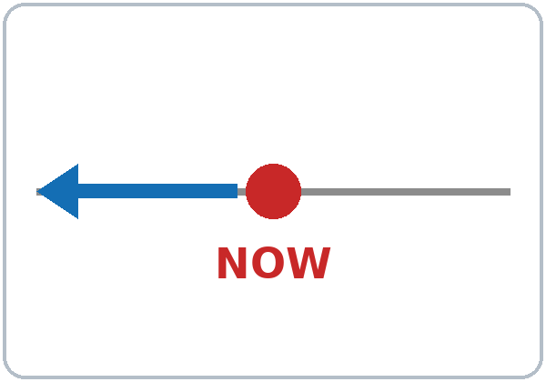
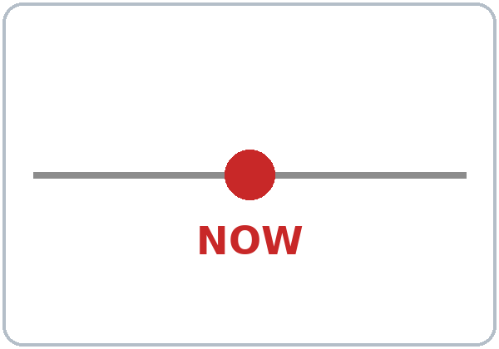
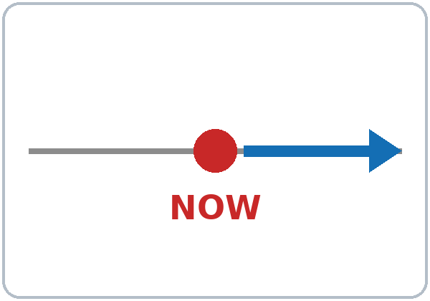
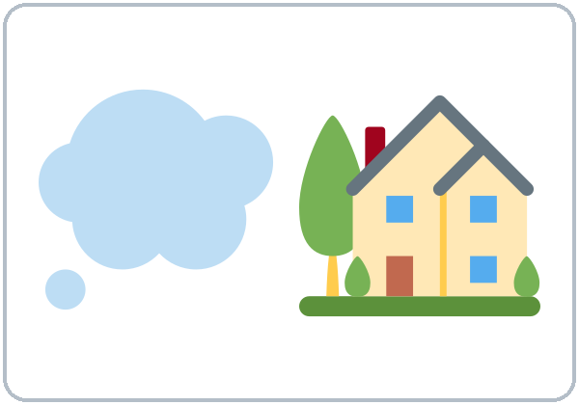


Then, now,
or next?
New Words
in the past
now
in the future
dream
goal
learn
Notes:
Step 2 · 6:10–6:18 · New Words (pairs). Point, say, repeat twice. Each click shows one word.
Star words here: in the past, now, in the future, dream, goal.
Then, now, or next? Say a sentence (I was nervous. / I'm going to graduate.). Learners point behind (past), down (now), or forward (future).
If behind: teach the star words only.
Source: Level2_Curriculum_v5_public.md, Lesson 13 (Step 2; Student Page 13 New Words).
Picture: Twemoji graphics by Twitter, Inc. and other contributors (https://github.com/jdecked/twemoji), CC BY 4.0 (https://creativecommons.org/licenses/by/4.0/); resized and combined.

Slide 5

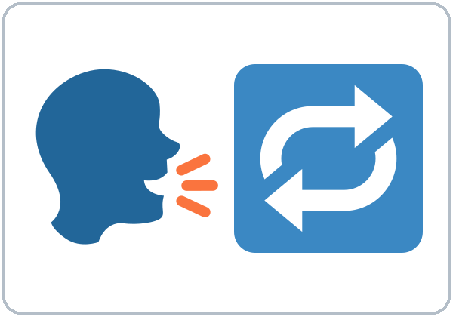

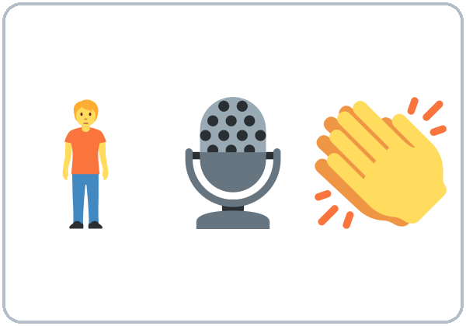

Point back,
down, forward.
More New Words
improve
practice
proud
give a talk
graduate
next step
Notes:
New Words, part 2. Each click shows one word. Star words here: improve, proud, give a talk.
Source: Level2_Curriculum_v5_public.md, Lesson 13 (Step 2; Student Page 13).
Picture: Twemoji graphics by Twitter, Inc. and other contributors (https://github.com/jdecked/twemoji), CC BY 4.0 (https://creativecommons.org/licenses/by/4.0/); resized and combined.

Slide 6
Listen. Then, now,
or next?
Listening A
1. She was nervous.
Then
Now
Next
2. She works at a bakery.
Then
Now
Next
3. She makes her own appointments.
Then
Now
Next
4. She is going to take a computer class.
Then
Now
Next
5. She is going to get an office job.
Then
Now
Next
Notes:
Step 3 · 6:18–6:30 · Listening + "Say it" (L13_listening.mp3, about 0:59). Audio: L13_listening.mp3 (about 0:59). The audio plays once, play again if needed. No speaker? Read the script with a volunteer learner.
Before you listen: "Ana gives a talk at graduation. What does she talk about?" Take 2 guesses.
Listen 1 → Task A (then / now / next). On the Student Page learners check ✓. Each click circles one answer.
Answer key: nervous = then; works at a bakery = now; makes appointments = now; computer class = next; office job = next (goal).
Source: Level2_Curriculum_v5_public.md, Lesson 13 (Step 3; Answer key).

Slide 7
Listen again.
True or False?
Listening B
1. One year ago, Ana felt relaxed.
True
False
She was nervous.
2. She practiced with her classmates.
True
False
3. Now she works at a restaurant.
True
False
At a bakery.
4. She feels proud now.
True
False
5. Her dream is to open a bakery.
True
False
To help people learn English.
Notes:
Listen 2 → Task B (true / false). Each click circles one answer and shows the correction. The audio plays once, play again if needed.
Answer key: 1 F (she was nervous); 2 T; 3 F (a bakery); 4 T; 5 F (help other people learn English).
Source: Level2_Curriculum_v5_public.md, Lesson 13 (Step 3; Answer key).

Slide 8
Listening C
C
Listen again.
Write the missing word.
1
One year ago, I ____ very nervous.
was
Find the time word.
It tells you the tense.
2
I ____ a lot with my classmates.
practiced
3
Now, I ____ at a bakery.
work
4
Next year, I am ____ to take a computer class.
going
Notes:
Listen 3 → Task C (fill in). Each click fills one blank. The audio plays once, play again if needed.
Answer key: was; practiced; work; going.
"Say it" (1–2 min): the class repeats "One year ago, I was nervous." and "Now I feel proud."
If behind: skip the third play; do Task C together.
Source: Level2_Curriculum_v5_public.md, Lesson 13 (Step 3; Answer key).

Slide 9
Then, Now,
Answers
and Next
I lived in ___ five years ago.
I live in ___ now.
The time word tells the tense.
I'm going to take a class.
Where
did
you live?
Where
do
you live now?
then · now · next
What
are
you going to do?
Notes:
Step 4 · 6:30–6:45 · Grammar: Review of all tenses. Say: "The time word tells you the tense. ago / last / yesterday → past. now / right now → present continuous. every day / usually → present. tomorrow / next year → going to."
Grammar Box 1: Then / Now / Next. Each click highlights did / do / are. Add: five years ago? now? next year?
Q: How do I choose the tense? Look at the time word.
Source: Level2_Curriculum_v5_public.md, Lesson 13 (Step 4; Grammar Box 1; Questions and answers).
Picture: Twemoji graphics by Twitter, Inc. and other contributors (https://github.com/jdecked/twemoji), CC BY 4.0 (https://creativecommons.org/licenses/by/4.0/); resized and combined.

Slide 10
Grammar Box 2
Feelings Then
and Now
QUESTION
ANSWER
How
did you feel in the first class?
I felt nervous.
I was shy.
How
do you feel now?
I feel proud.
I am happy.
Notes:
Grammar Box 2: Feelings then and now. Click 1 and click 2 highlight one pair each.
More from the box: nervous / shy / excited; proud / happy / more confident.
Q: was or did? was / were with adjectives and places: I was nervous. did with other verbs in questions and negatives: Did you study?
Source: Level2_Curriculum_v5_public.md, Lesson 13 (Grammar Box 2; Questions and answers).
Picture: Twemoji graphics by Twitter, Inc. and other contributors (https://github.com/jdecked/twemoji), CC BY 4.0 (https://creativecommons.org/licenses/by/4.0/); resized and combined.

Slide 11
Grammar Box 3
Goals and Dreams
QUESTION
ANSWER
Your
goal?
My goal is to
get a better job.
Your
dream?
My dream is to
help my kids.
Your
next step?
My next step is to
improve my English.
Notes:
Grammar Box 3: Goals and dreams. Each click highlights one row. Full question: What's your goal? What's your dream?
Q: How do I talk about a goal? My goal is to + verb: My goal is to get an office job.
Source: Level2_Curriculum_v5_public.md, Lesson 13 (Grammar Box 3; Questions and answers).
Picture: Twemoji graphics by Twitter, Inc. and other contributors (https://github.com/jdecked/twemoji), CC BY 4.0 (https://creativecommons.org/licenses/by/4.0/); resized and combined.

Slide 12
Common Mistakes
Don't say
Say
I am agree.
I agree.
One year ago I am nervous.
One year ago I was nervous.
Next year I take a class.
Next year I'm going to take a class.
Notes:
Common mistakes (part 1). Each click shows the correct sentence.
Write the correct form on the board. Learners can read the note on their Grammar page; you don't need to explain it.
Source: Level2_Curriculum_v5_public.md, Lesson 13 (Common mistakes; Teacher notes).
Picture: Twemoji graphics by Twitter, Inc. and other contributors (https://github.com/jdecked/twemoji), CC BY 4.0 (https://creativecommons.org/licenses/by/4.0/); resized and combined.

Slide 13
Fix These Mistakes
Don't say
Say
In the next year…
Next year…
My goal is get a job.
My goal is to get a job.
I have 30 years.
I'm 30 (years old).
Notes:
Common mistakes (part 2). Each click shows the correct sentence.
Tip: before you speak, find the time word. It tells you which tense to use.
Source: Level2_Curriculum_v5_public.md, Lesson 13 (Common mistakes).
Picture: Twemoji graphics by Twitter, Inc. and other contributors (https://github.com/jdecked/twemoji), CC BY 4.0 (https://creativecommons.org/licenses/by/4.0/); resized and combined.

Slide 14
Quick Check
Find the time word
1
2
3
Last year I ___ at a hotel. (work)
Next year I ___ a class. (take)
I am agree or I agree?
worked
'm going to take
I agree.
Notes:
Step 4 check questions. Learners answer; each click shows one answer.
Answers: worked · am going to take · I agree.
Short "Time Word Dice" (last 5 min): pairs take a card with a time word and a verb (last year + live) and make a sentence. If behind: skip it.
Source: Level2_Curriculum_v5_public.md, Lesson 13 (Step 4 Check).

Slide 15
Tense helper · the time word
Then or Next?
ago, last year
then
I moved here
two years ago.
next year
next
I'm going to take
a computer class.
Notes:
Tense helper. Click 1 and click 2 show one row each.
All rows: ago, last year, yesterday → past (I moved here two years ago. I was nervous.); every day, usually, always → present (I work at a bakery.); now, right now, today → present continuous (I'm studying English now.); tomorrow, next year, this weekend → going to (I'm going to take a computer class.); offers, promises → will, recognize only (I'll help you).
Pronunciation (If time ①): stress the important words: "One year AGO, I was NERVOUS. NOW, I feel PROUD." Pause at each period.
Source: Level2_Curriculum_v5_public.md, Lesson 13 (Tense helper; If time).
Picture: Twemoji graphics by Twitter, Inc. and other contributors (https://github.com/jdecked/twemoji), CC BY 4.0 (https://creativecommons.org/licenses/by/4.0/); resized and combined.

Slide 16
Talk Time
Graduation Talks
Read from your paper. That's OK!
7:00–7:10
1
Fill in the talk frame.
Then / Now / Next / Thank you
2
Give your talk (1 min).
One year ago, I was nervous.
3
Listeners:
one compliment + one question
Notes:
Step 5 · 7:00–7:10 · Talk Time: Practice Graduation Talks. Groups of 3 (15: 5 groups) / two groups of 3–4 (7–8). Each click shows one step.
Do (3 min): each learner fills in the talk frame on the Homework page: Then / Now / Next / Thank you. Practice (7 min): each learner gives the talk to the group (about 1 minute). Listeners give one compliment and one question (How did you feel? What are you going to study?).
Reassure: at graduation, learners can read from their paper, give the talk with a partner, or just say 2 sentences. Graduation talks are optional; never force a learner to speak in front of guests.
If behind: learners write the frame only; practice at home.
Source: Level2_Curriculum_v5_public.md, Lesson 13 (Step 5; Teacher notes).
Picture: Twemoji graphics by Twitter, Inc. and other contributors (https://github.com/jdecked/twemoji), CC BY 4.0 (https://creativecommons.org/licenses/by/4.0/); resized and combined.

Slide 17
Before You Go
01
Exit ticket
02
Homework
Write 3 sentences:
one past, one
present, one future.
Finish your talk
(4–6 sentences).
Practice it 3 times.
Final exam: next week.
Notes:
Step 6 · 7:10–7:15 · Exit Ticket + Homework. NEVER SKIP.
Exit ticket: three sentences: one past, one present, one future.
Homework: My Graduation Talk (15 minutes): 1. Complete your talk (4–6 sentences): Then / Now / Next / Goal or dream / Thank you. Practice it aloud 3 times. 2. Final next week: look at the Final Review pages in the workbook. 3. Bonus: record your talk on your phone and listen.
Remind learners: final next week (Week 15), graduation in Week 16.
Source: Level2_Curriculum_v5_public.md, Lesson 13 (Step 6; Student Page 13 Homework).
Picture: Twemoji graphics by Twitter, Inc. and other contributors (https://github.com/jdecked/twemoji), CC BY 4.0 (https://creativecommons.org/licenses/by/4.0/); resized and combined.

Slide 18
Credits
Pictures
Vocabulary pictures use Twemoji graphics by Twitter, Inc. and other contributors (https://github.com/jdecked/twemoji), licensed under CC BY 4.0 (https://creativecommons.org/licenses/by/4.0/). The graphics were resized and combined, and arrows, calendars, clocks, and labels were added.
This deck
© 2026 the authors. The authors license this deck under CC BY-NC-SA 4.0.
Audio and font
Audio: Chatterbox TTS (Resemble AI, MIT); AI voices with a Perth watermark. Font: Lexend Deca (OFL 1.1). Provided as-is, without warranty.
Notes:
Credits. Lesson content: Level 2 Adult ESL Curriculum v5, public edition, Lesson 13.
Image credit line copied exactly from images/CREDITS.md. Deck notice: © 2026 the authors; the authors license this deck under CC BY-NC-SA 4.0 (Section 7.2).
Audio and font credits: Chatterbox TTS (Resemble AI, MIT; Perth watermark), Lexend Deca (SIL OFL 1.1).

