Slide 1
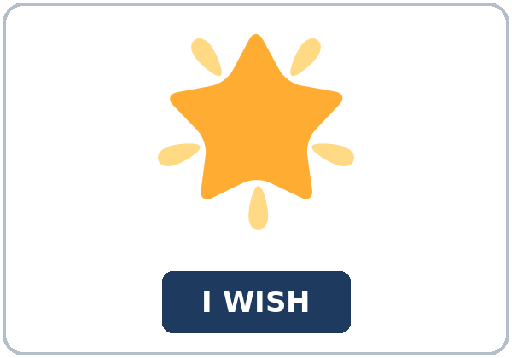
I Wish I Had Asked
Today you will:
• I can say I wish I had… for a past regret.
• I can say I wish I knew… for something I want now.
• I can say one If I had…, I would have… sentence.
Lesson 3 · Level 5
Notes:
Welcome learners as they arrive.
Read the three lines under Today you will.
Lesson plan: Topic; At a glance: Objectives.
Picture: Twemoji graphics by Twitter, Inc. and other contributors (https://github.com/jdecked/twemoji), CC BY 4.0 (https://creativecommons.org/licenses/by/4.0/); resized and combined, with signs and labels (images/CREDITS.md).

Slide 2
Today's
Goals
01
I can say I wish I had… for a past regret.
02
I can say I wish I knew… for something I want now.
03
I can say one If I had…, I would have… sentence.
By the end of class, you can do these things.
04
I can say what I will do next time.
Notes:
Read each goal slowly. Learners repeat.
Lesson plan: At a glance: Objectives.

Slide 3
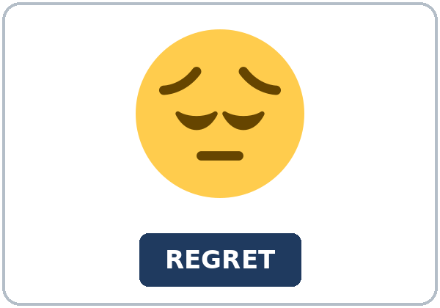
OPENING TALK · 6:00
Opening Talk
Work with a partner. Ask about
last week. Then switch.
Homework check: read one sentence from
your Lesson 2 note.
Notes:
Step 1 · 6:00–6:06 · Opening Talk.
Work with a partner.
Lesson plan: Step 1; Opening Talk page.
Picture: Twemoji graphics by Twitter, Inc. and other contributors (https://github.com/jdecked/twemoji), CC BY 4.0 (https://creativecommons.org/licenses/by/4.0/); resized and combined, with signs and labels (images/CREDITS.md).

Slide 4
Opening Talk
Cards
01
What had you already finished before class?
02
Say one earlier event with had.
Work with a partner. Ask about last week. Then
switch.
03
Say the later event with by the time.
04
Homework check: read one sentence from your Lesson 2 note.
Notes:
Each click shows the next card.
A asks. B answers. Then switch.
Lesson plan: Step 1; Opening Talk page.

Slide 5
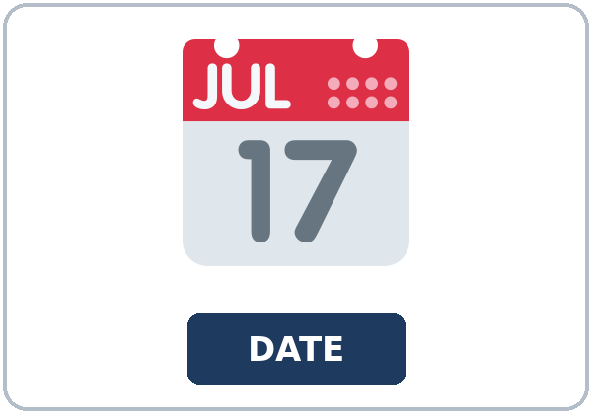
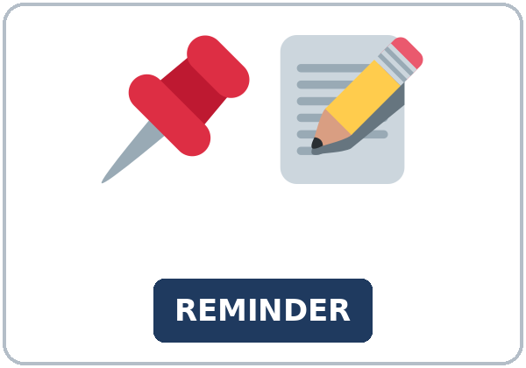
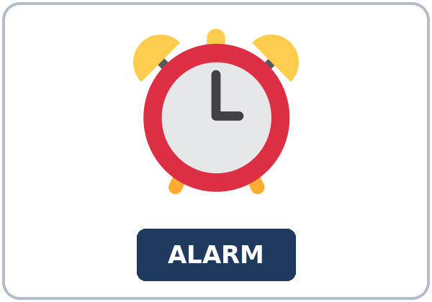
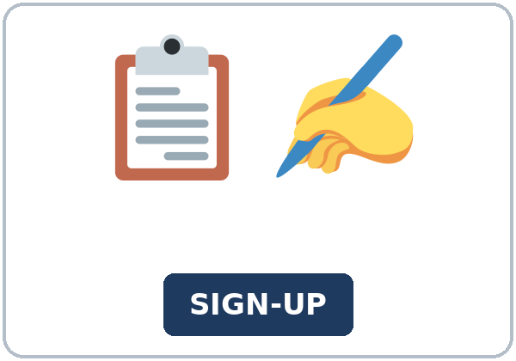
Look. Listen.
Repeat.
New Words
★ wish
★ regret
★ calendar
★ reminder
★ alarm
★ sign-up sheet
Notes:
Step 2 · 6:06–6:12 · New Words.
Point to each picture. Learners repeat. ★ = most important.
Lesson plan: Step 2; New Words page.
Pictures: Twemoji graphics by Twitter, Inc. and other contributors (https://github.com/jdecked/twemoji), CC BY 4.0 (https://creativecommons.org/licenses/by/4.0/); resized and combined, with signs and labels (images/CREDITS.md).

Slide 6
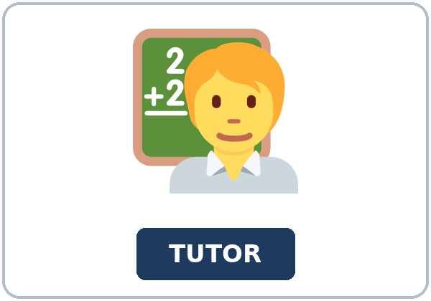
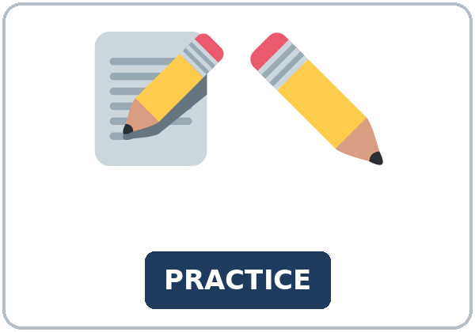
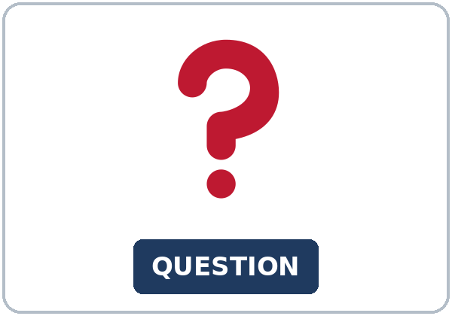
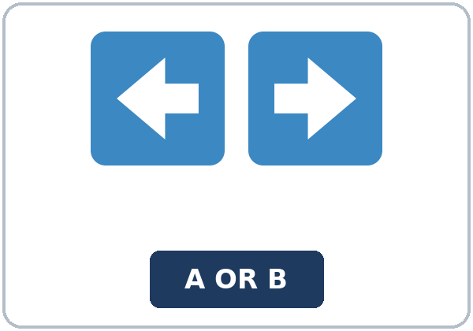
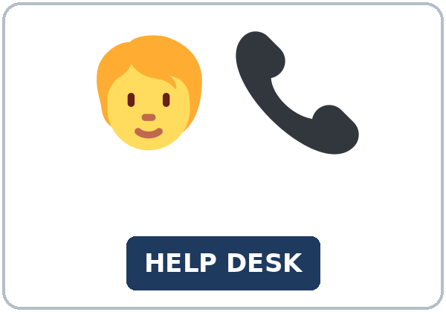
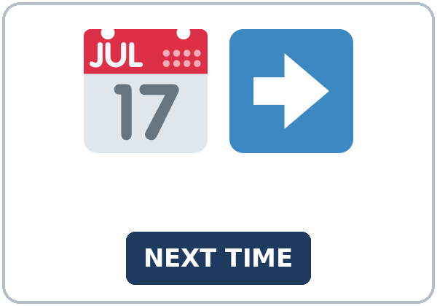
Partner game:
Point and wish
More New Words
★ tutor
★ practice
★ question
★ choice
help desk
next time
Notes:
A points to a picture. B names it and uses it in one sentence. Then switch.
Lesson plan: Step 2; New Words page; Partner game.
Pictures: Twemoji graphics by Twitter, Inc. and other contributors (https://github.com/jdecked/twemoji), CC BY 4.0 (https://creativecommons.org/licenses/by/4.0/); resized and combined, with signs and labels (images/CREDITS.md).

Slide 7
Check the Meaning
Look at the picture. Answer the question.
1
2
3
Is a calendar a list of dates?
What can wake you up?
Where can you ask for help?
yes
an alarm
the help desk
Notes:
The answers are hidden. Ask, then click.
1. yes
2. an alarm
3. the help desk
Lesson plan: Step 2: Check the Meaning.
Pictures: Twemoji graphics by Twitter, Inc. and other contributors (https://github.com/jdecked/twemoji), CC BY 4.0 (https://creativecommons.org/licenses/by/4.0/); resized and combined, with signs and labels (images/CREDITS.md).

Slide 8
Before You
Listen for:
Listen
Listen. What do they regret?
After class, Alicia and Chris talk about a workshop they signed up for late.
| 6:12–6:32 | Listening.
01
Audio: about 1:23. It plays once.
Narrator
02
Alicia
Play 1: Task A
03
Chris
Notes:
Step 3 · 6:12–6:32 · Listening. Play 1 is Task A. Play 2 is Tasks B and C. A third play is fine.
After class, Alicia and Chris talk about a workshop they signed up for late.
The script says going to and want to. Learners only need to recognize gonna and wanna.
Lesson plan: Step 3; Listening page.
Picture: Twemoji graphics by Twitter, Inc. and other contributors (https://github.com/jdecked/twemoji), CC BY 4.0 (https://creativecommons.org/licenses/by/4.0/); resized and combined, with signs and labels (images/CREDITS.md).

Slide 9
Listen. What do they regret?
Listening A
1.
a. They lost a book
b. They signed up for the workshop late
c. They want to leave the class
Notes:
Click to circle b.
Lesson plan: Step 3; Listening Task A; Answer key.

Slide 10
B. Listen again. Circle the answers.
Listening B
1. Alicia's wish
asked the tutor
left the class
skipped practice
2. Chris's wish
set an alarm
changed jobs
missed the class
3. Next time Alicia will
ask on the first day
wait a year
stay quiet
4. The if sentence uses
would have known
will know
knew
Notes:
Click to circle each answer: 1 asked the tutor • 2 set an alarm • 3 ask on the first day • 4 would have known
Lesson plan: Step 3; Listening Task B; Answer key.

Slide 11
Listen again.
Listen again. Write wish I h
Listening C
1
Alicia: "I ______ asked the tutor."
wish I had
2
"If I had asked, I ______ known the date."
would have
3
Chris: "I ______ set an alarm."
wish I had
Write the missing words.
Then check together.
4
"If I had set one, I ______ arrived on time."
would have
5
Alicia: "Then I ______ known."
would have
6
Chris: "I ______ put a reminder on the calendar."
wish I had
Notes:
Click to show each answer: 1 wish I had • 2 would have • 3 wish I had • 4 would have • 5 would have • 6 wish I had
Lesson plan: Step 3; Listening Task C; Answer key.

Slide 12
Hear it: gonna and wanna are short forms
Hear It,
Say It
Say it: use the full forms
I want to ask the tutor.
I am going to sign up on the first day.
gonna and wanna are short forms. This listening uses the full forms.
You can say going to and want to.
Say each line two times.
I wish I had asked.
If I had asked, I would have known.
Notes:
gonna and wanna are short forms. This listening uses the full forms. Say each line two times.
Lesson plan: Step 3: Hear it, say it.

Slide 13
Grammar Box 1
a wish about now
WISH
MEANING
I wish I knew the deadline.
a wish about now
I wish I had a reminder.
had means owned
I wish I were on the list.
were, for now
Notes:
Grammar Box 1: a wish about now. Each click shows the answer side.
Lesson plan: Step 4; Grammar Box 1.
Picture: Twemoji graphics by Twitter, Inc. and other contributors (https://github.com/jdecked/twemoji), CC BY 4.0 (https://creativecommons.org/licenses/by/4.0/); resized and combined, with signs and labels (images/CREDITS.md).

Slide 14
Grammar Box 2
a wish about the past
WISH
MEANING
I wish I had asked the tutor.
a past regret
I wish I had set an alarm.
had + participle
I wish we had signed up on Monday.
the sign-up is finished
Notes:
Grammar Box 2: a wish about the past. Each click shows the answer side.
Lesson plan: Step 4; Grammar Box 2.
Picture: Twemoji graphics by Twitter, Inc. and other contributors (https://github.com/jdecked/twemoji), CC BY 4.0 (https://creativecommons.org/licenses/by/4.0/); resized and combined, with signs and labels (images/CREDITS.md).

Slide 15
Grammar Box 3
one different past
IF
RESULT
If I had asked, I would have known.
one pattern
If he had set an alarm, he would have arrived on time.
same pattern
If we had read the reminder, we would have signed up.
same pattern
Notes:
Grammar Box 3: one different past. Each click shows the answer side.
Lesson plan: Step 4; Grammar Box 3.
Picture: Twemoji graphics by Twitter, Inc. and other contributors (https://github.com/jdecked/twemoji), CC BY 4.0 (https://creativecommons.org/licenses/by/4.0/); resized and combined, with signs and labels (images/CREDITS.md).

Slide 16
Grammar Box 4
should have, and next time
NOW
NEXT
I should have asked earlier.
same idea as the wish
Next time I will ask on the first day.
a plan
If I had another chance, I would ask.
next time
Notes:
Grammar Box 4: should have, and next time. Each click shows the answer side.
Lesson plan: Step 4; Grammar Box 4.
Picture: Twemoji graphics by Twitter, Inc. and other contributors (https://github.com/jdecked/twemoji), CC BY 4.0 (https://creativecommons.org/licenses/by/4.0/); resized and combined, with signs and labels (images/CREDITS.md).

Slide 17
Practice A
Write.
Practice A
1
I wish I ______ the deadline.
knew
2
I wish I ______ asked the tutor.
had
3
If I had asked, I ______ have known.
would
Write the missing word.
Pairs: check your answers.
4
I ______ have asked earlier.
should
5
Next time I ______ ask on the first day.
will
6
I wish I ______ a reminder.
had
Notes:
Click to show each answer: 1 knew • 2 had • 3 would • 4 should • 5 will • 6 had
Lesson plan: Step 4; Grammar Practice A; Answer key.

Slide 18
Circle the correct words.
Practice B
1. I wish I
knew
know
2. I wish I
had asked
would have asked
3. If I
had asked
would have asked
4. I
should have asked
should asked
5. Next time I
will ask
would have ask
6. If I had another chance, I
would ask
would have asked
Notes:
Click to circle each answer: 1 knew • 2 had asked • 3 had asked • 4 should have asked • 5 will ask • 6 would ask
Lesson plan: Step 4; Grammar Practice B; Answer key.

Slide 19
Common Mistakes
Don't say
Say
I wish I would have asked.
I wish I had asked.
If I would have asked, I would have known.
If I had asked, I would have known.
I wish I know the deadline.
I wish I knew the deadline.
I should asked earlier.
I should have asked earlier.
Notes:
Read Don't say, then Say. Learners try first. Then click.
Lesson plan: Grammar: Common mistakes.
Picture: Twemoji graphics by Twitter, Inc. and other contributors (https://github.com/jdecked/twemoji), CC BY 4.0 (https://creativecommons.org/licenses/by/4.0/); resized and combined, with signs and labels (images/CREDITS.md).

Slide 20
Pair Check
A says.
01
Then switch.
A says a mild regret from class.
B answers.
02
B says I wish I had… and Next time I will….
Notes:
A says a mild regret from class. B says I wish I had… and Next time I will…. Then switch. ---
Break · 6:45–7:00.
Lesson plan: Step 4: Pair check.
Picture: Twemoji graphics by Twitter, Inc. and other contributors (https://github.com/jdecked/twemoji), CC BY 4.0 (https://creativecommons.org/licenses/by/4.0/); resized and combined, with signs and labels (images/CREDITS.md).

Slide 21
Talk Time
Talk Time
Pairs.
Pairs.
7:00–7:18
1
Pairs.
2
I missed the sign-up.
3
I did not ask for the example.
Notes:
Round 1.
Lesson plan: Step 5; Talk Time.
Picture: Twemoji graphics by Twitter, Inc. and other contributors (https://github.com/jdecked/twemoji), CC BY 4.0 (https://creativecommons.org/licenses/by/4.0/); resized and combined, with signs and labels (images/CREDITS.md).

Slide 22
Talk Time
Talk Time
Pairs.
Pairs.
7:00–7:18
1
Pairs.
2
Say If I had…, I would have….
3
The group repeats the clearest sentence.
Notes:
Round 2.
Lesson plan: Step 5; Talk Time.
Picture: Twemoji graphics by Twitter, Inc. and other contributors (https://github.com/jdecked/twemoji), CC BY 4.0 (https://creativecommons.org/licenses/by/4.0/); resized and combined, with signs and labels (images/CREDITS.md).

Slide 23
Read.
Answer.
Read &
Write
1
What did the learner miss?
The workshop sign-up
2
Which wish is about now?
I wish I knew the deadline
Read the page.
Answer the questions.
3
Which wish is about the past?
I wish I had asked the tutor
4
What is the if sentence?
If I had asked, I would have known
5
What will the learner do next time?
Ask on the first day
Notes:
Step 6 · 7:18–7:25 · Read & Write.
Click to show each answer: 1 The workshop sign-up • 2 I wish I knew the deadline • 3 I wish I had asked the tutor • 4 If I had asked, I would have known • 5 Ask on the first day
Lesson plan: Step 6; Read & Write page; Answer key.

Slide 24
Before You Go 7:25–7:30
01
Exit ticket
02
Homework
Write about one mild regret.
Name: Date:
The wish, the if sentence, what you should have done, and the next step.
Give this page to your teacher.
About 20–25 minutes.
1. Write I wish I knew and one past wish.
2. Finish the six-sentence note from Read & Write.
3. Tell a friend one next step. Write the sentence.
4. Review: had already. Write one sentence from Lesson 2.
Bring it next week!
Notes:
Step 7 · 7:25–7:30 · Exit ticket and homework. Never skip the exit ticket.
Write about one mild regret.
Lesson plan: Step 7; Exit Ticket page; Homework page.
Picture: Twemoji graphics by Twitter, Inc. and other contributors (https://github.com/jdecked/twemoji), CC BY 4.0 (https://creativecommons.org/licenses/by/4.0/); resized and combined, with signs and labels (images/CREDITS.md).

Slide 25
Goodbye! See You Next Week!
Now you can:
• I can say I wish I had… for a past regret.
• I can say I wish I knew… for something I want now.
• I can say one If I had…, I would have… sentence.
Lesson 3 · Level 5
Notes:
Read the three Now you can lines.
Homework is about 20–25 minutes. Bring it next week.
Lesson plan: At a glance: Objectives; Step 7.
Picture: Twemoji graphics by Twitter, Inc. and other contributors (https://github.com/jdecked/twemoji), CC BY 4.0 (https://creativecommons.org/licenses/by/4.0/); resized and combined, with signs and labels (images/CREDITS.md).

Slide 26
Credits
Pictures
Vocabulary pictures use Twemoji graphics by Twitter, Inc. and other contributors (https://github.com/jdecked/twemoji), licensed under CC BY 4.0 (https://creativecommons.org/licenses/by/4.0/). The graphics were resized and combined, and signs and labels were added.
Names and story
Alicia and Chris are invented names. The listening story is invented.
Audio and font
Audio: synthetic voices made with Chatterbox TTS (MIT License), cloned from short synthetic reference clips made with Kokoro-82M (Apache License 2.0). No recordings of real people were used. Each file carries an inaudible Perth watermark marking it as AI-generated. Font: Lexend Deca (OFL 1.1).
© 2026 the authors. The authors license this deck under CC BY-NC-SA 4.0.
Notes:
Credits. You don't need to read this slide in class.
Pictures: Twemoji graphics by Twitter, Inc. and other contributors, CC BY 4.0; the file-by-file list is in images/CREDITS.md.
Audio: synthetic voices, computer-generated (Chatterbox TTS cloned from Kokoro-82M reference clips). No recordings of real people. The names and the story are invented.
Course materials: © 2026 the authors, licensed under CC BY-NC-SA 4.0 (https://creativecommons.org/licenses/by-nc-sa/4.0/).
Lesson plan: Picture Credits. Picture list: images/CREDITS.md.

