Slide 1
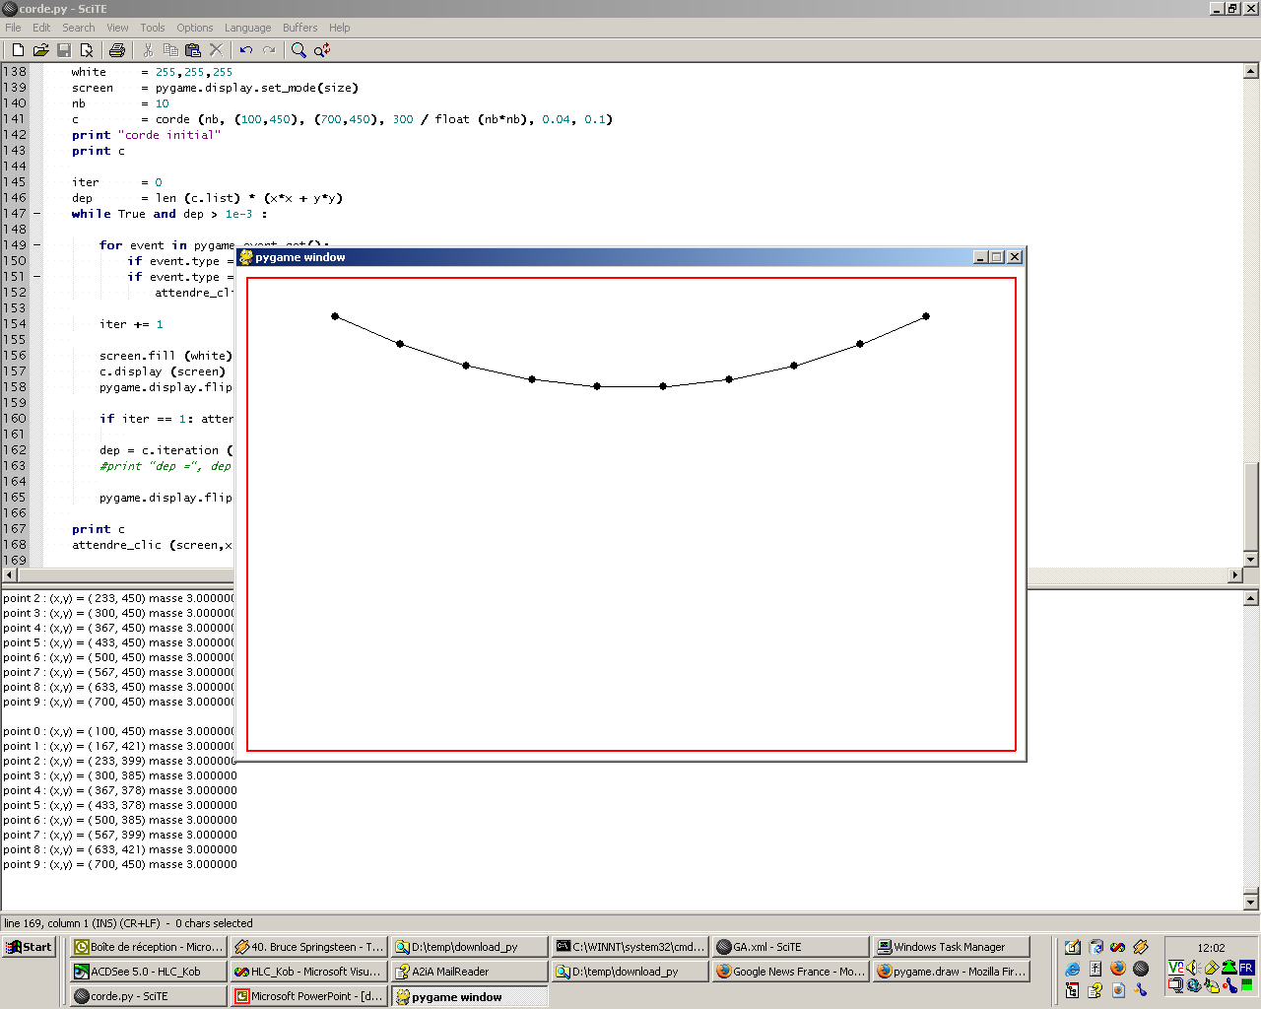
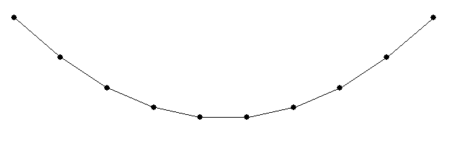
tension
tension
poids

Slide 2
WinampXML
playlist
num_entries = 190
label = "New playlist"
entry
Playstring = "file:C:\x_Musique\Rock\_melting pot\Bruce Springsteen 04 - Track 04.mp3"
Name
Bruce Springsteen - Track 04
Length
168446
entry
Playstring = "file:C:\x_Musique\Rock\_melting pot\Pulp Fiction - 07_Track 07.mp3"
Name
Pulp Fiction - Track 07
Length
297019

