Slide 1
Weekly report
Aug. 5 – Aug. 9

Slide 2
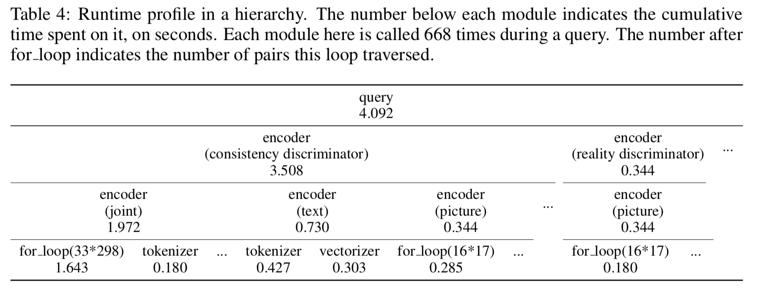
Progress
Build new labeling specifications for text2scene data
Analyses of the current model, in terms of runtime, performance and feature contributions

Slide 3
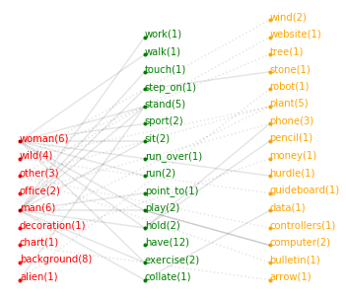
Progress
Prepare features for the new dataset
Preprocessing and analyses on the sample data

Slide 4
Progress

Slide 5
Skills
Learned about sophisticated textual embedding techniques
Related papers
Top-k Exploration of Query Candidates for Efficient Keyword Search on Graph-Shaped (RDF) Data
A Semantic Approach to Recommending Text Advertisements for Images
Related tools
BabelNet
ConceptNet
Wikipedia-based Explicit Semantic Analysis

Slide 6
To do
A feature encoder that properly tackle the curse of dimensionality
Synonym replacement to handle unseen tokens
Make use of babelNet or ConceptNet to encode the similarity between tokens with different POS tags
Optimization on the runtime efficiency

