Slide 1
MINE Financial management

Slide 2
Table of contents
01
Problem
02
Solution
03
PACT Framework
04
Figma layout

Slide 3
Problem
01
Many individuals struggle to keep track of their expenses, leading to difficulty in budgeting and managing their finances effectively
Manual methods of expense tracking, such as pen and paper or spreadsheets, can be time-consuming and prone to errors.
Without a clear understanding of their spending habits, users may find it challenging to identify areas where they can cut costs or save money.
Additionally, the lack of real-time insights into their financial activities can result in overspending or exceeding budget limits.

Slide 4
Solution
02
The primary purpose of the Expenses Tracker Application is to help users manage their finances efficiently by tracking their expenses.
It should provide users with insights into their spending habits, enabling them to make informed financial decisions.
The app should aim to simplify expense tracking, making it convenient for users to record and categorize their expenses on-the-go.

Slide 5
PACT Framework
03
People:
Student
- Elementary to College
- Age 14 to 18 years old
Employer
- Work in private company or government agencies.
- Age 20 to 40 years old
Normal people
- includes individuals of all ages who want to monitor and manage their expenses.

Slide 6
PACT Framework
03
Activities:
The Expenses Tracker Application will allow users to add, edit, and delete expenses, providing a straightforward interface for inputting financial transactions.
Users can categorize expenses into predefined categories (e.g., groceries, transportation, utilities) or create custom categories to suit their needs.
Users can view detailed summaries and reports of their spending habits, including graphical representations to visualize trends over time.

Slide 7
PACT Framework
03
Context:
Users will likely use the Expenses Tracker Application in various contexts, such as at home, work, or while traveling.
The app should be accessible across multiple devices, including smartphones, tablets, and desktop computers, to accommodate different usage scenarios.
It should function well both online and offline, allowing users to input expenses even when they don't have an internet connection, with data syncing once they're back online.

Slide 8
PACT Framework
03
Technology:
Flutter framework
Dart programming
Flutter hive

Slide 9
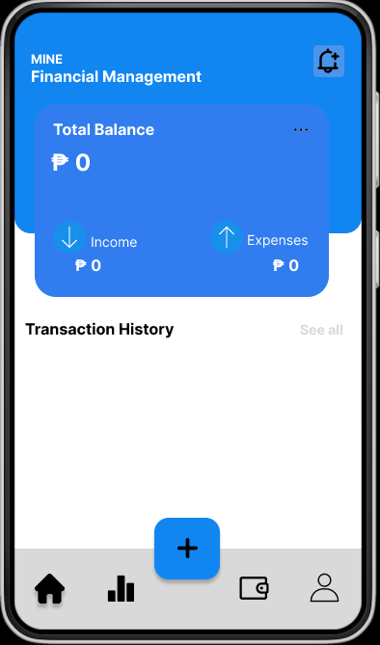
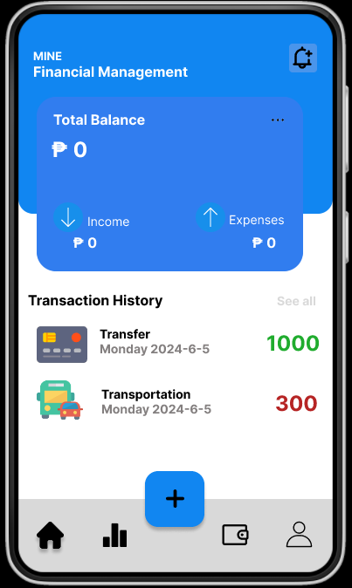
Figma Layout
04
HOME DASHBOARD

Slide 10
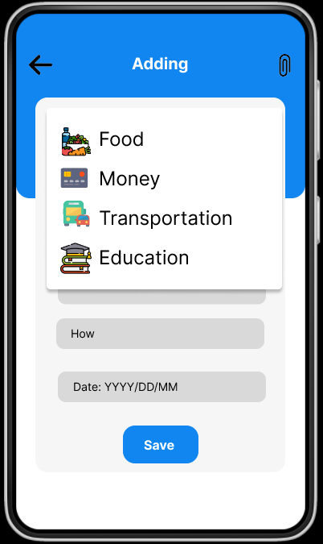
Figma Layout
04
ADDING CATEGORIES

Slide 11
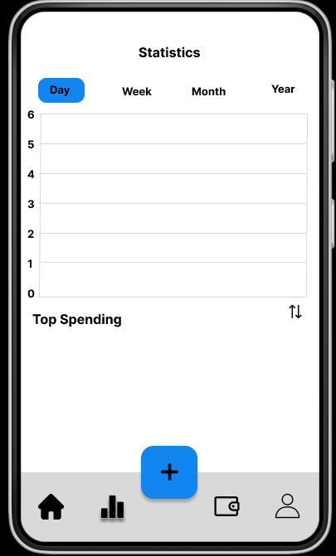
Figma Layout
04
DATA ANALYTICS

Slide 12
Thank You
05

