Slide 1

PROJECT REPORT on MOVIE RECOMMENDER SYSTEM B. TECH in Artificial Intelligence and Data Science 2020-24
Submitted to: Submitted by:
Department of computer Applications Saumya Deep Rawat (16)
University Roll Number: 2017666
Under the guidance of Dr Surender Singh Samant

Slide 2
Introduction
A recommender system is a type of information filtering system that seeks to predict the "rating" or "preference" a user would give to an item.
Recommender systems are utilized in a variety of areas, with commonly recognized examples taking the form of playlist generators for video and music services, product recommenders for online stores, or content recommenders for social media platforms and open web content recommenders.
There are two types of movie recommender systems: content-based and collaborative-based. Content-based systems focus on the attributes of the movies, such as genre, director, and actors. Collaborative-based systems focus on the past behaviour of other users and make recommendations based on that.

Slide 3
Problem Statement
A movie recommender system takes in a user's movie preferences and outputs a list of recommended movies.
The system should be able to recommend new movies to a user based on their past watch history.
The system should also be able to handle new users and new movies. As such, the system should be constantly updated with the latest movies and user preferences.
One issue is that recommender systems may suffer from the "cold start" problem, where they are unable to recommend anything to new users because they lack data on their preferences.
To address these issues, some movie recommender systems use a hybrid approach, combining the collaborative filtering approach with content-based filtering.
In content-based filtering, the system recommends movies based on their similarity to other movies that the user has liked.

Slide 4
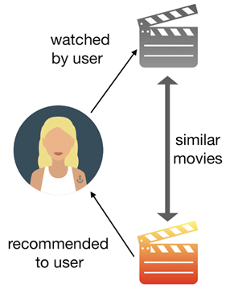
Methodology
For our project, we focused on Content-based filtering for
generating recommendations.
Content-Based filtering doesn't involve other users, but
is based on our preferences. It can be difficult to find new,
interesting content. There are a few ways to get around
this. One is to search for specific keywords that relate to
your interests. This can help you find content that you might not have been able to find otherwise. If you're still having trouble finding new content, there are a few other options you can try.

Slide 5
we build this recommender system based on the following key features:
Genre 2. Overview
Keywords 4. Cast
Crew
Now, moving forward to the term that we hold on mentioning, similarity, and what it approach in our context. It may not appear like some thing we could quantify, however it is able to be measured.
Cosine Similarity can be defined as a method of determining how similar two objects are. The cosine similarity is calculated using the cosine of the angle between two objects. The cosine similarity is also used in recommender systems and collaborative filtering. The cosine similarity is used to find the similarity between two vectors.

Slide 6
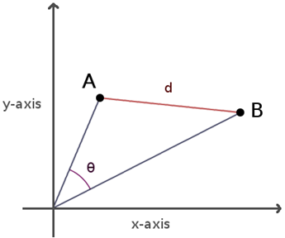
the area below the movie vectors A and B, represent the contents of the movies, and the angle, θ, between them represents the similarities between the movie contents. Thus, the lower the angle θ, the more similar the movie contents are.
The cosine similarity values can range between 0 and 1, depending on the θ value bounded between 0 and 90.

Slide 7
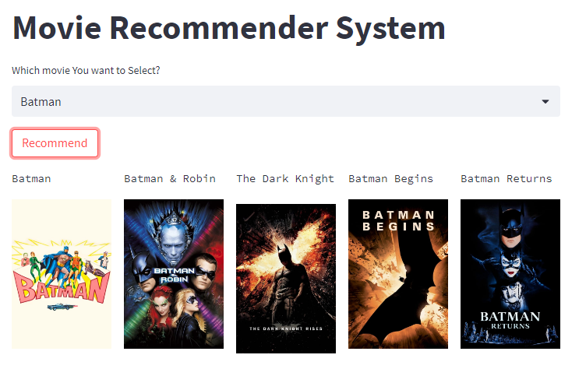
Result The system is designed to help the user find new movies that they will enjoy, and to make the process of finding new movies easier. This is the result when we select a batman movie on the movie recommender system.

Slide 8
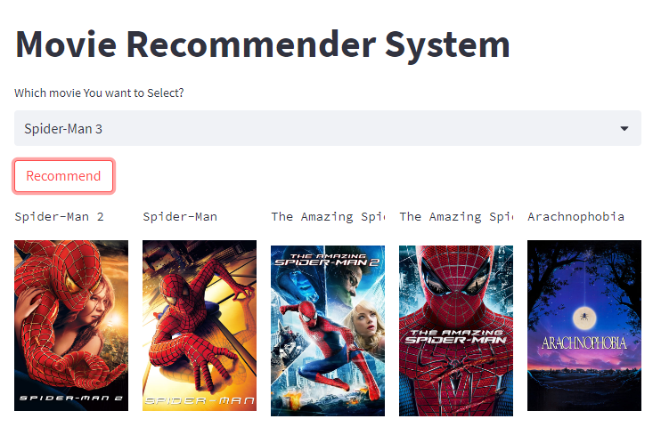
This is the result when we select a spider-man movie on the movie recommender system.

Slide 9
Conclusion
To conclude, a recommender system powered by content-based filtering performed using the cosine similarity algorithm can make better recommendations for users by suggesting them movies that have similar key features like the genre, keywords, overview, casts, directors etc.
Future Work
We can improve the content based recommender by adding more movie data and using a more sophisticated technique to extract the features.
We can make this a mixed type recommender system more accurate by adding more data and using a more sophisticated technique to extract the features. This will help us to better recommend movies to users.
Additionally, this system will help us to better understand the movie preferences of our users.

