Slide 1
Bellabeat Wellness Technology Case Study
Dragos-Andrei SPATAREANU
April 2025

Slide 2
Executive Summary
This case study analyzes wellness behaviors of FitBit users to provide clear, actionable insights for Bellabeat. Results revealed peak activity on Mondays and Wednesdays, with notable declines on weekends. Sedentary behavior was higher toward the week's end.
Recommendations include personalized notifications for inactive days, targeted features in Bellabeat Leaf to reduce sedentary time, and strategic marketing aligned with peak activity periods.

Slide 3
Introduction & Objectives
• Analyze wellness behaviors of FitBit users;
• Identify weekly activity trends;
• Propose marketing strategies and optimizations for Bellabeat Leaf;
• Key stakeholders: Bellabeat, Marketing Team, Customers.

Slide 4
Data Source and Description
• Dataset: FitBit Fitness Tracker Data (Kaggle, 2016);
• Activity, calories, sleep, sedentary behavior data;
• Limitations: small sample size (30 users), short duration (2 days), potential bias.

Slide 5
Analysis Methodology
• Data cleaning/manipulation using R (tidyverse, lubridate);
• Data integrity checks (missing values, duplicates, outliers);
• Weekly aggregation and correlation analysis.

Slide 6
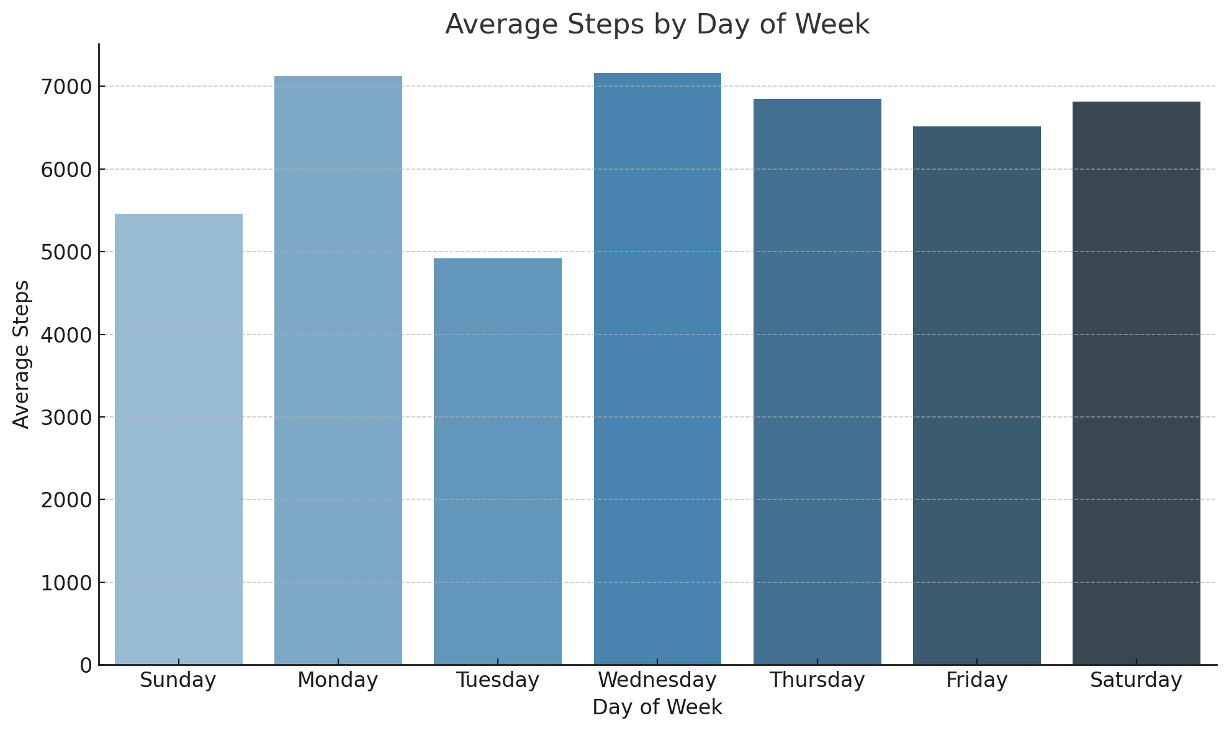
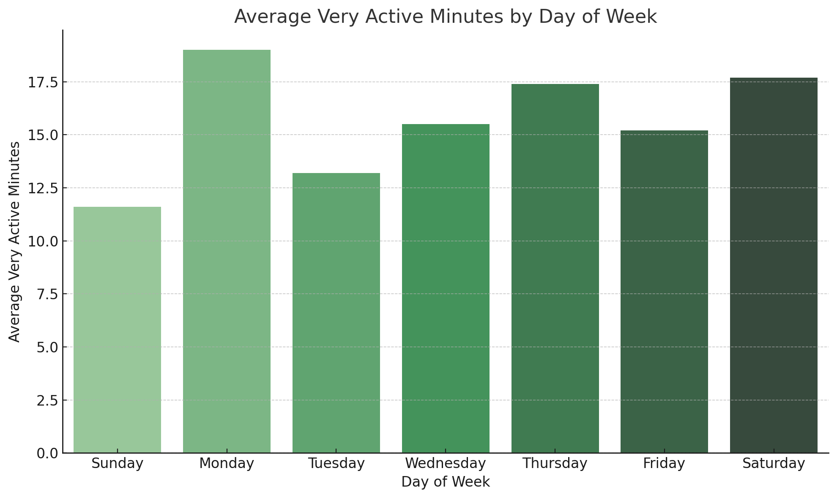
Results – Weekly Activity Patterns
• Highest activity: Wednesday (7,157 steps), Monday (7,119 steps);
• Lowest activity: Sunday (5,457 steps) - 30% less compared to Wednesday;
• Increased very active minutes on Monday and Saturday.

Slide 7
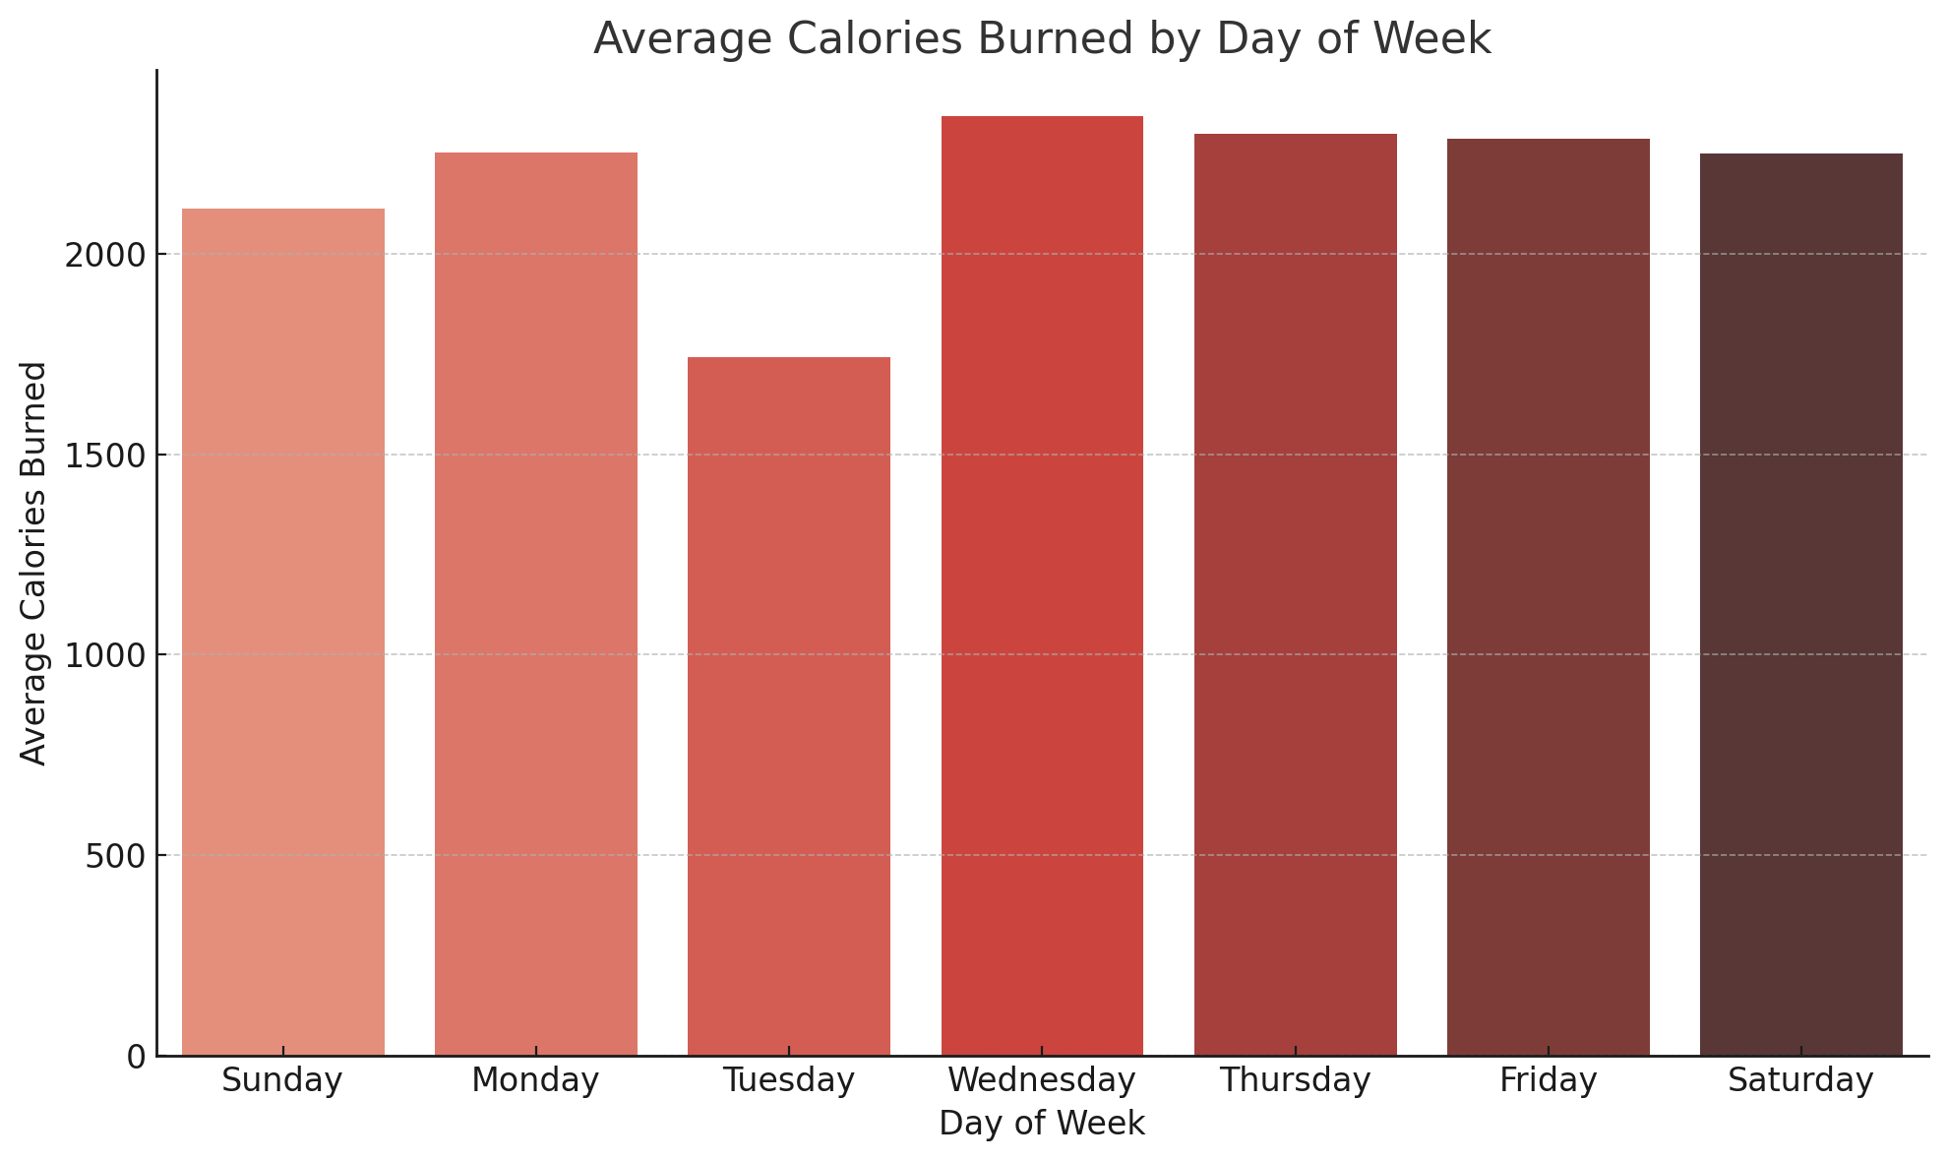
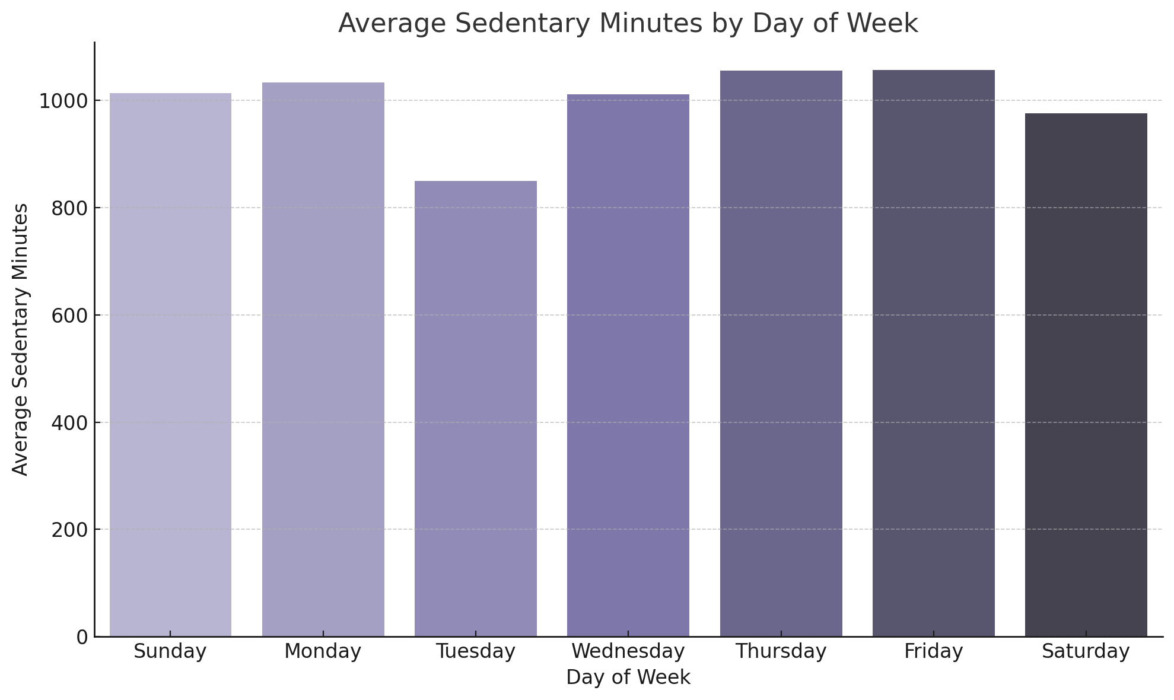
Results – Calories and Sedentary Behavior
• Positive correlation (0.54) between steps and calories burned;
• Increased sedentary minutes towards end of week (Thursday, Friday).

Slide 8
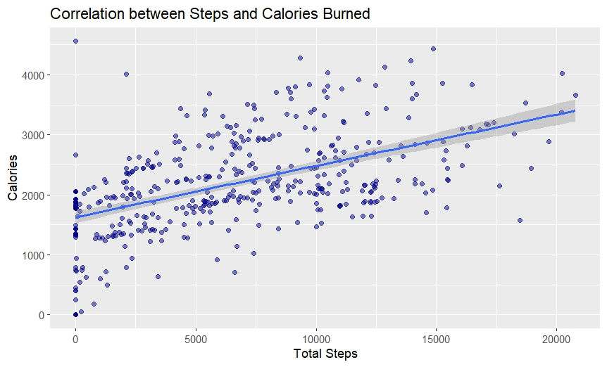
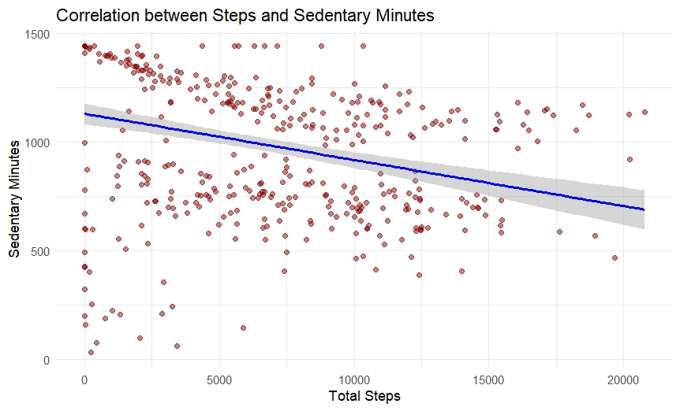
Identified Correlations
• Steps vs Calories: Moderate positive correlation (0.54);
• Steps vs Sedentary behavior: Moderate negative correlation (-0.32);
• Increased steps naturally lead to reduced sedentary time.

Slide 9
Actionable Recommendations for Bellabeat
• Personalized notifications on Sundays (activity 30% lower than Wednesdays);
• Hourly sedentary break reminders integrated into Bellabeat Leaf (based on -0.32 correlation);
• Highlight benefits of increased daily steps (0.54 correlation with calories) in marketing;
• Target campaigns on peak engagement days (Monday, Wednesday).

Slide 10
Thank You & Contact
Thank you for your attention!
Dragos-Andrei SPATAREANU
Email: dragos.spatareanu14@gmail.com

