Slide 1
Cyclistic Bike-Share Case Study
Data Analysis and Key Findings
Prepared for the Executive Team

Slide 2
Key Insights Summary
Members take more rides per month than casual riders.
Casual riders take longer rides on average (20-25 min) compared to members (12-13 min).
Casual usage peaks in warmer months, while members ride consistently year-round.
Casual riders use stations near tourist areas; members use commuter hubs.
Casual riders have longer late-night rides; members have steady usage.

Slide 3
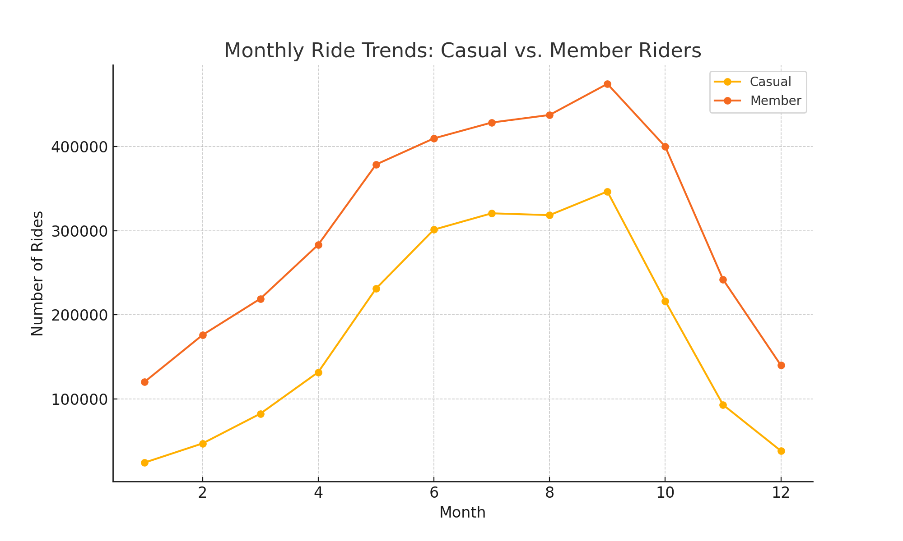
Monthly Ride Trends: Casual vs. Member Riders

Slide 4
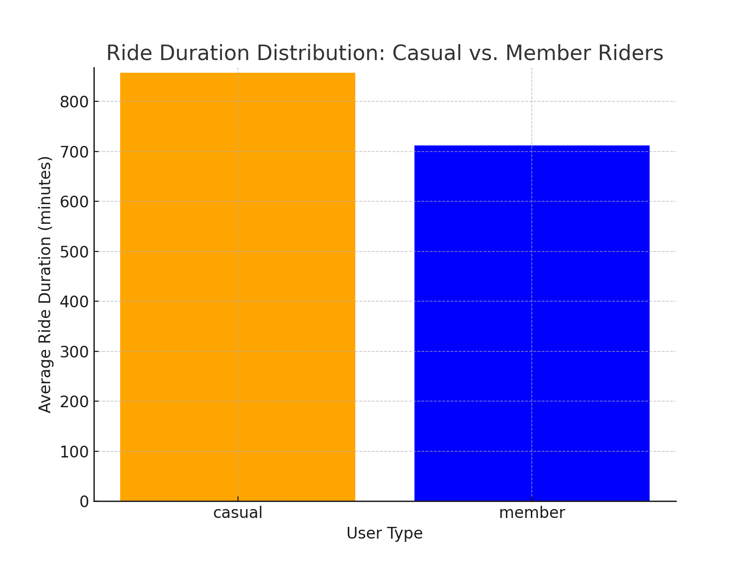
Ride Duration Comparison

Slide 5
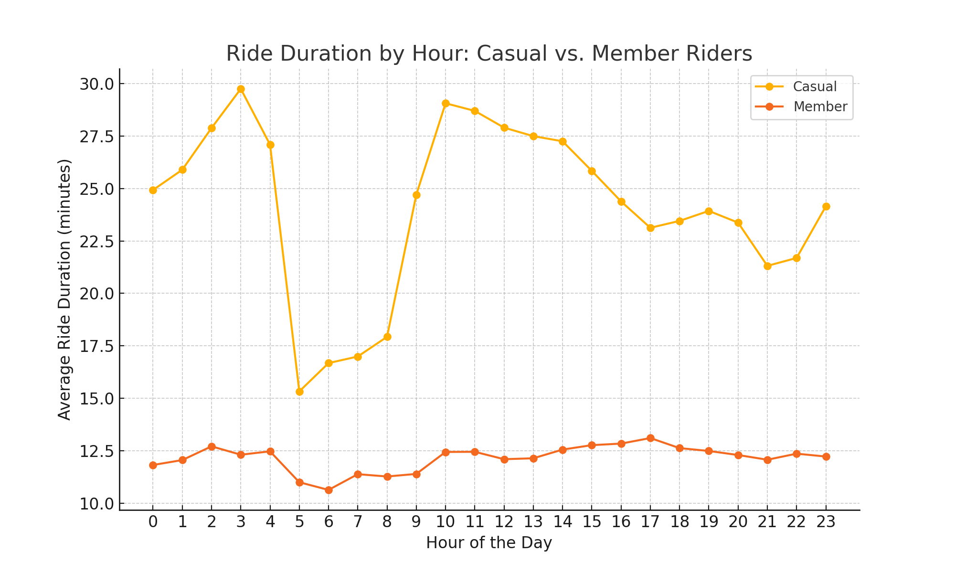
Ride Duration by Hour

Slide 6
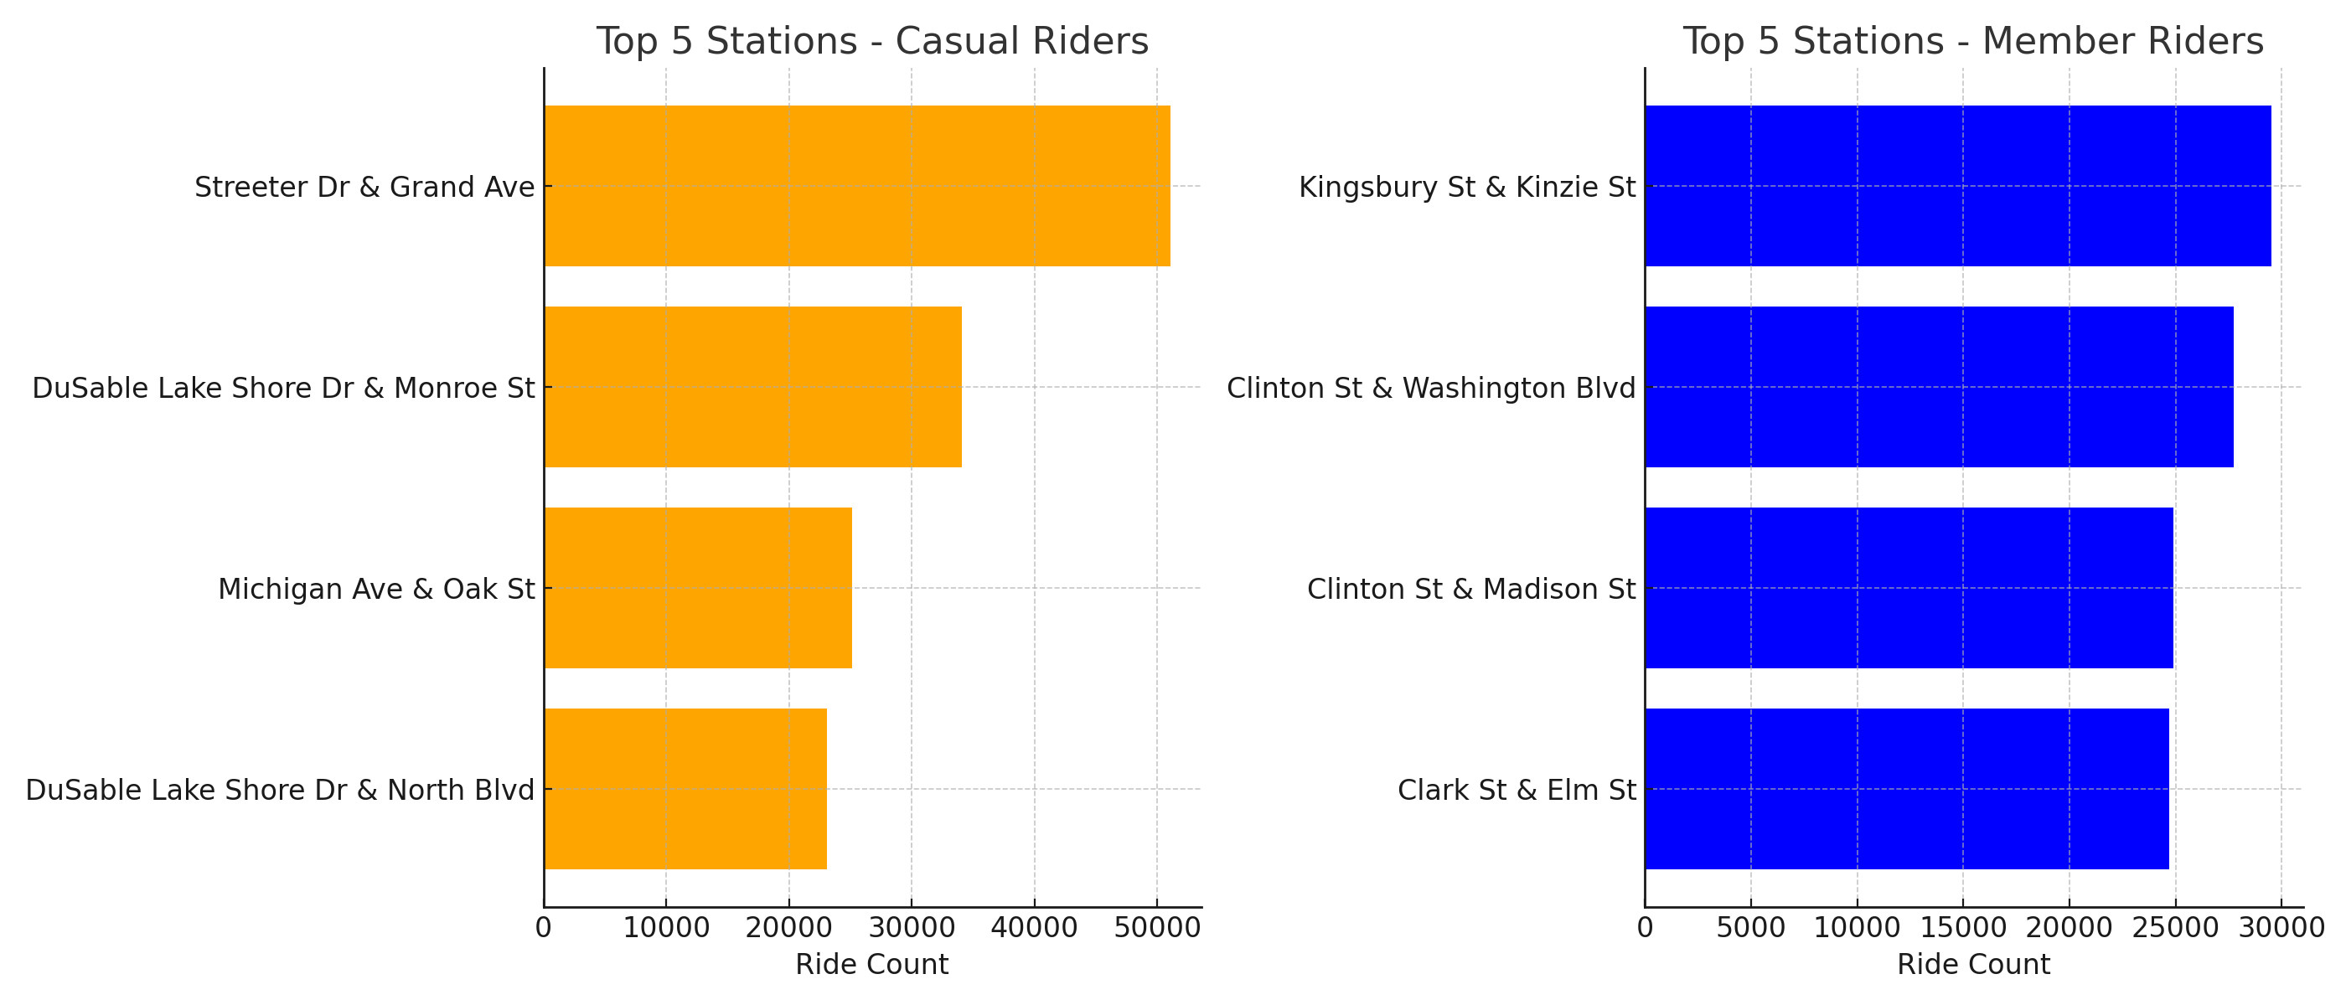
Top 5 Start Stations for Casual and Member Riders

Slide 7
Business Recommendations
Offer ‘Weekend Warrior’ memberships to high-usage casual riders.
Provide discounts for long rides to encourage casual rider conversions.
Advertise memberships at popular casual stations.
Target commuter benefits to members for sustained engagement.
Consider nighttime promotions for casual riders who ride late.

