Slide 1
Unit 8 Loop Unrolling and Nested Loops
EL-GY 9463: Introduction to Hardware Design
ProfS. Sundeep Rangan, Siddharth Garg

Slide 2
Learning Objectives
How to unroll loops in Vitis HLS
Mitigate memory bottlenecks in unrolled loops with:
Increased memory bit width
Memory partitioning
Design efficient nested loops

Slide 3
Outline
Loop Unrolling and Memory Constraints
Nested Loops
FIR Filter Example

Slide 4
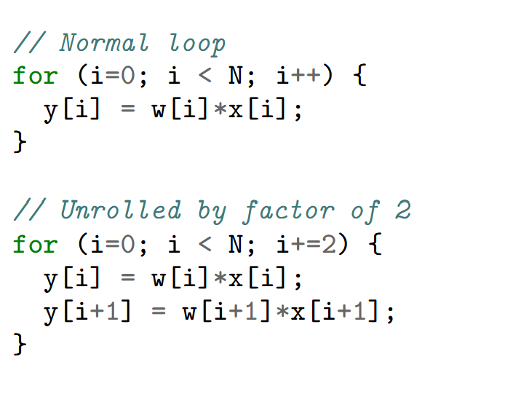
Loop Unrolling
Simple idea: Repeat processing in each cycle
Unroll by 2
Need half the number of iterations
But double the logic

Slide 5
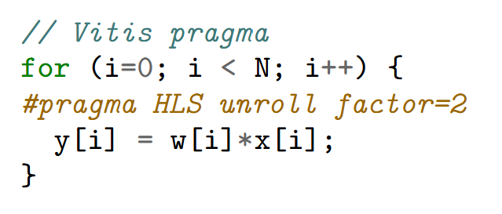
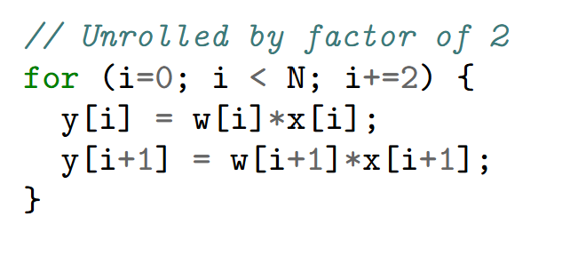

Loop Unrolling in Vitis
Can be done with a simple pragma
No need to manually unroll!
Handles cases when $N$ is not divisible by unroll factor
=

Slide 6
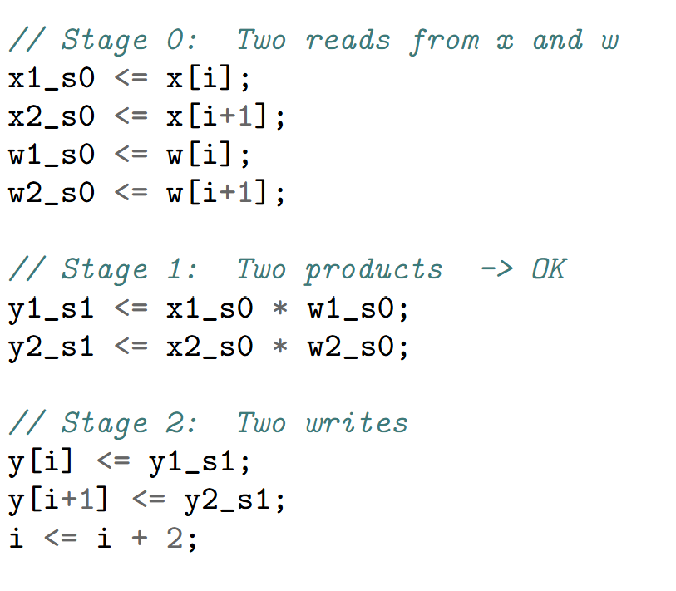
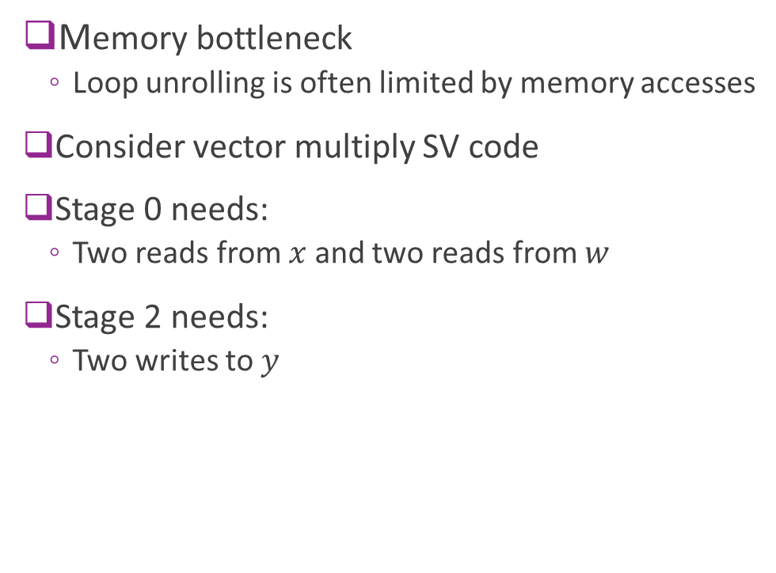
Memory Bottleneck
Memory bottleneck
Loop unrolling is often limited by memory accesses
Consider vector multiply SV code
Stage 0 needs:
Two reads from $x$ and two reads from $w$
Stage 2 needs:
Two writes to $y$

Slide 7
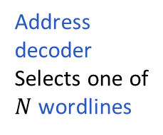
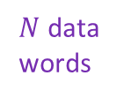
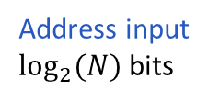



Single Port Memory
Recall memory architecture from Unit 4
Basic memories are single port
There is a single address decoder
Can read / write one word in a cycle
$N$ data words
Data Bus
R/W
$N$ wordlines
Address input $\log_{2}{(N)}$bits
$$⋮$$
$$⋮$$
Address decoder Selects one of
$N$ wordlines

Slide 8
Three Solutions
Solution 1: Use a true multi-port RAM
Most general. Allows read and write from any combination of addresses
Xilinx FGPA BRAMs are two port
But most costly in hardware
Solution 2: Use a wider bitwidth
Say 64 bits to read two 32 bit numbers
Works only when the accesses are contiguous
Solution 3: Bank or partition memory
Divide memory into partitions
Each partition has its own decoder
Works if accesses can be across different partitions

Slide 9
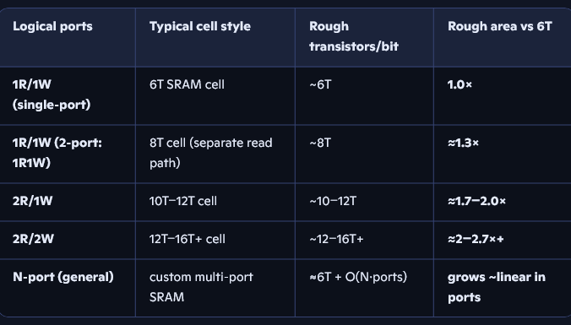

Mutli-Port RAMs
Allow arbitrary read / writes
Except for read-write collisions to same address in same cycle
BRAM in FPGAs generally only support true two port
BMutli-port SRAMs in ASICs are expensive
Memory
Address Decoder 1
Data1, Addr1
$$⋮$$
Data2, Addr2
Address Decoder 2

Slide 10
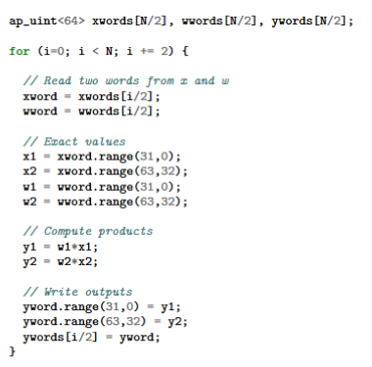
Using Wider Bit widths
Narrow bit width design
Access only one word per cycle
Memory bottleneck
Wide bit width design
Only one R/W to each array
Can pipeline with II=1
But need accesses to be contiguous

Slide 11
Mutli-Port RAMs
Allow arbitrary read / writes
Except for read-write collisions to same address in same cycle
BRAM in FPGAs generally only support true two port
BMutli-port SRAMs in ASICs are expensive
Memory
Address Decoder 1
Data1, Addr1
$$⋮$$
Data2, Addr2
Address Decoder 2

