Slide 1
Unit 4 Memory and Basic Processor Interfaces
EL-GY 9463: Introduction to Hardware Design
ProfS. Sundeep Rangan, Siddharth Garg

Slide 2
Learning Objectives
Describe the basic components of random access memory
Address and data bus, address decoder, storage
Identify which types of memory should be used for storage
External vs. internal
Registers vs. block memory
Describe and analyze timing for the AXI4-Lite protocol for reading and writing registers
Implement a simple IP with AXI4-Lite control registers using Vitis HLS
Synthesize and simulate the IP and analyze the timing diagrams
Deploy the IP on an FPGA board and interface with the IP via PYNQ

Slide 3
Outline
Random Access Memory and Memory-Mapped Registers
Processor Interfaces with AXI4-Lite
Implementing AXI4-Lite Interface in Vitis HLS

Slide 4

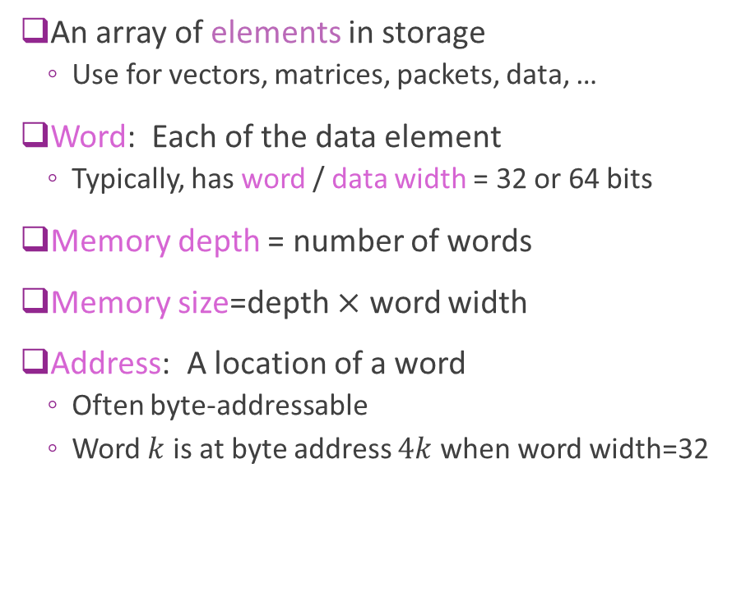


Addressable Memory
An array of elements in storage
Use for vectors, matrices, packets, data, …
Word: Each of the data element
Typically, has word / data width = 32 or 64 bits
Memory depth = number of words
Memory size=depth $×$ word width
Address: A location of a word
Often byte-addressable
Word $k$ is at byte address $4k$ when word width=32
Byte address
Data
0
Word 0
4
Word 1
8
Word 2
$$4(N−1)$$
Word $N−1$
Example 32-bit memory with $N$ depth

Slide 5
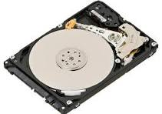
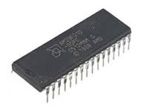
Sequential vs Random Access
Sequential Access
Access time depends on position
You must move through data in order
Ex: Hard disks (seek + rotation)
FIFO queues (logical sequential access)
Random access
Any element can be accessed in constant time
SRAM (on chip block memory, FPGA BRAM)
DRAM (external memory)
Register files (architecturally random access)

Slide 6
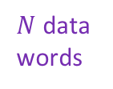
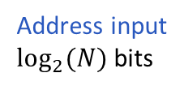

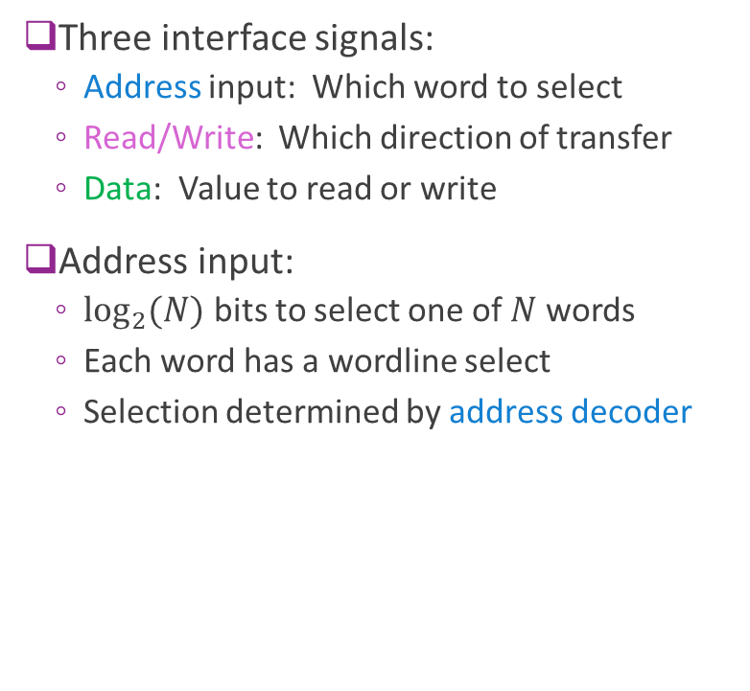


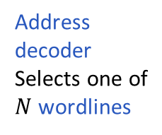
Typical RAM Architecture
Data Bus
Three interface signals:
Address input: Which word to select
Read/Write: Which direction of transfer
Data: Value to read or write
Address input:
$\log_{2}{(N)}$ bits to select one of $N$ words
Each word has a wordline select
Selection determined by address decoder
$N$ data words
R/W
$N$ wordlines
Address input $\log_{2}{(N)}$bits
$$⋮$$
$$⋮$$
Address decoder Selects one of
$N$ wordlines

Slide 7
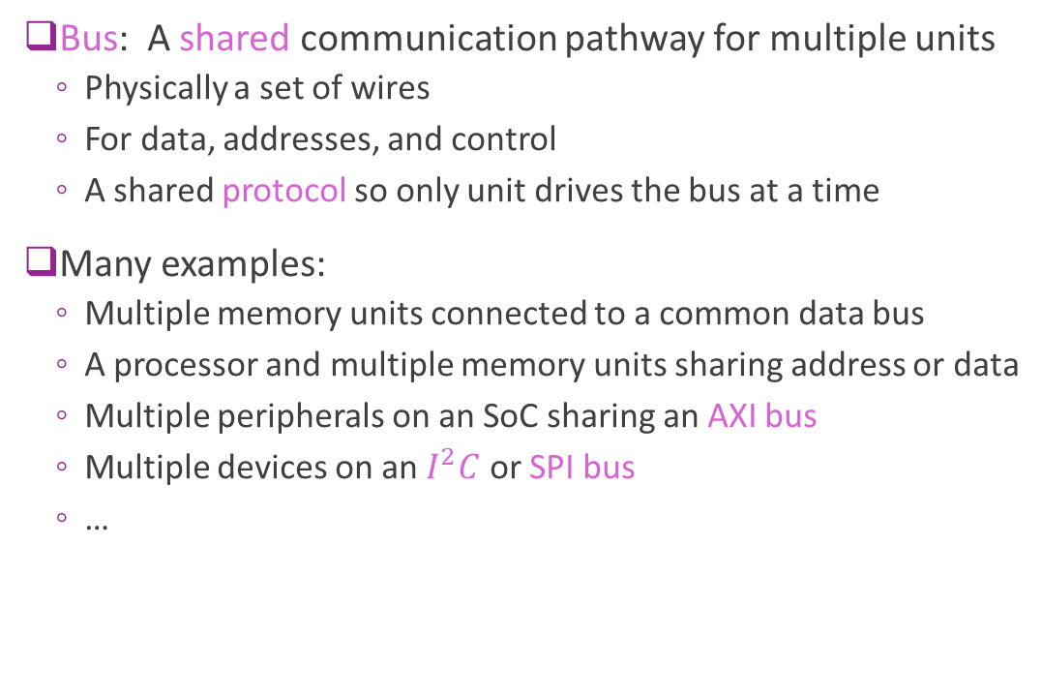
Bus
Bus: A shared communication pathway for multiple units
Physically a set of wires
For data, addresses, and control
A shared protocol so only unit drives the bus at a time
Many examples:
Multiple memory units connected to a common data bus
A processor and multiple memory units sharing address or data
Multiple peripherals on an SoC sharing an AXI bus
Multiple devices on an $I^{2}C$ or SPI bus
…
Bus

Slide 8

High Impedance
Method to share a common bus
One unit drives a value $V$ on the bus
Other units go into a high-impedance state, noted $Z$
High impedance units are disconnected
Bus value= $V$
Sometimes called Tri-State
Each bit is 0, 1 or Z
Bus
A
B
C
A | B | C | Bus Value | Remarks
Z | 15 | Z | 15 | B drives bus
41 | Z | Z | 41 | A drives bus
Z | Z | Z | X | No driver- no reliable value
32 | 78 | Z | X | Collision of A, B – no reliable value Protocols will avoid this condition

Slide 9

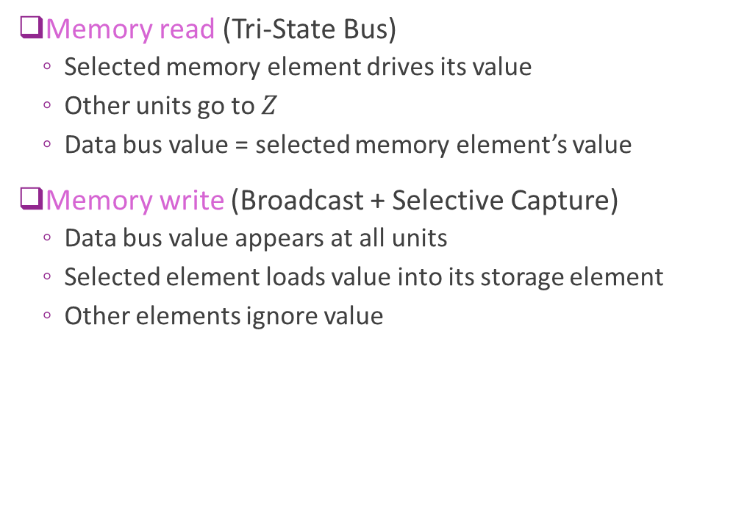
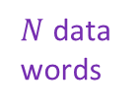

High Impedance on a Data Bus
$N$ data words
Data Bus
Memory read (Tri-State Bus)
Selected memory element drives its value
Other units go to $Z$
Data bus value = selected memory element’s value
Memory write (Broadcast + Selective Capture)
Data bus value appears at all units
Selected element loads value into its storage element
Other elements ignore value
R/W
$$⋮$$
$$⋮$$

Slide 10
External vs. Internal Memory
Processing Hardware
External memory
Off-chip
High capacity (GBs)
But need I/O to process
Internal memory
On-chip
Low capacity (KB-MB)
Direct access to processing
Low latency

Slide 11
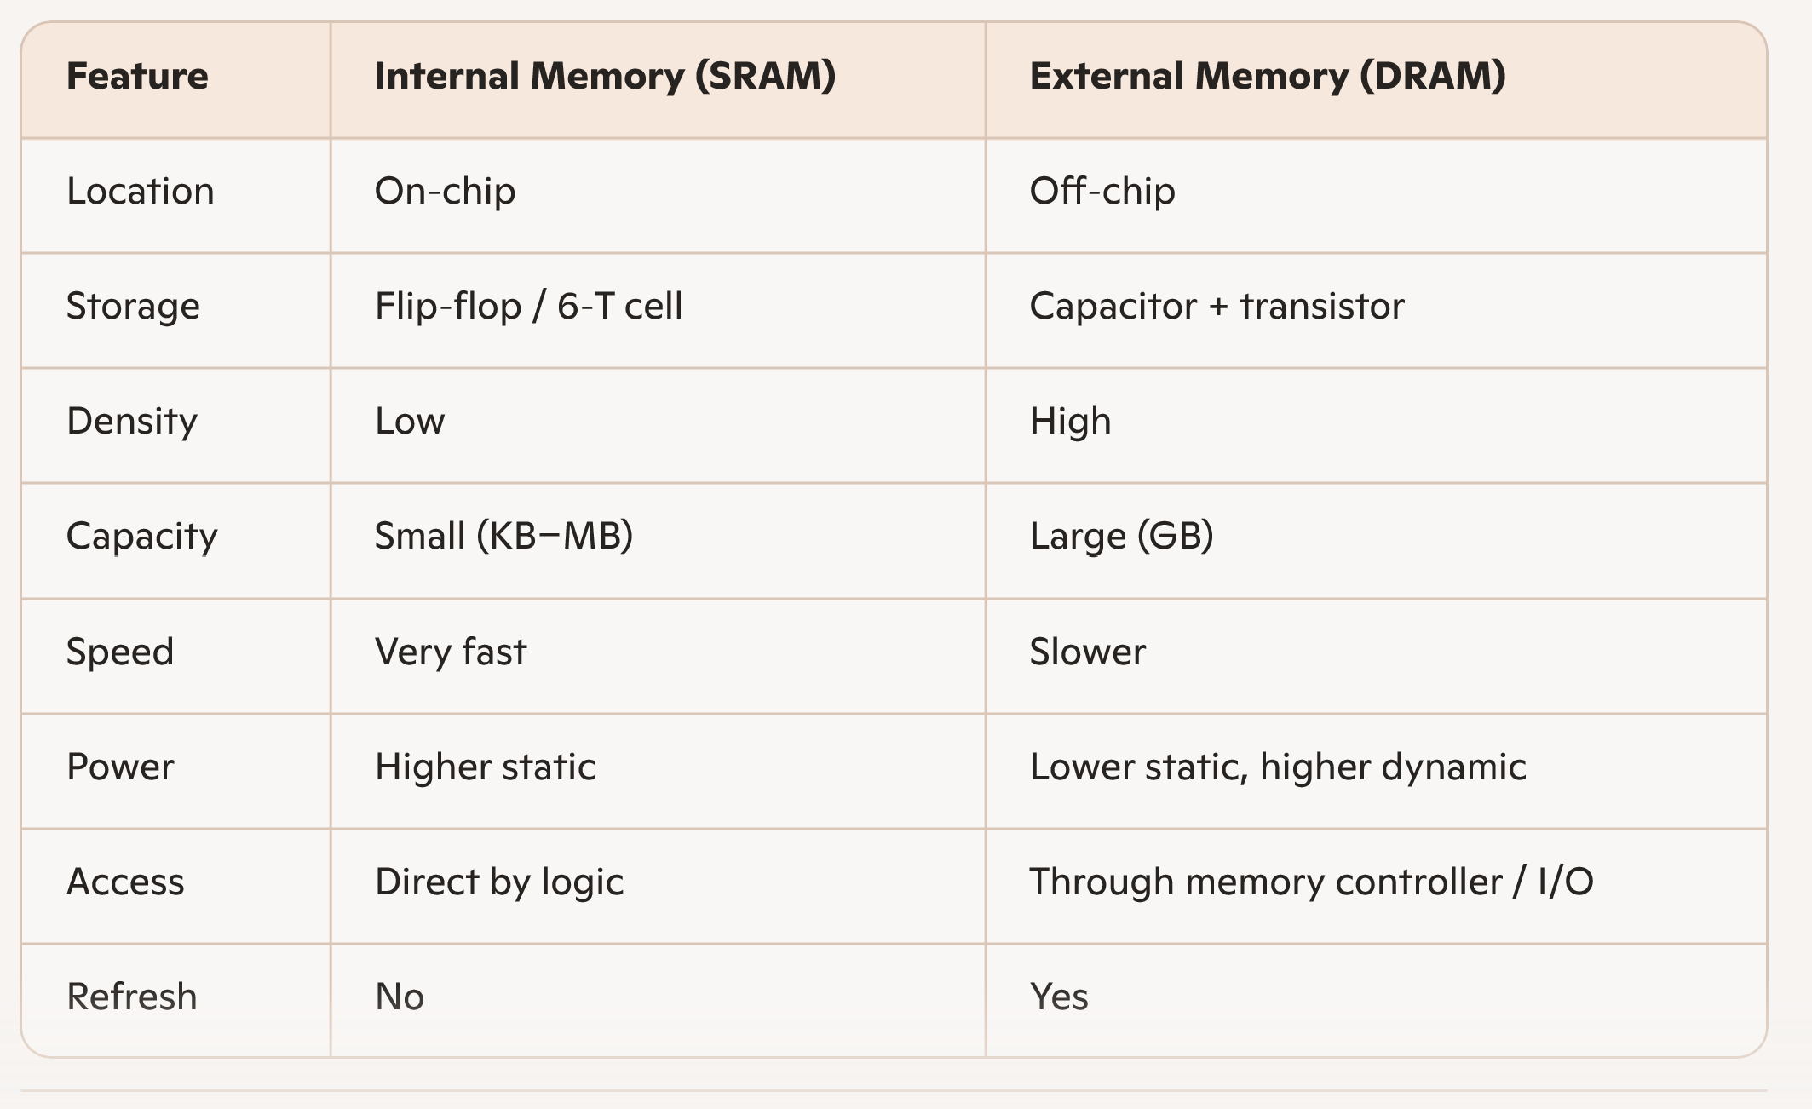
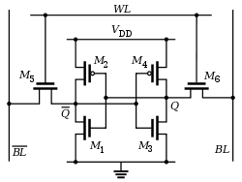
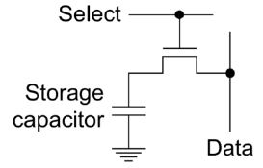
External vs. Internal Compared
SRAM cell
DRAM cell

Slide 12
Example Memory Internal Sizes
Platform | On-Chip Memory Type | Typical Size | Notes
Laptop CPU (Intel Core) | SRAM (L1/L2/L3) | 20–40 MB | L3 dominates; very fast
NVIDIA A100 GPU | SRAM (L2 cache) | ~40 MB | HBM2e (40–80 GB) is off-chip/on-package
Xilinx Virtex-7 FPGA | BRAM (36 Kb blocks) | 2–6 MB | Distributed across fabric
Custom ASIC (5 mm² @16nm) | SRAM | 5–10 MB | Depends on layout & redundancy
Lesson: Internal memory is limited! Use judiciously.

Slide 13
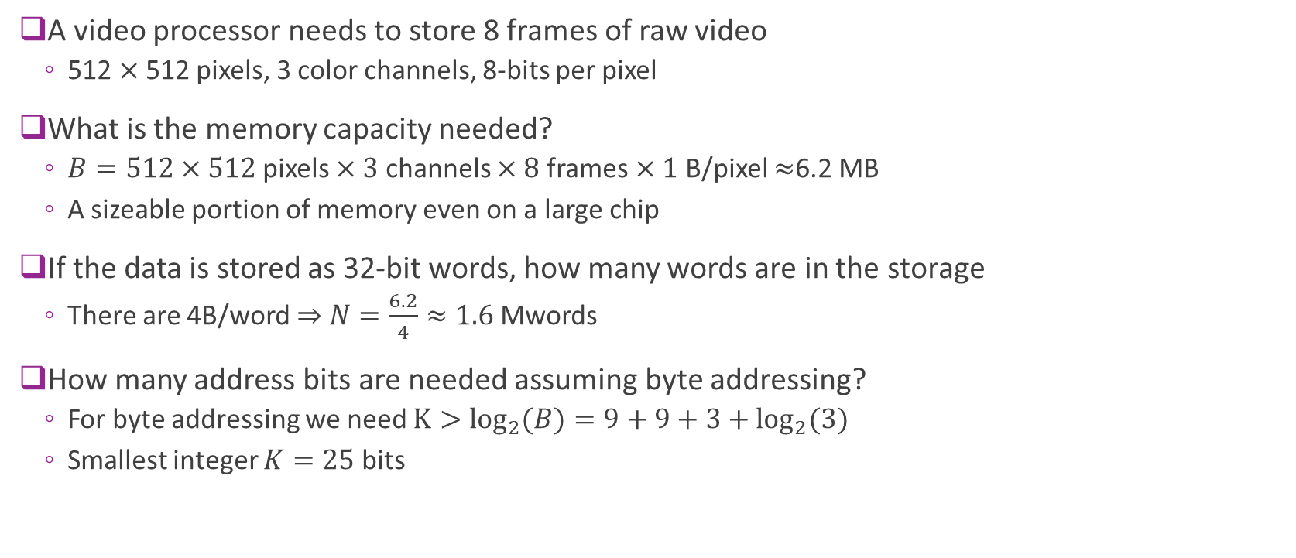
Example: Video
A video processor needs to store 8 frames of raw video
512 $×$512 pixels, 3 color channels, 8-bits per pixel
What is the memory capacity needed?
$B=512×512$pixels $×3$ channels $×8$ frames $×1$ B/pixel $≈$6.2 MB
A sizeable portion of memory even on a large chip
If the data is stored as 32-bit words, how many words are in the storage
There are 4B/word $⇒$ $N=\frac{6.2}{4}≈1.6$Mwords
How many address bits are needed assuming byte addressing?
For byte addressing we need $K>\log_{2}{(B)}=9+9+3+\log_{2}{(3)}$
Smallest integer $K=25$ bits

Slide 14

Registers vs. Block Memory
We have seen two storage types
Registers
Typically implemented as flip-flops
Useful for small, individual data pieces
Control registers, intermediate calculations, …
Block memory
Typically, DRAM or SRAM
Ideal for large arrays
Vectors or arrays
Registers
$$⋮$$
Block memory

Slide 15

Memory Mapped Registers
Registers can also be memory-mapped
Connected to their own address decoder
Determines which register to read/write
Common interface to processor
Processor sees registers & block memory together
One continuous address space
ADDR bus
Register address
decoder
Data bus
Registers
Block mem
address decoder
$$⋮$$
Block memory

Slide 16





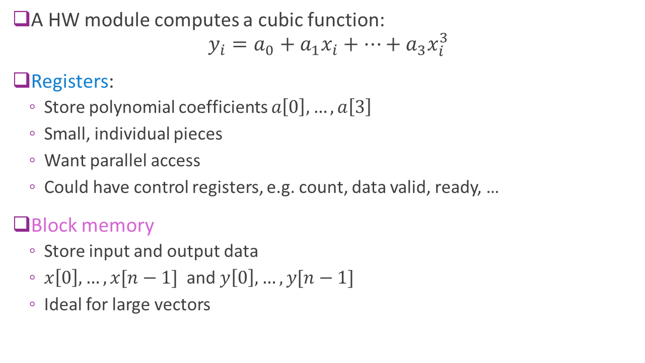







Example
Registers
$a[0]$
A HW module computes a cubic function: $y_{i}=a_{0}+a_{1}x_{i}+⋯+a_{3}x_{i}^{3}$
Registers:
Store polynomial coefficients $a\left[0\right],…,a\left[3\right]$
Small, individual pieces
Want parallel access
Could have control registers, e.g. count, data valid, ready, …
Block memory
Store input and output data
$x\left[0\right],…,x[n−1]$ and $y\left[0\right], …, y[n−1]$
Ideal for large vectors
$a[1]$
$a[2]$
$a[3]$
$x[0]$
$y[0]$
$x[1]$
$y[1]$
$$⋮$$
$$⋮$$
$x[n−1]$
$y[n−1]$
Block memory

Slide 17
Outline
Random Access Memory and Memory-Mapped Registers
Processor Interfaces with AXI-Lite
Implementing AXI-Lite Interface in Vitis

Slide 18
AXI4-Lite Protocol
ARM Extensible Interface family of protocols
Others we will use in class are AXI4-Full and AXI4-Stream
Industry-standard, ubiquitously used
AXI4-Lite:
Simple
Ideal for programming registers
Modular enables flexibility in delays and scheduling at both ends
Typical throughput: 1 read / 1 write every 3-5 clock cycles

Slide 19
AXI4-Lite Use Case: Processor to Hardware IP
Control registers
Bus signals
Address, data
Control
Processor
E.g. ARM core
Hardware IP
Ex: FPGA module you have designed
Widely-used use case
Hardware IP has control registers
Need read / write access from an embedded processor

Slide 20
Master-Slave and Transactions
MASTER
SLAVE
Control registers
Bus signals
Address, data
Control
Processor
E.g. ARM core
Hardware IP
Ex: FPGA module you have designed
In AXI4-Lite:
Each read or write of a single word is a transaction
Master: The unit that initiates all transaction (typically the processor in this example)
Slave: The unit that responds to the transaction (typically the hardware IP)

Slide 21
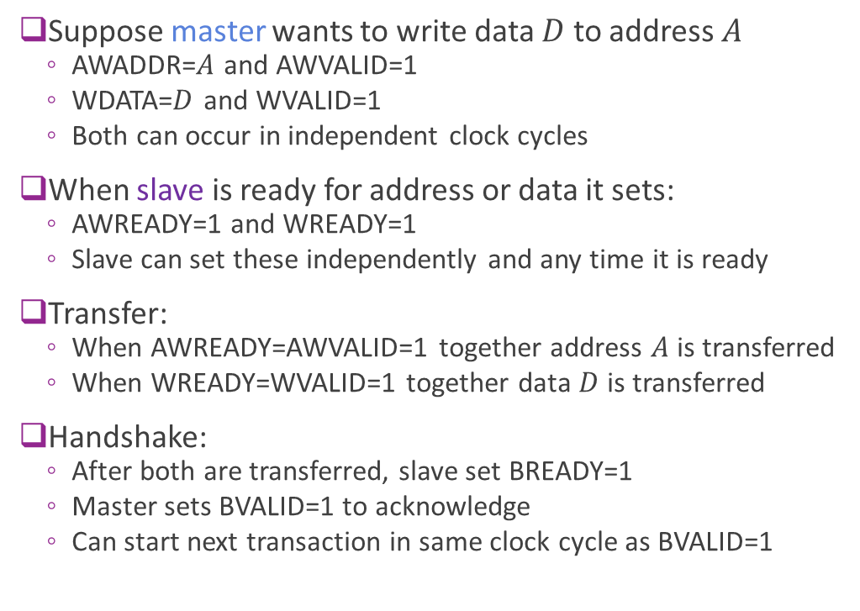
Review: AXI4-Lite Write Protocol
Suppose master wants to write data $D$ to address $A$
AWADDR=$A$ and AWVALID=1
WDATA=$D$ and WVALID=1
Both can occur in independent clock cycles
When slave is ready for address or data it sets:
AWREADY=1 and WREADY=1
Slave can set these independently and any time it is ready
Transfer:
When AWREADY=AWVALID=1 together address $A$ is transferred
When WREADY=WVALID=1 together data $D$ is transferred
Handshake:
After both are transferred, slave set BREADY=1
Master sets BVALID=1 to acknowledge
Can start next transaction in same clock cycle as BVALID=1
MASTER
SLAVE
AWADDR, AWVALID
AWREADY
WDATA, WVALID
WREADY
BVALID
BREADY

Slide 22
Additional AXI4-Full Signals
MASTER
SLAVE
AWADDR, AWVALID
AWREADY
WDATA, WVALID
WREADY
BVALID
BREADY

Slide 23
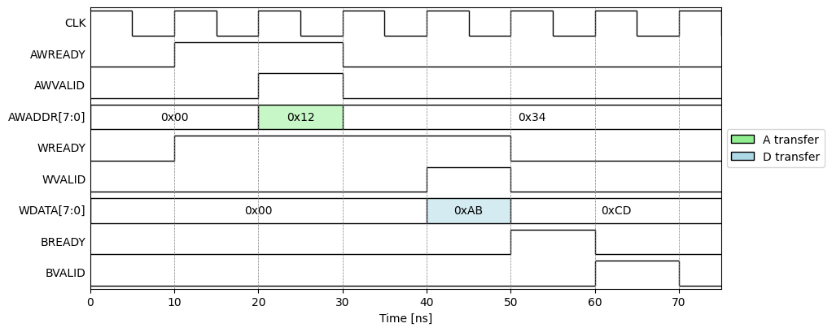
Example AXI4-Lite Write
Example with
Slave is ready before master
Address write before data write
But either order or together is fine
Transaction 4 cycles

Slide 24
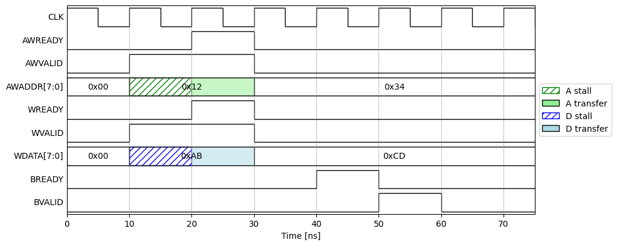
Example AXI4-Lite Write With Stall
Example:
Master sets valid
Slave is not ready
Transfer stalls
Provides flow control
Ensures data waits until RX is ready
Transaction 4 cycles

Slide 25
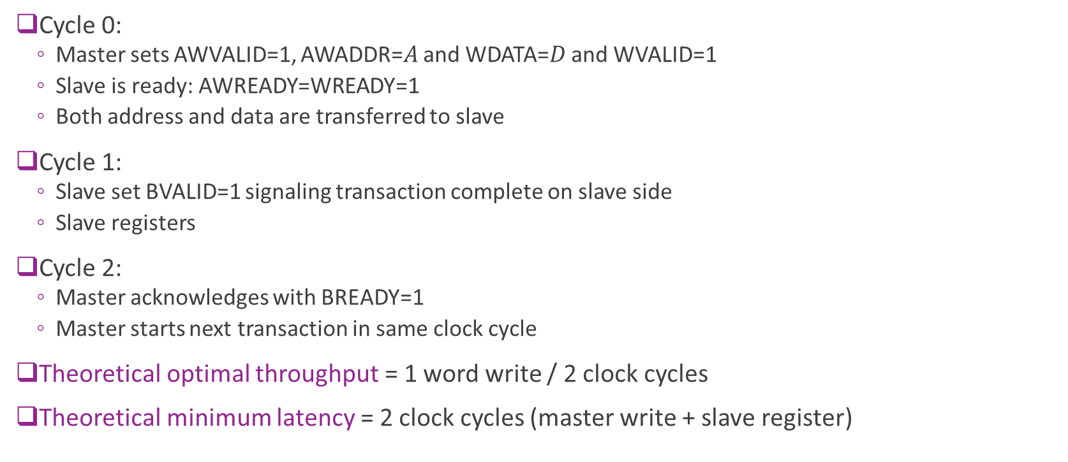
Theoretical Optimal Write Throughput
Cycle 0:
Master sets AWVALID=1, AWADDR=$A$ and WDATA=$D$ and WVALID=1
Slave is ready: AWREADY=WREADY=1
Both address and data are transferred to slave
Cycle 1:
Slave set BVALID=1 signaling transaction complete on slave side
Slave registers
Cycle 2:
Master acknowledges with BREADY=1
Master starts next transaction in same clock cycle
Theoretical optimal throughput = 1 word write / 2 clock cycles
Theoretical minimum latency = 2 clock cycles (master write + slave register)

Slide 26
Practical AXI4-Lite Latency
Suppose:
Master sets data and address on cycle 0
Slave is ready
In most practical register systems:
Slave takes 1-2 additional clock cycles for BREADY=1
Master takes at 1-2 additional clock cycles for BVALID=1 and next input
Practical throughput with AXI4-Lite: 1 word write per 3-5 clock cycles

Slide 27
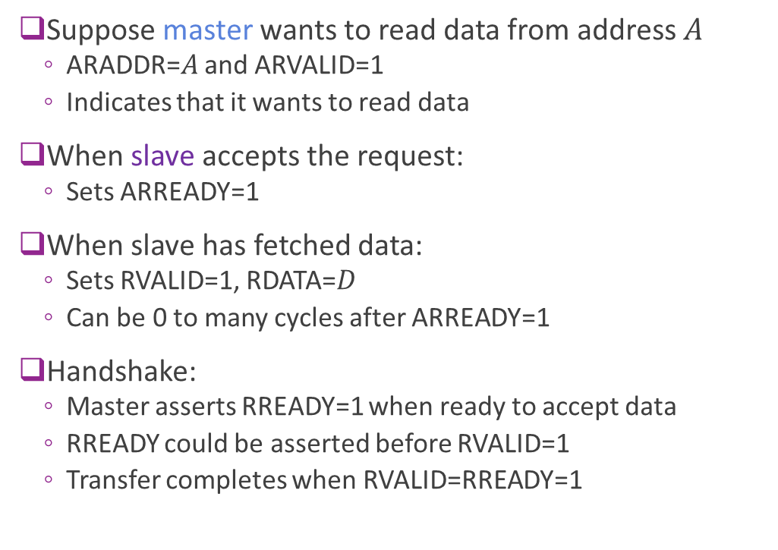
AXI4-Lite Read Protocol
Suppose master wants to read data from address $A$
ARADDR=$A$ and ARVALID=1
Indicates that it wants to read data
When slave accepts the request:
Sets ARREADY=1
When slave has fetched data:
Sets RVALID=1, RDATA=$D$
Can be 0 to many cycles after ARREADY=1
Handshake:
Master asserts RREADY=1 when ready to accept data
RREADY could be asserted before RVALID=1
Transfer completes when RVALID=RREADY=1
MASTER
SLAVE
ARADDR, ARVALID
ARREADY
RVALID, RDATA
RREADY
BVALID

Slide 28
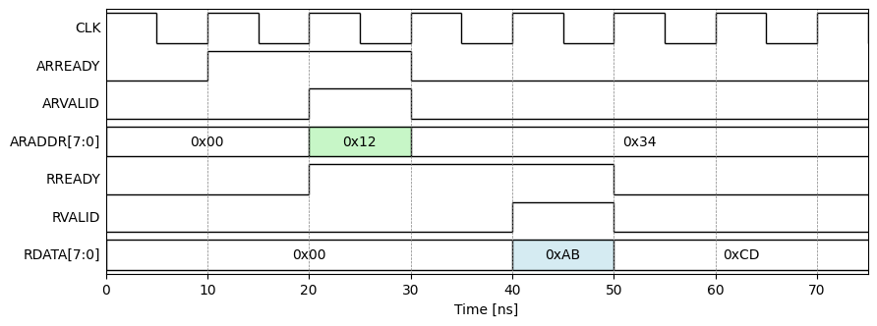
Example Read Timing
In this example:
Slave is initially ready (ARREADY=1)
Slave immediately accepts request
Master is immediately available for
Data valid with two cycle delay

Slide 29
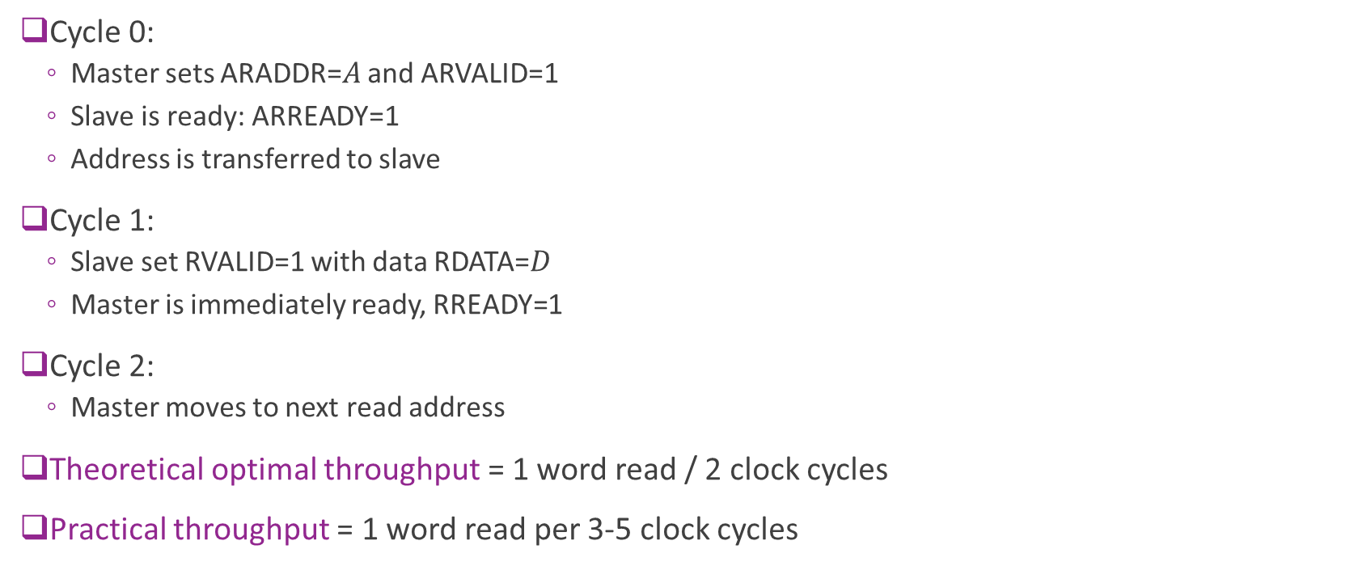
Theoretical Optimal Read Throughput
Cycle 0:
Master sets ARADDR=$A$ and ARVALID=1
Slave is ready: ARREADY=1
Address is transferred to slave
Cycle 1:
Slave set RVALID=1 with data RDATA=$D$
Master is immediately ready, RREADY=1
Cycle 2:
Master moves to next read address
Theoretical optimal throughput = 1 word read / 2 clock cycles
Practical throughput = 1 word read per 3-5 clock cycles

Slide 30
Outline
Random Access Memory and Memory-Mapped Registers
Processor Interfaces with AXI-Lite
Implementing AXI-Lite Interface in Vitis HLS

Slide 31



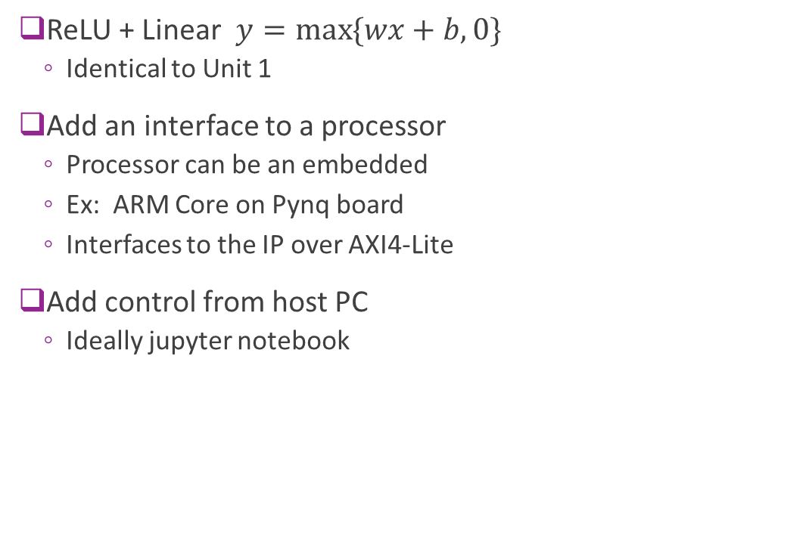



Example: Connecting a Simple IP
ReLU + Linear $y=\max{\{wx+b, 0\}}$
Identical to Unit 1
Add an interface to a processor
Processor can be an embedded
Ex: ARM Core on Pynq board
Interfaces to the IP over AXI4-Lite
Add control from host PC
Ideally jupyter notebook
FPGA board
AXI4-Lite
$$w$$
$$b$$
$$x$$
$$y$$
Memory- mapped registers
Linear + ReLU
Hardware “IP”
Processor system (e.g., ARM)
Host PC

Slide 32
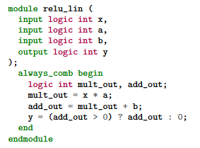


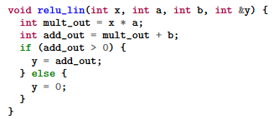
HLS vs. RTL
RTL: Register Transfer Language
Use specialized languages (e.g., SystemVerilog)
Manually schedule action in each clock cycle
Interfaces designed from scratch
High control, supports custom interfaces
But time-consuming, difficult to maintain
HLS: High-Level Synthesis
Write in general purpose languages (e.g., C++)
Clock-level schedule determined automatically by compiler
API support for common interfaces (e.g., AXI)
Sacrifice some performance and flexibility
But enables rapid development

Slide 33


HLS vs. RTL FPGA Design Flow
Human-written RTL files (e.g. SV)
Package
Traditional RTL Design Flow
Designer directly writes RTL
Tools simulate and synthesize
HLS Flow
Designer write high-level language (e.g., C)
Standard software compile-synthesis
RTL files auto-generated
RTL Simulate
$$⋯$$
Human-written C files
C simulation
C Synthesis
Auto-generated RTL files
RTL Simulation
Package

Slide 34
Bad vs. Good HLS Code Write
Bad: Treat HLS tool as a black box
Results in RTL code with poor performance
No way to evaluate if resulting design is good
Good: Have a mental model
Think what the RTL code should look like
What should happen on each clock cycle
What resources should be used
HLS Tool
RTL Tool
Mental RTL model
HLS Tool
RTL Tool

Slide 35

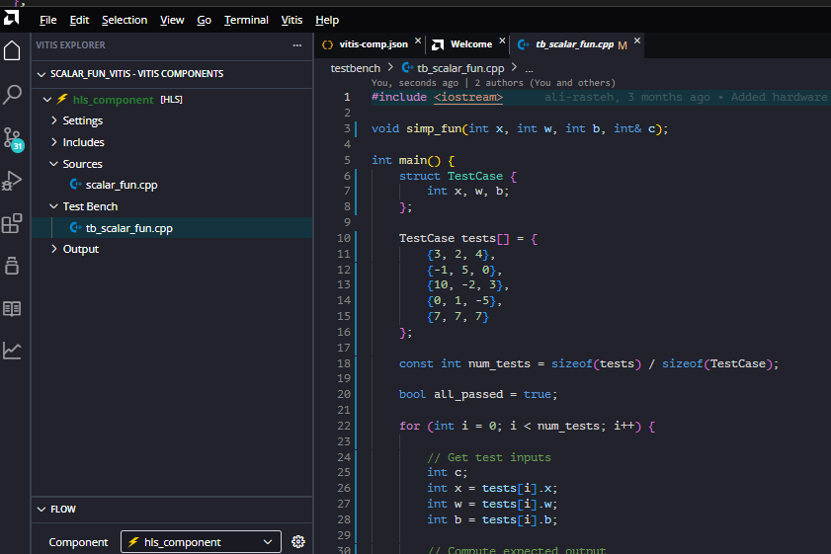
Vitis HLS
Developed by Xilinx (now AMD)
Evolved from Vivado HLS
Supports C / C++
Simple, common development
Some python support for testbenches
Ships with Vitis IDE
Native support for AXI protocols
No need to build handshake from scratch

Slide 36
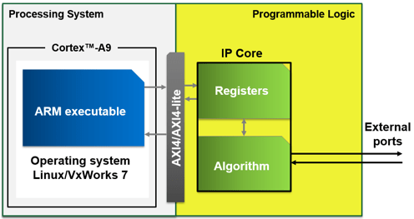
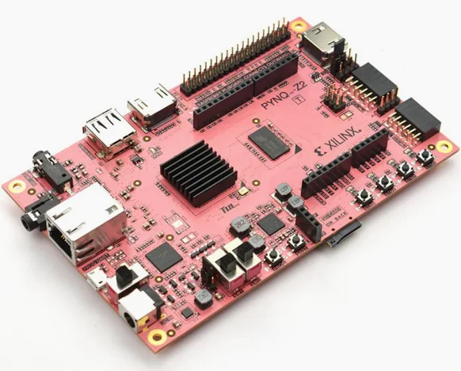
FPGA Board Components
We target a design on a real FPGA board
Boards have three components
Processing system (PS)
A lightweight processor
Often an ARM core
E.g., ARM A9
Programmable logic (PL)
The programmable fabric
This is where your IP will reside
Also contains the registers and internal memory
An AXI4 interface
Image from MathWorks page on embedded design

Slide 37





Target Architecture
Pynq Z2 board
We will rapidly build
Complete AXI4-Lite I/F
Interface done automatically
No need to code any handshaking
Control through host
Simple python jupyter notebook
Deploy to a real FPGA!
AXI4-Lite
$$w$$
$$b$$
$$x$$
$$y$$
Memory- mapped registers
Linear + ReLU
Hardware “IP”
PS
Host PC
PL

Slide 38
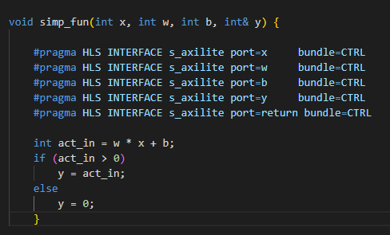
IP Source Code
IP Source Code is simple
Module declaration
Port descriptions
Main functional description

Slide 39
Module Declaration
Module declaration
Defines inputs and outputs
Standard C

Slide 40
Module Declaration
Port definitions
Use pragma statements
Do not change function
But tell synthesizer how to map to hardware
Indicates ports are axislite (AXI4-Lite slave)
Share a common bundle (all on the same AXI4-Lite interface)
Additional port=return (Provides start, stop, see later)

Slide 41
Module Declaration
Main function definition
Plain C
Do not specify the implementation Just the desired behavior
Synthesizer may map to multiple clock cycles
You do not have to do scheduling manually

Slide 42
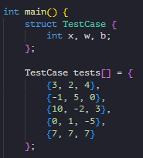
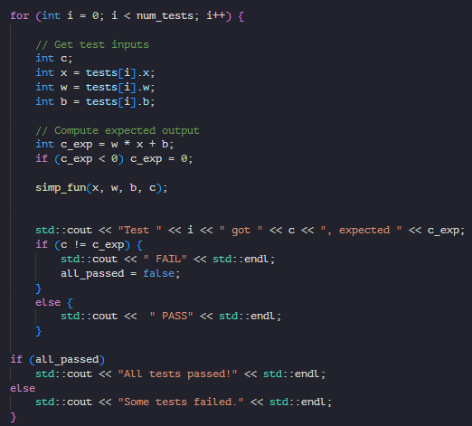
Vitis HLS Testbench
Testbench
Program simulating another unit interacting with IP
IP is the device-under-test (DUT)
In HLS:
Testbench another C program
Calls the DUT module like a C function
Sequential behavior
Testbench code can use any C / C++ functions
Does not need to be “synthesizable”

Slide 43
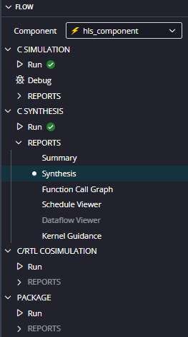
Vitis HLS Flow Described in Flow Panel
Tool follows expected steps for HLS flow
C simulation
C Synthesis
Auto-generated RTL files
RTL Simulation
Package

Slide 44
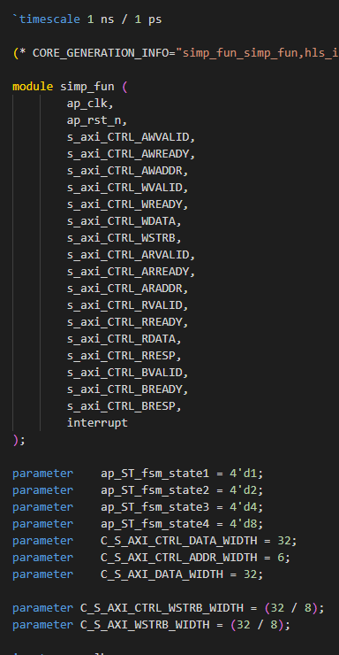
Synthesis Output
Resulting Verilog files are massive!
Main function in this case:
simp_fun.v
> 200 lines of Verilog
Hard to read code
You saved a lot of time coding

Slide 45
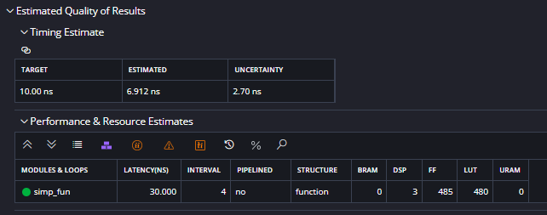
Synthesis Report
Generate a Report in Vitis Tool
Later, we will write python to parse these
Timing estimate
Timing of critical path
Can verify that lower than clock period
Estimated latency
In this case = 4 clock cylces
Estimate resources
Amount of each FPGA resources used
BRAM, DSP, …
We will discuss these in detail later

Slide 46
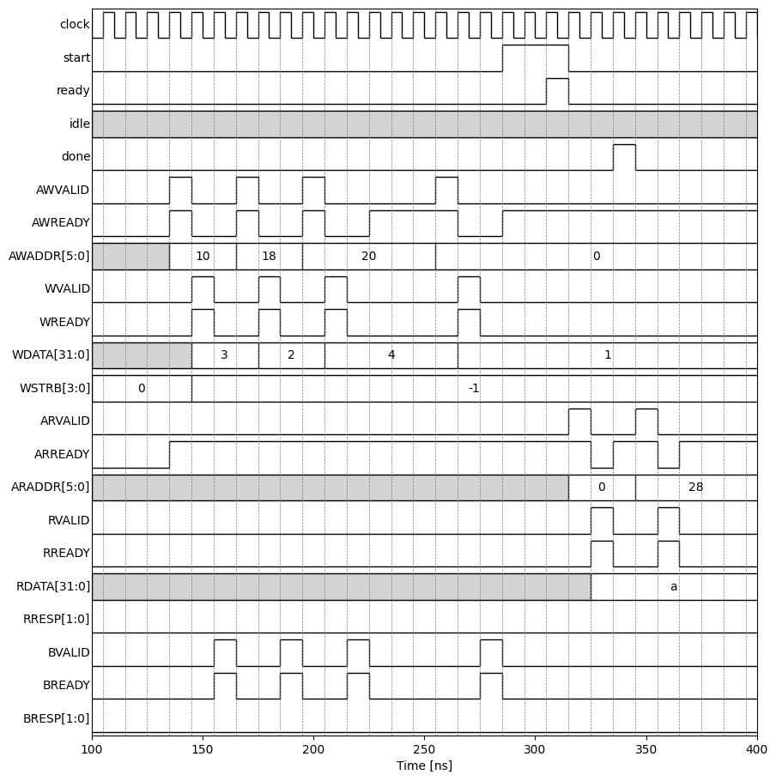
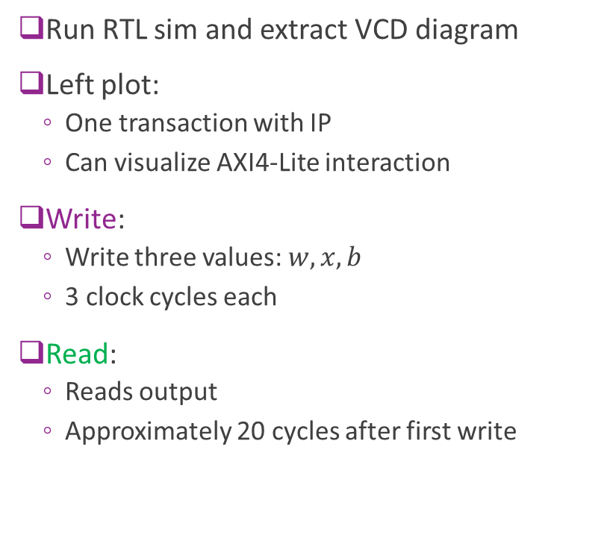
RTL Simulation
Run RTL sim and extract VCD diagram
Left plot:
One transaction with IP
Can visualize AXI4-Lite interaction
Write:
Write three values: $w, x, b$
3 clock cycles each
Read:
Reads output
Approximately 20 cycles after first write

Slide 47
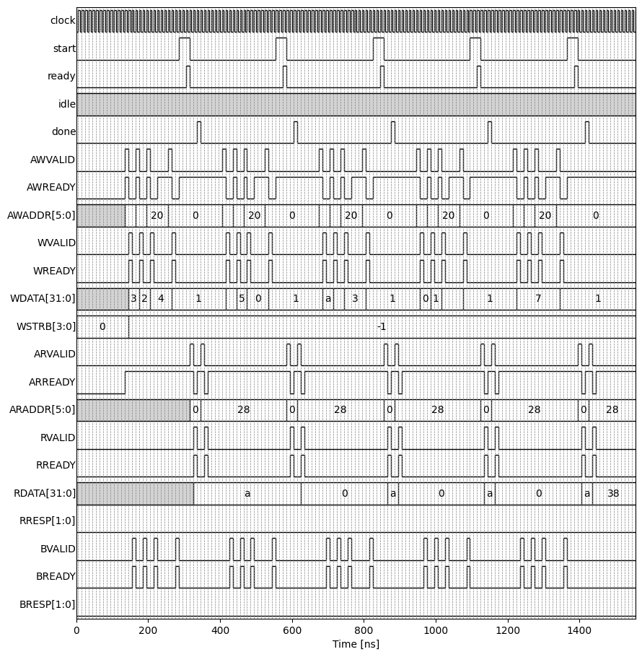
RTL Simulation over Multiple Interactions
Approximately 20 cycles for each input
We will be able to do this much faster
Will use an AXI-Streaming interface
Next lecture
AXI4-Lite is design for slowly varying items

Slide 48
Execution Model
Write phase
PS writes input control registers
PS “start” on the control register
Transaction starts when “ready”
IP asserts “done”
PS reads outputs

Slide 49
Deploying on an FPGA Board
Will show this in class

