Slide 1
Unit 10 Arrays and Matrix Multiplications
EL-GY 9463: Introduction to Hardware Design
ProfS. Sundeep Rangan, Siddharth Garg

Slide 2
Learning Objectives
Estimate compute and memory operations for basic matrix operations
Determine which operations are compute or data-limited
Describe how to store and address matrices in sequential memory
Row-major and column-major
Implement simple baseline multiplication with loop unrolling
Implement using Vitis pragmas
Estimate cost
Recognize high fanout computations
Implement and describe cycle-to-cycle behavior of systolic arrays
Implement and estimate timing for tiled matrix multiplication

Slide 3
Outline
Matrix Multiplications
Hardware Implementation via Broadcast
Systolic Arrays
Tiling for Large Matrices

Slide 4
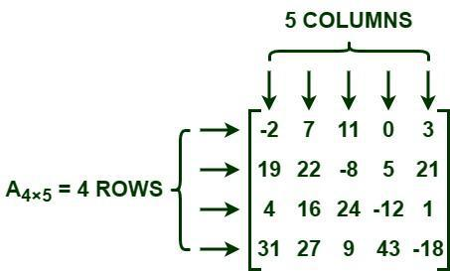
What is a Matrix?
An array of numbers
Rows x columns
Many applications
Data matrix
Ex: Each row is a set of values of a sample
Image
Each entry is a pixel
Time series
Each row is a time step
Each column is some attribute that changes over time

Slide 5
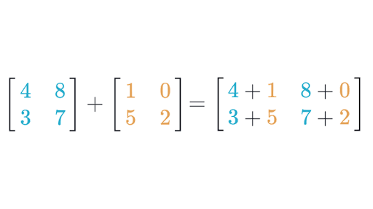

Matrix Addition and Subtraction
$Y=A+B$
$A$and $B$ must be the same size
Can be rectangular
Simply add elements:
$Y_{ij}=A_{ij}+B_{ij}$
From Khan Academy. Excellent review of matrix math if you need it

Slide 6
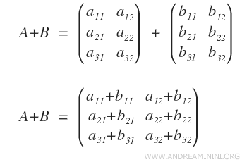
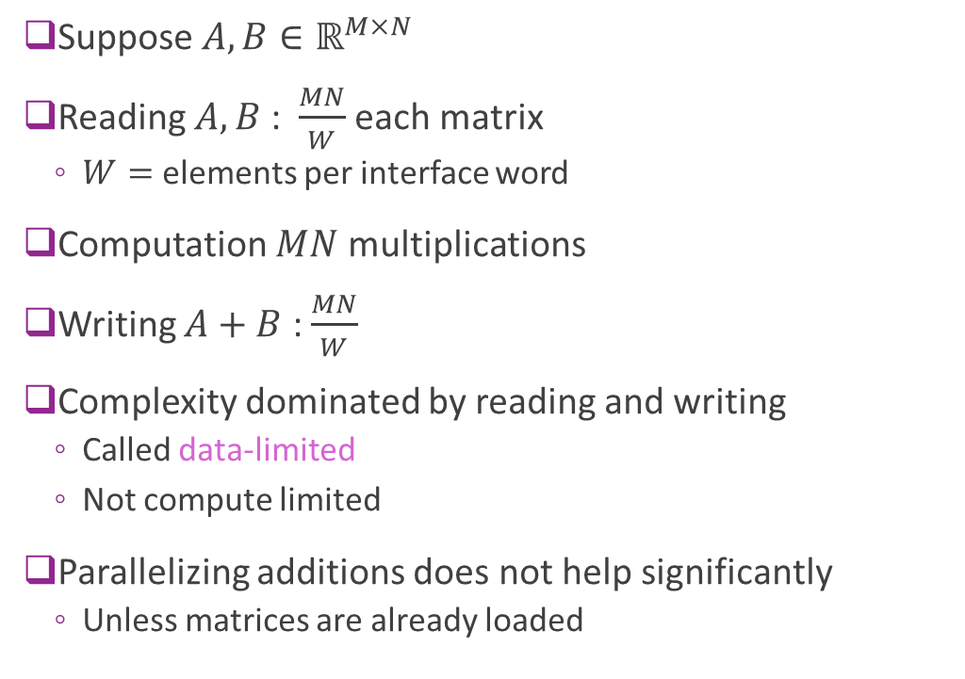
Matrix Addition Complexity
Suppose $A, B∈ℝ^{M×N}$
Reading $A, B$ : $\frac{MN}{W}$ each matrix
$W=$ elements per interface word
Computation $MN$ multiplications
Writing $A+B$ : $\frac{MN}{W}$
Complexity dominated by reading and writing
Called data-limited
Not compute limited
Parallelizing additions does not help significantly
Unless matrices are already loaded

Slide 7
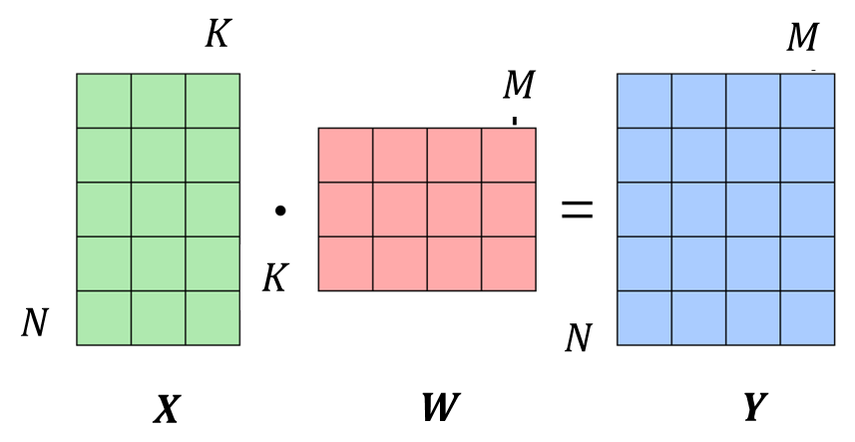
Matrix Multiplication
Basic operation in range of fields
Machine learning
Communications
Robotics
…
Virtually every mathematical field

Slide 8
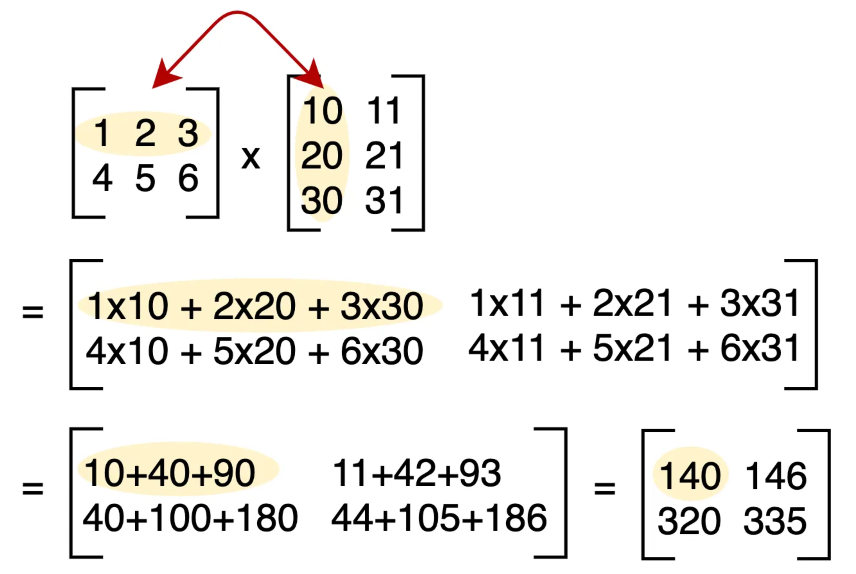
Multiplying Two Matrices
From excellent Medium post
A Complete Beginners Guide to Matrix Multiplication for Data Science with Python Numpy

Slide 9
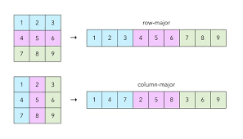

Storing Matrices in Hardware Memory
Typically stored in RAM
SRAM / BRAM for internal memory
Smaller matrices or portions of matrices
DRAM for external memory
Larger / complete memory
Often stored in row-major order
Store first row $x\left[0,0\right], …, x[0,m−1]$
Store second row $x\left[1,0\right], …, x\left[1,m−1\right]$
…

Slide 10
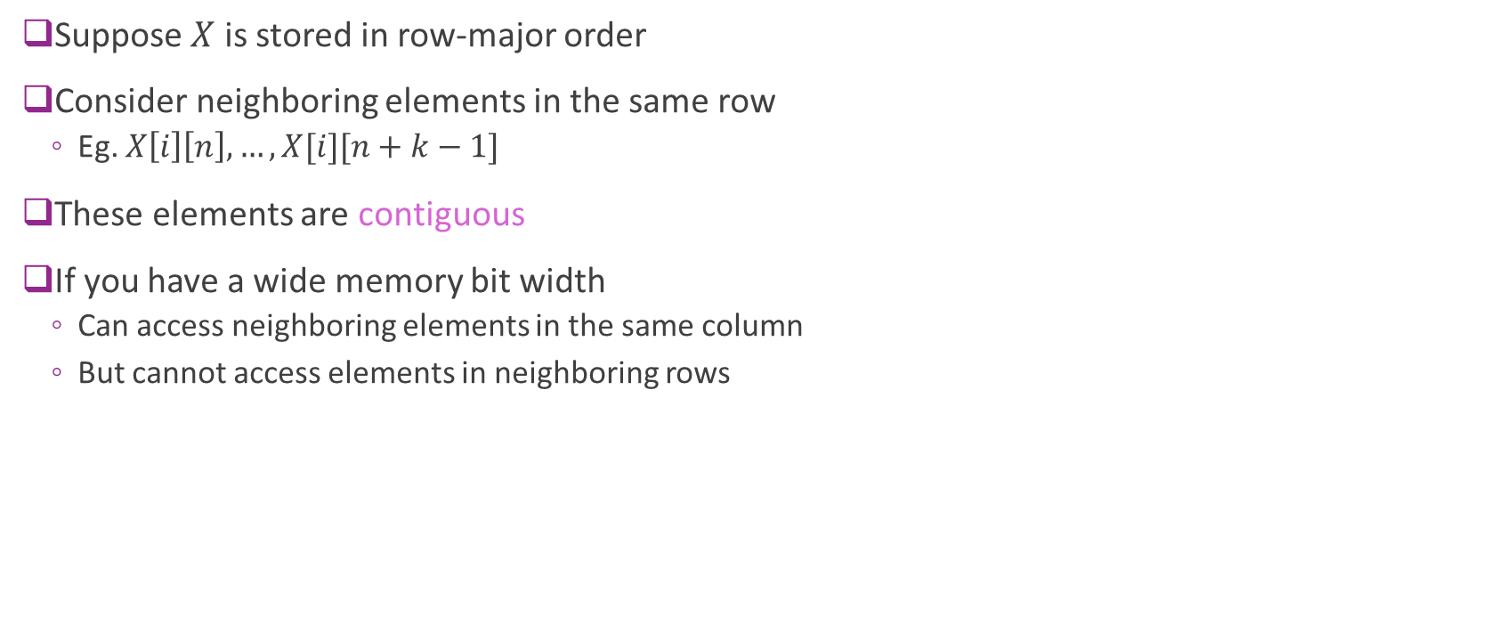
Row-Major Order in Memory
Suppose $X$ is stored in row-major order
Consider neighboring elements in the same row
Eg. $X\left[i\right]\left[n\right],…, X[i][n+k−1]$
These elements are contiguous
If you have a wide memory bit width
Can access neighboring elements in the same column
But cannot access elements in neighboring rows

Slide 11
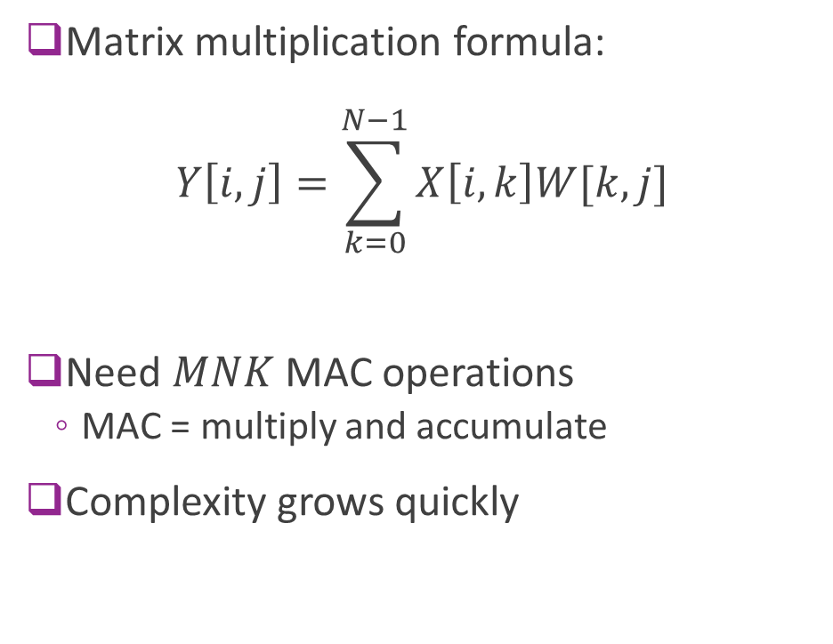
Matrix Multiplication Complexity
Matrix multiplication formula: $Y\left[i,j\right]=\sum_{k=0}^{N−1}{X\left[i,k\right]W[k,j]}$
Need $MNK$ MAC operations
MAC = multiply and accumulate
Complexity grows quickly

Slide 12

Multiplication Memory Accesses
Read $X$ and $W$
$NK+KM$ reads
Write $C$
$NM$ writes
Can read / write $B/W$ words per cycle
$B=$ memory bit width
$W=$ word bit width
Typically compute dominates
Thus matrix multiplication needs efficient compute

Slide 13
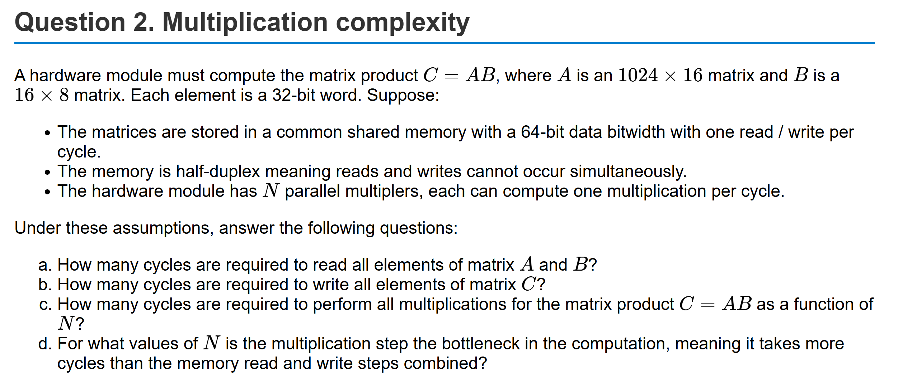
Sample Problem

Slide 14
Outline
Matrix Multiplications
Hardware Implementation via Broadcast
Systolic Arrays
Tiling for Large Matrices

Slide 15
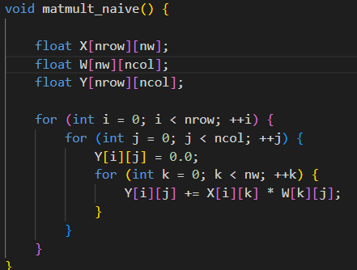
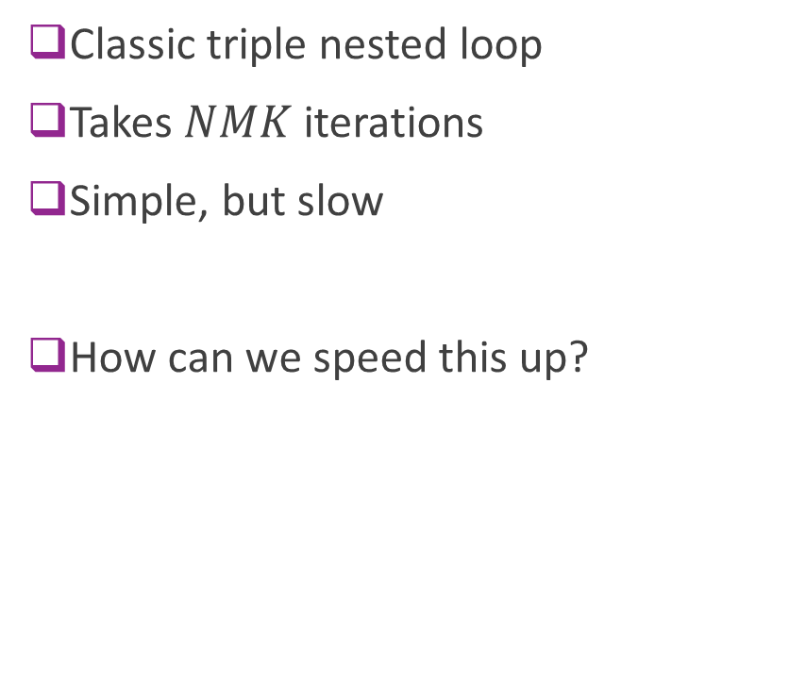
Naïve Implementation in Vitis
Classic triple nested loop
Takes $NMK$ iterations
Simple, but slow
How can we speed this up?

Slide 16
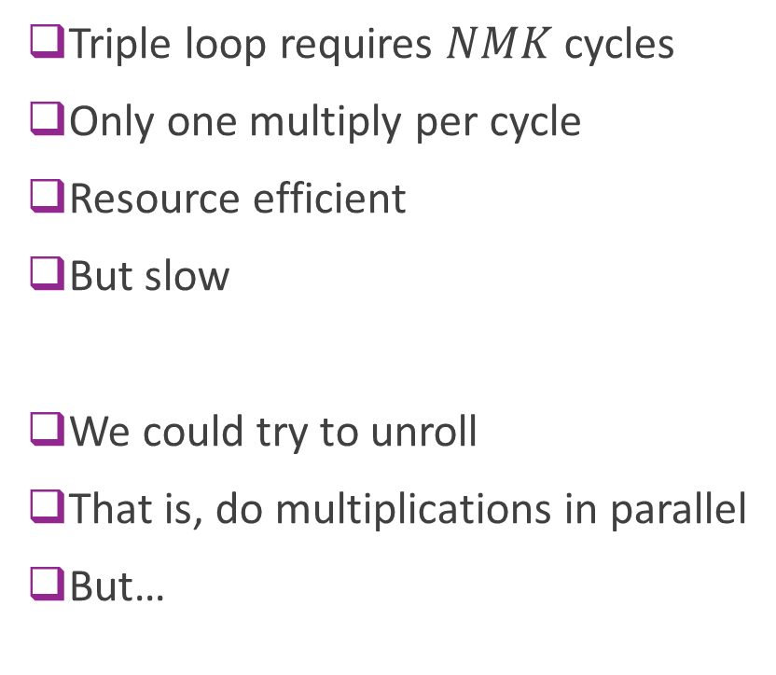
Problem 1: No Parallelism
Triple loop requires $NMK$ cycles
Only one multiply per cycle
Resource efficient
But slow
We could try to unroll
That is, do multiplications in parallel
But…

Slide 17
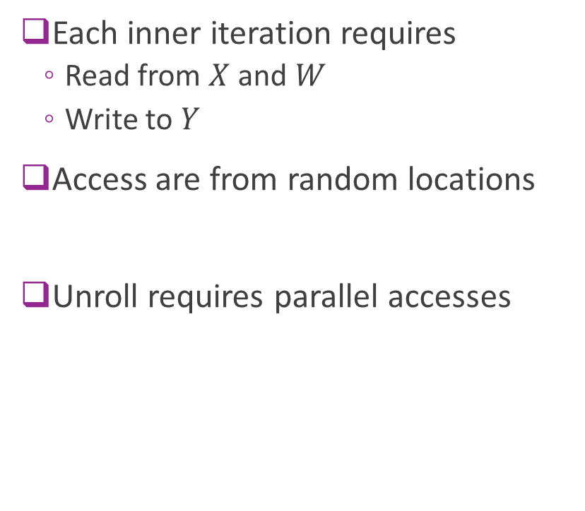
Problem 2: Array Accesses
Each inner iteration requires
Read from $X$ and $W$
Write to $Y$
Access are from random locations
Unroll requires parallel accesses

Slide 18
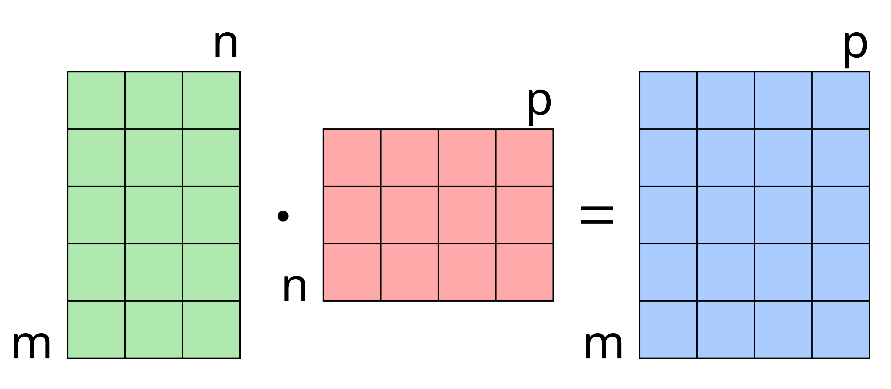



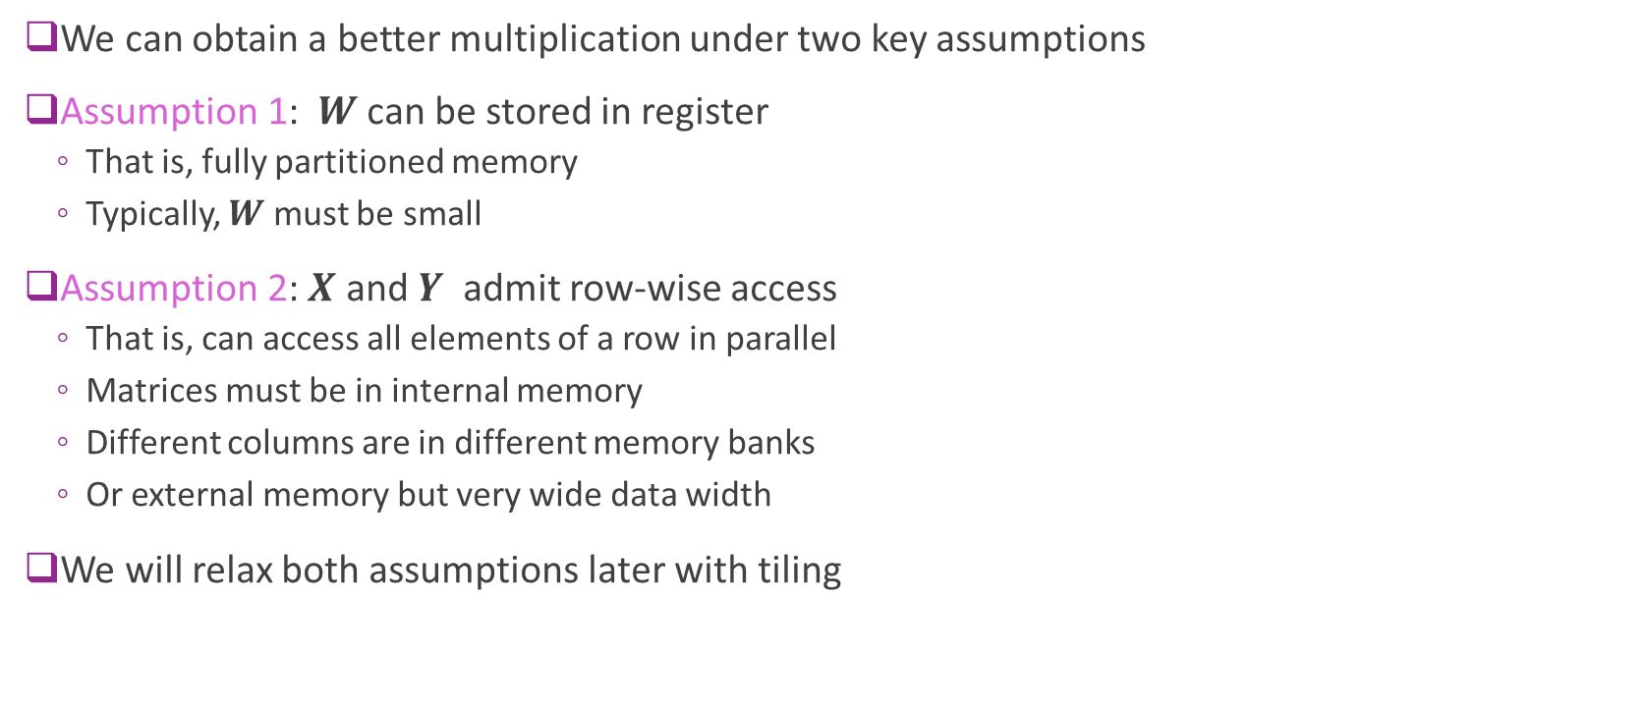






Two Assumptions
We can obtain a better multiplication under two key assumptions
Assumption 1: $W$ can be stored in register
That is, fully partitioned memory
Typically, $W$ must be small
Assumption 2: $X$ and $Y$ admit row-wise access
That is, can access all elements of a row in parallel
Matrices must be in internal memory
Different columns are in different memory banks
Or external memory but very wide data width
We will relax both assumptions later with tiling
$$K$$
$$M$$
$$M$$
$$K$$
$$N$$
$$N$$
$$X$$
$$W$$
$$Y$$

Slide 19
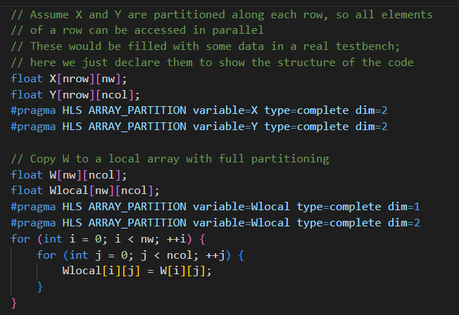
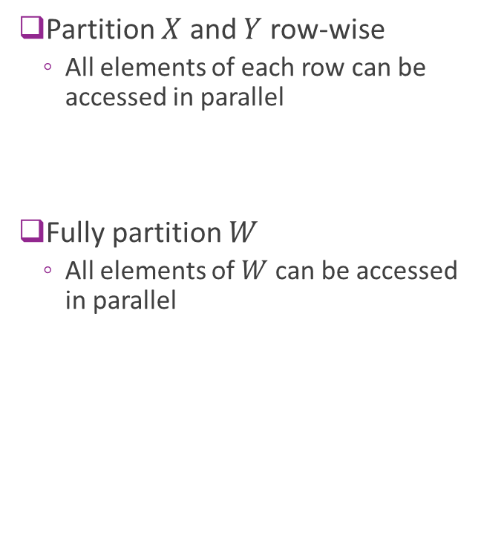
Memory Partitioning in Vitis
Partition $X$ and $Y$ row-wise
All elements of each row can be accessed in parallel
Fully partition $W$
All elements of $W$ can be accessed in parallel

Slide 20
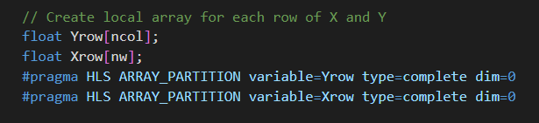

Local Row Buffers
Create row buffers
Store each row of $X$ and $Y$
Fully partition row buffers

Slide 21
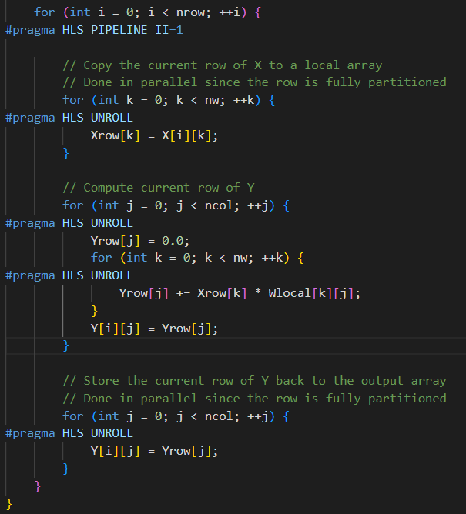
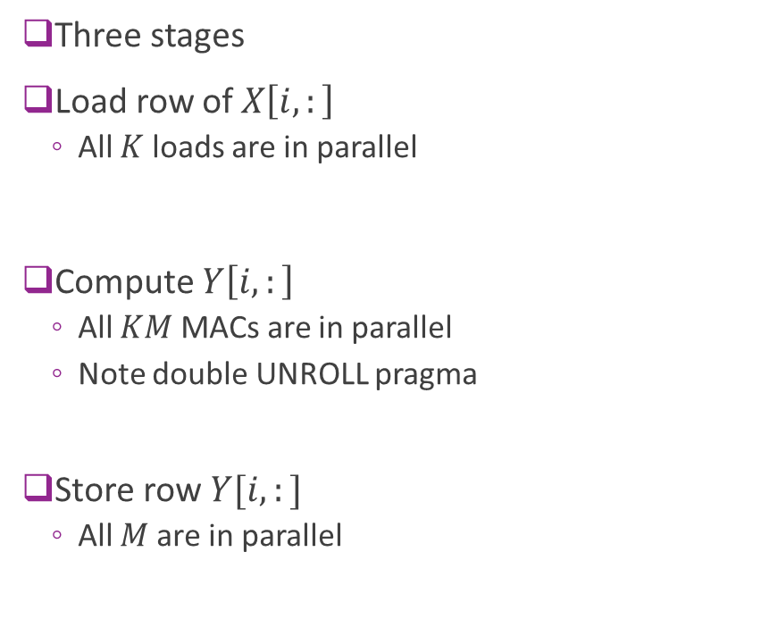
Pipeline Loop
Three stages
Load row of $X\left[i,:\right]$
All $K$ loads are in parallel
Compute $Y\left[i,:\right]$
All $KM$ MACs are in parallel
Note double UNROLL pragma
Store row $Y[i,:]$
All $M$are in parallel

Slide 22
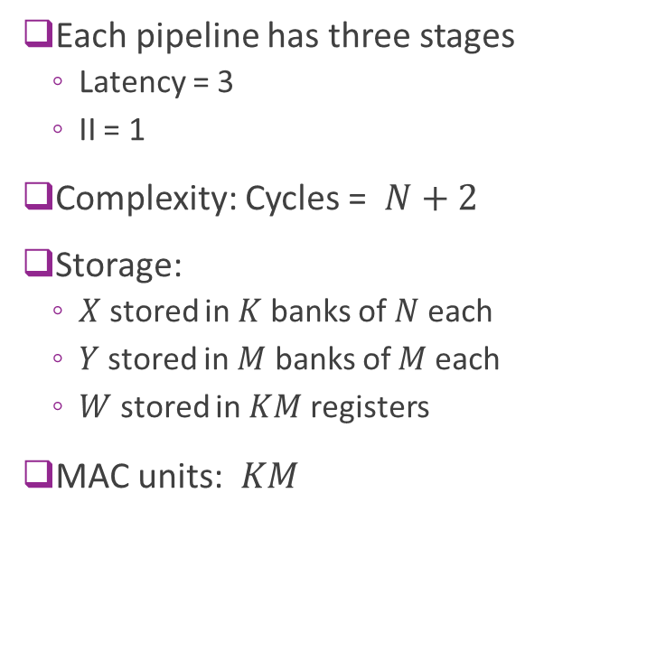
Best Case Complexity
Each pipeline has three stages
Latency = 3
II = 1
Complexity: Cycles = $N+2$
Storage:
$X$ stored in $K$ banks of $N$each
$Y$stored in $M$ banks of $M$each
$W$ stored in $KM$ registers
MAC units: $KM$

Slide 23
Baseline Implementation Summary
Conclusion: Baseline implementation achieves
Dramatic speed up
Enables highly parallel MACs
But there are two problems:
Problem 1: Local storage:
Requires local storage and partitioned arrays
We will address this with tiling
Problem 2: Complex routing
We will discuss and address this next

Slide 24
Outline
Matrix Multiplications
Hardware Implementation via Broadcast
Systolic Arrays
Tiling for Large Matrices

Slide 25
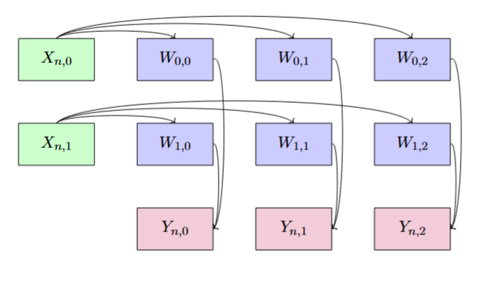
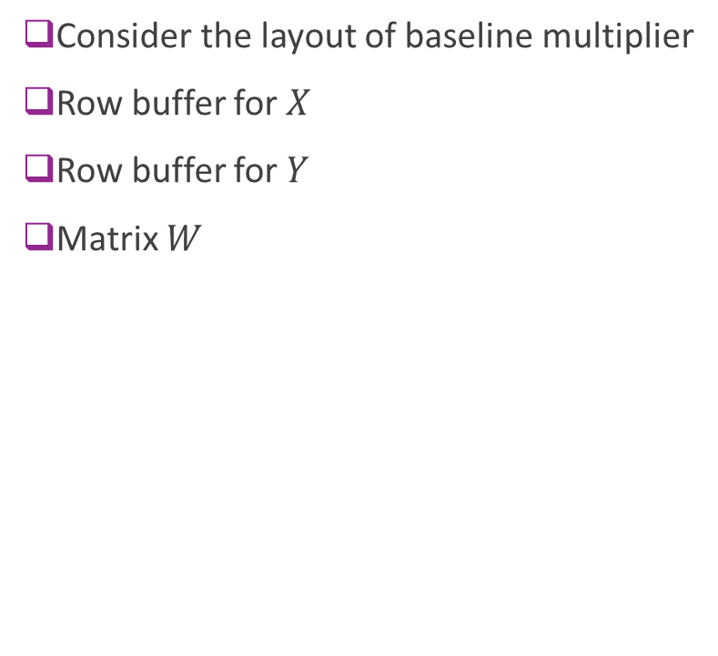


Baseline Implementation Layout
Consider the layout of baseline multiplier
Row buffer for $X$
Row buffer for $Y$
Matrix $W$
Row of $X$ ($K$ elements)
Row of $Y$ ($M$ elements)

Slide 26
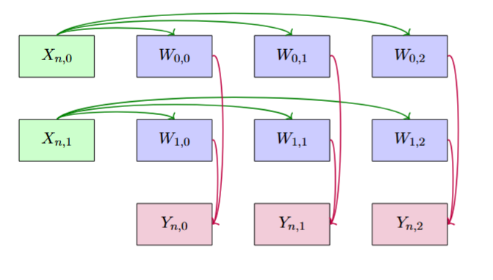
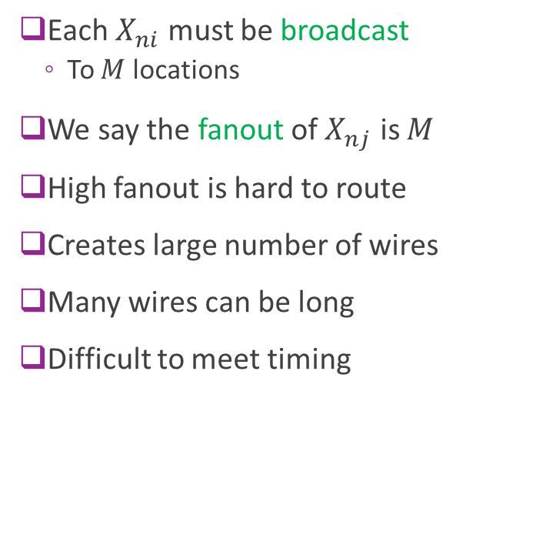
Routing Challenges: Fanout
Each $X_{ni}$ must be broadcast
To $M$ locations
We say the fanout of $X_{nj}$ is $M$
High fanout is hard to route
Creates large number of wires
Many wires can be long
Difficult to meet timing

Slide 27
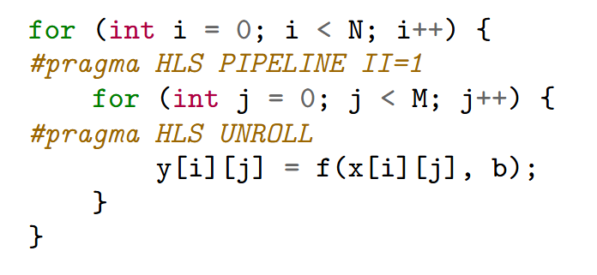
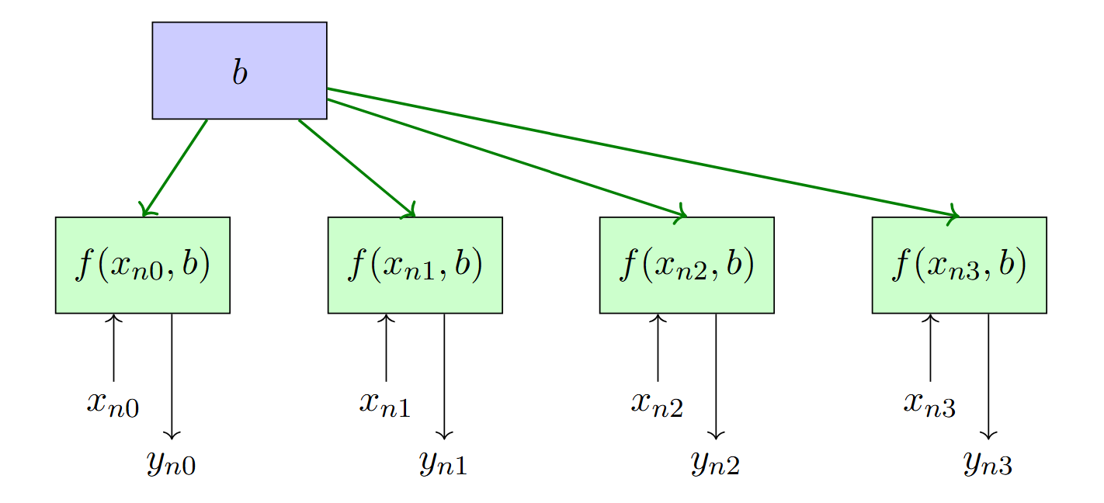

Simple Example
Consider simple example to left
Parameter $b$ is broadcast
To $M$ instances of function $f(x_{ij},b)$
Fanout is $M$

Slide 28

Fanout Visualized
Fanout is $M$

Slide 29
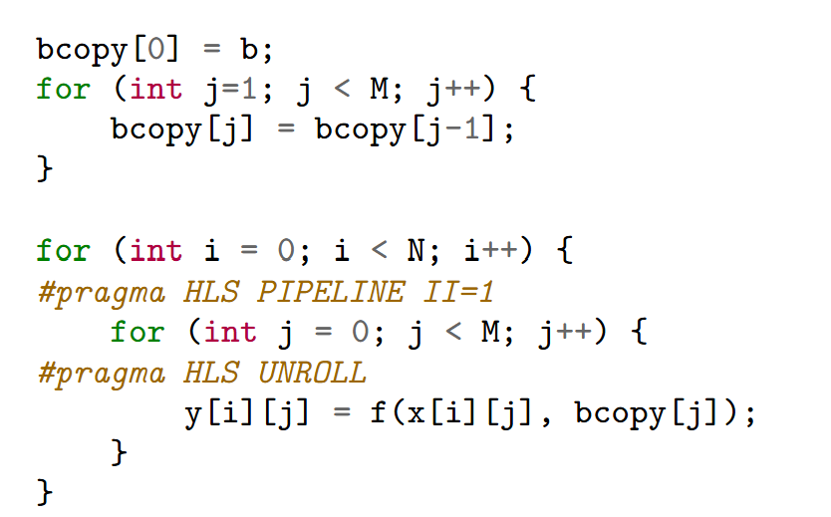
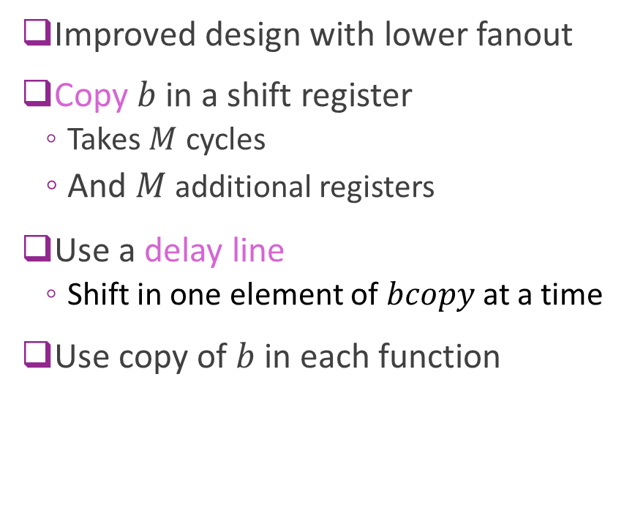
Reduced Fan-Out Design
Improved design with lower fanout
Copy $b$ in a shift register
Takes $M$ cycles
And $M$ additional registers
Use a delay line
Shift in one element of $bcopy$ at a time
Use copy of $b$ in each function

Slide 30
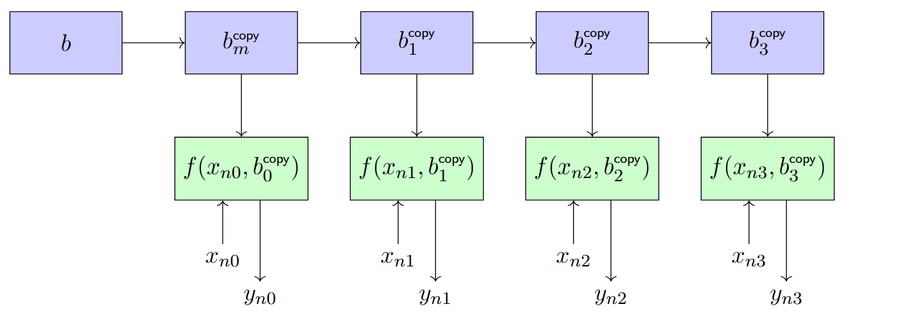

Reduced Fan-Out Visualized
Fan-out is reduced from $M$ to 2
Computations can be local
Key lesson: Add additional delay and register
But greatly improve routing

Slide 31
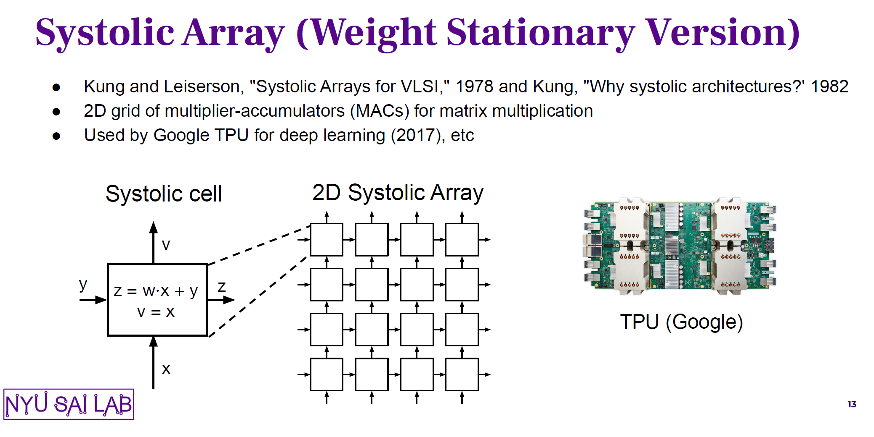
Systolic Arrays
See slides from Prof Sai Zhang
Provided to NYU students on Brightspace

Slide 32
Outline
Matrix Multiplications
Hardware Implementation via Broadcast
Systolic Arrays
Tiling

Slide 33

Memory Bottleneck
Suppose matrices $X$ and $Y$ can only be read one word per cycle
Reading and writing take $NK+NM$ cycles
If we have $K×M$ systolic array:
Computation take s $O(N)$ cycles
So, memory, not computation is the bottleneck

Slide 34
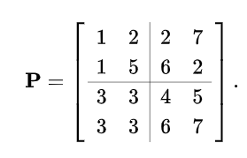
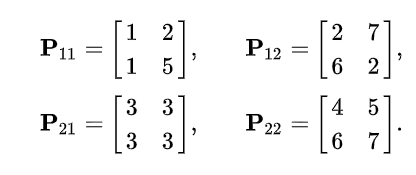
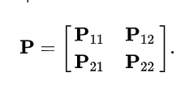

Block Matrices
Partition a matrix $P$ into sub-matrices or blocks
Full matrix
Matrix blocks
Block matrix form

Slide 35



Tiling for Matrix Multiplication
Divide rows in tiles of size $T_{r}$
$X$ and $Y$ will have $\frac{N}{T_{r}}$ block rows
$W$ will have $\frac{K}{T_{r}}$ block rows
Divide columns in tiles of size $T_{c}$
$Y$ and $W$ will have $\frac{M}{T_{c}}$ block columns
$X$ will have $\frac{K}{T_{c}}$ block columns
Systolic array will be $T_{r}×T_{c}$
$$T_{r}$$
$$T_{c}$$

Slide 36

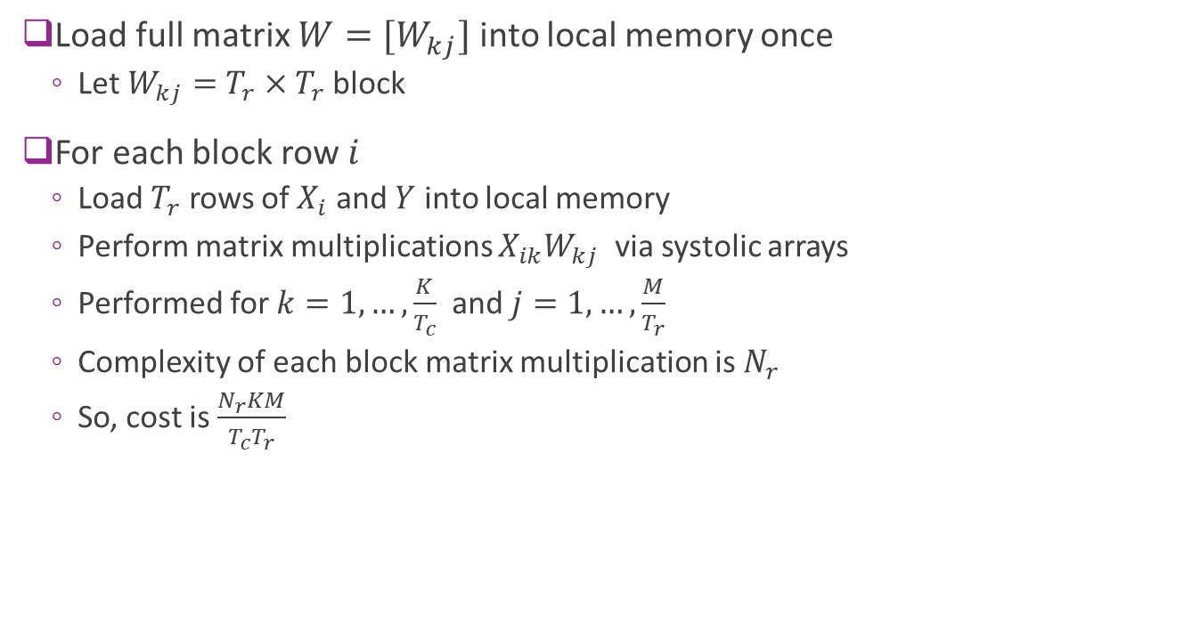

Tiling Procedure
Load full matrix $W=[W_{kj}]$ into local memory once
Let $W_{kj}=$ $T_{r}×T_{r}$ block
For each block row $i$
Load $T_{r}$ rows of $X_{i}$ and $Y$ into local memory
Perform matrix multiplications $X_{ik}W_{kj}$ via systolic arrays
Performed for $k=1,…,\frac{K}{T_{c}}$ and $j=1,…,\frac{M}{T_{r}}$
Complexity of each block matrix multiplication is $N_{r}$
So, cost is $\frac{N_{r}KM}{T_{c}T_{r}}$
$$T_{r}$$
$$T_{c}$$

