Slide 1
Unit 0 Course Introduction
Ece-GY 6463: advanced Hardware Design
Prof. Sundeep Rangan, Siddharth Garg

Slide 2
Outline
Course Admin
What is Custom Hardware and What Can it Do?

Slide 3
Course Details
Instructor
Sundeep Rangan, 370 Jay St, 9-th floor
Course assistant:
Ruibin Chen,
Office Hours:
Instructor: Tuesday, 2-3
Time and Location:
Jacob’s Hall, 6 Metrotech Room 201
Wednesdays 11-1:30

Slide 4
Learning Objectives
Identify tasks for hardware acceleration
Design, simulate, and evaluate designs for hardware accelerators
Called Intellectual Property or IPs
Use state-of-the-art tools
High-level synthesis (HLS) and AI
Integrate IP into processor-based systems for real-world applications
Deploy and test systems on FPGA boards

Slide 5
Pre-Requisites
Anyone can learn hardware
No prior hardware experience is required!
No hard pre-requisites!
Just have
Some software experience (e.g., C, python)
Desire to learn
Many possible disciplines
Robotics, wireless, scientific computation, cryptography, networking, …

Slide 6
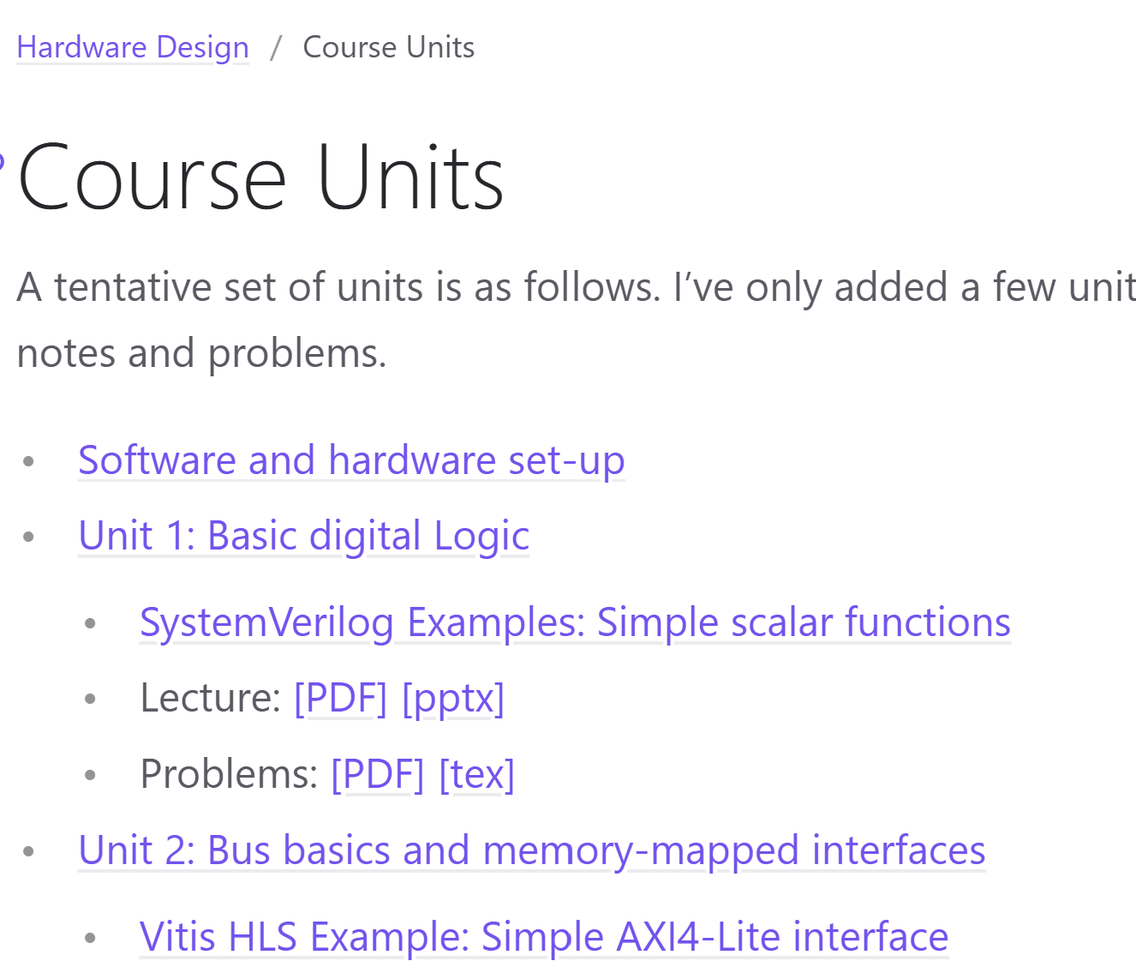
Course Webpage
All the material for the class is on GitHub
Demos:
SystemVerilog
Vitis HLS
Python
Lecture notes
Problems, Lab assignnments
Repository is work in progress
Re-sync periodically
https://sdrangan.github.io/hwdesign/docs

Slide 7
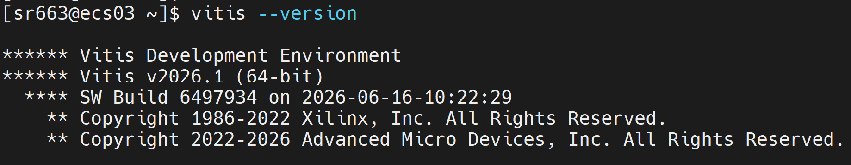
Software Set-Up: ECS Server
Main tools are Vitis and Vivado
Basic software for digital design
You can run all demos and labs on NYU ECS servers
No need for set-up on your local machine
Ideal for MacOS users
Local set-up only supported on Windows and Linux
Instructor will provide your email to NYU IT
You will then be able to log into ecs03.poly.edu to ecs06.poly.edu
SSH for command line
Or FastX for a GUI-based system

Slide 8
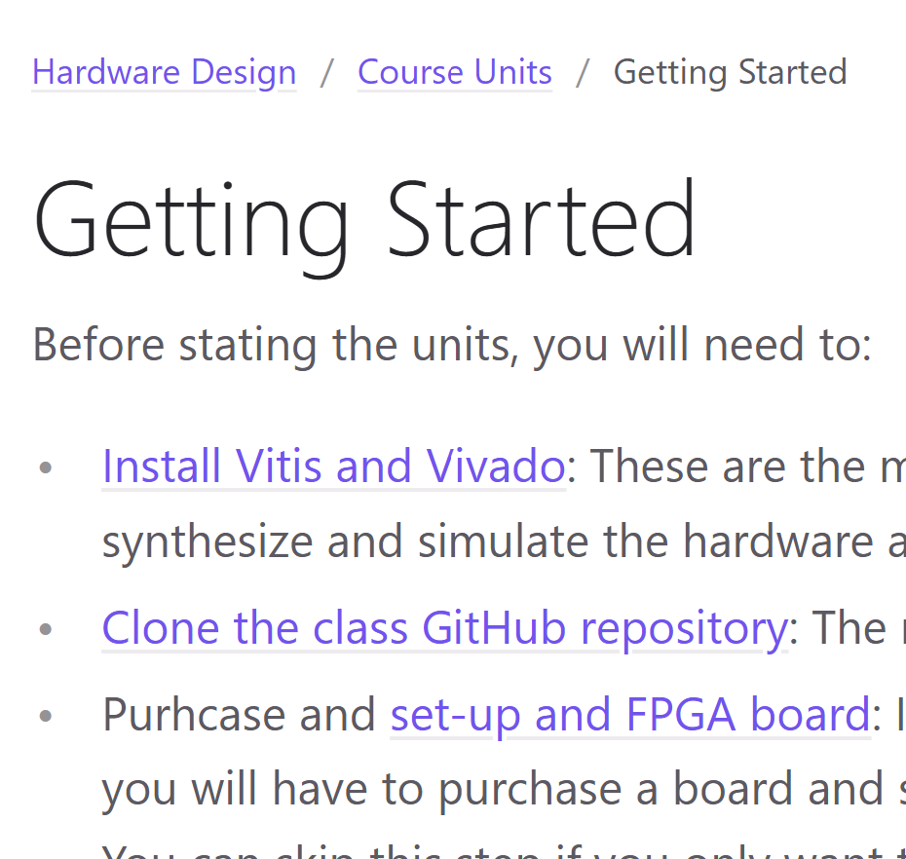
Software Set-Up: Local Machine
You can also install Vitis and Vivado on local machine
But only works for Windows and Linux
Does not work for MacOS
Optional: Purchase an actual FPGA board
See next slide
See installation instructions in class

Slide 9
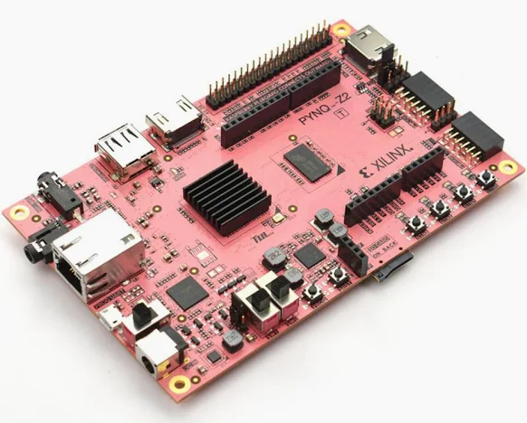
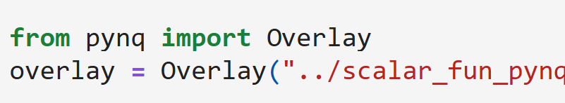
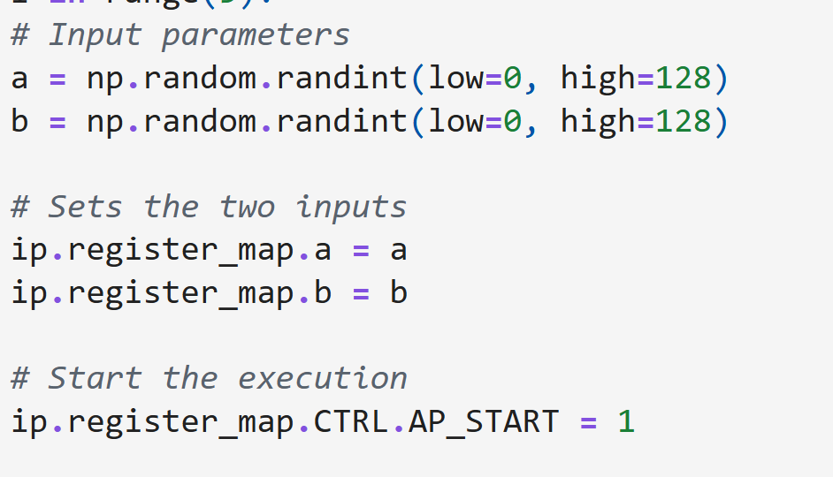
FPGA Boards
Projects and labs can be deployed on actual hardware
Currently optional due to price
We suggest: Pynq-Z2 board
$300
USB connection to your laptop
Pynq: Simple python interface
Low-end, but ideal for teaching
Other boards may be available in lab
Ex: RFSoC 4x2 for wireless communications

Slide 10
Tentative Grading
Points
Homework + Labs: 25%
Midterm: 25%
Final: 25%
Project: 25%
Labs will be mostly SystemVerilog and VitisHLS
Approximately 4 Vitis HLS assignments
Approximately 5 written assignments
Midterm and Final are in class
Closed book, no electronic aids

Slide 11
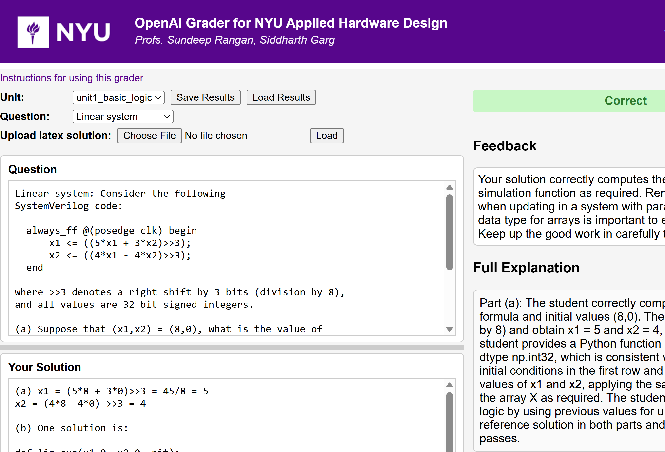
AI Autograder
An LLM-automated grader
Will use for:
In class exercises
For Gradescrope submissions
Provides
Instant, detailed feedback
But
May make mistakes
Still experimental
Need your feedback

Slide 12
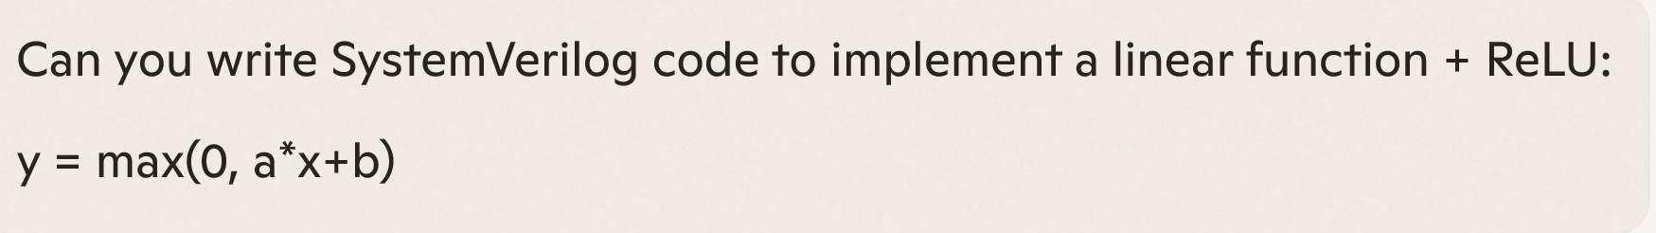
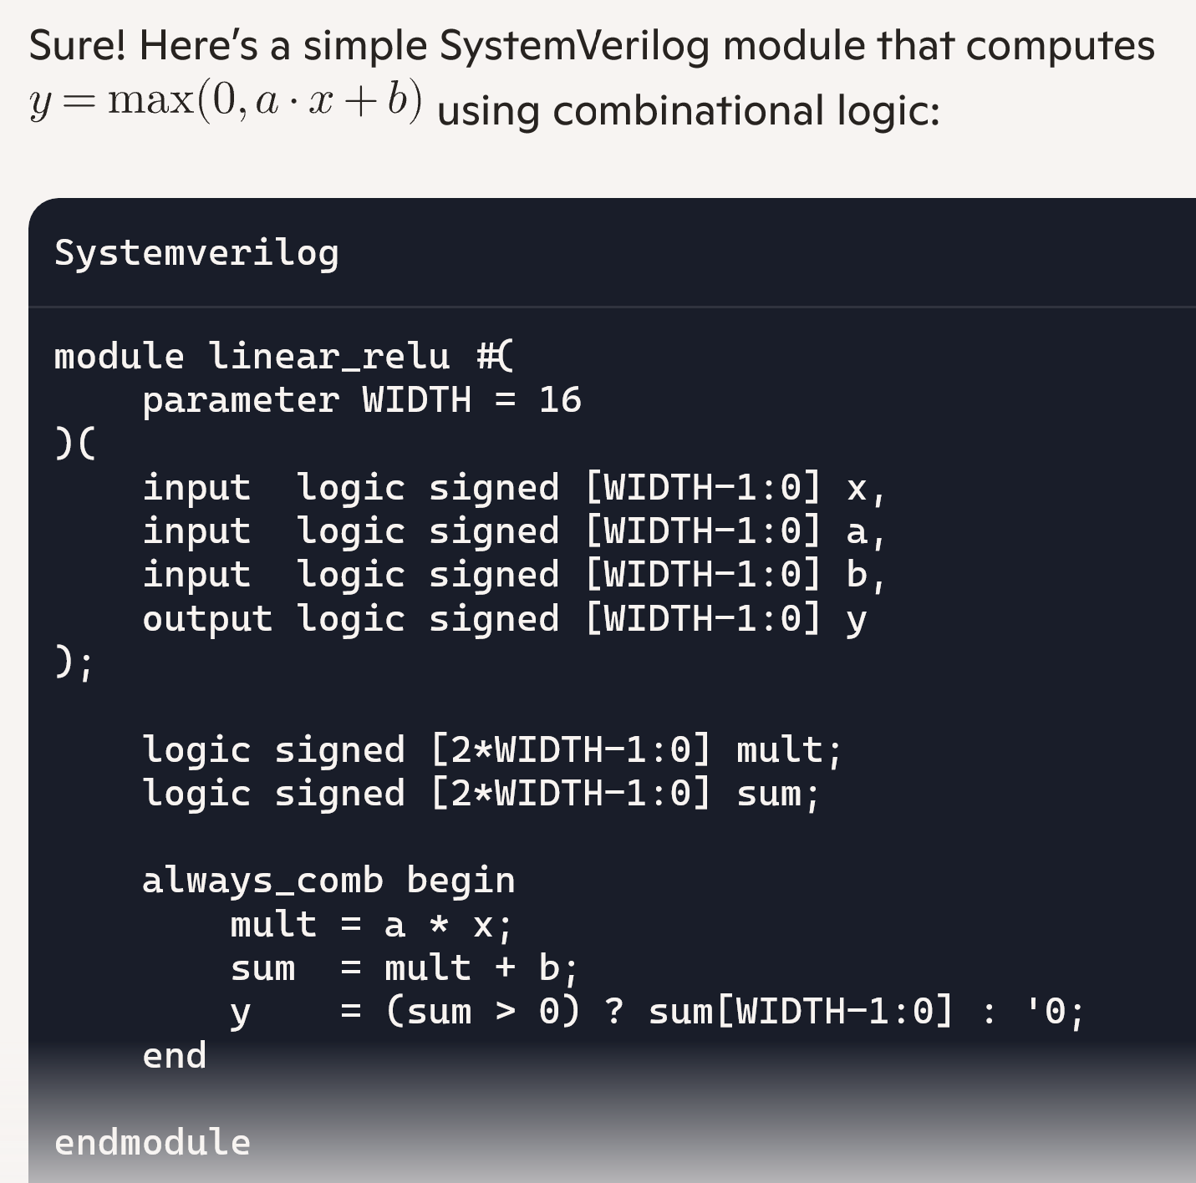

Using AI
It is encouraged!
Use it for labs, problems, projects
But learn to use it well:
It still makes mistakes.
Learn to test the results
Write clear, specific prompts
Use it as a tutor
Have it generate questions
Explain results
On the midterm & final there are no aids!

Slide 13
Tentative Syllabus 1
Week | Date | Material
1 | 1/20/2026 | Course Admin Unit 1. Data Types and Combinational Logic
2 | 1/27/2026 | Unit 2. Sequential Logic and Finite State Machines
3 | 2/3/2026 | Unit 3. Floating and Fixed Point
4 | 2/10/2026 | Unit 4. Bus Basics and Memory Mapped Interfaces
5 | 2/17/2026 | Unit 5. FIFO and Streaming Interfaces
6 | 2/24/2026 | Unit 6. Loop optimization
7 | 3/3/2026 | Buffer
8 | 3/10/2026 | Midterm

Slide 14
Tentative Syllabus 2
Week | Date | Material
9 | 3/17/2026 | Spring Break- No class
10 | 3/24/2026 | Unit 6. FIR filters and systolic arrays
11 | 3/31/2026 | Unit 7. Shared memory and the load-store compute pattern
12 | 4/7/2026 | Unit 8. Multi-threaded control
13 | 4/14/2026 | Unit 10. Multiple processes and message passing architectures
14 | 4/21/2026 | Buffer
15 | 4/28/2026 | Final Exam
 | 5/5/2026 | Project presentations

Slide 15


Project
Build your own IP
You must provide:
A clearly defined hardware IP block (RTL or HLS)
A well‑specified interface and integration model with a host system
A testbench and evaluation methodology
Documentation that allows others to reproduce your result
Any topic of choice
Computer vision, communications, computing, …
Work in groups of 2 to 4
Individual projects require instructor permission
Hardware IP or accelerator
Host system

Slide 16
Project Grading
See full rubric on project page on the GitHub pages
Submission on GitHub
Create a repo for the project. You can start now!
Submit only the repo URL.
IP definition and interface: Clear role, well-justified boundary between host and IP
IP implementation: Efficient design, correct, design choices
Evaluation:
Testbench that are comprehensive, test corner cases, evaluate performance
Measure design options
Process: Graded on GitHub commit history. No last minute drop before deadline
Presentation: Assume you are pitching to a prospective employer

Slide 17
Outline
Course Admin
What is Custom Hardware and What Can it Do?

Slide 18


Hardware vs. Software
Hardware
Any electronic circuit that performs some computation
Software
Instructions executed on hardware

Slide 19
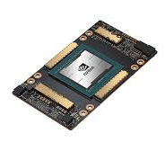
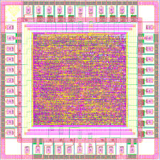
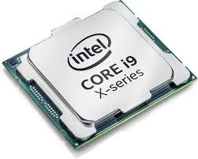
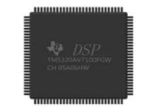
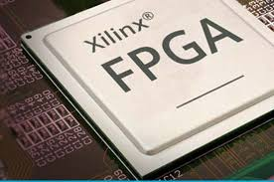
Hardware Comes in Many Forms
General purpose CPU Intel, AMD, ARM
DSP Texas Instruments,
Qualcomm Hexagon
GPU Nvidia Intel Radeon
FPGA Xilinx / AMD, Intel / Altera
Custom ASIC
Qualcomm, Apple, Broadcomm

Slide 20
General Purpose vs. Custom
General purpose CPU
DSP
GPU
FPGA
Custom ASIC
General purpose, Applies in many domains, Re-programmed with software, Performance via SW optimization, multi-cores
Domain specific, HW optimized for specific task, Can enable:
Higher performance,
Lower power / OP, size
Focus of this course

Slide 21

Accelerator or IP Model
Host system Runs main application, User interface, May be embedded as well (e.g., smartphone)
Embedded Processor (DSP, ARM,…) Configures HW, Manages data transfer, Performs some DSP
Hardware IP or accelerator Compute intensive tasks
Domain specific
High-speed IO Network interface, Digital communication data
This class

Slide 22
What is Custom Hardware Good At
Compute‑intensive kernels
High arithmetic density, many operations per data
Structured, repetitive tasks
Same operation repeated many times
Regular data flow, memory access
Regular dataflow and memory patterns
Tight control of timing, no OS jitter
High throughput with low energy
Custom datapaths, optimized bit-widths, specialized memories
Examples: DSP, linear algebra, ML inference, crypto, compression

Slide 23
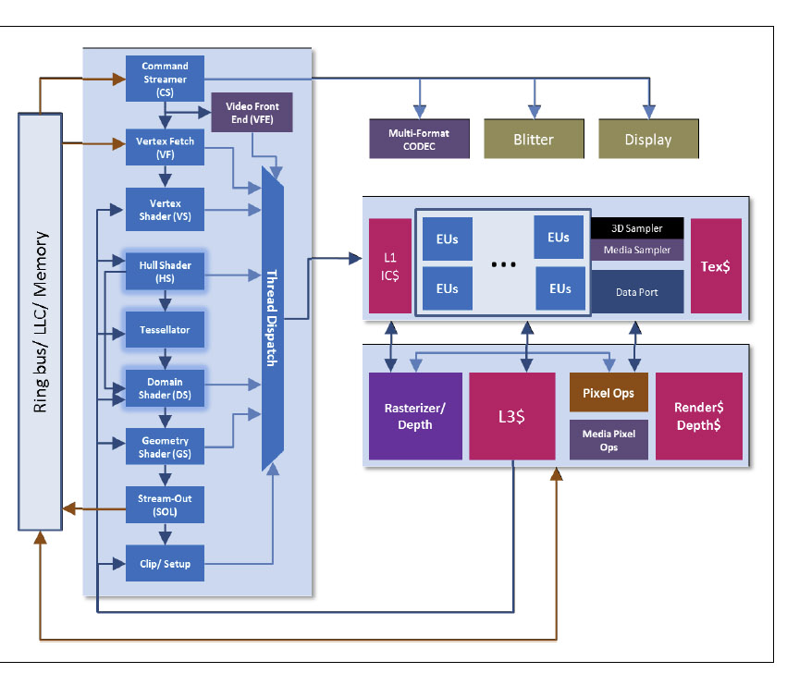
Example: Intel Quick Sync Media Processor
Intel specialized graphics units
Programmable shaders for parallel math
Fixed‑function blocks (rasterizer, tessellator, texture units)
Media engines for video encode/decode (Quick Sync)
Integrated into Core‑i3 / i5 / i7 / i9 processors
Physically part of the CPU die
Shares memory hierarchy with CPU cores
High‑speed on‑chip interfaces
Direct access to system memory
High‑bandwidth internal fabric
Connecting CPU, GPU, and media engines
Low‑latency paths

Slide 24

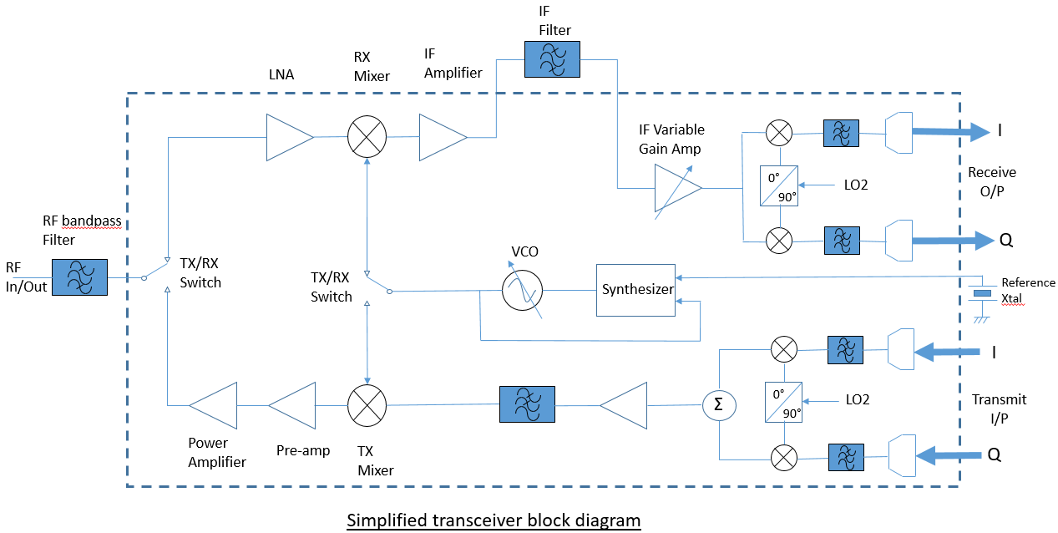
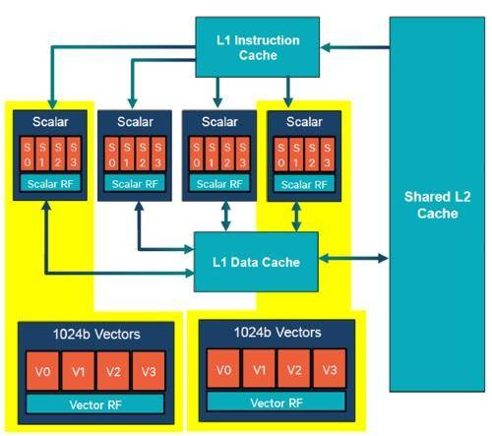
Example: 5G Modem Core
Gsamps / s
ARM Core Upper layer SW, Configuration,
Networking,
Packet processing
5G HW Filtering,
Equalization, Decoding, …
RFIC Antenna interface, Radio frequency operations, DACs / ADCs
Hexagon DSP Control channels, Infrequent, but complex, data processing

Slide 25
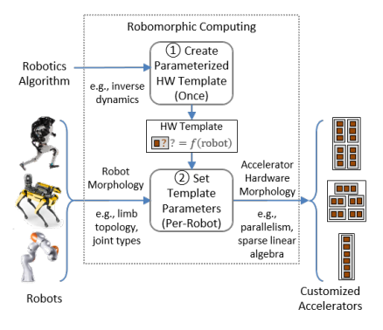
Example: Robomorphic Computing
Custom accelerator for robotic computation
Performs complex kinematic simulations for:
Model predictive control
Path planning
Key challenge:
How do you describe robot morphology?
Need a general structure applicable to many robots
Many algorithms
Neuman, S. M., Plancher, B., Bourgeat, T., Tambe, T., Devadas, S., & Reddi, V. J. (2021, April). Robomorphic computing: a design methodology for domain-specific accelerators parameterized by robot morphology. In Proceedings of the 26th ACM International Conference on Architectural Support for Programming Languages and Operating Systems (pp. 674-686).

Slide 26
FPGA vs. ASIC
FPGA: Field‑Programmable Gate Array
Reconfigurable hardware
Great for prototyping and teaching: no fabrication needed
Slower and less power‑efficient than ASICs
Research, rapid development, low‑volume products, networking gear, some accelerators
ASIC: Application‑Specific Integrated Circuit
Custom hardware chip designed for one purpose (e.g., video codec, 5G modem, ML accelerator)
Much faster and more power‑efficient than FPGAs
Cannot be changed after fabrication — the design is permanent
Manufactured (“fabricated”) at a semiconductor foundry
Ex: TSMC,
Smartphones, GPUs, Automotive, …

Slide 27


Turnaround Time Contrasted
Seconds
Write code
Compile
Run
Software
Design
Simulate
Synthesize
Generate Bitstream
Run
FPGA
Custom ASIC
Design
Simulate
Synthesize
Layout
Fabrication
Package
Integrate
Run
Months

Slide 28
Three Conceptual Challenges for Hardware
Concurrency
Hardware modules run in parallel
Like multi-threaded programs
Must consider resource contention, information passing, …
Long turnaround time
Need reliable simulation and test before fabrication
High level of rigor
Need for interface abstraction
Hardware must work over broad range of problems
But provide gains specific to domain

Slide 29



HW Design Is Getting Easier
Traditional view: HW is Hard
Rarely-used languages
Small, elite community
Complex tool chain
Long turnaround time
Need to design concurrent systems
New Tools
High-Level Synthesis
Program in C/C++/Python
AI-assisted design
LLMs are learning HW fast
Python-based tool flow
FPGA Python APIs
Python simulation, …

Slide 30
In-Class Exercise
Break into small groups
Select any domain of interest to your group
Robotics, scientific computing, finance, gaming, …
Propose a hardware accelerator for a specific task in that domain
Be specific
Ex., “Fast solver for molecular simulations”, “Real-time obstacle detection for drones”, …
What would it interface with?
CPU, Any sensor data / peripherals? How much data does it need?
Why would custom hardware help?
What are the computations involved? Is it structured, compute intensive?

