Slide 1
Unit 4
Memory and Basic Processor Interfaces
ECE-GY 6463: Advanced Hardware Design
Profs. Sundeep Rangan, Siddharth Garg

Slide 2
Learning Objectives
Skill | You will be able to
Size memory for a data stream | Compute data rate, capacity and the number of memories, and choose registers, block memory or external memory
Compute memory addresses | Convert between word and byte addresses, split a global address into a local one, and lay out a register map
Identify bus manager and subordinate | Say which party initiates a transaction, whichever way the data flows
Time a valid/ready handshake | Work out the cycle a transfer happens on, including when the receiver is busy
Analyze AXI4-Lite transactions | Time reads and writes across the AW, W, B, AR and R channels
Build an IP with AXI4-Lite registers | Write the Vitis HLS signature and s_axilite pragmas, and state the registers they produce
Determine the limiting resource | Compare the time spent moving data against the time spent computing
Each skill is assessed by problems in the LLM grader.

Slide 3
Outline
Random Access Memory and Memory-Mapped Registers
Processor Interfaces with AXI4-Lite
Implementing AXI4-Lite Interface in Vitis HLS

Slide 4
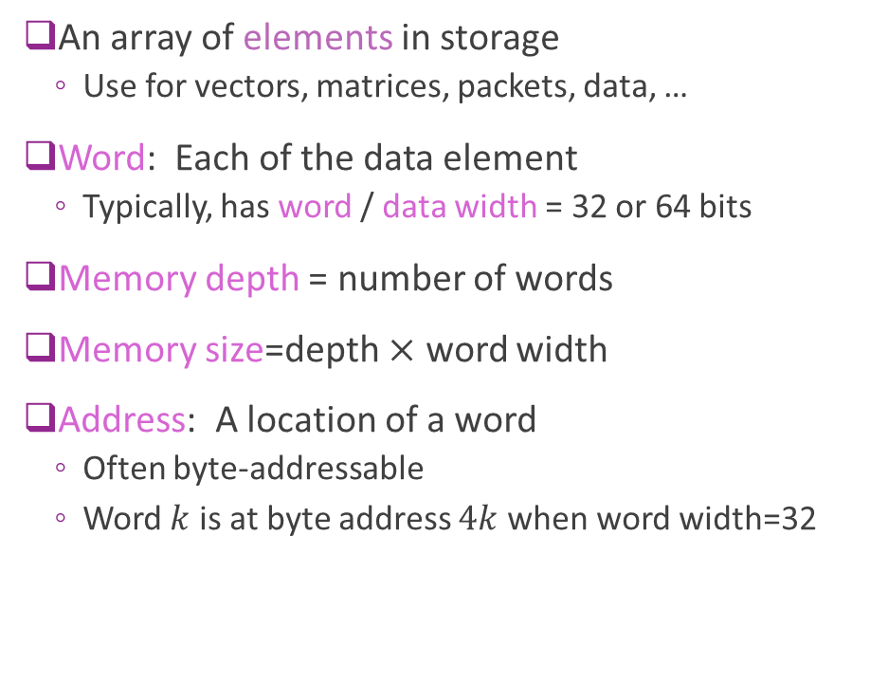
Addressable Memory
An array of elements in storage
  Use for vectors, matrices, packets, data, …
Word: Each data element
  Typically, has word / data width = 32 or 64 bits
Memory depth = number of words
Memory size=depth $×$ word width
Address: A location of a word
  Often byte-addressable
  Word $k$ is at byte address $4k$ when word width=32
Byte address | Data
0 | Word 0
4 | Word 1
8 | Word 2
⋮ | ⋮
4(𝑁−1) | Word 𝑁−1
A 32-bit memory, 𝑁 words deep

Slide 5
Byte vs. Word Addressing
Word address: counts words: 0, 1, 2, …
Byte address: counts bytes
  A 𝑊-bit word spans 𝑊/8 byte addresses
  Word 𝑘 starts at byte 4𝑘 (32-bit) or 8𝑘 (64-bit)
A byte address splits into two fields
  Low log₂(𝑊/8) bits: the byte within the word
  Remaining bits: the word index
Processor buses, including AXI, use byte addresses
  even when every access is a whole word
32-bit memory, byte-addressable
Word
Byte addresses
0
0
1
2
3
1
4
5
6
7
2
8
9
10
11
⋮
𝑘
4𝑘
4𝑘+1
4𝑘+2
4𝑘+3
A 32-bit byte address
word index
bits 31–2
byte
1–0
e.g. 0x14 → word 5, byte 0

Slide 6
Byte and Word Addresses
PRACTICE
A memory stores 64-bit words and is byte-addressable: byte address 0 is the first byte of word 0, and each word occupies consecutive byte addresses.
(a) What is the byte address of word 13? Give it in decimal and in hexadecimal.
(b) Which word contains byte address 0x5C, and at which byte offset within that word?
(c) The memory has a depth of 4096 words. How many address bits are needed with byte addressing? How many with word addressing?
64-bit words: 8 bytes each
0
0
1
2
3
4
5
6
7
1
8
9
10
11
12
13
14
15
⋮
Word 13 starts at byte ?
Also in the LLM grader: Unit 4 › Byte and word addresses

Slide 7
Byte and Word Addresses
SOLUTION
(a) 8 bytes per word, so word 13 starts at 13 × 8 = 104 = 0x68
(b) 0x5C = 92 = 8 × 11 + 4 → word 11, byte 4
word = addr >> 3 byte = addr & 0x7
(c) Word addressing: 4096 = 2¹² words → 12 bits
Byte addressing: 4096 × 8 = 2¹⁵ bytes → 15 bits
The extra 3 bits select the byte within the word
A byte address, 64-bit words
word index
bits 14–3
byte
2–0
Common error
Using 4 bytes per word, the 32-bit habit, gives 52, word 23 and 14 bits.
Also in the LLM grader: Unit 4 › Byte and word addresses

Slide 8
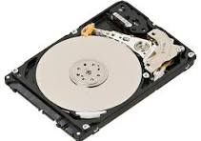
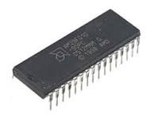
Sequential vs Random Access
Sequential Access
  Access time depends on position
  You must move through data in order
  Ex: Hard disks (seek + rotation)
  FIFO queues (logical sequential access)
Random access
  Any element can be accessed in constant time
  SRAM (on chip block memory, FPGA BRAM)
  DRAM (external memory)
  Register files (architecturally random access)

Slide 9
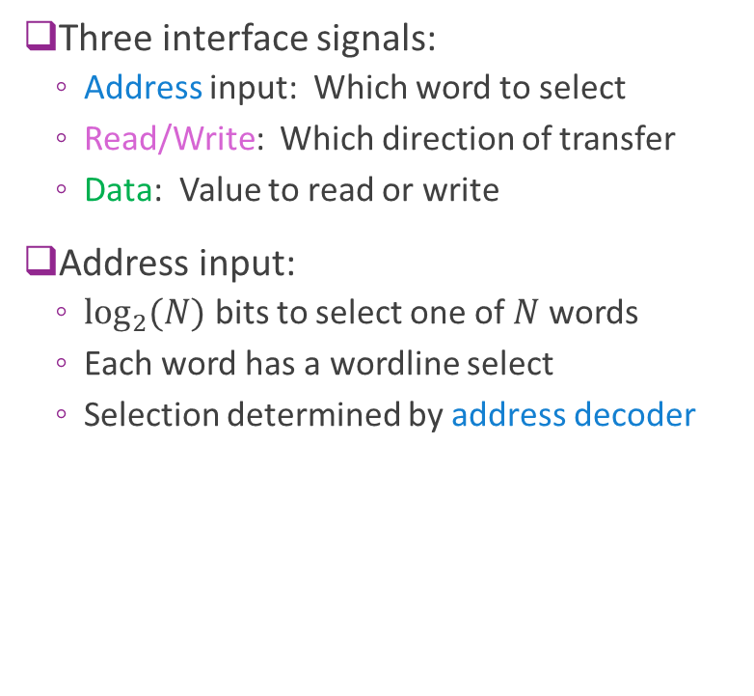
Typical RAM Architecture
Three interface signals:
  Address input: Which word to select
  Read/Write: Which direction of transfer
  Data: Value to read or write
Address input:
  $\log_{2}{(N)}$ bits to select one of $N$ words
  Each word has a wordline select
  Selection determined by address decoder
𝑁 data words
Data bus
Address input
log₂(𝑁) bits
Address
decoder
selected word
one row per word
R/W

Slide 10
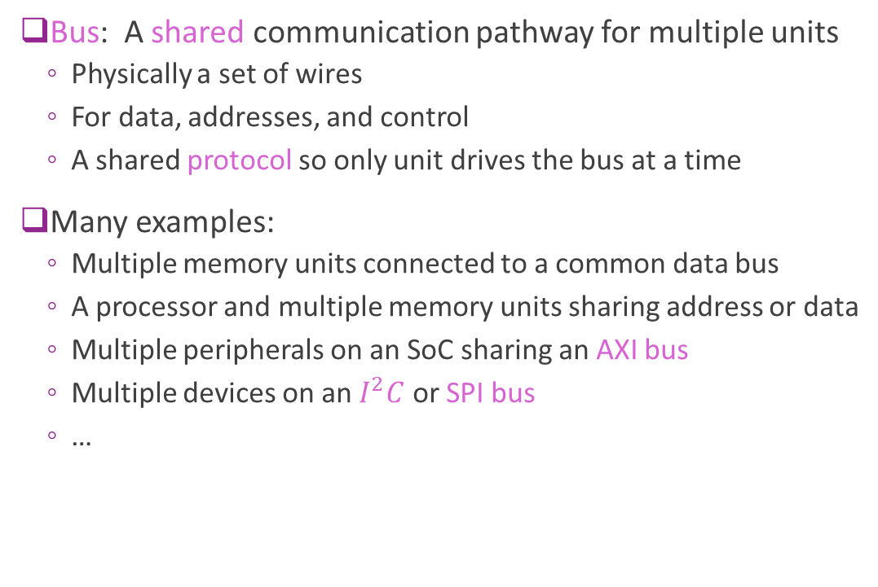
Bus
Bus: A shared communication pathway for multiple units
  Physically a set of wires
  For data, addresses, and control
  A shared protocol so only one unit drives the bus at a time
Many examples:
  Multiple memory units connected to a common data bus
  A processor and multiple memory units sharing address or data
  Multiple peripherals on an SoC sharing an AXI bus
  Multiple devices on an $I^{2}C$ or SPI bus
  …
Bus
Unit A
Unit B
Unit C
One unit drives the bus at a time

Slide 11
Address Maps
Modules on a shared bus share one global address space
Each module gets a base address and a size
  Size a power of two; base aligned to the size
Local address: the offset within a module
  Global address = base + local address
  The module's decoder sees only the local address
Decoding a global address
  Upper bits select the module
  Lower bits are the local address
Example address map (not to scale)
0x0000_0000
DDR
1 GB
0x3FFF_FFFF
0x4000_0000
BRAM
8 KB
0x4000_1FFF
0x4001_0000
IP registers
4 KB
0x4001_0FFF
Global 0x4000_0104 → BRAM
local = 0x4000_0104 − 0x4000_0000 = 0x104
Vitis also says “global memory” for off-chip DDR, a different meaning.

Slide 12
Global and Local Addresses
PRACTICE
A processor bus uses 32-bit byte addresses. Three modules share it, each occupying a contiguous range of the global address space that starts at its base address.
(a) What global address does the processor use to access word 100 of Memory B?
(b) The processor reads global address 0x0000_2A0C. Which module responds? What is the local byte address, and which local word is it?
(c) What is the highest global address that belongs to Memory B? How many bits does Memory B need for its local byte address?
Module | Base address | Size
Memory A | 0x0000_0000 | 16 KB
Memory B | 0x0001_0000 | 64 KB
IP registers | 0x0002_0000 | 256 B
Both memories store 32-bit words.
1 KB = 1024 bytes.
Local address: offset from the module's base address
Global address = base + local address
Also in the LLM grader: Unit 4 › Global and local addresses

Slide 13
Global and Local Addresses
SOLUTION
(a) Word 100 → local byte 100 × 4 = 400 = 0x190
Global: 0x0001_0000 + 0x190 = 0x0001_0190
(b) Memory A spans 0x0000_0000–0x0000_3FFF (16 KB = 0x4000)
0x2A0C falls inside → Memory A, local byte 0x2A0C (10764)
Local word = 0x2A0C / 4 = 0xA83 = 2691
(c) 64 KB = 0x1_0000 bytes → B ends at 0x0001_FFFF
Local byte addresses 0x0000–0xFFFF → 16 bits
0x0000_0000
Memory A · 16 KB
0x2A0C is here
0x0000_3FFF
0x0001_0000
Memory B · 64 KB
word 100 at local 0x190
0x0001_FFFF
0x0002_0000
IP registers · 256 B
Also in the LLM grader: Unit 4 › Global and local addresses

Slide 14

High Impedance
Method to share a common bus
  One unit drives a value $V$ on the bus
  Other units go into a high-impedance state, denoted $Z$
  High impedance units are disconnected
  Bus value= $V$
Sometimes called Tri-State
  Each bit is 0, 1 or Z
Bus
A
B
C
A | B | C | Bus Value | Remarks
Z | 15 | Z | 15 | B drives bus
41 | Z | Z | 41 | A drives bus
Z | Z | Z | X | No driver- no reliable value
32 | 78 | Z | X | Collision of A, B – no reliable value Protocols will avoid this condition

Slide 15
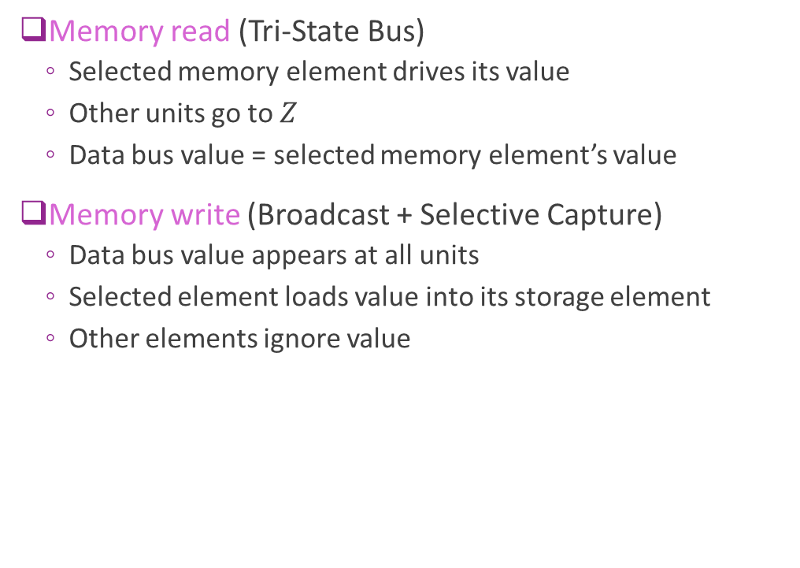
High Impedance on a Data Bus
Memory read (Tri-State Bus)
  Selected memory element drives its value
  Other units go to $Z$
  Data bus value = selected memory element’s value
Memory write (Broadcast + Selective Capture)
  Data bus value appears at all units
  Selected element loads value into its storage element
  Other elements ignore value
𝑁 data words
Data bus
drives the bus
others go to 𝑍
R/W

Slide 16
External vs. Internal Memory
One chip
External memory
DRAM
Internal memory
SRAM, BRAM
Processing
hardware
I/O
Off-chip
High capacity (GB)
Reached over an I/O interface
On-chip
Low capacity (KB–MB)
Direct, low-latency access from the datapath

Slide 17
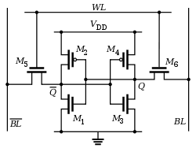
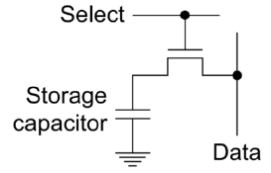
External vs. Internal Compared
Feature | Internal memory (SRAM) | External memory (DRAM)
Location | On-chip | Off-chip
Storage cell | 6-T cell (cross-coupled inverters) | Capacitor + access transistor
Density | Low | High
Capacity | Small (KB–MB) | Large (GB)
Speed | Very fast | Slower
Power | Higher static | Lower static, higher dynamic
Access | Direct by logic | Through a memory controller
Refresh | No | Yes
SRAM cell
DRAM cell

Slide 18
Example On-Chip Memory Sizes
Platform | On-chip memory | Typical size | Notes
Laptop CPU (Intel Core) | SRAM (L1/L2/L3) | 20–40 MB | L3 dominates; very fast
NVIDIA A100 GPU | SRAM (L2 cache) | ~40 MB | HBM2e (40–80 GB) is off-chip, on-package
Xilinx Virtex-7 FPGA | BRAM (36 Kb blocks) | 2–6 MB | Distributed across the fabric
Custom ASIC (5 mm², 16 nm) | SRAM | 5–10 MB | Depends on layout and redundancy
Lesson: internal memory is limited. Use it judiciously.
A 16 nm 6-T high-density bitcell is about 0.07 µm² (TSMC 128 Mb SRAM, ISSCC 2014), so 5 mm² of bitcells holds ≈ 70 Mbit — roughly 5–7 MB once decoders and sense amplifiers are counted.

Slide 19
Example: Video
A video processor stores 8 frames of raw video
  512 × 512 pixels, 3 color channels, 8 bits per channel
Memory capacity
  𝐵 = 512 × 512 × 3 × 8 bytes = 3·2²¹ bytes ≈ 6.3 MB
  A sizeable portion of memory, even on a large chip
Stored as 32-bit words
  𝑁 = 𝐵/4 = 3·2¹⁹ ≈ 1.57 M words
Address bits: the smallest K with 2^{K} ≥ the count
  Byte addressing: 2^{K} ≥ 3·2²¹ → K = 23
  Word addressing: 2^{K} ≥ 3·2¹⁹ → K = 21
512 × 512 × 3
one frame
8 frames
6.3 MB
23 bits
capacity
byte address

Slide 20
Registers vs. Bulk Storage
Every IP holds a mix. The choice is made per value, not per design.
Registers
Parallel access: many values in the same cycle
Any register value is available to the datapath
Higher area per bit
A host reads and writes them one at a time
Bulk storage
Typically one word per access
Much higher density
A host moves data to and from it in bulk
Block RAM on chip, DRAM off chip
A few values needed at once → registers. Thousands touched one at a time → bulk storage.

Slide 21
Memory-Mapped Storage
Registers can also be memory-mapped
  Connected to their own address decoder
  Determines which register to read/write
Common interface to processor
  Processor sees registers and block memory in one address space
  Being addressable is independent of what the storage is made of
Data bus
Address bus
Registers
decoder
Block memory
decoder

Slide 22
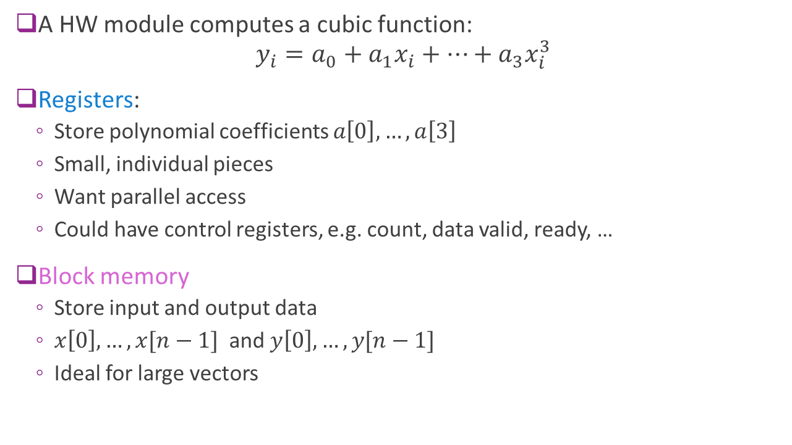
Example: The Cubic IP
A HW module computes a cubic function:
$y_{i}=a_{0}+a_{1}x_{i}+⋯+a_{3}x_{i}^{3}$
Registers:
  Store polynomial coefficients $a\left[0\right],…,a\left[3\right]$
  Four values, all needed in the same cycle
  Want parallel access
  Could have control registers, e.g. count, data valid, ready, …
Block memory
  Store input and output data
  $x\left[0\right],…,x[n−1]$ and $y\left[0\right], …, y[n−1]$
  n values, only one touched per cycle
Registers
𝑎[0]
𝑎[1]
𝑎[2]
𝑎[3]
𝑥[0]
𝑦[0]
𝑥[1]
𝑦[1]
⋮
⋮
𝑥[𝑛−1]
𝑦[𝑛−1]
Block memory

Slide 23
Register Maps
Register map: where each field lives
  Offset from the IP's base, name, field bits, access
For now: no field spans two registers
  Each field fits inside one 32-bit register
  Tight packing comes later, with serialization
Unused upper bits are zero padding
  Read back as 0; ignored by the hardware
Example: a vector-scaling IP
Offset | Register | Field bits | Access
0x00 | CTRL | start [0], done [1] | R/W
0x04 | GAIN | 7:0 | R/W
0x08 | LEN | 9:0 | R/W
0x0C | SUM | 23:0 | R
The LEN register: 32 bits
zero padding
22 bits
LEN
10 bits
31
10
9
0

Slide 24
Register Map of the Cubic IP
PRACTICE
The cubic IP computes 𝑦[𝑖] = 𝑎₀ + 𝑎₁𝑥[𝑖] + 𝑎₂𝑥[𝑖]² + 𝑎₃𝑥[𝑖]³ over a vector of length 𝑛. Its registers hold:
start, done: 1 bit each, sharing CTRL (start = bit 0, done = bit 1)
a0–a3: 16-bit signed coefficients
n: 12-bit unsigned vector length
(a) Write the register map: offset, field(s) and zero-padding bits for each register.
(b) The IP is mapped at base 0x4000_0000. What global address does the processor write to set a2?
(c) The processor writes 𝑎₂ = −3. What 32-bit value reads back, in hex? What number does code get if it treats that as a signed 32-bit integer?
Layout rules
32-bit registers, one field each (CTRL holds both bits)
Fields in the low bits, zero padding above
Order from 0x00: CTRL, a0, a1, a2, a3, n
Offset | Register | Field bits | Padding
 | CTRL
 | a0
 | a1
 | a2
 | a3
 | n
Also in the LLM grader: Unit 4 › Register map

Slide 25
Register Map of the Cubic IP
SOLUTION
(a) See the table: registers sit 4 bytes apart
(b) 0x4000_0000 + 0x0C = 0x4000_000C
(c) −3 in 16-bit two's complement is 0xFFFD
Zero padding → reads back as 0x0000_FFFD
As a signed 32-bit integer: 65533, not −3
Offset | Register | Field bits | Padding
0x00 | CTRL | start [0], done [1] | 30
0x04 | a0 | 15:0 | 16
0x08 | a1 | 15:0 | 16
0x0C | a2 | 15:0 | 16
0x10 | a3 | 15:0 | 16
0x14 | n | 11:0 | 20
The a2 register after writing −3
Watch out: zero padding does not sign-extend.
Software must sign-extend a padded signed field itself.
0000 0000 0000 0000
bits 31–16: padding
1111 1111 1111 1101
bits 15–0: −3
Also in the LLM grader: Unit 4 › Register map

Slide 26
Where Does Each Value Live?
IN CLASS
Pick a computation that interests you: filtering in video processing, encryption, a neural-network layer, a matrix product. It must take at least one array, image or stream.
(a) List the inputs and outputs, with a size or a rate for each.
(b) Which would you hold in registers? Why?
(c) Which would you hold in bulk storage? Why?
(d) Choose a problem size. Give the register map, and the size of the bulk storage in words.
Decide per value
Registers: parallel access, available to the datapath, higher area per bit
Bulk storage: one word per access, much higher density
How the data crosses into the IP is the next section, and units 5 and 9.
Also in the LLM grader: Unit 4 › Storage partitioning

Slide 27
Outline
Random Access Memory and Memory-Mapped Registers
Processor Interfaces with AXI4-Lite
Implementing AXI4-Lite Interface in Vitis HLS

Slide 28
AXI4-Lite Protocol
ARM Extensible Interface family of protocols
  Others we will use in class are AXI4-Full and AXI4-Stream
Industry-standard, ubiquitously used
AXI4-Lite:
  Simple
  Ideal for programming registers
  Modular enables flexibility in delays and scheduling at both ends
  Typical throughput: 1 read / 1 write every 3-5 clock cycles

Slide 29
AXI4-Lite Use Case: Processor to Hardware IP
Control registers
Bus signals
Address, data
Control
Processor
E.g. ARM core
Hardware IP
Ex: FPGA module you have designed
Widely-used use case
Hardware IP has control registers
Need read / write access from an embedded processor

Slide 30
Managers and Subordinates
MANAGER
SUBORDINATE
Control registers
Bus signals
Address, data
Control
Processor
E.g. ARM core
Hardware IP
Ex: FPGA module you have designed
Called master and slave until AMBA renamed them in 2021, and the port names (S_AXI, s_axilite) still do. In AXI4-Lite:
Each read or write of a single word is a transaction
Manager: The unit that initiates all transaction (typically the processor in this example)
Subordinate: The unit that responds to the transaction (typically the hardware IP)

Slide 31
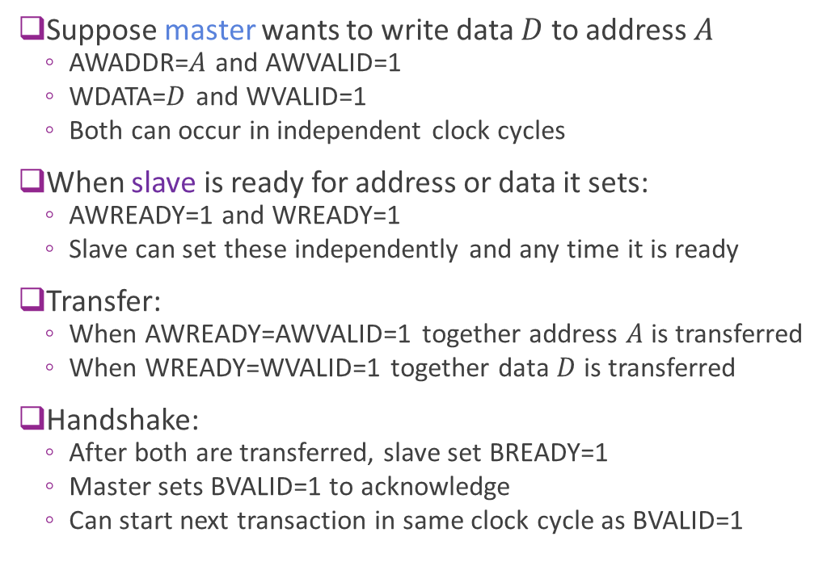
Review: AXI4-Lite Write Protocol
Suppose manager wants to write data $D$ to address $A$
  AWADDR=$A$ and AWVALID=1
  WDATA=$D$ and WVALID=1
  Both can occur in independent clock cycles
When subordinate is ready for address or data it sets:
  AWREADY=1 and WREADY=1
  Subordinate can set these independently and any time it is ready
Transfer:
  When AWREADY=AWVALID=1 together address $A$ is transferred
  When WREADY=WVALID=1 together data $D$ is transferred
Write response (B channel):
  After both transfers, the subordinate sets BVALID=1 with the write response
  The manager sets BREADY=1 to accept it; the response transfers when BVALID=BREADY=1
  Each channel is free for the next transaction once its own handshake completes
MANAGER
SUBORDINATE
AWADDR, AWVALID
AWREADY
WDATA, WVALID
WREADY
BVALID
BREADY

Slide 32
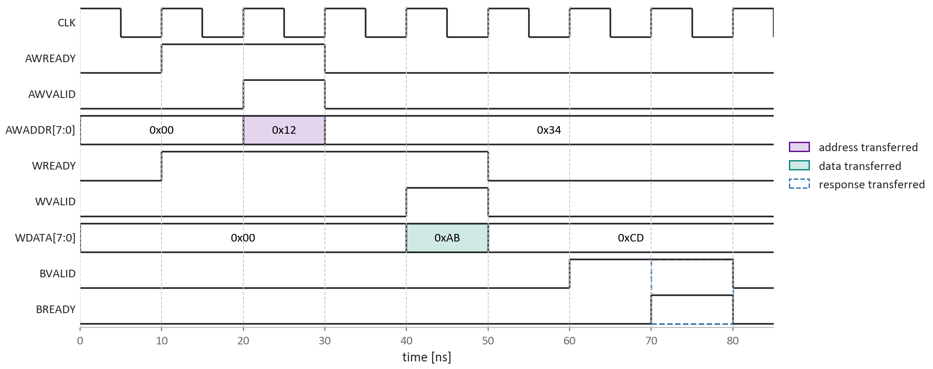
Example AXI4-Lite Write
Example with
Subordinate is ready before manager
Address write before data write
But either order or together is fine

Slide 33
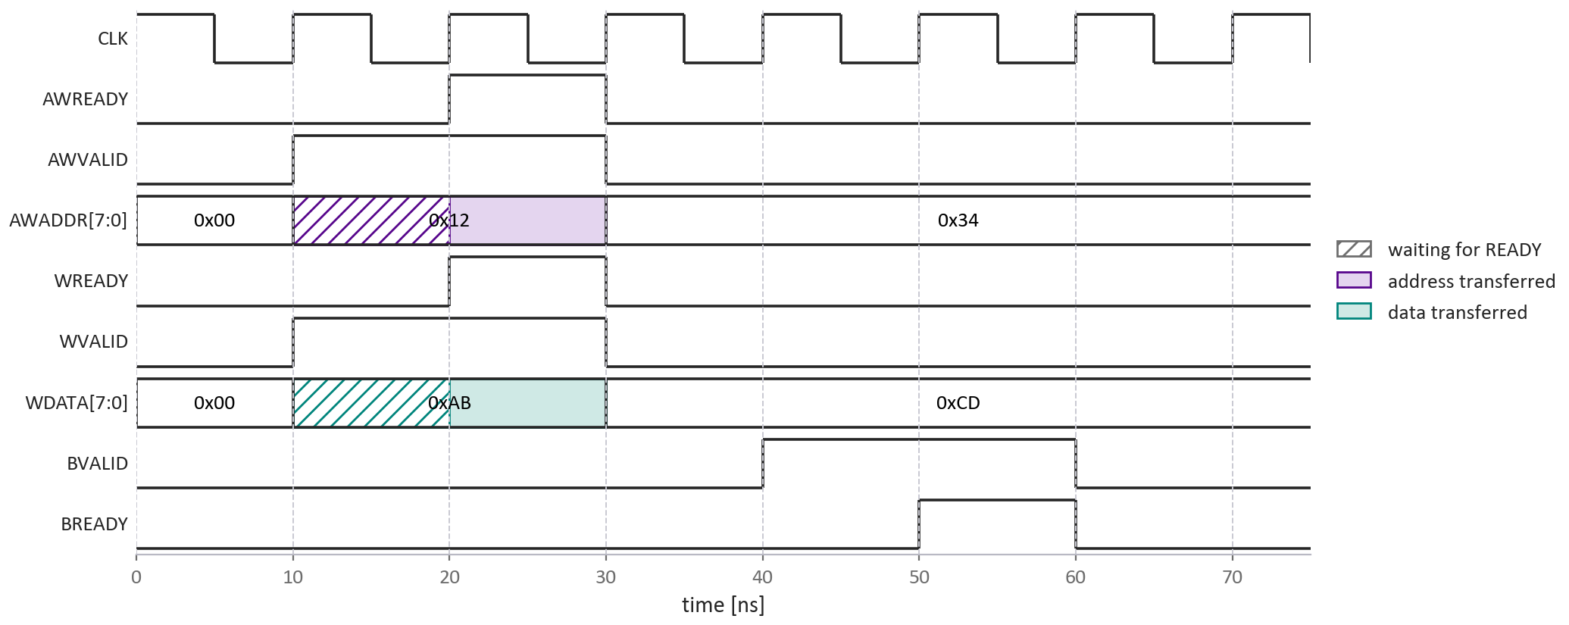
Example AXI4-Lite Write With Stall
Example:
Manager sets valid
Subordinate is not ready
Transfer stalls
Provides flow control
  Ensures data waits until RX is ready

Slide 34
Read the Timing Diagram
IN CLASS
Using the write-with-a-stall diagram on the previous slide:
(a) In which cycle does the address transfer on the AW channel? How do you know?
(b) In which cycle does the write data transfer on the W channel?
(c) In which cycle does the write response transfer on the B channel?
(d) The hatched region marks a wait. Which side is waiting, what is it waiting for, and for how many cycles?
A transfer happens on the first cycle where VALID and READY are both high.
Also in the LLM grader: Unit 4 › Reading a write timing diagram

Slide 35
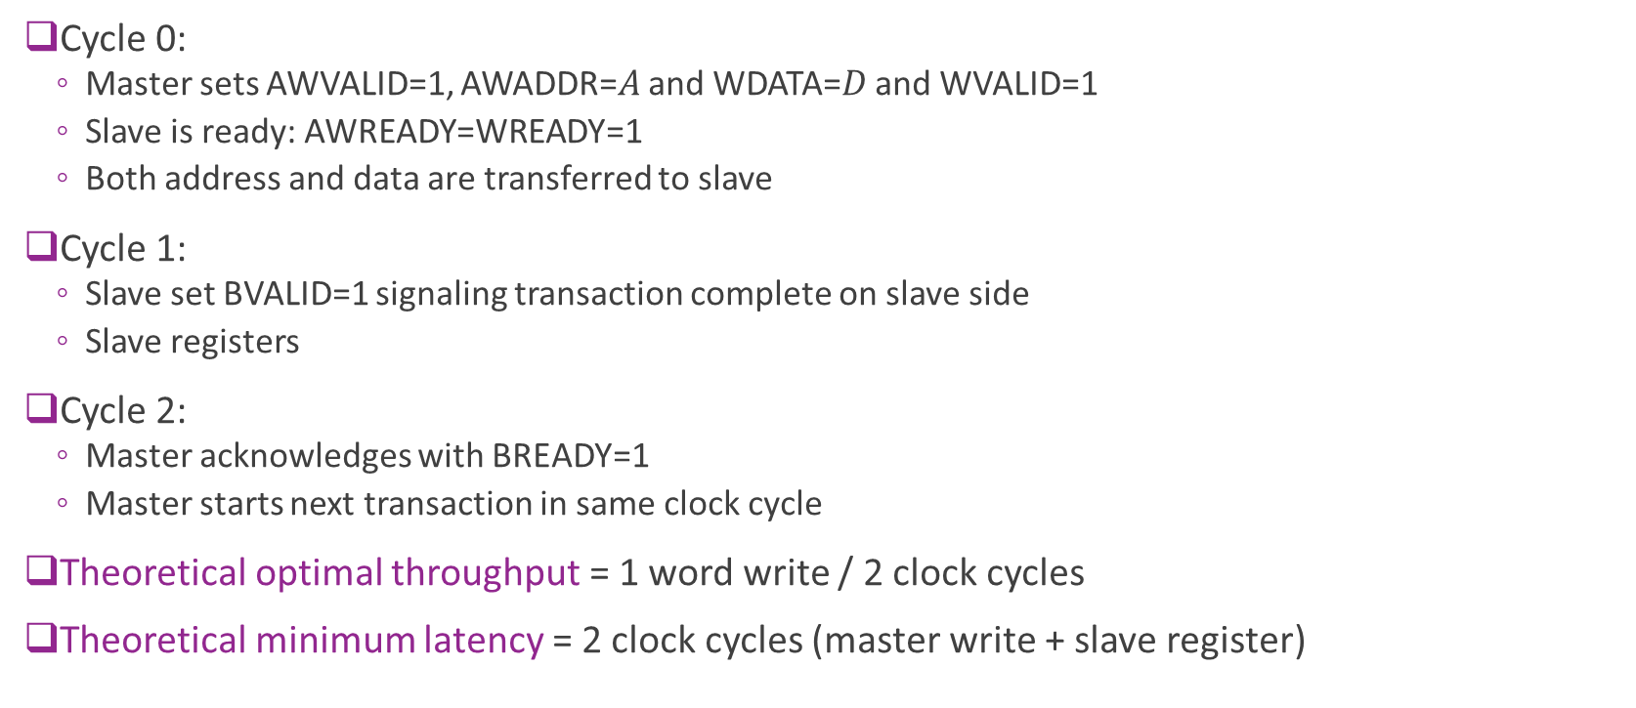
Theoretical Optimal Write Throughput
Cycle 0:
  Manager sets AWVALID=1, AWADDR=$A$ and WDATA=$D$ and WVALID=1
  Subordinate is ready: AWREADY=WREADY=1
  Both address and data are transferred to subordinate
Cycle 1:
  Subordinate set BVALID=1 signaling transaction complete on subordinate side
  Subordinate registers
Cycle 2:
  Manager acknowledges with BREADY=1
  Manager starts next transaction in same clock cycle
Theoretical optimal throughput = 1 word write / 2 clock cycles
Theoretical minimum latency = 2 clock cycles (manager write + subordinate register)

Slide 36
Practical AXI4-Lite Latency
Suppose:
  Manager sets data and address on cycle 0
  Subordinate is ready
In most practical register systems:
  Subordinate takes 1-2 additional clock cycles for BREADY=1
Manager takes at 1-2 additional clock cycles for BVALID=1 and next input
Practical throughput with AXI4-Lite: 1 word write per 3-5 clock cycles

Slide 37
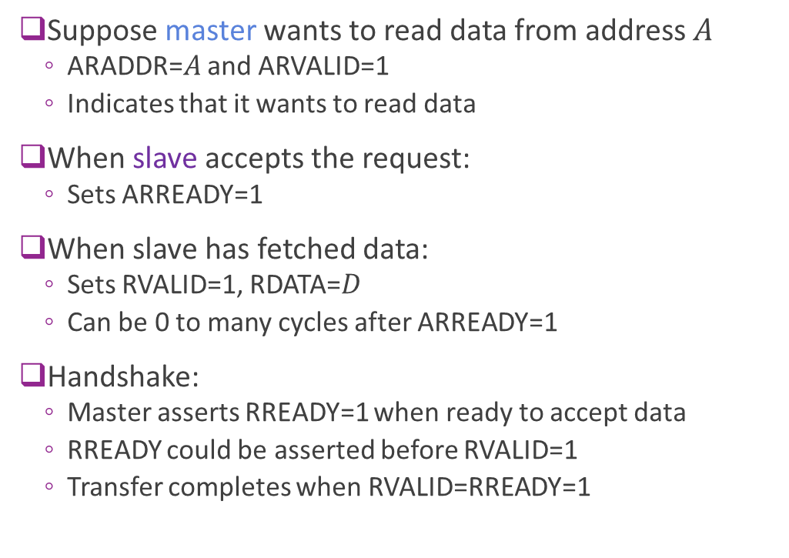
AXI4-Lite Read Protocol
Suppose manager wants to read data from address $A$
  ARADDR=$A$ and ARVALID=1
  Indicates that it wants to read data
When subordinate accepts the request:
  Sets ARREADY=1
When subordinate has fetched data:
  Sets RVALID=1, RDATA=$D$
  Can be 0 to many cycles after ARREADY=1
Handshake:
  Manager asserts RREADY=1 when ready to accept data
  RREADY could be asserted before RVALID=1
  Transfer completes when RVALID=RREADY=1
MANAGER
SUBORDINATE
ARADDR, ARVALID
ARREADY
RVALID, RDATA
RREADY
BVALID

Slide 38
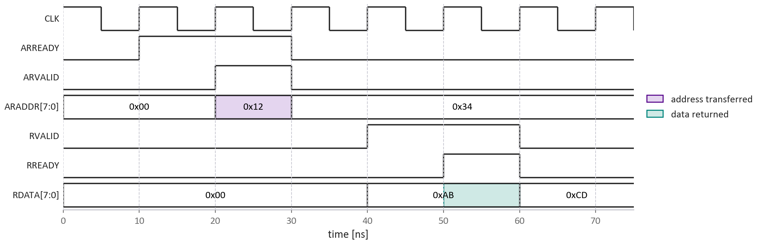
Example Read Timing
In this example:
Subordinate is initially ready
(ARREADY=1)
Subordinate immediately accepts
request
Manager is immediately available for
Data valid with two cycle delay

Slide 39
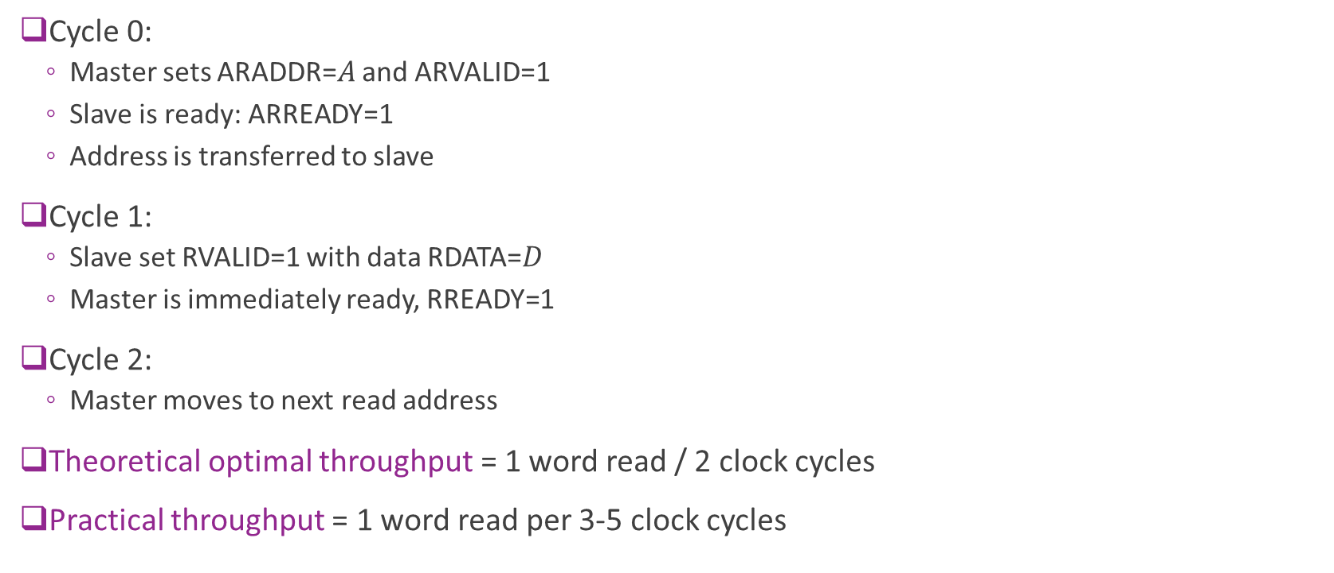
Theoretical Optimal Read Throughput
Cycle 0:
  Manager sets ARADDR=$A$ and ARVALID=1
  Subordinate is ready: ARREADY=1
  Address is transferred to subordinate
Cycle 1:
  Subordinate set RVALID=1 with data RDATA=$D$
  Manager is immediately ready, RREADY=1
Cycle 2:
  Manager moves to next read address
Theoretical optimal throughput = 1 word read / 2 clock cycles
Practical throughput = 1 word read per 3-5 clock cycles

Slide 40
Outline
Random Access Memory and Memory-Mapped Registers
Processor Interfaces with AXI-Lite
Implementing AXI-Lite Interface in Vitis HLS

Slide 41



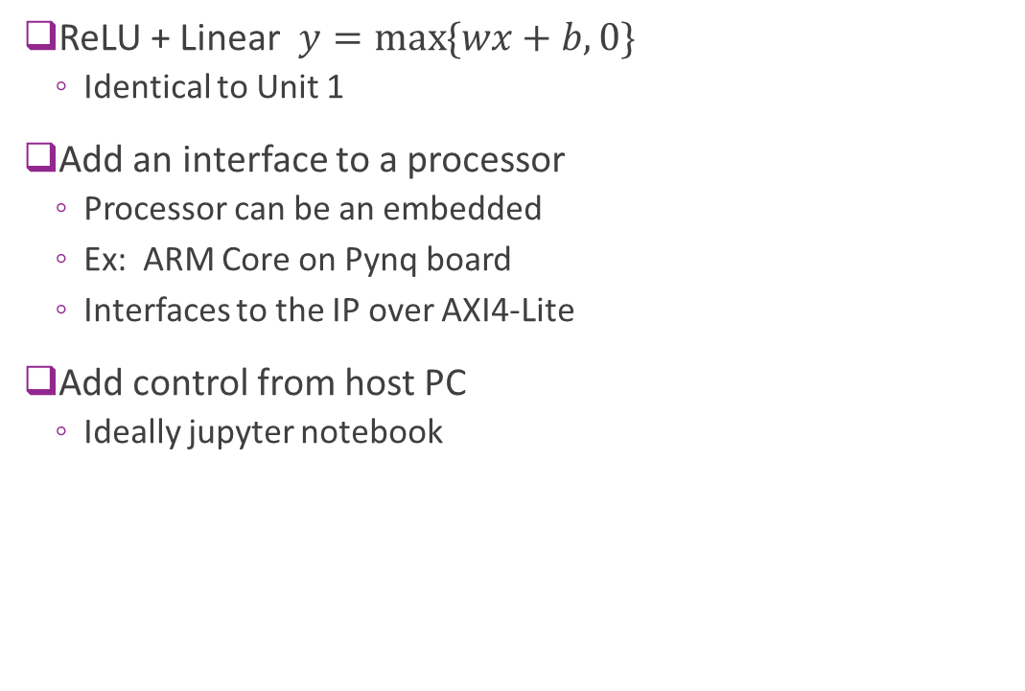



Example: Connecting a Simple IP
ReLU + Linear $y=\max{\{wx+b, 0\}}$
  Identical to Unit 1
Add an interface to a processor
  Processor can be an embedded
  Ex: ARM Core on Pynq board
  Interfaces to the IP over AXI4-Lite
Add control from host PC
  Ideally jupyter notebook
FPGA board
AXI4-Lite
$$w$$
$$b$$
$$x$$
$$y$$
Memory-
mapped
registers
Linear + ReLU
Hardware “IP”
Processor
system
(e.g., ARM)
Host PC

Slide 42
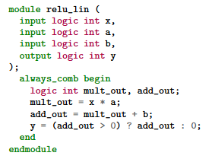


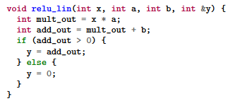
HLS vs. RTL
RTL: Register Transfer Language
  Use specialized languages (e.g., SystemVerilog)
  Manually schedule action in each clock cycle
  Interfaces designed from scratch
  High control, supports custom interfaces
  But time-consuming, difficult to maintain
HLS: High-Level Synthesis
  Write in general purpose languages (e.g., C++)
  Clock-level schedule determined automatically by compiler
  API support for common interfaces (e.g., AXI)
  Sacrifice some performance and flexibility
  But enables rapid development

Slide 43

HLS vs. RTL Design Flow
Traditional RTL — you write the hardware description
no high-level model to simulate — the first thing you write is hardware
SystemVerilog
written by hand
RTL Simulation
Package
you
HLS — you write behaviour, the tool writes the hardware
C / C++
written by hand
C Simulation
C Synthesis
RTL Simulation
Package
you
RTL generated here
One flow, two front ends — the last stages are identical. HLS changes what you write, not what the FPGA gets.

Slide 44
Bad vs. Good HLS Code
AVOID
Treat the tool as a black box
You get RTL you cannot judge
Poor performance, and no idea why
HLS
tool
RTL
tool
what should the RTL look like?
AIM FOR
Keep a mental model of the RTL
What should happen on each clock cycle?
What resources should it use?
HLS
tool
RTL
tool
The tool schedules the cycles — but only you can tell whether what it produced is any good.

Slide 45

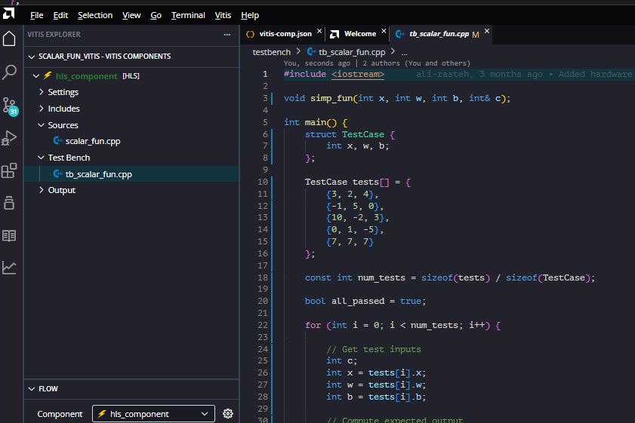
Vitis HLS
Developed by Xilinx (now AMD)
  Evolved from Vivado HLS
Supports C / C++
  Simple, common development
Some python support for testbenches
Ships with Vitis IDE
Native support for AXI protocols
  No need to build handshake from scratch

Slide 46
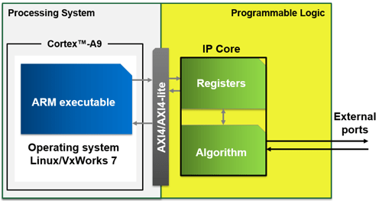
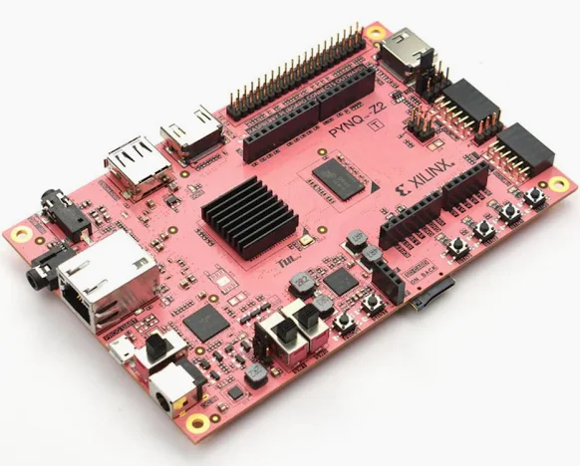
FPGA Board Components
We target a design on a real FPGA board
Boards have three components
Processing system (PS)
  A lightweight processor
  Often an ARM core
  E.g., ARM A9
Programmable logic (PL)
  The programmable fabric
  This is where your IP will reside
  Also contains the registers and internal memory
An AXI4 interface
Image from MathWorks page on embedded design

Slide 47





Target Architecture
Pynq Z2 board
We will rapidly build
Complete AXI4-Lite I/F
  Interface done automatically
  No need to code any handshaking
Control through host
  Simple python jupyter notebook
Deploy to a real FPGA!
AXI4-Lite
$$w$$
$$b$$
$$x$$
$$y$$
Memory-
mapped
registers
Linear + ReLU
Hardware “IP”
PS
Host PC
PL

Slide 48
Vitis Kernel Types
Vitis kernels come in two shapes. The difference is who decides when the kernel runs.
Host-Activated
Free-Running Task
#pragma HLS INTERFACE s_axilite port=return
ap_ctrl_hs — the default
Explicitly started by the processor
Signals completion with a status bit, and can raise an interrupt
The closest thing to a function call in hardware
But the processor writes every input and reads every output
Not how most production designs move data
Our focus — it is the easiest to reason about, and every idea in it carries over.
#pragma HLS INTERFACE ap_ctrl_none port=return
ap_ctrl_none
Runs continuously, waiting on data
Operates without the processor once started
Enables far greater concurrency
Data arrives on a stream, not in registers
How real accelerators are built
Examined in the advanced course — and glimpsed next lecture, with AXI4-Stream.

Slide 49
Host-Activated Execution Model
Processor (PS)
Vitis IP (PL)
write x, w, b · 0x10, 0x18, 0x20
write 1 to CTRL — ap_start · 0x00
processor waits,
or does something else
kernel runs
5 cycles
ap_done set in CTRL · optionally an interrupt
read CTRL — poll for done · 0x00
return y · 0x28
Measured on the bus: 4 writes and 2 reads per call, 22 cycles of traffic for 5 cycles of computation.

Slide 50
The Demo: a Scalar Function IP
sdrangan.github.io/hwdesign — Demos › Bus Basics and Memory-Mapped Interfaces
RUN THE WHOLE FLOW
WHAT TO WATCH FOR
cd demos/scalar_fun/scalar_fun_vitis
python scalar_fun_build.py --list-steps
python scalar_fun_build.py --through verify_csim
python scalar_fun_build.py --through report
Each step declares what it needs — the order is derived, not written down
A step whose inputs have not changed is skipped
The build refuses to synthesize code that failed its checks
Results are checked twice: after C simulation, and again against the synthesized RTL
The demo ends with a timing diagram decoded from a real co-simulation — the processor writing x, w and b, starting the IP, polling for done, and reading y back.
Everything on the next slide was measured from it.

Slide 51
Waveflow: a Python Model First
“From waveform to silicon — in Python.” Describe the datapath once, simulate it fast and bit-exact, and generate the hardware from the same source.
HLS codegen
typed · generated
RTL synth / sim
slow · cycle-exact
THE FLOW, FOR THIS SAME IP
1
Model it in Python
the kernel, and its registers as a VitisRegMap
slow loop
2
Simulate in Python
function, and cycle-approximate timing
Python model
architecture · algorithm
Python sim
fast · bit-exact
3
Generate the Vitis C++
kernel and testbench; you keep the compute hook
fast loop
4
C-simulation checks function
against the Python result
design · verify · calibrate · iterate
Co-simulation checks timing
against the Python estimate
5
You have already run part of it: scalar_fun_build.py is a Waveflow build graph. What is new above is the modelling layer.

Slide 52
Waveflow vs. Native Vitis
What it costs
What it buys
A Python layer between you and the tool — one more thing to learn, and to debug
Its own vocabulary — VitisRegMap, HostActivated, SeqTB — before you see any hardware
Early-stage research software, by its own description
Only the sequential testbench lowers to Vitis: a C++ testbench is one straight-line main(), so a concurrent model has nothing to lower onto
One source of truth — simulation, generated C++ and the register map all come from the same Python
A model you can explore in seconds, instead of minutes of synthesis per idea
The build checks itself: the Python result is the golden the C-simulation is graded against
Timing you can trust before synthesis, because the estimate is checked against measured cycles
For scalar_fun, nothing — the kernel is four lines, and a model of it is pure overhead.
The payoff starts when the algorithm is worth exploring before it is worth synthesizing. sdrangan.github.io/waveflow

Slide 53
Limitations of AXI4-Lite for Data
22
cycles of bus traffic
per call
5
cycles of actual
computation
3.7 M
calls/s — one DSP
does 100 M MAC/s
IT IS SLOW TO MOVE EACH VALUE
THE PROCESSOR MUST POLL
Four writes and two reads to deliver 3 values and collect 1
About 3 cycles per register transfer
The bus cost does not shrink if the kernel gets cleverer — here the interface dominates completely
The host cannot know when the IP is done — it asks, repeatedly
Each poll is a full AXI4-Lite read transaction
Interrupts avoid the spinning, but cost a context switch — more than a 5-cycle kernel is worth
AXI4-Lite is not the problem — using a control interface as a data interface is.
Next: AXI4-Stream — one transfer per cycle, no addresses, and the processor out of the inner loop.

